Slide 1
The Neolithic Revolution
How the shift from foraging to farming changed where humans lived, what they ate, and how society was organized.
© More Lessons Less Planning | morelessonslessplanning.com
Notes:
Opening slide. Around 10,000 BCE, humans slowly changed from foraging (hunting and gathering) to farming. This shift, called the Neolithic Revolution, changed almost everything: people settled in permanent villages, produced a food surplus, and built new kinds of societies.

Slide 2
Learning Targets
Explain what the Neolithic Revolution was and how farming replaced foraging.
★
Describe how domesticating plants and animals changed the food supply.
★
Explain how a food surplus led people to settle in permanent villages.
★
Analyze how a surplus reshaped society and use a primary source.
★
© More Lessons Less Planning | morelessonslessplanning.com
Notes:
Read the four learning targets. Today we trace one chain: domestication produced a food surplus, a surplus led to permanent settlement, and settlement led to new social organization.

Slide 3
The World Before Farming
Foraging
Finding food by hunting wild animals and gathering wild plants; how humans lived before farming.
Nomad
A person who moves from place to place to find food instead of settling down.
Key Concept: For most of human history, people lived by FORAGING and moved as NOMADS to follow food.
© More Lessons Less Planning | morelessonslessplanning.com
Notes:
For most of human history, everyone survived by FORAGING - hunting wild animals and gathering wild plants, nuts, roots, and berries. Because the wild food in any one area was quickly used up, people lived as NOMADS, moving from place to place to find food instead of settling down. Groups stayed small because a wandering life could not feed many people in one spot.

Slide 4
The Great Change: The Neolithic Revolution
Neolithic Revolution
The shift from hunting and gathering to farming that began around 10,000 BCE.
✔
When and where
About 10,000 BCE, at the end of the last Ice Age, starting in the Fertile Crescent.
✔
Why 'revolution'
It happened slowly over generations, but it changed human life more than almost any event before it.
✔
Key Concept: The NEOLITHIC REVOLUTION was the shift from foraging to farming that began around 10,000 BCE.
© More Lessons Less Planning | morelessonslessplanning.com
Notes:
The NEOLITHIC REVOLUTION was the shift from hunting and gathering to farming. It began around 10,000 BCE, at the end of the last Ice Age, in a region called the Fertile Crescent. We call it a 'revolution' not because it happened overnight - it took many generations - but because farming changed human life more deeply than almost any change before it.

Slide 5
Taming Plants and Animals
Domestication
Taming wild animals and growing wild plants on purpose so people can use them for food.
Agriculture
The practice of growing crops and raising animals for food; farming.
Key Concept: Through DOMESTICATION, people tamed animals and plants, making AGRICULTURE possible.
© More Lessons Less Planning | morelessonslessplanning.com
Notes:
The heart of the Neolithic Revolution was DOMESTICATION - taming wild animals and growing wild plants on purpose so people can use them for food. Early farmers domesticated grains such as wheat and barley and animals such as sheep, goats, and cattle. This new way of life is called AGRICULTURE: the practice of growing crops and raising animals for food.

Slide 6
The First Farm Tools and Crops
First crops
Early farmers planted grains such as wheat and barley.
✔
First animals
They domesticated sheep, goats, and cattle for meat, milk, and wool.
✔
First tools
They cut grain with a flint sickle and ground it into flour with grinding stones.
✔
Key Concept: The first farmers used simple stone tools like the flint sickle to harvest their grain.
© More Lessons Less Planning | morelessonslessplanning.com
Notes:
Early farmers worked with simple stone tools. They cut and harvested their grain with a flint sickle - a curved blade of sharp flint set in a wooden or bone handle - and ground the grain into flour with heavy grinding stones. They planted grains such as wheat and barley and raised sheep, goats, and cattle. The next slide shows a real Neolithic flint sickle.

Slide 7
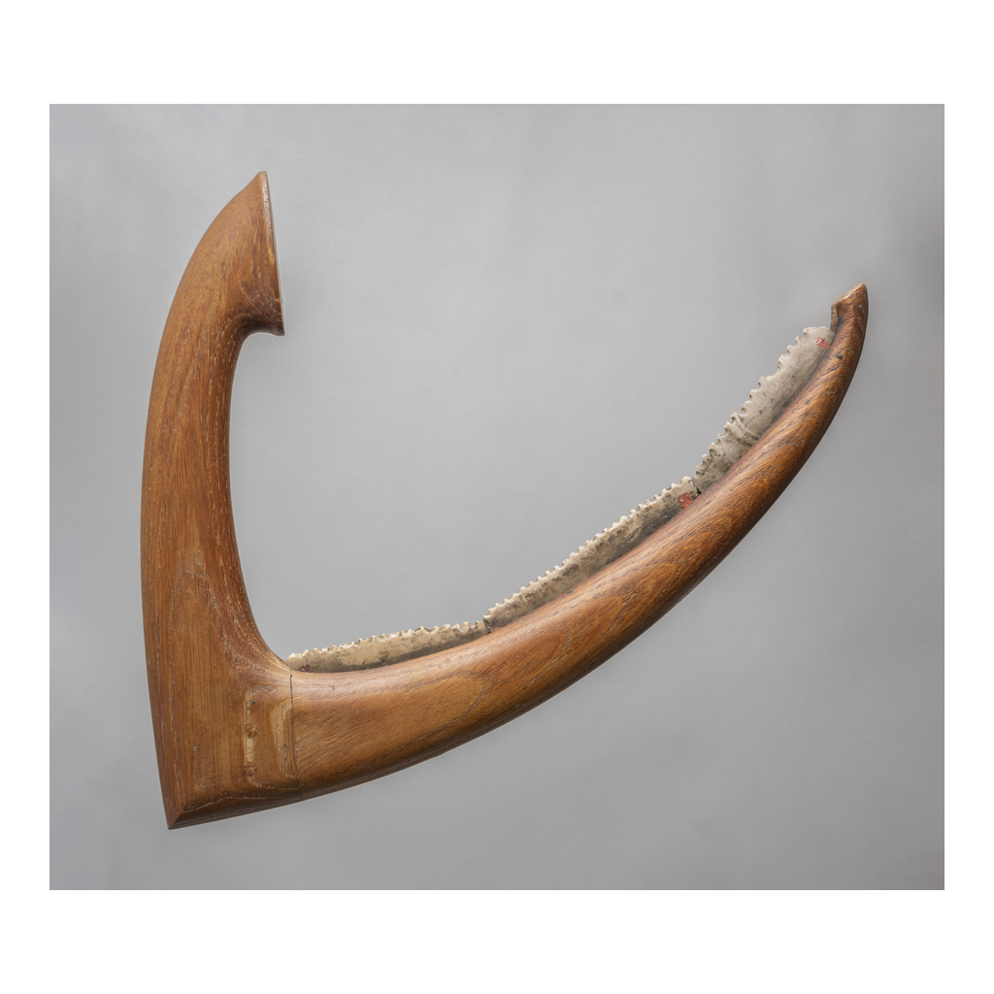
A Flint Sickle
Example of a Neolithic flint sickle (reconstructed; Egypt c.3900-3300 BC)
© More Lessons Less Planning | morelessonslessplanning.com
Notes:
Public-domain (CC0) photograph of a flint-bladed sickle from Predynastic Egypt (c. 3900-3300 BC). The ancient serrated flint blades are set into a reconstructed handle so students can see the sickle's curved shape. Give students a moment to notice the sharpened flint edge, then connect the tool to how farming replaced foraging.
Reference labels (point to these chart features when teaching): Serrated flint blades; Grain-harvesting tool

Slide 8
Food Surplus Changes Everything
Surplus
Extra food produced beyond what a family needs to survive.
Permanent settlement
A place where people live year-round instead of moving from place to place.
Key Concept: Farming created a SURPLUS of food, which let people build PERMANENT SETTLEMENTS.
© More Lessons Less Planning | morelessonslessplanning.com
Notes:
Farming did something foraging never could: it produced a SURPLUS - extra food beyond what a family needs to survive. A surplus could be stored in pits and jars for later. Because farmers had to stay near their fields and their stored food, they built a PERMANENT SETTLEMENT - a place where people live year-round instead of moving from place to place.

Slide 9
Villages and Permanent Settlement
A food surplus meant people no longer had to wander to survive.
Farmers built permanent villages of mud-brick houses near their fields.
Early villages like Jericho and Catalhoyuk held hundreds or thousands of people.
People stored grain in pits and clay jars to last through the year.
Key Concept: With a stored food surplus, people settled in permanent VILLAGES instead of wandering.
© More Lessons Less Planning | morelessonslessplanning.com
Notes:
Once a stored surplus freed people from wandering, they built permanent villages of mud-brick houses near their fields. Early farming villages such as Jericho and Catalhoyuk grew to hold hundreds or even thousands of people - far more than any foraging band. Villagers stored grain in pits and clay jars so it would last through the year.

Slide 10
New Jobs: Specialization and Artisans
Specialization
When a food surplus lets some people focus on one kind of job instead of finding food.
✔
Artisan
A skilled worker who makes goods by hand, such as pottery, tools, or cloth.
✔
New village jobs
Villages now had potters, weavers, toolmakers, traders, priests, and leaders.
✔
Key Concept: A food surplus allowed SPECIALIZATION, so some villagers became ARTISANS instead of farmers.
© More Lessons Less Planning | morelessonslessplanning.com
Notes:
When farmers grew more food than they needed, not everyone had to farm. This is SPECIALIZATION - some people focus on one kind of job instead of finding food. Skilled workers called ARTISANS made goods by hand, such as pottery, tools, and cloth. Villages soon had potters, weavers, toolmakers, traders, priests, and leaders - jobs that a foraging band could never support.

Slide 11
A New Social Order
Social class
A group of people in a society who share a similar level of wealth and status.
How it changed
As some families stored more surplus and land, society split into richer and poorer groups.
Key Concept: Stored surplus and land created SOCIAL CLASSES - groups with different wealth and status.
© More Lessons Less Planning | morelessonslessplanning.com
Notes:
Farming villages did not stay equal for long. As some families stored more surplus, controlled more land, or led trade, they became richer and more powerful than others. Society split into SOCIAL CLASSES - groups of people who share a similar level of wealth and status. For the first time, there were leaders and followers, rich and poor - a new social order that foraging bands had never had.

Slide 12
How We Know: Reading the Evidence
Archaeology
Learning about the past by digging up and studying physical remains - tools, seeds, bones, and buildings.
Written accounts
Later thinkers, such as the scientist John Lubbock in 1865, wrote early explanations of how farming began.
Key Concept: We reconstruct the Neolithic Revolution from ARCHAEOLOGY and from written accounts, cross-checked.
© More Lessons Less Planning | morelessonslessplanning.com
Notes:
No one witnessed the Neolithic Revolution 10,000 years ago, so how do we know about it? Archaeologists dig up and study physical remains - flint sickles, grinding stones, storage pits, seeds, animal bones, and mud-brick houses. Historians also read written accounts: in 1865, the scientist John Lubbock wrote one of the first scientific explanations of how people shifted from foraging to farming. In the activity you will read Lubbock's account and check it against the archaeological evidence.

Slide 13
Key Takeaways
The Neolithic Revolution was the shift from foraging to farming (~10,000 BCE).
★
Domestication of plants and animals gave people a stored food surplus.
★
A surplus let people settle in permanent villages instead of living as nomads.
★
Surplus led to specialization, artisans, trade, and new social classes.
★
© More Lessons Less Planning | morelessonslessplanning.com
Notes:
Recap the four takeaways. The big idea: farming produced a surplus, and that surplus reshaped where people lived and how society was organized. In the activity, students reconstruct this change using archaeology and Lubbock's 1865 account.

