Slide 1
The Mound Builders of Cahokia
The Largest City in Ancient North America
© More Lessons Less Planning | morelessonslessplanning.com
Notes:
Ask students to name the biggest city in North America in the year 1200. Most will name a modern city. The answer for this lesson is a place almost none of them have heard of, on the Mississippi River.

Slide 2
Learning Targets
Describe the size, location, and dates of Cahokia at its height.
★
Explain how Monks Mound, Woodhenge, and the palisade were built and used.
★
Explain what archaeologists learn from mounds, post holes, and borrow pits.
★
Use Brackenridge's 1811 account of the mounds as evidence.
★
Explain why the causes of Cahokia's decline are still an open question.
★
© More Lessons Less Planning | morelessonslessplanning.com
Notes:
Point out target five. It says the question is open. Students are used to lessons that end with one answer, and this one does not.

Slide 3
A City on the Mississippi
Cahokia stood on the Mississippi River near present-day St. Louis.
The city flourished from about A.D. 1000 to 1350.
At its height 10,000 to 20,000 people lived there.
Cahokia covered more than six square miles.
About 120 mounds once stood inside the city.
Did You Know: No city in what is now the United States would be that large again for centuries.
© More Lessons Less Planning | morelessonslessplanning.com
Notes:
Anchor the location first. Students who know St. Louis can picture it. Then give the dates, because the whole lesson turns on Cahokia being pre-contact.

Slide 4
Three Words to Start With
Mississippian
The Native American mound-building culture of the Mississippi valley, about A.D. 800 to 1600
Cahokia
The largest city of that culture, covering more than six square miles near present-day St. Louis
Archaeology
The study of the human past through physical remains such as mounds, post holes, and pottery
Key Concept: No one at Cahokia left a written record, so almost everything we know comes from the ground.
© More Lessons Less Planning | morelessonslessplanning.com
Notes:
Say the third definition slowly. Archaeology is the method behind every fact in this lesson, and students will be asked in Part 5 what that method cannot tell them.

Slide 5
Cahokia by the Numbers
Measure | Figure | Notes
Peak population | 10,000 to 20,000 | Around A.D. 1100
Area of the city | More than 6 square miles | Mounds, plazas, houses, fields
Mounds once standing | About 120 | Only some survive today
Height of Monks Mound | About 30 meters | Roughly 100 feet
Construction stages of Monks Mound | 14 | Built over generations
Key Concept: Cahokia was a planned city, not a scattering of villages that happened to grow together.
© More Lessons Less Planning | morelessonslessplanning.com
Notes:
Students use this table again in Activity Part 3. Do not do the arithmetic for them here; just make sure everyone can read a row across.

Slide 6
Building a City by Hand
What the Builders Did Not Have
What They Used Instead
No wheels or carts
No horses, oxen, or draft animals
No metal tools
No writing system
Woven baskets carried on the back
Digging sticks and stone hoes
Shell and stone scraping tools
Large, organized work crews
Key Concept: Every basket of earth in Monks Mound was dug by hand and carried there on someone's back.
© More Lessons Less Planning | morelessonslessplanning.com
Notes:
This is the slide that turns Cahokia from a curiosity into an achievement. The scale is impressive because of the missing left column, not in spite of it.

Slide 7
The Great Mound, Stage by Stage
Monks Mound is the largest earthen structure north of Mexico.
It was raised in fourteen separate construction stages.
The finished mound rises in four flat terraces.
It stands about 30 meters, or roughly 100 feet, tall.
A large building once stood on the highest terrace.
Fact: Fourteen stages means fourteen separate building projects, spread across generations of workers.
© More Lessons Less Planning | morelessonslessplanning.com
Notes:
The next slide is the photograph. Do not rush past it. Ask students to find the two people standing on the summit before you say anything else.

Slide 8
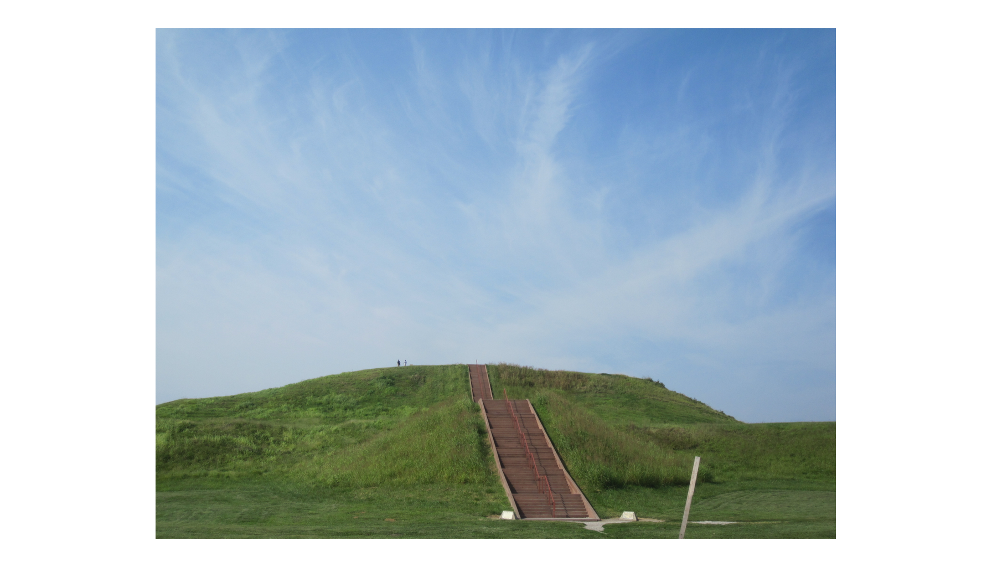
Monks Mound Today
Note: two people on top.
© More Lessons Less Planning | morelessonslessplanning.com
Notes:
Give the class twenty silent seconds with the photograph. Point out the two tiny visitors on the summit, then ask how many people it would take to build that by hand.
Reference labels (point to these chart features when teaching): Stairway up the face; Visitors for scale

Slide 9
Three Words for the Great Mound
Monks Mound
The largest earthen structure north of Mexico
Terrace
A flat, level step built into the side of a mound
Borrow pit
A pit dug by Cahokia's builders to remove the earth they carried away by basket
Note: The earth for the mound came out of borrow pits, so the builders dug the holes that they filled.
© More Lessons Less Planning | morelessonslessplanning.com
Notes:
Borrow pit is the term students find strangest. Point out that the pits are still visible on the site as low, damp hollows.

Slide 10
Three More Things the Builders Made
The Grand Plaza
Woodhenge
The Palisade
A large open square at the foot of Monks Mound
Leveled and filled by hand to make it flat
Used for gatherings, markets, and ball games
A circle of tall upright red cedar posts
Rebuilt at least five times in different sizes
Lined up with sunrise at key points in the year
A wall of upright logs around the city center
Roughly two miles around, with towers along it
Rebuilt several times using thousands of logs
Did You Know: Woodhenge was found in the 1960s when archaeologists mapped a curve of unusual post holes.
© More Lessons Less Planning | morelessonslessplanning.com
Notes:
None of these three survives above ground. Say that plainly here, because it sets up the post hole slide and the whole idea of reading evidence.

Slide 11
Four More Words for Cahokia
Grand Plaza
The large open square at the foot of the great mound, leveled by hand for gatherings
Woodhenge
A circle of upright wooden posts at Cahokia used to track the sun through the year
Palisade
The defensive wall of upright logs that enclosed the center of Cahokia
Post hole
A dark stain in the soil where a wooden post once stood, used to map vanished buildings
Key Concept: Woodhenge and the palisade are both gone. Archaeologists know them only from post holes.
© More Lessons Less Planning | morelessonslessplanning.com
Notes:
The last row is the hinge of the lesson. A post hole is not an object; it is a stain. Everything students see in the next slides was reconstructed from stains.

Slide 12
Woodhenge: A Calendar Made of Posts
Woodhenge is a circle of upright wooden posts at Cahokia.
The posts were cut from red cedar and set in deep holes.
A center post let an observer watch sunrise across the year.
Certain posts line up with sunrise at the solstices.
The circle was rebuilt at least five times.
Fact: Woodhenge told Cahokians when the seasons turned, which mattered for planting and for ceremonies.
© More Lessons Less Planning | morelessonslessplanning.com
Notes:
Students often assume any circle of posts is religious. Woodhenge is practical first: it is a farming calendar that also carried ceremonial meaning.

Slide 13
What the Ground Still Holds
Mounds
Earth piled in stages. Their size and shape show what each mound was used for.
✔
Post holes
Dark soil stains that map house walls, the palisade, and Woodhenge.
✔
Borrow pits
The hollows left where builders dug out earth. Some later filled with water.
✔
Artifacts
Pottery, stone tools, shell beads, and food remains left behind in the soil.
✔
Key Concept: Archaeologists read Cahokia from what is left in the ground, not from written records.
© More Lessons Less Planning | morelessonslessplanning.com
Notes:
Work down the list and ask what each one can and cannot tell you. That question is exactly what Activity Part 5 asks them to answer in writing.

Slide 14
An American Traveler Sees the Mound, 1811
What a stupendous pile of earth!
— Henry M. Brackenridge, at the foot of the great mound at Cahokia, 1811
He climbed one mound to count the others, then walked on to the great mound and paced its base.
Note: Students read a longer passage from this same account in Activity Part 4.
© More Lessons Less Planning | morelessonslessplanning.com
Notes:
Read the line aloud. He wrote it standing at the FOOT of the great mound, looking up, not from its top. It is the reaction of an educated traveler who had no idea anything like this existed in Illinois, and students usually have the same reaction.

Slide 15
What He Recorded
Henry Brackenridge visited the Cahokia mounds in 1811.
He climbed one mound and counted the others from its top.
He counted forty-five mounds visible from that one summit.
He then walked to Monks Mound, which he called the principal mound: eight hundred yards around.
He put its height at about ninety feet.
Note: Brackenridge wrote over two hundred years ago, so his figures are careful estimates, not survey data.
© More Lessons Less Planning | morelessonslessplanning.com
Notes:
Write forty-five and about 120 on the board side by side. The gap between them is the exit ticket question. Make clear he counted from one mound and then walked on to the largest mound before measuring it. The engraving on the next slide is from the 1880s, about seventy years after Brackenridge, so say the date out loud and point out the farmhouse on the summit.

Slide 16
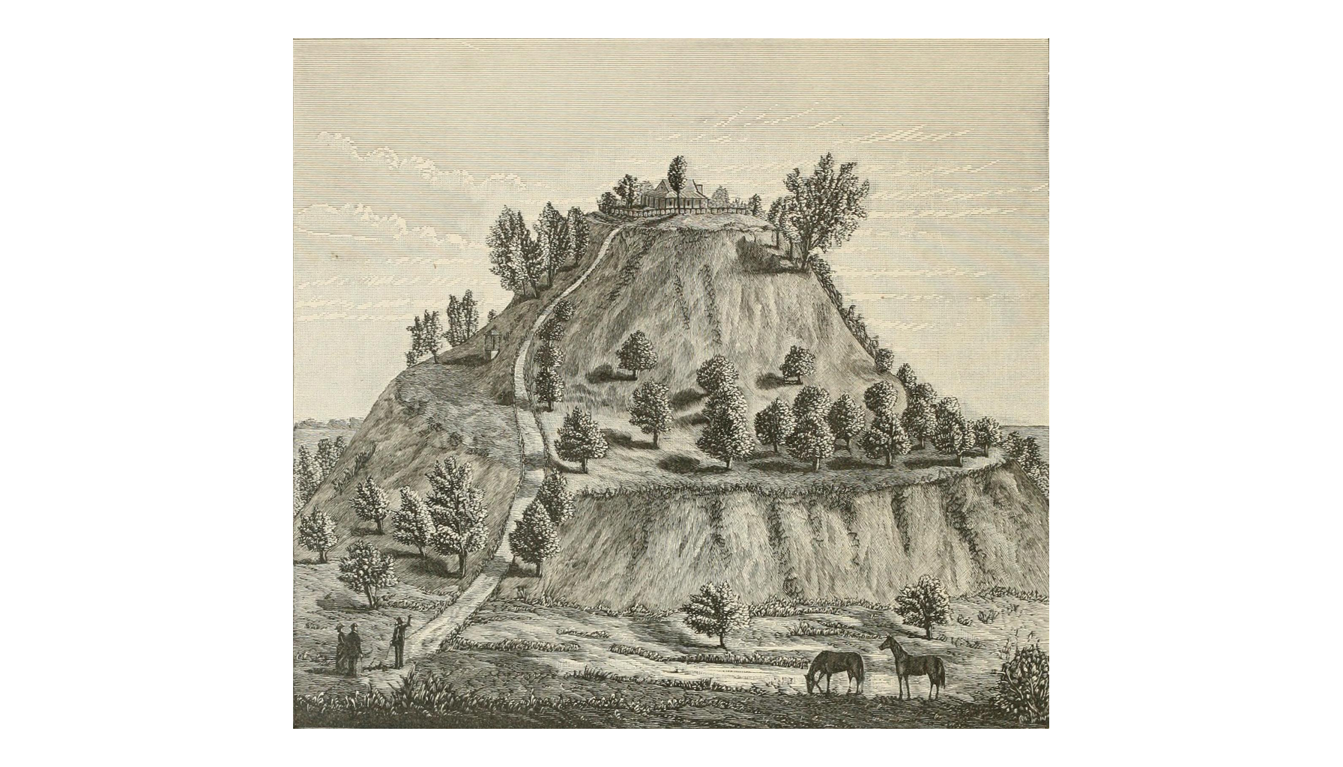
The Great Mound as Americans Drew It, 1882
Note: an 1882 engraving.
© More Lessons Less Planning | morelessonslessplanning.com
Notes:
State plainly that this engraving is from 1882, not from Brackenridge's 1811 visit, and that the deck labels it that way on purpose. Ask students what the farmhouse on the summit tells them about how Americans treated the mound.
Reference labels (point to these chart features when teaching): Lower terrace; Farmhouse on summit

Slide 17
1811 and Today: Two Sets of Numbers
Measure | Brackenridge, 1811 | Modern figure
Mounds counted or known | 45 seen from one summit | About 120 once stood
Height of the principal mound | About 90 feet | About 30 meters, near 100 feet
Distance around the base | About 800 yards | About 1,150 yards
Construction stages | Not known in 1811 | 14 stages found by excavation
Key Concept: He was close on height, well short on distance, and could not know how it was built.
© More Lessons Less Planning | morelessonslessplanning.com
Notes:
The point is not that he was wrong. Ninety feet against about thirty meters is close for an eye estimate; eight hundred yards against about 1,150 is not. An eyewitness measures what is reachable, and excavation adds what is not.

Slide 18
Why Did Cahokia Empty Out?
Climate and Crops
Wood and Land
People and Power
Tree rings point to drought after A.D. 1200.
Poor harvests would strain a city this size.
Some researchers doubt it was that severe.
Building and heating used huge amounts of timber.
Clearing the uplands may have caused floods.
Newer soil studies question that flooding.
The palisade suggests rising conflict or fear.
Leaders may have lost authority over the work.
Families may simply have chosen to move away.
Warning: These are competing explanations, not settled answers.
© More Lessons Less Planning | morelessonslessplanning.com
Notes:
Do not let the class settle on one card. Every card has a third bullet that undercuts it, and that is the design.

Slide 19
An Open Question
Cahokia declined after about A.D. 1200.
The site was largely abandoned by about A.D. 1400.
That is a century before Columbus reached the Americas.
So the arrival of Europeans cannot explain the decline.
No single cause is accepted by all researchers today.
Abandoning the city did not mean the people vanished; Native nations still live across this region today.
Key Concept: A historian can say what the evidence rules out even when it cannot name one single cause.
© More Lessons Less Planning | morelessonslessplanning.com
Notes:
Bullet four is the one students most need. Many will reach for disease or conquest by default, and the dates rule both out.

Slide 20
Key Takeaways
Cahokia was a planned city of 10,000 to 20,000 people, built entirely by hand.
★
Monks Mound rose in fourteen stages to four terraces and about 30 meters.
★
Woodhenge tracked the sun, and a palisade wall enclosed the city center.
★
Archaeologists read Cahokia from mounds, post holes, borrow pits, and artifacts.
★
Cahokia was abandoned by about A.D. 1400, and why is still an open question.
★
© More Lessons Less Planning | morelessonslessplanning.com
Notes:
Ask which takeaway students would defend in Activity Part 5. Picking a side out loud makes the written verdict much easier.

