Slide 1
The Mongols and the Silk Road
How the Pax Mongolica made Silk Road trade safer and connected Europe and Asia under Mongol rule.
© More Lessons Less Planning | morelessonslessplanning.com
Notes:
Opening slide. The Silk Road linked Asia and Europe for centuries before the Mongols. What changed under Mongol rule was safety and connection: for a few generations, a single vast empire governed the roads, and long-distance trade became safer and busier. Historians call this the Pax Mongolica, the 'Mongol Peace' - a modern term, not a formal treaty. Keep the tone honest: the same empire that made trade safer was built on brutal conquest that killed millions, and the roads carried disease as well as goods.

Slide 2
Learning Targets
Explain that the Silk Road existed before the Mongols, who unified it.
★
Describe how the Pax Mongolica made trade safer: the yam, roads, the paiza.
★
Trace cultural diffusion of goods and ideas, and weigh benefits vs. violence.
★
Analyze a primary source: Marco Polo on travel and trade under Mongol rule.
★
© More Lessons Less Planning | morelessonslessplanning.com
Notes:
Learning targets. Point out target 3 is where the lesson refuses to simplify: the Pax Mongolica moved goods, technology, and ideas across Eurasia, but it was built on conquest, and the same roads carried the Black Death. Historians hold both the benefits and the costs at once.

Slide 3
What Was the Silk Road?
The SILK ROAD was a network of overland trade routes across Asia and Europe.
It carried silk, spices, paper, and many other goods for centuries.
It existed long BEFORE the Mongols - traders used it under earlier empires.
Not one road but a web of routes across deserts, mountains, and oases.
Travel was slow and dangerous, crossing many rival kingdoms.
Key Concept: The SILK ROAD was a network of trade routes linking Asia and Europe - and it existed for centuries BEFORE the Mongols.
© More Lessons Less Planning | morelessonslessplanning.com
Notes:
The SILK ROAD was a network of overland trade ROUTES linking China, Central Asia, the Middle East, and Europe. It carried silk, spices, paper, gems, and many other goods. The single most important correction for students: the Silk Road existed for centuries BEFORE the Mongols - Han China, Persia, and the Islamic caliphates all traded along it. It was never a single paved road but a shifting web of routes across deserts, mountains, and oasis cities. Before the Mongols, a merchant crossing the whole route had to pass through many rival kingdoms, each with its own tolls, bandits, and wars - so long-distance trade was slow, costly, and dangerous.

Slide 4
One Empire Across Eurasia
Contiguous Empire
A single connected block of territory; the Mongols' conquests joined long stretches of the Silk Road under one authority.
Why it mattered
One ruler could protect and tax the roads instead of dozens of rival kings fighting over them.
Big idea: The Mongols' CONTIGUOUS empire put long stretches of the Silk Road under a single authority.
© More Lessons Less Planning | morelessonslessplanning.com
Notes:
Genghis Khan's conquests created the largest CONTIGUOUS land empire in history - and that word matters. A CONTIGUOUS empire is one CONNECTED block of territory, not scattered colonies across the seas. For the first time, long stretches of the Silk Road lay under ONE AUTHORITY instead of being divided among dozens of rival kingdoms. That single fact is the engine of everything that follows: one ruler could set one set of rules, protect the roads, and tax the trade, rather than a merchant facing a new border, toll, and army every few hundred miles. The Mongol conquests were brutal and bloody - but their result was a single connected zone across Eurasia.

Slide 5
The Pax Mongolica
Pax Mongolica
The 'Mongol Peace,' a period when Mongol control made Silk Road trade across Eurasia safer.
✔
A modern term
Coined by modern historians (like 'Pax Romana'); the Mongols signed no treaty and used no such phrase.
✔
Only relative
The stability was real but rested on force and fear, not on a true, gentle peace.
✔
Key Concept: The PAX MONGOLICA - the 'Mongol Peace' - was a period when Mongol rule made Silk Road trade safer.
© More Lessons Less Planning | morelessonslessplanning.com
Notes:
The PAX MONGOLICA, or 'Mongol PEACE,' was a period of roughly a century when Mongol control made Silk Road trade across Eurasia safer and busier. Two honesty notes for students. First, 'Pax Mongolica' is a term coined by MODERN historians (modeled on 'Pax Romana'); the Mongols never signed a peace treaty and no one at the time used the phrase. Second, the 'peace' was only relative - it rested on conquest, fear, and force, not on gentleness. Within that stability, a merchant could travel from the Black Sea to China under broadly one system of protection, which had almost never been possible before. That is the real meaning of the term: safer, more connected trade - not an era without violence.

Slide 6
The Yam: Relay Across an Empire
Yam
The Mongol postal-relay system of horse stations that carried the Khan's messengers across the empire.
How it worked
Post-houses stood every 25-30 miles, each stocked with fresh horses so a rider could change mounts and race on.
Fact: The YAM was the Mongol relay of post-houses and fresh horses that sped the Khan's messengers across the empire.
© More Lessons Less Planning | morelessonslessplanning.com
Notes:
The YAM was the Mongol postal-relay system of HORSE stations that carried the Khan's messengers across the empire at astonishing speed. Post-houses stood every twenty-five to thirty miles along the main roads, each stocked with hundreds of fresh horses. A messenger could gallop to a station, swap for a rested horse, and race on, so news and orders crossed thousands of miles far faster than an ordinary traveler. Be honest about who it was FOR: the yam served the Mongol government and army FIRST - it was built to move the Khan's messages, officials, and troops. MERCHANTS benefited only secondarily, because the same well-kept, guarded roads that sped the messengers also made ordinary travel safer. This is exactly the system Marco Polo describes in the Primary Source Spotlight.

Slide 7
Safe Roads and the Paiza
Marking the Roads
The Paiza
Trees were planted along the highways so no one lost the way.
Stone pillars marked the route across open deserts.
Patrols and Mongol law made bandit attacks riskier.
A PAIZA was a tablet of authority - a kind of passport.
It granted the holder safe passage and protection.
Officials and favored merchants carried one on the roads.
Note: A PAIZA was a Mongol passport-tablet granting safe passage; roads were marked and patrolled so travelers rarely lost their way.
© More Lessons Less Planning | morelessonslessplanning.com
Notes:
Beyond the yam, Mongol rule made the roads themselves safer and easier to follow. The Khan had trees planted along the highways, two paces apart, so that travelers could not LOSE their way by day or night, and stone pillars marked the route across open deserts. Patrols and the threat of harsh Mongol law made bandit attacks far riskier than before. The key tool of safe travel was the PAIZA - a tablet of authority, essentially a PASSPORT, made of wood, silver, or gold depending on rank. A paiza granted its holder safe passage and protection and demanded that local officials provide food, horses, and shelter. Mongol officials, envoys, and favored merchants carried one. Together, marked roads, patrols, and the paiza made long-distance travel far safer than it had been.

Slide 8
Merchants and Caravans
Merchants rarely traveled alone; they joined a CARAVAN for safety.
A CARAVAN was a group of traders and pack animals moving together.
Traveling in a large group protected goods from bandits and the harsh desert.
Caravans rested at oasis cities and roadside inns called caravanserais.
Under Mongol protection, caravans could cross the whole width of Asia.
Key Concept: A CARAVAN was a group of merchants and pack animals that traveled together for safety across the Silk Road.
© More Lessons Less Planning | morelessonslessplanning.com
Notes:
Long-distance merchants almost never traveled alone. Instead they joined a CARAVAN - a group of traders and pack ANIMALS, often camels, that moved together across the routes. The reason was safety: a large, organized group was far harder for BANDITS to rob and better able to survive deserts and mountains than a lone trader. Caravans rested, restocked, and traded at oasis cities and at roadside inns called caravanserais, spaced roughly a day's journey apart. Under the Pax Mongolica, with the roads marked, patrolled, and under one authority, caravans could cross the entire width of Asia far more safely than before. The next slide shows a real medieval European image of such a Silk Road caravan.

Slide 9
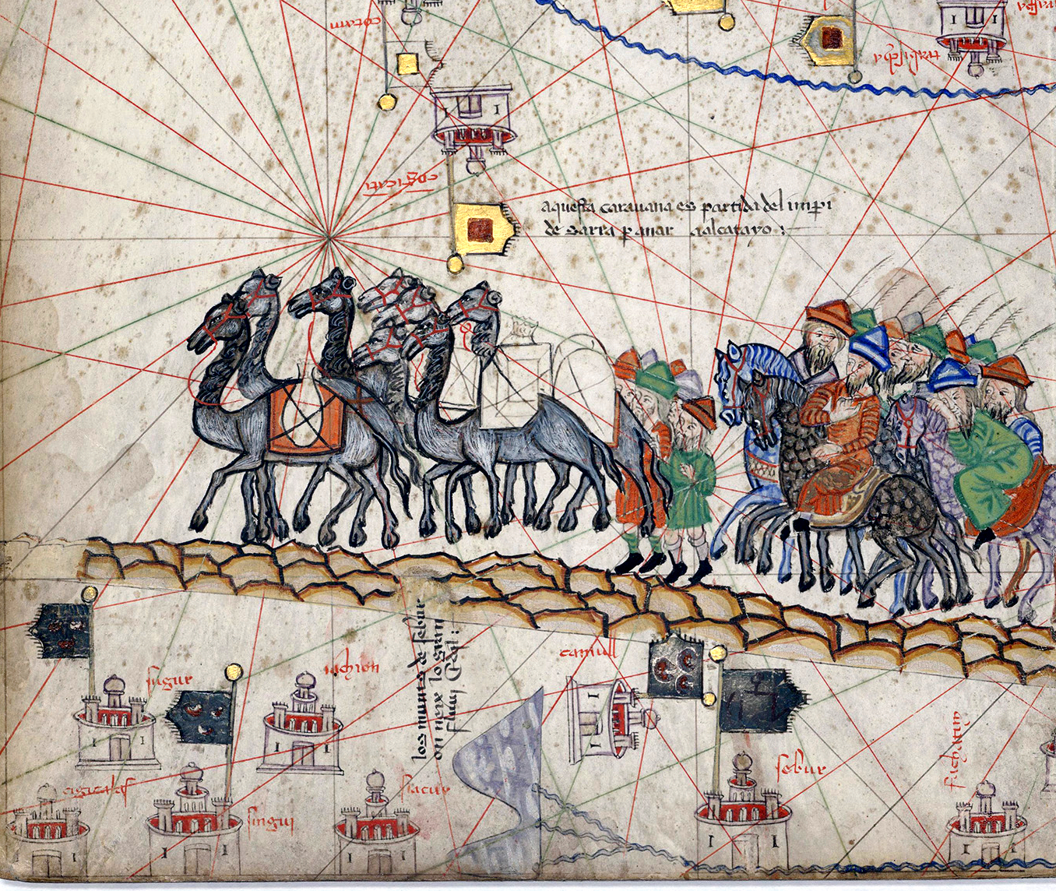
A Silk Road Caravan
A merchant caravan on the Silk Road (Catalan Atlas, 1375).
© More Lessons Less Planning | morelessonslessplanning.com
Notes:
A detail from the Catalan Atlas, a famous world map made in 1375 by the Majorcan mapmaker Abraham Cresques for the king of Aragon. It shows a caravan of camels and merchants on horseback crossing Central Asia toward Cathay (China); the map's caption says the caravan set out from the 'Empire of Sarra' to go to Cathay. Point out that this is a European image made about a century after the events, drawn from travelers' reports - it is how Europeans pictured Silk Road trade, and it captures the essentials: laden camels, merchants moving together, and the long overland route across Asia.
Reference labels (point to these chart features when teaching): A train of laden camels; Merchants riding together

Slide 10
Kublai Khan and Cambaluc
Kublai Khan
Grandson of Genghis Khan and ruler of the Mongol realm in China, who received Marco Polo at his court.
Cambaluc
Marco Polo's name for the Great Khan's capital, Khanbaliq, which today is the city of Beijing.
Fact: KUBLAI KHAN ruled from CAMBALUC (Khanbaliq, modern Beijing) and welcomed foreign traders and travelers to his court.
© More Lessons Less Planning | morelessonslessplanning.com
Notes:
By Marco Polo's time the Mongol empire had split into several khanates, and the greatest of these was ruled by KUBLAI KHAN, the GRANDSON of Genghis Khan. Kublai ruled the Mongol realm in China (the Yuan dynasty) and received foreign travelers, envoys, and merchants at his court - including, by his own account, Marco Polo. Kublai's capital was a great city Marco Polo called CAMBALUC - the Mongol Khanbaliq, which today is BEIJING. The reach of Kublai's authority is central to our story: because one powerful ruler controlled the roads, the relay stations, and the trade at the eastern end of the Silk Road, foreign merchants and travelers could reach his court and do business under his protection.

Slide 11
Marco Polo, the Venetian Traveler
MARCO POLO was a merchant from VENICE who traveled to the Mongol empire.
He claimed to have served Kublai Khan for many years before returning home.
Back in Italy, he DICTATED his story to a writer named Rustichello around 1298.
His book made Europeans eager to reach the riches of the East.
He was an OUTSIDE observer, and some of his details are debated or exaggerated.
Key Concept: MARCO POLO, a Venetian merchant, described the Mongol empire in a book he dictated to Rustichello around 1298.
© More Lessons Less Planning | morelessonslessplanning.com
Notes:
MARCO POLO was a merchant from VENICE, in Italy, who traveled the Silk Road to the Mongol empire in the late 1200s and claimed to have served Kublai Khan for about seventeen years. His account is one of Europe's most famous windows onto the medieval East. But handle the sourcing honestly. Polo did not write the book himself: after returning to Italy he was captured in a war and, in prison, DICTATED his story from memory to a fellow prisoner, a writer named Rustichello of Pisa, around 1298. That means the book is a memoir told years later and shaped by a professional storyteller, so some of Polo's numbers and marvels are debated or exaggerated. He was also an OUTSIDE observer - a foreigner describing a world he did not fully understand. Used carefully, though, his account is powerful evidence for how Mongol rule organized travel and trade.

Slide 12
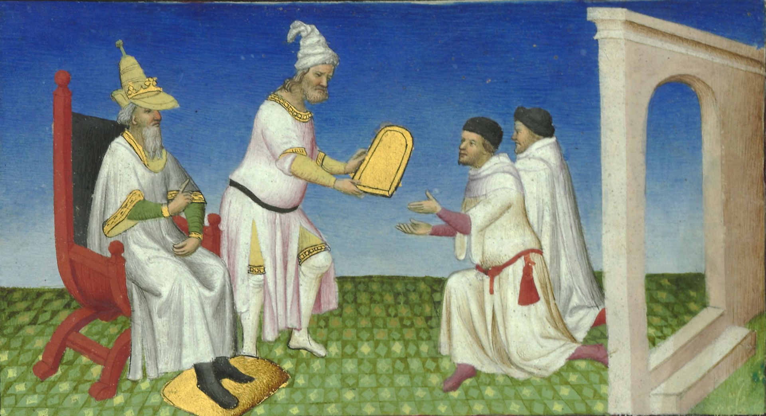
Kublai Khan Receives the Polos
Kublai Khan grants a golden paiza to the Polos (Livre des Merveilles, c. 1410).
© More Lessons Less Planning | morelessonslessplanning.com
Notes:
A miniature from the Livre des Merveilles ('Book of Marvels'), a lavishly illustrated French manuscript of Marco Polo's travels made around 1410-1412. It shows the Great Khan's court receiving the two Polo brothers, who kneel as an official hands them a golden tablet - a paiza, the passport of authority that guaranteed safe passage on the roads. Point out that this is a European image painted more than a century after the events, in French medieval dress and setting, not an accurate picture of the Mongol court. But it captures two ideas from this lesson: foreign travelers were received at the Khan's court, and the golden paiza was the key to safe travel across the empire.
Reference labels (point to these chart features when teaching): The Khan enthroned at left; A golden paiza handed over

Slide 13
What Crossed the Roads
From East to West
From West to East
Silk, porcelain, and spices from China and Asia.
Inventions: gunpowder, paper, printing, the compass.
New knowledge of medicine and astronomy.
Gold, silver, wool, and fine glass.
Horses, hunting birds, and new foods.
European and Middle Eastern goods and coins.
Fact: Goods and inventions moved BOTH ways along the Silk Road - silk and gunpowder west, silver and glass east.
© More Lessons Less Planning | morelessonslessplanning.com
Notes:
During the Pax Mongolica the goods moving along the Silk Road flowed in BOTH directions. From East to West came silk, porcelain, and spices, but also world-changing Chinese inventions: GUNPOWDER, paper, printing, and the compass, along with new medical and astronomical knowledge. From West to East came gold, silver, wool, fine glass, horses, hunting birds, and new foods. The point for students is that the safer roads did not just move luxury goods - they moved technologies and knowledge that reshaped both ends of Eurasia. Gunpowder and printing reaching Europe, for example, would eventually help transform European warfare and communication. Trade was a two-way exchange, not a one-way flow.

Slide 14
Ideas, Technology, and Disease
CULTURAL DIFFUSION is the spread of goods, technology, and ideas.
Religions, art styles, and knowledge traveled with the merchants.
Technologies like printing and the compass spread across Eurasia.
Even DISEASE traveled: the Black Death likely moved west along the trade routes.
Connection brought costs as well as benefits.
Big idea: CULTURAL DIFFUSION - the spread of ideas, technology, and even disease - followed the safer Silk Road.
© More Lessons Less Planning | morelessonslessplanning.com
Notes:
The safer roads carried more than goods - they carried CULTURAL DIFFUSION, the spread of goods, technology, and IDEAS between distant societies. Religions, artistic styles, scientific knowledge, and skilled people all moved with the merchants and caravans. Chinese technologies like printing and the compass spread across Eurasia and reshaped the societies that received them. But connection had a dark side too, and students must hold it honestly: even DISEASE traveled the roads. The Black Death - the plague that killed a huge share of Europe's and Asia's population in the 1300s - very likely spread west along the same trade routes the Pax Mongolica had made safe. The lesson is that connection is powerful but double-edged: the network that spreads ideas can also spread catastrophe.

Slide 15
The Honest Picture
Built on Conquest
Safer, Not Gentle
The Pax Mongolica rested on brutal conquest.
The Mongols killed millions and destroyed whole cities.
The same empire that made trade safe was built by violence.
'Pax Mongolica' is a modern term - there was no true peace.
Stability was real but rested on force and fear.
Both truths are real at the same time.
Warning: The Pax Mongolica made trade safer, but it was built on brutal CONQUEST - the Mongols killed millions.
© More Lessons Less Planning | morelessonslessplanning.com
Notes:
This slide exists to keep the lesson honest, and it should not be skipped. The Pax Mongolica made Silk Road trade safer - that is true - but it was built on brutal CONQUEST. The Mongol wars killed millions of people and destroyed great cities across Asia and the Middle East. The same empire that protected merchants and sped messages was created by massacre and terror. And 'Pax Mongolica' is a modern historians' term: the stability was real, but it rested on FORCE and fear, not on gentleness or consent. Teach students to hold both truths at once: the Mongols made long-distance trade safer AND their empire was one of the most violent conquests in history. A careful history student can say both in the same breath, without cancelling either.

Slide 16
How Do We Know? Reading Marco Polo
Much of what Europe learned about the East came from Marco Polo's book.
But Polo was an OUTSIDE observer, not a Mongol official.
He dictated the book years later, from memory, to Rustichello.
Some of his numbers and details are debated or EXAGGERATED.
Historians cross-check Polo with Persian, Chinese, and Arab sources.
Tip: Marco Polo is a useful source, but an outsider writing from memory - historians CROSS-CHECK his account.
© More Lessons Less Planning | morelessonslessplanning.com
Notes:
This is the sourcing slide, and it sets up the Primary Source Spotlight. Much of what medieval Europe learned about the East came from Marco Polo's book - but students must weigh it carefully. First, Polo was an OUTSIDE observer, a Venetian merchant, not a Mongol official who ran the system he describes. Second, he dictated the book from memory to Rustichello years after his travels, so details could blur or grow in the telling. Third, some of his numbers and marvels are debated or EXAGGERATED - a few scholars have even doubted how much he saw firsthand. So historians do not simply trust Polo; they CROSS-CHECK him against Persian historians, Chinese records, and Arab travelers' accounts. Where several independent sources agree - for example, that the Mongols ran an organized relay and made roads safer - we can be confident. Match each source to what it can actually tell you.

Slide 17
Legacy of the Pax Mongolica
A connected world
For a few generations Eurasia was more connected than ever before.
✔
Trade and knowledge
Goods, technology, and ideas moved farther and faster along the safer roads.
✔
The costs
The Black Death and the violence of conquest traveled the same routes.
✔
The end
As the empire broke apart, the routes grew dangerous and long-distance trade declined.
✔
Note: The Pax Mongolica connected Eurasia for a few generations - then faded as the Mongol empire broke apart.
© More Lessons Less Planning | morelessonslessplanning.com
Notes:
Close the loop with the legacy. For a few GENERATIONS, the Pax Mongolica connected Eurasia more tightly than ever before: goods, technology, and ideas moved farther and faster than they had under any earlier empire, and Europeans like Marco Polo could reach China and return with stories that reshaped the European imagination. But the legacy is genuinely mixed. The same connection carried the Black Death and rested on the violence of conquest. And it did not last: as the Mongol empire broke APART into feuding khanates in the 1300s, the roads grew dangerous again, tolls and wars returned, and long-distance overland trade declined. That decline is part of why, a century later, Europeans would start looking for SEA routes to Asia - the search that led to the Age of Exploration. The Pax Mongolica was a bright, brief, double-edged moment of connection.

Slide 18
Key Takeaways
The Silk Road existed for centuries before the Mongols - they made it safer.
★
The Mongols' contiguous empire put the Silk Road under one authority.
★
The Pax Mongolica made Silk Road trade safer and connected Europe and Asia.
★
The yam relay and paiza served the Khan's messengers first, merchants second.
★
Cultural diffusion spread goods, ideas - and the Black Death - across Eurasia.
★
Marco Polo described this world, but as an outsider his details are debated.
★
© More Lessons Less Planning | morelessonslessplanning.com
Notes:
Close the loop. If students remember one thing, make it this: the Mongols did not invent the Silk Road - they made it SAFER by placing it under one authority, and that safety, the Pax Mongolica, connected Europe and Asia for a few generations. And make them hold the honest double truth: the same empire that protected trade was built on mass violence, and the same roads that carried silk and ideas also carried the Black Death. A good history student can say both in the same breath.

