Slide 1
The Middle Passage
The trans-Atlantic slave trade in the eyewitness words of Olaudah Equiano, 1789
© More Lessons Less Planning | morelessonslessplanning.com
Notes:
Open on the through-line: the Middle Passage was the forced ocean crossing at the heart of the trans-Atlantic slave trade. In 1789 Olaudah Equiano, who survived it as a child, described it in his own words to help end the trade. The lesson asks students to weigh its scale and to see the enslaved as people who grieved and resisted.

Slide 2
Learning Targets
Explain what the Middle Passage and slave trade were, and describe their scale.
★
Describe the conditions Equiano witnessed in the ship's hold.
★
The enslaved were not passive; they grieved and resisted, in Equiano's words.
★
© More Lessons Less Planning | morelessonslessplanning.com
Notes:
Use the targets to preview the scale of the trade, the eyewitness source, and the two misconception corrections. The third target names resistance on purpose.

Slide 3
The trans-Atlantic slave trade and the Middle Passage
The Middle Passage was the forced ocean voyage from Africa to the Americas.
It was part of the trans-Atlantic slave trade, a system run for profit.
About 12.5 million Africans were forced aboard slave ships.
About 10.7 million survived the Middle Passage; the rest died.
This was one of the largest forced migrations in all of history.
Key Point: The Middle Passage carried millions of enslaved Africans - about 12.5 million shipped, about 10.7 million survived.
© More Lessons Less Planning | morelessonslessplanning.com
Notes:
Establish the scale before the primary source. The Middle Passage was the forced crossing of the trans-Atlantic slave trade; about 12.5 million Africans were shipped and about 10.7 million survived. State the scale plainly so students never treat the trade as marginal.

Slide 4
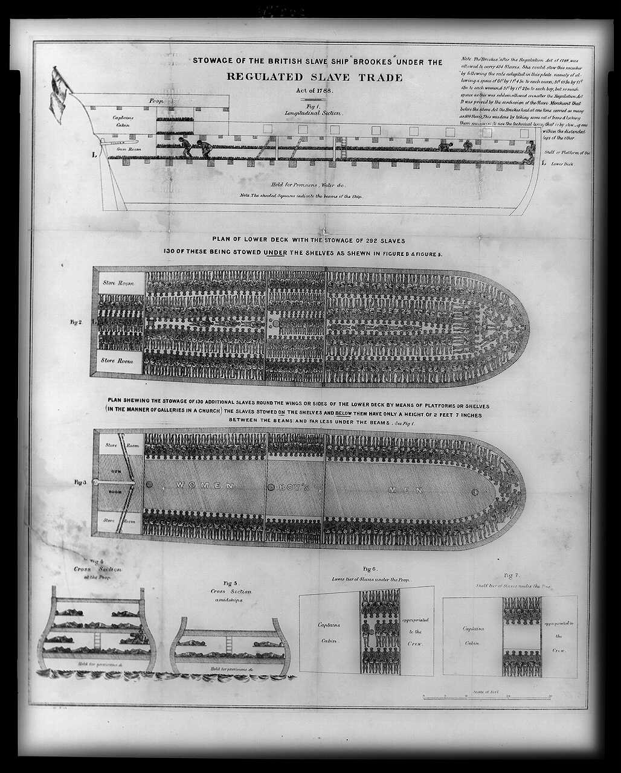
A period diagram of a slave ship's hold (1788)
Stowage of the slave ship Brookes, 1788 (Library of Congress broadside).
© More Lessons Less Planning | morelessonslessplanning.com
Notes:
Frame the image honestly: it is a printed diagram from 1788, made by abolitionists to expose how tightly captives were packed into a slave ship. It is a documentary broadside, not a photograph. Use it only to picture the crowding Equiano describes, and keep the tone sober and respectful.

Slide 5
Who was Olaudah Equiano?
A survivor
Olaudah Equiano was an African who survived the Middle Passage as a child.
✔
His freedom
He was later able to buy his own freedom, an act called manumission.
✔
His memoir
In 1789 he published a memoir, a true story of his own life.
✔
An abolitionist
He was an abolitionist who worked to end slavery and addressed Parliament for abolition.
✔
Key Point: Equiano, a survivor who bought his freedom, wrote a 1789 memoir as an abolitionist to argue for abolition.
© More Lessons Less Planning | morelessonslessplanning.com
Notes:
Introduce Equiano before reading his words. He survived the Middle Passage as a child, later bought his own freedom (manumission), and in 1789 published a memoir addressed to Parliament to argue for abolition. He is a first-person survivor and an abolitionist, not a modern narrator.

Slide 6
Conditions in the hold
Below deck, captives were packed with 'scarcely room to turn himself.'
The hold's air became pestilential, or disease-breeding.
The foul air bred a sickness that killed many of the enslaved.
The galling of the chains became insupportable, or unbearable.
Filthy latrine tubs and the shrieks of the dying filled the hold.
Key Point: In the crowded, pestilential hold, foul air, galling chains, and filth brought sickness and death.
© More Lessons Less Planning | morelessonslessplanning.com
Notes:
Describe the hold from Equiano's account (F2, F3, F5): captives packed with scarcely room to turn himself; pestilential air that bred a deadly sickness; chains whose galling became insupportable; filthy tubs; the shrieks of the women and the groans of the dying. Keep it sober and factual, not gratuitous.

Slide 7
Why so many died: 'improvident avarice'
A common but wrong idea
What Equiano says
The deaths were just an unavoidable part of a long ocean voyage.
Nothing could have been done to prevent them.
Ships were overcrowded on purpose to carry more captives for profit.
Equiano blames the deaths on 'improvident avarice,' or reckless greed.
The victims fell to the greed of their purchasers, he writes.
Key Point: Equiano blames the deaths on the reckless greed - the avarice - of the purchasers, not on mere chance.
© More Lessons Less Planning | morelessonslessplanning.com
Notes:
This is the first misconception repair. The deaths were not simple bad luck. Ships were overcrowded on purpose for profit, and Equiano blames the deaths on the improvident avarice - the reckless greed - of the captives' purchasers (F4). Connect greed to the deadly conditions in the hold.

Slide 8
Not passive: grief and resistance
The enslaved were not passive; they grieved and resisted.
Equiano describes chained men who leaped overboard into the sea.
They chose death, 'preferring death to such a life of misery.'
Grief and resistance fill Equiano's eyewitness account.
Resistance took courage against overwhelming force.
Key Point: The enslaved grieved and resisted - chained men leaped overboard, preferring death to such a life of misery.
© More Lessons Less Planning | morelessonslessplanning.com
Notes:
This is the second misconception repair. The enslaved were not passive victims. Equiano describes chained men who leaped overboard into the sea, preferring death to such a life of misery (F6). Present resistance as courage against overwhelming force, in Equiano's own words.

Slide 9
The trade and its people: vocabulary
Middle Passage
The forced ocean voyage that carried enslaved Africans across the Atlantic to the Americas.
Trans-Atlantic slave trade
The centuries-long system that shipped millions of enslaved Africans to the Americas for profit.
Olaudah Equiano
An African who survived the Middle Passage, bought his freedom, and wrote a famous 1789 memoir.
Hold
The lower inside deck of a ship, where enslaved people were confined during the crossing.
Abolitionist
A person who worked to end slavery and the slave trade.
Key Point: These terms name the crossing, the system behind it, the survivor who described it, the hold, and those who fought to end it.
© More Lessons Less Planning | morelessonslessplanning.com
Notes:
These are the first five reference-guide terms. Connect each to a claim students will use in the activity and quiz.

Slide 10
Conditions and testimony: vocabulary
Pestilential
Full of disease; likely to spread sickness and death.
Avarice
Extreme greed, especially for money or profit.
Manumission
The act of freeing an enslaved person; Equiano bought his own freedom.
Memoir
A true story a person writes about their own life.
Embarked
Put on board a ship; used to count how many captives were loaded for the crossing.
Key Point: These terms name the deadly air, the greed behind it, Equiano's freedom, his memoir, and how captives were counted.
© More Lessons Less Planning | morelessonslessplanning.com
Notes:
These are the last five reference-guide terms. Pestilential and avarice anchor the conditions and their cause; manumission and memoir anchor Equiano's story; embarked anchors how the scale was counted.

Slide 11
Reading Equiano as a source
Whose account is this?
Why his purpose matters
Olaudah Equiano was a survivor of the Middle Passage himself.
He wrote his memoir in 1789, in his own words.
Equiano was an abolitionist writing to help end the slave trade.
He addressed Parliament to argue for abolition.
His account is a survivor's eyewitness testimony, not a distant report.
Key Point: Equiano wrote as a survivor and abolitionist; his memoir is eyewitness testimony aimed at ending the trade.
© More Lessons Less Planning | morelessonslessplanning.com
Notes:
Model critical reading. Equiano was a first-person survivor who wrote his memoir in 1789 as an abolitionist, addressing Parliament to end the trade. His purpose does not make him unreliable - it makes him a survivor testifying, in his own words, to what he lived through.

Slide 12
Building a precise account
Setting: name the trans-Atlantic slave trade and the Middle Passage.
Scale: about 12.5 million shipped and about 10.7 million survived.
Conditions: the crowded hold, pestilential air, chains, and sickness.
People: the enslaved grieved and resisted; they were not passive.
Source: Equiano wrote as a first-person survivor and abolitionist.
Remember: A precise account names the scale, the conditions, and the resistance - in Equiano's own words.
© More Lessons Less Planning | morelessonslessplanning.com
Notes:
Prepare students to write the activity's final account. A precise account defines the trade and the Middle Passage, states the scale, describes the hold, shows the enslaved grieved and resisted, and treats Equiano as a survivor's eyewitness testimony.

Slide 13
Key Takeaways
The Middle Passage forced millions of Africans across the Atlantic for profit.
★
About 12.5 million were shipped and about 10.7 million survived the crossing.
★
Equiano's memoir describes the crowded hold, the sickness, and the chains.
★
The enslaved were not passive; they grieved and resisted their captivity.
★
© More Lessons Less Planning | morelessonslessplanning.com
Notes:
Close by returning to the essential question and asking students for one precise account that names the scale, the conditions, and the resistance, in Equiano's own words. Keep the tone documentary and respectful throughout.

