Slide 1
The Mayflower Compact
How 41 men wrote a government before anyone set foot on land
© More Lessons Less Planning | morelessonslessplanning.com
Notes:
Open by asking: what happens when a ship lands somewhere its paperwork does not cover?

Slide 2
Learning Targets
Explain why the ship landed outside the area its patent covered.
★
Describe the shipboard dispute that led the passengers to draft a compact.
★
List what the signers promised each other in the Compact.
★
Explain how the Compact built a government on the consent of the governed.
★
Evaluate the Compact's limits by asking who signed it and who did not.
★
© More Lessons Less Planning | morelessonslessplanning.com
Notes:
Read each target aloud; these five drive the Compact study.

Slide 3
A Ship Off Course
In September 1620, the Mayflower left England bound for northern Virginia.
Storms and shoal waters pushed the ship north of its planned course.
Cape Cod is the hooked arm of land in New England where the Mayflower anchored.
The landing site lay outside the territory the Virginia Company had granted.
The passengers now faced land no charter covered and no law governed.
Did You Know: That curved shoreline looked to sailors like an arm reaching into the sea.
© More Lessons Less Planning | morelessonslessplanning.com
Notes:
Emphasize the gap between planned destination and actual landing site.

Slide 4
Two Groups, One Ship
Separatists
Strangers
Separatists were English Protestants who broke away from the Church of England.
Organized the voyage for religious reasons
A minority of the passengers aboard
Strangers were Mayflower passengers not part of that religious congregation.
Hired by investors or seeking opportunity
Made up most of the ship's passengers
Note: Both groups had to agree before any lasting order could hold.
© More Lessons Less Planning | morelessonslessplanning.com
Notes:
Contrast motives: religious purpose versus economic opportunity.

Slide 5
The Patent Problem
What Was a Patent
Where It Applied
The Result
A patent was a legal grant of permission to found a colony in a named place.
The grant named northern Virginia as the passengers' destination.
Without one, colonists had no claim to settle at all.
The grant covered land far south of where the Mayflower anchored.
The landing site sat outside the Virginia Company's chartered territory.
Landing there voided its legal protection.
Some passengers argued no valid grant meant no authority over them.
Leaders needed a new source of legal order before anyone went ashore.
That gap in authority set up the crisis the Compact solved.
Key Concept: A grant of that kind only applied inside its named boundaries.
© More Lessons Less Planning | morelessonslessplanning.com
Notes:
Bridge from the geography problem to the legal problem it created.

Slide 6
Mutinous Speeches
That when they came ashore they would use their own liberty, for none had power to command them.
— William Bradford, describing discontented talk aboard the Mayflower
Without a patent covering that landing, some passengers argued no one could legally give them orders once they landed.
Warning: Talk like this threatened to split the settlement apart.
© More Lessons Less Planning | morelessonslessplanning.com
Notes:
Read the quote aloud slowly; let students feel the threat it posed to order.

Slide 7
A Combination Before Landing
Leaders realized the mutinous talk had to be settled before anyone went ashore.
They drafted a short written combination binding everyone to one set of rules.
The document borrowed language from church covenants the Separatists knew well.
Roughly 41 adult men signed it aboard the ship in November 1620.
Only after signing did passengers begin sending parties ashore to scout land.
Tip: The signing happened on the ship, not on land - order came first, landing came second.
© More Lessons Less Planning | morelessonslessplanning.com
Notes:
Set up the paired image as illustrative, not a contemporary eyewitness record.

Slide 8
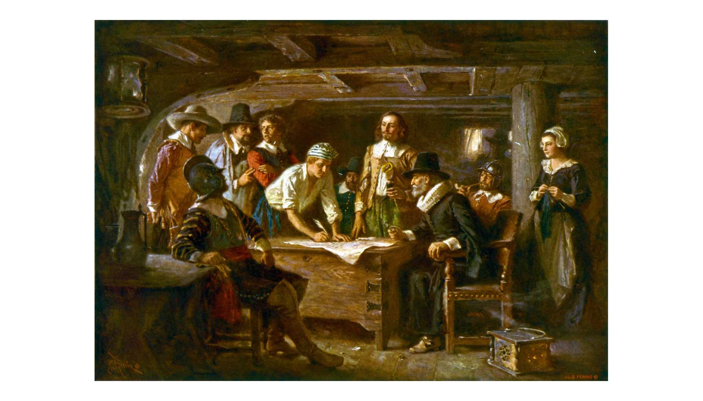
Signing the Compact, as an Artist Imagined It
Jean Leon Gerome Ferris painted this scene about 1899, long after 1620.
© More Lessons Less Planning | morelessonslessplanning.com
Notes:
Point out the painting postdates the event by nearly 280 years; treat it as illustration, not proof.
Reference labels (point to these chart features when teaching): Painted 1899; Not painted from life

Slide 9
What the Compact Actually Says
loyal subjects
The signers first declared loyalty to King James before anything else.
covenant
A binding promise made in the presence of God and one another.
civil body politic
A group of signers acting as one lawmaking body.
combine
The signers bound themselves together into that single body.
Note: The Compact starts with loyalty to the king, then pivots to self-made law - both ideas coexist in one document.
© More Lessons Less Planning | morelessonslessplanning.com
Notes:
Walk the document phrase by phrase; students should see the covenant language directly.

Slide 10
Just and Equal Laws
Form the body
Combine into a civil body politic for order and to advance their goals.
✔
Enact laws
Frame just and equal laws for the general good of the colony.
✔
Consent of the governed
The idea that a government's authority comes from the people who agree to obey it.
✔
Sign as proof
Every signature confirmed the signer agreed to be bound by these terms.
✔
Key Concept: Authority in the Compact comes from the signers' agreement, not a king's grant - this is consent of the governed.
© More Lessons Less Planning | morelessonslessplanning.com
Notes:
This slide is the heart of the self-government argument.

Slide 11
Who Signed, and Who Did Not
Group | Signed? | Why
Adult men among the passengers | Yes, about 41 | They signed in the ship's cabin before anyone landed
John Carver | Yes, first signer | Chosen governor of Plymouth soon after
Some servants | Yes | John Howland, George Soule, Edward Doty and Edward Leister signed
Women | No | Not recognized as political signers under the era's norms
Children | No | Considered dependents, not independent agents
Did You Know: Some servants signed, but not one woman aboard was given a signature line.
© More Lessons Less Planning | morelessonslessplanning.com
Notes:
Push students to hold both facts at once: real innovation, real limits.

Slide 12
The First Winter
~50%
2-3
of the company died
months of worst sickness
Cause: Cold, poor shelter, and disease over the winter of 1620-1621
Leadership: John Carver led under the Compact until his death in spring 1621
Outcome: The government the signers made held together despite the losses
Note: The Compact was tested immediately - it survived its first winter even as half the colony did not.
© More Lessons Less Planning | morelessonslessplanning.com
Notes:
Let the stat land before moving to the detail rows.

Slide 13
Why It Still Matters
An Early Experiment
Who Preserved It
The Limits to Remember
Self-government is a community making and enforcing its own laws.
It let colonists make binding rules without a distant king's approval.
That habit shaped later colonial charters and constitutions.
William Bradford was a passenger and governor whose history preserves the text.
The Compact's text was first printed in Mourt's Relation in 1622.
The original signed document was lost and never found.
That agreement covered about 41 signers, not everyone aboard.
No woman or child aboard was given a signature line.
The Compact was both an innovation and a limited one.
Remember: Self-government means a community making and enforcing its own laws instead of taking them from a distant authority.
© More Lessons Less Planning | morelessonslessplanning.com
Notes:
Close by asking students to weigh both halves of the legacy.

Slide 14
Key Takeaways
The Mayflower anchored outside the territory its patent named.
★
Mutinous talk aboard pushed leaders to draft a compact before landing.
★
41 signers covenanted into a civil body politic under just, equal laws.
★
The Compact rests on consent of the governed, later central to America.
★
Self-government was real but narrow: many aboard had no signature.
★
© More Lessons Less Planning | morelessonslessplanning.com
Notes:
Close the loop on all five learning targets in order.

