Slide 1
The Maya Calendar and Astronomy
How the Maya used interlocking calendars and careful sky-watching to keep time for farming, history, and faith.
© More Lessons Less Planning | morelessonslessplanning.com
Notes:
Opening slide. The Maya of Mesoamerica built one of the most precise calendar systems of the ancient world - without telescopes or modern math. They ran several calendars at once: a 260-day sacred round, a 365-day solar year, and a Long Count that recorded exact dates across thousands of years. They also watched the sky carefully with the naked eye, tracking the Sun, Moon, and especially the planet Venus, and wrote their findings into bark-paper books. Students will learn how these calendars worked and meshed together, how Maya astronomy tied planting and religion to the sky, and how to read a primary source about the Maya count of time. Along the way they will learn to tell a colonial-era Maya text apart from an ancient codex, and to correct the popular myth that the Maya predicted the world would end in 2012.

Slide 2
Learning Targets
Describe the Tzolk’in, the Haab’, and the 52-year Calendar Round.
★
Explain the Long Count and how the Maya used a zero placeholder.
★
Explain Maya naked-eye astronomy and the Dresden Codex tables.
★
Tell a colonial Maya text from an ancient codex and correct the 2012 myth.
★
© More Lessons Less Planning | morelessonslessplanning.com
Notes:
Read the four learning targets. Today's lesson pairs the mechanics of the Maya calendars with a history skill: reading a primary source carefully and knowing what kind of source it is. Keep the big idea in mind - the Maya tracked time in cycles, and understanding those cycles is the key both to how they farmed and worshipped and to why the famous '2012' date was simply the turn of a large cycle, not a prediction of doom.

Slide 3
Two Interlocking Calendars
Tzolk’in (260 days)
Haab’ (365 days)
The sacred/ritual calendar.
20 day-names paired with numbers 1 to 13.
Set festivals and lucky (auspicious) days.
The solar calendar of the farming year.
18 months of 20 days, plus 5 extra days.
Tracked planting and harvest seasons.
Key Concept: The TZOLK’IN is the 260-day sacred calendar; the HAAB’ is the 365-day solar calendar of the farming year.
© More Lessons Less Planning | morelessonslessplanning.com
Notes:
The Maya did not use just one calendar - they ran two main ones at the same time. The TZOLK’IN was the 260-day sacred calendar. It combined 20 day-names with the numbers 1 to 13, so each day had a name and a number, like '4 Ahau.' The Tzolk’in set the schedule of religious festivals and told priests which days were auspicious - lucky or favorable - for important events. The HAAB’ was the 365-day solar calendar, close to the length of a real year. It had 18 months of 20 days each, plus 5 extra days at the end that were considered unlucky. Because it followed the sun, the Haab’ tracked the farming year - when to burn fields, plant maize, and harvest. Every Maya day therefore had TWO names at once: one from the Tzolk’in and one from the Haab’. Running both together is what made the Maya system so rich.

Slide 4
The Calendar Round
Calendar Round
The 52-year cycle formed when the 260-day Tzolk’in and the 365-day Haab’ mesh together, after which a given day combination repeats.
Meshing gears
The two calendars turn like linked gears; a full Tzolk’in-plus-Haab’ day name returns only once every 18,980 days, or about 52 years.
Key Concept: The CALENDAR ROUND is the 52-year cycle where the Tzolk’in and Haab’ mesh before a day combination repeats.
© More Lessons Less Planning | morelessonslessplanning.com
Notes:
So what happens when you run a 260-day calendar and a 365-day calendar side by side? The two dates only line up again after a long stretch of time. Picture two gears of different sizes turning together: a specific tooth on one gear meets the same tooth on the other only once in a while. For the Maya, a full day name - its Tzolk’in name plus its Haab’ name - repeats only once every 18,980 days, which is almost exactly 52 years. This 52-year cycle is called the CALENDAR ROUND. It was a huge unit of time in Maya life. The end of a Calendar Round was a tense, important moment, marked by ceremonies to make sure time - and the world - would continue into the next cycle. But notice the key idea: the Calendar Round REPEATS. It is cyclical. On its own it cannot tell you WHICH 52-year cycle you are in, only where you are inside one. To pin down an exact date in history, the Maya needed a different tool.

Slide 5
The Long Count and Zero
Long Count
The Maya linear count of days from a mythical zero (starting) date, used to record exact historical dates across thousands of years.
Zero
A placeholder symbol the Maya developed independently for the Long Count, letting them mark an empty position and write very large date numbers.
Key Concept: The LONG COUNT counts days from a mythical ZERO date, so the Maya could record exact dates across thousands of years.
© More Lessons Less Planning | morelessonslessplanning.com
Notes:
To record exact dates far into the past or future, the Maya used the LONG COUNT. Instead of repeating in cycles, the Long Count simply counts the total number of days that have passed since a mythical starting point - a 'zero date' set thousands of years in the Maya past. Because it is a straight line of days rather than a loop, the Long Count can name an exact date with no confusion, the way we might say 'the year 2026.' To write such huge numbers, the Maya used a place-value system and a symbol for ZERO - a placeholder that marks an empty position, often drawn as a shell. This let them record and add up enormous spans of time. It is worth being careful here: the Maya developed and used a zero on their own, independently, which was a remarkable achievement - but that does not mean they invented the idea of zero for the whole world. Several ancient peoples arrived at a zero-like idea separately. The point is that the Maya had one, and it made their Long Count possible.

Slide 6
Bundling Days: Katun and B’ak’tun
Katun (about 20 years)
A Long Count period of 7,200 days, about 20 years; the Books of Chilam Balam record a count of katuns, each with its own prophecy.
✔
B’ak’tun (about 394 years)
A large Long Count period of 144,000 days, about 394 years - one of the biggest bundles the Maya counted.
✔
21 December 2012
The 13th b’ak’tun simply ended and a new one began; the Maya treated it as the turn of a big cycle, not the end of the world.
✔
Key Concept: A KATUN is about 20 years and a B’AK’TUN about 394 years; the end of the 13th b’ak’tun in 2012 was just a new cycle.
© More Lessons Less Planning | morelessonslessplanning.com
Notes:
The Long Count groups days into bundles of growing size, a bit like seconds, minutes, and hours. Two of these bundles matter for our lesson. A KATUN is 7,200 days - just under 20 years. The Maya paid close attention to katuns: the Books of Chilam Balam, which we will read, record a whole count of katuns, each linked to its own prophecy about what that age would bring. A B’AK’TUN is much larger: 144,000 days, or about 394 years - one of the biggest units the Maya normally counted. Now to the famous date. On 21 December 2012, the Long Count reached the end of its 13th b’ak’tun. In modern pop culture this got turned into a prediction that the world would end. But that is a misconception. To the Maya, the end of the 13th b’ak’tun was simply the turning over of a very large cycle - like a car's odometer rolling from 99,999 to 100,000 - after which the count kept right on going. Maya time is built on cycles that end and begin again, not on a single doomsday.

Slide 7
Watching the Sky
Naked-eye observers
The planet Venus
No telescopes - only careful eyes over years.
Watched the Sun, Moon, and stars for patterns.
Recorded cycles as tables of numbers.
Venus was watched most closely of all.
Its cycle was tracked to within a day or two.
Tied to war, ceremony, and lucky dates.
Key Concept: The Maya watched the sky with the naked eye, tracking VENUS so carefully their tables matched its real cycle.
© More Lessons Less Planning | morelessonslessplanning.com
Notes:
Maya calendars rested on real astronomy. Maya sky-watchers had no telescopes - everything was done by the naked eye, by observers who recorded the sky night after night for years and passed their records down. They followed the Sun, the Moon, and the stars, and turned what they saw into tables of numbers. Above all, they watched the planet VENUS, the brilliant 'morning star' and 'evening star.' Venus follows a cycle of a little under 584 days as it moves from morning sky to evening sky and back, and Maya astronomers tracked that cycle so carefully that their records stayed accurate to within a day or two over many years. Venus mattered because the Maya linked it to war, ceremony, and auspicious dates - some kings even timed battles to its appearances. It is important to be fair about what this was: the Maya were remarkably precise sky-watchers who built accurate tables and warnings, but they were observing and predicting patterns by eye, not measuring the heavens with instruments. That makes their accuracy even more impressive.

Slide 8
The Dresden Codex
Dresden Codex
A pre-Columbian Maya bark-paper book that contains astronomical tables, including the famous Venus table and eclipse table.
Venus and eclipse tables
Pages of bar-and-dot numbers that predicted where Venus would appear and warned when solar eclipses were possible.
Key Concept: The DRESDEN CODEX is a pre-Columbian Maya book whose tables tracked Venus and warned of possible eclipses.
© More Lessons Less Planning | morelessonslessplanning.com
Notes:
Where did the Maya keep all this astronomy? In books. The Maya wrote folding books on bark paper called codices, and the most famous survivor is the DRESDEN CODEX - a genuine pre-Columbian Maya book, made before the Spanish arrived, that ended up in a library in Dresden, Germany. Its pages are covered in bar-and-dot numbers and glyphs, and among them are two of the most impressive astronomical tables in the ancient world. The Venus table let Maya priests predict where the planet Venus would appear in its cycle. The eclipse table listed the dates when a solar eclipse was possible - not a guarantee that one would happen, but an accurate warning of the dangerous days to watch. Only a handful of Maya codices survived the Spanish conquest, when many were destroyed, so the Dresden Codex is a precious window into Maya science. The next slide shows a real page from it, so you can see how the astronomical tables actually look.

Slide 9
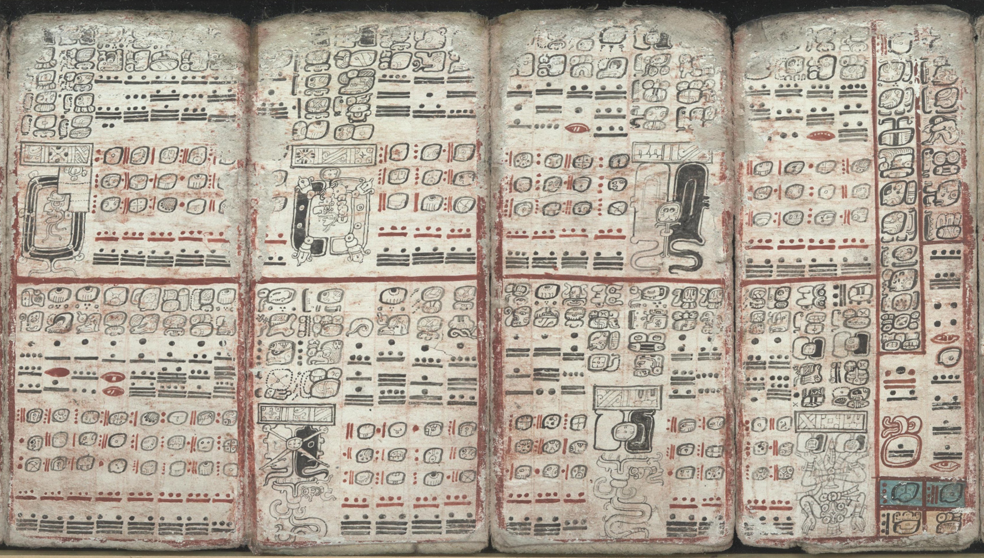
A Page from the Dresden Codex
A Dresden Codex page of Maya astronomical tables.
© More Lessons Less Planning | morelessonslessplanning.com
Notes:
Public-domain facsimile of a real Dresden Codex page (pages 58-61), photographed from the Forstemann 1880 facsimile of the pre-Columbian original. Point out the grid-like tables, the bar-and-dot numbers (a bar is five, a dot is one), and the day glyphs - the same style of tables the Maya used to track Venus and warn of eclipses. Use it purely as a reference visual to make the previous slide's description concrete; students are not asked to decode the page as evidence.

Slide 10
The Books of Chilam Balam
Written AFTER the conquest
The Books of Chilam Balam are colonial-era Maya texts, written in Yucatec Maya using the Latin alphabet after the Spanish arrived - not ancient codices.
✔
They PRESERVED old knowledge
Maya writers used the new alphabet to record older traditions, including the count of katuns and their prophecies.
✔
Different from the Dresden Codex
The Dresden Codex is a pre-Columbian book; the Chilam Balam books are later, colonial copies that keep the memory of the calendar alive.
✔
Key Concept: The BOOKS OF CHILAM BALAM are colonial-era Maya texts that preserved older calendar knowledge - not ancient codices.
© More Lessons Less Planning | morelessonslessplanning.com
Notes:
Not every Maya text is ancient, and this distinction is the heart of today's history skill. The BOOKS OF CHILAM BALAM are colonial-era Maya books - written AFTER the Spanish conquest, mostly in the 1500s to 1700s. They were written in the Yucatec Maya language but using the Latin alphabet the Spanish brought, not the old Maya glyphs. So they are not ancient codices at all. What makes them precious is that Maya writers used the new alphabet to PRESERVE older traditions - including the count of katuns and the prophecies attached to each one. In this way the Books of Chilam Balam keep the memory of the Maya calendar alive even though they were written in colonial times. Be careful not to confuse them with the DRESDEN CODEX. The Dresden Codex is a genuine pre-Columbian book of glyphs and astronomical tables. The Books of Chilam Balam are later, colonial-era texts in alphabetic Maya. Both are valuable, but they come from different worlds - and knowing which is which is exactly the kind of sourcing skill good historians practice.

Slide 11
Time for Planting and Prayer
Timing the farm
Timing worship
The Haab’ tracked the solar farming year.
Sky signs marked when to burn and plant maize.
Good timing meant a good harvest.
The Tzolk’in set festival and ritual days.
Venus and eclipse dates guided ceremonies.
Kings timed events to auspicious days.
Key Concept: Maya astronomy tied the calendars to real life - the Haab’ timed FARMING and the Tzolk’in timed RELIGION.
© More Lessons Less Planning | morelessonslessplanning.com
Notes:
Why did the Maya care so much about all these cycles? Because the calendars ran daily life. On the farming side, the HAAB’ followed the sun, so it marked the seasons of the agricultural year. Sky signs - the position of the sun and certain stars - told farmers when to burn their fields, when to plant maize, and when to expect rain, and good timing was the difference between a full harvest and hunger. On the religious side, the TZOLK’IN set the calendar of festivals and rituals, and the astronomical tables in books like the Dresden Codex told priests when Venus would appear and when eclipses were possible. Maya rulers used all of this to choose auspicious dates - lucky days blessed by the sky - for ceremonies, coronations, and even wars. In short, the Maya calendar system was not just about numbers on a page. It tied the sky to the soil and to the temple, connecting farming, religion, and the power of kings into one careful reckoning of time.

Slide 12
Setting the Record Straight: 2012
What actually happened
On 21 December 2012 the Long Count finished its 13th b’ak’tun and began a new one - a cycle turning over, like an odometer.
✔
What the Maya believed
Maya time is cyclical: when a count is finished it begins again. No surviving Maya source predicts the world ending in 2012.
✔
Why the myth spread
Modern pop culture, not the Maya, turned the end of a big cycle into a doomsday story - a good reminder to check the real evidence.
✔
Key Concept: The 2012 'doomsday' is a MODERN myth; the Maya calendar simply turned over a large cycle and kept counting.
© More Lessons Less Planning | morelessonslessplanning.com
Notes:
Let's set the record straight on the most famous Maya date of all. In the years before 2012, films, websites, and TV specials claimed the ancient Maya had predicted the world would end on 21 December 2012. Here is what actually happened: on that date, the Long Count simply finished its 13th B’AK’TUN and rolled over into a new one - a large cycle turning over, much like a car's odometer passing 100,000 miles. That is completely normal for a calendar built on cycles. Maya time is cyclical by design: when a count is finished, it begins again. No surviving Maya source - not the Dresden Codex, not the Books of Chilam Balam - predicts the destruction of the world in 2012. The doomsday idea came from MODERN pop culture, not from the Maya. This is a perfect example of the history skill we have practiced all lesson: check what the real sources actually say before believing a dramatic story. The Maya calendar is a monument to careful reckoning, not a prophecy of doom.

Slide 13
Key Takeaways
The Tzolk’in and Haab’ mesh into the 52-year Calendar Round.
★
The Long Count used a zero to record exact dates over millennia.
★
Naked-eye astronomy tracked Venus, recorded in the Dresden Codex.
★
Chilam Balam books are colonial, not ancient; 2012 was just a cycle.
★
© More Lessons Less Planning | morelessonslessplanning.com
Notes:
Recap the four takeaways. The big ideas: the Maya ran several calendars at once - the 260-day Tzolk’in for sacred and ritual life and the 365-day Haab’ for the farming year - which meshed into the 52-year Calendar Round; the Long Count counted days in a straight line from a mythical zero date, using a zero placeholder the Maya developed independently, so they could record exact dates over thousands of years, bundled into katuns of about 20 years and b’ak’tuns of about 394 years; Maya astronomy was careful naked-eye observation of the Sun, Moon, and especially Venus, written into the pre-Columbian Dresden Codex as Venus and eclipse tables, and it tied the calendar to farming and religion; and finally, the Books of Chilam Balam are colonial-era Maya texts that preserved older knowledge - not ancient codices - and the famous 2012 date was simply the turn of a large cycle, not a Maya prediction of the end of the world.

