Slide 1
The Labor Movement and Strikes
How workers organized unions, walked out on strike, and demanded a political voice with The People's Charter.
© More Lessons Less Planning | morelessonslessplanning.com
Notes:
Opening slide. Factory workers who had almost no power alone began organizing together - through trade unions, strikes, and a political movement called Chartism - to demand better conditions and a voice in the laws that governed their lives.

Slide 2
Learning Targets
Explain why factory workers began forming trade unions.
★
Describe how strikes and collective bargaining won gains.
★
Identify the six demands of The People's Charter (1838).
★
Explain why political voice mattered for lasting reform.
★
© More Lessons Less Planning | morelessonslessplanning.com
Notes:
Read the four learning targets. Today combines an economic story (unions and strikes) with a political story (Chartism and The People's Charter).

Slide 3
Life Before Unions
Factory workers often worked 12-14 hours a day, six days a week.
Wages were low; employers could cut pay or fire without warning.
Workers had no legal right to negotiate as a group.
Alone, a single worker had almost no power to change conditions.
Key Concept: Because a single worker had little power alone, workers began joining together to demand change.
© More Lessons Less Planning | morelessonslessplanning.com
Notes:
Factory workers often worked twelve to fourteen hours a day, six days a week, for low wages that employers could cut or eliminate at will by firing a worker without warning. Workers had no legal right to negotiate with their employer as a group. Alone, a single worker had almost no power to change these conditions - which is exactly why workers began organizing together.

Slide 4
Trade Unions Rise
Trade union
An organization of workers in the same trade who join together to bargain for better wages, hours, and working conditions.
✔
Power in numbers
By joining a union, individual workers gained the power of numbers instead of negotiating alone.
✔
Collective bargaining
Negotiating with employers on behalf of all a union's members, instead of one worker negotiating alone.
✔
Organizing anyway
Early unions were often illegal or restricted under British law, but workers organized anyway.
✔
Key Concept: A TRADE UNION lets workers use COLLECTIVE BARGAINING to negotiate as a group instead of alone.
© More Lessons Less Planning | morelessonslessplanning.com
Notes:
A TRADE UNION is an organization of workers in the same trade or industry who join together to bargain for better wages, hours, and conditions. By joining a union, individual workers gained the power of numbers. Unions used COLLECTIVE BARGAINING - negotiating with employers on behalf of all their members - instead of one worker negotiating alone. Early unions were often illegal or restricted under British law, but workers organized anyway.

Slide 5
The Strike Weapon
A STRIKE is a work stoppage until workers' demands are met.
A strike uses COLLECTIVE ACTION - acting together, not alone.
Strikes could win higher wages, shorter hours, safer conditions.
Next: a real photo of the famous 1888 matchgirls' strike.
Key Concept: A STRIKE is a work stoppage that uses COLLECTIVE ACTION to pressure employers for change.
© More Lessons Less Planning | morelessonslessplanning.com
Notes:
A STRIKE is an organized work stoppage in which workers refuse to work until their demands are met. A strike used COLLECTIVE ACTION - workers acting together instead of alone - to pressure an employer who could easily ignore one worker but not an entire striking workforce. Strikes could win higher wages, shorter hours, or safer conditions.

Slide 6
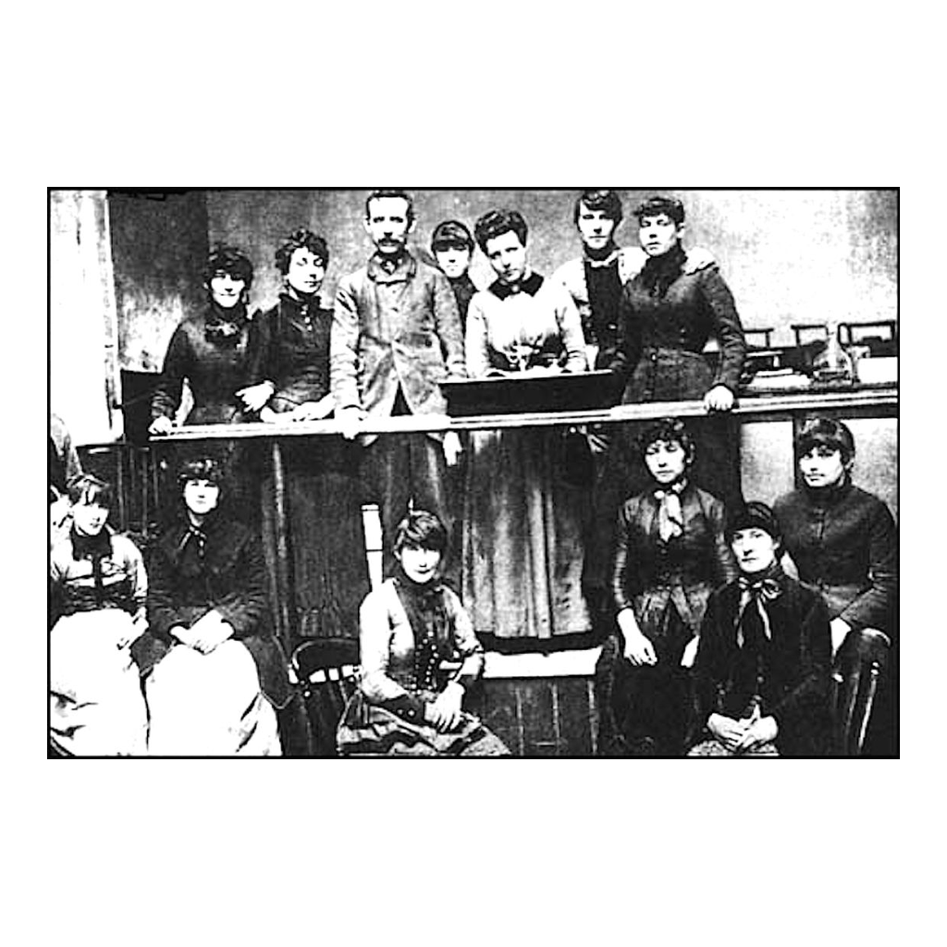
The Matchgirls' Strike Committee, 1888
A period photo of the 1888 Matchgirls' Strike Committee.
© More Lessons Less Planning | morelessonslessplanning.com
Notes:
This is a real period photograph of the Matchgirls' Strike Committee - the women who led the famous 1888 strike at the Bryant and May match factory in London. Use it as a reference image to picture real workers organizing collective action, not as evidence for any single graded claim.
Reference labels (point to these chart features when teaching): Strike committee; Bryant and May, 1888

Slide 7
Chartism: A Political Movement
Real power
Trade unions and strikes could win small gains, but employers and the law still held the real power.
Chartism
A working-class movement in Britain that argued the real fix was political, not just economic.
The vote
Chartists believed that if working men could vote, Parliament would finally pass laws that helped workers.
The People's Charter
The movement took its name from a petition called The People's Charter.
Key Concept: CHARTISM argued that workers needed political power, not just union gains, to win lasting change.
© More Lessons Less Planning | morelessonslessplanning.com
Notes:
Trade unions and strikes could win small gains, but employers and the law still held the real power. CHARTISM was a working-class movement in Britain that argued the real fix was political, not just economic: if working men could vote, Chartists believed, Parliament would finally pass laws that helped workers. The movement took its name from a petition called The People's Charter.

Slide 8
The People's Charter's Six Demands
The People's Charter
Written in 1838 by the London Working Men's Association, a petition listing six demands.
✔
Universal manhood suffrage
The biggest demand: the vote for every adult man, not just property owners.
✔
Secret ballot
Voting in private, so a worker's vote could not be seen or punished by an employer.
✔
Four more points
No property qualification for MPs, payment for MPs, equal districts, and annual Parliaments.
✔
Key Concept: THE PEOPLE'S CHARTER (1838) listed six demands, starting with UNIVERSAL MANHOOD SUFFRAGE and the SECRET BALLOT.
© More Lessons Less Planning | morelessonslessplanning.com
Notes:
In 1838 the London Working Men's Association wrote THE PEOPLE'S CHARTER, a petition listing six demands for political reform. The biggest demand was UNIVERSAL MANHOOD SUFFRAGE - the vote for every adult man, not just property owners. Another demand was the SECRET BALLOT, so a worker's vote could not be seen or punished by an employer or landlord. The remaining points demanded no property qualification for Members of Parliament, payment for MPs, equal-sized election districts, and a new Parliament every year.

Slide 9
A Mass Movement
Chartism was the largest working-class political movement.
Chartists collected millions of signatures on giant petitions.
In April 1848, a huge crowd gathered at Kennington Common.
Next: a real photo of that 1848 meeting - crowds, captured early.
Key Concept: Chartists used mass petitions and mass meetings, like the 1848 gathering at Kennington Common, to demand change.
© More Lessons Less Planning | morelessonslessplanning.com
Notes:
Chartism became the largest working-class political movement of the 19th century. Chartists collected millions of signatures on giant petitions and presented them to Parliament three times. In April 1848, a huge crowd gathered at Kennington Common in London to support the Charter. The next slide shows a real photograph of that 1848 meeting - one of the earliest photographs ever taken of a crowd.

Slide 10
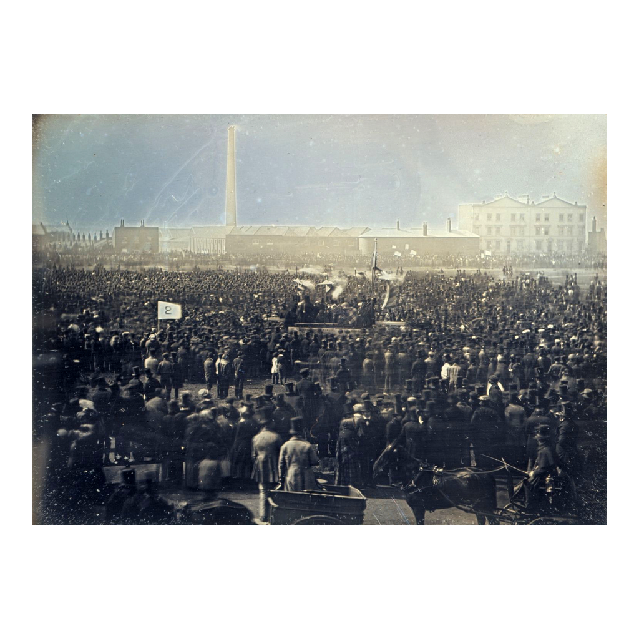
The Great Chartist Meeting, 1848
The Great Chartist Meeting, Kennington Common, 1848.
© More Lessons Less Planning | morelessonslessplanning.com
Notes:
This is William Edward Kilburn's 1848 daguerreotype of the Great Chartist Meeting on Kennington Common - one of the earliest surviving photographs of a crowd. Use it as a reference image to picture the scale of the Chartist movement, not as proof of an exact attendance count.
Reference labels (point to these chart features when teaching): Kennington Common; Chartist crowd, 1848

Slide 11
Political Voice and Economic Reform
Lawmakers
Winning the vote mattered because voters, not petitioners, could choose lawmakers who represented working people.
Collective action in politics
Chartists argued collective action in politics could win what strikes alone could not: new laws.
Answering to workers
If working men could vote, Parliament would have to answer to them, not only to factory owners and landlords.
Setting the agenda
Chartism itself did not win the vote in 1848, but its six demands set the agenda for reform.
Key Concept: Chartists believed that political voice and COLLECTIVE ACTION together could win lasting economic reform.
© More Lessons Less Planning | morelessonslessplanning.com
Notes:
Winning the vote mattered because voters, not petitioners, could choose lawmakers who represented working people. Chartists argued that COLLECTIVE ACTION in politics could win what strikes alone could not: new laws that applied everywhere, not just at one factory. If working men could vote, Parliament would have to answer to them, not only to factory owners and landlords. Chartism itself did not win the vote in 1848, but its six demands set the agenda for reform.

Slide 12
Partial Victories: The Factory Acts
Parliament rejected the Charter three times; it faded by the 1850s.
Collective action still pushed lawmakers toward reform.
The FACTORY ACTS gradually limited hours, improved safety.
Over time, five of six demands eventually became law - not annual parliaments.
Key Concept: The FACTORY ACTS show that collective action won real reforms, even when the Charter itself was rejected.
© More Lessons Less Planning | morelessonslessplanning.com
Notes:
Parliament rejected the Chartists' petitions three times, and the movement faded by the 1850s. But collective action from unions, strikes, and Chartism still pushed lawmakers toward reform. A series of FACTORY ACTS gradually limited working hours and improved safety in factories and mines. Over the following decades, five of the Charter's six demands eventually became law - only annual parliaments never passed.

Slide 13
Reference Guide: Organizing for Power
Trade union
An organization of workers in the same trade who bargain for better wages, hours, and conditions.
Strike
A work stoppage in which workers refuse to work until their demands are met.
Collective bargaining
A union negotiates with employers on behalf of all its members.
Chartism
A working-class movement in Britain that campaigned for political reform using The People's Charter.
The People's Charter
An 1838 petition that listed six demands for political reform, including the vote for working men.
Key Concept: Trade unions, strikes, and collective bargaining won economic power; Chartism and The People's Charter demanded political power.
© More Lessons Less Planning | morelessonslessplanning.com
Notes:
Review slide with five exact definitions: trade union, strike, collective bargaining, Chartism, and The People's Charter.

Slide 14
Reference Guide: Demands and Reform
Universal manhood suffrage
The demand that every adult man, not just property owners, have the right to vote.
Secret ballot
Voting in private so that a worker's vote could not be seen or punished by an employer or landlord.
Collective action
Workers acting together, rather than alone, to pressure employers or lawmakers for change.
Factory Acts
A series of British laws that gradually limited working hours and improved conditions in factories and mines.
Labor movement
The broad organized effort by workers to win better pay, hours, safety, and political rights.
Key Concept: The Charter's demands and the Factory Acts were both won through collective action - the heart of the labor movement.
© More Lessons Less Planning | morelessonslessplanning.com
Notes:
Review slide with five exact definitions: universal manhood suffrage, secret ballot, collective action, Factory Acts, and labor movement.

Slide 15
Key Takeaways
Trade unions let workers use collective bargaining, not act alone.
★
Strikes used collective action for better wages, hours, conditions.
★
Chartism and The Charter (1838) demanded political voice.
★
Parliament rejected the Charter, but reform came - the Factory Acts.
★
© More Lessons Less Planning | morelessonslessplanning.com
Notes:
Recap the four takeaways. The big idea: workers moved from isolated powerlessness to organized economic AND political power.

