Slide 1
The Korean War
Containment's first real fight
© More Lessons Less Planning | morelessonslessplanning.com
Notes:
Open by asking what happens when a Cold War promise (containment, from the Truman Doctrine lesson) meets an actual invading army. Korea is that moment - the first time the U.S. had to back containment with troops instead of just aid and speeches.

Slide 2
Learning Targets
Explain how North Korea's invasion tested the U.S. policy of containment.
★
Describe how the UN authorized action and why the Soviet boycott mattered.
★
Trace the war's turning points: invasion, Pusan, Inchon, Chinese intervention.
★
Analyze Truman's justification for sending U.S. forces into Korea.
★
Explain why the 1953 Armistice halted the fighting but never ended the war.
★
© More Lessons Less Planning | morelessonslessplanning.com
Notes:
Point out that target four is the one the Activity's Primary Source Spotlight assesses: students read Truman's actual June 27, 1950 statement and explain what it reveals about the era.

Slide 3
Containment Faces Its First War
1945: Japan's defeat left Korea divided at the 38th parallel
Soviet troops occupied the north; American troops occupied the south
North Korea became communist; South Korea became a U.S. ally
Containment: stopping communism's spread without full-scale war
Korea was the first place containment faced an actual invasion
Key Concept: Korea turned a Cold War promise into an actual test.
© More Lessons Less Planning | morelessonslessplanning.com
Notes:
Containment - U.S. Cold War strategy of stopping the spread of communism without full-scale war against the Soviet Union. 38th parallel - the line of latitude that divided communist North Korea from democratic South Korea before the war. This is a direct callback to the Truman Doctrine toolkit; containment already existed as policy, Korea is where it gets tested with troops.

Slide 4
June 25, 1950: North Korea Invades
Crossing the Line
Seoul Falls Fast
A Cold War First
North Korean troops crossed the 38th parallel at dawn
Soviet-supplied tanks led the invasion force
South Korea's capital, Seoul, fell within three days
South Korean forces retreated south in disorder
First armed invasion across a Cold War dividing line
The world watched to see how the U.S. would respond
Fact: Seoul, the South Korean capital, fell in less than a week.
© More Lessons Less Planning | morelessonslessplanning.com
Notes:
This is the invasion Truman's statement (the Primary Source Spotlight) responds to two days later. Keep the description factual and non-graphic: troop movements and the speed of the collapse, not combat detail.

Slide 5
Truman Acts, the UN Responds
June 27, 1950: Truman ordered U.S. air and sea forces to help
Same day: UN Security Council Resolution 83 backed South Korea
The Soviet Union was boycotting the Council over the China seat
With the USSR absent, it could not veto the resolution
Truman called it proof communism now used armed invasion
Did You Know: the USSR's own boycott let Resolution 83 pass.
© More Lessons Less Planning | morelessonslessplanning.com
Notes:
This slide previews the Activity's Primary Source Spotlight - students read Truman's actual June 27, 1950 statement. The Soviet boycott detail is the single best 'why did the UN act' hook; make sure students can restate it in their own words before the Activity.

Slide 6
The Pusan Perimeter
A Shrinking Foothold
By August 1950 UN and South Korean troops held a small corner of Korea.
✔
The Port of Pusan
Pusan's port let reinforcements and supplies keep arriving by sea.
✔
Holding the Line
Troops dug in and held the perimeter through the summer of 1950.
✔
General MacArthur
MacArthur commanded UN forces and was already planning a counterstrike.
✔
Note: the Pusan Perimeter was the line that never broke.
© More Lessons Less Planning | morelessonslessplanning.com
Notes:
Pusan Perimeter - the defensive line in southeastern Korea where UN and South Korean forces held out in summer 1950. This is the low point of the war for the UN side; the tone should be about holding on and the promise of relief, not desperation.

Slide 7
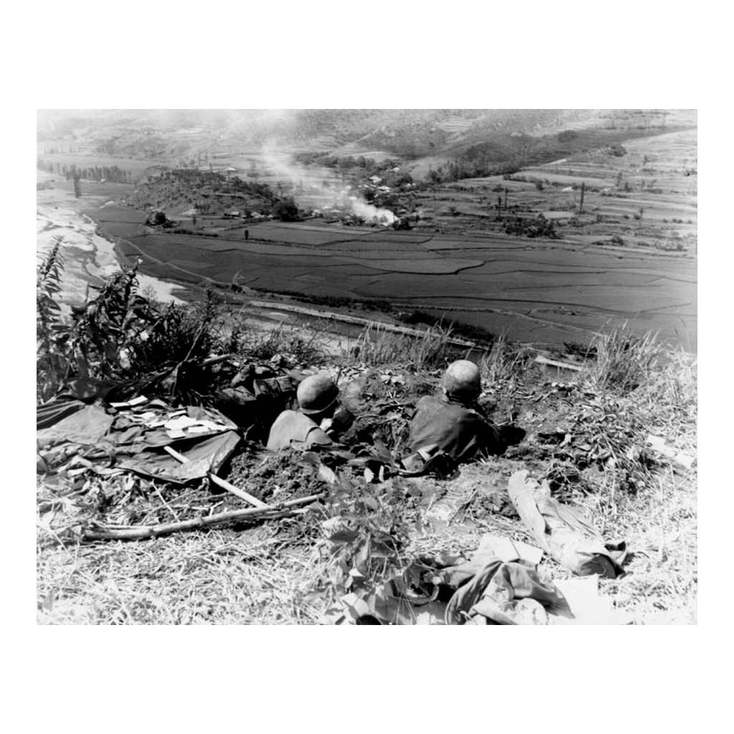
Holding the Pusan Perimeter
Note: a dug-in defensive position
© More Lessons Less Planning | morelessonslessplanning.com
Notes:
Give students ten seconds to look before you say anything. Two soldiers are dug into a shallow position on a hillside overlooking a valley - point out the vantage point and the dug-in gear, then move on. This is a reference image, not an evidence task.

Slide 8
MacArthur's Gamble: Inchon
A Risky Choice
September 15, 1950
Seoul Retaken
Inchon's extreme tides made a landing very risky
Many military advisers argued against the plan
UN forces landed at Inchon, behind North Korean lines
The landing cut off North Korean troops and supplies
UN forces recaptured Seoul by month's end
North Korean forces were routed and pushed north
Fact: Inchon is remembered as one of the war's boldest gambles.
© More Lessons Less Planning | morelessonslessplanning.com
Notes:
Inchon landing - General MacArthur's amphibious assault behind North Korean lines in September 1950. This is the war's biggest turning point; stress that it reversed the whole trajectory of the war within two weeks.

Slide 9
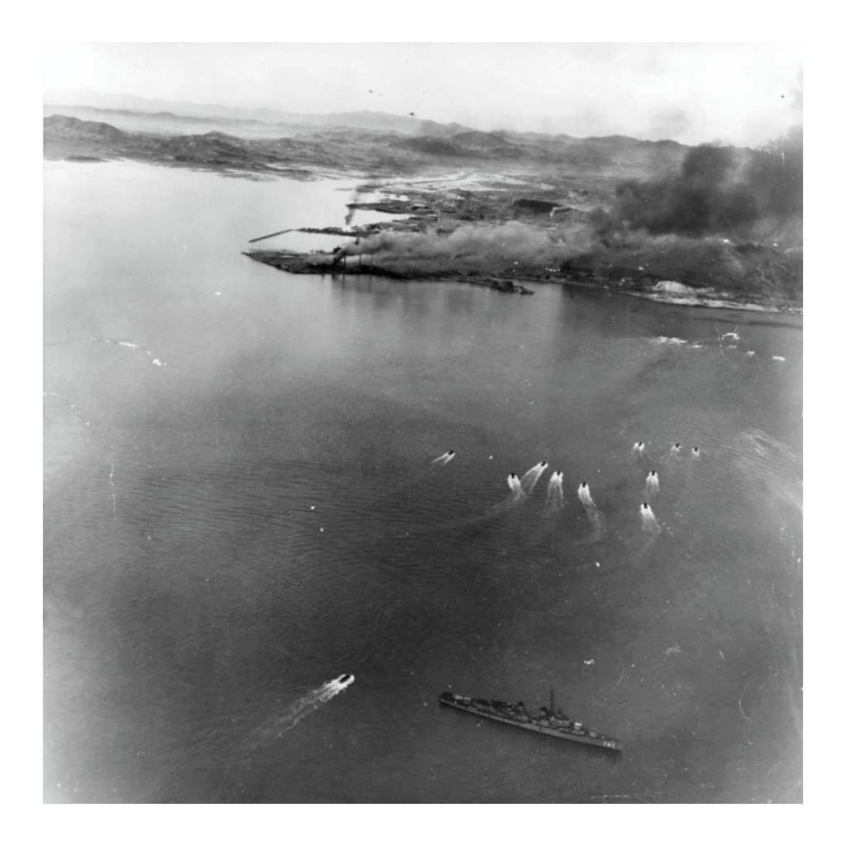
Landing at Inchon, September 1950
Note: landing craft approach the shore
© More Lessons Less Planning | morelessonslessplanning.com
Notes:
Landing craft move toward shore with a Navy destroyer offshore and smoke rising over the coastline. This is a wide naval scene, not a close combat shot - keep the discussion on the scale of the operation.

Slide 10
From Containment to Rollback
Containment (the goal so far)
Rollback (the new goal)
Stop the invasion at the 38th parallel
Restore South Korea's original border
Push north and reunify Korea by force
October 1950: UN forces crossed the 38th parallel
UN troops advanced toward the Yalu River
Key Concept: rollback aimed for more than containment ever promised.
© More Lessons Less Planning | morelessonslessplanning.com
Notes:
Rollback - strategy of pushing communist forces back across a border instead of merely stopping them. This is the pivot the whole rest of the lesson depends on: crossing the 38th parallel in October 1950 changed the war's goal and is the direct cause of Chinese intervention on the next slide.

Slide 11
China Enters the War
China warned that troops near its border was a threat
October 19, 1950: Chinese forces crossed the Yalu River
Chinese troops pushed UN forces back in two offensives
Seoul changed hands again in January 1951
Fact: China's entry turned a rollback into a much longer war.
© More Lessons Less Planning | morelessonslessplanning.com
Notes:
This is the direct consequence of the rollback strategy on the previous slide. Keep the framing on strategy and dates, not combat detail; the point is that rollback provoked a response containment alone would not have.

Slide 12
A Limited War
Limited war
A conflict fought with restricted goals and methods, not total war.
Stalemate
A drawn-out standoff where neither side gains a decisive advantage.
Truman vs. MacArthur
MacArthur pushed to expand the war; Truman relieved him in April 1951.
Key Point: Truman fired MacArthur to keep the war limited.
© More Lessons Less Planning | morelessonslessplanning.com
Notes:
Limited war - a conflict fought with restricted goals and methods rather than total war. Stalemate - a drawn-out standoff in which neither side can gain a decisive advantage. This is the moment to close the loop on MacArthur, introduced two slides ago at Inchon: Truman fired him for insubordination after he publicly pushed to expand the war into China.

Slide 13
The Human Cost
~100,000
14,000
Millions
Korean refugees evacuated by sea from Hungnam, December 1950
refugees carried on one ship, the SS Meredith Victory
Korean civilians displaced from their homes during the war
Real Talk: this war reshaped ordinary lives, not just front lines.
© More Lessons Less Planning | morelessonslessplanning.com
Notes:
The Hungnam evacuation happened as UN forces retreated south after Chinese intervention. Keep the framing on the scale of civilian displacement and the evacuation effort, respectfully - this is not the place for graphic detail.

Slide 14
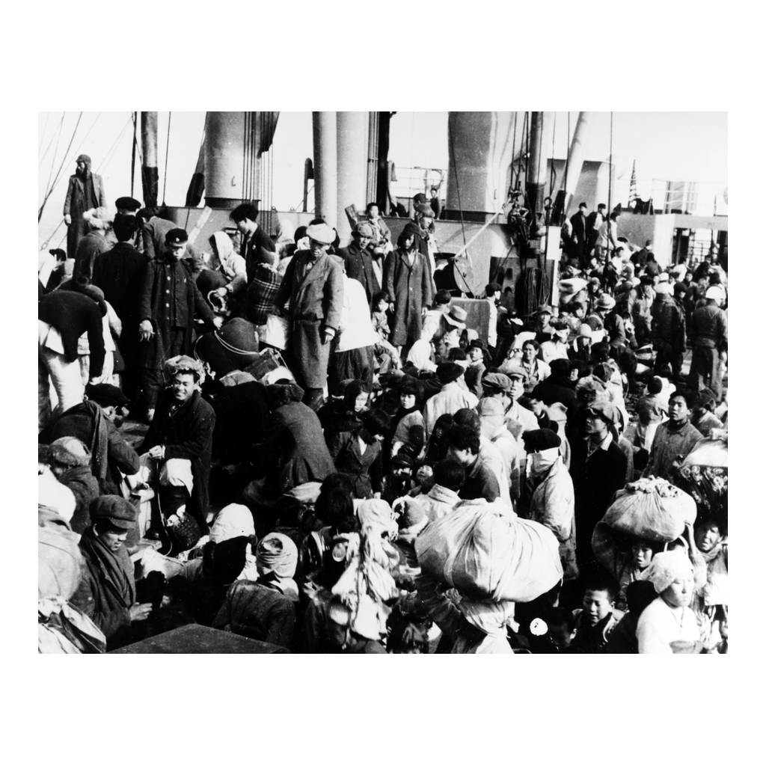
The Hungnam Evacuation, December 1950
Note: refugees aboard the evacuation ship
© More Lessons Less Planning | morelessonslessplanning.com
Notes:
Korean civilians in winter clothing stand closely together on a crowded ship deck. Frame this respectfully: these are people who chose evacuation over staying, not a scene of chaos or harm.

Slide 15
The Armistice, July 27, 1953
Armistice talks began in July 1951 and dragged on two years
Fighting continued near the 38th parallel during the talks
July 27, 1953: commanders signed the Korean Armistice Agreement
The armistice stopped the fighting - it did not end the war
No peace treaty between North and South Korea was ever signed
Fact: the two Koreas are still technically at war today.
© More Lessons Less Planning | morelessonslessplanning.com
Notes:
Armistice - an agreement to stop fighting without a signed peace treaty ending the war. This is the single most important factual guardrail in the lesson: never say the war 'ended' in 1953 without this qualification.

Slide 16
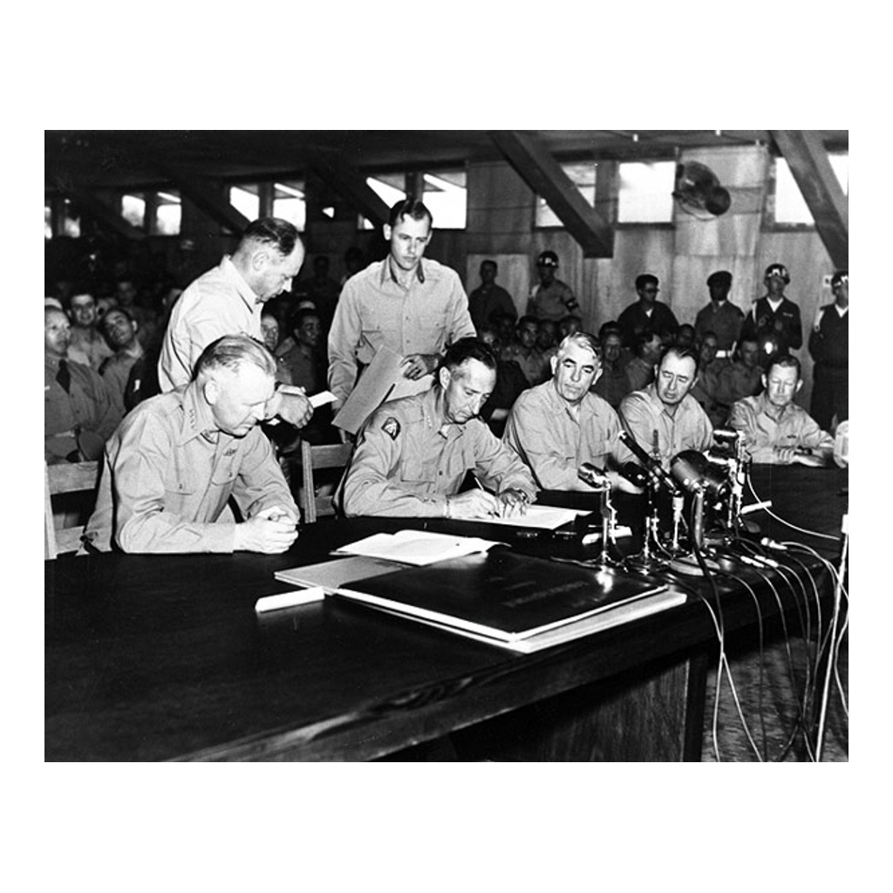
Signing the Armistice, 1953
Note: General Clark signs the agreement
© More Lessons Less Planning | morelessonslessplanning.com
Notes:
General Mark W. Clark, the UN Far East commander, signs the agreement at a table surrounded by other officers. This is a formal, unremarkable signing photo - no graphic content of any kind.

Slide 17
A War Without a Peace Treaty
Demilitarized Zone (DMZ)
A buffer about 2.5 miles wide along the 1953 cease-fire line.
Divided Korea
North and South Korea remain separate along nearly the same line.
The Forgotten War
A nickname reflecting how overshadowed this war is in U.S. memory.
Key Point: the line barely moved, but the war changed the Cold War.
© More Lessons Less Planning | morelessonslessplanning.com
Notes:
Demilitarized Zone (DMZ) - the buffer zone established along the 1953 cease-fire line that still divides Korea today. Close the content arc here: the war changed almost nothing about the map but changed how the U.S. understood the Cold War going forward.

Slide 18
Key Takeaways
North Korea's invasion turned containment into an actual war
★
The UN fought under Resolution 83 because a Soviet boycott blocked a veto
★
Inchon reversed the war, but Chinese intervention led to a stalemate
★
The 1953 Armistice stopped the fighting but never ended the war
★
© More Lessons Less Planning | morelessonslessplanning.com
Notes:
Close by returning to the opening question: does a war fought to 'contain' something usually end in a clear win, a clear loss, or something messier? Korea is the messier case, and that is the point.

