Slide 1
The Islamic Golden Age
How Baghdad's House of Wisdom drove advances in mathematics, medicine, and astronomy during the Abbasid era.
© More Lessons Less Planning | morelessonslessplanning.com
Notes:
Opening slide. During the Abbasid caliphate (750-1258), with its capital at Baghdad, the Islamic world entered what historians call a Golden Age - a period of remarkable advances in mathematics, medicine, astronomy, and many other fields. At its heart was the House of Wisdom (Bayt al-Hikma), a center of translation and scholarship where scholars of many faiths preserved and advanced Greek, Persian, and Indian knowledge. Set the frame from the first minute, in a respectful, academic tone: this is a history of scientific and cultural achievement, and we credit real scholars for what they actually did. Two anchors run through the whole lesson. First, these scholars BUILT ON earlier work - Babylonian, Greek, and Indian - rather than inventing everything from nothing. Second, the scholarship was multi-faith and multi-ethnic, and we describe the era as a civilization's achievements, not as a lesson about any one religion's beliefs.

Slide 2
Learning Targets
Explain what the Islamic Golden Age was and how Baghdad supported learning.
★
Describe the House of Wisdom and the many-faith translation movement.
★
Identify advances in math, medicine, and astronomy, built on earlier work.
★
Analyze al-Khwarizmi's own introduction to his algebra book as a primary source.
★
© More Lessons Less Planning | morelessonslessplanning.com
Notes:
Read the four learning targets. Keep two anchors in mind throughout. First, we treat this as a history of achievement studied academically: we describe what scholars discovered and credit them, while being honest that they built on earlier Babylonian, Greek, and Indian work. Second, we keep the scholarship's multi-faith, multi-ethnic character in view (Muslim, Christian, Jewish, Persian, Arab scholars). Pay special attention to target three (the specific advances in mathematics, medicine, optics, and astronomy, and how scholars built on earlier work), because it corrects two common oversimplifications - that the Golden Age invented everything from nothing, and that the House of Wisdom was 'just a library' - and to target four (reading al-Khwarizmi's algebra introduction), because that document is the primary source students will analyze in the activity.

Slide 3
Baghdad and the Abbasid Golden Age
A new capital of learning
Why historians say 'Golden Age'
The Abbasid caliphate ruled from 750 to 1258 CE.
The Abbasids built a new capital city: Baghdad.
Baghdad became a hub of trade, wealth, and learning.
Scholars there made major advances in math and science.
Wealth from trade helped pay for books and scholars.
This flowering of learning is called the Golden Age.
Key Concept: The ABBASID caliphate (750-1258) ruled from BAGHDAD, which became the leading center of learning during the Islamic Golden Age.
© More Lessons Less Planning | morelessonslessplanning.com
Notes:
Start with the setting. The Abbasid caliphate ruled the Islamic world from 750 to 1258 CE, and one of its first great acts was to build a brand-new capital city, Baghdad, in what is now Iraq. Sitting on trade routes between east and west, Baghdad quickly grew into one of the largest and richest cities in the world, a hub of trade, craft, and administration. That wealth mattered for learning: the Abbasid caliphs and wealthy patrons could afford to pay scholars, buy and copy expensive books, and gather knowledge from across three continents. The result was such a remarkable flowering of mathematics, medicine, astronomy, and philosophy that historians call this period the Islamic Golden Age. Present this as the history of a civilization's achievements: we are asking how a city and a state became a world center of science and learning.

Slide 4
The House of Wisdom (Bayt al-Hikma)
A center of translation and scholarship
The House of Wisdom (Bayt al-Hikma) in Baghdad was a center of translation and scholarship, not just a book warehouse.
✔
Preserved AND advanced knowledge
Scholars there did more than store books - they preserved older knowledge and advanced it with new work.
✔
An institution, not one grand building
Historians debate its exact form; picture a scholarly institution and movement under the Abbasids, not a single library building.
✔
Key Concept: The HOUSE OF WISDOM in Baghdad was a center of translation and scholarship where scholars preserved AND advanced knowledge.
© More Lessons Less Planning | morelessonslessplanning.com
Notes:
Now name the heart of the Golden Age: the House of Wisdom, in Arabic Bayt al-Hikma. It is easy to picture it as a single grand library full of shelves, but that image can mislead, so be careful and accurate. The House of Wisdom is best understood as a center of translation and scholarship in Baghdad - a hub, sponsored by the Abbasid caliphs, where scholars gathered, translated works from other languages, studied them, and produced new knowledge of their own. Two points keep this accurate. First, it was not merely a warehouse where books were stored: its scholars preserved older knowledge AND advanced it, adding their own discoveries. Second, historians actually debate exactly what the House of Wisdom was - how big it was, whether it was one building or a broader institution and movement - so we describe it as a scholarly institution and movement under the early Abbasids rather than claiming certainty about a single grand library. The key idea for students: Baghdad became a place where knowledge from many cultures was gathered, translated, studied, and pushed forward.

Slide 5
The Translation Movement
Gathering the world's knowledge
Scholars of many faiths
Caliphs sponsored a huge translation movement in Baghdad.
Greek, Persian, and Indian works were translated into Arabic.
This saved knowledge that might otherwise have been lost.
Translators were Muslim, Christian, Jewish, Persian, and Arab.
It was a multi-faith, multi-ethnic effort, not one group.
Shared Arabic let scholars build on each other's work.
Did You Know? The TRANSLATION MOVEMENT translated Greek, Persian, and Indian works into Arabic - and its scholars came from many faiths and peoples.
© More Lessons Less Planning | morelessonslessplanning.com
Notes:
This slide explains how knowledge from around the world came together in Baghdad, and it carries an important honesty anchor about who did the work. Under the Abbasid caliphs, Baghdad became the center of a huge translation movement: a sustained, well-funded effort to translate the great works of other civilizations - Greek philosophy and science, Persian literature and administration, and Indian mathematics and astronomy - into Arabic. This mattered enormously, because it gathered and preserved knowledge that might otherwise have been scattered or lost, and it put it into one shared scholarly language. Just as important is WHO did this work: the translators and scholars were a genuinely diverse group - Muslim, Christian, Jewish, Persian, and Arab - and the translation movement was multi-faith and multi-ethnic, not the achievement of a single group. Because they worked in a shared language, Arabic, scholars from different backgrounds and generations could read and build directly on one another's work. Present this factually and respectfully: it is one of history's great collaborative scholarly efforts.

Slide 6
Mathematics: al-Khwarizmi and Algebra
al-Khwarizmi, a House of Wisdom mathematician
al-Khwarizmi worked at the House of Wisdom and wrote a clear, systematic book on solving equations.
✔
He systematized and named algebra
He organized older methods into algebra - the name comes from the Arabic 'al-jabr' in his book's title.
✔
His name gave us 'algorithm'
His Latinized name became our word algorithm, a step-by-step procedure for solving a problem.
✔
Key Concept: AL-KHWARIZMI systematized and named ALGEBRA (from 'al-jabr'); his Latinized name gave us the word ALGORITHM.
© More Lessons Less Planning | morelessonslessplanning.com
Notes:
Now the most famous mathematical achievement of the Golden Age, and a key honesty anchor. Muhammad ibn Musa al-Khwarizmi was a mathematician who worked at the House of Wisdom in Baghdad in the early 800s. His great contribution was to take older methods of solving equations and organize them into a clear, systematic system, which he laid out in a practical book. The Arabic word in his book's title, 'al-jabr' (meaning 'completion' or 'restoring'), became our word ALGEBRA - so we say al-Khwarizmi systematized and NAMED algebra. Be precise here: he did NOT invent mathematics or equations from nothing. Mathematicians before him - Babylonian, Greek (such as Diophantus), and Indian - had already worked on these problems; what al-Khwarizmi did was pull the ideas together into one organized method and explain it clearly, which is itself a major achievement. There is a second famous legacy: when his works were later translated into Latin, his own name (Latinized as 'Algoritmi') became our word ALGORITHM, meaning a step-by-step procedure for solving a problem. So one Baghdad scholar's name and book title live on in two words students use today.

Slide 7
'Arabic' Numerals - Really Indian
Where the numbers came from
How they spread
The digits we use (0-9) are called 'Arabic numerals.'
But they are Indian in origin, developed in India first.
This system includes the powerful idea of zero.
Scholars in the Islamic world adopted the Indian numerals.
From there the numerals spread to Europe.
Europeans called them 'Arabic' - the name stuck.
Did You Know? ARABIC NUMERALS are Indian in origin; they were transmitted and spread to Europe through the Islamic world.
© More Lessons Less Planning | morelessonslessplanning.com
Notes:
This slide corrects one of the most common misunderstandings in the whole topic, so make the point clearly. The number symbols we use every day - 0, 1, 2, 3, and so on - are usually called ARABIC NUMERALS. But the name is misleading: these numerals are Indian in origin. Mathematicians in India developed this decimal, place-value number system, including the powerful idea of ZERO as a number, well before it reached the Islamic world. Scholars in the Islamic world, including at the House of Wisdom, learned the Indian system, saw how useful it was, and adopted and used it widely. From the Islamic world, the numerals were then transmitted onward to Europe, where Europeans, encountering them through Arabic sources, called them 'Arabic numerals' - and that name simply stuck. So the honest story is one of transmission: Indian in origin, spread and passed on through the Islamic world to Europe. This is a perfect example of the Golden Age's real role - gathering, using, and passing on knowledge across cultures.

Slide 8
Ibn al-Haytham and the Scientific Method
Ibn al-Haytham (Alhazen)
Ibn al-Haytham, known in Latin as Alhazen, was a scholar who studied optics - how light and vision work.
✔
Test ideas with evidence
He stressed testing ideas with careful experiments and evidence, not just accepting old authorities.
✔
A step toward the scientific method
This insistence on evidence and experiment was an early step toward the modern scientific method.
✔
Key Concept: IBN AL-HAYTHAM (Alhazen) advanced OPTICS and stressed testing ideas with evidence - an early step toward the scientific method.
© More Lessons Less Planning | morelessonslessplanning.com
Notes:
Move from mathematics to the study of the natural world, and to a scholar whose method was as important as his findings. Ibn al-Haytham - known in Europe by the Latin name Alhazen - was a scholar of the Golden Age famous above all for his work in OPTICS, the study of how light behaves and how we see. He carried out careful investigations of light, lenses, and vision, and improved on the ideas of earlier Greek thinkers. But his greatest legacy is HOW he worked: Ibn al-Haytham insisted that ideas about the natural world should be TESTED with careful experiments and checked against EVIDENCE, rather than simply accepted because an old authority had said them. This emphasis on observation, experiment, and evidence was an early step toward what we now call the scientific method. Present him as an example of the Golden Age's spirit of inquiry: not only new discoveries, but a more rigorous way of finding out what is true. Note, as always, that he built on earlier Greek optics and advanced it.

Slide 9
Medicine: al-Razi and Ibn Sina
al-Razi, a careful physician
Ibn Sina and The Canon
al-Razi was a physician who wrote widely on disease.
He described illnesses carefully from real observation.
His works helped later doctors recognize diseases.
Ibn Sina (Avicenna) wrote The Canon of Medicine.
It organized medical knowledge into one huge reference.
It was used by doctors for centuries, even in Europe.
Key Concept: IBN SINA (Avicenna) wrote The Canon of Medicine, a reference used for centuries; al-Razi advanced medicine through careful observation.
© More Lessons Less Planning | morelessonslessplanning.com
Notes:
Medicine was one of the Golden Age's greatest strengths, and two physicians stand out. The first is al-Razi (known in Latin as Rhazes), a physician who wrote a great deal about disease and treatment. His special contribution was careful, honest OBSERVATION: he described illnesses as he actually saw them in patients - famously distinguishing between diseases that earlier writers had confused - which helped later doctors recognize and treat them. The second, and even more influential, is Ibn Sina, known in Europe as Avicenna. Ibn Sina was a physician and philosopher whose masterwork, The Canon of Medicine, gathered and organized the medical knowledge of his time - Greek, Persian, and Islamic - into one enormous, well-arranged reference. The Canon was so thorough and clear that it was used to train doctors for CENTURIES, not only in the Islamic world but in Europe as well, where it was translated into Latin. Present both as examples of the Golden Age pattern: gathering and organizing earlier knowledge, then advancing it with careful new work of their own.

Slide 10
Astronomy and the Astrolabe
Studying the sky
Golden Age scholars studied astronomy - the positions and motions of the sun, moon, and stars.
✔
The astrolabe, a key tool
They improved the astrolabe, a brass instrument for measuring the position of stars and the sun.
✔
Practical uses
The astrolabe helped with timekeeping, finding directions, and knowing the times for daily life.
✔
Key Concept: Golden Age scholars advanced ASTRONOMY and refined the ASTROLABE, a brass instrument for measuring the positions of stars and the sun.
© More Lessons Less Planning | morelessonslessplanning.com
Notes:
The last field of achievement is astronomy, the study of the sky. Golden Age scholars carefully observed and mapped the positions and motions of the sun, moon, planets, and stars, correcting and extending the work of earlier Greek and Indian astronomers, and building observatories to make more accurate measurements. One of their most important tools was the ASTROLABE, a beautifully made brass instrument that could measure the position of a star or the sun above the horizon. Scholars in the Islamic world refined the astrolabe and made it more accurate and versatile. It was highly practical: an astrolabe could be used to tell the time of day or night, to find directions, to help travelers know their location, and to determine the times for daily activities and prayer. The next slide shows a real medieval Islamic brass astrolabe so students can see how finely made these instruments were. Present astronomy as another example of the Golden Age pattern - building on earlier work and advancing it with careful observation and better instruments.

Slide 11
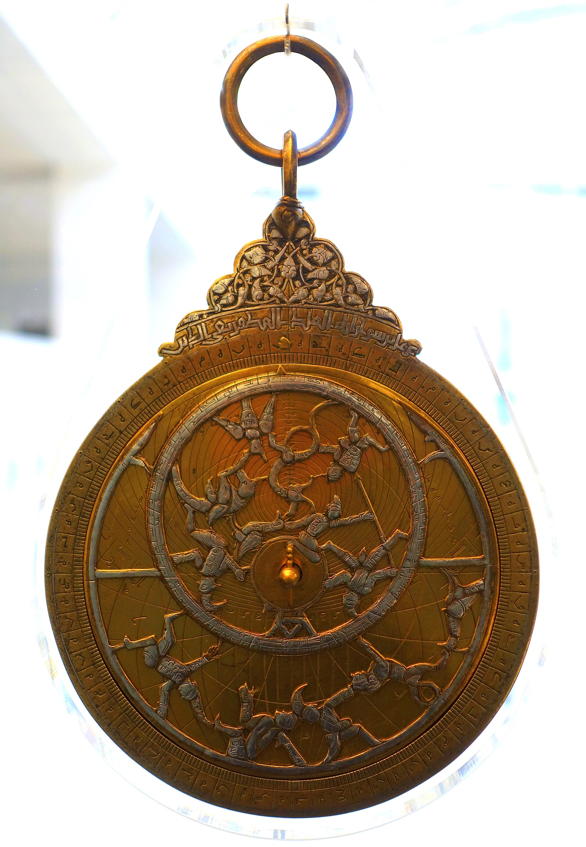
A Medieval Islamic Astrolabe
A medieval Islamic brass astrolabe (Syria, c. 1180-1280 CE).
© More Lessons Less Planning | morelessonslessplanning.com
Notes:
A real public-domain photograph of a medieval Islamic brass astrolabe, made by al-Sahl al-Nisaburi in Syria around 1180-1280 CE and now held in the Germanisches Nationalmuseum in Nuremberg. Use it purely as a reference image to make the astronomy achievement concrete: point out the finely engraved brass disc, the ring for hanging it, and the intricate markings scholars used to measure the position of the sun and stars. This is a photograph of an OBJECT - a scientific instrument - and contains no image of any person, including no depiction of al-Khwarizmi or any prophet. Students are not asked to decode the astrolabe as evidence; it simply supports the content slide. Image: medieval Islamic brass astrolabe, photograph in the public domain (own-work dedication by the photographer Daderot, via Wikimedia Commons).
Reference labels (point to these chart features when teaching): Brass astrolabe; Used to measure star positions

Slide 12
Building On - and Passing On - Knowledge
Built on earlier work
Passed knowledge on
Golden Age scholars built on Babylonian, Greek, and Indian work.
They did not invent everything from nothing.
Organizing and advancing knowledge is itself an achievement.
Their books were later translated into Latin in Europe.
Algebra, numerals, and medicine reached Europe this way.
The Golden Age is a story of shared, connected learning.
Key Concept: Golden Age scholars BUILT ON earlier Babylonian, Greek, and Indian work and PASSED IT ON - later shaping learning in Europe too.
© More Lessons Less Planning | morelessonslessplanning.com
Notes:
Bring the lesson together with the honesty anchor that ties everything else together, and set up the primary source. The most accurate way to describe the Islamic Golden Age is as a great chapter in a connected, shared human story of knowledge. On one side, its scholars BUILT ON earlier work: Babylonian, Greek (like Diophantus in mathematics and the Greek doctors and astronomers), and Indian (like the numerals and much astronomy). They did not invent everything from nothing - but organizing, correcting, and advancing that inherited knowledge, and adding real discoveries of their own, is itself a major achievement. On the other side, they PASSED knowledge on: in later centuries their books were translated from Arabic into Latin in Europe, and it was largely through the Islamic world that algebra, the Indian numerals, Ibn Sina's Canon of Medicine, and much Greek learning reached medieval and Renaissance Europe. So the Golden Age is not an isolated miracle; it is a crucial link in a long, shared chain of learning across cultures. This sets up the activity, where students read al-Khwarizmi's own introduction to his algebra book and see a Golden Age scholar explaining, in his own words, why he wrote it.

Slide 13
Key Takeaways
Abbasid Baghdad sponsored the House of Wisdom and a translation movement.
★
Many-faith scholars preserved AND advanced Greek, Persian, and Indian knowledge.
★
al-Khwarizmi named algebra and 'algorithm'; the numerals are Indian in origin.
★
In medicine, optics, and astronomy, scholars built on and passed on knowledge.
★
© More Lessons Less Planning | morelessonslessplanning.com
Notes:
Let us recap the Islamic Golden Age. First, the setting: during the Abbasid caliphate (750-1258), the capital Baghdad became a world center of learning, where the caliphs sponsored the House of Wisdom - a center of translation and scholarship - and a great translation movement that rendered Greek, Persian, and Indian works into Arabic. Second, who did it: scholars of many faiths and peoples - Muslim, Christian, Jewish, Persian, and Arab - who preserved older knowledge AND advanced it. Third, the specific achievements, credited accurately: in mathematics, al-Khwarizmi systematized and named algebra and gave his name to the word 'algorithm,' while the numerals we call 'Arabic' are really Indian in origin; in medicine, al-Razi observed disease carefully and Ibn Sina wrote The Canon of Medicine; in optics and the scientific method, Ibn al-Haytham stressed testing ideas with evidence; and in astronomy, scholars refined the astrolabe. Fourth, the honest through-line: they built on earlier work and passed it on, including to Europe. Throughout, we have studied the Golden Age respectfully as a history of scientific and cultural achievement.

