Slide 1
The Home Front
How governments turned posters, ration books, and war bonds into weapons of total war
© More Lessons Less Planning | morelessonslessplanning.com
Notes:
Open with the lesson question: how do you fight a war that consumes more shells, food, and money than any war before it? The answer in every warring nation was the same - turn the civilians at home into part of the war machine. Preview the arc: what total war means, how propaganda and bond drives moved money, how food was saved or rationed, and what happened to work and free speech.

Slide 2
Learning Targets
Define total war and explain what the home front was.
★
Explain how governments used propaganda to rally civilians.
★
Describe how war bonds and the Four Minute Men financed the war.
★
Compare food conservation in the United States with rationing in Europe.
★
Analyze how the war changed work, rights, and free speech at home.
★
© More Lessons Less Planning | morelessonslessplanning.com
Notes:
Read the five targets aloud. Flag target 3: students will read a real Four Minute Men speech, lightly modernized for reading - the government's own script for its theater speakers - in the Primary Source Spotlight.

Slide 3
Total War: The War Behind the Lines
By 1917 the Great War was swallowing whole economies, not just armies.
Historians call this total war: a war fought by entire societies.
The home front: the civilians - homes, farms, factories - behind the armies.
Every shell, uniform, and loaf of bread began as civilian work.
Governments needed civilians' money, food, labor, and loyalty.
Key Concept: In a total war, the side that organizes its home front best can outlast its enemies.
© More Lessons Less Planning | morelessonslessplanning.com
Notes:
By 1917 the Great War was swallowing whole economies, not just armies. Historians call this total war: a war fought by entire societies. The home front means the civilians - the homes, farms, and factories - behind the armies. Every shell, uniform, and loaf of bread began as civilian work, so governments needed four things from their people: money, food, labor, and loyalty. The rest of the lesson shows the tool each government invented to get each one.

Slide 4
Propaganda: Selling the War
What Governments Wanted
The Tools They Used
Convince men to enlist and civilians to lend money.
Persuade families to save food for the front.
Keep public support for the war strong.
Bold posters in shop windows and streetcars.
Films, pamphlets, exhibitions, and staged rallies.
Posters printed in many languages to reach immigrants.
Key Concept: Propaganda treated public opinion as a weapon of war.
© More Lessons Less Planning | morelessonslessplanning.com
Notes:
Every warring government discovered that public opinion was a weapon, and propaganda was how you aimed it. The goals: convince men to enlist, civilians to lend money, families to save food, and everyone to keep supporting the war. The tools: bold posters in shop windows and streetcars, films, pamphlets, exhibitions, staged rallies - and posters printed in many languages so the message reached immigrant communities too. The next slide shows a real one.

Slide 5
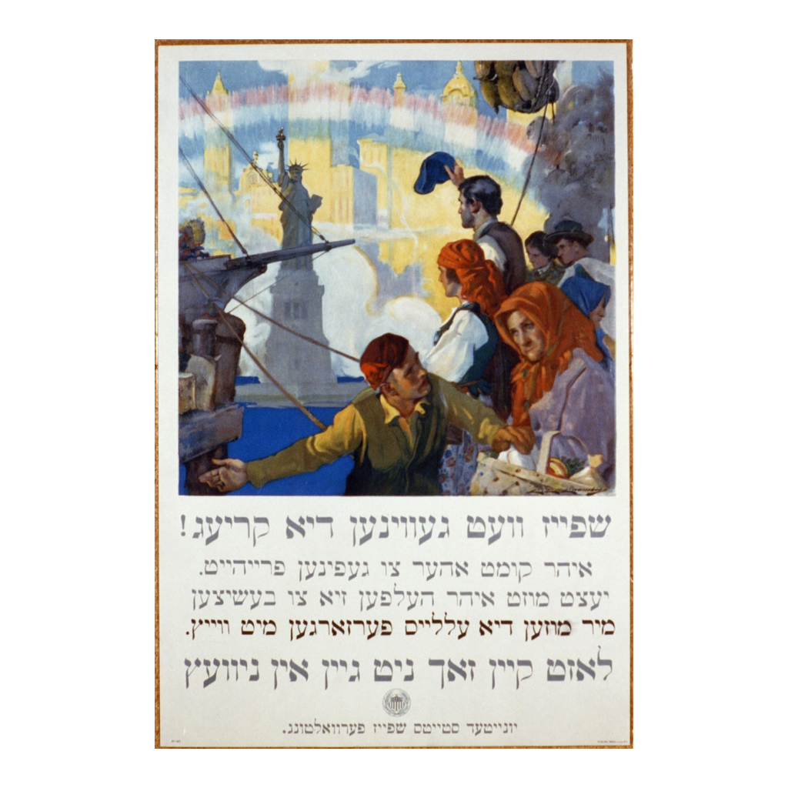
A Poster in Action
U.S. Food Administration poster in Yiddish by C. E. Chambers, 1917
© More Lessons Less Planning | morelessonslessplanning.com
Notes:
This is a real U.S. Food Administration poster from 1917, painted by Charles E. Chambers. It shows immigrants arriving in New York harbor, with the Statue of Liberty beneath a rainbow - and its text is printed in Yiddish, aimed at Jewish immigrant families. The English version of the same design read: 'Food will win the war. You came here seeking freedom. You must now help to preserve it. Wheat is needed for the allies. Waste nothing.'

Slide 6
The CPI: Washington's Persuasion Machine
In April 1917 the U.S. created the Committee on Public Information (CPI).
Journalist George Creel led the agency.
The CPI produced posters, films, pamphlets, and official war news.
Its mission: sell the war to a divided American public.
Britain, France, and Germany ran similar propaganda offices.
Did You Know: Creel refused to call it propaganda - he called it 'the world's greatest adventure in advertising.'
© More Lessons Less Planning | morelessonslessplanning.com
Notes:
In April 1917 - the same month it declared war - the United States created the Committee on Public Information, led by the journalist George Creel. The CPI produced posters, films, pamphlets, and official war news, all with one mission: sell the war to a divided American public. Creel refused to call his work propaganda; he called it 'the world's greatest adventure in advertising.' Britain, France, and Germany ran similar offices - the CPI is our case study because students will read one of its real scripts, lightly modernized for reading.

Slide 7
The Four Minute Men
Who They Were
How It Worked
Why It Worked
About 75,000 volunteer speakers
Local citizens, not officials
Named for a four-minute time limit
Spoke in movie theaters between reels
CPI bulletins supplied the talking points
Topics: bonds, food saving, the draft
A neighbor's voice, not an official's
Short enough that no one walked out
Reached millions every week
Did You Know: The four minutes matched the time it took to change a movie reel.
© More Lessons Less Planning | morelessonslessplanning.com
Notes:
The CPI's cleverest program put the government's message in a neighbor's mouth. About 75,000 volunteer Four Minute Men - local citizens, not officials - spoke in movie theaters between reels, for exactly the four minutes it took a projectionist to change a reel. The CPI mailed numbered bulletins that supplied the official talking points on bonds, food saving, and the draft. It worked because a neighbor's voice carried trust an official's could not, and because the theater audience was already seated. Students read one of these real bulletin scripts, lightly modernized for reading, in the Activity.

Slide 8
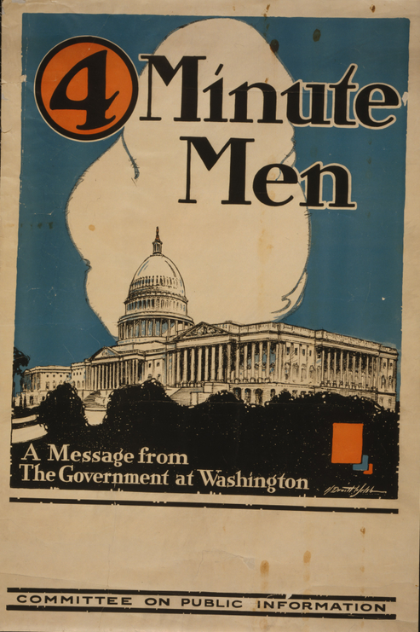
A Message from the Government at Washington
CPI theater poster for the Four Minute Men by H. Devitt Welsh, 1917
© More Lessons Less Planning | morelessonslessplanning.com
Notes:
This is the CPI's official Four Minute Men poster, designed by H. Devitt Welsh in 1917. It shows the United States Capitol and the words '4 Minute Men - A message from the government at Washington,' with a large blank space below - theaters filled that space with the night's speaker and topic. The poster stood in the lobby or on stage while the volunteer spoke.

Slide 9
Paying for the War: Liberty Loans
Modern war was staggeringly expensive - billions of dollars a year.
Governments borrowed from their own citizens through war bonds.
A bond was a loan to the government, repaid later with interest.
Four Liberty Loan drives raised about $17 billion in the United States.
Rallies, posters, and movie stars urged everyone to buy.
Key Concept: Bond drives turned saving money into a public, patriotic act.
© More Lessons Less Planning | morelessonslessplanning.com
Notes:
Where did the billions come from? Taxes covered only part, so governments borrowed from their own citizens through war bonds. A bond was a loan to the government, repaid later with interest - not a gift. In the United States, four Liberty Loan drives raised about $17 billion, in a country whose entire pre-war federal budget was under a billion dollars a year. Rallies, posters, and movie stars urged everyone to buy, and buying happened in public - at theaters, rallies, and workplaces where neighbors could see who had subscribed.

Slide 10
Food Is Ammunition: Pledges and Ration Books
The United States: Persuasion
Europe: Compulsion
The U.S. Food Administration, led by Herbert Hoover.
Families pledged meatless Tuesdays and wheatless Wednesdays.
Households planted victory gardens to grow their own food.
Britain rationed sugar, meat, and butter by 1918.
Ration coupon books set each family's weekly share.
Blockaded Germany endured the 'turnip winter' of 1916-17.
Note: The American campaign's slogan was blunt: 'Food will win the war.'
© More Lessons Less Planning | morelessonslessplanning.com
Notes:
Armies and allies had to be fed, so every government managed food - but in different ways. The United States chose persuasion: the U.S. Food Administration, led by Herbert Hoover, asked families to pledge meatless Tuesdays and wheatless Wednesdays and to plant victory gardens, all voluntary. Much of Europe chose compulsion: Britain rationed sugar, meat, and butter by 1918, with coupon books setting each family's weekly share. And blockaded Germany had the hardest lesson - when the 1916 potato crop failed under the British naval blockade, civilians endured the 'turnip winter,' surviving largely on turnips.

Slide 11
New Hands: Women and Wartime Work
Millions of men left for the front - their jobs did not leave with them.
Women stepped into factories, farms, offices, and streetcars.
In Britain, women filled artillery shells in arms plants.
Wartime work strengthened the case for women's suffrage - the vote.
Britain (1918: women 30+) and the U.S. (1920) extended the vote.
Did You Know: British arms-plant workers were nicknamed munitionettes.
© More Lessons Less Planning | morelessonslessplanning.com
Notes:
Conscription pulled millions of men out of the economy, and their work did not leave with them. Women stepped into factories, farms, offices, and streetcars. In Britain, hundreds of thousands of women filled artillery shells in arms plants - the newspapers nicknamed them munitionettes, and the TNT they handled could stain their skin yellow. When the war ended, the argument that women had not earned full citizenship was much harder to make: wartime work strengthened the case for women's suffrage, and Britain in 1918 - at first only for women aged 30 and over who met a property qualification, with equal voting rights following in 1928 - and the United States in 1920 extended the vote.

Slide 12
The Other Hand: Censorship and Control
Britain
Germany
United States
The Defence of the Realm Act (DORA)
Let the government censor the press
Could seize land and factories for war
Military leaders directed the economy
War news was tightly censored
Civilian hardship was kept out of print
Espionage Act (1917), Sedition Act (1918)
Made blocking the war effort a crime
War critics faced fines or prison
Note: In total war, every major power treated information as something to control.
© More Lessons Less Planning | morelessonslessplanning.com
Notes:
Persuasion was one hand of the wartime state; control was the other. Britain's Defence of the Realm Act - DORA - let the government censor the press and seize land and factories for the war. In Germany, military leaders directed much of the economy, war news was tightly censored, and civilian hardship was kept out of print. The United States passed the Espionage Act in 1917 and the Sedition Act in 1918, which made blocking the war effort a crime - war critics faced fines or prison. The socialist Eugene Debs was convicted in 1918 for an anti-war speech and entered federal prison in April 1919. In total war, every major power treated information as something to control.

Slide 13
The Home Front Bargain: Needs and Tools
What Governments Needed | How They Got It
Money | Liberty Bond drives and Four Minute Men speeches
Food | Rationing, meatless days, and victory gardens
Labor | Women hired into factory and farm jobs
Soldiers | Conscription laws drafted young men
Loyalty | Propaganda posters and censorship laws
Remember: Every row pairs a need with persuasion, law, or both.
© More Lessons Less Planning | morelessonslessplanning.com
Notes:
Pull the lesson together with this table. Governments needed five things from the home front, and they built a tool for each: money came through Liberty Bond drives and Four Minute Men speeches; food through rationing, meatless days, and victory gardens; labor through women hired into factory and farm jobs; soldiers through conscription laws that drafted young men; and loyalty through propaganda posters and censorship laws. Ask students to label each row's tool as persuasion, law, or both - that distinction is the heart of the Activity's final verdict.

Slide 14
Reference Guide: The War at Home
Home front
The civilian side of a nation at war - the homes, farms, and factories behind the armies.
Total war
A war fought by entire societies - their soldiers, factories, farms, and families.
Propaganda
Posters, films, and speeches designed to push public opinion toward one point of view.
Committee on Public Information
The U.S. agency, created in April 1917, that produced posters, films, and speakers to build support for the war.
Liberty Bonds
U.S. war bonds - loans from ordinary citizens to the government, repaid later with interest.
Tip: These five terms name the battlefield at home and the tools of persuasion.
© More Lessons Less Planning | morelessonslessplanning.com
Notes:
Walk the first five Reference Guide terms with their exact definitions: home front, the civilian side of a nation at war - the homes, farms, and factories behind the armies; total war, a war fought by entire societies - their soldiers, factories, farms, and families; propaganda, posters, films, and speeches designed to push public opinion toward one point of view; the Committee on Public Information, the U.S. agency, created in April 1917, that produced posters, films, and speakers to build support for the war; and Liberty Bonds, U.S. war bonds - loans from ordinary citizens to the government, repaid later with interest. Students use these exact definitions to complete the Activity Reference Guide.

Slide 15
Reference Guide: Food, Labor, and Law
Four Minute Men
About 75,000 volunteers who gave short, government-scripted speeches in movie theaters.
Rationing
Government limits on how much food or fuel each person may buy in wartime.
Victory garden
A home or community garden planted in wartime so more farm food could go to the front.
Conscription
Required military service - the government drafts citizens into the armed forces.
Censorship
Government control over what newspapers may print and citizens may say in wartime.
Tip: These five terms cover the food, labor, and speech sides of the home front.
© More Lessons Less Planning | morelessonslessplanning.com
Notes:
Walk the second five Reference Guide terms with their exact definitions: the Four Minute Men, about 75,000 volunteers who gave short, government-scripted speeches in movie theaters; rationing, government limits on how much food or fuel each person may buy in wartime; victory garden, a home or community garden planted in wartime so more farm food could go to the front; conscription, required military service in which the government drafts citizens into the armed forces; and censorship, government control over what newspapers may print and citizens may say in wartime.

Slide 16
Key Takeaways
World War I was a total war - whole societies, not just armies, fought it.
★
Propaganda, from posters to Four Minute Men, sold the war to civilians.
★
Liberty Bonds turned citizens' savings into the money that paid for war.
★
Food was managed everywhere: pledges in America, ration books in Europe.
★
Total war expanded government power over work, food, and even speech.
★
© More Lessons Less Planning | morelessonslessplanning.com
Notes:
Close by rebuilding the lesson from the five takeaways: total war defined, then the four tools - propaganda, bonds, food control, and speech control - in the order taught. Then return to the opening question: did governments mainly persuade their citizens or command them? Students answer a version of this in the Activity's Part 5 verdict, and the Exit Ticket quick write asks whether the home-front campaigns actually mattered to winning the war.

