Slide 1
The Home Front (WWII)
Rationing, War Production, and Women at Work, 1941-1945
© More Lessons Less Planning | morelessonslessplanning.com
Notes:
Ask students what it would take to reorganize an entire country's daily life around a war being fought overseas. That reorganization is the whole lesson.

Slide 2
Learning Targets
Explain how rationing and price controls shared scarce wartime goods.
★
Describe how the War Production Board converted industry to war work.
★
Explain why women entered industrial work, and what followed after 1945.
★
Identify ways ordinary Americans supported the war effort at home.
★
Use Executive Order 8802 as evidence of the home front's uneven opportunity.
★
© More Lessons Less Planning | morelessonslessplanning.com
Notes:
Target five is the one that shapes the second half of the lesson. Point at it now so students listen for the difference between shared sacrifice and shared opportunity.

Slide 3
The Home Front: A Nation Reorganizes
By 1942 the United States was fighting a war on two oceans at once.
The home front meant the civilian side of the war: factories and families.
Ordinary Americans rationed goods, changed jobs, and grew their own food.
Government agencies asked families to sacrifice for the war effort.
This lesson traces rationing, war production, and women entering the workforce.
Key Concept: Winning a global war took the whole country, not just its soldiers.
© More Lessons Less Planning | morelessonslessplanning.com
Notes:
Start with the idea that a home front is not a metaphor here; it is where this lesson lives for the next twenty minutes. Everything that follows is a different way the war reached into daily life.

Slide 4
How Rationing Worked
Why ration
Scarce goods like rubber, sugar, and meat had to reach the military first
✔
Ration books
Every American received a ration book of stamps to buy limited goods
✔
Point system
Meat, cheese, and canned foods used a point system starting in 1943
✔
Breaking the rules
Buying rationed goods without stamps, or above the price limit, was illegal
✔
Fact: Rubber and tires were the first goods rationed nationwide, in January 1942.
© More Lessons Less Planning | morelessonslessplanning.com
Notes:
Walk the four rows in order. Point out that rationing was not one program but a growing list of programs, starting with tires and ending with shoes by 1943.

Slide 5
What Was Rationed, and When
Good | First Rationed | Method
Tires and rubber | January 1942 | Certificate required to buy new tires
Sugar | May 1942 | Ration book stamps, one of the first foods limited
Gasoline | Nationwide by December 1942 | Windshield sticker limited miles driven
Coffee | November 1942 | Ration book stamps, about one pound per person
Meat, cheese, canned goods | 1943 | Point system inside the ration book
Shoes | February 1943 | Limited to about three pairs per person per year
Note: Gasoline was rationed on the East Coast in May 1942 but did not go nationwide until December 1942.
© More Lessons Less Planning | morelessonslessplanning.com
Notes:
Students meet this exact table again in the Activity. Do not solve anything here; just make sure they can read across a row.

Slide 6
Rationing Words to Know
Rationing
The government system limiting how much of a scarce good each family could buy
Ration Book
The set of stamps or coupons a family used to buy rationed goods
Price Control
A government-set limit on how much a good could legally cost
Remember: You will use all three of these words again in the Activity packet.
© More Lessons Less Planning | morelessonslessplanning.com
Notes:
Rationing is the system, a ration book is the tool a family held in their hands, and price control is a related but separate government tool covered on the next slide.

Slide 7
Price Controls and the Black Market
Why Prices Were Controlled
The Temptation to Cheat
The Office of Price Administration set legal ceiling prices on goods
Without controls, scarce goods would go to the highest bidder
Price controls kept rationed goods affordable for every family
A black market grew for goods sold above the legal price
Some families traded ration stamps illegally with neighbors
The government prosecuted black market sellers as a threat to the war effort
Note: The OPA set both the ration limits and the legal prices for rationed goods.
© More Lessons Less Planning | morelessonslessplanning.com
Notes:
Read the left column first, then the right. The point is that rationing and price control worked together, and that both created a real temptation to break the rules.

Slide 8
The War Production Board Retools Industry
Roosevelt created the War Production Board by executive order in January 1942.
Chairman Donald Nelson directed factories to convert to war production.
Civilian car and truck production was halted by February 1942.
Factories that once made cars, radios, and typewriters made war goods.
By 1944 nearly all major American industry served the war effort.
Key Concept: The War Production Board decided what American factories were allowed to build.
© More Lessons Less Planning | morelessonslessplanning.com
Notes:
This is the turn from consumer economy to war economy. Every plant on the next slide is a specific example of the general rule stated here.

Slide 9
From Factory Floor to War Material
Automobiles
Detroit's car plants built tanks, jeeps, and aircraft engines instead
✔
Ford's Willow Run
A single Michigan plant built thousands of B-24 Liberator bombers
✔
Appliances
Companies that made refrigerators and radios built shell casings and parts
✔
Typewriters
Typewriter factories retooled their precision machinery to build rifles
✔
Fact: Ford's Willow Run plant built more than 8,000 B-24 Liberator bombers.
© More Lessons Less Planning | morelessonslessplanning.com
Notes:
Four very different industries, one instruction from Washington. Ask students what skill a typewriter factory and a rifle factory actually share: precision machining.

Slide 10
Supporting the War Without a Uniform
Victory Gardens
Scrap Drives
War Bonds
About 20 million families planted one.
By 1944 they grew about 40 percent of U.S. vegetables.
Home-grown food freed up commercial food for troops.
Communities collected metal, rubber, and paper.
Scrap metal became new tanks, ships, and shells.
Children often organized neighborhood scrap collections.
Citizens loaned the government money by buying bonds.
Payroll deduction made buying bonds automatic for workers.
Americans bought about $185 billion in war bonds by 1945.
In practice: None of these three efforts required a factory job or a uniform.
© More Lessons Less Planning | morelessonslessplanning.com
Notes:
Ask which card students think mattered most to the war effort versus which mattered most to morale. Victory gardens and scrap drives did real material work; war bonds mostly financed it.

Slide 11
Women Answer the Call
As men left for the military, factories needed millions of new workers.
About six million women entered the paid workforce during the war.
Women's share of the civilian labor force rose from about 27 to 37 percent.
Rosie the Riveter became the cultural symbol of women in war industry.
Women worked as welders, riveters, machinists, and assembly-line inspectors.
Key Concept: Millions of American women took industrial jobs that had been closed to them before the war.
© More Lessons Less Planning | morelessonslessplanning.com
Notes:
This is the pivot of the lesson. Say plainly that this was a genuinely new thing in American working life, not a small or temporary shift, before the numbers slide makes the scale concrete.

Slide 12
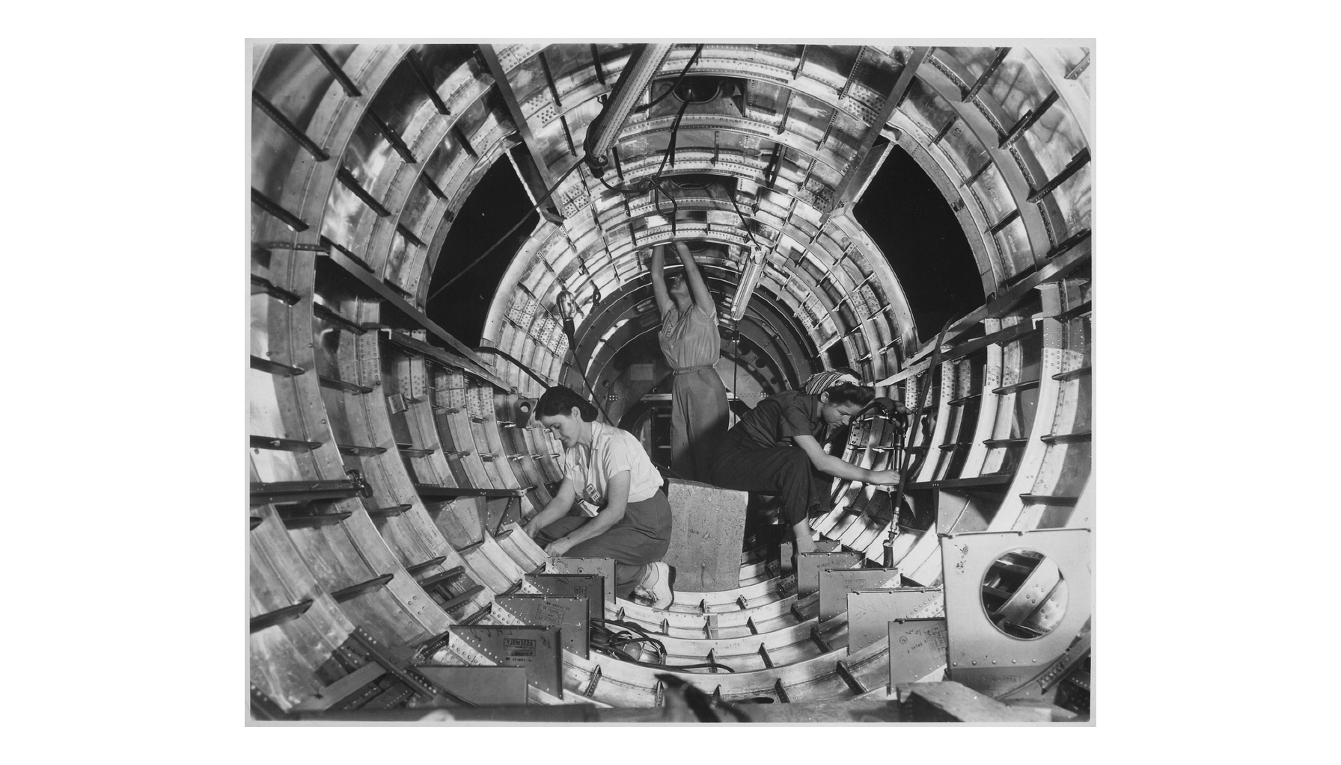
Women Assemble Aircraft Parts on a Wartime Production Line
Note: NARA photograph.
© More Lessons Less Planning | morelessonslessplanning.com
Notes:
Give the class a few silent seconds with the photo before you speak. Point out that every person doing this precision work is someone who, three years earlier, had almost no path into this kind of job.
Reference labels (point to these chart features when teaching): Assembly line stations; Aircraft parts in progress

Slide 13
Women in War Industry, By the Numbers
Measure | Figure
Women in the civilian labor force, 1940 | About 27 percent
Women in the civilian labor force, 1945 | About 37 percent
Women who entered the workforce during the war | About 6 million
Share of aircraft-industry workers who were women, 1943 | About 65 percent
Share of aircraft-industry workers who were women, before the war | About 1 percent
Key Concept: In the aircraft industry, the change was from almost no women workers to nearly two out of three.
© More Lessons Less Planning | morelessonslessplanning.com
Notes:
Students meet this exact table again in the Activity's data section. Let the last two rows sit for a moment; the contrast is the whole point of the slide.

Slide 14
Industry and Effort in Three Words
War Production Board
The federal agency that directed American factories to convert to war production
Rosie the Riveter
The cultural symbol of American women who took factory jobs during WWII
War Bond
A loan to the government that citizens could buy to help pay for the war
Remember: You will use all three of these words again in the Activity packet.
© More Lessons Less Planning | morelessonslessplanning.com
Notes:
One is an agency, one is a symbol, and one is a financial tool. Ask students to sort the three before you explain, and the categories fix better than the definitions alone would.

Slide 15
During the War, After the War
During the War (1942-1945)
After the War (1945-1946)
Government campaigns urged women to take defense jobs
Women were praised as patriotic for working in factories
Some factories added childcare to keep women workers
About one in four wartime factory women lost her job by fall 1945
In the auto industry, women's share of jobs fell from 25 to about 7.5 percent
Many women were pushed toward lower-paid clerical or service work
Note: Overall, women's share of the workforce fell after 1945 but never returned all the way to 1940 levels.
© More Lessons Less Planning | morelessonslessplanning.com
Notes:
Read the left column as the wartime promise and the right column as what actually happened next. This split is the clearest single fact in the lesson for correcting the idea that Rosie the Riveter's story ended in victory.

Slide 16
Uneven Opportunity on the Home Front
The demand
Black leaders asked why Americans should fight racism abroad but tolerate it at home
✔
The campaign
The Pittsburgh Courier launched the Double V Campaign in February 1942
✔
The order
Executive Order 8802 in June 1941 banned discrimination in defense-industry hiring
✔
The reality
Discrimination continued in housing, unions, and many workplaces despite the order
✔
Big Idea: The home front's sacrifices and its opportunities were not shared equally.
© More Lessons Less Planning | morelessonslessplanning.com
Notes:
Note for students that Executive Order 8802 came before the Double V Campaign had a name, issued after A. Philip Randolph threatened a march of 100,000 people on Washington in 1941. The campaign and the order answer the same demand from two directions.

Slide 17
The Home Front in Four Words
Victory Garden
A vegetable garden planted at home to free up commercial food for the troops
Scrap Drive
A community collection of metal, rubber, and other materials needed for war production
Double V Campaign
The Black press campaign for victory over fascism abroad and racism at home
Reconversion
The postwar shift of factories and jobs back to civilian production
Remember: You will use all four of these words again in the Activity packet.
© More Lessons Less Planning | morelessonslessplanning.com
Notes:
Ask students to sort the four into 'during the war' and 'after the war.' Reconversion is the only one that belongs after 1945, and that sort fixes the sequence better than repeating definitions.

Slide 18
A President Puts a Policy in Writing
...there shall be no discrimination in the employment of workers in defense industries or government because of race, creed, color, or national origin...
— President Franklin D. Roosevelt, Executive Order 8802, June 25, 1941
Roosevelt issued this order six days before a planned march of 100,000 people on Washington, D.C.
Remember: You will read the opening of this order in Activity Part 4.
© More Lessons Less Planning | morelessonslessplanning.com
Notes:
Frame this as evidence, not narration. This is the exact wording of a real federal order, and the wording is part of what students analyze in the Activity.

Slide 19
Why the Home Front Mattered
Rationing and price controls kept scarce goods flowing to the military.
The War Production Board turned industry into the 'Arsenal of Democracy.'
Six million women entered the workforce and did skilled industrial work.
The home front's opportunities were not shared equally by every American.
Big Idea: The home front was not a sideshow to the war - it was how the war got won.
© More Lessons Less Planning | morelessonslessplanning.com
Notes:
This is the review slide. Bullet four is the one students take a side on in Activity Part 5; read it slowly and let it sit before moving to takeaways.

Slide 20
Key Takeaways
The OPA used rationing and price controls to spread out scarce goods.
★
The War Production Board converted industry from civilian to war work.
★
About six million women entered the workforce during the war.
★
Home-front opportunity was not shared equally by every American.
★
© More Lessons Less Planning | morelessonslessplanning.com
Notes:
Close by connecting the four takeaways back to the essential question the Activity will ask students to answer in Part 5.

