Slide 1
The Holocaust
Persecution, Mass Murder, and What Allied Forces Found in 1945
© More Lessons Less Planning | morelessonslessplanning.com
Notes:
Say plainly at the start what this lesson is and how it is organized: the facts of what happened, in order, and then the record the Allied armies made when they reached the camps.

Slide 2
Learning Targets
Trace how Nazi persecution escalated from laws to violence to murder.
★
Explain what ghettos, concentration camps, and extermination camps were.
★
Describe the scale of the Holocaust and identify who Nazi Germany targeted.
★
Explain how Allied forces reached the camps in 1945 and what they did next.
★
Use a report printed by Congress in 1945 as evidence of the Allied record.
★
© More Lessons Less Planning | morelessonslessplanning.com
Notes:
Target four is the one that shapes the second half of the lesson. Point at it now so students listen for the difference between what happened and how it came to be documented.

Slide 3
Antisemitism Before the Nazis Took Power
Antisemitism is hostility toward or prejudice against Jewish people.
It was centuries old in Europe long before Adolf Hitler was born.
By 1900 German Jews were citizens, many in business, law, and medicine.
Defeat in 1918 and the Depression left millions of Germans seeking blame.
Nazi propaganda named Jews as the cause of every German problem.
Key Concept: The Nazis did not invent antisemitism; they made it state policy.
© More Lessons Less Planning | morelessonslessplanning.com
Notes:
Start here rather than with 1933. Students who think this began with Hitler cannot explain why the policy found an audience, and that is the question the rest of the lesson answers.

Slide 4
From Words to Laws, 1933-1939
What the Laws Did
What It Meant Day to Day
1933: Jews dismissed from government jobs and university posts
1935: the Nuremberg Laws took away German citizenship
Marriage between Jews and other Germans was forbidden
Later orders took away businesses, licenses, and property
Families lost incomes with no court left to appeal to
A 1933 quota limited Jewish places in schools and universities
Passports were stamped so Jews could be identified
About half had left by 1939; most countries kept immigration quotas
Note: The persecution began with paperwork, years before any camp.
© More Lessons Less Planning | morelessonslessplanning.com
Notes:
The right column is the point of the slide. A law that removes citizenship is an abstraction until students see that it also removes a paycheck, a school place, and any court that will hear you.

Slide 5
Kristallnacht, November 1938
The pretext
A German diplomat in Paris was shot by a Jewish teenager
✔
The night
On November 9 and 10 Nazi party members attacked Jewish property
✔
The damage
Synagogues were burned and thousands of shops were wrecked
✔
The result
About 30,000 Jewish men were arrested and sent to camps
✔
Fact: German Jews were then fined for the damage done to their own property.
© More Lessons Less Planning | morelessonslessplanning.com
Notes:
Walk the four rows in order. The last row is the turning point: before November 1938 the persecution was mostly legal and economic, and after it arrest became routine.

Slide 6
The Persecution in Four Words
Holocaust
The Nazi state's organized murder of six million European Jews
Antisemitism
Hostility toward or prejudice against Jewish people
Nuremberg Laws
The 1935 German laws that stripped Jews of citizenship and rights
Kristallnacht
The November 1938 night of attacks on Jewish homes and shops
Remember: You will use all four of these words again in the Activity packet.
© More Lessons Less Planning | morelessonslessplanning.com
Notes:
Holocaust is the name for the whole thing; the other three are steps inside it. Ask students to say which is the category and which are the parts before you explain.

Slide 7
War Widens the Persecution, 1939-1941
September 1939
Germany invaded Poland, home to about three million Jews
✔
From 1940
Jews were forced into sealed city districts called ghettos
✔
Inside a ghetto
Families were crowded together with little food or medicine
✔
Warsaw
The largest ghetto held more than 400,000 people at its peak
✔
Note: Ghettos were guarded on the outside; leaving without permission was punished.
© More Lessons Less Planning | morelessonslessplanning.com
Notes:
The war is what turns a German policy into a European one. Poland held the largest Jewish population in Europe, and the German half of the country came under Nazi rule in weeks.

Slide 8
From Persecution to Mass Murder, 1941-1943
June 1941
Germany invaded the Soviet Union with killing units behind the army
✔
1941
German units and local helpers shot Jewish civilians near their towns
✔
January 1942
Officials met at Wannsee to organize the Final Solution
✔
From 1942
Jews were deported from the ghettos to camps built for mass killing
✔
1943
Jews in the Warsaw ghetto fought back in an armed uprising
✔
Key Concept: In 1942 mass murder became the organized policy of the German state.
© More Lessons Less Planning | morelessonslessplanning.com
Notes:
This is the slide the whole lesson turns on. Keep it factual and keep it moving; the sequence is what students need, and the sequence is grim enough without elaboration.

Slide 9
Two Kinds of Camps
Concentration Camps
Extermination Camps
Built from 1933 onward, at first inside Germany itself
Held political prisoners, Jews, Roma and Sinti, and many others
Prisoners were held without trial and forced to work
Dachau and Buchenwald are the best known examples
Built from 1941 in German-occupied Poland, not in Germany
Built for the single purpose of mass killing
Most were killed in gas chambers within hours of arrival
Treblinka and Auschwitz-Birkenau are the best known
Important: Auschwitz was both at once, a labor camp and a killing center.
© More Lessons Less Planning | morelessonslessplanning.com
Notes:
Students routinely merge these two. Keep the distinction on the board for the rest of the lesson; the Activity comparison table in Part 3 is graded on it.

Slide 10
The System in Three Words
Ghetto
A sealed city district where Nazi Germany confined Jews under guard
Final Solution
The Nazi plan to murder every Jew in Europe, organized in 1942
Concentration Camp
A guarded camp holding prisoners without trial and forcing them to work
Remember: A ghetto confined people; a concentration camp also forced them to work.
© More Lessons Less Planning | morelessonslessplanning.com
Notes:
Ask students to put the three in time order before you explain: ghettos from 1940, the Final Solution from 1942, and concentration camps running through the whole period from 1933.

Slide 11
The Scale of the Holocaust
Group targeted | Estimated number murdered
Jews of Europe | About 6,000,000
Soviet civilians | About 7,000,000
Soviet prisoners of war | About 3,000,000
Non-Jewish Polish civilians | About 1,800,000
Roma and Sinti (Romani people) | About 250,000
People with disabilities | Up to 250,000
Key Concept: Two of every three Jews in Europe were murdered. The rows overlap, so do not add this column.
© More Lessons Less Planning | morelessonslessplanning.com
Notes:
Read the table straight through without commentary and then stop for a moment. Do not add the column up: the Soviet civilian row overlaps the top row, and every figure here is a rounded estimate covering real people.

Slide 12
The Allies Reach the Camps, 1944-1945
July 1944
Soviet troops reached Majdanek in Poland, the first major camp
✔
January 1945
Soviet troops reached Auschwitz and found about 7,000 survivors
✔
April 4, 1945
U.S. Third Army troops reached Ohrdruf in central Germany
✔
April 1945
American forces reached Buchenwald, then Dachau later that month
✔
Note: No unit had orders for this; the camps were found in the course of advancing.
© More Lessons Less Planning | morelessonslessplanning.com
Notes:
The dates matter. The camps were not an Allied objective; they were reached because armies were moving through the territory, and that is why the response had to be improvised.

Slide 13
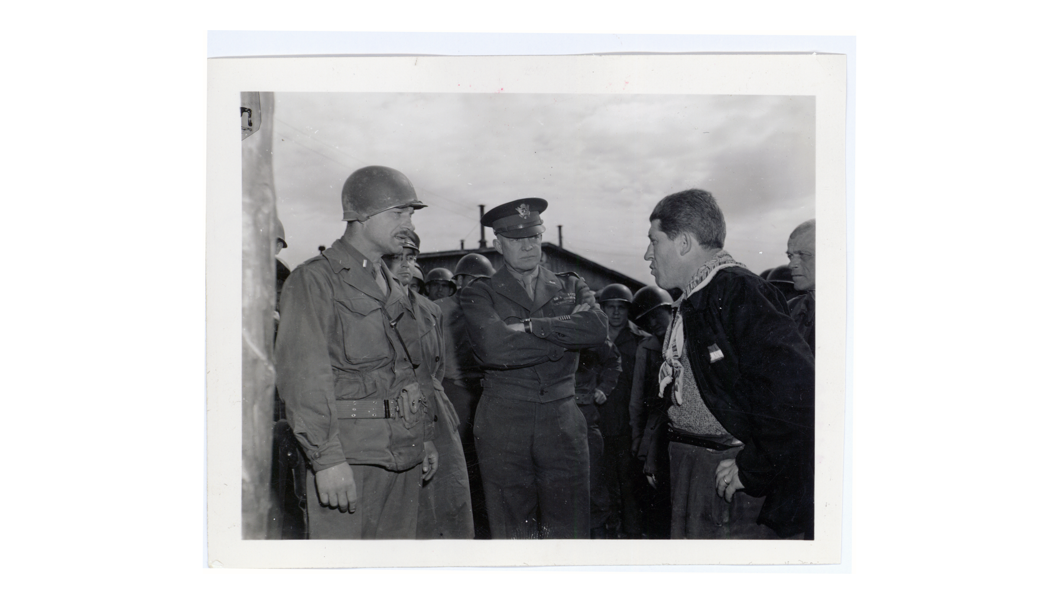
A U.S. Army Officer Questions a Survivor at Ohrdruf, 1945
Note: U.S. Army photo.
© More Lessons Less Planning | morelessonslessplanning.com
Notes:
Point out what is actually happening here: the survivor is talking and the American officers are listening. An interpreter was brought forward so that what he said could be written down.
Reference labels (point to these chart features when teaching): Third Army interrogator; Gen. Eisenhower, center

Slide 14
The Response: Make a Record
What Was Ordered
Why It Was Ordered
Nearby units not in the line were sent to see the camp
Signal Corps photographers and film crews recorded the sites
German civilians from nearby towns were brought to view them
Congress and American editors were invited to come and look
Eisenhower wanted first-hand evidence held by many witnesses
He expected the reports to be dismissed later as propaganda
One commander's word would not settle the question by itself
A record made at the time cannot be revised afterward
Key Concept: Eisenhower treated the camps as evidence that had to be documented.
© More Lessons Less Planning | morelessonslessplanning.com
Notes:
This is the pedagogical center of the lesson. The Allied response was not only to feed and treat survivors but to build a body of evidence deliberately, because the commander expected the facts to be denied.

Slide 15
Three Ways the Record Was Made
Photograph
Witness
Report
Signal Corps crews filmed the sites.
Stills were captioned and dated.
Footage was used at Nuremberg.
Soldiers were sent to walk through.
Local civilians were brought in.
Congress and editors flew over.
Interrogators questioned survivors.
Units filed written reports.
Commanders cabled Washington.
In practice: No one of these three would have been enough on its own.
© More Lessons Less Planning | morelessonslessplanning.com
Notes:
Ask which of the three a historian would trust most and why. The honest answer is that they are strongest together, which is exactly why all three were ordered.

Slide 16
The Record in Three Words
Extermination Camp
A camp built by Nazi Germany for the single purpose of mass killing
Liberation
The freeing of a camp and its prisoners by advancing Allied troops
Genocide
The deliberate destruction of a national, ethnic, racial, or religious group
Remember: Genocide was a new word in 1944, invented to name what was happening.
© More Lessons Less Planning | morelessonslessplanning.com
Notes:
Genocide is the one to slow down on. The word did not exist until 1944, and the reason it was coined is the reason this lesson ends where it does.

Slide 17
After the Camps Were Reached
Army medical units set up hospitals inside the camps themselves.
Thousands of survivors were still too ill to be moved for weeks.
Army chaplains held the first open religious services after liberation.
Most survivors had no home or family left to return to.
Displaced persons camps housed many of them for years afterward.
Fact: Some displaced persons camps in Germany were still open in 1952.
© More Lessons Less Planning | morelessonslessplanning.com
Notes:
Liberation was a date, not an ending. This slide exists so students do not leave the lesson thinking the story stopped when the gates opened.

Slide 18
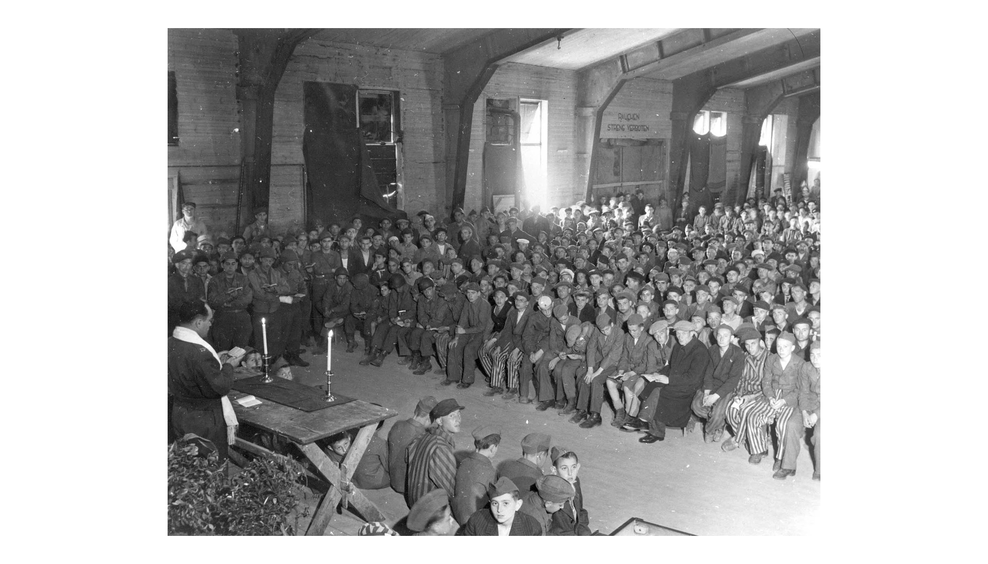
An Army Chaplain Leads a Service at Buchenwald, May 1945
Note: Army photo, 1945.
© More Lessons Less Planning | morelessonslessplanning.com
Notes:
Point out how many of the people seated here are teenagers, and that American soldiers are sitting among them rather than standing over them. Both facts are worth naming out loud.
Reference labels (point to these chart features when teaching): Army chaplain at the table; Survivors and U.S. soldiers

Slide 19
Eisenhower Asks Congress to Come and See
From my own personal observation, I can state unequivocally that all written statements up to now do not paint the full horrors.
— Gen. Dwight D. Eisenhower, cablegram to Gen. George C. Marshall, April 1945
Congress printed this cablegram in its own report explaining why twelve of its members flew to Germany that month.
Remember: You will read this whole passage in Activity Part 4.
© More Lessons Less Planning | morelessonslessplanning.com
Notes:
Frame this as evidence rather than as narration. A commander is telling the Chief of Staff that the written record is not good enough, which is why he wants independent witnesses.

Slide 20
Why the Record Mattered
Allied evidence was used to prosecute Nazi leaders at Nuremberg.
Signal Corps film was shown in the courtroom as documentary proof.
The word genocide entered international law in 1948.
Survivor testimony has been collected and preserved ever since.
Denial began early, and the documented record is the answer to it.
Big Idea: The Holocaust is among the best documented crimes in history, by design.
© More Lessons Less Planning | morelessonslessplanning.com
Notes:
Close the loop opened on slide 14. Eisenhower expected denial in April 1945, and the reason the denial has never gained ground is the record that he and others insisted on making.

Slide 21
Key Takeaways
Nazi persecution moved from laws in 1933 to open violence in 1938.
★
War brought millions more Jews under German control after 1939.
★
From 1942 mass murder was the organized policy of the German state.
★
About six million Jews were murdered, two of every three in Europe.
★
Allied forces reached the camps in 1945 and documented what they found.
★
© More Lessons Less Planning | morelessonslessplanning.com
Notes:
Ask which takeaway students would put first if they had to explain this lesson to someone who had missed it. Saying it out loud makes the Activity's written response much easier.

