Slide 1
The Han Dynasty and Confucian Government
How the ideas of Confucius reshaped the Han dynasty's government - rule by moral virtue and example instead of harsh law - and gave rise to the Mandate of Heaven and the ideal of the learned scholar-official.
© More Lessons Less Planning | morelessonslessplanning.com
Notes:
Opening slide. The Han dynasty (206 BCE-220 CE) built one of the greatest empires of the ancient world, and it chose the teachings of Confucius as the official philosophy of its government. Confucianism taught that a good ruler governs by his own moral virtue and good example, not by force - a sharp contrast with Legalism, which relied on strict laws and harsh punishments. Students will learn how Emperor Wu adopted Confucianism, how the Mandate of Heaven tied a ruler's virtue to his right to rule, and how the Confucian ideal of the learned scholar-official shaped the civil service - and they will read a primary source in which Confucius describes the duties of a ruler.

Slide 2
Learning Targets
Explain how the Han made Confucianism official under Emperor Wu.
★
Describe ruling by virtue and li instead of Legalist punishment.
★
Explain the scholar-official ideal - and how it differed from Han reality.
★
Explain the Mandate of Heaven and analyze a Confucian source.
★
© More Lessons Less Planning | morelessonslessplanning.com
Notes:
Read the four learning targets. Today's lesson combines the story of how an empire chose a governing philosophy with a history skill: reading a Confucian primary source carefully. Keep the big idea in mind - Confucian government was supposed to work through the ruler's moral virtue and example, a very different theory of power from ruling by fear.

Slide 3
What Was Confucianism?
Confucianism
A political and ethical philosophy, based on the teachings of Confucius, that taught rulers to govern by moral virtue and good example rather than by force.
A philosophy of government, not a religion
Confucianism was mainly a guide to right conduct, good relationships, and good government - a set of ideas about how rulers and people should behave.
Key Concept: CONFUCIANISM taught rulers to govern by moral VIRTUE and good example, not by force.
© More Lessons Less Planning | morelessonslessplanning.com
Notes:
CONFUCIANISM was a political and ethical philosophy based on the teachings of the Chinese thinker Confucius, who lived about 551-479 BCE. At its heart was a simple but powerful idea about power: a good ruler should govern by his own moral VIRTUE and good example, not by force or fear. Confucius taught that if leaders behaved with honesty, courtesy, and self-control, the people would follow their example and society would be orderly and good. Confucianism is best understood as a guide to right conduct, proper relationships, and good government - not a religion about gods and the afterlife. Centuries after Confucius died, the Han dynasty would make these ideas the official philosophy of the whole empire. The next slide shows how Confucius has been pictured.

Slide 4
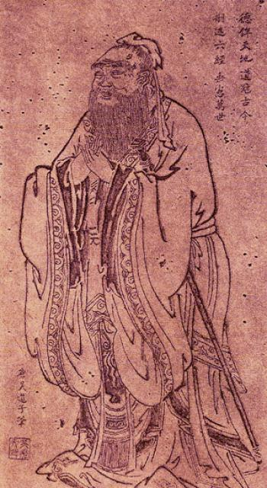
Confucius, the Teacher Behind the Philosophy
Tang-dynasty ink drawing of Confucius, whose ideas shaped Han rule.
© More Lessons Less Planning | morelessonslessplanning.com
Notes:
Public-domain Tang-dynasty ink drawing of Confucius, after the famous painter Wu Daozi. Point out that Confucius lived centuries before the Han dynasty, yet his teachings became the philosophy the Han chose to govern by. Use it purely as a reference visual to put a face to the philosophy taught on the previous slide - students are not asked to analyze the drawing as evidence.
Reference labels (point to these chart features when teaching): Confucius (c. 551-479 BCE); The teacher behind it

Slide 5
The Han Adopt Confucianism
Han dynasty
The long-lasting Chinese dynasty (206 BCE-220 CE) that made Confucianism the official philosophy of its government.
✔
Emperor Wu (Wudi)
The Han emperor who officially adopted Confucianism as the state philosophy and founded the imperial university.
✔
Dong Zhongshu
The Confucian scholar who advised Emperor Wu to make Confucianism the empire's official teaching.
✔
Key Concept: The HAN DYNASTY made Confucianism official; EMPEROR WU adopted it as the state philosophy on the advice of the scholar DONG ZHONGSHU.
© More Lessons Less Planning | morelessonslessplanning.com
Notes:
The HAN DYNASTY ruled China from 206 BCE to 220 CE and built one of the greatest empires of the ancient world. Early Han rulers experimented with different ideas about government, but the turning point came under EMPEROR WU (also called Wudi), who ruled from 141 to 87 BCE. On the advice of the Confucian scholar DONG ZHONGSHU, Emperor Wu made Confucianism the official philosophy of the Han state. From then on, the government promoted Confucian ideas, and educated men studied the Confucian classics to serve in government. Emperor Wu also founded an imperial university in 124 BCE to train officials in these teachings. This decision shaped Chinese government for the next two thousand years.

Slide 6
Government by Virtue, Not Fear
Rule by virtue
Li (ritual propriety)
Virtue means moral goodness and good character.
A good ruler leads by his own good example.
If leaders are honest and fair, the people follow.
Li is proper conduct, courtesy, and ritual.
It guides how rulers and people should behave.
Good manners and respect keep society in order.
Key Concept: Confucian government rules by VIRTUE and by LI (ritual propriety) - moral example and proper conduct - not by fear of punishment.
© More Lessons Less Planning | morelessonslessplanning.com
Notes:
Confucianism taught a distinctive theory of power: govern by VIRTUE, not fear. Virtue means moral goodness and good character, and Confucius taught that a ruler should lead the people mainly through his own good example. If those in charge are honest, fair, and self-controlled, the people will respect them and behave well in turn. Alongside virtue came LI, or ritual propriety - the ideal of proper conduct, courtesy, and ritual that guides how both rulers and people should behave. Good manners, respect for elders and superiors, and proper ceremony were believed to hold society together far better than threats. In the Confucian view, a ruler who governed with virtue and li would earn genuine loyalty, while a ruler who relied only on punishment would earn only fear.

Slide 7
The Mandate of Heaven
Mandate of Heaven
The belief that Heaven gives a just, virtuous ruler the right to rule and takes it away from a cruel or corrupt one.
Virtue keeps the Mandate
A ruler who governed with virtue was believed to keep Heaven's approval; disasters and rebellion were read as signs a ruler had lost the Mandate.
Key Concept: The MANDATE OF HEAVEN meant Heaven granted a virtuous ruler the right to rule - and could withdraw it from a cruel or corrupt one.
© More Lessons Less Planning | morelessonslessplanning.com
Notes:
Confucian ideas about virtue fit closely with an older Chinese belief called the MANDATE OF HEAVEN. This was the belief that Heaven grants a just and virtuous ruler the right to rule, and takes that right away from a ruler who becomes cruel or corrupt. A wise, moral emperor was thought to have Heaven's approval; but if an emperor became selfish and harsh, natural disasters, famines, and rebellions were read as signs that he had lost the Mandate and deserved to be replaced. This idea tied a ruler's virtue directly to his legitimacy - his right to hold power. It gave emperors a strong reason to govern well, and it gave the people a way to justify overthrowing a bad ruler. Confucian government and the Mandate of Heaven reinforced each other.

Slide 8
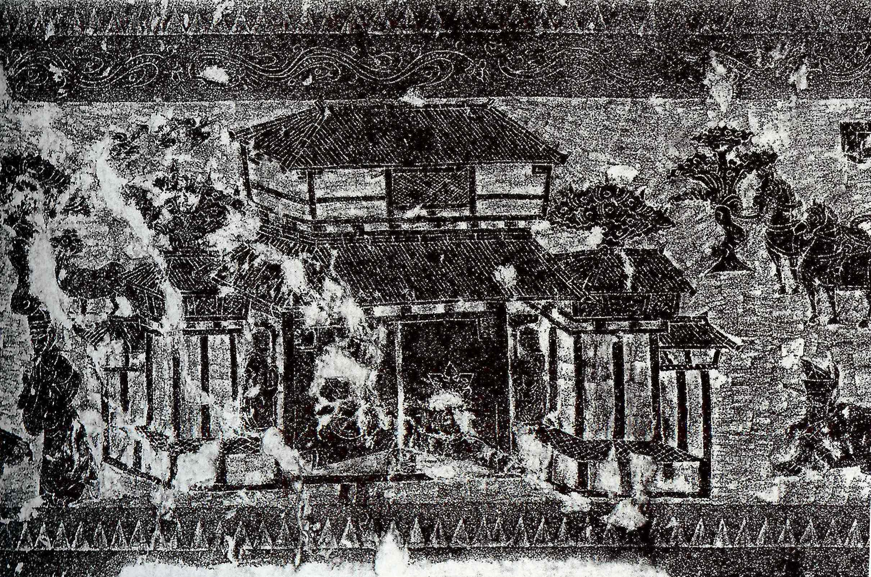
A Han Stone Rubbing of an Offering Shrine
A rubbing of a Han dynasty carved stone offering shrine (citang).
© More Lessons Less Planning | morelessonslessplanning.com
Notes:
Public-domain rubbing of a Han dynasty carved stone offering shrine (citang). A rubbing is made by pressing paper onto a carved stone and inking it so the raised design shows. The scene is dominated by a large two-story tiled pavilion - a Han offering hall where families honored their ancestors - with small standing attendants beside its pillars and a horse and rider at the right. Point out that ritual, respect for ancestors, and proper ceremony (li) ran through Han society - the same world of ceremony and duty that Confucian-trained officials were meant to govern. Use it purely as a reference visual for Han ritual and society - students are not asked to analyze the scene as evidence.
Reference labels (point to these chart features when teaching): Han carved stone shrine; A pavilion with attendants

Slide 9
The Scholar-Official Ideal
Scholar-official
An educated government official chosen for his learning in the Confucian classics and expected to serve with virtue.
Civil service
The body of trained officials who run the empire's day-to-day government for the emperor.
Key Concept: The Confucian ideal was the SCHOLAR-OFFICIAL - an educated, virtuous man - staffing the empire's CIVIL SERVICE.
© More Lessons Less Planning | morelessonslessplanning.com
Notes:
If government should work through virtue, then the men who run it should be virtuous and wise. This was the Confucian ideal of the SCHOLAR-OFFICIAL: an educated government official chosen for his learning in the Confucian classics and expected to serve with moral virtue, not just to obey orders. These officials made up the CIVIL SERVICE - the body of trained officials who ran the empire's day-to-day government for the emperor, collecting taxes, judging disputes, and keeping order. In the Confucian ideal, a man should rise in government because of his education and character, not only because of the family he was born into. This was a powerful idea: that learning and virtue, rather than birth alone, should decide who governs.

Slide 10
The Ideal vs. Han Reality
The imperial university (124 BCE)
Emperor Wu founded an imperial university to train officials in the Confucian classics.
✔
Recommend and examine
The Han began choosing some officials by recommendation and testing, but many still came from noble and wealthy families.
✔
The exam system came later
The full civil-service examination system did not mature until centuries later, under the Sui and Tang dynasties.
✔
Key Concept: The Han founded the imperial UNIVERSITY (124 BCE), but the full exam system matured LATER under the Sui and Tang.
© More Lessons Less Planning | morelessonslessplanning.com
Notes:
It is important to separate the Confucian IDEAL from Han REALITY. The Han did take real steps toward government by merit: Emperor Wu founded an imperial UNIVERSITY in 124 BCE to train officials in the Confucian classics, and the government began choosing some officials by recommendation and by testing their knowledge. But the ideal was only partly real. Many high officials still came from noble and wealthy families, and personal connections and birth still mattered a great deal. The famous system of written civil-service examinations that chose officials purely by merit did not fully develop until centuries later, under the SUI and TANG dynasties. So the Han planted the seed of the scholar-official system, but it did not yet run a mature merit-exam bureaucracy. Good history means holding both facts together: a real beginning, but not the finished system.

Slide 11
Confucianism vs. Legalism
Confucianism
Legalism
People are guided by virtue and good example.
Order comes from li (ritual propriety) and respect.
The ruler leads morally, and loyalty is earned.
People obey only strict laws and harsh punishments.
Order comes from fear of severe penalties.
The ruler controls behavior through force.
Key Concept: LEGALISM said people obey only strict laws and harsh punishments - the opposite of Confucian rule by virtue and example.
© More Lessons Less Planning | morelessonslessplanning.com
Notes:
To understand why Confucian government mattered, compare it with its main rival, LEGALISM. Legalism was a philosophy that argued people are naturally selfish and will obey only strict laws backed by harsh punishments. To a Legalist, order comes from fear: make the penalties severe enough, apply them to everyone, and people will fall in line. The earlier Qin dynasty had governed this way, with rigid laws and brutal punishments. Confucianism offered the opposite theory: people can be led to be genuinely good through virtue, good example, and li (ritual propriety), so a ruler should govern morally and earn loyalty rather than force obedience. The Han rejected the harshest Legalism of the Qin and chose the Confucian path, though in practice Han government still kept firm laws too. The contrast - virtue versus fear - is the heart of the lesson.

Slide 12
Why Confucian Government Mattered
A theory of good rule
Confucianism gave the Han a model of government based on the ruler's moral virtue and good example, not just force.
✔
Virtue and legitimacy
Tied to the Mandate of Heaven, a ruler's virtue became the measure of his right to rule.
✔
A lasting model
The scholar-official ideal shaped Chinese government for two thousand years and influenced Korea, Japan, and Vietnam.
✔
Key Concept: Confucian government tied good rule to the ruler's VIRTUE, shaping Chinese government for two thousand years.
© More Lessons Less Planning | morelessonslessplanning.com
Notes:
Why does Confucian government matter so much in world history? Because the Han's choice created a model of good rule that lasted for two thousand years. Confucianism gave the empire a clear theory: government should rest on the ruler's moral VIRTUE and good example, not on force alone. Tied to the Mandate of Heaven, a ruler's virtue became the very measure of his legitimacy - his right to rule. And the ideal of the learned, virtuous scholar-official shaped how China chose and trained its officials long after the Han, eventually through the great examination system, and it spread to Korea, Japan, and Vietnam. Even though the Han reality never fully matched the ideal, the idea that leaders should be educated and moral, and that power should be used for the good of the people, became one of the most influential political ideas in world history.

Slide 13
Key Takeaways
Under Emperor Wu, advised by Dong Zhongshu, the Han adopted Confucianism.
★
Confucian government ruled by virtue and li, not by Legalist fear.
★
The Mandate of Heaven tied a ruler's virtue to his right to rule.
★
The scholar-official ideal began under the Han; the exam system matured later.
★
© More Lessons Less Planning | morelessonslessplanning.com
Notes:
Recap the four takeaways. The big ideas: under Emperor Wu, advised by Dong Zhongshu, the Han dynasty made Confucianism the official philosophy of government; Confucian government was supposed to rule by virtue and li (ritual propriety), the opposite of Legalist rule by strict law and harsh punishment; the Mandate of Heaven tied a ruler's virtue directly to his legitimacy; and the ideal of the learned, virtuous scholar-official began under the Han - who founded the imperial university and started recommend-and-examine recruiting - but the full civil-service examination system did not mature until later, under the Sui and Tang.

