Slide 1
The Haitian Revolution and Toussaint Louverture
How enslaved people in France's richest colony won their freedom and built the first Black-led republic
© More Lessons Less Planning | morelessonslessplanning.com
Notes:
Open with the lesson question: could enslaved people overthrow slavery itself and found their own nation? Preview the answer: in Saint-Domingue they did, in the only successful large-scale slave revolt in history, and Toussaint Louverture led them for most of the way.

Slide 2
Learning Targets
Explain why Saint-Domingue was France's richest slave colony
★
Describe the 1791 uprising and why the revolution was historically unique
★
Explain Toussaint Louverture's leadership and the 1801 Constitution
★
Explain Toussaint's capture and death and Dessalines's 1804 declaration
★
Connect Haiti's founding to the Enlightenment ideal of liberty
★
© More Lessons Less Planning | morelessonslessplanning.com
Notes:
The five targets keep the lesson centered on the colony's foundation in enslaved labor, the uniqueness of the revolt, Toussaint's leadership and constitution, the honest ending of his story, and the Enlightenment connection.

Slide 3
Saint-Domingue: France's Richest Colony
Saint-Domingue was a French colony on the western third of Hispaniola.
By the 1780s it was the richest colony in the world.
Its plantations produced a large share of the sugar and coffee sold in Europe.
A plantation economy grows export crops on estates worked by enslaved people.
All of that wealth rested on the forced labor of enslaved Africans.
Key Concept: Saint-Domingue was France's richest colony, and its sugar and coffee wealth depended entirely on enslaved labor.
© More Lessons Less Planning | morelessonslessplanning.com
Notes:
Saint-Domingue, on the western third of Hispaniola, was by the 1780s the richest colony in the world and France's most valuable possession. Its plantations produced much of the sugar and coffee sold in Europe. A plantation economy is one built on large estates worked by enslaved people to grow cash crops for export, and in Saint-Domingue that entire economy rested on the forced labor of enslaved Africans.

Slide 4
A Colony Built on Enslaved Labor
Who Lived There
How They Were Treated
About half a million enslaved people lived in Saint-Domingue by 1789
They far outnumbered the white colonists and free people of color
Most had been kidnapped and shipped from Africa
Enslaved workers faced brutal conditions on the sugar and coffee plantations
Overwork, disease, and cruelty killed so many that owners kept importing more
The system's harshness gave enslaved people powerful reasons to resist
Key Concept: Enslaved people were the large majority of Saint-Domingue's population and endured brutal conditions that fueled resistance.
© More Lessons Less Planning | morelessonslessplanning.com
Notes:
By 1789 about half a million enslaved people lived in Saint-Domingue, far outnumbering the white colonists and free people of color, and most had been kidnapped and shipped from Africa. Conditions on the sugar and coffee plantations were brutal: overwork, disease, and cruelty killed so many people that enslavers kept importing more. That harshness gave the enslaved majority powerful reasons to resist.

Slide 5
Who Was Toussaint Louverture?
Toussaint Louverture was born enslaved in Saint-Domingue around 1743.
He gained his freedom years before the revolution and educated himself.
He became the revolution's most skilled military and political leader.
He turned bands of rebels into a disciplined army.
He was largely self-taught, not a trained European general or philosopher.
Key Concept: Toussaint Louverture, born enslaved, became the brilliant self-taught military and political leader of the Haitian Revolution.
© More Lessons Less Planning | morelessonslessplanning.com
Notes:
Toussaint Louverture was born enslaved in Saint-Domingue around 1743 and gained his freedom years before the revolution began. He educated himself and became the revolution's most skilled military and political leader, turning scattered bands of rebels into a disciplined army. It is important to keep him accurate: he was a brilliant, largely self-taught commander and administrator, not a trained European general or a well-read philosopher.

Slide 6
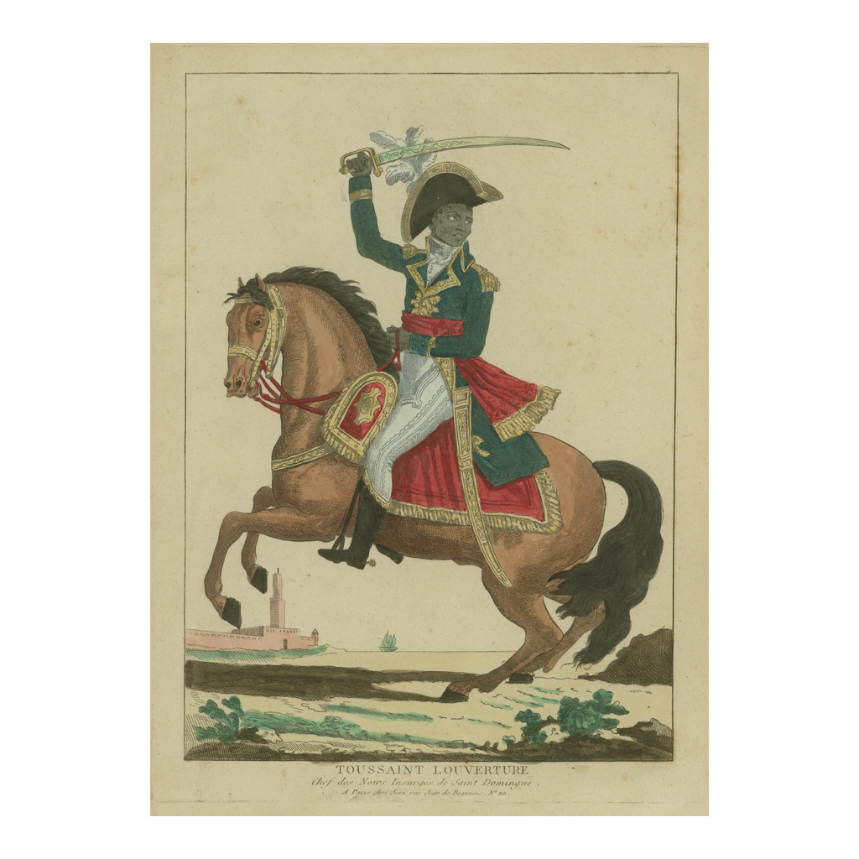
Period Engraving of Toussaint Louverture
Period engraving of Toussaint Louverture
© More Lessons Less Planning | morelessonslessplanning.com
Notes:
This is a period engraving of Toussaint Louverture made around the time of the revolution. Use it as a historical reference image to put a face to the leader, not as evidence for any claim beyond identifying him.

Slide 7
The 1791 Uprising
In August 1791 enslaved people in the northern plain rose in revolt.
They burned plantations and fought the enslavers who had held them.
The 1791 uprising began the Haitian Revolution.
Talk of liberty and the rights of man had reached the colony from France.
Those rights were not extended to the enslaved, so they seized freedom by force.
Key Concept: The August 1791 uprising in the northern plain began the Haitian Revolution as enslaved people seized freedom by force.
© More Lessons Less Planning | morelessonslessplanning.com
Notes:
In August 1791 enslaved people in the northern plain of Saint-Domingue rose in revolt, burning plantations and fighting the enslavers who had held them. This 1791 uprising began the Haitian Revolution. Talk of liberty and the rights of man from the French Revolution had reached the colony, but those rights had not been extended to the enslaved, so they took their freedom by force.

Slide 8
A Long War and a Master Strategist
A Complicated War
Toussaint's Skill
The revolution became a long war lasting from 1791 to 1804
France, Spain, and Britain all sent forces into the colony
Toussaint shifted alliances to protect the freedom of the formerly enslaved
Toussaint outmaneuvered European armies with military and political skill
By 1801 he controlled the colony and led its government
He used both fighting and negotiation to keep slavery from returning
Key Concept: In a long war among France, Spain, and Britain, Toussaint used military and political skill to control the colony and protect freedom.
© More Lessons Less Planning | morelessonslessplanning.com
Notes:
The revolution became a long war from 1791 to 1804, with France, Spain, and Britain all sending forces into the colony. Toussaint shifted alliances to protect the freedom of the formerly enslaved, outmaneuvering European armies with both military and political skill. By 1801 he controlled the colony and led its government, using fighting and negotiation together to keep slavery from returning.

Slide 9
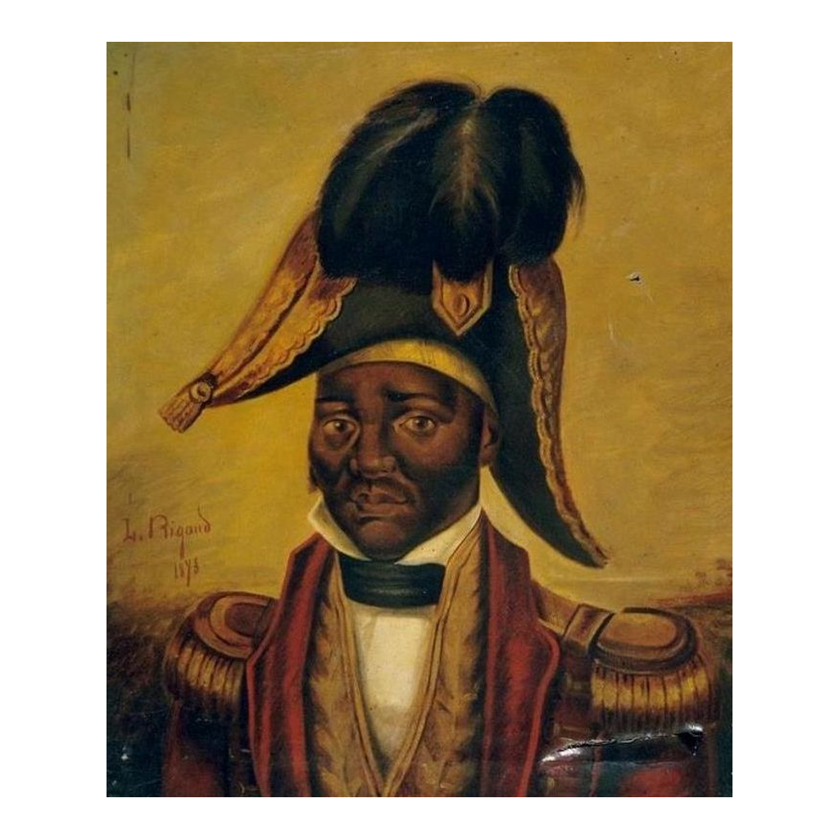
Jean-Jacques Dessalines, Who Won Independence
Historical portrait of Jean-Jacques Dessalines
© More Lessons Less Planning | morelessonslessplanning.com
Notes:
This is a historical portrait of Jean-Jacques Dessalines, Toussaint's general who led the final campaign that defeated Napoleon's army and who would declare Haiti independent on January 1, 1804. Use it as a reference image to put a face to the leader who finished the revolution.

Slide 10
The 1801 Constitution
In 1801 Toussaint had a constitution drafted for Saint-Domingue.
The 1801 Constitution declared that slavery was forever abolished.
Abolition means the ending of slavery; all men were born free and French.
The colony was kept nominally French, still part of the French empire on paper.
It named Toussaint governor for life, which alarmed Napoleon.
Key Concept: The 1801 Constitution abolished slavery forever and named Toussaint governor for life while keeping Saint-Domingue nominally French.
© More Lessons Less Planning | morelessonslessplanning.com
Notes:
In 1801 Toussaint had a constitution drafted for Saint-Domingue. The 1801 Constitution declared slavery forever abolished and said all men were born free and French. Abolition means the ending of slavery. The colony was kept nominally French, still part of the French empire on paper, but the constitution named Toussaint governor for life, which alarmed Napoleon, France's leader, because it showed France had lost real control.

Slide 11
Capture, Deportation, and Death
Napoleon Strikes Back
The Honest Ending
In 1802 Napoleon sent a large army to retake the colony and restore slavery
Toussaint was captured and deported to France in 1802
He was imprisoned at Fort de Joux, a cold mountain prison
Toussaint died at Fort de Joux in 1803, before independence was won
He did NOT declare independence himself
His capture did not end the revolution, which continued without him
Key Concept: Napoleon's 1802 invasion led to Toussaint's capture and death at Fort de Joux in 1803; he did not live to declare independence.
© More Lessons Less Planning | morelessonslessplanning.com
Notes:
In 1802 Napoleon sent a large army to retake the colony and restore slavery. Toussaint was captured and deported to France that year and imprisoned at Fort de Joux, a cold mountain prison, where he died in 1803, before independence was won. This is the honest ending students must hold onto: Toussaint did not declare independence himself, and his capture did not end the revolution, which continued without him.

Slide 12
Dessalines and Independence, 1804
Jean-Jacques Dessalines was Toussaint's general who took over leadership.
On January 1, 1804, Dessalines declared the colony independent.
He gave the new nation the name Haiti.
Haiti became the first Black-led republic in the world.
It was the second independent nation in the Americas, after the United States.
Key Concept: On January 1, 1804, Dessalines declared independence and named the new nation Haiti.
© More Lessons Less Planning | morelessonslessplanning.com
Notes:
Jean-Jacques Dessalines, Toussaint's general, took over leadership and defeated Napoleon's forces. On January 1, 1804, Dessalines declared the colony independent and named the new nation Haiti. Haiti became the first Black-led republic in the world and the second independent nation in the Americas, after the United States. It was the only nation ever created by a successful large-scale slave revolt.

Slide 13
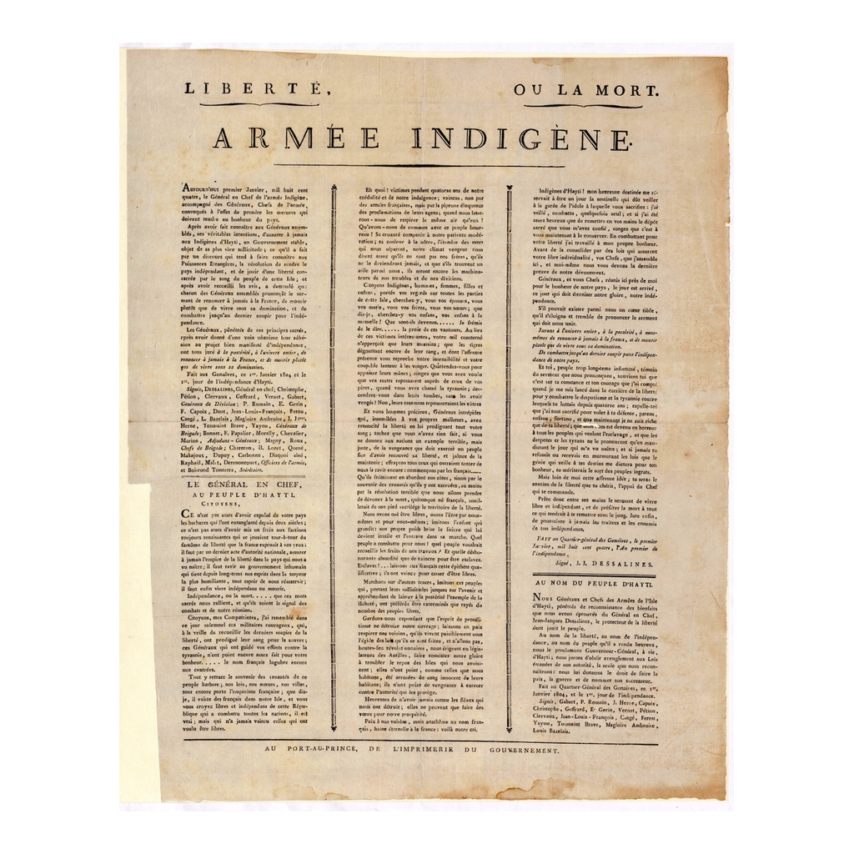
The 1804 Haitian Declaration of Independence
The 1804 Haitian Declaration of Independence
© More Lessons Less Planning | morelessonslessplanning.com
Notes:
This is the 1804 Haitian Declaration of Independence. Use it to picture the founding document of the new nation, not as a reading task.

Slide 14
Haiti and the Rights of Man
The Ideals Extended
An Honest Cost
The American and French Revolutions proclaimed liberty and the rights of man
But they did not extend those rights to enslaved people
Haiti took the Enlightenment ideal of liberty and applied it to everyone
Independence came at an enormous cost in human lives
Slaveholding nations feared Haiti's example and left it isolated
The new nation began its life burdened and alone, not with a clean happy ending
Key Concept: Haiti applied the ideal of liberty to everyone, but independence came at enormous cost and left it isolated.
© More Lessons Less Planning | morelessonslessplanning.com
Notes:
The American and French Revolutions proclaimed liberty and the rights of man, but they did not extend those rights to enslaved people. Haiti took the Enlightenment ideal of liberty and applied it to everyone, which is what made it so radical. Be honest about the cost: independence came at an enormous cost in human lives, and slaveholding nations feared Haiti's example and left it isolated, so the new nation began its life burdened and alone, not with a clean happy ending.

Slide 15
Reference Guide: The Colony and the Revolt
Saint-Domingue
France's richest colony, on the western third of Hispaniola, built on enslaved labor.
plantation economy
An economy based on large estates worked by enslaved people to grow export crops.
Toussaint Louverture
The formerly enslaved leader whose skill guided the revolution and drafted the 1801 Constitution.
Haitian Revolution
The 1791-1804 revolt in Saint-Domingue, the only slave revolt to create a nation.
1791 uprising
The August 1791 revolt in the northern plain that began the Haitian Revolution.
Tip: These five terms name the colony, its economy, the revolution's leader, the revolution itself, and how it began.
© More Lessons Less Planning | morelessonslessplanning.com
Notes:
Review the five terms exactly as defined: Saint-Domingue, plantation economy, Toussaint Louverture, Haitian Revolution, and the 1791 uprising. Students use these definitions to complete the Reference Guide in the Activity.

Slide 16
Reference Guide: Constitution and Nation
1801 Constitution
The constitution drafted under Toussaint that abolished slavery while the colony stayed French.
Jean-Jacques Dessalines
Toussaint's general who declared Haiti's independence on January 1, 1804.
abolition
The ending of slavery, which the 1801 Constitution declared forever on the territory.
Haiti
The nation declared independent in 1804, the first Black-led republic in the world.
Fort de Joux
The French mountain prison where Toussaint was held and died in 1803.
Tip: These five terms name the constitution, the man who declared independence, the ending of slavery, the nation, and where Toussaint died.
© More Lessons Less Planning | morelessonslessplanning.com
Notes:
Review the five terms exactly as defined: the 1801 Constitution, Jean-Jacques Dessalines, abolition, Haiti, and Fort de Joux. Students use these definitions to complete the Reference Guide in the Activity.

Slide 17
Key Takeaways
Saint-Domingue was France's richest colony, built on enslaved labor.
★
The 1791 uprising began the only slave revolt in history to create a nation.
★
Toussaint led the revolution and had the 1801 Constitution abolish slavery.
★
Toussaint was captured in 1802 and died in prison in 1803.
★
Dessalines declared independence on January 1, 1804, naming the nation Haiti.
★
Haiti extended liberty to everyone, but independence came at enormous cost.
★
© More Lessons Less Planning | morelessonslessplanning.com
Notes:
Close with the essential question. Each takeaway connects the colony's foundation in enslaved labor, the uniqueness of the revolt, Toussaint's leadership and honest fate, the true declaration of independence, and the Enlightenment connection with its real cost.

