Slide 1
The Gutenberg Printing Press
How movable type broke the elite monopoly on information - and helped set the stage for the Reformation.
© More Lessons Less Planning | morelessonslessplanning.com
Notes:
Opening slide. This lesson explores how Johann Gutenberg's movable-type printing press, developed in Mainz in the 1440s, changed who controlled information in Europe. Before the press, every book was copied by hand, so books were rare and expensive and mostly owned by the Church and the wealthy. Gutenberg's press mass-produced identical pages quickly and cheaply, spreading literacy and ideas far more widely. The lesson stays honest: movable type existed earlier in East Asia, the press was a risky and expensive business that cost Gutenberg his workshop in a lawsuit with his financier Johann Fust, and printing helped set the stage for the Reformation without being its single cause. Our primary source is the 1455 court record of that lawsuit.

Slide 2
Learning Targets
Explain what Gutenberg's press was and how it differed from hand-copying.
★
Explain why mass-produced books were revolutionary and spread ideas.
★
Describe how printing helped set the stage for the Reformation - honestly.
★
Analyze the 1455 Fust v. Gutenberg court record as a primary source.
★
© More Lessons Less Planning | morelessonslessplanning.com
Notes:
Learning targets. Target 1 introduces the printing press and movable type versus hand-copied manuscripts. Target 2 explains why mass production was revolutionary - speed and cost - and how cheaper books spread literacy and ideas beyond the Church and elites. Target 3 is a key honesty point: printing helped set the stage for the Reformation but was an enabler, not the single cause, and movable type existed earlier in Asia. Target 4 practices sourcing on the 1455 notarial court record of the Fust v. Gutenberg lawsuit.

Slide 3
Before Printing: A World of Handwritten Books
Before printing, every book was a MANUSCRIPT - copied by HAND.
Scribes copied books slowly, one page at a time, for months.
Hand-copied books were rare and very expensive to make.
Most books were owned by the Church, monasteries, and elites.
Ordinary people almost never owned or read their own books.
Key Concept: A MANUSCRIPT is a book copied by HAND - slow, rare, and expensive, so few people owned books.
© More Lessons Less Planning | morelessonslessplanning.com
Notes:
Set the scene for the world before the printing press. A MANUSCRIPT is a book or document written by HAND. For centuries in Europe, that was the only way to make a book: a trained scribe copied every word by hand, one page at a time, and a single book could take months or even years to finish. Because each copy took so much labor, hand-copied books were rare and very expensive. As a result, most books were owned by the Church, monasteries, and wealthy elites, and ordinary people almost never owned or read their own books. This is the key starting point: before Gutenberg, information was scarce and controlled by a powerful few.

Slide 4
Who Was Johann Gutenberg?
Johann Gutenberg
A German craftsman in Mainz who developed Europe's movable-type printing press in the 1440s.
Mainz
The German city where Gutenberg built his workshop and printed his famous Bible.
A metalworker's skill
Gutenberg trained in metalworking, which helped him cast small, precise metal letters.
Key Concept: JOHANN GUTENBERG, a craftsman in the German city of MAINZ, built Europe's printing press in the 1440s.
© More Lessons Less Planning | morelessonslessplanning.com
Notes:
Introduce the man behind the press. JOHANN GUTENBERG (about 1400-1468) was a German craftsman who worked in the city of MAINZ, in what is now Germany. In the 1440s he developed Europe's first practical movable-type printing press. Gutenberg trained as a metalworker, and that skill mattered: casting small, precise, identical metal letters is a metalworking problem, and it was central to making movable type work. Stress that Gutenberg was an inventor-businessman solving a hard technical puzzle, not a scholar or a churchman - and that all of this happened in Mainz, the home city of the printing revolution in Europe.

Slide 5
Movable Type: The Big Idea
MOVABLE TYPE means small, REUSABLE metal letters.
Each letter is cast as its own separate metal block.
Workers arrange the letters into words, lines, and a page.
After printing, the letters are cleaned and reused.
One set of letters can print page after page, rearranged.
Big Idea: MOVABLE TYPE uses small, REUSABLE metal letters - arranged, inked, printed, then rearranged for the next page.
© More Lessons Less Planning | morelessonslessplanning.com
Notes:
Explain the core invention. MOVABLE TYPE means small, REUSABLE metal letters. Instead of carving a whole page into one wooden block, Gutenberg cast each letter of the alphabet as its own tiny metal block. Workers could then arrange those loose letters into words, lines, and a full page, lock them in place, ink them, and print. When the page was done, they cleaned the letters and rearranged the very same pieces to set the next page. That reusability is the whole point: one set of letters could print page after page, book after book. Movable type is what made fast, repeatable printing possible - and it fit the small alphabet of European languages especially well.

Slide 6
The Printing Press: How It Worked
Set the type
Workers lock arranged MOVABLE TYPE into a frame to form a full page.
✔
Ink and press
The PRINTING PRESS inks the type and presses paper firmly against it.
✔
Repeat fast
The same page prints again and again - hundreds of identical COPIES.
✔
Key Concept: The PRINTING PRESS presses inked movable type onto paper to make many identical COPIES fast.
© More Lessons Less Planning | morelessonslessplanning.com
Notes:
Show how the machine turned movable type into printed books. The PRINTING PRESS is a machine that presses inked movable type onto paper to make many identical pages quickly. The process had a clear rhythm: first, workers locked the arranged movable type into a frame to form a full page of text; next, they spread ink across the raised metal letters and used the press to squeeze a sheet of paper firmly against the inked type, leaving a clean printed page; then they repeated the same page again and again, producing hundreds of identical COPIES. Gutenberg adapted the kind of screw press already used to press grapes and olives. The result was speed and sameness no hand-copyist could match.

Slide 7
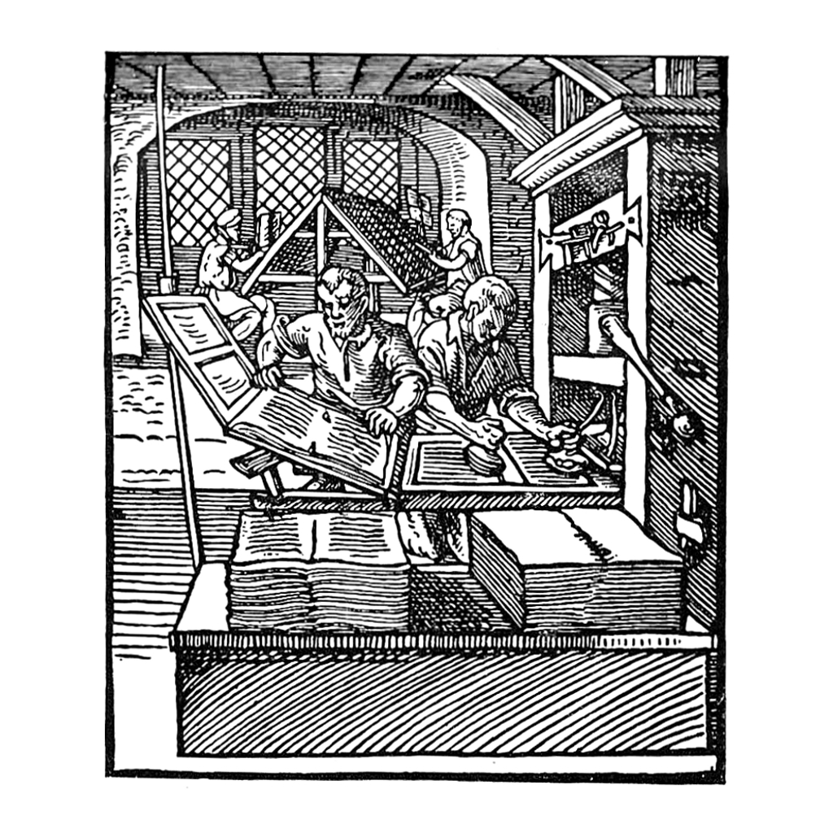
Inside a Renaissance Print Shop
A 1568 woodcut of a European print shop with a screw press.
© More Lessons Less Planning | morelessonslessplanning.com
Notes:
This is Jost Amman's 1568 woodcut of a European book printer's workshop. On the right, a printer works the large screw press that squeezes paper against the inked type; nearby, another worker inks the type or sets loose letters into a frame. Use it as a concrete picture of how the printing press turned movable type into printed pages. Remind students that this is a real Renaissance-era image, roughly a century after Gutenberg, showing the same basic press-and-type system he pioneered in Mainz - not a modern illustration.
Reference labels (point to these chart features when teaching): The screw press at work; A worker setting the type

Slide 8
The Gutenberg Bible
Around 1455, Gutenberg printed the GUTENBERG BIBLE in Mainz.
It is also called the 42-line Bible for its lines per column.
It was the first major book printed with movable type in Europe.
About 180 copies were printed - a huge number for the time.
Each page still looks rich, like a fine handwritten manuscript.
Did You Know? The GUTENBERG BIBLE, printed about 1455, was the first major European book made with movable type.
© More Lessons Less Planning | morelessonslessplanning.com
Notes:
Introduce the masterpiece of early printing. Around 1455, in Mainz, Gutenberg printed the GUTENBERG BIBLE. It is often called the 42-line Bible because most of its pages have 42 lines of text in each column. It was the first major book printed with movable type in Europe, and it proved the new technology could produce a long, complex, beautiful book. Gutenberg printed roughly 180 copies - an enormous number for a time when books were copied one at a time by hand. Point out the irony students should notice: the Gutenberg Bible was made by machine, yet each page was designed to look rich and handsome, much like a fine handwritten manuscript, because that is what readers of the time expected a book to look like.

Slide 9
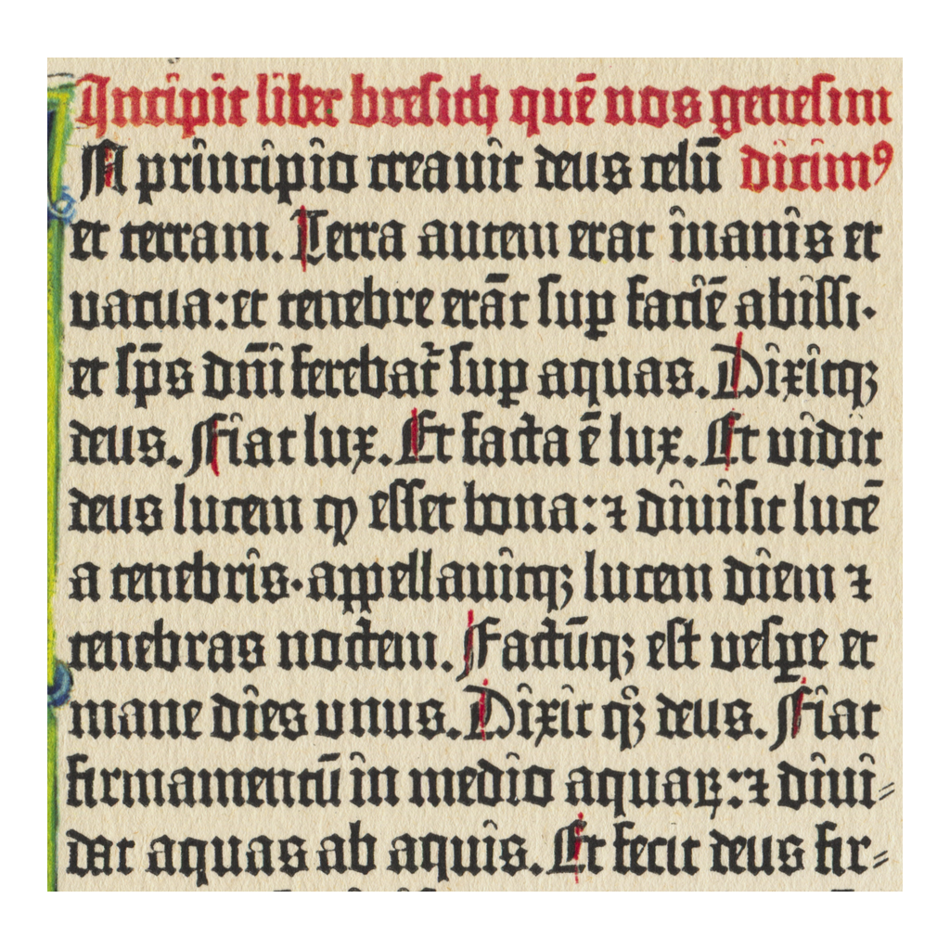
A Page from the Gutenberg Bible
A page from the Gutenberg Bible, printed at Mainz around 1455.
© More Lessons Less Planning | morelessonslessplanning.com
Notes:
This is a real page from the Gutenberg Bible, printed at Mainz around 1455. Have students notice the two dense columns of dark, even text - printed with movable type, not written by hand - and the rich, decorated look that imitated the finest handwritten manuscripts. Point out that the black text was printed by the press, while some copies had colored initials and decorations added by hand afterward. Remind students this is a genuine 15th-century printed page, one of the first books ever made this way in Europe, not a modern reproduction.
Reference labels (point to these chart features when teaching): Two columns of printed text; Printed with movable type

Slide 10
Faster, Cheaper, More: Why It Was Revolutionary
The old way (by hand)
The new way (the press)
One scribe copied one book slowly over many months.
Books were rare, costly, and easy to copy wrong.
MASS PRODUCTION made hundreds of copies quickly.
Printed books were far CHEAPER, so more people bought them.
Key Concept: MASS PRODUCTION made books faster, CHEAPER, and more identical than hand-copying ever could.
© More Lessons Less Planning | morelessonslessplanning.com
Notes:
Make the revolution concrete by comparing the two worlds side by side. The old way was hand-copying: one scribe copied one book slowly over many months, so books were rare, costly, and easy to get wrong (every copy could add new mistakes). The new way was the printing press and MASS PRODUCTION - making many identical copies quickly and cheaply. A print shop could turn out hundreds of copies of a book in the time a scribe needed for one, and printed books were far CHEAPER to produce, so their prices dropped and far more people could afford to buy them. Stress the three-word summary students should remember: faster, cheaper, and more identical. That change in speed and cost is what made printing revolutionary.

Slide 11
Spreading Literacy and Ideas
Cheaper books meant more people could learn to read.
LITERACY is the ability to READ and write.
Books spread beyond the Church and wealthy ELITES.
New ideas in science, religion, and politics traveled fast.
Knowledge was no longer controlled by only a powerful few.
Big Idea: As books got cheap, LITERACY spread and ideas reached far beyond the Church and the ELITES.
© More Lessons Less Planning | morelessonslessplanning.com
Notes:
Connect cheap books to the spread of literacy and ideas - the heart of the disruption. As printed books got cheaper and more common, more people had a reason and a chance to learn to read. LITERACY is the ability to READ and write, and it slowly spread to more of the population than ever before. Just as important, books now spread far beyond the Church and wealthy ELITES who had once owned nearly all of them; merchants, students, and ordinary townspeople could own printed works. New ideas in science, religion, and politics could travel across Europe quickly in printed form. The big shift is this: knowledge was no longer controlled by only a powerful few - printing began to put information into far more hands.

Slide 12
Setting the Stage for the Reformation
Ideas could spread fast
Printed pages carried new religious ideas across Europe in weeks, not years.
✔
The Reformation (from 1517)
The REFORMATION was a 1500s movement that split Western Christianity.
✔
The press was an enabler
Cheap printing did not cause it alone - it helped reform ideas SPREAD fast.
✔
Important: Printing helped SET THE STAGE for the REFORMATION - it SPREAD ideas fast, but did not cause it alone.
© More Lessons Less Planning | morelessonslessplanning.com
Notes:
Draw the honest link to the Reformation - and be careful not to overstate it. Because printed pages were cheap and quick to produce, new religious ideas could SPREAD across Europe in weeks rather than years. The REFORMATION was a religious movement of the 1500s that split Western Christianity; historians often date its start to 1517, when Martin Luther challenged the Church (students meet Luther in detail in a later lesson). Printing let Luther's ideas and pamphlets travel farther and faster than any earlier reform effort. But here is the crucial honesty point: the printing press did NOT cause the Reformation by itself. Deep religious, political, and economic tensions were already building. Printing was an enabler - it poured fuel on ideas that already existed and helped them spread fast. Correct any answer that says printing single-handedly caused the Reformation.

Slide 13
An Honest Look: Movable Type Was Not Brand New
Gutenberg did NOT invent paper or printing itself.
China and Korea used movable type centuries earlier.
Korea printed a book with metal type in 1377, before Gutenberg.
Gutenberg's new idea was a full SYSTEM for Europe's alphabet.
He combined metal type, oily ink, and a press that worked together.
Note: Movable type existed earlier in East Asia - Gutenberg's advance was a practical printing SYSTEM for Europe.
© More Lessons Less Planning | morelessonslessplanning.com
Notes:
Keep the story honest so students do not overcredit Gutenberg. Gutenberg did NOT invent paper (which came from China long before) or printing itself. Movable type was also not brand new: printers in China and Korea had used movable type centuries earlier. In fact, Korea printed a book called the Jikji with metal movable type in 1377, decades before Gutenberg. So what was Gutenberg's real achievement? He built a full, practical SYSTEM that worked for Europe's small alphabet: a fast way to cast large numbers of precise metal letters, a new oil-based ink that stuck to metal type, and a strong press that pushed paper against the type - all engineered to work together and to be run as a business. Framing it this way is more honest and, if anything, more interesting: Gutenberg was a brilliant systems-builder, not a lone inventor of a single idea.

Slide 14
A Risky, Expensive Business: Gutenberg and Fust
A costly venture
Building a press and printing a Bible cost a fortune Gutenberg did not have.
Johann Fust
A wealthy financier who lent Gutenberg the money to fund the printing press.
The lawsuit (1455)
Fust sued Gutenberg over the loans and won control of his WORKSHOP.
Key Concept: JOHANN FUST funded Gutenberg's press, then sued him in 1455 and won control of his WORKSHOP.
© More Lessons Less Planning | morelessonslessplanning.com
Notes:
Show that the printing press was a risky, expensive business - not just a clever invention. Building a press and printing a whole Bible cost a fortune, far more money than Gutenberg had on his own. To pay for it, he borrowed heavily from JOHANN FUST, a wealthy financier who lent him the money to fund the printing press. But the venture ran long and cost more than expected, and around 1455 Fust sued Gutenberg over the loans. Fust won the lawsuit and took control of Gutenberg's WORKSHOP, including the equipment and much of the Bible work; Fust then ran the business with Gutenberg's skilled assistant, Peter Schoffer. Point out the honest, human lesson: even a world-changing technology depended on money and could ruin its own inventor. This lawsuit is exactly what our primary source records.

Slide 15
How Do We Know? The 1455 Court Record
Much of what we know comes from a 1455 court record.
A NOTARY wrote down the result of the Fust v. Gutenberg lawsuit.
This legal record proves the loans and the dispute were real.
But it records only the MONEY side, not the whole story.
We read it as solid evidence, but not a complete picture.
Tip: The 1455 court record is strong PRIMARY-source evidence - but it tells only the MONEY side of the story.
© More Lessons Less Planning | morelessonslessplanning.com
Notes:
Set up the Primary Source Spotlight and teach how to read the document. A great deal of what we know about Gutenberg's business comes from a 1455 court record called the Helmasperger notarial instrument. A NOTARY - an official trained to record legal agreements and judgments - wrote down the outcome of the Fust v. Gutenberg lawsuit, including who lent money, how much, and what the court decided. Explain why this is such valuable evidence: it is an official legal record made at the time, so it proves that the loans, the debt, and the dispute were real, not legend. But warn students about its limits: it records only the MONEY side - the sums, the interest, the judgment - and says almost nothing about Gutenberg the person, his feelings, or the printing itself. So a historian reads it as solid evidence for the business dispute, while remembering it gives only a partial, money-focused picture, not the whole human story.

Slide 16
Key Takeaways
Gutenberg built Europe's movable-type PRINTING PRESS in Mainz in the 1440s.
★
MOVABLE TYPE and MASS PRODUCTION made books fast, cheap, and identical.
★
The GUTENBERG BIBLE (about 1455) was Europe's first major printed book.
★
Cheap books spread LITERACY and ideas far beyond the Church and elites.
★
Printing helped set the stage for the REFORMATION - an enabler, not the cause.
★
Movable type existed earlier in Asia; Gutenberg lost his workshop to Fust.
★
© More Lessons Less Planning | morelessonslessplanning.com
Notes:
Close the loop and hold the honesty frames. If students remember one thing, make it this: Johann Gutenberg's movable-type PRINTING PRESS, built in Mainz in the 1440s, changed who controlled information in Europe. MOVABLE TYPE and MASS PRODUCTION made books fast, cheap, and identical, and the GUTENBERG BIBLE of about 1455 proved it could be done. Cheaper books spread LITERACY and new ideas far beyond the Church and elites, which helped set the stage for the REFORMATION - though printing was an enabler, not the single cause. And keep the honest edges: movable type existed earlier in East Asia, and the press was a risky, expensive business that Gutenberg himself lost to his financier Johann Fust in the 1455 lawsuit recorded in the primary source they analyzed.

