Slide 1
The Great Law of Peace and the Iroquois Confederacy
How Five Nations Built One Council, and Who Wrote It Down
© More Lessons Less Planning | morelessonslessplanning.com
Notes:
Open on the gap. This law is older than any European settlement on this coast, and every version a student can read was set down centuries afterwards by people with names. The Confederacy it founded still governs, so keep the verbs in the present tense.

Slide 2
Learning Targets
Explain how the Great Law was carried for centuries with no writing.
★
Describe how a question moves through the Confederate Council.
★
Explain the hold clan mothers have on a leader's title.
★
Name who set a record down, how long after, and from what standpoint.
★
Weigh the evidence for and against the claim about the Constitution.
★
© More Lessons Less Planning | morelessonslessplanning.com
Notes:
Targets one to three are the government itself. Targets four and five are the historical thinking. Point at target five and say out loud that the lesson ends on a question historians still argue about.

Slide 3
A Law Carried in Memory, Not on Paper
The Great Law of Peace is the constitution of the Iroquois Confederacy.
For many generations the Iroquois did not put their code in written form.
Trained sachems made it their business to learn it and hand it on.
Belts and strings of shell beads were made so each law could be recalled.
Key Concept: A law carried by trained memory is a record, not a hole in the evidence.
© More Lessons Less Planning | morelessonslessplanning.com
Notes:
Say the mechanism out loud before anyone can call it vague. Certain leaders made learning the law their job, and a belt of shell beads gave the trained reader the index that let the wording come back the same way every time.

Slide 4
Three Words for a Law With No Paper
Great Law of Peace
Gayanashagowa, the founding law that binds five nations into one Confederacy and sets out how they meet, decide, and keep peace
Oral tradition
Knowledge kept and handed on by trained memory and by speaking, rather than by writing it on paper
Wampum
Shell beads worked into belts and strings that hold an agreement in place and are read back aloud by someone trained to read them
Note: Gayanashagowa is also translated as the Great Binding Law and the Great Immutable Law.
© More Lessons Less Planning | morelessonslessplanning.com
Notes:
These three words carry the whole first half of the lesson. Read the wampum definition twice: the belt is not decoration and it is not money here, it is the thing that makes the law recitable.

Slide 5
What the Belts and Strings Hold
The 1916 printing says its knowledge was preserved on belts and strings.
Each belt or string served to recall one law or regulation.
In that printing a tag after each law names the record it came from.
In 1898 the Six Nations of New York made the State Museum their custodian.
Fact: A tag such as 8-VIII, TLL names a wampum string and the section of the code.
© More Lessons Less Planning | morelessonslessplanning.com
Notes:
Point at the tag convention. Because the tag is printed with each law, a reader can see which particular string held which particular law. That is what turns a memory system into something a stranger can check.

Slide 6
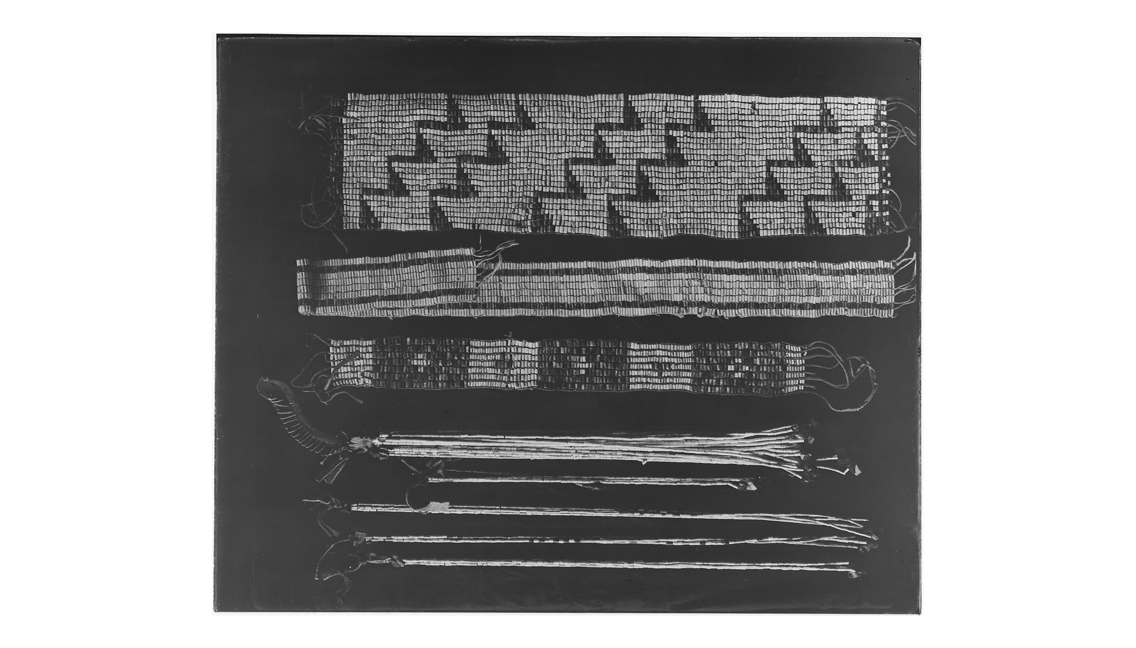
Wampum Belts and Strings
Wampum belts and strings, from the holdings of the National Archives.
© More Lessons Less Planning | morelessonslessplanning.com
Notes:
Give the class twenty silent seconds with the photograph before you say anything. Then ask what a person would have to know before this object counts as a record at all.
Reference labels (point to these chart features when teaching): Three woven belts; Strings beneath the belts

Slide 7
Two Names for One People, and Five Nations or Six
Haudenosaunee
What these nations call themselves. It means People of the Longhouse, and it is the name to use in your own writing.
✔
Iroquois
The name outsiders wrote in their documents. It is still the name in most textbooks, in the 1916 printing, and in the 1988 resolution.
✔
Five Nations
Mohawk, Oneida, Onondaga, Cayuga, and Seneca: the five nations bound together by the Great Law at the founding.
✔
Six Nations
The very same Confederacy after the Tuscarora joined. The 1916 printing puts it in one line: the Five Nations, since 1715 the Six Nations.
✔
Key Concept: Five Nations and Six Nations are two names for one Confederacy at two dates.
© More Lessons Less Planning | morelessonslessplanning.com
Notes:
Do not let this slide go by fast. Students meet all four of these names in this lesson, and nothing in the documents stops to explain that they are two pairs of names for one people and one government.

Slide 8
Four Words for the Council
Sachem
A leader who holds one of the fifty titles of the Confederacy and answers to the people who raised him to it
Clan mother
The woman in whose family a title is vested; she names the man who wears it and she can have it taken from him
Firekeepers
The Onondaga leaders who keep the fire, open and close every council, and rule when the two sides of the house cannot settle a matter
Consensus
A decision both sides of a council reach together, rather than a vote in which the larger number simply wins
Warning: The 1916 printing spells it Firekeepers in some laws and Fire Keepers in others. Same leaders.
© More Lessons Less Planning | morelessonslessplanning.com
Notes:
The spelling warning matters because students will meet both forms inside the Part 4 passage. Say once that the printing is inconsistent and that this toolkit uses Firekeepers everywhere outside a direct quotation.

Slide 9
The Tree, the Roots, and the Eagle
The Tree of the Great Peace
The Great White Roots
The Eagle
Dekanawidah plants it in Onondaga territory.
The Firekeepers are seated beneath its branches.
There the Council Fire of the Confederacy is watched.
Roots run north, east, south, and west.
Their nature is Peace and Strength.
A nation that obeys the law may trace them in.
An eagle is placed at the top of the tree.
It is able to see afar.
It warns the people of any danger approaching.
Key Concept: This law is built out of pictures anyone can hold in mind and repeat.
© More Lessons Less Planning | morelessonslessplanning.com
Notes:
Ask why a council that keeps no paper would build its law out of images. The tree marks where the council sits, the roots are the way in for outsiders, and the eagle is the warning system watching the horizon.

Slide 10
How a Question Moves Through the Council
Step | Who acts | What happens
1 | Mohawk and Seneca Lords | They pass upon the question first
2 | Oneida and Cayuga Lords | They deliberate and report a unanimous decision back
3 | Mohawk Lords | They report the standing of the case to the Firekeepers
4 | Onondaga Lords, the Firekeepers | They confirm, or decide when the two sides disagree
5 | Mohawk Lords | They announce the decision to the open council
Key Concept: A question crosses the house and comes back before anything is final.
© More Lessons Less Planning | morelessonslessplanning.com
Notes:
Walk the five steps on the board with your finger. The point students miss is step four: the Firekeepers are not outvoting anybody. They confirm what the two sides already agreed and only decide when the sides cannot.

Slide 11
The Women Who Hold the Titles
Descent runs in the female line, and everyone follows the mother's status.
The law says women shall be considered the progenitors of the Nation.
It says they shall own the land and the soil.
The women heirs of the titles are called Royaneh, meaning Noble.
Fact: The law names forty-eight, now fifty, Royaneh families whose women hold the titles.
© More Lessons Less Planning | morelessonslessplanning.com
Notes:
State the mechanism plainly. A title belongs to a family line held by a clan mother. She raises a man to it, and the title never becomes his property. That is the sentence students should be able to say back.

Slide 12
How a Title Is Taken Back
The first complaint
The men or the women of the Confederacy, or both together, come to the Council and upbraid the erring Lord through his War Chief.
✔
The second and third warning
If the complaint is not heeded it is uttered again, and then a third complaint and warning is given.
✔
The order to remove
The War Chiefs divest him of his title by order of the women in whom the titleship is vested.
✔
The replacement
The women select another of their sons as a candidate, the Lords elect him, and the seat stays in the same family line.
✔
Key Concept: To upbraid is to publicly scold. The people complain, the women give the order, and the War Chiefs carry it out.
© More Lessons Less Planning | morelessonslessplanning.com
Notes:
Ask who really holds the power in that sequence: the ones who complain, the ones who give the order, or the ones who carry it out. There is no single right answer and the argument is the point.

Slide 13
Three Words for Reading a Record
Exonym
A name outsiders use for a people, different from the name that people use for themselves
Provenance
The record of who set a document down, when, and whose hands it passed through before it reached us
Interpreter
The person who turns a speaker's meaning into another tongue on the spot, before anyone writes anything down
Key Concept: These three words are the tools for the second half of this lesson.
© More Lessons Less Planning | morelessonslessplanning.com
Notes:
Provenance is the word the whole lesson turns on. Say it, spell it, and tell students it does not mean a source is bad. It means you know enough about the source to say what weight it can carry.

Slide 14
Who Set This Law Down, and When
Seth Newhouse, Mohawk
Albert Cusick, Onondaga-Tuscarora
Arthur C. Parker, Seneca
He brought the first manuscript together.
He had expended a large amount of time on it.
The manuscripts were found on the Six Nations reserve in 1910.
He reviewed and criticized the Newhouse manuscript.
He worked more than a month correcting it.
He was already an authority on Iroquois law and civic rites.
He was an archaeologist at the New York State Museum.
He edited both manuscripts and printed them in 1916.
He told his readers where each text came from.
Key Concept: The 1916 book is a documented recitation of the law, set down by named people.
© More Lessons Less Planning | morelessonslessplanning.com
Notes:
This is the slide that answers the lesson's title question. Three Haudenosaunee men, named on the page, put a law that had never been written into print. Say documented recitation out loud; students will need the idea in Part 4.

Slide 15
Two Manuscripts in One Volume, Two Answers About the Founding
The Newhouse manuscript
The Six Nations chiefs' manuscript
Brought together by Seth Newhouse, corrected by Albert Cusick
Prints each law with a wampum tag after it
Carries no date for the founding of the League
Compiled by the chiefs of the Six Nations council
Opens with an introduction signed by those chiefs
That introduction dates the founding to about the year 1390
Warning: About the year 1390 is the chiefs' own introduction, not Arthur C. Parker's writing.
© More Lessons Less Planning | morelessonslessplanning.com
Notes:
Do not let the 1390 date get attached to the editor. It belongs to the chiefs' introduction, printed in the same volume, and the other manuscript in that volume gives no date at all. Two versions, one book, no agreement.

Slide 16
A Colonial Official Describes the Council: 1727 and 1747
What he could see from outside
What he could not settle
He describes five nations joined in one confederacy
In his account no nation ranks above another
A Sachem's authority rests on the nation's opinion of him
"They never execute their Resolutions by Force"
When it began: the "Christians know nothing of the Original of it"
Anything said inside a council he never entered
Whether his own praise served his colony's interest
Warning: First printed in New York in 1727. The wording used here is the 1747 London reprint.
© More Lessons Less Planning | morelessonslessplanning.com
Notes:
Cadwallader Colden was Surveyor General and later Lieutenant Governor of New York, writing for English readers who wanted these nations on the English side. The bullets in quotation marks are his own words. Say both dates out loud, because Activity Part 3 asks students to use them.

Slide 17
A Speech Written Down by Someone Else, 1744
"Our wise Forefathers established Union and Amity between the Five Nations; this has made us formidable . . ."
— Canassatego, an Onondaga speaker, at the treaty council in Lancaster, Pennsylvania, July 4, 1744
He spoke in his own language. Conrad Weiser, the interpreter, turned the words into English on the spot. A clerk wrote that English down, and Benjamin Franklin printed it in Philadelphia later the same year.
Warning: Two printings differ. 1744 reads "never fall out one with another"; 1851 reads "never fall out with one another".
© More Lessons Less Planning | morelessonslessplanning.com
Notes:
Count the hands the sentence passed through before it reached a page: a speaker, an interpreter, a clerk, a printer. Four sets, and only one of them Haudenosaunee. Read both endings in the warning aloud and let the class hear how small the difference is.

Slide 18
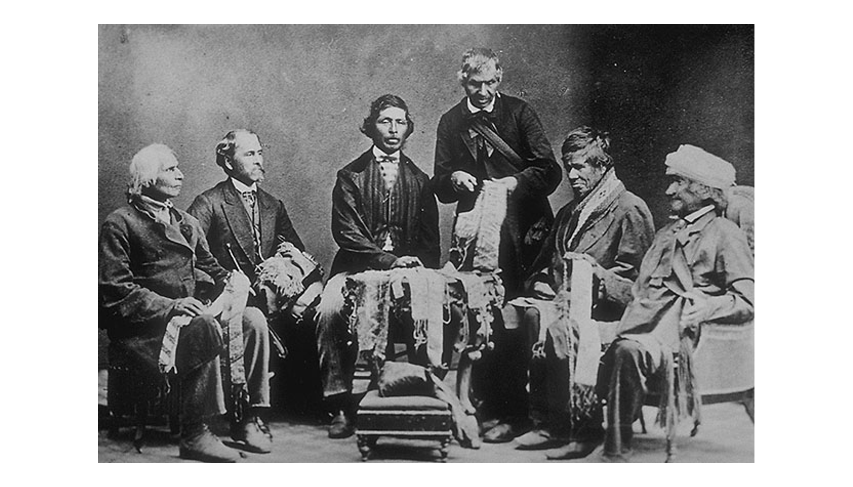
Six Nations Chiefs Reading Wampum Belts, 1871
Six Nations chiefs explaining their wampum belts, Brantford, 1871.
© More Lessons Less Planning | morelessonslessplanning.com
Notes:
This is what the whole lesson looks like in one frame: Six Nations chiefs at Brantford, Ontario, in September 1871, holding their wampum belts and explaining them for an outside recorder who had come to write down what they said. Ask the class which person in this photograph they would most want to hear from directly.
Reference labels (point to these chart features when teaching): Belts across their laps; Studio backdrop behind

Slide 19
Franklin Points at the Six Nations, 1751
"It would be a very strange Thing, if Six Nations of ignorant Savages should be capable of forming a Scheme for such an Union . . ."
— Benjamin Franklin to James Parker, a printer in New York, March 20, 1751
Franklin says this Union "has subsisted Ages, and appears indissoluble," then asks why "a like Union should be impracticable" for the colonies.
Warning: Every phrase in quotation marks is Franklin's own wording, insult included. Name it out loud.
© More Lessons Less Planning | morelessonslessplanning.com
Notes:
Name the insult out loud before you go one word further. Franklin calls the Six Nations by an eighteenth-century racial slur in the same sentence in which he calls their union the thing the colonies should copy. Tell the class plainly that the phrase is his contempt, not a description of anybody, and that carrying both halves of the sentence is exactly what makes it evidence about Franklin rather than about the Confederacy.

Slide 20
What Congress Said in 1988
House Concurrent Resolution 331 was agreed to on October 21, 1988.
It says the framers greatly admired the concepts of the Six Nations.
It says the confederation of the Thirteen Colonies was influenced by it.
A concurrent resolution is a statement both houses of Congress agree to.
Warning: It is not a law, no court is bound by it, and it names no delegate and no debate.
© More Lessons Less Planning | morelessonslessplanning.com
Notes:
This resolution is the reason students meet the influence claim at all. It is solid evidence of what Congress was willing to say in 1988 and it is not, by itself, evidence about what happened in Philadelphia in 1787.

Slide 21
What These Records Can and Cannot Settle
What they can show
How the Confederacy governs itself: the path a question takes, the hold clan mothers have on a title, and how the law was carried.
✔
What they cannot fix
The year the Confederacy was founded. The two versions in the 1916 volume do not agree, and Colden said nobody in his world knew.
✔
What they do not contain
No framer of the Constitution saying he took anything from the Confederacy.
✔
What would settle it
A record made at the convention itself, by somebody in the room, naming the Confederacy as a source.
✔
Key Concept: Naming the limits of a record is part of doing history well, not a failure.
© More Lessons Less Planning | morelessonslessplanning.com
Notes:
Work down the four rows and ask what each one would take to answer. The last row is exactly the question Activity Part 5 asks students to answer in writing, so do not answer it for them here.

Slide 22
Key Takeaways
The Great Law bound five nations into one council under one law.
★
It was carried by trained memory and by belts and strings of wampum.
★
A question crosses both sides of the house before the Firekeepers rule.
★
Clan mothers hold the titles and can order a leader removed.
★
Every version students can read was set down long after, by named people.
★
© More Lessons Less Planning | morelessonslessplanning.com
Notes:
Ask which takeaway a student would defend in Activity Part 5. Picking a side out loud makes the written ruling far easier to start.

