Slide 1
The Great Depression
From the 1929 Crash to a World in Crisis
© More Lessons Less Planning | morelessonslessplanning.com
Notes:
Open by asking what students already picture when they hear the phrase Great Depression. Most will name bread lines or the Dust Bowl; tell them the lesson explains how a Wall Street crash produced those scenes worldwide.

Slide 2
Learning Targets
Explain what happened in the stock market crash of October 1929.
★
Trace how a U.S. crash spread into a worldwide economic collapse.
★
Describe the human toll of the Depression on ordinary families.
★
Compare unemployment in the United States, Germany, and Britain.
★
Use FDR's 1933 inaugural address as evidence about the crisis.
★
© More Lessons Less Planning | morelessonslessplanning.com
Notes:
Read the targets aloud and point out that the last one is the primary source they will analyse in the Activity.

Slide 3
The Boom Before the Bust
The 1920s brought factory jobs, cars, radios, and rising wages.
Ordinary Americans began buying stocks for the first time.
Easy credit let people buy goods and shares before they could pay.
Stock prices rose far faster than company profits did.
By 1929 the market ran on confidence more than on earnings.
Key Concept: A boom built on borrowed money is only as strong as the confidence behind it.
© More Lessons Less Planning | morelessonslessplanning.com
Notes:
Stress the gap between share prices and actual company earnings. That gap is what makes a boom fragile.

Slide 4
How the 1920s Stock Market Worked
Speculation
Buying an asset mainly to resell it quickly at a higher price rather than to hold it
Buying on Margin
Borrowing money from a stockbroker to buy shares while paying only part of the price up front
Bull Market
A long stretch of rising stock prices that encourages more people to invest
Did You Know: Margin buyers in 1929 could put down as little as 10% and borrow the rest.
© More Lessons Less Planning | morelessonslessplanning.com
Notes:
Margin is the term that makes the crash understandable: a 10% down payment means a 10% price drop can wipe out the buyer.

Slide 5
Black Tuesday: October 29, 1929
On October 24, 1929, panicked selling began on Wall Street.
On October 29, 1929, about 16 million shares changed hands.
Margin buyers were forced to sell as their brokers demanded cash.
The Dow Jones average closed at 230, down about 40% from its peak.
The crash did not by itself cause the Depression, but it started it.
Note: The Dow peaked at 381 on September 3, 1929, its highest close for 25 years.
© More Lessons Less Planning | morelessonslessplanning.com
Notes:
Emphasize the forced-selling loop: falling prices trigger margin calls, margin calls trigger more selling, more selling drives prices lower.

Slide 6
The Market's Collapse, 1929-1932
Date | Dow Jones close | Change from the 1929 peak
September 3, 1929 | 381 | Peak
October 29, 1929 | 230 | About 40% below peak
July 8, 1932 | 41 | About 89% below peak
Remember: The market did not return to its 1929 peak until November 1954.
© More Lessons Less Planning | morelessonslessplanning.com
Notes:
Have students read the third row aloud. The 1932 low, not the 1929 crash, is the real measure of the collapse.

Slide 7
Why a Crash Became a Depression
Banks Failed
Spending Collapsed
Trade Collapsed
About 9,000 U.S. banks failed between 1930 and 1933.
Savings accounts were not insured, so deposits vanished.
Surviving banks stopped lending to anyone.
Families with no savings stopped buying goods.
Factories cut output and laid off workers.
Laid-off workers then spent even less.
Countries raised tariffs to protect their own factories.
World trade fell by about two-thirds by 1934.
Export industries shut down everywhere.
Key Concept: Each collapse fed the next, turning a bad year into a decade-long slump.
© More Lessons Less Planning | morelessonslessplanning.com
Notes:
This is the central causal slide of the lesson. Students should be able to say all three loops out loud before moving on.

Slide 8
Inside the Banking Panic
Bank Run
A rush of depositors demanding their money at once, which can drain a bank in a day
Bank Failure
The closing of a bank that cannot repay its depositors, wiping out the savings held there
Deflation
A general fall in prices that raises the real burden of debts and pushes people to delay buying
Warning: Deposit insurance did not exist yet, so a failed bank meant lost savings.
© More Lessons Less Planning | morelessonslessplanning.com
Notes:
Explain that a healthy bank can still fail in a run, because it lends out most of what it holds.

Slide 9
The Crisis Goes Global
Why America Mattered
When the Money Stopped
U.S. loans rebuilt Europe after 1918.
Germany paid reparations with U.S. money.
Britain and France repaid war debts.
U.S. buyers took the world's exports.
U.S. banks called their loans home.
Austria's largest bank fell in 1931.
Britain left the gold standard in 1931.
Factories closed across Europe.
Note: The world economy was linked by loans, so a U.S. crisis became everyone's crisis.
© More Lessons Less Planning | morelessonslessplanning.com
Notes:
Draw the money circle on the board: U.S. loans to Germany, German reparations to Britain and France, Allied war debts back to the U.S.

Slide 10
Trade Walls and War Debts
Smoot-Hawley Tariff
The 1930 U.S. law that raised import taxes on thousands of goods to protect American producers
✔
War Debts and Reparations
The payments Germany and the Allies owed after World War I, which kept money moving between nations
✔
The Gold Standard
The rule tying currencies to gold, which forced governments to cut spending instead of helping
✔
Fact: More than 25 countries answered Smoot-Hawley with tariffs of their own.
© More Lessons Less Planning | morelessonslessplanning.com
Notes:
Smoot-Hawley is the clearest example of a policy that made national sense and global disaster at the same time.

Slide 11
Unemployment at the Depth of the Depression
Country | Peak unemployment | Year
United States | About 25% | 1933
Germany | About 30% | 1932
Great Britain | About 22% | 1932
Remember: In 1933 about one in four American workers had no job at all.
© More Lessons Less Planning | morelessonslessplanning.com
Notes:
Ask students to convert each percentage into a classroom count. In a room of 30, roughly 8 people are out of work.

Slide 12
The Human Toll
Families lost homes, savings, and steady meals at the same time.
Cities set up soup kitchens and bread lines to feed the jobless.
Shantytowns of scrap wood and tin grew on the edges of cities.
Many teenagers left school and rode freight trains to look for work.
Marriage and birth rates fell as couples put off starting families.
Real Talk: Hunger in the 1930s was not rare or hidden; it stood in line on Main Street.
© More Lessons Less Planning | morelessonslessplanning.com
Notes:
Keep this factual and respectful. The point is that the statistics on the last slide were lived by ordinary families.

Slide 13
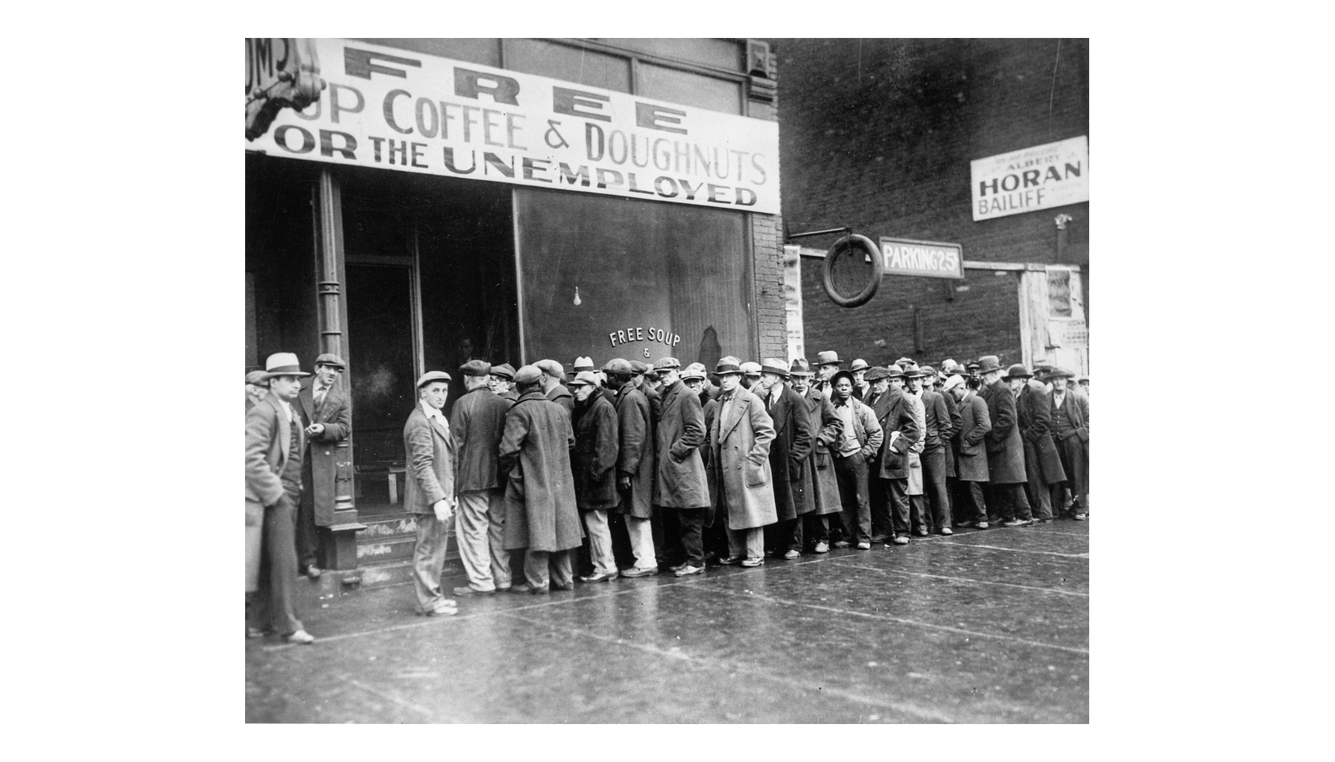
A Chicago Relief Line, 1931
Note the line's length.
© More Lessons Less Planning | morelessonslessplanning.com
Notes:
Give students thirty seconds of silence with the photograph before anyone speaks, then ask what they notice about the length of the line.
Reference labels (point to these chart features when teaching): Line runs down the block; Storefront relief kitchen

Slide 14
The Language of Hard Times
Unemployment Rate
The share of workers who want a job and cannot find one, given as a percentage
Bread Line
A queue of people waiting for free food handed out by a charity or a city relief agency
Hooverville
A shantytown of homemade shacks named in blame for President Herbert Hoover
Did You Know: People called an empty pocket turned inside out a Hoover flag.
© More Lessons Less Planning | morelessonslessplanning.com
Notes:
The vocabulary of blame matters: naming shantytowns after the president was a political act.

Slide 15
Disaster on the Southern Plains
Dust Bowl
The drought-stricken southern Plains region where plowed topsoil blew away in huge dust storms during the 1930s
Black Blizzard
A dust storm so thick it turned day into night and buried fences, roads, and machinery
Okies
The nickname given to Plains families who left their farms and headed west looking for work
Fact: On April 14, 1935, a single dust storm darkened the sky from Oklahoma to Texas.
© More Lessons Less Planning | morelessonslessplanning.com
Notes:
Stress that the Dust Bowl was a separate disaster that struck an economy already on its knees.

Slide 16
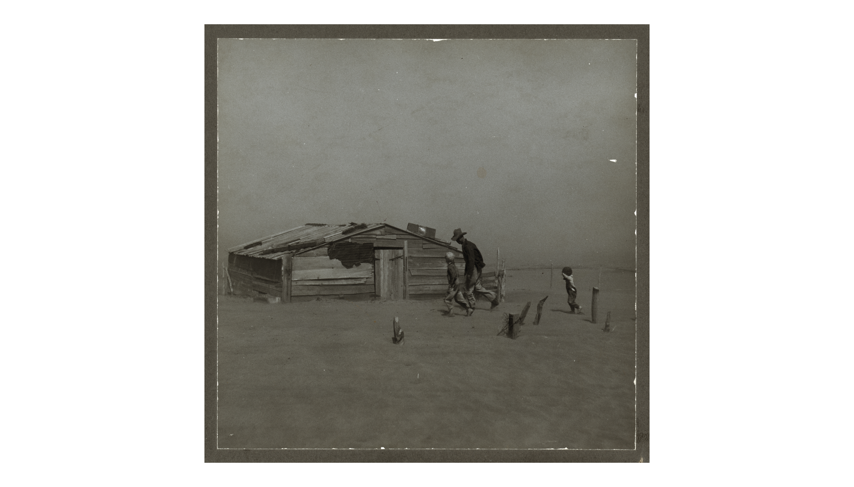
A Dust Storm in Cimarron County, 1936
Note the buried shed.
© More Lessons Less Planning | morelessonslessplanning.com
Notes:
Point out the drifted soil banked against the buildings. That is farmland that has physically moved.
Reference labels (point to these chart features when teaching): Half-buried farm buildings; Drifted soil on the ground

Slide 17
Governments Respond
New Deal
Franklin D. Roosevelt's 1933 program of relief, recovery, and reform for the U.S. economy
✔
Bank Holiday
Roosevelt closed every U.S. bank in March 1933 and reopened only those judged sound
✔
Public Works
Governments hired the jobless to build roads, dams, parks, schools, and bridges
✔
Britain and Germany
Britain cut spending and left gold; Germany's crisis helped the Nazis take power in 1933
✔
Key Point: Every government tried something, and none of it worked quickly.
© More Lessons Less Planning | morelessonslessplanning.com
Notes:
The last row is the hinge to the rest of Unit 12. Economic collapse had political consequences.

Slide 18
A New President Speaks: March 4, 1933
So, first of all, let me assert my firm belief that the only thing we have to fear is fear itself.
— Franklin D. Roosevelt, First Inaugural Address, March 4, 1933
Roosevelt spoke at the depth of the banking panic, with about one in four American workers jobless.
Big Idea: Roosevelt's first job was to restore confidence before he could restore the economy.
© More Lessons Less Planning | morelessonslessplanning.com
Notes:
Tell students they will read a longer passage from this same address in the Activity, including his description of frozen credit and empty markets.

Slide 19
Key Takeaways
The 1929 crash exposed a boom built on speculation and borrowed money.
★
Bank failures and falling spending turned a crash into a long slump.
★
U.S. loans and new tariffs carried the collapse to Europe and beyond.
★
About one in four American workers was jobless at the 1933 low point.
★
Roosevelt answered with relief, recovery, and reform in the New Deal.
★
© More Lessons Less Planning | morelessonslessplanning.com
Notes:
Close by having students state the causal chain in one sentence, from margin buying to the New Deal.

