Slide 1
The Great Awakening: Preaching That Crossed the Colonies
US History - Unit 2: Colonial America
© More Lessons Less Planning | morelessonslessplanning.com
Notes:
Open by asking what colonists in 1740 might have dropped their tools to go hear. This lesson explains why so many did.

Slide 2
Learning Targets
Explain what the Great Awakening was and when it swept the colonies.
★
Describe how traveling preachers reached crowds no building could hold.
★
Analyze a 1741 sermon for the techniques that moved its listeners.
★
Explain why the new preaching split colonists into two rival camps.
★
Evaluate how one shared event helped link the colonies together.
★
© More Lessons Less Planning | morelessonslessplanning.com
Notes:
Read target three and four aloud - both are graded directly in the Activity's Primary Source Spotlight and final Part.

Slide 3
One Colony, One Official Faith
established church
The church a colony's government supported with tax money and law.
congregation
The group of people who regularly worship at one particular church.
Key Concept: Most colonies before 1740 taxed everyone to support one official church.
© More Lessons Less Planning | morelessonslessplanning.com
Notes:
Both terms sit on the Reference Guide. Hold the line: colony law, not personal choice, usually decided the local church.

Slide 4
Worried Ministers, Emptier Pews
By the 1720s many ministers worried devotion was fading fast.
Younger colonists had not lived through the founders' fervor.
Growing farms and towns spread families from worship sites.
Trade and land competed hard for attention ministers wanted.
Some preachers tried plainer, more urgent sermons to wake listeners.
Note: Ministers called this problem a cooling of religion, not a loss of belief.
© More Lessons Less Planning | morelessonslessplanning.com
Notes:
This is the calm-before setup. Nothing dramatic happens yet - that is the point.

Slide 5
Fire in the Connecticut Valley, 1734
revival
A large gathering held to stir up religious feeling, often lasting several days.
conversion
A personal change of heart in which a person claims a new religious commitment.
Did You Know: Edwards counted roughly 300 new professions of faith in Northampton within six months.
© More Lessons Less Planning | morelessonslessplanning.com
Notes:
Northampton, 1734-1735, is the spark. Both terms describe what a revival tries to produce in one person.

Slide 6
The Preacher Who Would Not Stay Put
itinerant
A preacher who traveled from town to town instead of leading one settled church.
denomination
A distinct religious group with its own name, organization, and beliefs.
Key Concept: Whitefield preached in nearly every colony from Georgia to New Hampshire between 1739 and 1741.
© More Lessons Less Planning | morelessonslessplanning.com
Notes:
Whitefield is the case study for both terms. He crossed colony and church-group lines on purpose.

Slide 7
Crowds No Building Could Hold
Outdoor crowds
Franklin's test
Fields held thousands no meetinghouse could fit.
Whitefield preached outdoors across every colony.
Crowds sometimes topped several thousand people.
Franklin walked back until words blurred.
He guessed how far the voice could reach.
His estimate ran past thirty thousand people.
Fun Fact: Franklin estimated Whitefield's voice could reach over thirty thousand listeners in the open air.
© More Lessons Less Planning | morelessonslessplanning.com
Notes:
Franklin's account is in his own Autobiography - a rare outside, non-religious witness to the scale of these crowds.

Slide 8
Enfield, July 8, 1741
On July 8, 1741, Edwards preached this sermon in Enfield, Massachusetts.
Witnesses reported loud crying and people gripping the pews.
Accounts say Edwards read it in an even voice, not a shout.
The sermon was printed in Boston later that same year.
Historians study it as a case in colonial preaching's reach.
Warning: Edwards's imagery is intense - the excerpt is presented as rhetoric to study, not belief to adopt.
© More Lessons Less Planning | morelessonslessplanning.com
Notes:
Set up the Primary Source Spotlight here. Students read the sermon as a document, not a call to respond personally.

Slide 9
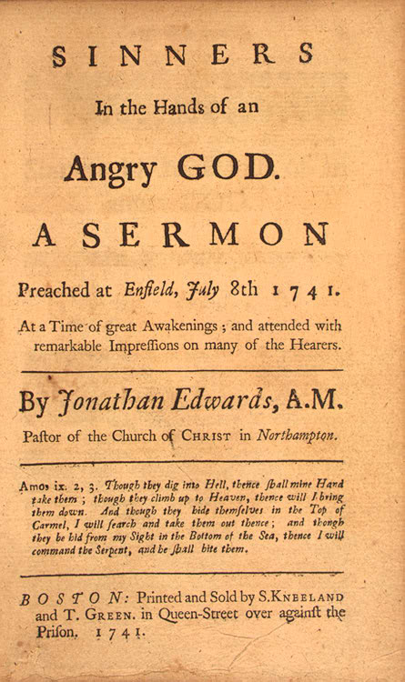
The Sermon in Print
The 1741 Boston printing: 'At a Time of great Awakenings'
© More Lessons Less Planning | morelessonslessplanning.com
Notes:
Give the class a few silent seconds, then ask what the subtitle phrase tells them about how contemporaries already named this wave of preaching.
Reference labels (point to these chart features when teaching): SINNERS title line; Boston imprint, 1741

Slide 10
How the Preaching Worked
Concrete Comparison
Direct Address
Urgency and Repetition
Compared sinners to a spider over flame.
Turned an abstract warning into a picture.
Made danger feel close and physical.
Spoke straight to 'you,' not people generally.
Made each listener feel personally named.
Turned the sermon into a private address.
Stressed danger as immediate, not distant.
Repeated key phrases to build pressure.
Words like 'now' pushed listeners to act.
Tip: Ask which technique students think worked hardest on a colonial audience, then test it against the Activity.
© More Lessons Less Planning | morelessonslessplanning.com
Notes:
Treat the sermon as rhetoric here - this slide is the toolbox students apply in the Activity's technique section.

Slide 11
A Divided Pulpit
New Light
A colonist who supported the awakening and the emotional preaching it brought.
Old Light
A colonist who rejected the awakening as disorderly and its preachers as unlearned.
Remember: Neither side is the villain here - both defended what they believed proper worship required.
© More Lessons Less Planning | morelessonslessplanning.com
Notes:
This is the central split. Both labels are contemporaries' own terms, not later historians' inventions.

Slide 12
Voices Without a Pulpit
exhorter
An unordained speaker who urged listeners to repent, often outside any pulpit.
dissenter
A colonist who left the official colonial church to worship in another way.
Did You Know: Some colonies briefly restricted unlicensed preaching in response to traveling exhorters.
© More Lessons Less Planning | morelessonslessplanning.com
Notes:
This slide names who gained a hearing they had not had before - neither role required formal training or ordination.

Slide 13
Growing Churches, Founding Colleges
New churches
Supporters who could not accept an old minister's stance started churches of their own.
✔
Baptist growth
Churches that required a personal profession of faith grew quickly in the decades after 1741.
✔
Presbyterian split
Presbyterians split into rival synods over the new preaching before reuniting later.
✔
New colleges
Supporters founded colleges that became Princeton, Dartmouth, and Brown to train preachers.
✔
Key Concept: A single argument over preaching style reorganized colonial religious life for a generation.
© More Lessons Less Planning | morelessonslessplanning.com
Notes:
Trace the split into institutions. These outcomes lasted long after the initial preaching wave passed.

Slide 14
Before and After
Category | Before the 1730s | By the 1750s
Membership | Inherited by family and standing | A personal choice to join
Preaching style | Calm, reasoned, from a settled pulpit | Urgent and emotional, often outdoors
Local authority | One tax-supported church per town | Rival churches compete for members
Colonial contact | Colonies mostly went separate ways | A shared event linked distant colonies
Note: The right column describes debate and change, not universal agreement - many colonists kept the older pattern.
© More Lessons Less Planning | morelessonslessplanning.com
Notes:
Use this as a review slide before moving to the colony-wide argument in the next two slides.

Slide 15
One Story in Thirteen Places
What carried it
What it created
Printed sermons sold across colony lines.
Newspapers tracked Whitefield's tour by colony.
Whitefield preached in nearly every colony.
Colonists argued about the same distant event.
News rarely crossed that many colonies at once.
It was a rare shared experience across colonies.
Fact: Colonial newspapers before this rarely covered news from more than one or two other colonies.
© More Lessons Less Planning | morelessonslessplanning.com
Notes:
This is the colonies-linked argument, in miniature. Slide 16 opens it up as a live historical debate.

Slide 16
What Historians Argue About
Some historians say the awakening taught habits of questioning authority.
Others counter that religious dissent and political revolt differ.
Revivals peaked in the 1740s - the Revolution began roughly thirty years later.
Not disputed: colonists organized and argued across colony lines.
This lesson leaves the debate open - historians still disagree.
Note: No single cause explains the Revolution - treat this connection as one thread historians debate.
© More Lessons Less Planning | morelessonslessplanning.com
Notes:
Present both positions in their strongest form. This debate stays open at the end of the lesson on purpose.

Slide 17
Key Takeaways
Revivals and traveling preachers reshaped religion, 1730s-1750s.
★
Edwards's 1741 Enfield sermon shows preaching's persuasive techniques.
★
The new preaching split colonists into New Light and Old Light camps.
★
The split built new meetinghouses, faster-growing groups, and new colleges.
★
Printed sermons and touring preachers linked colonists across colonies.
★
© More Lessons Less Planning | morelessonslessplanning.com
Notes:
Close on the last point - this is the through-line the whole lesson has been building toward.

