Slide 1
The Golden Age of the Gupta Empire
Why classical India's Gupta era is remembered as a Golden Age of math, art, and trade - and why that label is a judgment, not just a fact.
© More Lessons Less Planning | morelessonslessplanning.com
Notes:
Opening slide. From about 320 to 550 CE the Gupta Empire ruled much of northern India during a burst of achievement in mathematics, astronomy, literature, and art. Historians often call it a Golden Age. Students will learn the real achievements behind that label - the decimal system, zero, Aryabhata, Kalidasa, the Ajanta Caves, and rich trade - and will also learn to treat 'Golden Age' as a historical judgment, testing it against an eyewitness account from the traveling monk Faxian.

Slide 2
Learning Targets
Explain who the Guptas were and when their empire ruled northern India.
★
Describe Gupta math and science: the decimal system, zero, and Aryabhata.
★
Describe Gupta art, literature, and trade: Ajanta, Kalidasa, and rich trade.
★
Explain why 'Golden Age' is a judgment and analyze Faxian's eyewitness account.
★
© More Lessons Less Planning | morelessonslessplanning.com
Notes:
Read the four learning targets. Today combines an impressive story - a burst of classical achievement in math, art, and trade - with a history skill: reading a primary source and asking who wrote it, when, and how far we should trust it.

Slide 3
Who Were the Guptas?
Gupta Empire
The empire that ruled much of northern India from about 320 to 550 CE, remembered for its scientific and cultural achievements.
Chandragupta I
The king who founded the Gupta Empire around 320 CE (not the same person as the earlier Mauryan founder Chandragupta Maurya).
Key Concept: The GUPTA EMPIRE ruled much of northern India from about 320 to 550 CE, and it was founded around 320 CE by Chandragupta I.
© More Lessons Less Planning | morelessonslessplanning.com
Notes:
The GUPTA EMPIRE ruled much of northern India from about 320 to 550 CE. It was founded around 320 CE by a king named Chandragupta I (a different person from the earlier Mauryan founder, Chandragupta Maurya). Under strong Gupta rulers, northern India enjoyed long stretches of peace and stability. That stability gave scholars, artists, and merchants the security to do remarkable work - which is why this empire is remembered for its scientific and cultural achievements.

Slide 4
India's Golden Age
What the label spotlights
What the label can hide
Great achievement in science and math.
Great art, literature, and learning.
Wealth and prosperity from trade.
The poverty of many ordinary people.
The hard lives of farmers and laborers.
Inequality the label leaves out.
Key Concept: A GOLDEN AGE is a period of great achievement in science, art, learning, and prosperity - but the label is a judgment, not a plain fact.
© More Lessons Less Planning | morelessonslessplanning.com
Notes:
Historians often call the Gupta era a GOLDEN AGE - a period of great achievement in science, art, learning, and prosperity. But it is important to be honest: 'Golden Age' is a historical judgment, not a plain fact. The label highlights real achievements, yet it can hide the poverty, inequality, and hard lives of many ordinary farmers and laborers. When we call the Gupta era a Golden Age, we are making an argument about which parts of the past to spotlight - and we should always ask, 'a golden age for whom?'

Slide 5
Breakthroughs in Mathematics
Decimal system
A way of writing numbers using place value and the digits 0 through 9, refined in Gupta India and later spread around the world.
Zero
The number and placeholder that Gupta mathematicians treated as a true number, making advanced mathematics possible.
Key Concept: Gupta India refined the DECIMAL SYSTEM (place value with the digits 0 through 9) and treated ZERO as a true number.
© More Lessons Less Planning | morelessonslessplanning.com
Notes:
Some of the most important math ideas in world history took shape in Gupta India. Scholars there refined the DECIMAL SYSTEM - a way of writing numbers using place value and the digits 0 through 9 - the same basic system the whole world uses today. Just as importantly, Gupta mathematicians treated ZERO as a true number and placeholder, not just an empty space. Zero made advanced mathematics possible, from large calculations to later algebra. These ideas spread west through trade and scholarship and became the number system used almost everywhere on Earth.

Slide 6
Aryabhata and the Stars
A great astronomer
Aryabhata was a Gupta-era mathematician and astronomer who wrote a famous book on math and the heavens.
✔
He estimated pi
Aryabhata calculated a strikingly accurate value for pi, the ratio used to measure circles.
✔
A rotating Earth
Aryabhata argued that the Earth rotates on its axis, which is why day turns to night - far ahead of his time.
✔
Key Concept: ARYABHATA, a Gupta-era mathematician and astronomer, estimated pi and argued that the Earth rotates on its axis.
© More Lessons Less Planning | morelessonslessplanning.com
Notes:
One of the greatest thinkers of the age was ARYABHATA, a Gupta-era mathematician and astronomer. He estimated a remarkably accurate value for pi, the number used to measure circles. Even more boldly, he argued that the Earth rotates on its axis - that the Earth spins, which is why day turns to night - at a time when most people believed the sky itself moved around a still Earth. Aryabhata's ideas were centuries ahead of many other astronomers and show how far Gupta science reached.

Slide 7
Kalidasa and Classical Literature
Kalidasa
The celebrated Gupta-era Sanskrit poet and playwright, author of the play Shakuntala.
Sanskrit
The classical language of learning and literature in Gupta India, in which Kalidasa wrote his poems and plays.
Key Concept: KALIDASA was the great Gupta-era Sanskrit poet and playwright, famous for his play Shakuntala.
© More Lessons Less Planning | morelessonslessplanning.com
Notes:
The Gupta era is also remembered for classical literature. Its greatest writer was KALIDASA, a Sanskrit poet and playwright often ranked among the finest in all of Indian literature. His best-known play, Shakuntala, tells a romantic story of a king and a young woman and was admired so widely that it was later translated and praised in Europe. Kalidasa wrote in SANSKRIT, the classical language of learning and literature in Gupta India. His work shows that the Gupta Golden Age was about beauty and imagination, not only science.

Slide 8
Masterpieces at the Ajanta Caves
Ajanta Caves
The Ajanta Caves are rock-cut caves in western India carved into a cliff, used as Buddhist monasteries and worship halls.
✔
Famous murals
Their walls are covered in murals - paintings made on the rock - many created during the Gupta era.
✔
Classical masterpieces
These Gupta-era Buddhist murals are counted among the masterpieces of classical Indian art.
✔
Key Concept: The AJANTA CAVES hold Gupta-era Buddhist murals - paintings on the rock - counted among the masterpieces of classical Indian art.
© More Lessons Less Planning | morelessonslessplanning.com
Notes:
The AJANTA CAVES are rock-cut caves in western India, carved into a cliff and used as Buddhist monasteries and worship halls. Their walls are covered in MURALS - paintings made directly on the rock - many of them created during the Gupta era. They show scenes from the life of the Buddha and from everyday life, painted with rich color and grace. These Gupta-era Buddhist murals are counted among the masterpieces of classical Indian art. The next slide shows one of these paintings up close.

Slide 9
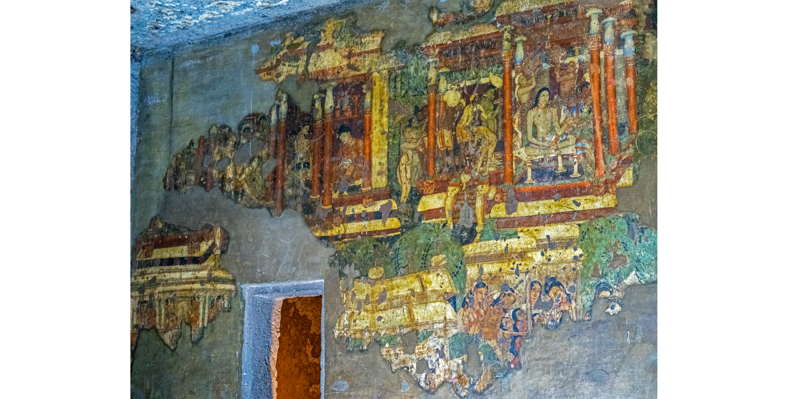
A Gupta-Era Fresco at Ajanta
A Gupta-era Buddhist mural painted on the rock wall of the Ajanta Caves.
© More Lessons Less Planning | morelessonslessplanning.com
Notes:
Public-domain photograph of a Gupta-era (5th-century CE) Buddhist mural on the rock wall of the Ajanta Caves. Point out the graceful figure, the rich earth-tone pigments, and the fact that this was painted directly on the cave wall roughly 1,500 years ago. Use it purely as a reference visual for the classical Gupta art taught on the previous slide.
Reference labels (point to these chart features when teaching): Painted figure; Ancient pigment

Slide 10
A Wealthy Trade Network
What Gupta India traded
How far trade reached
Silk, spices, cotton, and ivory.
Goods prized in distant lands.
Gold and Roman coins flowed back.
Along the Silk Road by caravan.
By sea across the Indian Ocean.
To Rome, East Africa, and China.
Key Concept: TRADE - the exchange of goods like silk, spices, cotton, and ivory - made Gupta India wealthy and paid for the Golden Age.
© More Lessons Less Planning | morelessonslessplanning.com
Notes:
Gupta India was rich, and much of that wealth came from TRADE - the exchange of goods such as silk, spices, cotton, and ivory with distant lands. Gupta merchants sent caravans along the Silk Road and sailed the Indian Ocean, trading with Rome, East Africa, Southeast Asia, and China. Indian cotton and spices were prized far away, and gold and Roman coins flowed back in return. This trade did more than make merchants rich: the wealth it brought helped pay for the art, learning, temples, and universities of the Golden Age.

Slide 11
An Eyewitness: The Monk Faxian
Faxian
Faxian was a Chinese Buddhist monk who traveled through Gupta India around 399 to 414 CE seeking Buddhist texts.
✔
The Middle Kingdom
He called the Gupta heartland the Middle Kingdom (Madhyadesha) and described it as peaceful, orderly, and prosperous.
✔
An admiring outsider
Because Faxian was an admiring outsider passing through, historians treat his account as one traveler's view, not proof India was perfect.
✔
Key Concept: FAXIAN, a Chinese monk in Gupta India c. 399-414 CE, praised the MIDDLE KINGDOM as prosperous - but as an admiring outsider.
© More Lessons Less Planning | morelessonslessplanning.com
Notes:
Much of what outsiders recorded about Gupta India comes from FAXIAN, a Chinese Buddhist monk who traveled through India around 399 to 414 CE to collect Buddhist writings. He called the Gupta heartland the MIDDLE KINGDOM (Madhyadesha) and described it as peaceful, orderly, and prosperous: light punishments, people free to move about, salaried officials, and free rest-houses and hospitals for the poor and sick. His account is precious eyewitness evidence. But remember: Faxian was an admiring outsider who saw only part of the empire, so historians treat his account as one traveler's view - valuable, but not proof that all of Gupta India was perfect.

Slide 12
Key Takeaways
The Gupta Empire ruled much of northern India from about 320 to 550 CE.
★
Gupta math gave the world the decimal system and zero.
★
Aryabhata's science, Kalidasa's poetry, Ajanta's art, and trade mark the age.
★
'Golden Age' is a judgment; Faxian's account is one traveler's view.
★
© More Lessons Less Planning | morelessonslessplanning.com
Notes:
Recap the four takeaways. The big ideas: the Gupta era produced real, world-changing achievements in math, science, art, and trade; that is why historians call it a Golden Age; but 'Golden Age' is a judgment, and even a glowing eyewitness account like Faxian's must be read critically.

