Slide 1
The First Toolmakers
Use chipped stone tools to reconstruct how early humans lived, worked, and slowly grew more skilled.
© More Lessons Less Planning | morelessonslessplanning.com
Notes:
Opening slide. Long before writing, early humans made tools by striking one stone against another. Those chipped stones are some of the only evidence we have of how the first people lived. In this lesson students act like archaeologists, reading stone tools to reconstruct early human life and the growth of skill over time.

Slide 2
Learning Targets
Describe how early humans made stone tools by chipping flint.
★
Explain how archaeologists date and interpret stone tools.
★
Analyze how tool complexity reveals growing skill and thinking.
★
Describe the daily survival tasks stone tools were used for.
★
© More Lessons Less Planning | morelessonslessplanning.com
Notes:
Read the four learning targets. Today combines a science of stone (how flint breaks) with a history skill (reading objects, not documents, to reconstruct the past).

Slide 3
Studying the Deep Past
Prehistory
The long span of the human past before written records, studied through artifacts.
Archaeologist
A scientist who studies the human past through the physical objects people left behind.
Key Concept: PREHISTORY is the human past before WRITTEN records, so an ARCHAEOLOGIST studies physical objects.
© More Lessons Less Planning | morelessonslessplanning.com
Notes:
PREHISTORY is the long span of the human past that comes before written records. Because no one wrote anything down, we cannot read about the first humans - we can only study what they left behind. An ARCHAEOLOGIST is a scientist who studies the human past through the physical objects people left behind, especially stone tools and bones. Reading objects instead of documents is the core skill of this whole lesson.

Slide 4
Clues in the Ground: Artifacts
Artifact
An object made or used by humans in the past, studied by archaeologists as evidence.
✔
Why it matters
A stone tool is an artifact; its shape and wear reveal how it was made and used.
✔
Key Concept: An ARTIFACT is an object made or used by humans that archaeologists study as evidence.
© More Lessons Less Planning | morelessonslessplanning.com
Notes:
An ARTIFACT is any object made or used by humans in the past that archaeologists study as evidence. A chipped stone tool is an artifact. By examining how an artifact was shaped and where its edges are worn down, archaeologists can figure out how it was made and what jobs it did - even though no one recorded it in writing.

Slide 5
Flint and Knapping
Flint
A hard stone that flakes into sharp edges when struck, used to make many early tools.
Knapping
Striking one stone against another to chip off flakes and shape a tool.
Key Concept: Early humans used KNAPPING - striking stones - to shape FLINT into sharp tools.
© More Lessons Less Planning | morelessonslessplanning.com
Notes:
Not every rock makes a good tool. FLINT is a hard stone that flakes into sharp edges when it is struck, which is exactly what a toolmaker needs. KNAPPING is the technique of striking one stone against another to chip off flakes and shape a tool. A skilled knapper controls each blow to shape the edge - it takes practice, not just brute force.

Slide 6
Cores and Flakes
Core
The stone that flakes are struck from; it can itself be shaped into a chopping tool.
✔
Flake
A sharp-edged piece struck off a stone, used for cutting and scraping.
✔
Key Concept: A CORE is the stone flakes are struck from; each FLAKE is a sharp tool for cutting and scraping.
© More Lessons Less Planning | morelessonslessplanning.com
Notes:
When a toolmaker knaps stone, two useful things are produced. A CORE is the stone from which flakes are struck; the core itself can be shaped into a heavy chopping tool. A FLAKE is a sharp-edged piece struck off a stone, used for cutting and scraping. So a single lump of flint can give an early human both a chopper and many small sharp blades.

Slide 7
Oldowan: The First Tools
The Oldowan is the earliest known stone tool tradition.
Oldowan tools are simple: a core with a few flakes struck off.
They made choppers for smashing and sharp flakes for cutting.
The next slide shows real Oldowan stone tools.
Key Concept: The OLDOWAN is the earliest known stone tool tradition - simple choppers and flakes.
© More Lessons Less Planning | morelessonslessplanning.com
Notes:
The OLDOWAN tradition is the earliest known stone tool tradition, named after Olduvai Gorge in East Africa. Oldowan tools are simple: a maker strikes a few flakes off a core, producing a rough chopper for smashing bones and sharp flakes for cutting. They are basic, but they were a huge advantage - a stone edge does jobs that bare hands and teeth cannot. The next slide shows real Oldowan tools.

Slide 8
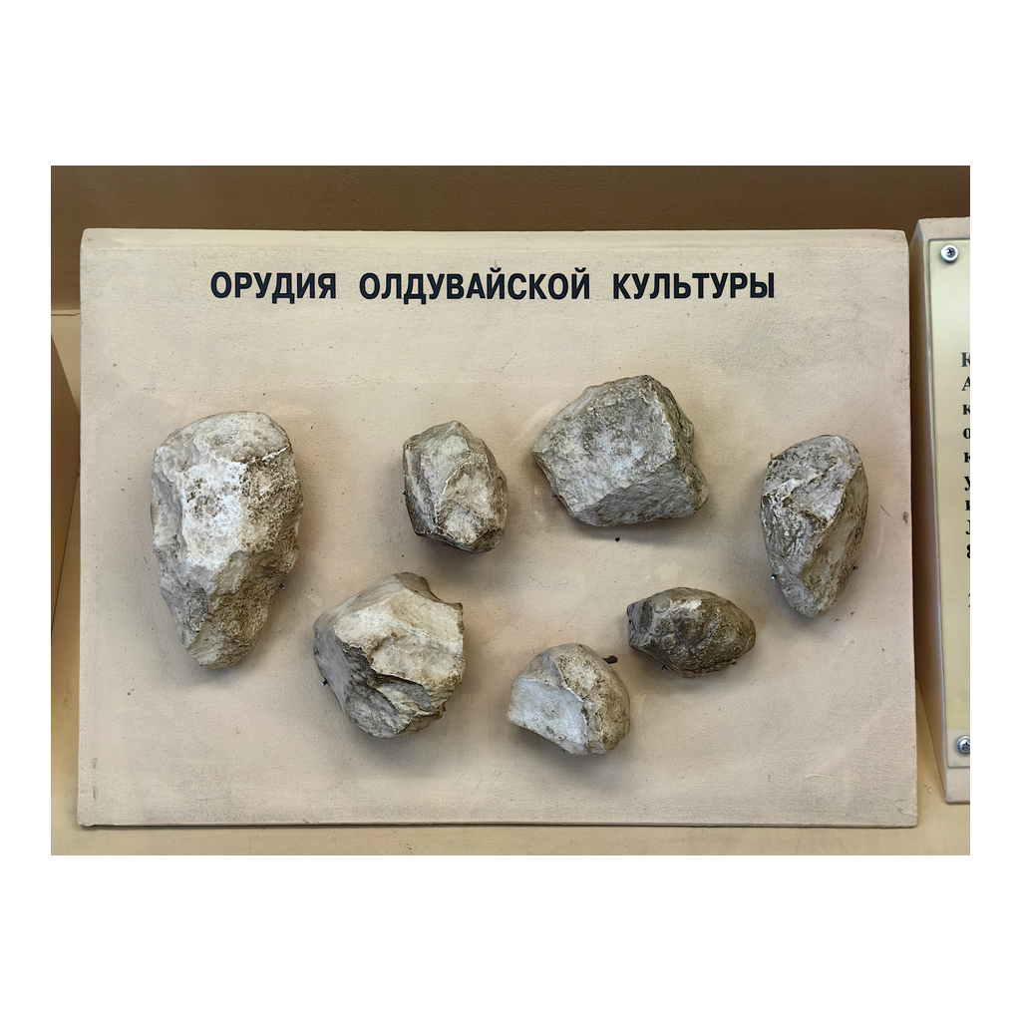
Oldowan Stone Tools
Simple Oldowan tools: a chopper core with sharp flakes struck from it.
© More Lessons Less Planning | morelessonslessplanning.com
Notes:
Real public-domain photograph of Oldowan stone tools. Give students a moment to notice how few, rough flake scars these earliest tools have compared with the hand axe shown later.
Reference labels (point to these chart features when teaching): Chopper core; Struck flakes

Slide 9
Acheulean: The Hand Axe
Acheulean
A later, more advanced stone tool tradition known for the teardrop hand axe.
✔
Hand axe
A teardrop-shaped stone tool worked on both sides to a point, for cutting and chopping.
✔
Key Concept: The ACHEULEAN tradition is known for the teardrop HAND AXE, worked on both sides.
© More Lessons Less Planning | morelessonslessplanning.com
Notes:
The ACHEULEAN tradition is a later, more advanced stone tool tradition than the Oldowan. Its signature tool is the HAND AXE - a teardrop-shaped stone tool worked on both sides to a point, used for cutting and chopping. Shaping both faces into a symmetrical teardrop takes many careful, planned blows, so the hand axe shows far more skill than a rough Oldowan chopper. The next slide shows a real hand axe.

Slide 10
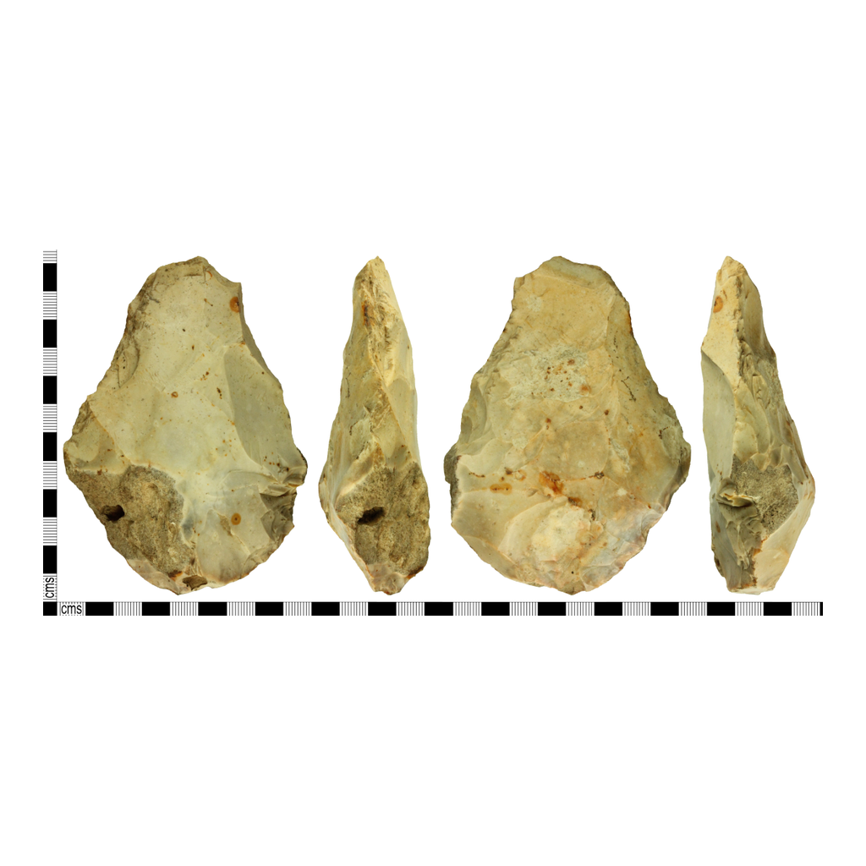
An Acheulean Hand Axe
An Acheulean hand axe: a symmetrical teardrop worked to a point on both sides.
© More Lessons Less Planning | morelessonslessplanning.com
Notes:
Real public-domain photograph of an Acheulean hand axe from the British Museum collection. Point out the symmetry and the many flake scars across both faces - evidence of careful, planned shaping.
Reference labels (point to these chart features when teaching): Teardrop shape; Worked on both sides

Slide 11
What Tools Reveal About Thinking
Simple: Oldowan
Complex: Acheulean
A few rough flakes off a core.
Little planning needed.
Made by earlier humans.
Symmetrical teardrop shape.
Many careful, planned blows.
Growing skill and thinking.
Key Concept: As tools grew more complex, they show early humans' growing skill and thinking over time.
© More Lessons Less Planning | morelessonslessplanning.com
Notes:
The change from simple Oldowan tools to complex Acheulean hand axes is not just about better tools - it is a window into the mind. As stone tools became more complex from the Oldowan to the Acheulean, they show early humans' growing skill and thinking. Making a symmetrical hand axe means holding a finished shape in your mind and planning many blows to reach it. Tool complexity tracks how early human thinking and technology changed over time.

Slide 12
Daily Survival Tasks
Cutting meat and slicing plants with sharp flakes.
Scraping hides clean to make clothing and shelter.
Chopping and working wood for spears and shafts.
Smashing bones with choppers to reach the marrow.
Did You Know? Early humans used stone flakes for cutting meat, scraping hides, and working wood.
© More Lessons Less Planning | morelessonslessplanning.com
Notes:
Stone tools were not decoration - they were survival gear. Early humans used sharp stone flakes for daily survival tasks such as cutting meat, scraping hides, and working wood. Heavy choppers smashed bones to reach the fatty marrow inside. Wear marks and residue on real tools let archaeologists match specific tools to these jobs, reconstructing the daily work of people who left no words behind.

Slide 13
Dating and Interpreting Tools
Read the layers
Tools buried in deeper rock layers are generally older than tools above them.
✔
Compare the styles
Comparing tool styles lets archaeologists reconstruct how technology changed over time.
✔
Key Concept: Deeper rock layers are older, so archaeologists reconstruct how tools changed over time.
© More Lessons Less Planning | morelessonslessplanning.com
Notes:
How do archaeologists know which tools are older? Tools buried in deeper rock layers are generally older than tools found above them, because layers build up over time. By comparing tool styles and where they are found in the layers, archaeologists reconstruct how early human technology changed over time - for example, from simple Oldowan tools in the lower layers to Acheulean hand axes higher up.

Slide 14
Key Takeaways
Early humans made tools by knapping flint into cores and flakes.
★
Tools grew from simple Oldowan choppers to Acheulean hand axes.
★
Rising tool complexity shows growing skill and thinking.
★
Archaeologists date and read tools to reconstruct early life.
★
© More Lessons Less Planning | morelessonslessplanning.com
Notes:
Recap the four takeaways. The big skill: with no written records, archaeologists read stone tools - how they were made, how complex they are, and where they are buried - to reconstruct early human life and the growth of human skill.

