Slide 1
The Fall of Rome
Investigate the political, economic, and military causes of the Western Roman Empire's decline - and why there was no single cause.
© More Lessons Less Planning | morelessonslessplanning.com
Notes:
Opening slide. Over centuries the Western Roman Empire slowly declined until, in 476 CE, the last Western emperor was deposed. Students will investigate the many causes - political instability, economic strain, and military pressure - and learn why historians reject any single explanation, while the Eastern (Byzantine) empire lived on for nearly 1,000 more years.

Slide 2
Learning Targets
Explain why only the Western empire 'fell' while the East survived.
★
Identify the political, economic, and military causes of decline.
★
Describe the roles of the Visigoths, Vandals, and 410 and 476 CE.
★
Analyze a primary source and judge how reliable it is.
★
© More Lessons Less Planning | morelessonslessplanning.com
Notes:
Read the four learning targets. Today combines a big history question - why did Rome fall? - with a source-analysis skill: reading a primary source and judging how trustworthy it is.

Slide 3
What Do We Mean by 'the Fall'?
Western Roman Empire
The western half that slowly declined and ended in 476 CE - this is what 'fell.'
Byzantine Empire
The Eastern Roman Empire, which survived nearly 1,000 more years, until 1453.
Key Concept: The 'fall of Rome' means the WESTERN empire; the BYZANTINE EMPIRE (the East) lived on until 1453.
© More Lessons Less Planning | morelessonslessplanning.com
Notes:
The 'fall of Rome' refers to the collapse of the WESTERN Roman Empire, not the entire Roman world. The BYZANTINE EMPIRE was the Eastern Roman Empire, and it survived nearly 1,000 more years, until 1453. Rome's fall was also a gradual transformation over centuries, not a single catastrophic day - 476 CE is a convenient marker, not the day everything ended.

Slide 4
No Single Cause
Political
Economic
Military
Emperors rose and fell fast.
Civil wars over the throne.
Weak central government.
Heavy taxes on citizens.
Debasement of the coins.
Disrupted trade and farming.
Germanic migrations and pressure.
Reliance on hired soldiers.
Borders too long to defend.
Key Concept: Historians agree Rome fell for MANY reasons - political, economic, and military - not one single cause.
© More Lessons Less Planning | morelessonslessplanning.com
Notes:
Historians agree Rome fell for MANY reasons, not one single cause. The three big categories of causes were political instability, economic strain, and military pressure. Popular single-cause explanations - lead poisoning, moral decay, or Christianity - are debated or overstated; the real story is that these many problems built up together over centuries. This slide is the multi-causal frame for the whole lesson.

Slide 5
Political Instability
Rapid turnover
In the 200s CE, emperors rose and fell fast, many killed by their own soldiers.
✔
Civil war
Rivals fought civil war for the throne, draining Rome's strength.
✔
Weak center
Constant power struggles left the central government weak and unstable.
✔
Did You Know? In about 50 years of the 200s CE, Rome had more than 20 emperors - most died violently.
© More Lessons Less Planning | morelessonslessplanning.com
Notes:
POLITICAL INSTABILITY was a major cause. In the 200s CE, emperors rose and fell rapidly, and many were killed by their own soldiers. Rivals repeatedly fought civil war for the throne, which drained Rome's strength and money. This constant turnover left the central government weak and unable to respond well to economic and military threats.

Slide 6
Economic Strain
Debasement
Reducing the silver in coins, which made money worth less and pushed prices up.
Inflation
A general rise in prices that made Roman money worth less.
Key Concept: DEBASEMENT (less silver in coins) fed INFLATION - a general rise in prices - so money bought less.
© More Lessons Less Planning | morelessonslessplanning.com
Notes:
The economy was under strain. DEBASEMENT meant reducing the silver in Roman coins so the government could make more of them; this made money worth less. Because coins held less silver, INFLATION - a general rise in prices - set in, so Roman money bought less and less. Heavy taxes, debasement, and disrupted trade all strained the economy, and reliance on enslaved labor limited new growth.

Slide 7
A Divided Empire
Diocletian
The emperor who split the empire into western and eastern halves to govern it more easily.
✔
Two halves
A Western half ruled from Italy and an Eastern half ruled from the Greek-speaking East.
✔
Why split
The empire was too big for one ruler to defend and govern at once.
✔
Key Concept: Emperor DIOCLETIAN split the empire into western and eastern halves to make it easier to govern.
© More Lessons Less Planning | morelessonslessplanning.com
Notes:
The empire was too large for one person to defend and govern. The emperor DIOCLETIAN split the empire into western and eastern halves to make it easier to govern, and Constantine later strengthened the East with a new capital, Constantinople. Splitting the empire into western and eastern halves was meant to help - but over time the wealthier, better-defended East pulled ahead while the West grew weaker. The next slide shows the divided empire on a map.

Slide 8
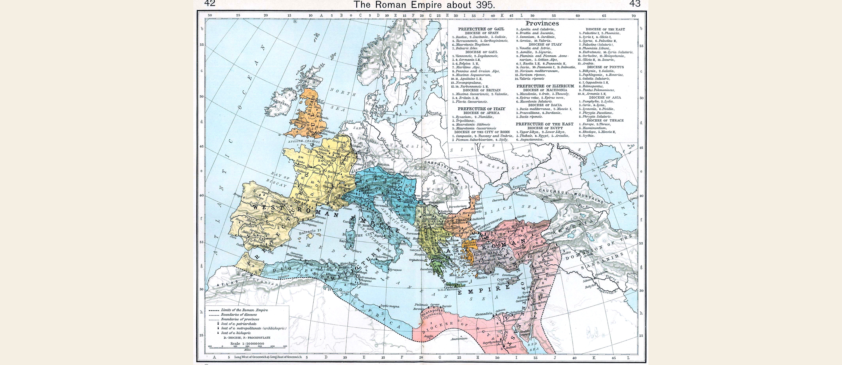
The Roman Empire Divided (c. 395 CE)
The empire was split into a Western half and an Eastern (later Byzantine) half.
© More Lessons Less Planning | morelessonslessplanning.com
Notes:
Public-domain historical map (Shepherd, 1911) of the Roman Empire divided into Western and Eastern halves around 395 CE. Point out that the West is what 'fell,' while the East became the long-lived Byzantine Empire.
Reference labels (point to these chart features when teaching): Western Roman Empire; Eastern Roman Empire

Slide 9
Military Pressure and Migration
Foederati
Germanic groups allowed to settle inside the empire and fight in the Roman army for land.
✔
Mercenaries
The late empire came to rely on mercenaries - soldiers who fight for pay, not loyalty.
✔
Not just 'barbarians'
Many Germanic peoples were Romanized and Christian and sought legal settlement.
✔
Note: FOEDERATI settled inside the empire and served in its army; MERCENARIES fought for pay, not loyalty.
© More Lessons Less Planning | morelessonslessplanning.com
Notes:
Military pressure grew as Germanic peoples migrated toward and into the empire, often pushed by other groups like the Huns. FOEDERATI were Germanic groups allowed to settle inside the empire and fight in the Roman army in exchange for land. Over time the army relied on the MERCENARY - a soldier who fights for pay rather than loyalty to the state. Importantly, these Germanic peoples were not mindless barbarians: many were Romanized and Christian and had sought legal settlement inside the empire. When Rome broke its promises to them, that trust broke down.

Slide 10
410 CE: The Sack of Rome
In 410 CE the Visigoths, led by Alaric, sacked the city of Rome.
It was the first time a foreign enemy had taken Rome in about 800 years.
The Goths had first asked Rome for land to settle legally.
Even so, they did not burn the whole city or destroy its churches.
Did You Know? Rome had not been captured by a foreign enemy in roughly 800 years before the 410 sack.
© More Lessons Less Planning | morelessonslessplanning.com
Notes:
In 410 CE the VISIGOTHS, a Germanic people led by Alaric, sacked the city of Rome. The 410 sack was a huge shock because Rome itself had not been captured by a foreign enemy in about 800 years. Remember: the Goths had first sent an embassy asking to settle legally inside the empire, and even during the sack they did not burn the whole city or destroy its holy places. The next slide shows an allegorical painting of a great city being sacked.

Slide 11
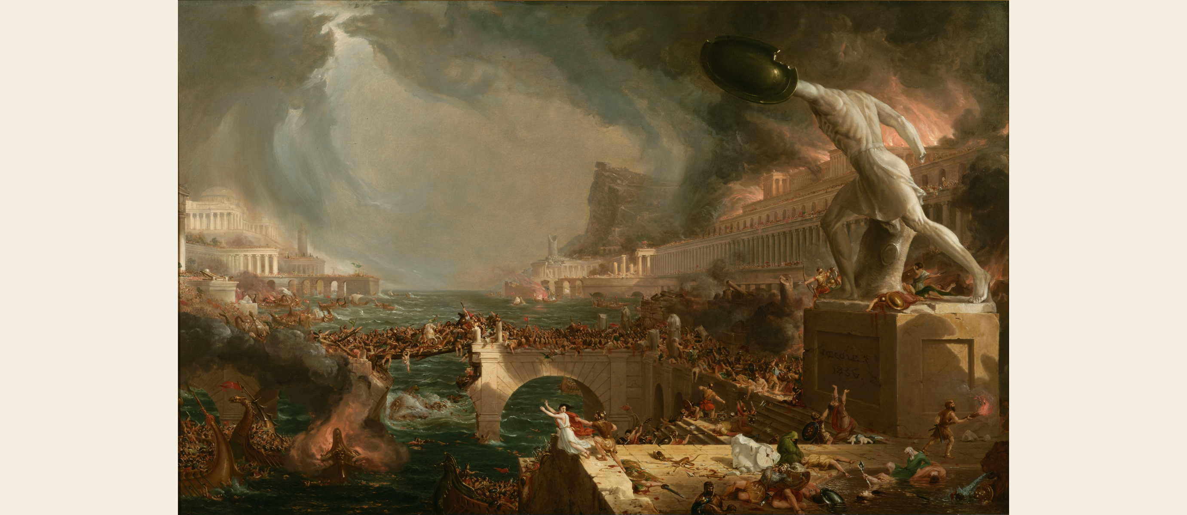
The Sack of a Great City (Cole, 1836)
Thomas Cole's 'Destruction' (1836): an imagined fall of a great city.
© More Lessons Less Planning | morelessonslessplanning.com
Notes:
Public-domain allegorical painting: Thomas Cole, The Course of Empire - Destruction (1836). Use it to set the mood of a great city being sacked, but be clear it is a 19th-century artist's imagined scene, not a record of the real 410 event.
Reference labels (point to these chart features when teaching): Imagined ancient city; Allegory, not a real record

Slide 12
455 and 476 CE: The Western Empire Ends
455 - Vandals
The Vandals sacked Rome in 455 CE and set up a kingdom in North Africa.
✔
476 - Odoacer
The Germanic commander Odoacer deposed the last Western emperor in 476 CE.
✔
The last emperor
Romulus Augustulus was the last emperor of the Western Roman Empire.
✔
Key Concept: In 476 CE ODOACER deposed ROMULUS AUGUSTULUS - the conventional marker for the end of the Western empire.
© More Lessons Less Planning | morelessonslessplanning.com
Notes:
The Western empire kept weakening. In 455 CE the VANDALS, another Germanic people, sacked Rome and set up a kingdom in North Africa. In 476 CE the Germanic commander ODOACER deposed the last Western emperor. That last emperor of the Western Roman Empire was ROMULUS AUGUSTULUS. Historians use 476 CE as the conventional marker for the 'fall,' but it was really the last step in a long, gradual transformation - no Roman felt the world end that day.

Slide 13
The East Lives On
Byzantine Empire
The Eastern Roman Empire, ruled from Constantinople, which survived until 1453.
Transformation
The Roman world changed and continued rather than simply disappearing in 476.
Key Concept: The BYZANTINE EMPIRE, ruled from Constantinople, carried Rome on for nearly 1,000 more years.
© More Lessons Less Planning | morelessonslessplanning.com
Notes:
The story does not end in 476. The BYZANTINE EMPIRE, the Eastern Roman half, kept its capital at Constantinople and lived on for centuries, calling itself Roman the whole time. Because the East survived nearly 1,000 more years, until 1453, the fall of Rome was really a transformation of the Roman world, not its total end. Roman law, the Latin and Greek languages, roads, and the Christian church all continued to shape Europe long after the Western emperors were gone.

Slide 14
Key Takeaways
The 'fall of Rome' means the Western empire; the East survived to 1453.
★
There was no single cause - political, economic, and military problems combined.
★
Visigoths (410) and Vandals (455) sacked Rome; Odoacer ended the West, 476.
★
Rome's fall was a gradual transformation, not one catastrophic day.
★
© More Lessons Less Planning | morelessonslessplanning.com
Notes:
Recap the four takeaways. The big ideas: the fall was western-only, multi-causal, and gradual, and historians reject any single-cause explanation.

