Slide 1
The European Witch Hunts
How Reformation-era fear turned neighbors into accusers.
© More Lessons Less Planning | morelessonslessplanning.com
Notes:
Opening slide. This lesson investigates, as HISTORY, how Reformation-era fear and religious upheaval fueled the European witch hunts (roughly 1450-1750). Frame the whole lesson clinically and analytically: we study how fear and a flawed legal process - not any real 'witchcraft' - led to the persecution of tens of thousands of people. Set the honesty anchor early: there were no real witches casting spells; there were frightened communities and a broken legal system. Treat the accused as victims of a historical phenomenon, and keep a neutral tone toward both Catholics and Protestants, who both took part.

Slide 2
Learning Targets
Explain how Reformation-era fear and upheaval led to the witch hunts.
★
Describe how manuals, gender, and scapegoating shaped who was accused.
★
Explain how a flawed legal process turned fear into legal persecution.
★
Analyze a 1566 trial pamphlet and explain how fear became persecution.
★
© More Lessons Less Planning | morelessonslessplanning.com
Notes:
Learning targets. Target 1 sets the causes: an age of religious division, plague, war, and shared fear of the Devil created the conditions for the hunts. Target 2 explains how witch-hunting manuals (the Malleus Maleficarum), gender, and social scapegoating shaped who was accused. Target 3 explains the flawed legal process - accusation, interrogation, and confession commonly extracted under torture - and why such confessions are unreliable. Target 4 practices sourcing on a 1566 English witch-trial pamphlet and explains how fear became legal persecution.

Slide 3
What Were the European Witch Hunts?
A WITCH HUNT is a campaign to find, accuse, and punish supposed witches.
It is driven by FEAR rather than by any real evidence of a crime.
In Europe, roughly 1450-1750, communities hunted people they feared as witches.
Tens of thousands of people were accused, tried, and executed.
There were no real witches casting spells - only fear and false accusation.
Key Concept: A WITCH HUNT is a campaign to find, accuse, and punish supposed witches, driven by fear rather than by real evidence.
© More Lessons Less Planning | morelessonslessplanning.com
Notes:
Define the topic. A WITCH HUNT is a campaign to find, accuse, and punish people believed to be witches, driven by FEAR rather than by any real evidence of a crime. Explain the scope: in Europe, roughly between 1450 and 1750, frightened communities hunted people they suspected of witchcraft. Over that period tens of thousands of people were accused, put on trial, and executed. State the honesty anchor plainly for students: there were no real witches casting harmful spells. The witch hunts are studied as an example of how fear and a flawed legal process can turn a whole community against innocent people. Keep the framing analytical - we are studying a historical phenomenon, not a real crime.

Slide 4
An Age of Fear and Upheaval
Religious upheaval
The Reformation split Christianity, and years of religious conflict left people anxious and uncertain.
Plague and hardship
Disease, crop failures, and hard winters brought sudden death and suffering people could not explain.
A search for blame
When misfortune struck, frightened communities looked for someone to BLAME - and blamed 'witches'.
Key Concept: In an age of religious UPHEAVAL, plague, and war, frightened communities looked for someone to blame for misfortune.
© More Lessons Less Planning | morelessonslessplanning.com
Notes:
Explain the climate of fear. The witch hunts grew out of an age of UPHEAVAL and anxiety. The Reformation had split Western Christianity, and decades of religious conflict left people fearful and uncertain about who and what to trust. At the same time, plague, crop failures, and harsh winters brought sudden death and suffering that ordinary people could not explain. Make the analytical point for students: when misfortune struck - a child fell sick, cattle died, a harvest failed - frightened communities often looked for someone to BLAME. In a deeply religious age, many blamed hidden 'witches' working with the Devil. Present this as context, not excuse: fear and hardship created the conditions in which false accusations could spread.

Slide 5
How Reformation Fear Fueled the Panic
The REFORMATION split Christianity into Catholic and Protestant churches.
Catholics and Protestants each feared the Devil was working against them.
Both Catholic and Protestant regions hunted witches.
Religious fear made people quick to suspect hidden, secret enemies.
The panic was worst where religious conflict and fear ran highest.
Key Concept: The REFORMATION split Christianity; Catholics and Protestants alike feared the Devil, and both hunted witches.
© More Lessons Less Planning | morelessonslessplanning.com
Notes:
Explain the Reformation's role. The REFORMATION was the 1500s split of Western Christianity into Catholic and Protestant churches, and it deepened religious fear and conflict across Europe. Explain the shared fear: both Catholics and Protestants believed the Devil was real and actively working against true faith, and each side feared hidden enemies. Make the fairness point clearly for students: witch hunting was NOT one side's crime. Both Catholic regions and Protestant regions held witch trials, and both used the same fears. Religious conflict made people quick to suspect secret, hidden enemies within their own communities, and the panic was often worst where religious fear ran highest. Keep the tone neutral toward both faiths - this is history, not a verdict on any religion.

Slide 6
Witch-Hunting Manuals and the Idea of Witchcraft
Malleus Maleficarum
A 1487 witch-hunting MANUAL ('Hammer of Witches') that spread ideas about how to identify and prosecute witches.
The witches' sabbath
The SABBATH was an imagined secret gathering where witches were falsely accused of meeting the Devil.
The familiar
A FAMILIAR was a small animal that accusers claimed was a demon serving a witch - treated as supposed evidence.
Key Concept: Manuals like the MALLEUS MALEFICARUM spread ideas of the witches' SABBATH and the FAMILIAR as supposed proof of witchcraft.
© More Lessons Less Planning | morelessonslessplanning.com
Notes:
Explain how the idea of witchcraft spread. The MALLEUS MALEFICARUM ('Hammer of Witches') was a 1487 witch-hunting manual that spread instructions about how to identify, question, and prosecute witches; printed on the new printing press, it reached officials across Europe. Explain the ideas these manuals spread. The witches' SABBATH was an imagined secret gathering where witches were falsely accused of meeting the Devil - a fantasy that made witchcraft sound like an organized conspiracy. A FAMILIAR was a small animal, such as a cat or toad, that accusers claimed was a demon serving a witch; a woman's ordinary pet could be twisted into supposed evidence of guilt. Make the analytical point: these manuals and ideas gave fear a shape and gave courts a checklist, turning rumor into 'proof.' The next slide shows a period pamphlet illustration of familiars. Keep it clinical.

Slide 7
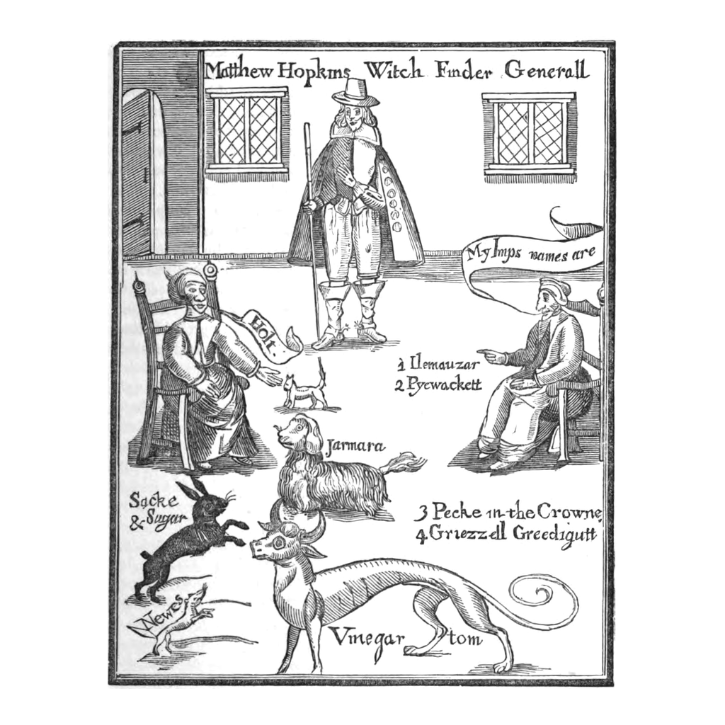
A Witch-Hunting Pamphlet (1647)
A 1647 pamphlet frontispiece: accused women and their supposed 'familiars'.
© More Lessons Less Planning | morelessonslessplanning.com
Notes:
This is the printed frontispiece to a real 1647 English witch-hunting pamphlet, 'The Discovery of Witches' by Matthew Hopkins, who called himself the 'Witch Finder General.' Use it simply to show how the idea of the FAMILIAR appeared in the printed materials of the time: it shows the witch-finder and two seated accused women, with small animals labeled with names, which accusers claimed were demons serving the women. Note honestly that this is a 17th-century printed illustration, not a photograph, and that it reflects the accusers' beliefs, not reality. It is a real historical document in the public domain. (This non-graphic pamphlet image deliberately replaces any graphic depiction of torture or execution.)

Slide 8
Who Was Accused?
Mostly women
The large majority of the accused were WOMEN, often older, poor, or widowed.
The scapegoat
A SCAPEGOAT is a person or group unfairly BLAMED for a community's misfortunes.
Outsiders and the vulnerable
Those with few defenders - midwives, healers, quarrelsome neighbors - were easiest to accuse.
Key Concept: Most of the accused were women, often poor or widowed - vulnerable SCAPEGOATS blamed for a community's misfortunes.
© More Lessons Less Planning | morelessonslessplanning.com
Notes:
Explain who was accused and why. The large majority of accused witches were WOMEN, and they were often older, poor, widowed, or living on the edges of their communities. Introduce the key term: a SCAPEGOAT is a person or group unfairly BLAMED for a community's misfortunes. Explain the pattern analytically: people with few defenders - widows, midwives, healers, or simply neighbors who had quarreled with the wrong person - were the easiest to accuse and the least able to fight back. Discuss with students why gender mattered: the manuals and preachers of the time often portrayed women as more easily tempted by the Devil, which made women far more likely to be accused. Present this as a historical pattern of prejudice and vulnerability, handled with respect for the victims.

Slide 9
How Accusations Began
An accusation often began with ordinary MISFORTUNE.
A frightened neighbor blamed a person they already disliked or feared.
RUMOR spread quickly, and old quarrels became 'proof' of witchcraft.
One accused person, under pressure, was made to name others.
In this way a single rumor could grow into a wave of accusations.
Key Concept: Accusations often began with ordinary MISFORTUNE and RUMOR, as neighbors blamed people they already feared or disliked.
© More Lessons Less Planning | morelessonslessplanning.com
Notes:
Explain how an accusation actually started. Most accusations began not with any crime but with ordinary MISFORTUNE: a child fell ill, cattle died, milk soured, or a harvest failed. A frightened person looked for a cause and blamed a neighbor they already disliked or feared. Explain how RUMOR did the rest: gossip spread quickly, and old quarrels or grudges were reinterpreted as evidence of witchcraft. Make the crucial process point for students: once one person was accused and pressured, they were often made to 'name' others, so a single rumor could grow into a wave of accusations that swept through a village. Present this as a chain of fear and social pressure - each step ordinary and human, and each step moving an innocent person closer to a courtroom.

Slide 10
The Legal Process of a Witch Trial
Inquisitorial trial
An INQUISITORIAL trial was a process in which officials both investigated and judged the accused.
The examination
The accused was questioned closely, and 'evidence' like a FAMILIAR or a confession was used against them.
A stacked system
The accused often had no lawyer and faced judges already convinced of their guilt.
Key Concept: In an INQUISITORIAL trial, the same officials investigated and judged the accused, who often had no defense.
© More Lessons Less Planning | morelessonslessplanning.com
Notes:
Explain the legal process - the heart of the lesson. Many witch trials used an INQUISITORIAL process, meaning the same officials both investigated the case and judged it, so the accused faced people who were often already convinced of their guilt. Walk students through what happened: the accused was arrested and examined - questioned closely before the court - and supposed 'evidence' was gathered against them. That 'evidence' might include the claim of a FAMILIAR (an animal said to be a demon), the testimony of frightened neighbors, or marks on the body said to be the Devil's. Make the analytical point: the accused usually had no lawyer, could not effectively challenge the accusations, and faced a system stacked against them. This is how ordinary fear became legal persecution: rumor entered a courtroom and came out as a verdict. The next slide shows a painting of such an examination.

Slide 11
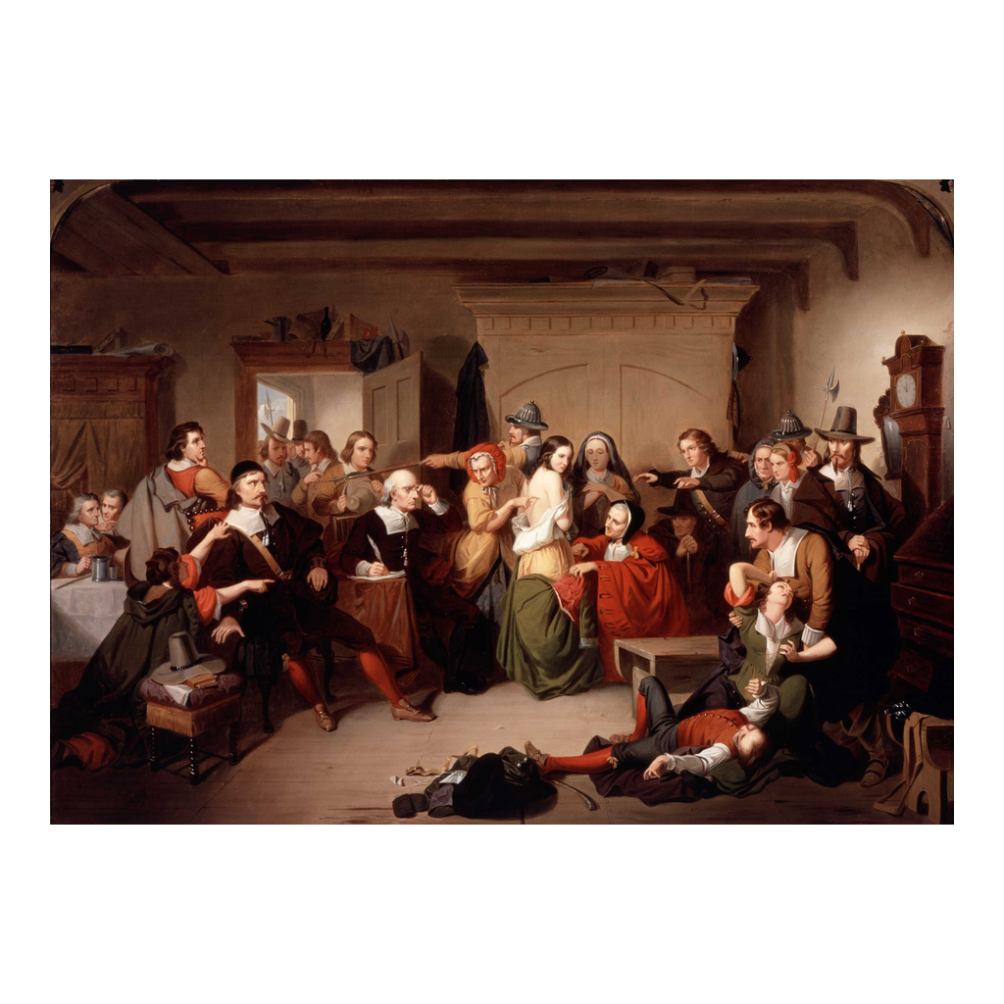
An Examination Before the Court
Matteson's 'Examination of a Witch' (1853): an accused woman before a court.
© More Lessons Less Planning | morelessonslessplanning.com
Notes:
This is a 19th-century history painting, 'Examination of a Witch' (1853) by T. H. Matteson, showing an accused woman standing before a group of examiners and townspeople during a witch trial. Use it to put a scene to the legal PROCESS students just studied: the accused, alone and without a defender, examined before a court that has already decided she is guilty. Note honestly that it is a painting made long after the events, not a photograph, and that the painter imagined the scene - but it captures the accusatory process accurately. It is a real historical painting in the public domain. (This non-graphic examination scene deliberately replaces any graphic depiction of torture or execution.)

Slide 12
Confession and the Problem of Torture
A CONFESSION was treated as the strongest proof of guilt in a witch trial.
In many regions, confessions were extracted under TORTURE or its threat.
People in pain will say whatever their questioners want to hear.
So these confessions are UNRELIABLE - they prove fear, not witchcraft.
Tortured people were often forced to name others, spreading the panic.
Key Concept: A CONFESSION was treated as proof, but confessions extracted under TORTURE are UNRELIABLE - they reveal fear, not guilt.
© More Lessons Less Planning | morelessonslessplanning.com
Notes:
Explain the central flaw in the system - handled clinically, without graphic detail. In witch trials a CONFESSION was treated as the strongest possible proof of guilt. But explain the fatal problem: in many parts of Europe, confessions were commonly extracted under TORTURE or the threat of it. TORTURE is the infliction of pain to force a confession or accusation, and it produced unreliable statements that fed still more accusations. Make the honesty anchor explicit for students: a person in pain or terror will say whatever their questioners want to hear, so these confessions are UNRELIABLE - they are evidence of fear and coercion, not of any real witchcraft. Add the process point: tortured people were often forced to name other 'witches,' which is how a single case could spread into a wave of accusations. Note fairly that some places (including England, where our primary source comes from) restricted judicial torture, but pressure, fear, and leading questions could still produce false confessions. Do NOT describe methods of torture - the point is the unreliability of coerced confession, not the suffering itself.

Slide 13
The Scale of the Hunts
Tens of thousands
Historians estimate roughly 40,000 to 60,000 people were EXECUTED as witches in Europe.
When and where
The hunts peaked between about 1560 and 1630 and were concentrated in certain regions, not everywhere.
Why numbers vary
Exact totals are UNCERTAIN because early-modern records are incomplete and estimates differ.
Key Concept: Historians estimate roughly 40,000-60,000 people were executed as witches, mostly between about 1560 and 1630.
© More Lessons Less Planning | morelessonslessplanning.com
Notes:
Give students a careful, honest sense of scale. Historians estimate that roughly 40,000 to 60,000 people were EXECUTED as witches across Europe over the whole period of the hunts. Explain when and where: the hunts were not constant or everywhere - they peaked roughly between 1560 and 1630 and were concentrated in certain regions (parts of the Holy Roman Empire were especially hard-hit), while some areas had very few trials. Be honest about the uncertainty: exact totals are UNCERTAIN because early-modern records are incomplete and historians' estimates differ. Explain why this matters for how we study history: we can be confident the hunts killed tens of thousands of innocent people, even though we cannot give a single exact number. Present the numbers soberly, as a measure of a human tragedy, not as a statistic for shock.

Slide 14
Why the Witch Hunts Ended
By the late 1600s, growing SKEPTICISM led people to doubt witch accusations.
Judges demanded higher standards of EVIDENCE for a conviction.
Many governments restricted or banned the use of torture in trials.
New thinking explained misfortune without blaming 'witches.'
Trials faded, and laws against witchcraft were eventually repealed.
Key Concept: Rising SKEPTICISM, higher standards of EVIDENCE, and legal reform brought the witch hunts to an end.
© More Lessons Less Planning | morelessonslessplanning.com
Notes:
Explain how the hunts ended - the hopeful, analytical close. By the late 1600s the witch hunts began to fade, and it is worth teaching students WHY. Growing SKEPTICISM - doubt about accepted claims - led more educated people, including some judges, to question whether witch accusations were real. Courts began to demand higher standards of EVIDENCE: vague rumor and confessions extracted under pressure were no longer accepted as proof. Many governments restricted or banned torture in trials, which removed the engine that had produced false confessions. New scientific and legal thinking offered other explanations for disease, weather, and misfortune, so people no longer needed to blame hidden witches. Over time, trials faded and the old laws against witchcraft were repealed. Make the point that matters: better evidence, doubt, and legal reform - not new 'proof' - are what ended the persecution.

Slide 15
How Do We Know? A Trial Pamphlet
Our primary source is a printed PAMPHLET about a 1566 English witch trial.
It records the questions, the TESTIMONY, and the confession from the courtroom.
We read it in a public-domain 1864 reprint, lightly modernized for readability.
It is a firsthand record of the legal process - not a modern summary.
Read it critically: it reflects the fears and beliefs of the accusers.
Tip: A trial PAMPHLET records the courtroom TESTIMONY - read it for how the process worked, not as proof that witchcraft was real.
© More Lessons Less Planning | morelessonslessplanning.com
Notes:
Set up the Primary Source Spotlight and teach how to read it. Our primary source is a printed PAMPHLET describing a real 1566 witch trial at Chelmsford in England - one of the earliest detailed English accounts of a witch trial. Explain what it contains: it records the questions the court asked, the TESTIMONY of witnesses, and the confession of the accused, straight from the courtroom. Students read it in a public-domain 1864 reprint (from the Philobiblon Society Miscellanies), lightly modernized for readability. Teach students what KIND of source this is: it is a firsthand record of the legal process, close to the events, not a modern historian's summary. But teach them to read it critically: the pamphlet reflects the fears and beliefs of the accusers and the court, so it shows us how the PROCESS worked and how fear became legal persecution - it is NOT evidence that witchcraft was real. A careful historian reads it for the process, not for the 'facts' of witchcraft.

Slide 16
Understanding the Witch Hunts as History
We study it as HISTORY
We respect the VICTIMS
We explain how FEAR and a flawed legal process led to persecution.
We remember there were no real witches - the accused were innocent.
The accused were real people wronged by their communities.
Understanding the causes helps us guard against panic and scapegoating.
Key Concept: We study the witch hunts analytically - explaining how FEAR and flawed process led to persecution - and we respect the VICTIMS.
© More Lessons Less Planning | morelessonslessplanning.com
Notes:
Model the honest, academic stance - this is the tone anchor for the whole lesson. Tell students plainly how we study a hard event like this. First, we study it as HISTORY: our job is to explain how FEAR, religious upheaval, and a flawed legal process combined to produce persecution - and to remember the honesty anchor, that there were no real witches and the accused were innocent people. Second, we respect the VICTIMS: the accused were real human beings - mostly women, often poor or vulnerable - who were wronged by their own communities and courts, not characters in a spooky story. Third, we study the causes because understanding how fear and scapegoating turn into persecution helps societies recognize and resist the same pattern today. Remind students that the value of studying the witch hunts is not to be entertained by them, but to understand a real human tragedy so we can guard against panic and injustice.

Slide 17
Key Takeaways
The WITCH HUNTS grew out of Reformation-era FEAR and religious upheaval.
★
Manuals like the MALLEUS MALEFICARUM spread the idea of witchcraft.
★
Most of the accused were women - vulnerable SCAPEGOATS blamed for misfortune.
★
A flawed legal process turned rumor and coerced CONFESSION into 'proof.'
★
Tens of thousands were executed, though there were no real witches.
★
Rising SKEPTICISM and legal reform finally ended the hunts.
★
© More Lessons Less Planning | morelessonslessplanning.com
Notes:
Close the loop and hold the analytical frame. If students remember a few things, make them these. The European WITCH HUNTS grew out of Reformation-era FEAR and religious upheaval - an age of plague, war, and religious division in which frightened communities looked for someone to blame. Witch-hunting manuals like the MALLEUS MALEFICARUM spread the idea of an organized witchcraft conspiracy. Most of the accused were women, often poor or widowed - vulnerable SCAPEGOATS blamed for misfortune. A flawed legal process turned rumor, neighbors' testimony, and CONFESSIONS extracted under pressure into 'proof,' and tens of thousands of innocent people were executed. In the end, rising SKEPTICISM, higher standards of evidence, and legal reform brought the hunts to an end. We study all of this carefully, as history, to understand how fear and scapegoating became persecution - and to respect the victims.

