Slide 1
The Dual Mandate: Jobs vs Prices
When jobs and prices pull in opposite directions, what does the Fed do?
© More Lessons Less Planning | morelessonslessplanning.com
Notes:
Open with the conflict. The Fed has TWO legal goals - maximum employment and stable prices. Most of the time those goals point in the same direction. But sometimes they conflict, and the Fed has to choose. The 2022 hike cycle is the cleanest recent example: inflation peaked at 9.1% in June 2022 while unemployment was just 3.6%. To bring inflation down the Fed had to slow the economy - knowing that would push unemployment up. Today: where the dual mandate came from, how the Phillips curve framed the trade-off, when goals align, when they conflict, and what the modern Fed framework looks like.

Slide 2
Learning Targets
State the Fed's dual mandate (employment + prices) and its statutory origin
★
Explain the Phillips curve trade-off and why it broke down in the 1970s
★
Evaluate Fed decisions when jobs and inflation pull in opposite directions
★
© More Lessons Less Planning | morelessonslessplanning.com
Notes:
Read the three targets aloud. T1 (state the dual mandate) is the conceptual frame - students need to know it is two goals, set by Congress in 1977-1978. T2 (the Phillips curve) is the analytical tool - the original 1958 trade-off and its 1970s breakdown. T3 (evaluate Fed decisions) is the cognitive payoff - students will judge the 2022 hike cycle as advisor to the FOMC.

Slide 3
The Dual Mandate - Maximum Employment + Stable Prices
Mandate 1: Maximum Employment
Mandate 2: Stable Prices
Lowest unemployment rate consistent with stable prices
Not zero unemployment - workers always between jobs
Fed estimates natural rate (u*) at about 4.0-4.5%
Unemployment below u* pushes inflation UP
Operationally defined as 2% annual PCE inflation
PCE = Personal Consumption Expenditures (Fed's measure)
Adopted 2% target formally in January 2012
Core PCE strips out volatile food and energy
Key Concept: Maximum employment and stable prices are EQUAL in the law - neither outranks the other. The Fed must pursue both.
© More Lessons Less Planning | morelessonslessplanning.com
Notes:
The Fed's dual mandate has TWO equal goals. Mandate 1: maximum employment - the lowest unemployment rate consistent with stable prices. Not zero, because some unemployment is natural (workers between jobs, new graduates, structural changes). The Fed estimates the natural rate (u*) at about 4.0-4.5% currently. Mandate 2: stable prices - operationally defined since 2012 as 2% annual PCE inflation. PCE is the Personal Consumption Expenditures price index, which the Fed prefers over CPI for measuring inflation. The two mandates are EQUAL in law - the Fed cannot privilege one over the other indefinitely.

Slide 4
The Humphrey-Hawkins Act 1978 - Origin of the Dual Mandate
1913 - Federal Reserve Act
Created the Fed but did NOT specify dual goals
✔
1977 - Federal Reserve Reform Act
Congress first wrote DUAL goals into law
✔
1978 - Humphrey-Hawkins Act
Locked in dual mandate; requires twice-yearly Congress report
✔
Co-sponsors: Humphrey + Hawkins
Both Democrats focused on 1970s unemployment
✔
Why dual instead of single?
Congress wanted the Fed to care about BOTH goals
✔
Key Concept: The dual mandate is a STATUTORY requirement set by Congress in 1977-1978, not a Fed policy choice.
© More Lessons Less Planning | morelessonslessplanning.com
Notes:
The dual mandate was NOT in the original 1913 Federal Reserve Act - which left the Fed's mission vague for 60+ years. Congress wrote dual goals into law in TWO steps. The 1977 Federal Reserve Reform Act first introduced 'maximum employment, stable prices, and moderate long-term interest rates' as Fed goals. The 1978 Humphrey-Hawkins Act (the Full Employment and Balanced Growth Act) locked it in and required the Fed Chair to report to Congress twice a year (February and July) on progress toward both goals. Senator Hubert Humphrey and Representative Augustus Hawkins were responding to BOTH the unemployment AND inflation pain of the 1970s. The dual mandate is a STATUTORY requirement - the Fed cannot legally choose to pursue only one goal.

Slide 5
The Phillips Curve - Jobs vs Inflation Trade-off
What Phillips Found (1958)
Why It Mattered to the Fed
Studied UK wage inflation vs unemployment 1861-1957
Found: low unemployment came with high wage inflation
Downward-sloping curve in u-rate / inflation space
Implied a short-run trade-off the Fed could exploit
If trade-off is real, Fed PICKS a point on the curve
Pick low u-rate -> accept higher inflation
Pick low inflation -> accept higher u-rate
1960s Fed policy assumed this trade-off was stable
Key Concept: The Phillips curve is the original short-run trade-off - low unemployment AND low inflation seemed impossible at the same time.
© More Lessons Less Planning | morelessonslessplanning.com
Notes:
A.W. Phillips (1958, LSE) studied 100 years of UK wage data and found that low unemployment came with high wage inflation - the relationship traced a downward-sloping curve. Other economists extended it from wages to CPI inflation. The implication: there is a short-run TRADE-OFF between unemployment and inflation, so the Fed could choose a point on the curve. Lower unemployment? Accept higher inflation. Lower inflation? Accept higher unemployment. Through the 1960s the Fed treated this trade-off as stable. The next slide shows the actual 1960s-1970s data (see the Phillips curve chart, scatter of U.S. data 1961-1980).

Slide 6
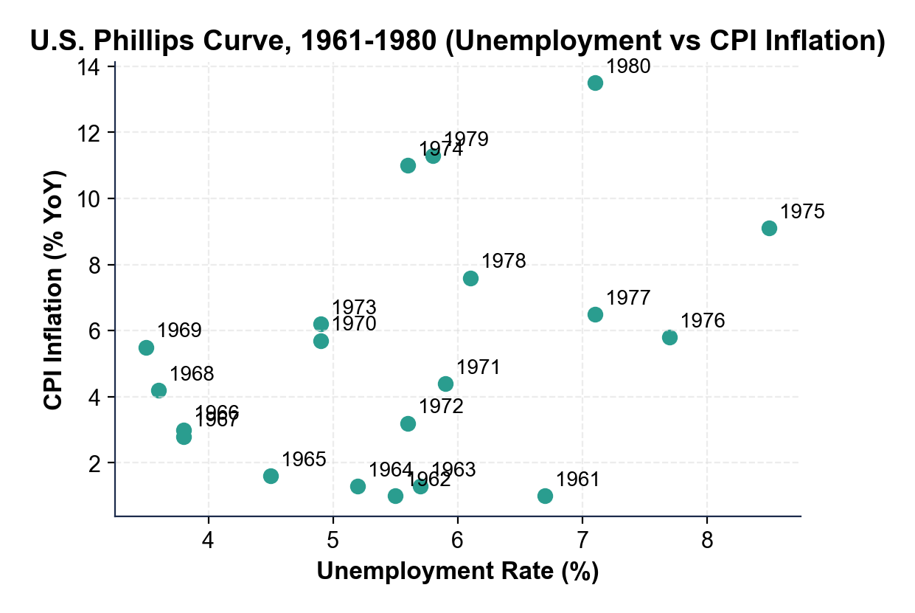
Note: Phillips Curve - U.S. Unemployment vs Inflation, 1961-1980
Phillips curve held in the 1960s; broke down in the 1970s (stagflation).
© More Lessons Less Planning | morelessonslessplanning.com
Notes:
Have students trace the cluster of 1961-1973 points - those years FOLLOW the Phillips curve (low unemployment paired with high inflation). Then point out the 1974-1980 cluster, which BREAKS the curve - those years have BOTH high unemployment AND high inflation (stagflation). The 1980 data point sits at about 7% unemployment with 13.5% inflation - in the OPPOSITE corner from where the Phillips curve said it should be. The chart visually proves that the simple short-run trade-off is not stable across decades.
Reference labels (point to these chart features when teaching): 1961-1973 downward curve; 1974-1980 stagflation cluster

Slide 7
When Goals Align - 1990s and 2010s
Late 1990s
2010s Recovery
Unemployment fell from 7.5% (1992) to 3.9% (2000)
Inflation stayed BELOW 3% the entire decade
Productivity boom kept both goals satisfied
Fed under Alan Greenspan held rates steady
Unemployment fell from 9.9% (2009) to 3.5% (Feb 2020)
Inflation stayed BELOW 2.5% almost every year
Fed could keep rates LOW with both goals OK
Yellen and Powell raised rates gradually after 2015
Key Concept: When goals align, the Fed's job is easy - both mandates point the same direction.
© More Lessons Less Planning | morelessonslessplanning.com
Notes:
When the dual mandate's two halves point the SAME direction, the Fed's policy choices are easy. Two clean examples. Late 1990s: unemployment fell from 7.5% (1992) to 3.9% by 2000 while inflation stayed below 3% the whole decade. The productivity boom let the economy run hot WITHOUT triggering inflation. Fed Chair Alan Greenspan let the expansion continue. 2010s recovery: unemployment fell from 9.9% (Oct 2009) to a 50-year low of 3.5% in February 2020 while inflation stayed below 2.5% almost every year. The Fed kept rates near zero through 2015 and raised them only gradually after that. Both decades show that when goals align, the dual mandate is straightforward.

Slide 8
When Goals Conflict - 1970s Stagflation and 2022 Inflation
1970s Stagflation
2022 Inflation Surge
OPEC oil shocks 1973 and 1979 - supply-side inflation
Both unemployment AND inflation spiked together
1980 reading: about 7% u-rate with 13.5% CPI
Volcker pushed fed funds to 20% to break inflation
CPI peaked at 9.1% in June 2022
Unemployment at 3.6% - BELOW the natural rate
Both goals demanded OPPOSITE Fed responses
Fed chose to fight inflation - 11 hikes in 16 months
Key Concept: When goals conflict, the Fed must CHOOSE which mandate to prioritize. Volcker chose prices; Powell chose prices.
© More Lessons Less Planning | morelessonslessplanning.com
Notes:
When the two mandates point in OPPOSITE directions, the Fed has to choose. Textbook cases. 1970s stagflation: OPEC oil price shocks (1973, 1979) drove inflation up while unemployment also rose - supply-side inflation that broke the Phillips curve. The 1980 reading was about 9% unemployment with 13% CPI inflation - both in crisis territory. Fed Chair Paul Volcker chose to break inflation - he pushed the federal funds rate to 20% in 1980-1981, triggered the 1981-82 recession that drove unemployment to 10.8%, but inflation fell from 13% to under 3%. The 2022 case: CPI peaked at 9.1% in June 2022 while unemployment was just 3.6% - far below the Fed's natural-rate estimate. The Fed chose to fight inflation - 11 rate hikes in 16 months took the federal funds rate from 0.25% to 5.50%. See the unemployment-vs-inflation scatter chart (2015-2026 U.S. data) on the next slide.

Slide 9
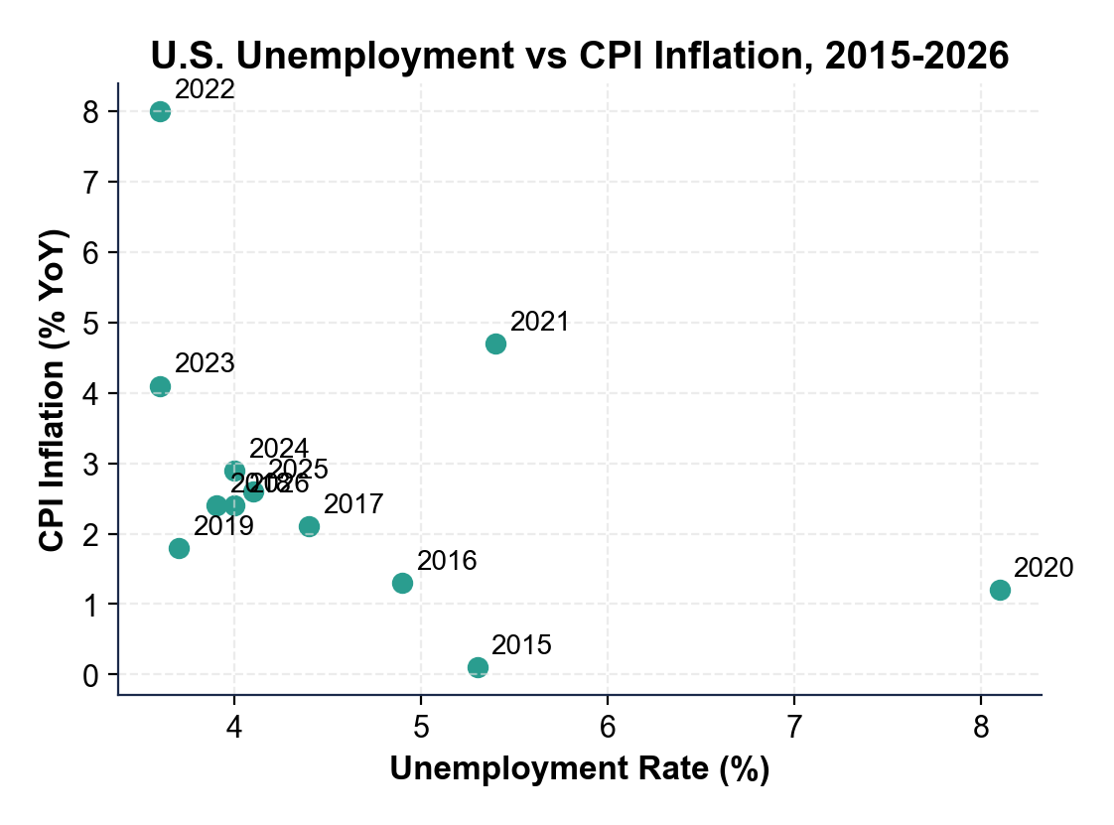
Note: U.S. Unemployment vs Inflation, 2015 - 2026
Most years cluster low/low. 2022 is the outlier - both rising together.
© More Lessons Less Planning | morelessonslessplanning.com
Notes:
Have students locate the 2022 point on the scatter. Most years (2015-2019, 2023-2026) cluster in the low-unemployment, low-inflation corner. The 2020 pandemic point is high unemployment + low inflation (one normal direction). But 2022 is the OUTLIER - 3.6% unemployment AND 8.0% CPI inflation (annual average). That is the goals-conflict point - both mandates demanding opposite responses. The chart visually drives home why the Fed had to choose, and why the 2022 hike cycle was so aggressive.
Reference labels (point to these chart features when teaching): 2015-2019: low / low cluster; 2022 outlier: 3.6% / 8% CPI

Slide 10
Modern Fed Framework - Average Inflation Targeting (2020)
Old Rule (1996-2020)
New Rule (Aug 2020)
Strict 2% inflation ceiling
Fed hiked rates BEFORE inflation hit 2%
Bias toward preempting inflation
Critics: cost too many jobs in slow recoveries
2% on AVERAGE over time, not a ceiling
Fed allows inflation to overshoot 2% briefly
Make up for periods of below-2% inflation
More patience before hiking; jobs-friendly
Key Concept: Average inflation targeting (AIT) tilts the dual mandate slightly toward MAXIMUM EMPLOYMENT - the Fed waits longer before hiking.
© More Lessons Less Planning | morelessonslessplanning.com
Notes:
August 2020 - Powell announced a major framework shift at Jackson Hole. The old rule (in effect since the 1996 implicit target and the 2012 formal target) treated 2% as a CEILING - the Fed would hike rates as soon as inflation got close to 2%. The new rule is AVERAGE INFLATION TARGETING (AIT): 2% on average over time. If inflation has been BELOW 2% for years (which it was 2010-2020), the Fed will LET inflation run modestly above 2% to make up for the shortfall. Critics argue AIT contributed to the Fed being SLOW to hike in 2021-2022, allowing inflation to surge to 9.1%. Defenders argue AIT correctly tilted the Fed toward MAXIMUM EMPLOYMENT and is the right framework when goals usually align.

Slide 11
Case Study - The 2022 Hike Cycle Decision
9.1%
3.6%
5.25 pp
Peak CPI, Jun 2022
Unemployment, Jun 2022
Total hikes 2022-23
Did You Know? Powell explicitly cited Volcker as the model - 'we must keep at it until the job is done' (Aug 2022 Jackson Hole).
© More Lessons Less Planning | morelessonslessplanning.com
Notes:
The 2022 hike cycle is the cleanest recent case of dual-mandate conflict. March 2022: federal funds rate at 0.00-0.25% (still pandemic-emergency level) while CPI inflation was already 8.5% and rising. Unemployment was 3.6% - below the Fed's natural-rate estimate of 4.0-4.5%. Mandates pulled OPPOSITE ways: prices said HIKE aggressively; jobs said HOLD or even CUT. The FOMC chose prices. The Fed hiked 11 times in 16 months, taking the federal funds rate from 0.25% to 5.50% by July 2023 - the fastest hike cycle since Volcker. Result so far: CPI fell from 9.1% (Jun 2022) to 3.0% (Jun 2023) - inflation broken. Unemployment rose only modestly to about 4.0% - no recession yet. Powell explicitly cited Volcker at his August 2022 Jackson Hole speech: 'We must keep at it until the job is done.' Whether this counts as a SOFT LANDING is still debated in 2026.

Slide 12
Key Takeaways
Dual mandate = maximum employment + stable prices, set by Humphrey-Hawkins 1978
★
Phillips curve found a short-run trade-off - broke down with 1970s stagflation
★
Goals align most of the time (1990s, 2010s) - Fed's job is easy then
★
Goals conflict in supply-shock periods (1970s, 2022) - Fed must choose
★
Modern framework: average inflation targeting (2020); 2022 prioritized prices
★
© More Lessons Less Planning | morelessonslessplanning.com
Notes:
Read each takeaway and connect to learning targets. T1 (state the dual mandate + origin) -> takeaways 1 and 2. T2 (Phillips curve + breakdown) -> takeaways 2 and 4. T3 (evaluate Fed decisions when goals conflict) -> takeaways 4 and 5. Tell students the activity puts them in the FOMC advisor seat in March 2022 - they will read the same data Powell read, weigh both mandates, and recommend a policy path.

