Slide 1
The Declaration of Independence
How the Declaration turned Enlightenment natural-rights theory into a real revolutionary act
© More Lessons Less Planning | morelessonslessplanning.com
Notes:
Open with the lesson question: where do a person's rights come from, and what gives a people the right to break away and form a new government? Preview the answer: the Declaration took Enlightenment natural-rights ideas and made them the basis of a revolution.

Slide 2
Learning Targets
Explain the Enlightenment natural-rights ideas that shaped the Declaration
★
Identify Jefferson as drafter and the Continental Congress as adopter (1776)
★
Explain the Declaration's claims: all men created equal and unalienable rights
★
Explain consent of the governed and the right to alter or abolish government
★
Explain how the Declaration turned philosophy into a revolutionary act
★
© More Lessons Less Planning | morelessonslessplanning.com
Notes:
The five targets keep the lesson centered: the Enlightenment ideas behind the document, who wrote and adopted it, its core claims, the consent and revolution principles, and the big picture that philosophy became a political act.

Slide 3
The Enlightenment Idea of Natural Rights
Enlightenment thinkers argued that all people are born with natural rights.
The philosopher John Locke named these rights life, liberty, and property.
Locke said government exists to protect these rights.
He argued that a government's power comes from the consent of the governed.
These ideas set the stage for the American Revolution.
Key Concept: Enlightenment natural-rights theory said people are born with rights and that government exists to protect them.
© More Lessons Less Planning | morelessonslessplanning.com
Notes:
Enlightenment thinkers argued that all people are born with natural rights. The English philosopher John Locke named these rights life, liberty, and property, and said government exists to protect them. Locke also argued that a government's power comes from the consent of the governed. These ideas set the stage for the American Revolution.

Slide 4
The Road to Revolution
Growing Anger
The Breaking Point
Britain taxed the colonies without their consent
Colonists had no representatives in Parliament
The cry became 'no taxation without representation'
Britain sent troops and closed the port of Boston
In 1775 fighting began at Lexington and Concord
By 1776 many colonists wanted full independence
Key Concept: Colonists came to believe Britain was violating their rights, which pushed them toward independence.
© More Lessons Less Planning | morelessonslessplanning.com
Notes:
Britain taxed the colonies without their consent, and the colonists had no representatives in Parliament, so their cry became 'no taxation without representation.' Britain sent troops and closed the port of Boston. In 1775 fighting began at Lexington and Concord, and by 1776 many colonists wanted full independence.

Slide 5
Who Wrote the Declaration?
In 1776 the Continental Congress met in Philadelphia.
It chose a committee to write a declaration of independence.
Thomas Jefferson was the principal drafter of the document.
The Continental Congress then debated, edited, and adopted it.
Jefferson built the Declaration on Enlightenment natural-rights ideas.
Key Concept: Thomas Jefferson drafted the Declaration, and the Continental Congress adopted it in 1776.
© More Lessons Less Planning | morelessonslessplanning.com
Notes:
In 1776 the Continental Congress met in Philadelphia and chose a committee to write a declaration of independence. Thomas Jefferson was the principal drafter of the document. The Continental Congress then debated, edited, and adopted it. Jefferson built the Declaration on Enlightenment natural-rights ideas.

Slide 6
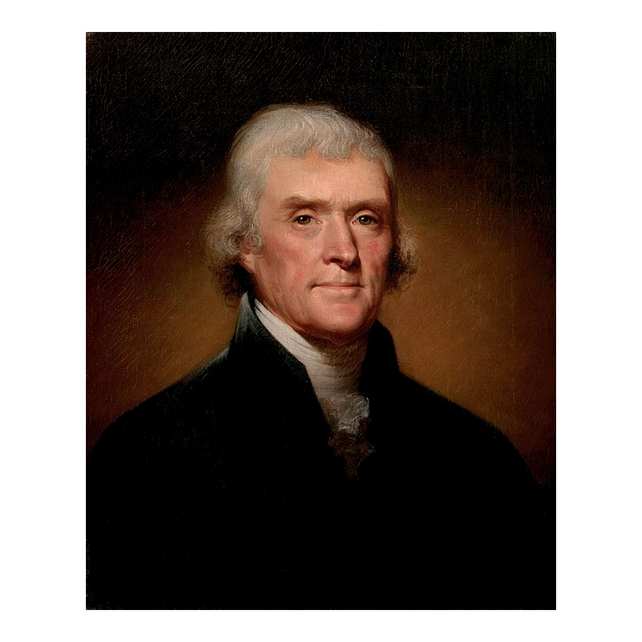
Thomas Jefferson, principal drafter of the Declaration
Thomas Jefferson, portrait by Rembrandt Peale (1800)
© More Lessons Less Planning | morelessonslessplanning.com
Notes:
This is a period portrait of Thomas Jefferson painted by Rembrandt Peale in 1800. Use it as a historical reference image to picture the Declaration's principal drafter, not as evidence for any idea.

Slide 7
The Preamble: A People's Right to Separate
The Declaration opens with a preamble, or introduction.
It says one people may sometimes dissolve the political bands with another.
It appeals to 'the Laws of Nature and of Nature's God.'
It promises to declare the causes that led to separation.
This lays out reasons for independence to 'a candid world.'
Key Concept: The preamble explains why the colonies believed they had the right to separate from Britain.
© More Lessons Less Planning | morelessonslessplanning.com
Notes:
The Declaration opens with a preamble, or introduction. It says that sometimes one people must dissolve the political bands with another, and it appeals to 'the Laws of Nature and of Nature's God.' It promises to declare the causes that led to separation, laying out reasons for independence to 'a candid world.'

Slide 8
Self-Evident Truths: All Men Are Created Equal
Truths Held Self-Evident
Unalienable Rights
The Declaration calls certain truths self-evident
Self-evident means obvious and needing no proof
It states that all men are created equal
People are 'endowed by their Creator' with unalienable rights
Unalienable rights cannot be taken away or given up
Among them are life, liberty, and the pursuit of happiness
Key Concept: The Declaration says all people are created equal and have unalienable rights that cannot be taken away.
© More Lessons Less Planning | morelessonslessplanning.com
Notes:
The Declaration calls certain truths self-evident, meaning obvious and needing no proof, and states that all men are created equal. It says people are endowed by their Creator with unalienable rights, which cannot be taken away or given up. Among them are life, liberty, and the pursuit of happiness.

Slide 9
Life, Liberty, and the Pursuit of Happiness
Locke had named the natural rights as life, liberty, and property.
Jefferson adapted this into life, liberty, and the pursuit of happiness.
This shows Enlightenment philosophy turned into a political document.
The switch from 'property' to 'the pursuit of happiness' was Jefferson's.
Jefferson adapted Locke's ideas; he did not copy them word for word.
Key Concept: Jefferson adapted Locke's 'life, liberty, and property' into 'life, liberty, and the pursuit of happiness.'
© More Lessons Less Planning | morelessonslessplanning.com
Notes:
Locke had named the natural rights as life, liberty, and property. Jefferson adapted this into life, liberty, and the pursuit of happiness, which shows Enlightenment philosophy turned into a political document. The change from 'property' to 'the pursuit of happiness' was Jefferson's wording. Jefferson adapted Locke's ideas rather than copying them word for word.

Slide 10
Consent of the Governed
Where Power Comes From
Why It Matters
Governments are instituted to secure people's rights
They derive their just powers from the consent of the governed
This means power comes from the people, not a king
A ruler's power is legitimate only with the people's agreement
The colonists said Britain ruled them without their consent
This idea overturned the divine right of kings
Key Concept: The Declaration says a government's just powers come from the consent of the governed.
© More Lessons Less Planning | morelessonslessplanning.com
Notes:
The Declaration says governments are instituted to secure people's rights and derive their just powers from the consent of the governed. This means power comes from the people, not a king. A ruler's power is legitimate only with the people's agreement. The colonists said Britain ruled them without their consent, and this idea overturned the divine right of kings.

Slide 11
The Right to Alter or Abolish Government
When Government Fails
A New Government
The Declaration says government must protect people's rights
When a government becomes destructive of these ends, it fails
Then it is the right of the people to alter or abolish it
The people may then institute a new government
This idea is called the right of revolution
It echoes John Locke's argument about broken government
Key Concept: When a government becomes destructive of people's rights, the people have the right to alter or abolish it.
© More Lessons Less Planning | morelessonslessplanning.com
Notes:
The Declaration says government must protect people's rights, and when a government becomes destructive of these ends, it fails. Then it is the right of the people to alter or abolish it and to institute a new government. This idea is called the right of revolution, and it echoes John Locke's argument about broken government.

Slide 12
Grievances Against King George III
To prove its case, the Declaration lists grievances, or complaints.
Grievance: the king imposed taxes on the colonists without their consent.
Grievance: he dissolved colonial representative houses.
Grievance: he kept standing armies among them in peacetime.
These specific complaints justified the colonies' break with Britain.
Key Concept: The Declaration lists grievances against King George III to justify separation.
© More Lessons Less Planning | morelessonslessplanning.com
Notes:
To prove its case, the Declaration lists grievances, or complaints, against King George III. Three examples: the king imposed taxes on the colonists without their consent; he dissolved colonial representative houses; and he kept standing armies among them in peacetime. These specific complaints justified the colonies' break with Britain.

Slide 13
Adopting and Signing the Declaration
On July 4, 1776, the Continental Congress adopted the Declaration.
John Hancock signed first; most delegates signed later, on August 2, 1776.
The signers pledged their lives, fortunes, and sacred honor.
The document announced the United States as an independent nation.
It made Enlightenment natural-rights theory a real revolutionary act.
Key Concept: On July 4, 1776, the Continental Congress adopted the Declaration, turning philosophy into a revolutionary act.
© More Lessons Less Planning | morelessonslessplanning.com
Notes:
On July 4, 1776, the Continental Congress ADOPTED the Declaration. The formal signing of the official (engrossed) copy came later — John Hancock signed first, in large, bold handwriting, on August 2, 1776, and most delegates signed that day. The signers pledged their lives, fortunes, and sacred honor. The document announced the United States as an independent nation and made Enlightenment natural-rights theory a real revolutionary act.

Slide 14
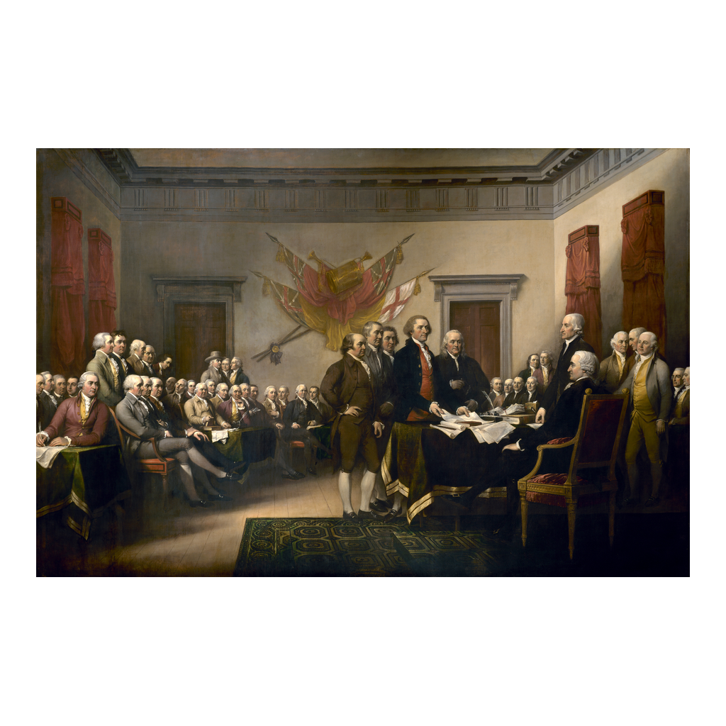
John Trumbull, Declaration of Independence (1818)
John Trumbull, Declaration of Independence (1818), U.S. Capitol Rotunda
© More Lessons Less Planning | morelessonslessplanning.com
Notes:
This is John Trumbull's painting Declaration of Independence, completed in 1818 and displayed in the U.S. Capitol Rotunda. It imagines the drafting committee presenting the document to the Continental Congress. Use it as a historical reference image, not as a photograph of the real event.

Slide 15
Reference Guide: The Declaration's Core Ideas
Declaration of Independence
The 1776 document that announced the colonies' break from Britain.
Thomas Jefferson
The principal drafter of the Declaration of Independence.
natural rights
Rights people have simply because they are human, not granted by a government.
unalienable rights
Rights that cannot be taken away or given up.
consent of the governed
The idea that a government's just powers come from the people's agreement.
Tip: These five terms name the document, its author, and the rights at its heart.
© More Lessons Less Planning | morelessonslessplanning.com
Notes:
Review the five terms exactly as defined: Declaration of Independence, Thomas Jefferson, natural rights, unalienable rights, and consent of the governed. Students use these definitions to complete the Reference Guide in the Activity.

Slide 16
Reference Guide: From Philosophy to Revolution
self-evident truths
Truths the Declaration says are obvious and need no proof.
right of revolution
The people's right to alter or abolish a government that destroys their rights.
Continental Congress
The delegates from the thirteen colonies who adopted the Declaration in 1776.
grievances
The complaints the Declaration lists against King George III.
life, liberty, and the pursuit of happiness
The three unalienable rights the Declaration names.
Tip: These five terms name the Declaration's claims, the people's last resort, and who adopted it.
© More Lessons Less Planning | morelessonslessplanning.com
Notes:
Review the five terms exactly as defined: self-evident truths, right of revolution, Continental Congress, grievances, and life, liberty, and the pursuit of happiness. Students use these definitions to complete the Reference Guide in the Activity.

Slide 17
Key Takeaways
The Declaration turned natural-rights theory into a real revolutionary act.
★
It says all men are created equal and have unalienable rights.
★
Governments derive their just powers from the consent of the governed.
★
When a government destroys rights, the people may alter or abolish it.
★
Jefferson drafted it; the Continental Congress adopted it on July 4, 1776.
★
© More Lessons Less Planning | morelessonslessplanning.com
Notes:
Close with the essential question. Each takeaway connects the Declaration's core claims to the Enlightenment ideas behind it, the consent principle, the right of revolution, and the basic facts of who wrote and adopted it.

