Slide 1
The Debt Snowball vs Avalanche: Paying It Off
You have several debts and some extra money to pay them down faster - but which debt do you attack first? The DEBT SNOWBALL says pay your SMALLEST BALANCE first for a quick motivating win. The DEBT AVALANCHE says pay your HIGHEST INTEREST RATE first to save the most money. Tessa Brooks has three debts - a $1,000 store card at 26%, a $600 medical bill at 8%, and a $3,000 car loan at 14% - and $200 extra each month. This lesson shows how to list your debts, find the payoff ORDER for each method, compare the total interest each one costs, and choose the method that fits you.
© More Lessons Less Planning | morelessonslessplanning.com
Notes:
Open with the choice every borrower with more than one debt faces: which debt do you pay off first? Two popular strategies give opposite answers. The DEBT SNOWBALL says line up your debts from smallest balance to largest and attack the smallest first - you pay it off fast, feel a win, and stay motivated. The DEBT AVALANCHE says line up your debts from highest interest rate (APR) to lowest and attack the highest-rate debt first - it saves the most money because the most expensive debt is gone soonest. Students follow Tessa Brooks, who has three debts: a $1,000 store card at 26% APR, a $600 medical bill at 8% APR, and a $3,000 car loan at 14% APR, plus $200 extra a month to throw at her debt. The insight students must leave with: both methods pay off all the debt, but they pay it in a different ORDER, and that order changes how much total interest you pay. The avalanche saves the most money (about $90 less interest here); the snowball pays off a debt sooner for motivation. As the seventh toolkit of Unit 5, this builds on what a loan is (TK41), interest and APR (TK42), and the costs of borrowing, turning the focus to the smart way to get OUT of debt.

Slide 2
Learning Targets
Define the debt snowball, the debt avalanche, payoff order, and motivation
★
List a set of debts and find the payoff order for the snowball and the avalanche
★
Read a bar chart comparing the total interest paid by each method
★
Compare motivation vs math and choose the method that is right for you
★
© More Lessons Less Planning | morelessonslessplanning.com
Notes:
Read the four targets aloud. Tell students the lesson follows Tessa Brooks, who has three debts (a $1,000 store card at 26% APR, a $600 medical bill at 8% APR, and a $3,000 car loan at 14% APR) and $200 extra a month. Target 1 is the vocabulary: the DEBT SNOWBALL pays the SMALLEST BALANCE first, the DEBT AVALANCHE pays the HIGHEST INTEREST RATE first, PAYOFF ORDER is the sequence you pay debts in, and MOTIVATION is the early-win drive the snowball is built around. Target 2 is the skill of listing every debt and putting it in the right order for each method - by balance for the snowball, by APR for the avalanche. Target 3 is reading a bar chart that compares the TOTAL INTEREST each method costs for the same scenario (snowball about $698, avalanche about $608). Target 4 is the judgment call: the avalanche wins on math (saves the most money) and the snowball wins on motivation (a fast first win), so students learn to choose the method that fits the person and situation. The monthly-interest model (interest = balance x APR/12) is treated as a labeled foundational model students use to see WHY the order matters.

Slide 3
Paying Off Debt: Which One First?
The problem: more than one debt
Two strategies, opposite answers
Most people owe several debts at once - a card, a bill, a loan
You can only put so much EXTRA toward debt each month
Tessa has $200 extra a month and three debts to clear
So which debt do you attack first with that extra $200?
DEBT SNOWBALL: attack the SMALLEST BALANCE first (for motivation)
DEBT AVALANCHE: attack the HIGHEST INTEREST RATE first (for math)
Both pay minimums on every debt and roll the extra to one target
Same debts, same $200 - only the PAYOFF ORDER is different
Key Concept: When you owe several debts, the order matters. The SNOWBALL targets the smallest balance; the AVALANCHE targets the highest APR.
© More Lessons Less Planning | morelessonslessplanning.com
Notes:
Set up the whole lesson. Almost everyone with debt owes more than one thing at once - a credit or store card, a medical or utility bill, a car loan - and there is only so much extra money to put toward them each month. Tessa Brooks has $200 extra a month and three debts: a $1,000 store card at 26% APR, a $600 medical bill at 8% APR, and a $3,000 car loan at 14% APR. The question the lesson answers: which debt should she attack first with that extra $200? Two well-known strategies give opposite answers. The DEBT SNOWBALL says attack the SMALLEST BALANCE first - here, the $600 medical bill - so you clear a whole debt quickly and feel a motivating win. The DEBT AVALANCHE says attack the HIGHEST INTEREST RATE first - here, the 26% store card - because the most expensive debt is costing you the most, so killing it first saves the most money. In BOTH methods you keep paying the minimum on every debt; the only thing that changes is which debt gets the extra $200 first - that is the PAYOFF ORDER. The next slide shows the punchline as a chart: same debts, same $200 a month, but the two orders cost different amounts of total interest.

Slide 4
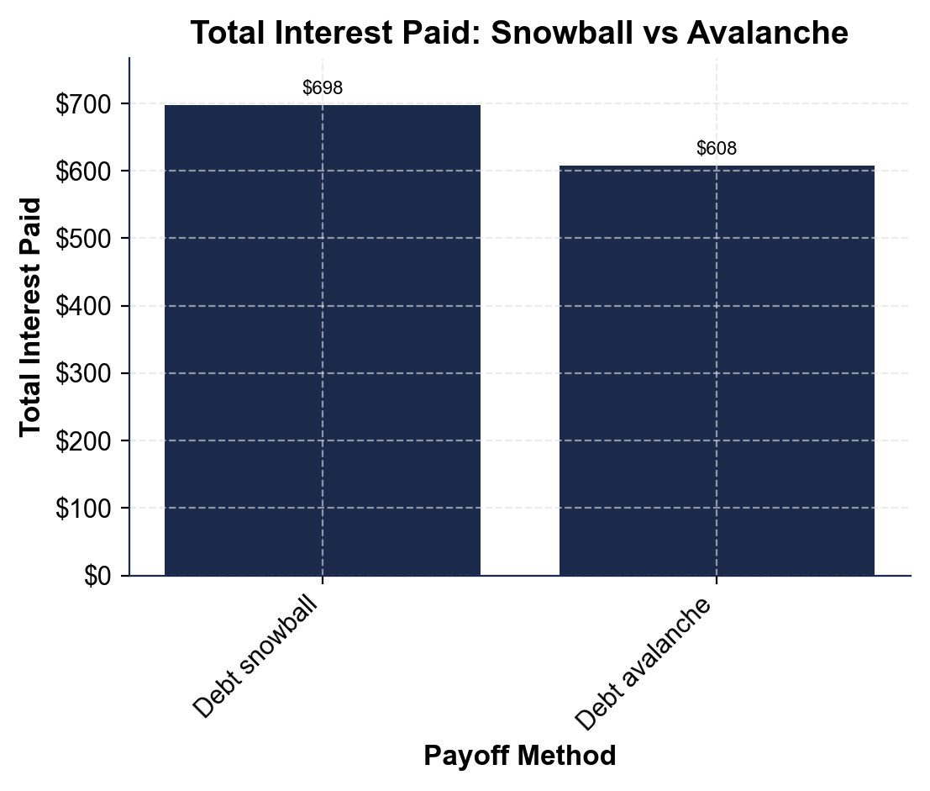
Total Interest Paid: Snowball vs Avalanche
Same debts, same $200/month - the avalanche pays less total interest.
© More Lessons Less Planning | morelessonslessplanning.com
Notes:
Have students read the bar chart. The x-axis lists the two payoff methods - the debt snowball and the debt avalanche - and the y-axis is the TOTAL INTEREST PAID in dollars until every debt is gone. Both bars use Tessa's exact same three debts (store card $1,000 at 26%, medical $600 at 8%, car loan $3,000 at 14%) and the exact same $200 extra each month - the ONLY difference is the order the debts are paid. The snowball bar is about $698 and the avalanche bar is about $608, so the avalanche saves about $90 in total interest. The reason: the snowball pays the small $600 medical bill first (a fast motivating win), which leaves the 26% store card sitting there accruing interest longer; the avalanche kills the 26% store card first, so the most expensive debt is gone soonest and less interest piles up. This is the chart Activity Part 3 reads. The takeaway the bars show: when the debts and the extra payment are identical, choosing the avalanche's order saves money - the snowball's edge is motivation, not dollars.
Reference labels (point to these chart features when teaching): Snowball ~$698; Avalanche ~$608

Slide 5
Step 1: List All Your Debts
Write down every debt you owe
List each debt with its BALANCE and its APR - Tessa: store card $1,000 / 26%, medical $600 / 8%, car loan $3,000 / 14%
✔
Note the minimum payment on each
Pay the MINIMUM PAYMENT on every debt each month in both methods, so no debt falls behind
✔
Find your extra money
Your EXTRA PAYMENT is the money beyond the minimums - Tessa has $200; this is what you snowball onto one target debt
✔
Now you can choose an order
With every debt's BALANCE and APR listed, sort by balance (for the snowball) or by APR (for the avalanche)
✔
Key Concept: List every debt's BALANCE and APR, pay the MINIMUM PAYMENT on all of them, and put your $200 EXTRA toward one target debt at a time.
© More Lessons Less Planning | morelessonslessplanning.com
Notes:
Teach the first step both methods share: you cannot pick an order until you can see all your debts. Have students list every debt with two numbers - its BALANCE (what you still owe) and its APR (the yearly interest rate). Tessa's list: a store card with a $1,000 balance at 26% APR, a medical bill with a $600 balance at 8% APR, and a car loan with a $3,000 balance at 14% APR - $4,600 owed in all. Next, note the MINIMUM PAYMENT on each debt - the smallest amount the lender will accept each month. The rule for BOTH the snowball and the avalanche is the same here: you always pay the minimum on EVERY debt so none falls behind. Then find your EXTRA PAYMENT - the money beyond all those minimums that you can put toward debt. Tessa has $200 extra a month. That $200 is the 'snowball' amount: it goes to ONE target debt at a time until that debt is gone, then rolls onto the next. The point of this slide: once every debt's balance and APR are written down, you can sort the list two different ways - smallest balance first (the snowball, next slide) or highest APR first (the avalanche, the slide after). Listing the debts is the shared starting line; the methods only differ in how they sort that list.

Slide 6
The Snowball Method: Smallest Balance First
Sort by BALANCE, smallest first
The DEBT SNOWBALL ignores interest rates and orders debts by BALANCE - smallest first. Tessa's order: Medical ($600), then Store card ($1,000), then Car loan ($3,000)
Attack the smallest with the extra $200
Pay minimums on everything; put the whole $200 EXTRA on the smallest debt (Medical $600) until it is gone - a debt you can clear fast
Roll the payment onto the next debt
When the medical bill is paid off, ROLL its freed-up money plus the $200 onto the next-smallest debt (Store card), then onto the Car loan
Built for MOTIVATION
Clearing a whole debt fast gives you an early WIN and MOTIVATION to keep going; the snowball trades a little extra interest for that momentum
Key Concept: The DEBT SNOWBALL pays the SMALLEST BALANCE first (Tessa: Medical $600 first), then rolls each payment forward - built for motivation.
© More Lessons Less Planning | morelessonslessplanning.com
Notes:
Teach the snowball in full. The DEBT SNOWBALL ignores interest rates entirely and orders your debts by BALANCE, smallest first. For Tessa that order is: the $600 medical bill, then the $1,000 store card, then the $3,000 car loan. You pay the minimum on all three debts, and you put your entire $200 extra on the SMALLEST balance - the $600 medical bill - until it is completely paid off. Because that debt is small, you clear it fast (a few months), and clearing a whole debt feels like a real win. When the medical bill is gone, you ROLL the money that was going to it - its old minimum plus the $200 - onto the next-smallest debt, the $1,000 store card. When that is gone, everything rolls onto the $3,000 car loan. Each payoff makes the next one faster, like a snowball growing as it rolls downhill - that is where the name comes from. The whole point of the snowball is MOTIVATION: people are far more likely to stick with a debt-payoff plan when they get an early, visible win, so paying off a small debt fast keeps them going. Be honest about the trade-off, though: because the snowball ignores APR, it can leave a high-rate debt (Tessa's 26% store card) sitting longer, so it usually costs a little more total interest than the avalanche - the price you pay for the motivation. The next slide shows the opposite approach.

Slide 7
The Avalanche Method: Highest Rate First
Sort by APR, highest first
The DEBT AVALANCHE ignores balances and orders debts by APR - highest first. Tessa's order: Store card (26%), then Car loan (14%), then Medical (8%)
Attack the highest rate with the extra $200
Pay minimums on everything; put the whole $200 EXTRA on the highest-APR debt (Store card, 26%) - the debt costing you the most each month
Roll the payment onto the next-highest rate
When the 26% store card is gone, ROLL its money plus the $200 onto the next-highest rate (Car loan 14%), then onto the Medical bill (8%)
Built for MATH (saves the most money)
Killing the most expensive debt first stops the most interest, so the avalanche pays the LEAST total interest - it is the math-optimal method
Key Concept: The DEBT AVALANCHE pays the HIGHEST APR first (Tessa: Store card 26% first), which saves the most total interest.
© More Lessons Less Planning | morelessonslessplanning.com
Notes:
Teach the avalanche in full, as the mirror image of the snowball. The DEBT AVALANCHE ignores balances entirely and orders your debts by APR (interest rate), highest first. For Tessa that order is: the 26% store card, then the 14% car loan, then the 8% medical bill. As before, you pay the minimum on all three debts, but now you put your entire $200 extra on the HIGHEST-RATE debt - the 26% store card - because that is the debt costing you the most interest every month. Using the foundational monthly-interest model (interest = balance x APR/12), the 26% store card costs about $1,000 x 0.26 / 12 = about $21.67 a month in interest, while the 8% medical bill costs only $600 x 0.08 / 12 = $4.00 a month. So the store card is bleeding the most money - kill it first. When the store card is gone, ROLL its money plus the $200 onto the next-highest rate (the 14% car loan), then onto the 8% medical bill. The whole point of the avalanche is MATH: because you always attack the most expensive debt first, you stop the most interest the soonest, so you pay the LEAST total interest of any order - it is the math-optimal method. The trade-off: the avalanche may make you wait longer for your first 'whole debt paid off' win (Tessa's biggest single APR is on a $1,000 card, not the $600 bill), so it asks for more patience. Set up the comparison: same debts, same $200, but the avalanche's order saves money while the snowball's order builds motivation.

Slide 8
Motivation vs Math
Snowball wins on MOTIVATION
Avalanche wins on MATH
Pays off a whole small debt fast - an early, visible WIN
That win builds MOTIVATION to keep going when it gets hard
Best if you have quit debt plans before or need momentum
Costs a little more interest (~$698 here) - the price of momentum
Kills the highest-APR debt first, so it stops the most interest
Pays the LEAST total interest (~$608 here) - saves about $90
Best if you are disciplined and want to save the most money
First win can feel slower, so it asks for more patience
Key Concept: The SNOWBALL wins on MOTIVATION (a fast first win); the AVALANCHE wins on MATH (~$90 less interest) - same debts, same $200.
© More Lessons Less Planning | morelessonslessplanning.com
Notes:
Put the two methods side by side so students see the real trade-off. On the left, the SNOWBALL'S strength is MOTIVATION. Because it attacks the smallest balance first, you pay off a whole debt quickly and get an early, visible win - and research and real-world experience both show that people are far more likely to STICK with a payoff plan when they feel that momentum. The snowball is the better choice for someone who has tried and quit a debt plan before, or who needs the psychological boost of seeing a debt disappear. The cost of that motivation is a little extra interest: for Tessa, the snowball pays about $698 in total interest. On the right, the AVALANCHE'S strength is MATH. Because it attacks the highest APR first, it stops the most expensive interest the soonest, so it pays the LEAST total interest of any order - for Tessa, about $608, saving about $90 versus the snowball. The avalanche is the better choice for someone who is disciplined and wants to squeeze out every dollar of savings. Its weakness is that the first 'whole debt gone' win can come later, so it asks for more patience. The honest bottom line students should take: neither method is 'wrong.' The avalanche always wins on dollars, but the best plan is the one you will actually FINISH - and for many people, the motivation of the snowball is what gets them to the end. Same debts, same $200 a month; the choice is about which strength matters more to you.

Slide 9
Which Method Is Right for You?
Choose the SNOWBALL if...
You have struggled to stick with a payoff plan, you need an early win to stay motivated, or your smallest debt is something you just want gone
✔
Choose the AVALANCHE if...
You are disciplined, you want to save the most money, and one debt has a much higher APR than the rest (like Tessa's 26% store card)
✔
Either way, two rules never change
Always pay the MINIMUM on every debt, and always ROLL a paid-off debt's payment onto the next target - that 'snowball effect' is what makes both fast
✔
The best method is the one you finish
The avalanche saves the most on paper, but a plan you quit saves nothing; pick the method whose strength (motivation or math) will keep YOU going
✔
Key Concept: Pick the SNOWBALL for motivation or the AVALANCHE for math - but always pay minimums and choose the plan you will actually finish.
© More Lessons Less Planning | morelessonslessplanning.com
Notes:
Turn the comparison into a decision students can actually make. Choose the SNOWBALL if you have struggled to stick with a debt-payoff plan in the past, if you need an early win to stay motivated, or if your smallest debt is just something you want gone (a nagging medical bill, a small store card). Choose the AVALANCHE if you are disciplined enough to keep going without a quick win, if your goal is to save the most money possible, and especially if one debt has a much higher APR than the rest - like Tessa's 26% store card, which is far more expensive than her 14% car loan or 8% medical bill, so killing it first saves real money. Then stress the two rules that NEVER change no matter which method you pick: always pay at least the MINIMUM on every debt (so nothing goes to collections or wrecks your credit), and always ROLL a paid-off debt's freed-up payment onto the next target debt - that rolling, growing payment is the 'snowball effect' that makes both methods accelerate. End on the most important point: the avalanche saves the most money on paper, but a plan you abandon halfway saves nothing. The best method is simply the one you will actually FINISH - so be honest about whether motivation or math is what will keep you going, and pick accordingly. This is exactly the choose-and-justify reasoning students do for Tessa in Activity Part 5.

Slide 10
Calculate the Payoff Order Both Ways
Steps to find each order
Worked: Tessa's three debts
List every debt with its BALANCE and its APR
SNOWBALL order = sort by balance, SMALLEST first
AVALANCHE order = sort by APR, HIGHEST first
Monthly interest = balance x (APR / 12) shows which debt costs most
Store card $1,000 / 26%; Medical $600 / 8%; Car loan $3,000 / 14%
SNOWBALL: Medical $600 -> Store card $1,000 -> Car loan $3,000
AVALANCHE: Store card 26% -> Car loan 14% -> Medical 8%
Store card interest = $1,000 x 0.26/12 = ~$21.67/mo (most costly)
Key Concept: Snowball order = sort by BALANCE (smallest first); Avalanche order = sort by APR (highest first). Monthly interest = balance x (APR/12).
© More Lessons Less Planning | morelessonslessplanning.com
Notes:
Give students a clean, repeatable procedure they will mirror in the Activity. Step 1: list every debt with two numbers - its BALANCE and its APR. Step 2: to get the SNOWBALL order, sort the debts by balance, smallest first - ignore the rates. Step 3: to get the AVALANCHE order, sort the debts by APR, highest first - ignore the balances. As a check on WHY the avalanche saves money, use the foundational monthly-interest model: monthly interest = balance x (APR / 12). Now work Tessa's three debts so students see the steps on real numbers. Her debts: a store card with a $1,000 balance at 26%, a medical bill with a $600 balance at 8%, and a car loan with a $3,000 balance at 14%. SNOWBALL order (by balance, smallest first): Medical ($600), then Store card ($1,000), then Car loan ($3,000). AVALANCHE order (by APR, highest first): Store card (26%), then Car loan (14%), then Medical (8%). Notice the two orders are almost reversed - the snowball starts with the small medical bill while the avalanche starts with the expensive store card. To show why the avalanche wins, compute each debt's monthly interest: the store card costs $1,000 x 0.26/12 = about $21.67 a month, the car loan $3,000 x 0.14/12 = $35.00 a month, and the medical bill $600 x 0.08/12 = $4.00 a month. The avalanche attacks the highest-RATE debt (the 26% card) first because, dollar for dollar of balance, it is the most expensive - which is exactly the calculate-the-order task students do in Part 4.

Slide 11
Key Takeaways
The DEBT SNOWBALL pays the SMALLEST BALANCE first - built for motivation
★
The DEBT AVALANCHE pays the HIGHEST APR first - built to save the most money
★
List every debt's BALANCE and APR, then sort to find each PAYOFF ORDER
★
Same debts, same $200: avalanche cost ~$608, snowball ~$698 (saves ~$90)
★
The best method is the one you will actually FINISH - motivation or math
★
© More Lessons Less Planning | morelessonslessplanning.com
Notes:
Read each takeaway and connect it to the learning targets. T1 (define) -> the DEBT SNOWBALL orders debts by BALANCE, smallest first, and is built for MOTIVATION: paying off a small debt fast gives an early win that keeps you going. T2 (define) -> the DEBT AVALANCHE orders debts by APR, highest first, and is built for MATH: killing the most expensive debt first stops the most interest, so it saves the most money. T2/T3 (the skill) -> for either method you first LIST every debt with its BALANCE and APR, then sort: smallest balance first for the snowball, highest APR first for the avalanche - that sorted list is the PAYOFF ORDER. For Tessa the snowball order is Medical -> Store card -> Car loan and the avalanche order is Store card -> Car loan -> Medical. T3 (the result) -> with the same three debts and the same $200 a month, the avalanche pays about $608 in total interest and the snowball about $698, so the avalanche saves about $90 - the bar chart makes that gap visible. T4 (the judgment) -> neither method is wrong: the avalanche always wins on dollars, but the best method is the one you will actually FINISH, so choose motivation (snowball) or math (avalanche) based on what will keep you going. As the seventh toolkit of Unit 5, this builds on what a loan is (TK41) and how interest and APR work (TK42), turning the focus to the smartest way to get out of debt.

