Slide 1
The Cuban Missile Crisis
Thirteen days at the edge of nuclear war
© More Lessons Less Planning | morelessonslessplanning.com
Notes:
Open by asking how close the world has ever actually come to nuclear war. October 1962 is the answer most historians give. Set the stakes without sensationalizing: this lesson is about decisions people made under pressure, not about destruction.

Slide 2
Learning Targets
Explain why the Soviets put nuclear missiles in Cuba in 1962.
★
Describe how a U-2 flight uncovered the missile sites on October 14.
★
Compare ExComm's options and why Kennedy chose a naval quarantine.
★
Analyze Kennedy's October 22, 1962 address to the nation.
★
Explain how the crisis was settled and what changed afterward.
★
© More Lessons Less Planning | morelessonslessplanning.com
Notes:
Point out that target four is the one the Activity's Primary Source Spotlight assesses: students read Kennedy's actual October 22, 1962 address and explain what it reveals.

Slide 3
How Cuba Became a Soviet Ally
1959: Fidel Castro's revolution took power 90 miles from Florida
1961: The Bay of Pigs invasion by U.S.-backed exiles failed badly
After that failure Castro turned to the Soviet Union for weapons
Soviet leader Nikita Khrushchev promised to defend Cuba
Fact: Cuba sits about 90 miles from the Florida coast.
© More Lessons Less Planning | morelessonslessplanning.com
Notes:
Bay of Pigs invasion - the failed 1961 landing by U.S.-backed Cuban exiles that pushed Cuba toward the Soviet Union. Keep the framing on why one small island became a Cold War flashpoint: distance plus a leader who now had a reason to want Soviet protection.

Slide 4
Why Put Missiles in Cuba?
What Khrushchev Wanted
Why the U.S. Was Alarmed
Protect Cuba from another U.S.-backed invasion
Answer American Jupiter missiles in Turkey near the Soviet border
Close the gap in long-range nuclear weapons
A ballistic missile is a rocket carrying a nuclear warhead
From Cuba they could reach U.S. cities in under ten minutes
Warning time would drop from hours to almost nothing
Key Concept: distance is what made these missiles different.
© More Lessons Less Planning | morelessonslessplanning.com
Notes:
ballistic missile - a rocket that carries a nuclear warhead to a distant target. Jupiter missiles in Turkey - American nuclear missiles near the Soviet border, secretly traded away to settle the crisis. Teach both columns as reasoning, not as villainy: each side saw its own missiles as defensive and the other side's as a threat.

Slide 5
October 14, 1962: The Photographs
The Flight
The Evidence
The Briefing
A U-2 reconnaissance flight photographed western Cuba
The high-altitude American spy plane flew above Soviet radar
Analysts identified missile sites under construction
Photos showed tents, a truck convoy, and missile trailers
Kennedy saw the photographs on October 16, 1962
He kept the discovery secret for six more days
Did You Know: analysts read the sites from patterns on the ground.
© More Lessons Less Planning | morelessonslessplanning.com
Notes:
U-2 reconnaissance flight - a high-altitude American spy plane flight that photographed the missile sites in Cuba. October 16 is day one of the thirteen days. The six days of secrecy are what gave ExComm time to argue before the world found out.

Slide 6
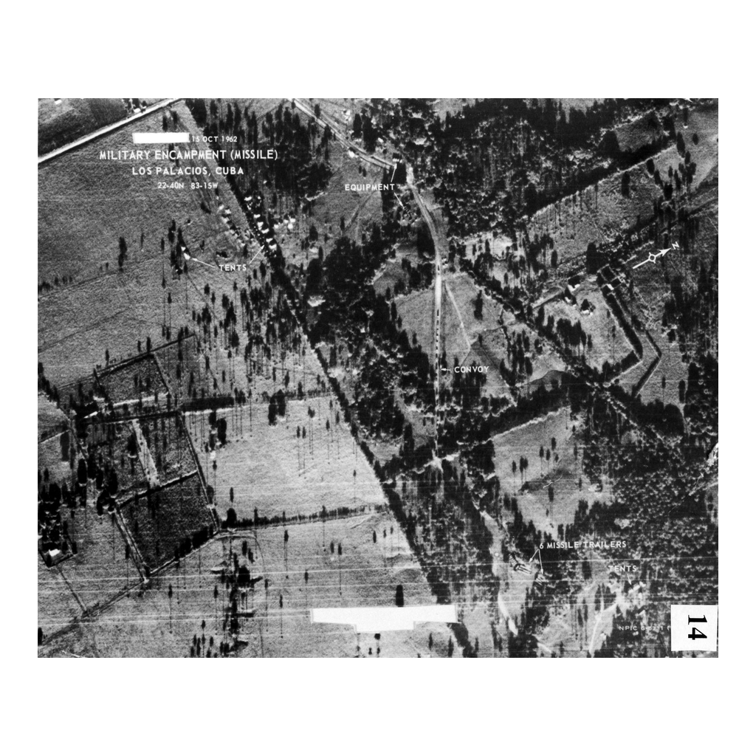
The U-2 Photograph, October 1962
Note: analyst labels mark tents and missile trailers
© More Lessons Less Planning | morelessonslessplanning.com
Notes:
The U-2 print that proved Soviet missiles were being placed in Cuba, from the October 14, 1962 mission flown by Major Richard 'Steve' Heyser. The white labels were added by photo interpreters at the National Photographic Interpretation Center: TENTS, EQUIPMENT, CONVOY, and 6 MISSILE TRAILERS. The stamp reads 15 OCT 1962, the day analysts read the film out, and the site is Los Palacios in the San Cristobal area of western Cuba.

Slide 7
ExComm Weighs the Options
The Group
Kennedy assembled ExComm, the Executive Committee of advisers, to manage the crisis.
✔
Do Nothing
Some argued U.S. missiles in Turkey made Soviet missiles in Cuba no different.
✔
Air Strike or Invasion
Military leaders pushed to bomb the sites or invade Cuba outright.
✔
Naval Quarantine
A blockade would stop new weapons without firing the first shot.
✔
Key Point: every option on this list carried a risk of war.
© More Lessons Less Planning | morelessonslessplanning.com
Notes:
ExComm - the Executive Committee of advisers Kennedy assembled to manage the crisis. Stress that the debate was genuine and unresolved for days; the recordings show Kennedy repeatedly pushing back on his own generals. This is the slide the Activity's Part 3 question about the rejected options is built on.

Slide 8
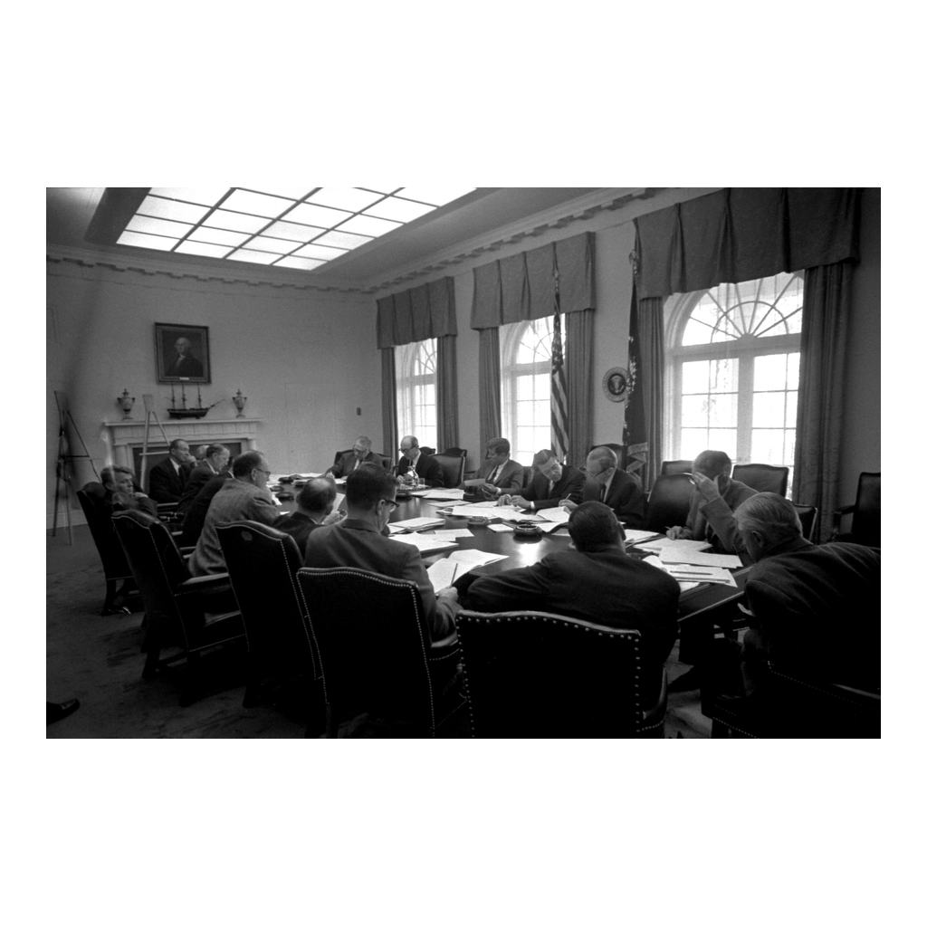
Kennedy Meets with ExComm
Note: the Cabinet Room, October 1962
© More Lessons Less Planning | morelessonslessplanning.com
Notes:
President Kennedy seated at the Cabinet Room table with the members of the Executive Committee. Point out how ordinary the room looks; the decision that shaped the crisis was made by people sitting around a table with legal pads. This particular photograph is from the October 29 meeting, just after the settlement - use it for the room and the people, not to date the debate.

Slide 9
Quarantine, Not Blockade
The Word Kennedy Chose
October 22, 1962
A blockade is an act of war under international law
Kennedy called his naval blockade a quarantine instead
The softer word left the Soviets room to back down
Kennedy told the nation on live television and radio
Navy ships would turn back ships carrying offensive weapons
He signed Proclamation 3504 the next day
Fact: Kennedy announced the quarantine to the public on October 22.
© More Lessons Less Planning | morelessonslessplanning.com
Notes:
quarantine - Kennedy's naval blockade of Cuba that turned back ships carrying offensive weapons. This is the speech students read in the Activity's Primary Source Spotlight. Use the transcript text only; do not play, link, or assign the broadcast recording, because some archives claim separate rights in the audio and video.

Slide 10
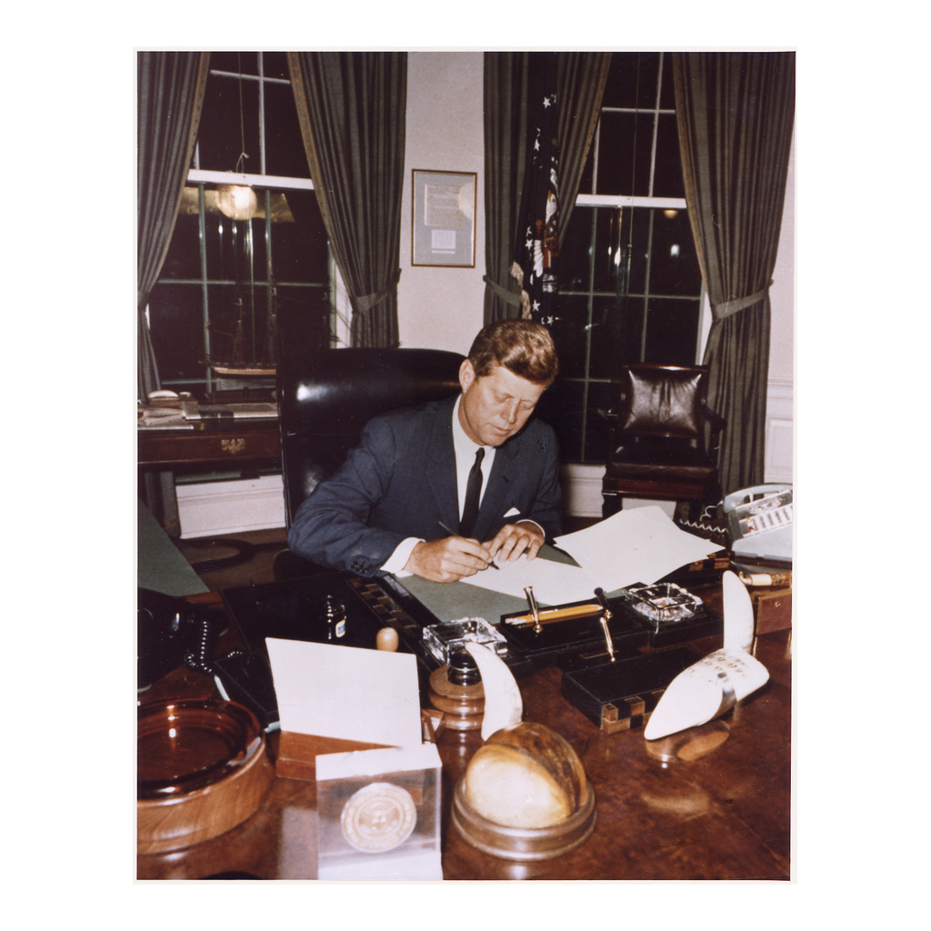
Signing the Quarantine Proclamation
Note: October 23, 1962, the Oval Office
© More Lessons Less Planning | morelessonslessplanning.com
Notes:
President Kennedy seated at his desk signing Proclamation 3504 on October 23, 1962, which put the quarantine into legal effect at 10:00 a.m. the next morning. A quiet photograph of a signature is the moment the Navy line became real.

Slide 11
The Line at Sea
500 miles
October 24
DEFCON 2
how far out from Cuba the quarantine line was drawn
the day Soviet ships stopped short of the line
the highest alert level U.S. bomber command ever reached
Real Talk: nobody on either side knew whether the ships would stop.
© More Lessons Less Planning | morelessonslessplanning.com
Notes:
The quarantine line was first drawn at 800 miles out and then pulled back to about 500 miles to give Khrushchev more time to decide before his ships reached it. On October 24 the Soviet ships carrying missile cargo stopped or turned around. DEFCON 2 is one step below all-out nuclear war, and U.S. forces have never gone higher.

Slide 12
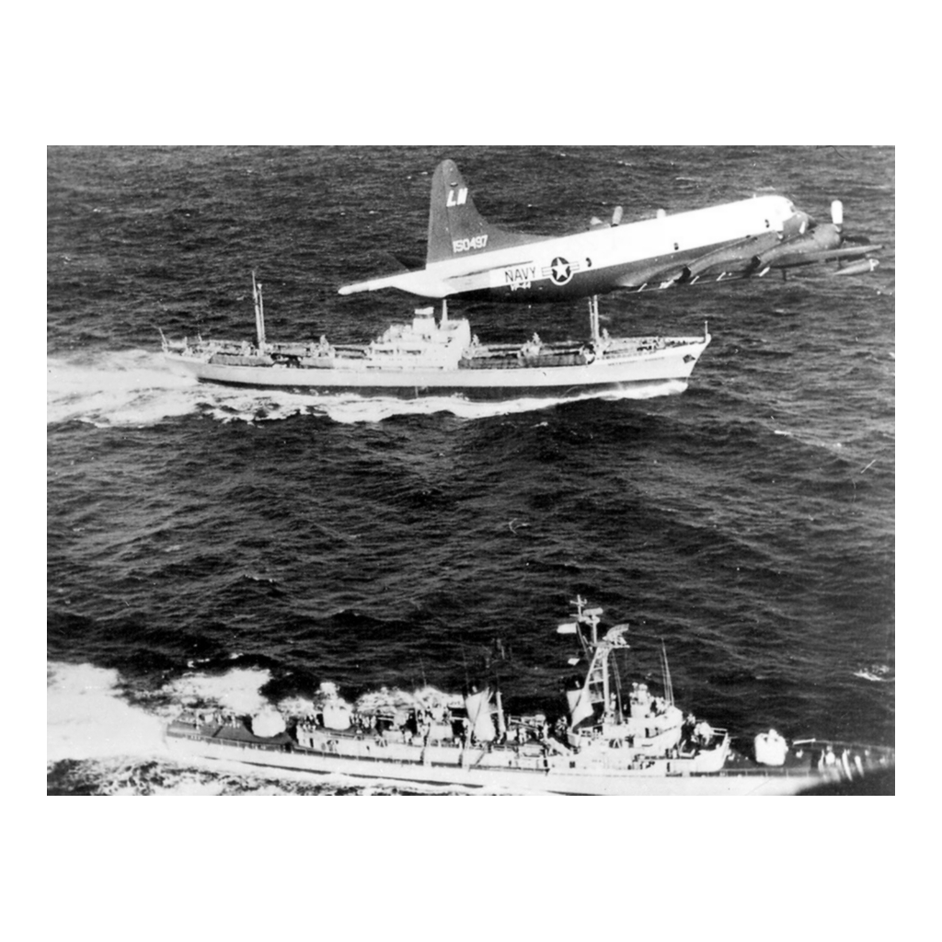
Watching the Quarantine Line
Note: a Navy patrol plane over the quarantine line
© More Lessons Less Planning | morelessonslessplanning.com
Notes:
A U.S. Navy patrol aircraft flying over the Soviet freighter Metallurg Anosov and the destroyer USS Barry during the 1962 quarantine. Note for accuracy: the quarantine stayed in force until November 20, and this photograph comes from that later enforcement period rather than from the thirteen days themselves - use it to show how the quarantine was enforced, not to date a specific confrontation.

Slide 13
Black Saturday, October 27
A U-2 was shot down over Cuba and its pilot was killed
A second U-2 strayed into Soviet airspace by mistake
A Soviet submarine crew argued over firing a nuclear torpedo
Escalation: each side answered the other with a stronger action
Warning: October 27 is the closest the crisis came to war.
© More Lessons Less Planning | morelessonslessplanning.com
Notes:
escalation - each side answering the other with a stronger action, pushing a conflict closer to war. Major Rudolf Anderson, the U-2 pilot, is the only combat death of the crisis; name him respectfully and move on. No graphic detail. The submarine story (B-59) became public decades later and is the single best illustration of how much depended on individual judgment.

Slide 14
October 28: The Crisis Breaks
Two Letters
The Public Deal
The Announcement
Oct 26 - softer letter: missiles out for a no-invasion promise
Oct 27 - harder letter: also demands U.S. missiles leave Turkey
Kennedy publicly answered only the first letter
The Soviet Union would remove the missiles from Cuba
The United States promised not to invade Cuba
Radio Moscow announced the withdrawal on October 28
The quarantine stayed in place until November 20
Fact: the standoff ran thirteen days, October 16 to October 28.
© More Lessons Less Planning | morelessonslessplanning.com
Notes:
The two-letter problem is the most teachable decision of the whole crisis: in public, Kennedy's team replied to the softer first letter as though the harder second one had never arrived. In private, on that same October 27, they accepted the harder letter's Turkey demand - so the demand was never actually ignored, only kept off the record. Radio Moscow broadcast the withdrawal on October 28, which is why that date closes the thirteen days.

Slide 15
The Part Nobody Announced
The harder letter's Turkey demand was met in private, not ignored
The U.S. secretly agreed to pull its Jupiter missiles from Turkey
Robert Kennedy delivered the offer to the Soviet ambassador
Those missiles were removed within about six months
The Turkey deal stayed secret from the public for decades
Did You Know: the Turkey half of the deal was hidden for years.
© More Lessons Less Planning | morelessonslessplanning.com
Notes:
Jupiter missiles in Turkey - American nuclear missiles near the Soviet border, secretly traded away to settle the crisis. This is why Khrushchev appeared at the time to have simply backed down, and why the popular story of the crisis was wrong for a generation. It also answers the Part 5 essay directly: both leaders got something.

Slide 16
Three Words for Thirteen Days
Brinkmanship
Pushing a conflict to the edge of war to make the other side back down.
Escalation
Each side answering the other with a stronger action, pushing a conflict closer to war.
Deterrence
Preventing an attack by convincing the other side the response would be devastating.
Key Concept: all three words describe the same thirteen days.
© More Lessons Less Planning | morelessonslessplanning.com
Notes:
These three terms are the analytical vocabulary the Activity's Part 5 essay and Exit Ticket both use. Brinkmanship is the strategy, escalation is what goes wrong while you use it, and deterrence is the underlying bet that neither side will actually fire.

Slide 17
What Changed After 1962
The Hotline
In 1963 the two governments set up the Moscow-Washington hotline so leaders could respond instantly.
✔
Test Ban Treaty
The 1963 Limited Test Ban Treaty banned nuclear tests in the atmosphere, space, and underwater.
✔
The Arms Race Went On
Both superpowers kept adding nuclear weapons - the arms race did not stop.
✔
Cuba Stayed Communist
Castro stayed in power; the U.S. never invaded Cuba again.
✔
Key Point: the crisis changed how the two sides talked to each other.
© More Lessons Less Planning | morelessonslessplanning.com
Notes:
Moscow-Washington hotline - the direct communication link created in 1963 so the two leaders could reach each other instantly. Close the content arc here: the crisis did not end the Cold War or the arms race, but it did change the machinery the two governments used to avoid another October 1962.

Slide 18
Key Takeaways
Soviet missiles in Cuba put U.S. cities minutes from a nuclear strike
★
Kennedy chose a naval quarantine over an air strike or an invasion
★
The crisis ended October 28 with a public deal and a secret one
★
Brinkmanship worked here, but October 27 shows how close it came
★
© More Lessons Less Planning | morelessonslessplanning.com
Notes:
Close by returning to the opening question: how close did the world actually come? Then push students to answer the Essential Question with evidence rather than with a feeling, which is exactly what Activity Part 5 asks them to write.

