Slide 1
The Crusades
Why Pope Urban II called the First Crusade in 1095, the mixed motives that drove it, and how we know.
© More Lessons Less Planning | morelessonslessplanning.com
Notes:
Opening slide. The Crusades were a series of religious wars, called by the pope, in which European Christians tried to capture the Holy Land from Muslim control. Students will learn why the First Crusade began (the Byzantine appeal and Urban II's 1095 speech at Clermont), the mixed motives behind it, the course of the war to the capture of Jerusalem in 1099, and its violent consequences - then analyze Urban's speech as a primary source. Keep the tone academic and even-handed toward Christian, Muslim, Byzantine, and Jewish people.

Slide 2
Learning Targets
Explain why the Byzantine appeal and Urban's 1095 speech launched the Crusade.
★
Identify the mixed motives: religious devotion AND worldly gain.
★
Describe the march to Jerusalem in 1099 and its violent consequences.
★
Analyze Urban's speech as a later reconstruction, not an exact transcript.
★
© More Lessons Less Planning | morelessonslessplanning.com
Notes:
Read the four learning targets. Today combines a cause (why the Crusade began), an analysis of motives (religious plus political/economic), a narrative (the march to Jerusalem and its violence), and a history skill (reading a reconstructed speech as evidence).

Slide 3
What Were the Crusades?
Crusade
A series of religious wars, called by the pope, in which European Christians tried to capture the Holy Land from Muslim control.
Holy Land
The region around Jerusalem, sacred to Christians, Muslims, and Jews, that the Crusades were fought to control.
Key Concept: A CRUSADE was a pope-called religious war to capture the Holy Land from Muslim control.
© More Lessons Less Planning | morelessonslessplanning.com
Notes:
A CRUSADE was a series of religious wars, called by the pope, in which European Christians tried to capture the Holy Land from Muslim control. The HOLY LAND was the region around Jerusalem, sacred to Christians, Muslims, and Jews alike. Because three faiths held the region sacred, control of it was deeply contested. The word 'crusade' comes from the cross that fighters wore. There were several Crusades over about two centuries; this lesson focuses on the First Crusade (1096-1099).

Slide 4
The World Before the Crusades
Byzantine Empire
The Eastern Christian empire, centered on Constantinople, bordering the Muslim world.
✔
Seljuk Turks
The Muslim power that took much of the Byzantine east and the Holy Land in the 1070s-1090s.
✔
A contested Jerusalem
Jerusalem, sacred to three faiths, sat inside this shifting frontier of empires.
✔
Key Concept: The Muslim SELJUK TURKS took much of the Byzantine east and the Holy Land, alarming Eastern Christians.
© More Lessons Less Planning | morelessonslessplanning.com
Notes:
The BYZANTINE EMPIRE was the Eastern Christian empire, centered on Constantinople. In the decades before the Crusade, the Muslim SELJUK TURKS took control of much of the Byzantine east and the Holy Land, including the region around Jerusalem. This was a frontier where Christian and Muslim empires met and shifted. Present this factually: the Seljuk Turks were an expanding power of their day, not villains. Their advance alarmed the Byzantine emperor and set the stage for his appeal to the West.

Slide 5
The Byzantine Appeal for Help
In 1095 the Byzantine emperor Alexios sent an appeal to Pope Urban II.
He asked for Western soldiers to help fight the Seljuk Turks in the east.
The emperor wanted mercenaries; he did not expect a huge armed movement.
The appeal gave the pope a reason to call Western knights to march east.
Urban saw a chance to help Eastern Christians and to unite a divided Europe.
Note: The Byzantine emperor asked for soldiers - the pope turned that request into a full Crusade.
© More Lessons Less Planning | morelessonslessplanning.com
Notes:
In 1095 the Byzantine emperor Alexios I sent an APPEAL to Pope Urban II, asking for Western soldiers to help fight the Seljuk Turks. Alexios wanted hired soldiers to recover lost land; he did not expect the massive armed movement that followed. Urban II saw an opportunity: he could aid Eastern Christians, perhaps heal the split between Eastern and Western Christianity, redirect the constant fighting among European knights outward, and expand the authority of the papacy. So the emperor's request became the spark that let Urban call Western knights to march east.

Slide 6
Pope Urban II at the Council of Clermont, 1095
Council of Clermont
The 1095 church meeting in France where Pope Urban II called on Western knights to march east.
Pope Urban II
The pope who launched the First Crusade with his 1095 speech at the Council of Clermont.
Key Concept: At the COUNCIL OF CLERMONT in 1095, POPE URBAN II called Western knights to march east.
© More Lessons Less Planning | morelessonslessplanning.com
Notes:
The COUNCIL OF CLERMONT was a church meeting held in France in 1095. There, POPE URBAN II gave a famous speech calling on Western knights to stop fighting one another and instead march east to aid Eastern Christians and recover Jerusalem. Crowds are said to have shouted 'God wills it!' There is no word-for-word record of exactly what Urban said - several chroniclers wrote different versions years later. The next slide shows a medieval manuscript image of Urban preaching the Crusade.

Slide 7
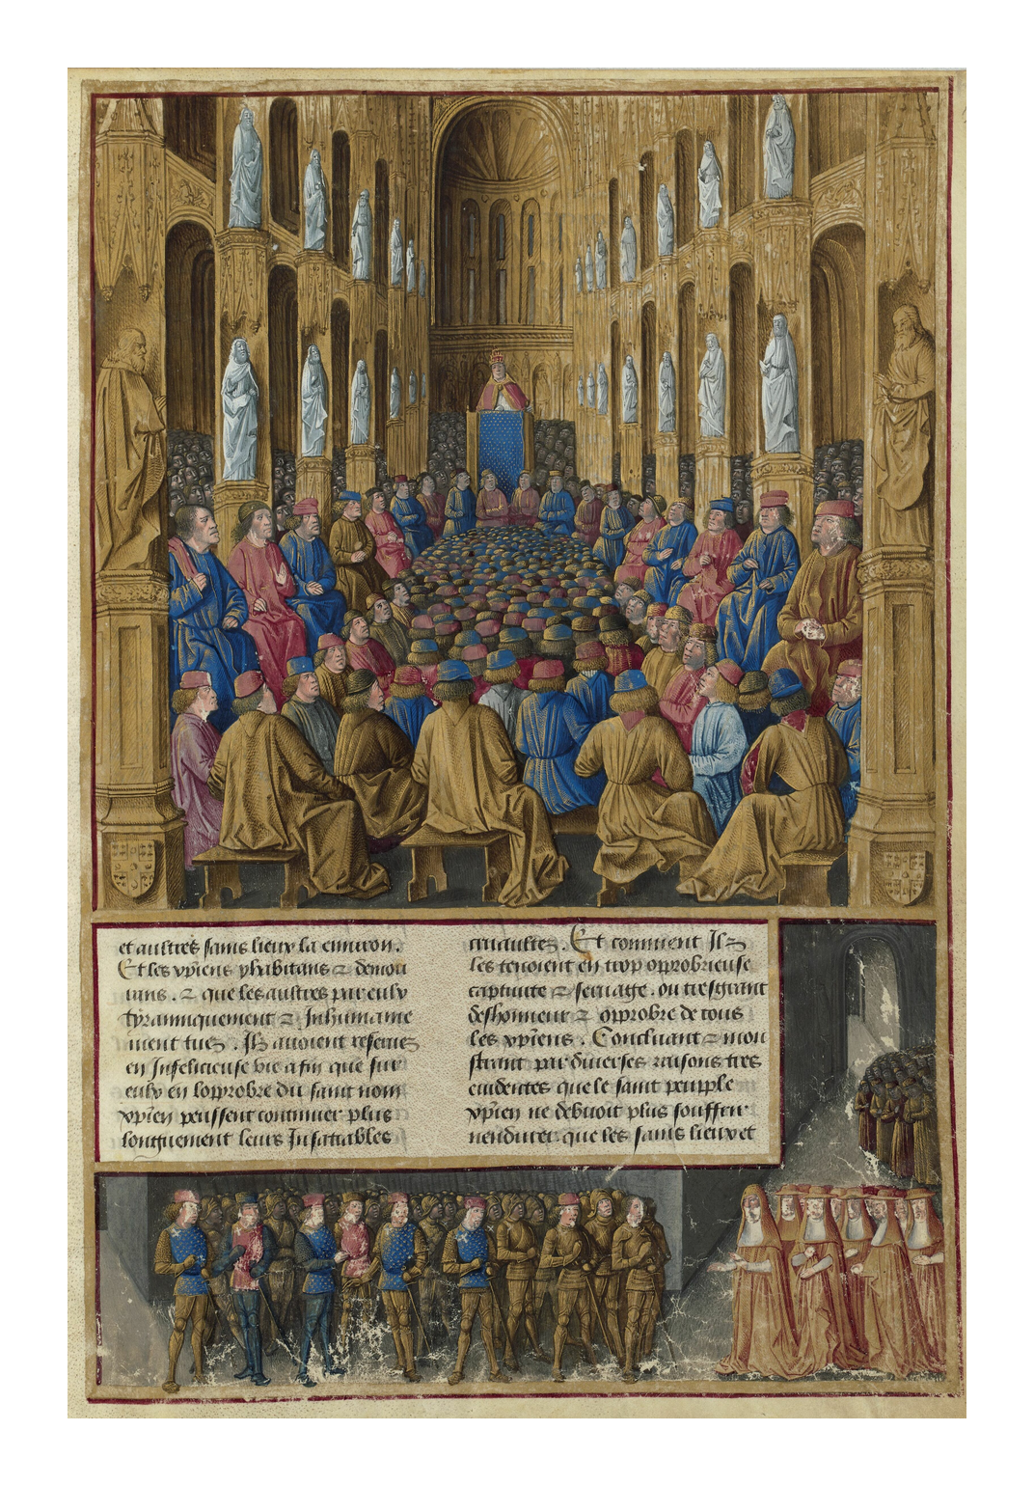
Urban II Calls the First Crusade
A medieval manuscript pictures Urban II preaching the Crusade at Clermont.
© More Lessons Less Planning | morelessonslessplanning.com
Notes:
Real public-domain medieval manuscript illumination of Urban II at the Council of Clermont. Give students a moment to see how medieval artists pictured the launching of the Crusade.
Reference labels (point to these chart features when teaching): Pope preaching; Crowd of knights

Slide 8
Urban's Promise: Indulgence and Pilgrimage
Indulgence
The pope's promise of remission of sins (a spiritual reward) for those who went on Crusade.
Pilgrimage
A religious journey to a holy site; the First Crusade was framed as an armed pilgrimage to Jerusalem.
Key Concept: An INDULGENCE promised remission of sins - a powerful spiritual reason to take the cross.
© More Lessons Less Planning | morelessonslessplanning.com
Notes:
To many people, the strongest reason to go was spiritual. An INDULGENCE was the pope's promise of remission of sins for those who joined the Crusade - a way to wipe out the penalty for one's sins. A PILGRIMAGE was a religious journey to a holy site, and the Crusade was framed as an armed pilgrimage to Jerusalem. For a medieval Christian who feared for their soul, the promise that going could count in place of all penance for their sins was enormously powerful. These religious motives were real and sincere - but, as the next slide shows, they were not the only motives.

Slide 9
Why They Went: Mixed Motives
Religious Motives
Political, Economic & Social
Win an indulgence: remission of sins.
Aid fellow (Eastern) Christians in need.
Recover Jerusalem and the Holy Land.
Land and wealth for landless younger knights.
Greater power and authority for the pope.
A way to redirect knightly violence outward.
Key Concept: The Crusades had MIXED motives - sincere religious devotion AND the pull of land, wealth, and power.
© More Lessons Less Planning | morelessonslessplanning.com
Notes:
The Crusades had MIXED motives, not a single cause. Religious motives were real: winning an indulgence (remission of sins), aiding Eastern Christians, and recovering Jerusalem. But political, economic, and social motives mattered too. Younger knights who would not inherit land saw a chance to win land and wealth in the East. The pope gained greater power and authority. And Church leaders saw the Crusade as a way to redirect the constant violence of European knights outward, away from Christian lands. It is not accurate to say the Crusades were 'only religious' - the honest picture is a mix of devotion and worldly gain.

Slide 10
The March to Jerusalem
Setting out (1096)
Thousands of knights and common people set out east in 1096 on the First Crusade.
✔
A brutal journey
The march covered thousands of miles, with hunger, disease, and heavy losses.
✔
Nearing the goal
After capturing Antioch, the crusaders pushed on toward the city of Jerusalem.
✔
Did You Know: The First Crusade set out in 1096 and marched roughly two thousand miles toward Jerusalem.
© More Lessons Less Planning | morelessonslessplanning.com
Notes:
The First Crusade set out in 1096. Thousands of knights and common people marched east on a journey of roughly two thousand miles. The march was brutal: crusaders faced hunger, disease, and heavy losses, and many died before reaching their goal. After a long siege they captured the city of Antioch, then pushed on toward the city of Jerusalem. Present the hardship factually - this was a costly, deadly campaign for the crusaders themselves.

Slide 11
The Capture of Jerusalem, 1099
In 1099 the crusaders besieged and captured the city of Jerusalem.
The First Crusade had reached its main goal after three hard years.
When the city fell, the crusaders killed many Muslim and Jewish inhabitants.
Chroniclers on all sides described the killing as terrible and widespread.
The crusaders set up Christian-ruled states in the Holy Land.
Note: The 1099 capture of Jerusalem reached the Crusade's goal - but it came with a massacre of the city's people.
© More Lessons Less Planning | morelessonslessplanning.com
Notes:
In 1099, after three hard years, the crusaders besieged and captured the city of JERUSALEM - the First Crusade's main goal. But the capture was extremely violent: when the city fell, the crusaders killed many of its Muslim and Jewish inhabitants. Chroniclers on multiple sides described the killing as terrible and widespread. Present this factually and without valorizing it: taking the city was a military success for the crusaders and a catastrophe for the people who lived there. The crusaders then set up Christian-ruled states in the Holy Land. The next slide shows a medieval manuscript image of the siege.

Slide 12
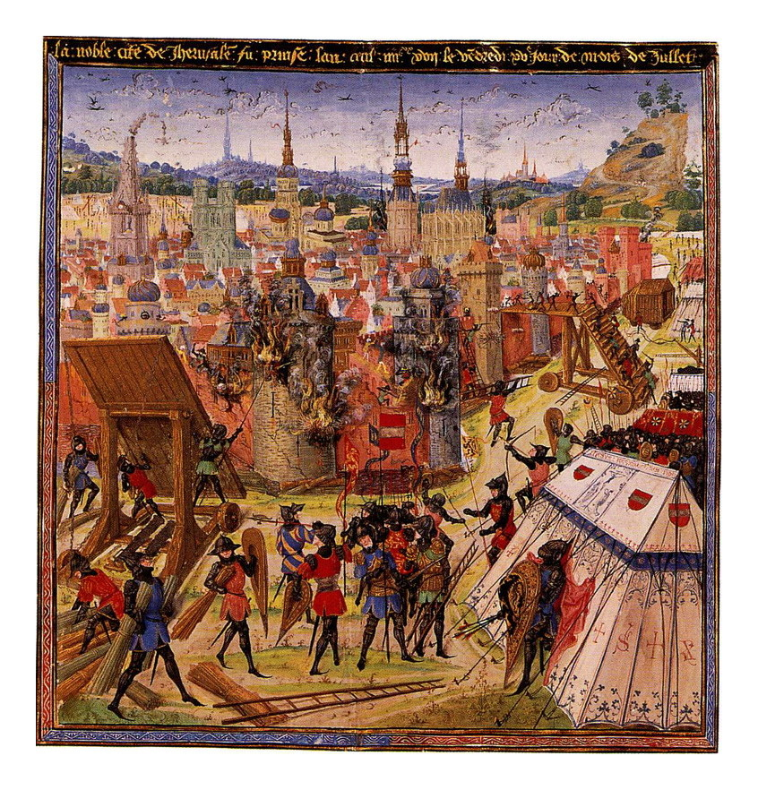
The Siege of Jerusalem, 1099
A medieval manuscript pictures the crusaders' siege of Jerusalem in 1099.
© More Lessons Less Planning | morelessonslessplanning.com
Notes:
Real public-domain medieval manuscript illumination of the 1099 siege of Jerusalem. Point out how medieval artists pictured the assault on the walled city.
Reference labels (point to these chart features when teaching): City walls; Armored crusaders

Slide 13
Violence and Its Victims
In Jerusalem, 1099
In the Rhineland, 1096
The crusaders killed many Muslim and Jewish residents.
Sources on multiple sides record the massacre.
Taking the city meant catastrophe for its people.
On the way east, crusaders attacked Jewish communities.
These 1096 Rhineland massacres killed thousands of Jews.
Local bishops sometimes tried, and failed, to protect them.
Note: The Crusades brought severe violence - the 1099 Jerusalem massacre and the 1096 Rhineland massacres of Jews.
© More Lessons Less Planning | morelessonslessplanning.com
Notes:
The Crusades involved severe violence against civilians, and honest history must include it. In JERUSALEM in 1099, the crusaders killed many Muslim and Jewish residents; sources on multiple sides record the massacre. And even before reaching the Holy Land, in the RHINELAND MASSACRES of 1096, groups of crusaders attacked Jewish communities in the Rhineland of Germany, killing thousands of Jews; some local bishops tried to shelter them and failed. Present these facts plainly and with respect for the victims - do not sensationalize or excuse them. The Jewish communities of the Rhineland and the Muslim and Jewish people of Jerusalem were real victims of this violence.

Slide 14
Consequences: Two Worlds in Contact
More trade
The Crusades increased long-term trade between Europe and the Islamic world.
✔
Exchange of ideas
Europeans gained goods, knowledge, and technologies through this contact.
✔
Lasting bitterness
The wars also left lasting mistrust among Christians, Muslims, and Jews.
✔
Key Concept: A major long-term result was increased TRADE and exchange of KNOWLEDGE between Europe and the Islamic world.
© More Lessons Less Planning | morelessonslessplanning.com
Notes:
In the long run, the Crusades increased contact between Europe and the Islamic world. TRADE grew, and Europeans gained goods, KNOWLEDGE, and technologies - from spices and textiles to mathematics, medicine, and preserved classical learning that flowed through the Islamic world. This contact helped reshape Europe. But the consequences were not all positive: the wars also left lasting bitterness and mistrust among Christians, Muslims, and Jews that echoed for centuries. Present both sides of the ledger honestly.

Slide 15
How Do We Know? Reconstructing Urban's Speech
No word-for-word transcript of Urban's Clermont speech survives.
Chroniclers like Fulcher of Chartres wrote their versions years later.
Several of them wrote after Jerusalem had already fallen in 1099.
So each account is a reconstruction, shaped by the outcome and the writer.
Historians still use these speeches as evidence of Crusade motives - with care.
Key Concept: Urban's speech survives only as later reconstructions, not a TRANSCRIPT - useful evidence, read with care.
© More Lessons Less Planning | morelessonslessplanning.com
Notes:
Here is the key history skill. No word-for-word TRANSCRIPT of Urban's speech at Clermont survives. Chroniclers like FULCHER of Chartres, Robert the Monk, Baldric, and Guibert wrote their versions years later - several of them AFTER Jerusalem had already fallen in 1099. That means every account is a reconstruction, shaped by the writer and by knowing how the Crusade turned out, not a stenographic record. This does not make the speeches useless: they are strong evidence of how people understood and justified the Crusade, and of the arguments that seemed persuasive. Historians simply use them with care, comparing the different versions rather than trusting any one as exact.

Slide 16
Key Takeaways
The First Crusade began with the Byzantine appeal and Urban's 1095 speech.
★
Its motives were mixed: religious devotion AND land, wealth, and power.
★
Crusaders took Jerusalem in 1099 - with massacres there and in the Rhineland.
★
Urban's speech survives only as later reconstructions, used with care.
★
© More Lessons Less Planning | morelessonslessplanning.com
Notes:
Recap the four takeaways. The big ideas: the First Crusade had mixed motives, not a single religious cause; it reached Jerusalem in 1099 at a terrible human cost; and the famous speech that launched it survives only as later reconstructions that historians must read critically. Keep the closing tone even-handed and respectful toward all the peoples in this story.

