Slide 1
The Columbian Exchange
How foods, animals, and diseases crossed the Atlantic both ways after 1492
© More Lessons Less Planning | morelessonslessplanning.com
Notes:
Open on the two-way idea: after 1492 the Atlantic became a two-way road for plants, animals, people, and diseases. The new foods and the disease catastrophe are one story, not two.

Slide 2
Learning Targets
Explain what the Columbian Exchange was and that it moved in two directions.
★
Describe what crossed each way between the Old and New Worlds.
★
Explain the disease catastrophe and why the exchange was not fair.
★
© More Lessons Less Planning | morelessonslessplanning.com
Notes:
Use the targets to preview the concept, the two-way map, and the misconception repair. The third target names the disease catastrophe on purpose.

Slide 3
What was the Columbian Exchange?
The Columbian Exchange moved plants, animals, people, and diseases after 1492.
It moved in two directions across the Atlantic Ocean, not just one.
The Old World was Europe, Africa, and Asia; the New World was the Americas.
Foods and farm animals crossed both ways and reshaped diets everywhere.
It also carried diseases that devastated Indigenous Americans.
Key Point: The exchange flowed both ways - and it was not a fair or even trade.
© More Lessons Less Planning | morelessonslessplanning.com
Notes:
Define the term precisely and stress the two-way flow. Preview both halves of the story at once: new foods and animals, and the diseases that devastated Native peoples.

Slide 4
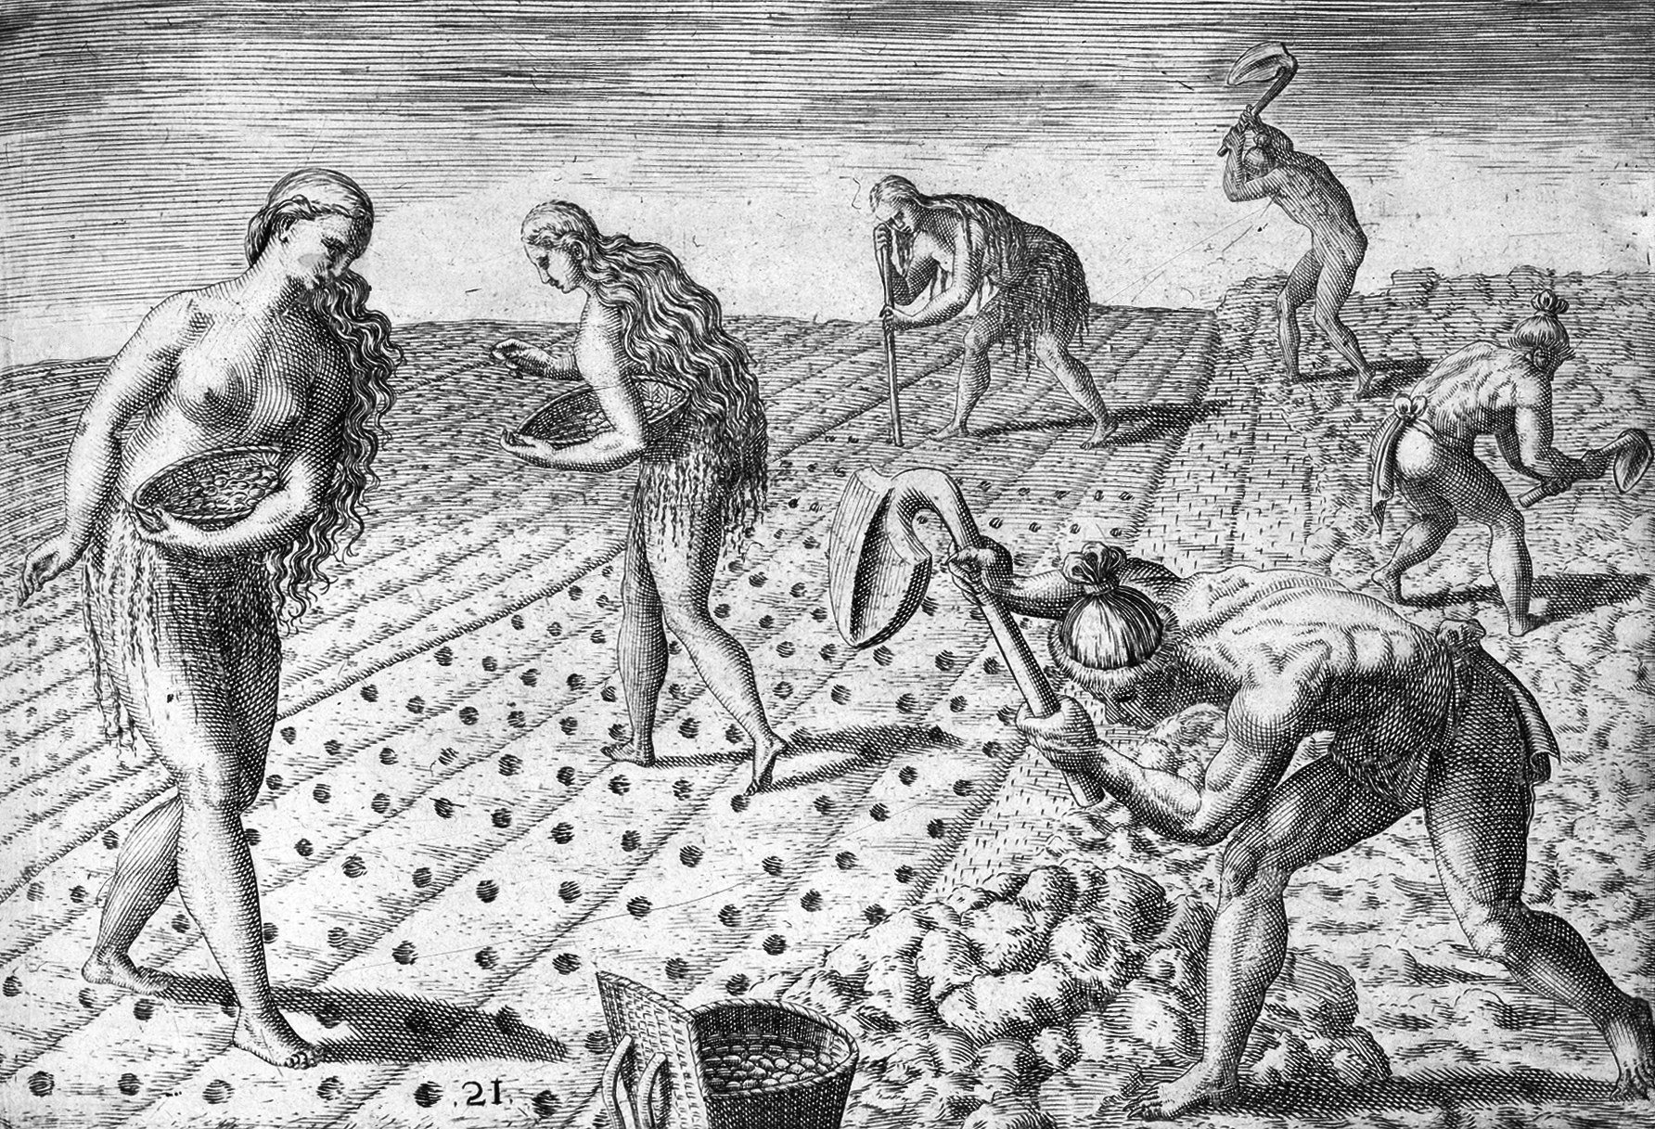
A later European engraving of Native farming
De Bry engraving of Florida people planting maize and beans, 1591.
© More Lessons Less Planning | morelessonslessplanning.com
Notes:
Frame the engraving honestly: it was made in 1591 by a European artist who never saw Florida, working from another artist's drawings. It shows how Europeans pictured Native maize farming; it is not a photograph or eyewitness record. Treat the people as farmers growing a crop the world would later depend on.

Slide 5
What crossed from the Americas
Maize (corn)
Maize, also called corn, was a grain first grown by Native Americans.
✔
Potatoes and tomatoes
Potatoes and tomatoes also came from the Americas.
✔
Fed the world
These American crops became important staple crops around the world.
✔
What 'staple' means
A staple crop is a basic food people eat in large amounts.
✔
Key Point: Maize, potatoes, and tomatoes are American crops that fed the world.
© More Lessons Less Planning | morelessonslessplanning.com
Notes:
Anchor the American side of the exchange in specific crops from the record. Maize, potatoes, and tomatoes are the named American crops that spread worldwide.

Slide 6
What crossed to the Americas
In return, Old World crops and animals crossed to the Americas.
Old World livestock included cattle, pigs, horses, sheep, and goats.
Livestock are farm animals raised for food and work.
Old World staple crops such as wheat and rice also took hold.
This two-way flow is what makes it an exchange, not a one-way gift.
Key Point: Old World livestock and crops reshaped farming in the Americas.
© More Lessons Less Planning | morelessonslessplanning.com
Notes:
Complete the two-way map with the return flow named in the record: Old World crops and livestock became important in the New World. Name livestock and staple crops from the glossary categories.

Slide 7
The exchange also carried disease
What also crossed
Why it was so deadly
The exchange did not only move foods; it also moved diseases.
Old World diseases, above all smallpox, spread to the Americas.
The Taino and other Native peoples had never faced these diseases.
These diseases caused epidemics that killed millions of Indigenous people.
An epidemic is a disease that spreads quickly to many people at once.
Key Point: Smallpox and other diseases killed a huge share of Indigenous Americans.
© More Lessons Less Planning | morelessonslessplanning.com
Notes:
This is the heart of the misconception repair. The record is explicit: the exchange carried Old World diseases, above all smallpox, that killed a huge share of Indigenous Americans. Keep the tone documentary and respectful, never graphic.

Slide 8
Not a fair or even trade
A common but wrong idea
What the evidence shows
The Columbian Exchange was a fair, mostly good swap of new foods.
Everyone came out ahead.
New crops and animals did move both ways and changed diets.
But Old World diseases killed a huge share of Indigenous Americans.
That catastrophe is central to the story, not a footnote.
Key Point: Always pair the new-crops story with the disease catastrophe.
© More Lessons Less Planning | morelessonslessplanning.com
Notes:
Do not let students leave with the 'fair swap' story. Give the accurate replacement: crops moved both ways, but disease made the exchange deeply unequal, and that catastrophe is central.

Slide 9
Exchange and place vocabulary
Columbian Exchange: The transfer of plants, animals, people, and diseases between the Americas and the rest of the world after 1492.
Espanola (Hispaniola): The Caribbean island (today Haiti and the Dominican Republic) that Columbus described in his 1493 letter.
Taino: The Indigenous people of the Caribbean islands whom Columbus first encountered.
maize: Corn; a grain first grown by Native Americans that spread around the world after 1492.
staple crop: A basic food people eat in large amounts, such as potatoes, wheat, rice, or maize.
Key Point: These terms name the exchange, the island, the people, and the food.
© More Lessons Less Planning | morelessonslessplanning.com
Notes:
Connect each definition to a claim students will use in the activity and quiz. These are the first five reference-guide terms.

Slide 10
Animals, disease, and world vocabulary
livestock
Farm animals such as cattle, pigs, horses, sheep, and goats.
smallpox
A deadly Old World disease that spread to the Americas and killed millions of Indigenous people.
epidemic
A disease that spreads quickly to many people in the same area at the same time.
Old World
Europe, Africa, and Asia - the lands connected to one another before 1492.
New World
The Americas, as Europeans called them after 1492.
Key Point: These terms name the animals, the disease, and the two halves of the world.
© More Lessons Less Planning | morelessonslessplanning.com
Notes:
These are the last five reference-guide terms. Smallpox and epidemic anchor the disease half of the story; Old World and New World anchor the geography.

Slide 11
Columbus's 1493 letter: the American side
In 1493, Columbus wrote a letter about the islands for the Spanish court.
He described Espanola as fertile and rich for planting and raising cattle.
He marveled at tall evergreen trees, palms, honey, fruit, and singing birds.
He wrote that the islands held mines of gold and other metals.
The letter shows only the American side of what became a two-way exchange.
Key Point: The 1493 letter shows one side - the Americas - not the return flow or the disease.
© More Lessons Less Planning | morelessonslessplanning.com
Notes:
Set up the primary source. The 1493 letter is glowing about the American land and riches, but it describes only the New-World side. It says nothing about crops sent back or the diseases to come.

Slide 12
Reading the letter critically
One perspective
The letter is useful evidence, but it gives only Columbus's perspective.
✔
Missing the return flow
It shows the American plants and riches, not the crops sent back.
✔
Silent on disease
It says nothing about the diseases that would devastate the Taino.
✔
Claiming the land
In the letter, Columbus claims he took possession of the islands for Spain.
✔
Key Point: A source can be valuable and still show only one side.
© More Lessons Less Planning | morelessonslessplanning.com
Notes:
Model critical reading. The letter is real evidence of the American side, but it is one-sided: no return flow, no disease, no Taino voice. Reading critically is different from dismissing the source.

Slide 13
Building a precise description
Facts: name specific crops or animals that crossed the ocean.
Directions: show the exchange moved both ways, not one.
People: describe the Taino as people, not as scenery.
Disease: always include the smallpox catastrophe, not just new foods.
Fairness: make clear the exchange was not fair or even.
Remember: A precise account pairs the new foods with the disease catastrophe.
© More Lessons Less Planning | morelessonslessplanning.com
Notes:
Prepare students to write the activity's final description. A precise account names crops in both directions, treats the Taino as people, and always includes the disease catastrophe.

Slide 14
Key Takeaways
The exchange moved plants, animals, people, and diseases both ways after 1492.
★
Maize, potatoes, and tomatoes came from the Americas; livestock came back.
★
Old World diseases like smallpox killed a huge share of Indigenous Americans.
★
Columbus's 1493 letter shows only the American side of a two-way exchange.
★
© More Lessons Less Planning | morelessonslessplanning.com
Notes:
Close by returning to the essential question and asking students for one precise description that pairs the new foods with the disease catastrophe.

