Slide 1
The Columbian Exchange: A New World Remade
What Crossed the Ocean, Which Way, and What the Record Can Count
© More Lessons Less Planning | morelessonslessplanning.com
Notes:
Open on the packing list. Ships went west loaded with seed and breeding animals and came back with grain and roots. One crossing was never on anybody's list.

Slide 2
Learning Targets
Sort a crop or an animal by the direction it travelled and the result recorded.
★
Describe how the disease crossing entered the written record.
★
Tell a counted figure apart from a writer's estimate.
★
Name who set a record down, when, and from what standpoint.
★
Judge what these four documents can and cannot establish.
★
© More Lessons Less Planning | morelessonslessplanning.com
Notes:
Stop on target three. It is the historical thinking skill this unit is built around, and it is what the Activity's final question is graded on.

Slide 3
Two Directions Across One Ocean
Ships sailing west carried seed, graftings, sugar-cane and slips of trees.
They also carried chickens and quadrupeds, brought from Europe.
Quadrupeds means four-footed animals: cattle, pigs and horses.
Ships sailing east carried maize, roots called potatoes, and a fruit.
A third cargo travelled with them that nobody loaded on purpose.
Key Concept: Everything on the first two lines was chosen. The last line was not.
© More Lessons Less Planning | morelessonslessplanning.com
Notes:
Hold the two lists side by side. Every westbound item was picked by somebody. The last line is the one no captain could have refused to load.

Slide 4
Three Words for What Crossed
Exchange
The movement of plants, animals, people and sickness in both directions between the Americas and the rest of the world after 1492
Staple crop
A crop a household grows in bulk and eats nearly every day, such as wheat, maize or the potato
Propagating
Carrying breeding males and females somewhere new so that the species will multiply there
Note: Exchange sounds like a bargain. Nobody on either side agreed to all of this.
© More Lessons Less Planning | morelessonslessplanning.com
Notes:
These three terms are on the Activity Reference Guide. Say each one aloud and have the class say it back before you move on.

Slide 5
How Fast the Sown Crops Came On
What was sown, and where | What the account reports
Cabbages, beets, lettuces and salads at Uraba | Ripe "within ten days" of the seeds going into the ground
Pumpkins and melons at Uraba | Picked "twenty-eight days after the seeds were sown"
Melons, pumpkins and cucumbers on Hispaniola | Ripe "for picking thirty-six days after they were planted"
Sugar-cane roots on Hispaniola | Grew to the height of "a cubit within fifteen days" of planting
Key Concept: Within and less than give a limit. A flat number gives a count. Quoted words are the chronicler's, 1912 translation.
© More Lessons Less Planning | morelessonslessplanning.com
Notes:
Every figure in this table comes from one writer. Read the callout before the table, because the difference between a limit and a count is the graded skill.

Slide 6
The Grain the King Ordered Sown
"The harvest produced nothing but straw, similar to twigs, and with little grain; although what there is, is large and well formed."
— Peter Martyr d'Anghera, De Orbe Novo, MacNutt translation, 1912
Spaniards found what the islanders made from their own grain insufficiently nourishing, so the King decreed wheat sown in different places and seasons. The sowing was planned. The straw was not.
Key Concept: The order was planned. The harvest was not.
© More Lessons Less Planning | morelessonslessplanning.com
Notes:
This is the cleanest example in the lesson of a planned crossing with an unplanned result. Students will need that distinction on the Activity.

Slide 7
Livestock Shipped Out in Breeding Pairs
What was loaded
"He carried twelve horses and swine, both male and female, for propagating the species in that region." - 1912 translation
✔
What happened at the harbour
The pilot "drove it upon a sandy reef" as the ship entered the port, and "all their animals were drowned."
✔
Where stock did get ashore
On Hispaniola: "The pigs have rapidly increased, but they have become wild since they are no longer kept by swineherds."
✔
What the chronicler concluded
His own conclusion: "There is no need to acclimatise any other species of animal or birds in Hispaniola."
✔
Key Concept: One wreck ends a shipment. The next ship carries the next pairs. Quoted words are the chronicler's, 1912 translation.
© More Lessons Less Planning | morelessonslessplanning.com
Notes:
Both male and female is the phrase to stop on. These were not provisions for the voyage; they were breeding stock meant to establish a species.

Slide 8
What Went the Other Way
Maize is the grain for bread-making, called maize on Hispaniola.
Maize is harvested twice yearly where winter cold is unknown.
Certain roots the islanders call potatoes grow there on their own.
The chronicler took those roots for Milanese turnips or mushrooms.
King Ferdinand ate a scaled fruit shaped like a pine-nut.
Only one of those fruits arrived unspoiled; the rest rotted at sea.
Fact: Maize and the potato now feed more people than any crop Europe sent west.
© More Lessons Less Planning | morelessonslessplanning.com
Notes:
The two plants on this slide are the reason the Columbian Exchange shows up in a world history course at all. In this document they are curiosities.

Slide 9
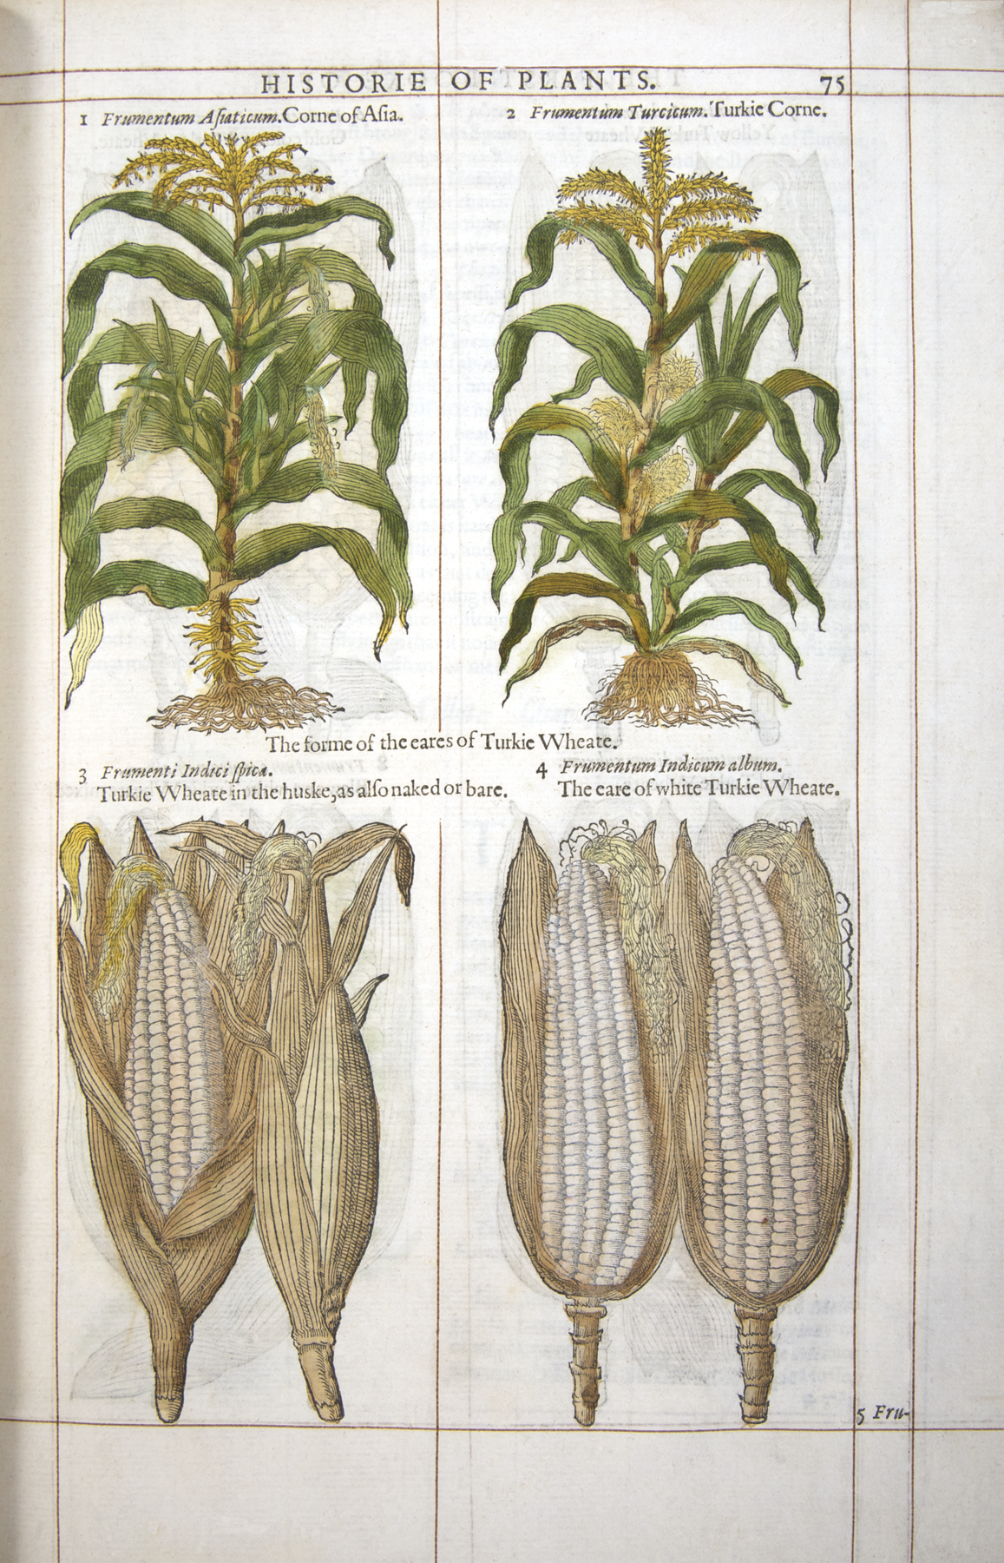
Maize in an English Herbal, Printed 1597
Gerard's Herball, London 1597, page 75: four figures of maize.
© More Lessons Less Planning | morelessonslessplanning.com
Notes:
Give the class twenty silent seconds with the page before you say anything, then ask what the printed names claim about where the plant came from.
Reference labels (point to these chart features when teaching): Turkie Corne; Turkie Wheate in the huske

Slide 10
American Plants Under Borrowed Names
Maize, London 1597
The potato, drawn about 1613
Printed as Turkie Corne and as Corne of Asia.
Also called Turkie Wheate in the huske, its 1597 spelling of husk.
Not one of those names points to the Americas.
Drawn in a German garden book as Papas Peruanorum.
That name does point to Peru, where the plant is from.
Within a century both plants were in European books.
Key Concept: Names travelled with the trade route, not with the plant.
© More Lessons Less Planning | morelessonslessplanning.com
Notes:
Two books, two American plants, two different levels of knowledge about where they came from. The names are the evidence.

Slide 11
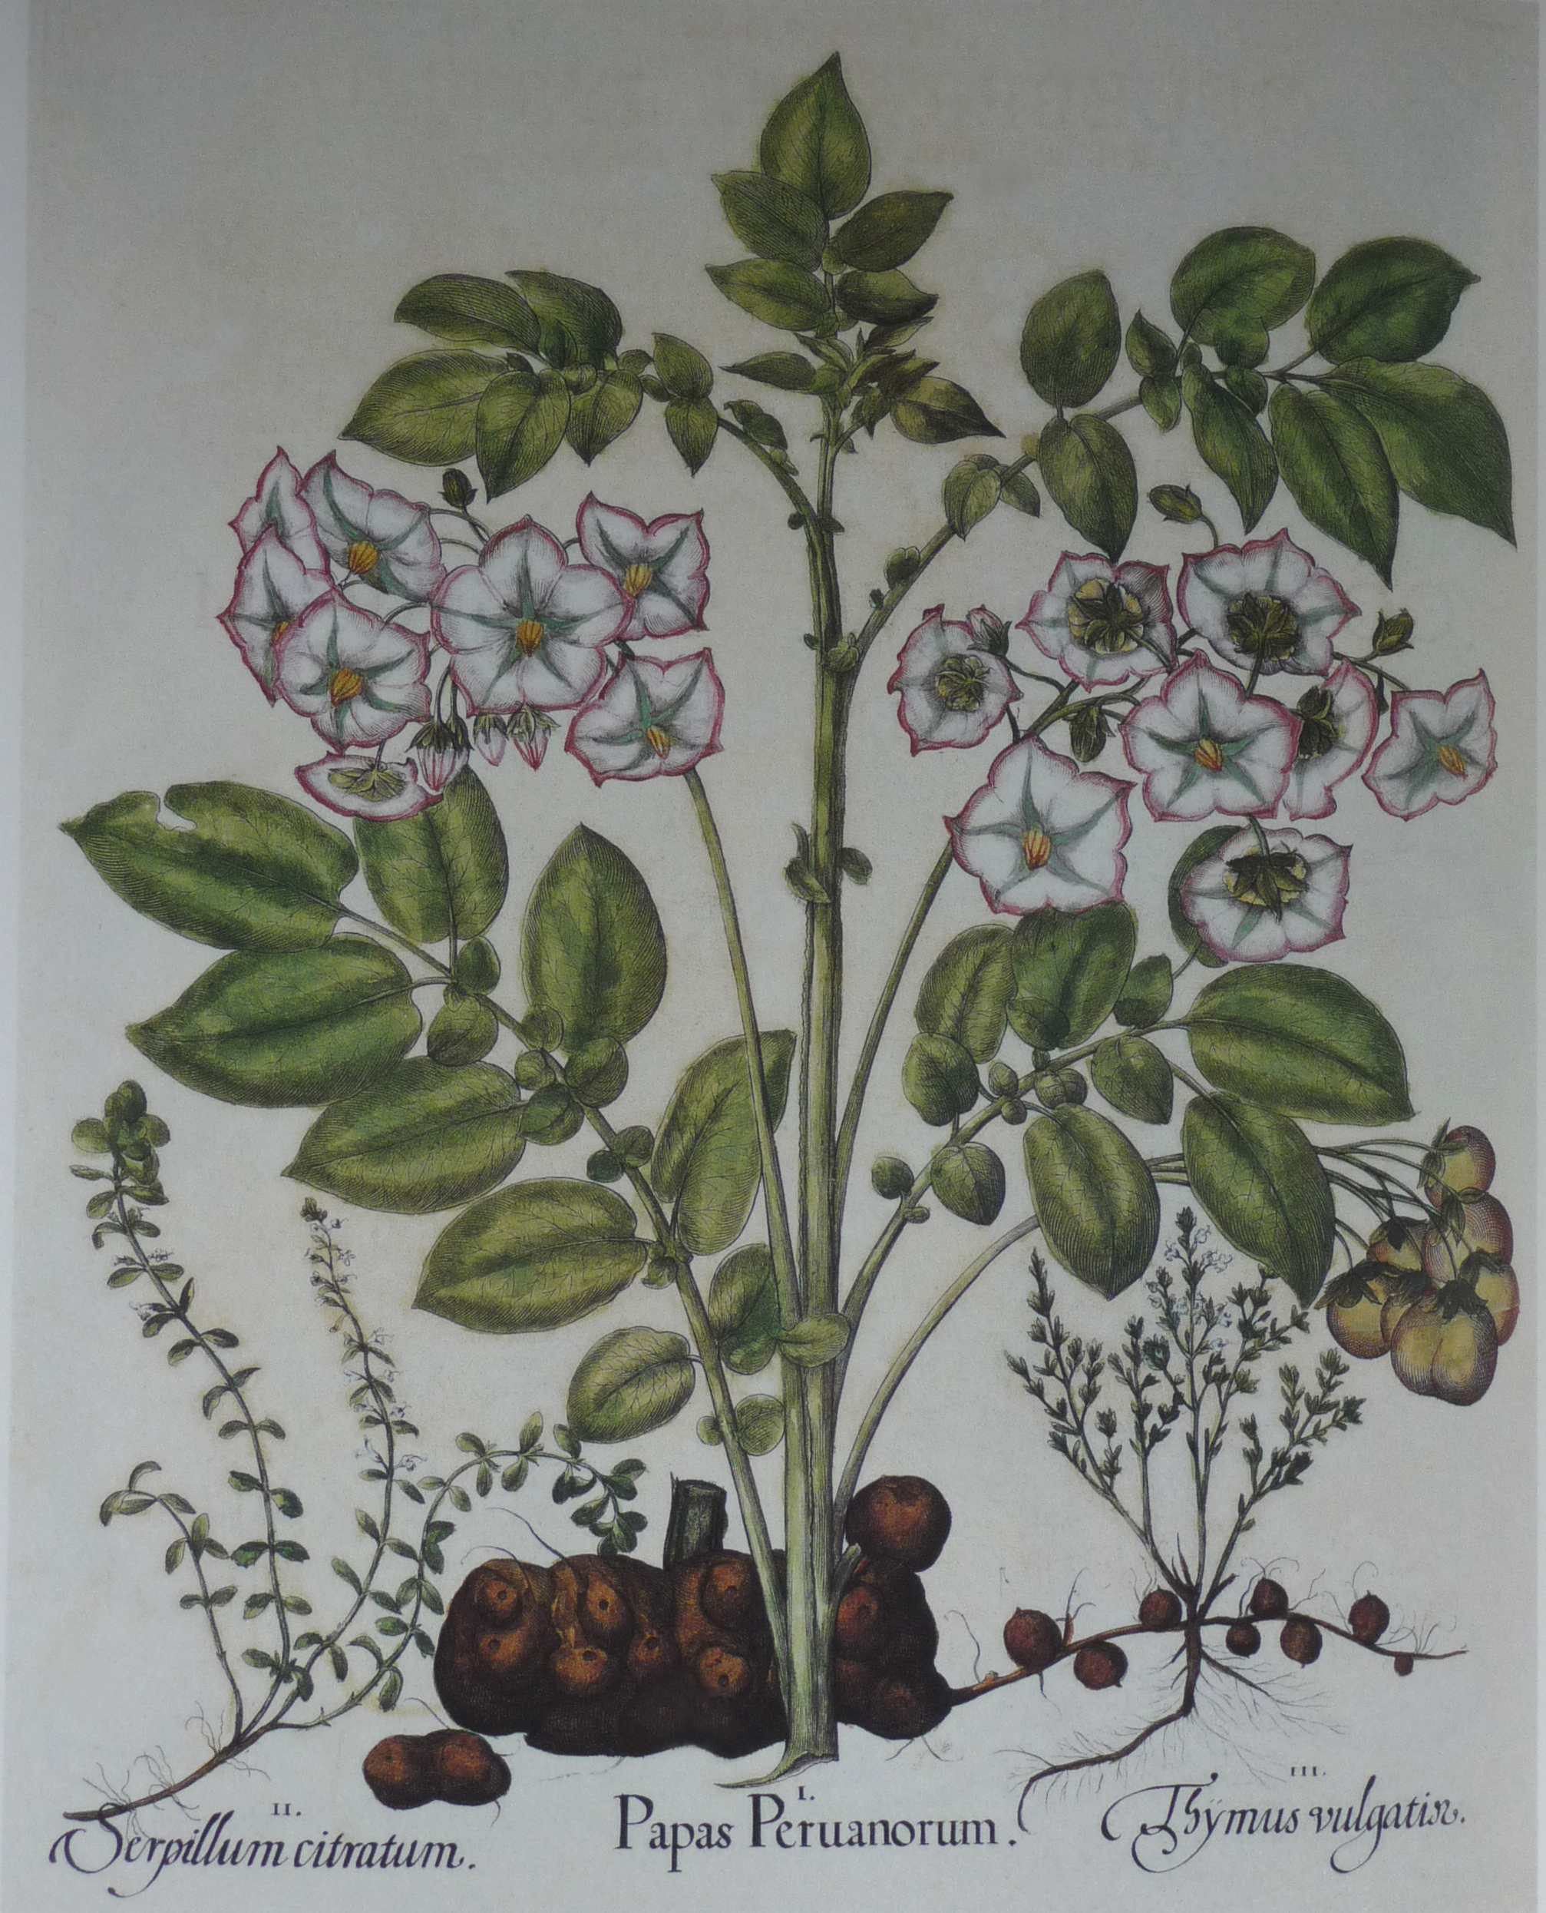
The Potato in a German Garden Book
Hortus Eystettensis, about 1613: Papas Peruanorum, the potato.
© More Lessons Less Planning | morelessonslessplanning.com
Notes:
Have students find the tubers at the base of the stem before you say anything about the caption. The plant part Europe ended up eating is the least showy thing on the plate.
Reference labels (point to these chart features when teaching): Flowers and leaves above; Tubers at the base

Slide 12
Three Words for Reading a Record
Eyewitness
Somebody who sets down what happened to him or in front of him, rather than what he was told afterwards
Second-hand account
A report set down by somebody who was not there, out of what other people told him
Estimate
A figure a writer reaches by impression or argument rather than by counting heads one at a time
Key Concept: Whether a writer was present changes what his page can prove.
© More Lessons Less Planning | morelessonslessplanning.com
Notes:
These three terms are the tools for the rest of the lesson. Every document from here on gets sorted with them.

Slide 13
The Man Who Wrote It Down and Never Sailed
"I have repeated what is told to me about the fertility of the country by all those, without exception, who have returned from there."
— Peter Martyr d'Anghera, De Orbe Novo, MacNutt translation, 1912
He held a post at the Spanish court and never crossed the Atlantic, and signed one of these letters from the Court of Spain in 1494. Every figure of his came from a returning sailor.
Note: Second-hand does not mean worthless. It means the page proves something else.
© More Lessons Less Planning | morelessonslessplanning.com
Notes:
This is the writer behind every crop and animal figure in the lesson. He states his own method inside his own report, which is unusually helpful.

Slide 14
The Cargo Nobody Loaded
A soldier wrote that Narvaez's company brought a man ill with smallpox.
Through that man the disease spread itself through New Spain.
The inhabitants said the disease was previously unknown in the country.
The same soldier writes that vast numbers were cut off.
He gives no figure, and no cargo list ever named this crossing.
Warning: Vast numbers is not a count. The soldier never counted anybody.
© More Lessons Less Planning | morelessonslessplanning.com
Notes:
Handle this factually. The disease crossing is the largest consequence in the lesson and the one the surviving documents measure worst.

Slide 15
Two Words for the Sickness
Pestilence
The word these writers use for a sickness that runs fast through a place and kills large numbers
Immunity
Protection from a sickness that a body carries after surviving it, and that a whole people builds up only where the sickness has already been
Fact: Not one writer in this lesson had the idea we now call immunity.
© More Lessons Less Planning | morelessonslessplanning.com
Notes:
Pestilence is the period word. Immunity is ours. Keeping them apart is what lets students read the documents without importing modern explanations.

Slide 16
The Same Years in a Kaqchikel Maya Account
Who kept it
The Xahila family of the Kaqchikel Maya kept annals in their own language. They are a Maya people of highland Guatemala, not Aztec or Nahua.
✔
How it began
"In the course of the fifth year the pestilence began. First there was a cough, then the blood was corrupted, and the urine became yellow."
✔
Who died
In order: Chief Vakaki Ahmak, the ancestor Diego Juan, the king Hunyg - and two days after the king, the writer's father, the Counselor Balam.
✔
What was left
"the stench was such that men died of it alone . . . we were all that remained."
✔
Key Concept: The only document here written by people the sickness reached. Quoted words are the 1885 English translation.
© More Lessons Less Planning | morelessonslessplanning.com
Notes:
Name the people accurately on the page. Students who have met this topic before usually expect an Aztec source, and this is not one.

Slide 17
Totals Without a Head Count
Place | What one accuser reported
Hispaniola | "Three Millions of Persons" had lived there; a "remnant of scarce Three Hundred" was left
The Lucayan islands | About "Five Hundred Thousand Men" dwelt there; a ship sent later "found Eleven Persons"
St. John and Jamaica | Held "six hundred thousand at least"; now "scarce two hundred men to be found in either of them"
Warning: No head count was ever taken on these islands before the ships came. Quoted words are the 1689 English translation.
© More Lessons Less Planning | morelessonslessplanning.com
Notes:
Treat every figure here as a claim printed to move a king, never as a measurement. The book names nobody who counted anyone.

Slide 18
Two Totals in One Paragraph
"[ . . . ] above Twelve Millions (computing Men, Women, and Children) have undeservedly perished; nor do I conceive that I should deviate from the Truth by saying that above Fifty Millions in all paid their last Debt to Nature."
— Bartolome de las Casas, A Brief Account of the Destruction of the Indies, English translation of 1689
Both totals cover the same forty years and sit in one paragraph. He wrote to force a decision, not to file a survey. A writer who prints two figures that far apart is estimating.
Key Concept: Two totals that far apart in one paragraph cannot both be counts.
© More Lessons Less Planning | morelessonslessplanning.com
Notes:
This is the clearest evidence in the lesson that a writer is estimating, and it comes from the writer himself, on the page, in one paragraph.

Slide 19
Two Words for Counting
Census
An actual head count of the people living in a place, taken and written down at one time
Polemic
A piece of writing made to win an argument and force a decision, rather than to give a balanced account
Key Concept: A polemic can be accurate and still be built to win an argument.
© More Lessons Less Planning | morelessonslessplanning.com
Notes:
These two words are the last on the Reference Guide, and they are the ones the Activity's final question is argued with.

Slide 20
What These Four Documents Can Establish
They can establish
They cannot establish
What a historian does next
What was loaded, sown, bred and drowned.
What one soldier says the inhabitants told him.
What one Kaqchikel Maya family lived through.
How many people lived here before the ships came.
How many died, because no one took a head count.
Why the sickness spread as fast as it did.
Reads tribute rolls, parish registers and tax lists.
Weighs archaeology against the written accounts.
Says plainly where the record runs out.
Key Concept: The record cannot give a total. The loss was still enormous.
© More Lessons Less Planning | morelessonslessplanning.com
Notes:
Hold the two halves of the callout apart. Both are true, and the second does not depend on the first.

Slide 21
Key Takeaways - What to Take Out of Today
Crops, animals and sickness crossed in both directions after 1492.
★
Some crossings were loaded on purpose; the sickness was not.
★
Maize and the potato went east and now feed much of the world.
★
One of these four writers never crossed the ocean at all.
★
No document here holds a head count taken before the ships came.
★
© More Lessons Less Planning | morelessonslessplanning.com
Notes:
Close on the last line. It is the sentence students need for the Activity's final question and the one they are most likely to forget.

