Slide 1
The Code of Hammurabi
How Babylon used written law to enforce order and justice.
© More Lessons Less Planning | morelessonslessplanning.com
Notes:
Open with the hook. Almost 3,800 years ago, a king named Hammurabi ruled the city of Babylon in Mesopotamia. He did something remarkable: he had hundreds of laws carved onto a tall stone stele and set it up in public where anyone could see it. It is one of the earliest written law codes in history. Today students learn who Hammurabi was, what his code said, how it treated different social classes, and how writing laws down in stone helped an early state keep order and claim to deliver justice. The lesson ends with students reading real laws from the Code in a 1915 translation.

Slide 2
Learning Targets
Explain who Hammurabi was and what the Code of Hammurabi was
★
Describe how the Code enforced order - case law, lex talionis, and social class
★
Analyze how public written law gave a state order, justice, and royal power
★
© More Lessons Less Planning | morelessonslessplanning.com
Notes:
Read each target aloud. Target 1 maps to slides 3-5 (Hammurabi, Babylon, and what the Code was). Target 2 maps to slides 6-11 (the stele, case law and precedent, lex talionis, social class, and everyday law). Target 3 maps to slides 12-13 (how written public law enforced order and justice) and drives the Primary Source Spotlight, where students analyze real laws from the Code. The quiz and activity test all three.

Slide 3
Who Was Hammurabi?
The King
The Place
HAMMURABI was the king of BABYLON
He reigned about 1792 to 1750 BCE
A skilled war leader and organizer
He issued history's most famous early law code
BABYLON was a city-state in MESOPOTAMIA
MESOPOTAMIA = the land between the rivers
The Tigris and Euphrates fed rich farmland
Babylon grew into a powerful capital city
Key Concept: HAMMURABI was the king of BABYLON (reigned about 1792-1750 BCE) who united MESOPOTAMIA and issued a famous written law code.
© More Lessons Less Planning | morelessonslessplanning.com
Notes:
Introduce the king and his world. HAMMURABI was the king of BABYLON who reigned from about 1792 to 1750 BCE. BABYLON was a city-state in MESOPOTAMIA - the 'land between the rivers,' meaning the Tigris and Euphrates, whose rich farmland had supported cities for thousands of years. Hammurabi was a skilled military leader and organizer who conquered rival cities and united much of Mesopotamia under Babylon's rule. But he is remembered today not mainly for his wars but for something he wrote down: the most famous early law code in history, which is the focus of this lesson.

Slide 4
Babylon and the Empire
Mesopotamia
MESOPOTAMIA was the 'land between the rivers' (the Tigris and Euphrates), where the world's first cities and empires developed.
Empire
An EMPIRE is a large territory of many cities and peoples ruled by one government; Hammurabi built a Babylonian empire across Mesopotamia.
One ruler, many peoples
Hammurabi's empire brought many cities under one king - each with its own customs and disputes
The problem of ruling
One king needed a single, clear standard of law that could apply to everyone he ruled
Big Idea: To rule a large EMPIRE of many different cities, Hammurabi needed one clear standard of law that applied to everyone.
© More Lessons Less Planning | morelessonslessplanning.com
Notes:
Explain the political problem the Code solved. MESOPOTAMIA, the land between the Tigris and Euphrates rivers, was dotted with cities that had their own rulers, customs, and ways of settling disputes. When Hammurabi conquered them, he built an EMPIRE - a large territory of many cities and peoples ruled by one government. Ruling such a mix created a problem: how do you keep order across many cities that each did things their own way? Hammurabi's answer was a single, written standard of law that applied across his empire, so that a dispute in one city would be judged by the same rules as a dispute in another. That need for one clear standard is exactly why a written law code was so valuable to a king.

Slide 5
What Was the Code of Hammurabi?
The Law Code
Set in Stone
The CODE OF HAMMURABI was a written law code
One of the earliest and most complete ever found
About 282 laws, issued around 1754 BCE
It covered crime, trade, family, and property
The laws were carved onto a tall stone STELE
The stele was set up in public for all to see
The same rules now applied across the empire
The stone survives and can still be read today
Key Concept: The CODE OF HAMMURABI was one of the earliest written law codes - about 282 laws carved on a stone STELE around 1754 BCE.
© More Lessons Less Planning | morelessonslessplanning.com
Notes:
Define the central term. The CODE OF HAMMURABI was one of the earliest and most complete written law codes ever discovered - about 282 laws issued by King Hammurabi of Babylon around 1754 BCE. It covered crime and punishment, trade and prices, marriage and family, property, and the work of professionals like builders and doctors. What made it powerful was not just that the laws existed but that they were WRITTEN DOWN and carved onto a tall stone STELE set up in public. Once the law was fixed in stone for all to see, the same rules applied across the empire, and no official could quietly change them. Because the stone survived, we can still read Hammurabi's actual laws today.

Slide 6
Law Set in Stone: The Stele and Shamash
The Stele
The God of Justice
A STELE is a tall stone pillar or monument
Hammurabi's stele was a black stone over 7 feet tall
Nearly 282 laws were carved down its sides
It was displayed in public for all to see
The top shows a carving of SHAMASH
SHAMASH was the sun god and god of JUSTICE
He hands Hammurabi the symbols of royal power
Message: the king's law comes from the gods
Key Concept: A STELE is a tall stone monument. At the top, SHAMASH - the god of JUSTICE - hands Hammurabi the authority to rule and judge.
© More Lessons Less Planning | morelessonslessplanning.com
Notes:
Describe the monument and its powerful image. A STELE is a tall stone pillar or monument. Hammurabi's stele was a polished black stone more than seven feet tall, with nearly 282 laws carved in cuneiform down its sides. It was set up in public so the law was visible to everyone. Carved at the very top is a scene that carried a political message: the god SHAMASH, the Mesopotamian sun god and god of JUSTICE, sits on a throne and hands King Hammurabi the rod and ring - symbols of the authority to rule and to judge. The message to every Babylonian was clear: these laws are not just one man's opinion; the king received his authority and his justice from the gods themselves. The next slide shows this carving. Making the law look divine made it much harder to challenge.

Slide 7
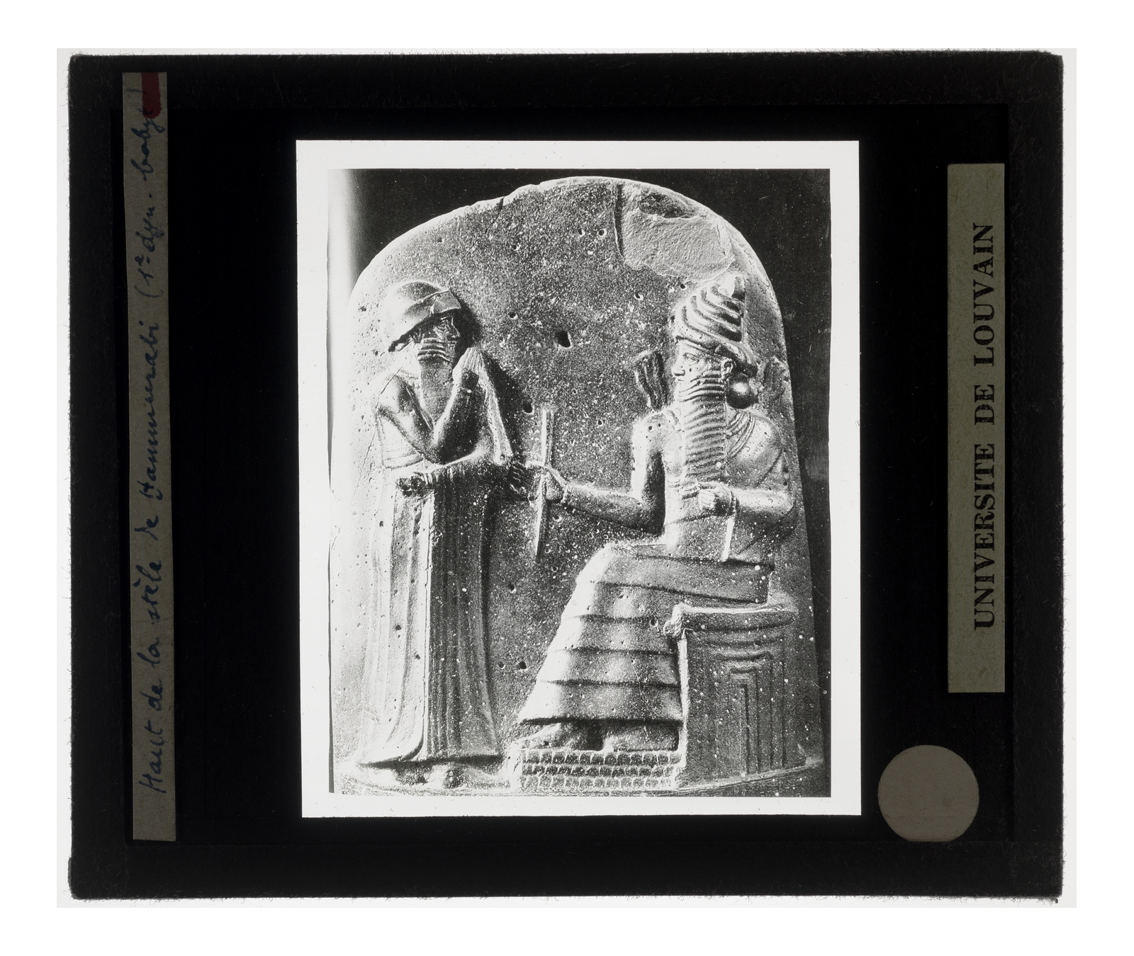
The Top of the Stele
The top of the stele: Hammurabi receives the law from Shamash
© More Lessons Less Planning | morelessonslessplanning.com
Notes:
Show the actual relief from the top of the Code of Hammurabi stele. On the right, the sun god SHAMASH sits on a throne, flames rising from his shoulders, holding out the rod and ring - the symbols of royal and legal authority. On the left, King Hammurabi stands in a pose of respect, receiving them. This single carving is the political heart of the whole monument: it shows the king getting his right to make law directly from the god of justice. Have students notice that Hammurabi stands lower and reaches up toward the seated god - the composition itself says the gods are the source of the law. This image is a real public-domain photograph of the carving; the teaching content lives on the previous slide.
Reference labels (point to these chart features when teaching): Hammurabi standing in respect; Shamash, god of justice

Slide 8
If a Man...: Case Law and Precedent
Case law
CASE LAW is law written as specific 'if...then' cases - a situation and its exact punishment; this is the form used throughout the Code.
The 'if...then' form
Each law names a situation and its result: 'If a man does X, then the punishment is Y'
Precedent
A PRECEDENT is an earlier case or decision used as a rule for judging later ones; the Code's cases set precedents for judges.
Predictable justice
Because the outcome was written in advance, people could know the punishment before acting
Key Concept: The Code is CASE LAW - 'if...then' rules. Each written case became a PRECEDENT that guided judges in later disputes.
© More Lessons Less Planning | morelessonslessplanning.com
Notes:
Explain how the laws were actually written. The Code of Hammurabi is written as CASE LAW: law made of specific 'if...then' cases, each naming a situation and its exact punishment. A typical law reads, 'If a man does X, then the punishment is Y.' This 'if...then' form is used through the whole code. The value of writing law this way is that each case became a PRECEDENT - an earlier decision used as a rule for judging later, similar cases. Because the outcome of a situation was written down in advance, a Babylonian could know the likely punishment before acting, and a judge had a fixed standard to follow instead of simply deciding however he wished. Predictable, written-down rules are a big step toward organized justice.

Slide 9
An Eye for an Eye: Lex Talionis
The Idea
Why Use It
LEX TALIONIS means 'an eye for an eye'
The punishment is meant to match the crime
Injure someone, and the same is done to you
Law 196: put out an eye, your eye is put out
It made punishments equal to the harm done
It replaced endless private revenge and feuds
The state, not the family, set the penalty
But it could be harsh and violent by our standards
Key Concept: LEX TALIONIS - 'an eye for an eye' - is a punishment meant to match the crime, and it runs throughout the Code of Hammurabi.
© More Lessons Less Planning | morelessonslessplanning.com
Notes:
Explain the code's most famous principle. LEX TALIONIS is the principle of 'an eye for an eye' - a punishment meant to match the crime done. If you put out another man's eye, your own eye is put out (Law 196); if you break his bone, your bone is broken. This idea runs throughout the Code of Hammurabi. To us it can sound brutal, but in its time it was actually a way to LIMIT violence: instead of a wronged family taking endless revenge - killing over an injury, feuding for generations - the state set a fixed, equal penalty. The punishment matched the harm, no more and no less, and it was the government, not private families, that carried it out. That shift, from private revenge to state-set penalties, is part of how an early state took control of justice.

Slide 10
Law and Social Class
Social class | Who they were | How the law treated them
Free people (awilum) | Landowners, officials, full citizens | Most protected - 'eye for an eye' for harming them
Commoners (mushkenum) | Dependents and lower free people | Protected less - harm often repaid with money
Enslaved people (wardum) | People owned as property | Least protected - harm repaid with a smaller payment
Big Idea: The Code shows a clear SOCIAL CLASS system - the SAME injury brought a harsher penalty when the victim was of higher class.
© More Lessons Less Planning | morelessonslessplanning.com
Notes:
Show that the law was not equal for everyone. Babylonian society was divided by SOCIAL CLASS - a group in society ranked by status. The Code recognizes roughly three classes: free people (landowners and officials), commoners (lower free people and dependents), and enslaved people (owned as property). The striking thing is that the law treated these classes DIFFERENTLY for the very same act. Harming a free person brought the harshest, 'eye for an eye' punishment. Harming a commoner or an enslaved person was often settled with a money payment instead, and the payment was smaller for lower-status victims. In other words, the same injury was punished more severely when the victim was of higher class. This tells us the Code was designed to protect the social order and the upper classes most strongly - even though Hammurabi claimed the code brought justice to all.

Slide 11
Everyday Law: Family, Property, and Responsibility
Area of life | Example law | What it shows
Property and theft | A thief who cannot repay what he stole is put to death | The state protected property and trade
Family | A husband who divorced a childless wife had to return her dowry | The law defined and regulated family life
Responsibility | A builder whose house collapses and kills the owner is put to death | People were held responsible for their work
Big Idea: The Code reached into everyday life - protecting property, defining marriage, and holding workers responsible for the harm they caused.
© More Lessons Less Planning | morelessonslessplanning.com
Notes:
Show how far the Code reached into daily life. The Code of Hammurabi was not only about violent crime; it governed everyday life across the empire. On PROPERTY and theft, it protected owners and trade: a thief who could not repay what he stole could be put to death, which shows how seriously the state guarded property. On FAMILY, the law defined marriage, inheritance, and divorce - for example, a husband who divorced a wife who had borne him no children had to return her dowry and marriage payment - which shows the state regulating family life. On RESPONSIBILITY, professionals were held accountable for their work: a builder whose poorly built house collapsed and killed its owner could be put to death. Together these laws show a state using written rules to protect property, order family life, and demand that people be responsible for the harm they caused - the same laws students will read in the activity.

Slide 12
Justice, Order, and the Power of Written Law
How Writing Law Down Helped
Justice and Royal Power
Everyone could know the same rules in advance
No official could secretly change the law
Judges had one fixed standard to follow
It brought ORDER across a large empire
Hammurabi claimed the code delivered JUSTICE
He said it protected the weak from the strong
Shown receiving law from SHAMASH, god of justice
So the king became the source of JUSTICE and order
Key Concept: Public written law brought ORDER and let Hammurabi claim to be the source of JUSTICE - fair treatment and the upholding of what is right.
© More Lessons Less Planning | morelessonslessplanning.com
Notes:
Bring the analysis together. Writing the law down and displaying it in public gave an early state real power to keep ORDER. Because the rules were written and visible, everyone could know the same law in advance, no official could quietly change it, and judges had one fixed standard to apply across a large empire. Just as important, the Code let Hammurabi claim to deliver JUSTICE - fair treatment and the upholding of what is right. In the code's own words, he presented himself as a king who protected the weak from the strong, and the stele's carving showed him receiving the law from SHAMASH, the god of justice. Whether or not the laws were truly fair - and the class-based penalties show they were not equal - the effect was to make the king the recognized source of justice and order. Controlling the law is one of the most powerful things an early state can do.

Slide 13
Why the Code of Hammurabi Mattered
Its Importance Then
Why It Matters to Us
One of the earliest written law codes we have
Set one standard of law across an empire
Moved justice from private revenge to the state
Made the ruler the public source of the law
A rare, detailed window into Babylonian life
Shows early ideas of justice and responsibility
The stele survived, so we read the actual laws
An early root of written, public legal systems
Big Idea: The Code of Hammurabi is one of the earliest written law codes, and because the stele survived we can still read an early state's own laws.
© More Lessons Less Planning | morelessonslessplanning.com
Notes:
Frame the significance. The Code of Hammurabi matters for several reasons. In its own time, it was one of the earliest written law codes, it set a single standard of law across a whole empire, it helped move justice from private revenge toward penalties set by the state, and it made the ruler the public source of the law. For us today, the Code is priceless evidence: it is a rare, detailed window into how Babylonians lived, traded, married, and settled disputes almost 3,800 years ago. Because the stele survived and could be read, we can study the actual laws of an early state - its ideas of justice, class, and responsibility - in its own words. The Code stands near the root of the long human story of written, public legal systems.

Slide 14
Key Takeaways
HAMMURABI of BABYLON issued one of the earliest written law codes (~1754 BCE)
★
The CODE OF HAMMURABI was carved on a public STELE and used 'if...then' CASE LAW
★
LEX TALIONIS ('an eye for an eye') set penalties; SOCIAL CLASS changed them
★
Public written law gave a state ORDER and made the king the source of JUSTICE
★
© More Lessons Less Planning | morelessonslessplanning.com
Notes:
Close the lesson. Review the four takeaways aloud. Students should be able to (a) say who Hammurabi was and what the Code of Hammurabi was, (b) describe how it worked - a public stele, 'if...then' case law, lex talionis, and class-based penalties, and (c) explain how writing law down and displaying it publicly gave an early state order and made the king the source of justice. The activity's Primary Source Spotlight asks them to analyze the Code's actual laws and connect them to how early states enforced order and justice.

