Slide 1
The Capture of Atahualpa
Pizarro, Cajamarca, and how a small Spanish force seized the Inca emperor in 1532
© More Lessons Less Planning | morelessonslessplanning.com
Notes:
Open on the through-line: in November 1532 a small Spanish force seized the Inca emperor Atahualpa in the square at Cajamarca. Pizarro boasted that so few had conquered so much. The lesson asks students to test that boast - was it technology, or a surprise ambush amid an Inca civil war?

Slide 2
Learning Targets
Explain who Pizarro and the conquistadors were and how they reached Atahualpa.
★
Describe what happened at Cajamarca on November 16, 1532, using Xerez's account.
★
The Spanish did not win by technology alone; other factors were decisive.
★
© More Lessons Less Planning | morelessonslessplanning.com
Notes:
Use the targets to preview the march to Cajamarca, the eyewitness source, and the misconception repair. The third target names the ambush, the Inca civil war, and smallpox on purpose.

Slide 3
The Inca Empire and Atahualpa
The Inca ruled a great empire in the Andes before the Spanish arrived.
Atahualpa was the Inca emperor when the Spanish reached his lands in 1532.
The empire stretched across the Andes of western South America.
Its wealth in gold and silver drew Spanish conquistadors toward its lands.
In 1532 the empire was weakened by a civil war between two royal brothers.
Key Point: The Inca ruled a vast Andean empire, and Atahualpa was its emperor in 1532.
© More Lessons Less Planning | morelessonslessplanning.com
Notes:
Establish the setting before the primary source. The Inca ruled a vast empire along the Andes; Atahualpa was emperor in 1532; the empire had just been divided by a civil war. Keep the tone respectful and factual.

Slide 4
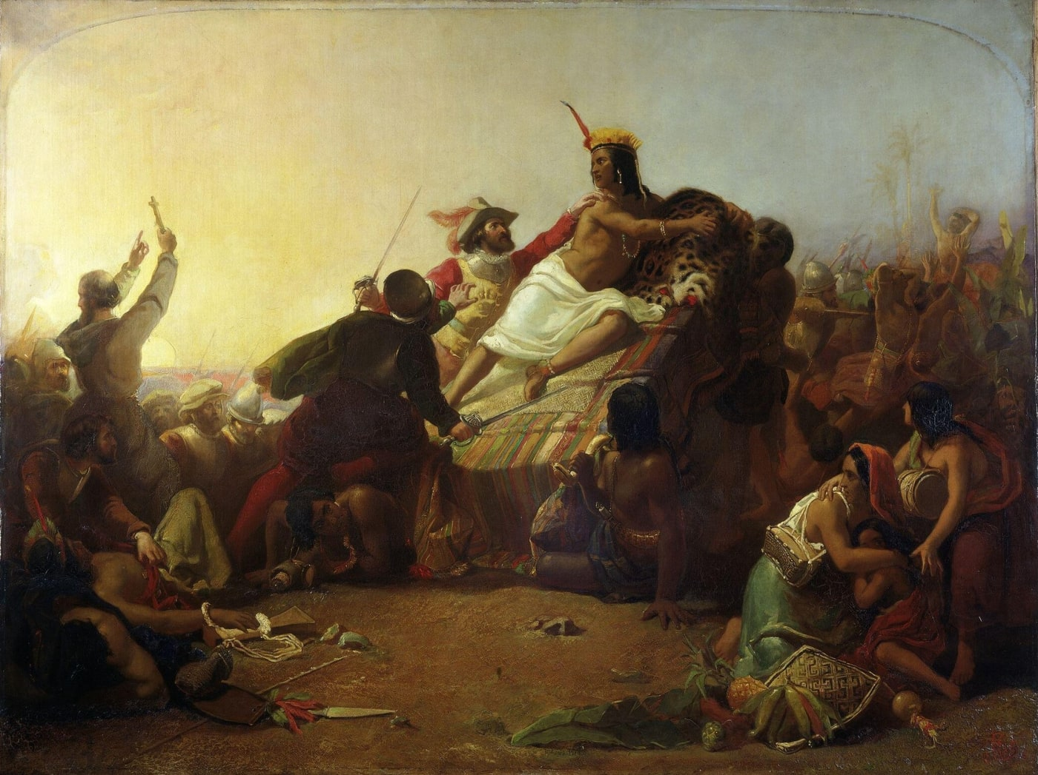
A later painting of the seizure of Atahualpa
Pizarro Seizing the Inca of Peru, John Everett Millais, 1845-46.
© More Lessons Less Planning | morelessonslessplanning.com
Notes:
Frame the painting honestly: it was made in 1845-46 by John Everett Millais, more than three hundred years after 1532. It is a dramatized 19th-century history painting, not a photograph or eyewitness record. Use it only for recognition of the scene, and note that a Victorian painter imagined the moment for a European audience.

Slide 5
Pizarro reaches Cajamarca (1532)
Who was Pizarro
Francisco Pizarro was the Spanish conquistador who led the conquest of the Inca Empire.
✔
What a conquistador was
A conquistador was a Spanish soldier-explorer who conquered lands in the Americas for Spain.
✔
Setting out
Pizarro's expedition set out from its settlement in search of Atahualpa on September 24, 1532.
✔
Reaching Cajamarca
The Spanish marched inland to Cajamarca, a northern Andean town, where Atahualpa was camped with his army.
✔
Key Point: Francisco Pizarro, a Spanish conquistador, led a small force to Cajamarca in 1532 in search of Atahualpa.
© More Lessons Less Planning | morelessonslessplanning.com
Notes:
Introduce Pizarro and the conquistadors and set the departure date from the record: September 24, 1532. The Spanish marched inland to Cajamarca, where Atahualpa was camped with his army after the civil war.

Slide 6
An empire divided: the Inca civil war
A divided empire
Why it mattered
Just before the Spanish arrived, the Inca were divided by a civil war.
It set two royal brothers, Atahualpa and Huascar, against each other.
The rival brothers fought for control of the Inca throne.
The war left the empire divided and exhausted.
Pizarro arrived at a moment of Inca weakness, not strength.
Key Point: A civil war between Atahualpa and Huascar had divided and weakened the Inca when Pizarro arrived.
© More Lessons Less Planning | morelessonslessplanning.com
Notes:
This context is essential to the misconception repair. An ongoing civil war between the brothers Atahualpa and Huascar had divided and weakened the Inca empire. Pizarro arrived at a moment of weakness he could exploit.

Slide 7
The ambush at Cajamarca (November 16, 1532)
Atahualpa entered the square in a litter adorned with gold and silver.
The friar Vicente de Valverde approached the emperor with an interpreter.
Valverde offered Atahualpa a holy book, which the Inca examined and threw down.
Pizarro seized Atahualpa by the arm, crying 'Santiago,' the Spanish war cry.
Hidden Spanish soldiers rushed the square in a surprise attack, an ambush.
Key Point: The seizure of Atahualpa on November 16, 1532 was a planned surprise ambush, not a battle fought in the open.
© More Lessons Less Planning | morelessonslessplanning.com
Notes:
Tell the seizure in order from the record: Atahualpa entered in a litter (F3); friar Valverde approached with an interpreter (F4); Valverde offered a holy book that Atahualpa examined and threw down (F2); Pizarro seized him by the arm crying 'Santiago' (F1) as hidden soldiers rushed the square. Present it as a planned ambush, stated factually, never celebrated.

Slide 8
Not technology alone: why the Inca fell
A common but wrong idea
What the evidence shows: four factors mattered
A tiny Spanish force beat the Inca purely because of steel, guns, and horses.
Superior technology alone toppled the empire.
First: a surprise ambush let a small force seize the emperor.
Second: capturing Atahualpa cut off the empire's leadership at once.
Third: the Inca were already divided by their civil war.
Fourth: a later smallpox epidemic devastated the Inca population.
Key Point: Not technology alone - the ambush, the captured emperor, the civil war, and smallpox were decisive.
© More Lessons Less Planning | morelessonslessplanning.com
Notes:
This is the heart of the misconception repair. State plainly that technology alone did not decide the conquest. Name all four factors completely and in order: the surprise ambush, the capture of the emperor, the Inca civil war, and the later smallpox epidemic. Keep the tone documentary.

Slide 9
People and place vocabulary
Inca
The people and empire that ruled the Andes of western South America before the Spanish arrived.
Atahualpa
The Inca emperor captured by Pizarro at Cajamarca in 1532.
Cajamarca (Caxamalca)
The northern Andean town where Pizarro ambushed and seized Atahualpa.
Francisco Pizarro
The Spanish conquistador who led the conquest of the Inca Empire.
conquistador
A Spanish soldier-explorer who conquered lands in the Americas for Spain.
Key Point: These terms name the people, their emperor, the town, the Spanish leader, and what a conquistador was.
© More Lessons Less Planning | morelessonslessplanning.com
Notes:
Connect each definition to a claim students will use in the activity and quiz. These are the first five reference-guide terms.

Slide 10
Conquest and capture vocabulary
litter
A covered seat carried on bearers' shoulders, used to carry the Inca emperor.
friar
A member of a Catholic religious order; Vicente de Valverde offered Atahualpa a holy book.
ransom
A payment demanded to free a prisoner; Atahualpa later filled a room with gold and silver.
Huascar
Atahualpa's brother; their civil war weakened the Inca just before the Spanish came.
ambush
A surprise attack from a hidden position, as the Spanish used to seize Atahualpa.
Key Point: These terms name how Atahualpa traveled, who offered the book, the ransom, the rival brother, and the ambush.
© More Lessons Less Planning | morelessonslessplanning.com
Notes:
These are the last five reference-guide terms. Huascar anchors the civil-war context; ambush anchors the seizure; ransom names what Atahualpa paid after his capture.

Slide 11
Reading Xerez as a source
Whose account is this?
The conquerors' perspective
Francisco de Xerez was Pizarro's own secretary and an eyewitness at Cajamarca.
He wrote the True Relation of the Conquest of Peru in 1534.
His account gives the Spanish side, not the Inca experience.
Pizarro's boast that 'so few' conquered great kingdoms is self-justification.
It leaves out the ambush, the civil war, and the disease behind the victory.
Key Point: Xerez wrote as Pizarro's secretary, so his account and Pizarro's boast give the conquerors' perspective, not neutral fact.
© More Lessons Less Planning | morelessonslessplanning.com
Notes:
Model critical reading. Xerez was Pizarro's own secretary and an eyewitness, writing in 1534, so his account gives the Spanish side. Pizarro's boast that 'so few' conquered great kingdoms is self-justification, not neutral fact - read it as the conqueror's own words, and notice what it leaves out.

Slide 12
Building a precise account
Setting: name the Inca empire, the emperor Atahualpa, and Cajamarca in 1532.
Event: the surprise ambush and seizure of Atahualpa on November 16, 1532.
Evidence: use one detail from Xerez's eyewitness account.
Causes: the ambush, the captured emperor, the civil war, and smallpox.
Perspective: treat Xerez and Pizarro's boast as the conquerors' side.
Remember: A precise account names the ambush, the civil war, and smallpox, never technology alone.
© More Lessons Less Planning | morelessonslessplanning.com
Notes:
Prepare students to write the activity's final account. A precise account sets the scene, describes the ambush and the November 16, 1532 seizure, uses one Xerez detail, names all four decisive factors, and treats Xerez as the conquerors' side.

Slide 13
Key Takeaways
The Inca ruled a vast Andean empire; Atahualpa was its emperor in 1532.
★
On November 16, 1532, Pizarro's force seized Atahualpa in a surprise ambush.
★
Technology alone did not defeat the Inca - ambush, civil war, and smallpox did.
★
Xerez was Pizarro's secretary, so his account gives the conquerors' side.
★
© More Lessons Less Planning | morelessonslessplanning.com
Notes:
Close by returning to the essential question and asking students for one precise account that names the ambush, the civil war, and smallpox, not technology alone. Note that after his capture Atahualpa paid a great ransom of gold and silver.

