Slide 1
The Business Cycle: Boom, Bust, Recovery
The four phases of the U.S. economy - expansion, peak, recession, trough/recovery - and how to classify recent years.
© More Lessons Less Planning | morelessonslessplanning.com
Notes:
Open with the question: 'Is the U.S. economy in an expansion or a recession right now?' Most students will not know how to answer with precision. Today's lesson teaches the four NBER-defined phases of the business cycle (expansion, peak, recession, trough/recovery), the average lengths since 1945, why cycles happen at all, and how to classify recent U.S. years into the correct phase. By the end students should be able to read any year on the FRED real-GDP chart and call out its phase using the NBER framework.

Slide 2
Learning Targets
Identify the four phases: expansion, peak, recession, trough/recovery
★
Describe what happens to GDP, jobs, prices, and confidence in each phase
★
Apply phase analysis to recent U.S. cycles and the years 2018-2026
★
© More Lessons Less Planning | morelessonslessplanning.com
Notes:
Read each target aloud. Target 1 maps to slides 3-7 (the wave + each phase). Target 2 maps to slides 4-7 (what happens to GDP, jobs, prices, confidence in each phase). Target 3 maps to slides 12 and the activity (classify recent years). The practical capstone is the Activity Part 3 scenario cards where students place specific years and quarters into phases.

Slide 3
The Business Cycle in One Diagram
Four Phases, One Wave
Around a Long-Run Trend
Expansion: real GDP rising
Peak: the highest point
Recession: real GDP falling
Trough: the lowest point (then recovery)
Trend line = long-run growth (about 2% real per year)
The cycle oscillates around the trend
Up in expansion, down in recession
NBER dates the peaks and troughs
Key Concept: The cycle has FOUR phases - expansion, peak, recession, trough/recovery - oscillating around a long-run growth trend.
© More Lessons Less Planning | morelessonslessplanning.com
Notes:
Introduce the four-phase wave. The business cycle is the recurring pattern of expansion, peak, recession, and trough in the real economy. The cycle is measured by NBER (National Bureau of Economic Research) which dates the peaks (when activity stops rising) and the troughs (when activity stops falling). The U.S. economy GROWS over the long run - real GDP has roughly tripled since 1980 - but it does not grow in a straight line. It oscillates around a long-run growth trend (about 2% real per year). EXPANSION = going up; PEAK = the top; RECESSION = going down; TROUGH = the bottom. After the trough comes the next expansion (the recovery phase). Students will see the idealized version after we walk through each phase, and the real U.S. record a few slides later.

Slide 4
Phase 1: Expansion
What it is
The phase when real GDP is GROWING - the trough-to-peak portion of the cycle
What happens to GDP
Real GDP rises quarter after quarter; growth often accelerates mid-expansion
What happens to jobs
Employment rises; the unemployment rate falls; firms hire and pay rises
What happens to prices
Inflation often picks up late in an expansion as the economy nears full capacity
How long it lasts
U.S. post-1945 expansions average about 64 months (over 5 years); the longest was 128 months (2009-2020)
Big Idea: Expansion is the LONG phase. Most years in the U.S. record have been expansion years; recessions are the exception.
© More Lessons Less Planning | morelessonslessplanning.com
Notes:
Introduce the expansion phase. Expansion is the period from the previous TROUGH to the next PEAK; it is the phase when real GDP is rising. During an expansion, employment rises, the unemployment rate falls, real incomes grow, and (typically late in the expansion) inflation picks up as the economy nears full capacity. U.S. post-1945 expansions average about 64 months - over five years. The LONGEST expansion on record ran from June 2009 to February 2020 (128 months - 10+ years), ending with COVID. The current expansion that began April 2020 is, as of 2026, in its sixth year. Students should leave knowing expansion is the LONG phase - most years in the U.S. record have been expansion years; recessions are the (shorter) exception.

Slide 5
Phase 2: Peak
The Top of the Cycle
What It Looks Like
The HIGHEST point of real economic activity
The month when activity stops rising
After the peak, the economy contracts
NBER dates each peak by month
Inflation often elevated, Fed often tightening
Yield curve often inverted at the peak
Stock market often hits a high (before falling)
Recent U.S. peaks: Feb 2020, Dec 2007, Mar 2001
Tip: A peak is dated by MONTH, not by quarter. NBER announces peaks well AFTER they have occurred.
© More Lessons Less Planning | morelessonslessplanning.com
Notes:
Introduce the peak. The PEAK is the highest point of real economic activity - the month when activity stops rising and begins to fall. NBER dates each peak by month, not by quarter. Recent U.S. peaks: February 2020 (the COVID peak), December 2007 (the Great Recession peak), March 2001 (the dot-com peak), July 1990, July 1981, January 1980. At a peak, the economy is typically running hot - inflation is often elevated, the Fed is typically tightening (raising rates), the yield curve is often inverted (or about to invert), and the stock market often hits a high just before falling. Important point: NBER announces peaks well AFTER they have occurred - it took NBER about four months to declare the February 2020 peak (announced June 2020). The peak is the dividing line between expansion and recession.

Slide 6
Phase 3: Recession (Contraction)
What it is
Real GDP is FALLING - the peak-to-trough part of the cycle
What happens to GDP
Real GDP falls; mild (1990-91 ~1.4%) to severe (2007-09 ~5%; 2020 ~9%)
What happens to jobs
Employment falls; unemployment rises; firms cut hiring
What happens to prices
Inflation usually slows as demand falls (1970s stagflation excepted)
How long it lasts
Average 10-11 months; 2020 COVID was 2 months; longest 16-18 months (2007-09)
Big Idea: Recession is the SHORT phase - usually 10-11 months. The pain is real but the average duration is less than one year.
© More Lessons Less Planning | morelessonslessplanning.com
Notes:
Introduce the recession phase. Recession (also called CONTRACTION) is the period from the peak to the trough - the phase when real GDP and employment are falling. Real GDP declines, often broadly across sectors. Employment falls; the unemployment rate rises (typically peaking AFTER the recession ends - it is a lagging indicator). Inflation typically slows as demand falls (the 1970s stagflation was an exception - recession AND high inflation together). Length: U.S. post-1945 recessions average about 10-11 months. The 2020 COVID recession was the SHORTEST on record at 2 months (February-April 2020). The longest were 1973-1975 (16 months), 1981-1982 (16 months), and 2007-2009 (18 months - the Great Recession). The pain of a recession is real, but the average duration is less than one year - much shorter than the average expansion.

Slide 7
Phase 4: Trough and Recovery
The Trough
The Recovery
The LOWEST point of the cycle
The month when activity stops falling
After the trough, the next expansion begins
Recent U.S. troughs: Apr 2020, Jun 2009, Nov 2001
Early part of the next expansion just after the trough
GDP starts rising, but the 'jobless recovery' is slow - jobs lag
Unemployment often KEEPS rising for months after the trough
Confidence and stocks usually turn up first
Key Concept: TROUGH is the LOW point; RECOVERY is the early part of the next expansion. Unemployment often keeps rising AFTER the trough.
© More Lessons Less Planning | morelessonslessplanning.com
Notes:
Introduce the trough and the recovery. The TROUGH is the lowest point of the cycle - the month when economic activity stops falling and begins to rise. Recent U.S. troughs: April 2020, June 2009, November 2001, March 1991, November 1982, July 1980. After the trough comes the RECOVERY - the early part of the next expansion. During the recovery, real GDP starts rising again, but employment is slow to recover - the unemployment rate often keeps rising for months AFTER the trough because firms wait to see if the upturn will stick before hiring. Consumer confidence and the stock market typically turn up first (often BEFORE the trough), followed by GDP, then employment. The 2009-2014 recovery was nicknamed the 'jobless recovery' because employment took nearly five years to return to pre-recession levels.

Slide 8
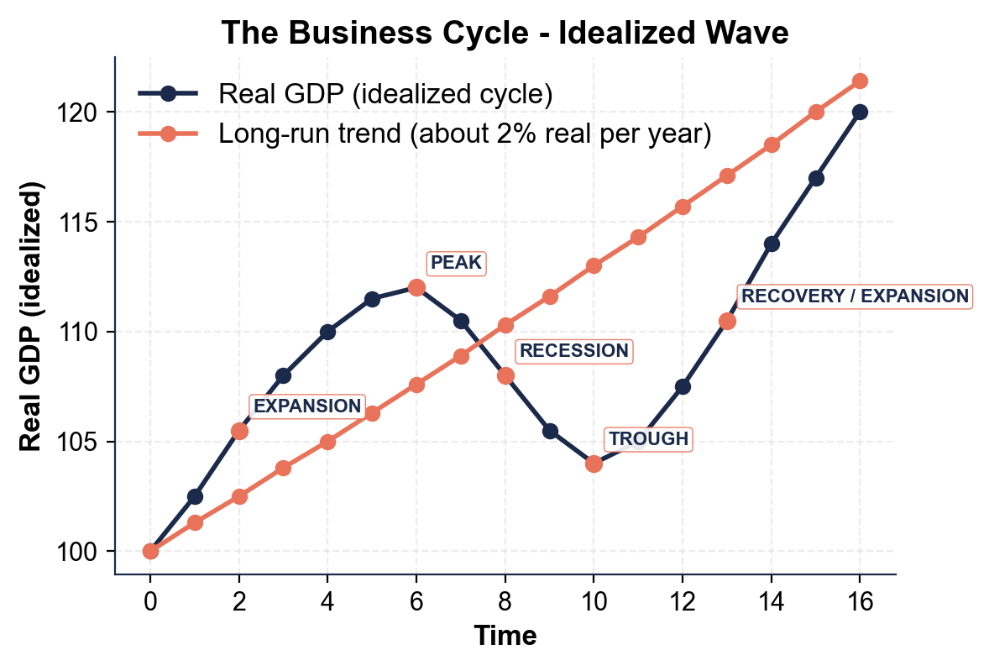
The Business Cycle - Idealized Wave
Note: The cycle oscillates around the long-run trend line.
© More Lessons Less Planning | morelessonslessplanning.com
Notes:
Read the idealized wave. The dashed line is the long-run trend (about 2% real growth per year). The solid line oscillates around it: EXPANSION rises above and back toward the trend, PEAK is the local high, RECESSION falls below and back toward the trend, TROUGH is the local low. After the trough, the next expansion begins. This is the textbook picture; real-world cycles vary in depth and length but follow the same four-phase pattern.
Reference labels (point to these chart features when teaching): Peak = top, Trough = bottom; Up = expand, down = recession

Slide 9
Cycle Lengths Historically
Era | Avg Expansion | Avg Recession
Pre-1945 | 26 months | 18 months
1945-2019 (post-WWII) | 64 months | 11 months
1985-2007 (Great Moderation) | 95 months | 8 months
2009-2020 expansion | 128 months (record) | n/a
2020 recession | n/a | 2 months (shortest)
Big Idea: Post-WWII cycles are LONGER expansions and SHORTER recessions than pre-1945 - the economy has become more stable.
© More Lessons Less Planning | morelessonslessplanning.com
Notes:
Walk through the historical cycle lengths. Pre-1945 cycles were SHORTER and more violent: expansions averaged only about 26 months, recessions averaged 18 months, and financial panics were frequent (1873, 1893, 1907, 1929). Post-1945 cycles are LONGER expansions and SHORTER recessions - expansions average 64 months, recessions average 11 months. The Great Moderation (roughly 1985-2007) was a period of unusually long expansions and mild recessions - expansions averaged 95 months. The 2009-2020 expansion was the LONGEST on record at 128 months. The 2020 COVID recession was the SHORTEST on record at 2 months. Why the shift? Better Fed policy, deposit insurance, more service-sector employment (less inventory-cycle volatility), automatic stabilizers (unemployment insurance, Social Security, progressive taxes). Real-world recessions still happen, but they are milder than the pre-WWII norm.

Slide 10
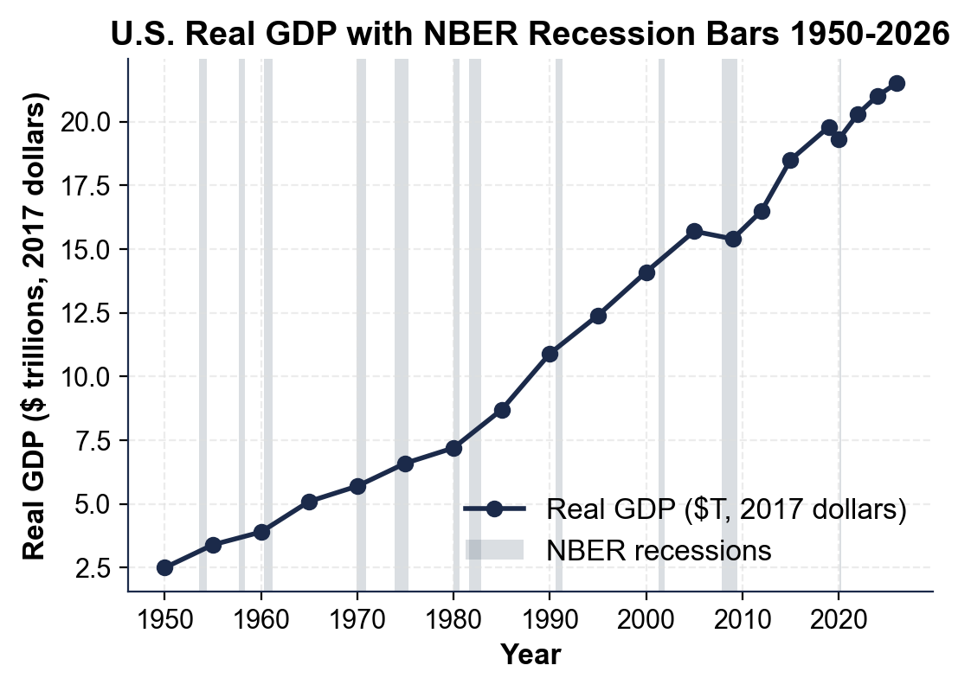
U.S. Recessions Since 1950
Note: Shaded bars = NBER recessions. Long expansions between them.
© More Lessons Less Planning | morelessonslessplanning.com
Notes:
Read the chart. Real GDP rises from about 2.5 trillion in 1950 to about 21.5 trillion in 2026 (in 2017 dollars). Each shaded vertical bar is an NBER-called recession. There are 11 recessions on the chart: 1953-54, 1957-58, 1960-61, 1969-70, 1973-75, 1980, 1981-82, 1990-91, 2001, 2007-2009, 2020. The visual lesson is clear: expansions are LONG (the unshaded gaps), recessions are SHORT (the narrow shaded bars). The longest gap is the 2009-2020 expansion. The deepest dip is the 2007-2009 Great Recession; the sharpest is the 2020 COVID recession (a sharp V). Use the chart in the activity to classify years.
Reference labels (point to these chart features when teaching): 11 recessions since 1950; Longest gap: 2009-2020

Slide 11
Why Cycles Happen
Aggregate demand shocks
Sudden drops in total spending (housing crash 2007, COVID lockdowns 2020, Fed tightening 1981-82)
Aggregate supply shocks
Sudden disruptions to production (oil price spikes 1973 and 1979, pandemics, disasters)
Monetary policy tightening
Fed raises interest rates to fight inflation, slowing borrowing and spending (1981-82, 2007)
Financial crises
Panics in credit and banking that freeze lending (1929, 2007-09 subprime crisis)
Inventory cycles
Firms over-build inventories then cut production; a driver of milder recessions (1953-54)
Tip: No two recessions are identical. The causes vary - but the pattern (peak, contraction, trough, recovery) repeats.
© More Lessons Less Planning | morelessonslessplanning.com
Notes:
Explain why cycles happen at all. Recessions are triggered by SHOCKS - sudden disruptions to demand or supply. AGGREGATE DEMAND SHOCKS are sudden drops in total spending: the housing crash in 2007 wiped out home equity and consumption; COVID lockdowns in March 2020 collapsed demand overnight; Fed tightening in 1981-82 raised borrowing costs and cut spending. AGGREGATE SUPPLY SHOCKS disrupt production: the 1973 and 1979 oil price spikes (OPEC) cut output; the 2020 pandemic disrupted supply chains. MONETARY POLICY TIGHTENING - when the Fed raises rates fast to fight inflation - is a frequent recession trigger (1981-82, 1990, 2007, possibly 2022-?). FINANCIAL CRISES - panics in credit and banking - have triggered the deepest recessions (1929 Great Depression, 2007-2009 Great Recession). INVENTORY CYCLES drive milder recessions: firms over-build inventories, then cut production. No two recessions are identical, but the four-phase pattern repeats.

Slide 12
Procyclical, Countercyclical, Acyclical
Procyclical
Moves WITH the cycle - rises in expansion, falls in recession (GDP, employment, profits, stocks)
Countercyclical
Moves AGAINST the cycle - rises in recession, falls in expansion (unemployment rate, jobless claims)
Acyclical
No clear cycle pattern - moves on its own schedule (long-run productivity, demographics)
Big Idea: classify any variable by whether it moves WITH the cycle, AGAINST it, or not at all.
© More Lessons Less Planning | morelessonslessplanning.com
Notes:
Classify economic variables by how they move relative to the business cycle. PROCYCLICAL variables move WITH the cycle - real GDP, employment, corporate profits, consumer spending, and the stock market all rise in an expansion and fall in a recession; these are the indicators NBER watches to date the cycle. COUNTERCYCLICAL variables move AGAINST the cycle - the unemployment rate and initial jobless claims rise during a recession and fall during an expansion. ACYCLICAL variables have no clear cycle pattern - long-run productivity growth and demographic change move on their own schedule. Drill the test: does it go UP or DOWN when the economy contracts? This sets up Activity Block D (SC-10 to SC-12).

Slide 13
Sort Recent Years Into Phases
Year/Period | Phase | Why
2018-2019 | Expansion (late) | Real GDP rising; unemployment 3.5%
Feb 2020 | Peak | Highest point before COVID
Feb-Apr 2020 | Recession | Real GDP fell ~9%; sharpest ever
Apr 2020 | Trough | NBER-dated low; next expansion starts
2020-2021 | Recovery | GDP rebounded; jobless rate fell toward 4%
2022-2025 | Expansion | +4.5M jobs in 2022; NBER called no recession
Big Idea: Use NBER dates to classify any year. Most years are expansion years; recessions are short, dated by month.
© More Lessons Less Planning | morelessonslessplanning.com
Notes:
Walk through the recent classification. 2018-2019 was LATE EXPANSION - real GDP was rising, unemployment was at a 50-year low (3.5% in late 2019), but the yield curve was flirting with inversion. February 2020 was the PEAK - the highest point of activity before COVID hit. February-April 2020 was the RECESSION - real GDP fell about 9% in two months, unemployment spiked to 14.7% in April 2020, retail and travel collapsed. April 2020 was the TROUGH - the lowest point, the start of the next expansion. 2020-2021 was the RECOVERY / early expansion - GDP rebounded fast (V-shaped), unemployment fell from 14.7% toward 4% by late 2021. 2022-2025 is the CURRENT EXPANSION (with debate) - the 2-quarter rule was met in 2022 but NBER did NOT call a recession because jobs and consumer spending kept growing (4.5 million jobs added in 2022). Students use this table as a model for the Activity Part 3 scenario cards.

Slide 14
Key Takeaways
Four phases: EXPANSION, PEAK, RECESSION, TROUGH/RECOVERY
★
Expansion is LONG (avg 64 months); recession is SHORT (avg 10-11 months)
★
NBER dates peaks and troughs by MONTH, well after they occur
★
Recessions are triggered by SHOCKS: demand, supply, monetary, financial
★
Post-WWII cycles are milder: longer expansions, shorter recessions
★
© More Lessons Less Planning | morelessonslessplanning.com
Notes:
Close the lesson with the five takeaways. Drill the four phases (expansion-peak-recession-trough). Reinforce that expansion is LONG and recession is SHORT - most years are expansion years. Use the U.S. recessions chart as the visual anchor: the unshaded gaps are LONG and the shaded recession bars are NARROW. Tomorrow's lesson (or the next toolkit) connects the cycle to policy: how the Fed (monetary) and Congress (fiscal) respond to recessions.

