Slide 1
The Bronze Age Collapse
Why the Mycenaean palace world burned around 1200 BCE - and how a lost age became the 'age of heroes' that Homer later sang about.
© More Lessons Less Planning | morelessonslessplanning.com
Notes:
Open with the scale of the mystery. Around 1200 BCE the eastern Mediterranean was a connected, wealthy world of great palace kingdoms - the Mycenaean Greeks, the Hittites, the city of Ugarit, and their trading partners. Then, within about two generations, city after city was burned and abandoned. The palaces fell, long-distance trade broke down, and even writing was lost. This is the BRONZE AGE COLLAPSE, one of history's great turning points. Set the honest frame at once: we know the collapse was REAL - archaeologists dig up the burned cities - but WHY it happened is genuinely DEBATED. Students will meet the usual suspect, the mysterious 'Sea Peoples,' and learn to treat the collapse as a SYSTEMS COLLAPSE with several overlapping causes, not one settled answer. And preview the payoff for the whole unit: the vanished Bronze Age became the Greeks' remembered 'age of heroes,' the lost world of great warriors that Homer would later sing about in the Iliad and Odyssey.

Slide 2
Learning Targets
Describe the Bronze Age Collapse and what was lost: palaces, trade, Linear B
★
Weigh the debated causes and read Ramesses III's monument critically
★
Trace the aftermath: the Greek Dark Age, oral tradition, and the age of heroes
★
© More Lessons Less Planning | morelessonslessplanning.com
Notes:
Read each target aloud. Target 1 maps to slides 3-4 (the Bronze Age world of the Mycenaeans, and the collapse itself). Target 2 maps to slides 5-8, the analytical heart of the lesson - the poorly understood Sea Peoples, the Medinet Habu relief, the multiple debated causes (systems collapse), and how to read a pharaoh's victory inscription as propaganda. Target 3 maps to slides 9-11 (the loss of Linear B and the Greek Dark Age, the survival of the epics through oral tradition, and the honest myth-vs-history verdict). Stress the load-bearing honesty ideas from the start: the collapse was REAL, but its causes are DEBATED; the most famous source is one-sided propaganda; and the 'age of heroes' is how later Greeks REMEMBERED a real-but-mythologized past, not a documentary record.

Slide 3
The Bronze Age World: Palaces, Trade, and Writing
The Mycenaean Palace World
A Connected Bronze Age
The MYCENAEANS were the Bronze Age Greeks of palace kingdoms like Mycenae
Their PALACES controlled trade, stored grain, and kept careful written records
They wrote in LINEAR B, the earliest form of Greek writing
Around 1200 BCE the eastern Mediterranean was a network of trading kingdoms
Egypt, the Hittites, and the Mycenaeans traded metals, grain, and goods
This wealthy, literate, connected palace world is what would soon collapse
Key Concept: The MYCENAEANS ran a Bronze Age world of PALACES, sea trade, and LINEAR B writing - the connected world that vanished in the collapse.
© More Lessons Less Planning | morelessonslessplanning.com
Notes:
Before the collapse, describe the world that was lost, so students feel the fall. Introduce the MYCENAEANS: the Bronze Age Greeks (named after their greatest city, Mycenae) who ruled a set of palace kingdoms across mainland Greece, such as Mycenae and Pylos, roughly 1600-1200 BCE. Stress how their world was organized around great PALACES - not just homes for kings, but administrative centers that controlled trade, stored and redistributed grain, ran workshops, and kept careful written records. Teach LINEAR B here: the earliest form of Greek writing, a script used mainly by palace scribes to keep records (lists of goods, workers, and offerings). This matters enormously for later in the lesson: writing existed, and then it was LOST. Widen the lens: around 1200 BCE the whole eastern Mediterranean was a connected, prosperous network - Egypt, the Hittite Empire in Anatolia, the rich trading city of Ugarit, Cyprus, and the Mycenaeans - all exchanging metals (especially the copper and tin needed to make bronze), grain, and luxury goods by sea. The takeaway: this was a wealthy, literate, deeply interconnected world. That is exactly what makes its sudden collapse so striking - and it is the reason a breakdown in trade could ripple across every kingdom at once.

Slide 4
The Collapse: A World Burns (c. 1200-1150 BCE)
Bronze Age Collapse
The BRONZE AGE COLLAPSE is the rapid fall of the eastern Mediterranean palace civilizations around 1200-1150 BCE - great cities burned within about two generations.
Cities BURNED
Archaeologists find layers of ash where Mycenae, Pylos, the Hittite capital Hattusa, and the city of Ugarit were BURNED and abandoned.
A world undone
The palaces fell, long-distance trade broke down, populations shrank, and writing itself was lost - a whole civilization came apart.
How fast
This was not a slow decline; across roughly two generations, kingdom after kingdom fell - part of what makes the collapse so dramatic and debated.
Key Concept: The BRONZE AGE COLLAPSE (c. 1200-1150 BCE) BURNED and emptied the great palace cities within about two generations.
© More Lessons Less Planning | morelessonslessplanning.com
Notes:
Now deliver the event itself. The BRONZE AGE COLLAPSE is the name historians give to the rapid fall of the eastern Mediterranean palace civilizations around 1200-1150 BCE. Make the destruction concrete and evidence-based: archaeologists digging at these sites find clear layers of ASH and BURNING. The great Mycenaean palace at Pylos burned; Mycenae itself was damaged and declined; the Hittite capital of Hattusa in Anatolia was destroyed and abandoned; the wealthy trading city of Ugarit on the Syrian coast was burned and never reoccupied - we even have clay tablets from Ugarit's final days describing enemy ships appearing on the coast. Stress the pattern: this was not one city having a bad year. Across the whole region, within roughly two generations, kingdom after kingdom fell. The palaces were destroyed, the long-distance trade networks broke down, populations shrank, cities were abandoned, and - crucially for this lesson - writing itself disappeared. A whole connected, literate civilization came apart in a short span of time. Set up the central question that drives the rest of the lesson: we KNOW this happened (the burned cities are the evidence), but WHY did it happen? That is where the real historical debate begins.

Slide 5
The Sea Peoples: A Poorly Understood Coalition
The Usual Suspects
What We Honestly Don't Know
The SEA PEOPLES are the raiders Egyptian records blame for the invasions
The name is a modern label from Egyptian texts - a loose word for many groups
They appear as a COALITION of migrating and raiding peoples
Their exact origins and homelands are genuinely DEBATED by scholars
The EGYPTIAN records name groups but do not clearly explain who they were
So the Sea Peoples are real in the sources, but poorly understood
Key Concept: The SEA PEOPLES were a poorly understood COALITION of raiders named in EGYPTIAN records - real, but their origins are genuinely debated.
© More Lessons Less Planning | morelessonslessplanning.com
Notes:
Introduce the most famous suspect in the collapse - but introduce it honestly. The SEA PEOPLES are the raiders that ancient Egyptian records blame for the great invasions at the end of the Bronze Age. Immediately correct the biggest misconception: 'Sea Peoples' is NOT what they called themselves and NOT the name of a single nation. It is a loose modern label, based on Egyptian texts, for what appears to have been a COALITION - a mix of different migrating and raiding groups moving through the eastern Mediterranean by both land and sea, often described as traveling with their families and belongings, as if whole populations were on the move. Egyptian inscriptions give names for some of the groups (the Peleset, Tjeker, Shekelesh, Denyen, Weshesh - students will see these in the primary source), but here is the honest core of the slide: we do NOT securely know where they came from or exactly who they were. Their origins and homelands are genuinely DEBATED by scholars - proposals range across the Aegean, Anatolia, and the central Mediterranean, but none is proven. So teach students to hold two things at once: the Sea Peoples are REAL in the sense that real raiders and migrations are recorded, but they are POORLY UNDERSTOOD - not a known nation with a settled identity. Do not let students walk away thinking 'the Sea Peoples' is a simple, solved answer. Preview the next slide: our single most famous image of them is a relief carved by an Egyptian pharaoh who fought them - which we will look at, and read critically.

Slide 6
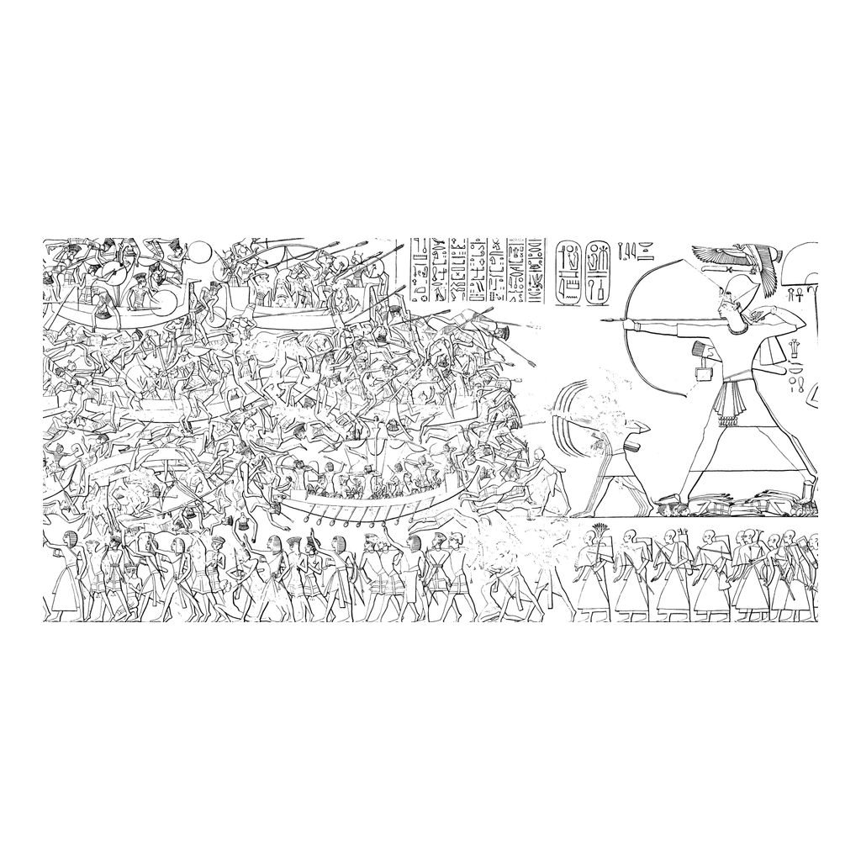
Medinet Habu: Ramesses III Fights the Sea Peoples
Medinet Habu relief: Ramesses III's victory over the Sea Peoples (propaganda)
© More Lessons Less Planning | morelessonslessplanning.com
Notes:
This is a real ancient Egyptian relief carved on the wall of the mortuary temple of the pharaoh Ramesses III at Medinet Habu, in Egypt, around 1177 BCE. It is the single most famous image of the Sea Peoples, and it shows a great naval battle: Egyptian ships and soldiers fighting the invaders' ships and warriors, with the Egyptians winning decisively. Two teaching jobs here. First, help students read the scene: point out the crowded ships, the tangle of fighting warriors, and the way the whole composition is built to show the Egyptians triumphant. Second - and this is the load-bearing point - keep the caption honest. This is NOT a neutral photograph of the war. It is PROPAGANDA: Ramesses III paid to have this carved onto his own temple to celebrate HIS victory and HIS greatness. Of course the pharaoh's own monument shows the pharaoh winning. It is powerful, real evidence that a major invasion happened and that Egypt fought these coalitions - but it is one-sided, and it tells us nothing about the many other kingdoms that fell, or about the other causes of the collapse. This image is genuine ancient art of a real event, shown so students can picture the invasions - NOT a movie image and NOT proof that the Sea Peoples alone brought down the Bronze Age.
Reference labels (point to these chart features when teaching): Egyptian and enemy warships; the pharaoh's claimed victory

Slide 7
Why Did It Fall? Systems Collapse, Not One Cause
Systems collapse
SYSTEMS COLLAPSE means many stresses - raiding, trade breakdown, drought and famine, earthquakes, and revolt - together brought down the Bronze Age world.
Trade and DROUGHT
The palaces depended on trade for metals and grain; when trade broke down and DROUGHT brought famine, the system lost its footing.
Earthquakes, revolt
A series of EARTHQUAKES damaged cities, and hungry, overtaxed people may have risen in REVOLT against the palace rulers.
Why it is DEBATED
No single cause fits all the evidence, so scholars DEBATE how these causes combined; most favor several overlapping stresses.
Big Idea: Most scholars call the fall a SYSTEMS COLLAPSE - several stresses combined - so its cause is DEBATED, not settled.
© More Lessons Less Planning | morelessonslessplanning.com
Notes:
This is the intellectual heart of the lesson: WHY did the Bronze Age world fall? Resist the temptation to give one answer. Introduce the concept historians actually use: SYSTEMS COLLAPSE - the idea that no single cause brought down the Bronze Age world, but rather many interacting stresses hit at once and fed on each other until the whole interconnected system came apart. Walk through the main causes scholars weigh, and be clear that each is supported by SOME evidence but none explains everything alone: (1) INVASION AND RAIDING - the Sea Peoples and other movements of people, attacking and disrupting kingdoms (the Medinet Habu evidence). (2) THE BREAKDOWN OF TRADE - because every palace depended on long-distance trade for the copper and tin to make bronze, and for grain, once the trade networks were disrupted, each kingdom was starved of what it needed. (3) DROUGHT AND FAMINE - scientific evidence (pollen cores, climate data) points to a long period of drought in the region, which would have caused famine and desperation. (4) EARTHQUAKES - the eastern Mediterranean is seismically active, and a cluster of earthquakes around this time damaged several cities. (5) INTERNAL REVOLT - hungry, overtaxed populations may have risen up against the palace elites who could no longer protect or feed them. The honest conclusion: because no single cause fits all the evidence, the collapse is genuinely DEBATED, and most historians today favor a systems-collapse model in which these stresses combined. Teach students the mature historical move: 'multiple interacting causes' is a stronger, more honest answer than picking one villain.

Slide 8
The Evidence Problem: Reading a Pharaoh's Propaganda
Our Most Famous Source
Why It Must Be Read Critically
MEDINET HABU is Ramesses III's temple, whose inscription records the Sea Peoples
It is the most detailed written account of the invasions we have
It names the coalition and describes a great battle at Egypt's border
RAMESSES III carved it to celebrate HIS own victory - it is royal PROPAGANDA
A victory monument naturally exaggerates the ruler's triumph and power
Egypt itself declined soon after, so the 'total victory' was not the whole story
Key Concept: The MEDINET HABU inscription of RAMESSES III is our best source on the Sea Peoples - but one-sided PROPAGANDA, weighed carefully.
© More Lessons Less Planning | morelessonslessplanning.com
Notes:
Turn the Medinet Habu relief into a lesson about EVIDENCE - the sourcing skill at the center of the activity. Explain what MEDINET HABU gives us: it is the mortuary temple of the pharaoh RAMESSES III, and its inscription is the most detailed WRITTEN account we have of the Sea Peoples and the invasions - it names the groups in the coalition and describes a huge land-and-sea battle at Egypt's border around 1177 BCE. Without it, we would know far less. BUT - and this is the skill students must learn - a source's usefulness depends on who made it and why. Ramesses III did not carve this to inform future historians; he carved it on his OWN temple to celebrate his OWN greatness and his claimed total victory. That makes it PROPAGANDA: a one-sided royal monument designed to glorify the ruler. Point students to the tells they will see in the primary source: the boastful language, the claim that the enemy's 'heart and soul are finished forever,' the piling of the dead 'into heaps.' Then give them the killer piece of context: Egypt itself weakened and declined not long after this supposed total victory, and the New Kingdom soon faded - so the 'complete triumph' the monument claims was clearly not the whole story. The honest conclusion for historians: the Medinet Habu inscription is powerful, real evidence that major invasions happened, but because it is one-sided propaganda, we WEIGH its claims carefully rather than taking them at face value - and we never treat one pharaoh's victory monument as proof of what caused a collapse across dozens of other kingdoms.

Slide 9
The Greek Dark Age: When Writing Was Lost
Linear B lost
LINEAR B, the earliest Greek writing used for palace records, was lost when the palaces fell - Greece went from literate to having no writing at all.
Greek Dark Age
The GREEK DARK AGE is the centuries after the collapse (c. 1100-800 BCE) when writing, palaces, and trade were lost and life grew simpler and poorer.
The ALPHABET returns
Writing revived around 800 BCE, when the Greeks adapted a new ALPHABET from the Phoenicians - a different script from the lost Linear B.
Why 'dark'
It is called 'dark' partly because, with no WRITING, we have very few records from these centuries until the alphabet brings history back.
Key Concept: When LINEAR B was lost, Greece entered the GREEK DARK AGE (c. 1100-800 BCE) with no writing until the ALPHABET revived around 800 BCE.
© More Lessons Less Planning | morelessonslessplanning.com
Notes:
Trace the most striking consequence of the collapse, the one that matters most for the Odyssey unit: the loss of writing. Remind students that the Mycenaeans wrote in LINEAR B, the earliest form of Greek writing, used mainly for palace records. When the palaces were destroyed, the scribes and the whole system of record-keeping vanished with them - and so did the writing. Greece went from a literate palace civilization to a world with NO writing at all. This begins what historians call the GREEK DARK AGE, roughly 1100-800 BCE: the centuries after the collapse when writing, monumental palaces, and long-distance trade were all lost, populations were smaller, and life became simpler and poorer. Explain the name honestly: it is called a 'dark' age partly because life was harder, but especially because - with no writing - we have very few written records from these centuries, so this period is 'dark' to historians too. Then deliver the crucial turn: writing did not come back in the same form. Around 800 BCE, the Greeks borrowed and adapted a new ALPHABET from the Phoenicians (a trading people of the eastern Mediterranean) - a completely different, simpler script from the lost Linear B. This new alphabet is what would eventually be used to write down the Iliad and the Odyssey. Set up the key puzzle for the next slide: if writing was lost for about 400 years, how did the stories of the Bronze Age heroes survive the gap to reach Homer?

Slide 10
From Memory to Homer: Oral Tradition and the Age of Heroes
Carried by Memory
A Remembered Golden Past
With writing gone, stories survived as ORAL TRADITION - passed by memory
Traveling poets, or BARDS, sang tales of the lost Bronze Age aloud
Across the Dark Age, these songs carried the memory of the vanished palace world
Later Greeks remembered the lost Bronze Age as a great AGE OF HEROES
In their memory it was a golden past of mighty warriors and grand palaces
This is the world HOMER sang about - written down long after, around 700 BCE
Big Idea: With writing lost, stories survived as ORAL TRADITION sung by BARDS, and later Greeks recalled the Bronze Age as a golden AGE OF HEROES.
© More Lessons Less Planning | morelessonslessplanning.com
Notes:
Answer the puzzle from the last slide and connect the whole lesson to Homer. With writing lost for centuries, the stories of the Bronze Age did not survive on paper - they survived in people's MEMORIES, as ORAL TRADITION: stories passed down by being spoken and, above all, performed. Teach the role of the BARDS - traveling poets who memorized and sang long tales aloud for their audiences, retelling and reshaping them across the generations of the Dark Age. Through this living chain of memory and performance, the memory of the vanished Mycenaean palace world - its kings, warriors, and great deeds - was carried across the centuries when no one could write it down. Now the payoff: as the centuries passed, later Greeks did not remember the Bronze Age accurately, as archaeologists do; they remembered it as a glorious AGE OF HEROES - a golden past of mighty warriors, grand palaces, and gods who walked among men, greater than their own harder times. This remembered, half-mythologized world is exactly what HOMER drew on. When the Iliad and Odyssey were finally written down (around 700 BCE, using the new alphabet), they were the crowning achievement of that long oral tradition - epic songs about a Bronze Age 'age of heroes' remembered across the Dark Age. Be careful and honest: Homer lived CENTURIES after the Bronze Age collapsed; he was not a reporter writing at the time, but the heir to generations of oral memory about a real-but-mythologized past.

Slide 11
Myth vs. History: A Real Collapse, a Remembered Age
What Is Real History
What Is Remembered and Mythologized
The Bronze Age Collapse REALLY happened - the burned cities are the evidence
But its causes are genuinely DEBATED - a systems collapse, not one answer
The Medinet Habu inscription is real evidence, but one-sided propaganda
The 'age of heroes' is how later Greeks REMEMBERED a real-but-mythologized past
Homer's epics reflect that memory - they are not a documentary of the Bronze Age
Doing history means WEIGHING evidence, not repeating one confident story
Big Idea: The collapse is REAL but its causes are DEBATED; the 'age of heroes' is a REMEMBERED, mythologized past - history means weighing evidence.
© More Lessons Less Planning | morelessonslessplanning.com
Notes:
Pull the whole lesson together around its honest core: doing history is about WEIGHING EVIDENCE, not repeating one confident story. First, what is solid, real history: the Bronze Age Collapse genuinely happened - the burned and abandoned cities are hard archaeological evidence, and the loss of Linear B and the Greek Dark Age that followed are real. Second, what is honestly UNCERTAIN: the CAUSE of the collapse is genuinely debated. There is no proven single villain; the best current explanation is a systems collapse in which raiding (the Sea Peoples), the breakdown of trade, drought and famine, earthquakes, and revolt all combined. And our most famous source, Ramesses III's Medinet Habu inscription, is real and valuable but one-sided propaganda that we must weigh critically. Third, what is REMEMBERED and mythologized: the 'age of heroes' is how later Greeks remembered the vanished Bronze Age - a glorified, half-legendary golden past. Homer's Iliad and Odyssey REFLECT that memory; they are epic literature inspired by a real lost world, NOT a documentary record of it. Give students the mature takeaway that ties the unit together: when we ask 'is the Odyssey history?', the honest answer is that it grows out of a REAL historical collapse and a REAL remembered age, but it is myth - and a good historian holds the real collapse, the debated causes, the one-sided sources, and the mythologized memory all at once, weighing each for what it can and cannot tell us.

Slide 12
Key Takeaways
The BRONZE AGE COLLAPSE (c. 1200-1150 BCE) burned the Mycenaean palace world
★
The cause is DEBATED - a SYSTEMS COLLAPSE of several combined stresses
★
The SEA PEOPLES are poorly understood; MEDINET HABU is one-sided propaganda
★
LINEAR B lost -> GREEK DARK AGE -> ORAL TRADITION -> the AGE OF HEROES
★
© More Lessons Less Planning | morelessonslessplanning.com
Notes:
Close the lesson by reviewing the four takeaways aloud. Students should be able to: (a) describe the BRONZE AGE COLLAPSE - the rapid fall of the Mycenaean palace world and its eastern-Mediterranean neighbors around 1200-1150 BCE, evidenced by burned and abandoned cities; (b) explain that the CAUSE is genuinely debated and best understood as a SYSTEMS COLLAPSE in which raiding (the Sea Peoples), the breakdown of trade, drought and famine, earthquakes, and internal revolt combined - not one single cause; (c) treat the evidence critically - the SEA PEOPLES are a poorly understood coalition, and RAMESSES III's MEDINET HABU inscription is our best written source but one-sided royal propaganda; and (d) trace the aftermath - LINEAR B and writing were lost in a GREEK DARK AGE until the alphabet revived around 800 BCE, the epics survived across the gap as ORAL TRADITION carried by bards, and later Greeks remembered the vanished Bronze Age as the AGE OF HEROES that Homer sang about. The Primary Source Spotlight now asks students to read and weigh Ramesses III's own Medinet Habu inscription (trans. Breasted, 1906) as evidence for the invasions.

