Slide 1
The Black Death
How the plague traveled from Central Asia to Europe, killed roughly one-third to one-half of the population, and broke apart medieval society.
© More Lessons Less Planning | morelessonslessplanning.com
Notes:
Opening slide. The Black Death was the plague pandemic that swept Europe from 1347 to 1351 and killed roughly one-third to one-half of the population. Students will learn how it traveled out of Central Asia along the Silk Road, arrived at Messina in October 1347, what it did to the body, why medieval medicine could not stop it, how people responded (quarantine, flight, the flagellants, and the murderous scapegoating of Jewish communities), and how the labor shortage that followed helped weaken serfdom. Keep the tone factual and documentary - this is a lesson about a real catastrophe, not a horror story.

Slide 2
Learning Targets
Trace how the plague traveled from Central Asia to Europe.
★
Explain how it spread and what it did to the body.
★
Describe the death toll and why medicine could not stop it.
★
Explain how the plague broke apart medieval society.
★
© More Lessons Less Planning | morelessonslessplanning.com
Notes:
Learning targets. Point out that target 4 is where the lesson goes beyond 'a lot of people died' - the plague reorganized European society, from the authority of the Church to the wages a peasant could demand.

Slide 3
What Was the Black Death?
Black Death
The pandemic of plague that swept Europe from 1347 to 1351 and killed roughly one-third to one-half of the population.
Yersinia pestis
The bacterium that causes plague; it lives in fleas that feed on rats and other rodents.
Key Concept: The BLACK DEATH was the plague pandemic of 1347-1351 that killed roughly one-third to one-half of Europe.
© More Lessons Less Planning | morelessonslessplanning.com
Notes:
The BLACK DEATH was the pandemic of plague that swept Europe from 1347 to 1351 and killed roughly one-third to one-half of the population. It is caused by YERSINIA PESTIS, the bacterium that causes plague; it lives in fleas that feed on rats and other rodents. Nobody in 1348 knew any of that - the germ was not identified until 1894. The name 'Black Death' was not used at the time either; contemporaries called it the pestilence or the great mortality.

Slide 4
Where It Came From: The Silk Road
Plague lived for centuries in rodent populations in Central Asia.
The SILK ROAD carried goods, people, rats, and fleas west toward Europe.
These overland trade routes linked Asia and Europe across thousands of miles.
In 1346 plague struck Caffa, a Genoese trading port on the Black Sea.
Genoese merchant ships then carried it into the Mediterranean.
Fact: The SILK ROAD - the overland trade routes linking Asia and Europe - carried the plague west toward the Black Sea.
© More Lessons Less Planning | morelessonslessplanning.com
Notes:
The SILK ROAD was the overland trade routes linking Asia and Europe that carried the plague west toward the Black Sea. Plague had lived for centuries in rodent populations in Central Asia. The same routes that carried silk, spices, and merchants also carried rats and the fleas riding on them. In 1346 the plague struck CAFFA, a Genoese trading port on the Black Sea (in modern Crimea). Genoese merchant ships leaving the Black Sea then carried the plague into the Mediterranean and on to Europe. The point for students: the plague followed TRADE. The more connected a place was, the sooner it was hit.

Slide 5
Arrival in Europe: October 1347
October 1347: Messina
Twelve Genoese galleys docked at Messina, Sicily. Most of the crews were dead or dying.
✔
1348: Italy and France
The plague reached Genoa, Venice, Pisa, Florence, and Marseille within months of landing.
✔
1348-1349: North and west
It spread to Paris, London, and across England, following roads, rivers, and trade.
✔
By 1351: Most of Europe
In roughly four years the plague reached from Sicily north to Norway and east into Russia.
✔
Note: The plague reached Messina, Sicily, in October 1347 and covered most of Europe within about four years.
© More Lessons Less Planning | morelessonslessplanning.com
Notes:
In October 1347 twelve Genoese galleys carried the plague into MESSINA, Sicily. Most of the crews were dead or dying when they docked. The city drove the ships back out to sea - too late. From Sicily the plague moved to Genoa, Venice, Pisa, Florence, and Marseille in 1348 (this is the Florence Boccaccio describes in the Primary Source Spotlight), then north to Paris, London, and across England in 1348-1349. In roughly FOUR years - by 1351 - it had spread from Sicily to Norway and Russia. Emphasize the speed: four years to cross a continent, in a world with no engines.

Slide 6
How the Plague Spread
Bubonic Plague
The most common form of the Black Death, spread by flea bites and marked by buboes.
Pneumonic Plague
A deadlier form that settled in the lungs and spread person to person through coughing.
Key Concept: BUBONIC PLAGUE spread by flea bites; the pneumonic form spread person to person through coughing.
© More Lessons Less Planning | morelessonslessplanning.com
Notes:
BUBONIC PLAGUE was the most common form of the Black Death, spread by flea bites and marked by buboes. An infected flea, riding on a rat, bites a person and the bacterium enters the body. PNEUMONIC PLAGUE settled in the LUNGS and spread person to person through coughing - no flea needed. That second form matters for the primary source: Boccaccio noticed the sickness passing from person to person by nearness and by touching clothes, and he was RIGHT to notice contagion, even though he had no idea what caused it. Two routes - fleas and breath - explain why the plague moved through a household so fast.

Slide 7
What It Did to the Body
What People Saw
What It Meant
BUBOES: painful swellings in the groin, armpits, or neck.
Boccaccio said some grew as big as an apple or an egg.
Black or livid spots then appeared on the arms and thighs.
Buboes were the first visible sign that plague had taken hold.
Most victims died within days of the first swelling.
Boccaccio's Florentines called the swellings gavoccioli.
Fact: BUBOES - painful swellings in the groin, armpits, or neck - were the first visible sign of plague. Boccaccio called them gavoccioli.
© More Lessons Less Planning | morelessonslessplanning.com
Notes:
BUBOES were the painful swellings in the groin, armpits, or neck that were the first visible sign of plague; Boccaccio called them GAVOCCIOLI. He wrote that some grew to the size of a common apple and others to the size of an egg. After the swellings, black or livid spots appeared on the arms and thighs. Boccaccio says both the gavocciolo and the spots were a certain sign of coming death. Most victims died within DAYS of the first swelling. Keep this factual and restrained - the point is that the symptoms were unmistakable and the outcome was near-certain, which is exactly why terror spread as fast as the disease.

Slide 8
The Death Toll
Roughly one-third to one-half of all Europeans died between 1347 and 1351.
Best modern estimates run to at least 25 million dead in Europe alone.
Some villages lost most of their people and were abandoned for good.
Cities were hit hardest, where people lived packed close together.
Graveyards filled, so cities dug huge burial trenches outside the walls.
Fact: The Black Death killed roughly one-third to one-half of Europe - at least 25 million people - in only four years.
© More Lessons Less Planning | morelessonslessplanning.com
Notes:
Roughly one-third to one-half of all Europeans died between 1347 and 1351 - at least 25 MILLION people in Europe alone, in only four years. Some villages lost most of their people and were abandoned permanently; you can still find their outlines in English fields today. Cities were hit hardest because people lived packed close together. Graveyards filled within weeks, so cities dug huge burial TRENCHES outside the walls - exactly what Boccaccio describes in the Primary Source Spotlight, where the dead were laid 'by the hundred' and stowed tier upon tier. Give students a moment with the scale: this is the deadliest event in European history.

Slide 9
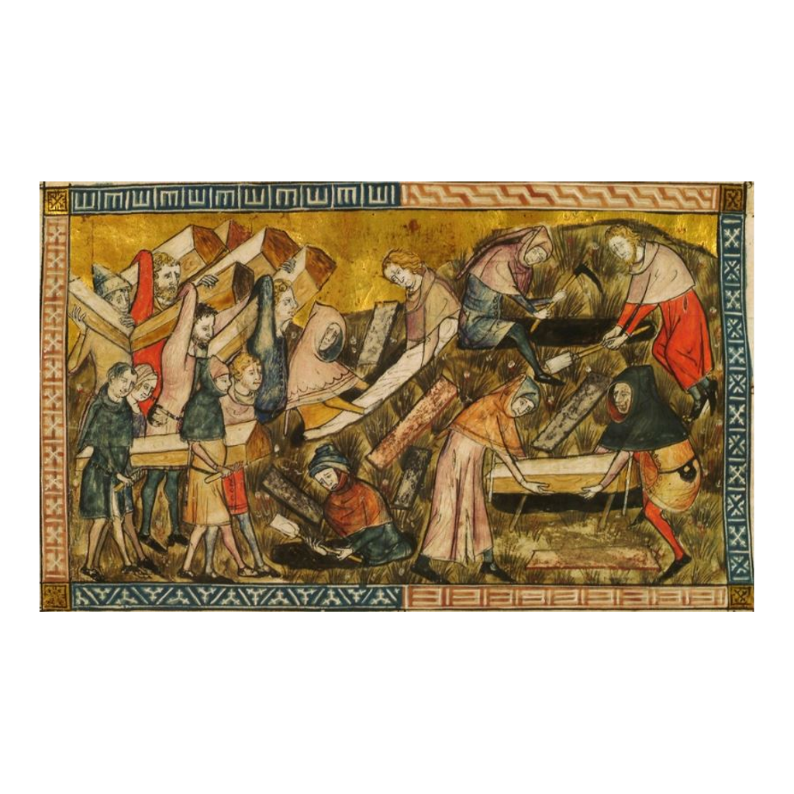
Burying the Dead at Tournai
Townspeople of Tournai bury plague victims (Pierart dou Tielt, c. 1353).
© More Lessons Less Planning | morelessonslessplanning.com
Notes:
A genuine manuscript miniature painted by Pierart dou Tielt around 1353, illustrating the chronicle of Gilles li Muisit, abbot of Tournai, who lived through the plague. It shows the 1349 burials at Tournai - painted within about four years of the events by someone in the city. Give students a moment to notice that these dead still get individual coffins and mourners: Tournai was overwhelmed but still coping. Boccaccio's Florence, where bodies went into trenches by the hundred with a little earth over each layer, was further gone than this.
Reference labels (point to these chart features when teaching): Coffins carried to the pit; Townspeople in mourning

Slide 10
Why Nobody Could Stop It
What Doctors Believed
What Was Actually True
Miasma: the idea that bad air caused disease.
That Saturn, Jupiter, and Mars had aligned badly in 1345.
That bleeding patients or burning herbs would drive sickness out.
Germs were unknown; no one had ever seen a bacterium.
There were no antibiotics for another 600 years.
Fleeing early and isolating the sick were the only things that worked.
Note: Medieval doctors blamed bad air and the planets. Germs were unknown, so nothing they tried could stop the plague.
© More Lessons Less Planning | morelessonslessplanning.com
Notes:
Medieval doctors blamed MIASMA - the idea that bad air caused disease - and a bad alignment of Saturn, Jupiter, and Mars (the University of Paris medical faculty formally blamed the 1345 conjunction). They bled patients and burned herbs to drive the sickness out. None of it could work: germs were unknown, no one had ever seen a bacterium, and there were no ANTIBIOTICS for another 600 years. Be fair to them - these were not stupid people. They were reasoning carefully from the best framework they had, and the framework was wrong. The only things that actually helped were fleeing early and isolating the sick.

Slide 11
Quarantine: The One Thing That Helped
Quarantine
Isolating arriving ships and travelers for a set period; the forty-day version adopted after the plague gives the word its name.
Cordon sanitaire
A guarded line around an infected town meant to stop anyone from leaving or entering.
Key Concept: QUARANTINE isolated arriving ships - the forty-day version, adopted after the plague, gives the word its name.
© More Lessons Less Planning | morelessonslessplanning.com
Notes:
QUARANTINE was the practice of isolating arriving ships and travelers for a set period; in the decades after the plague, Ragusa (modern Dubrovnik) and Venice settled on FORTY days, which gives the word its name - Italian quaranta giorni, 'forty days.' Ragusa passed the first known such law in 1377. A CORDON SANITAIRE was a guarded LINE around an infected town meant to stop anyone from leaving or entering. Here is the honest point: quarantine worked, and it worked for the WRONG reason. Officials thought they were keeping out bad air. They were actually keeping out fleas, rats, and infected people. A wrong theory produced a right policy.

Slide 12
The Flagellants
Who they were
Bands of Christians who marched town to town whipping themselves in public.
✔
What they believed
That the plague was God's punishment for sin, and that public suffering could turn it aside.
✔
Why they spread
With priests dying and no cure in sight, ordinary people reached for any answer at all.
✔
How it ended
The movement grew violent and disorderly, and the pope condemned it in 1349.
✔
Fact: The FLAGELLANTS whipped themselves in public, believing the plague was God's punishment for sin.
© More Lessons Less Planning | morelessonslessplanning.com
Notes:
The FLAGELLANTS were bands of Christians who whipped themselves in public, believing the plague was God's punishment for SIN. They marched from town to town, staging public rituals of self-punishment, and drew crowds. Why did the movement spread? Because priests were dying at high rates, no cure existed, and ordinary people reached for any answer. The movement grew violent and disorderly - flagellant bands attacked clergy and, in several cities, led attacks on Jewish communities - and Pope Clement VI condemned it in 1349. Frame this for students as a response to helplessness, not as foolishness: when nothing works, people try anything.

Slide 13
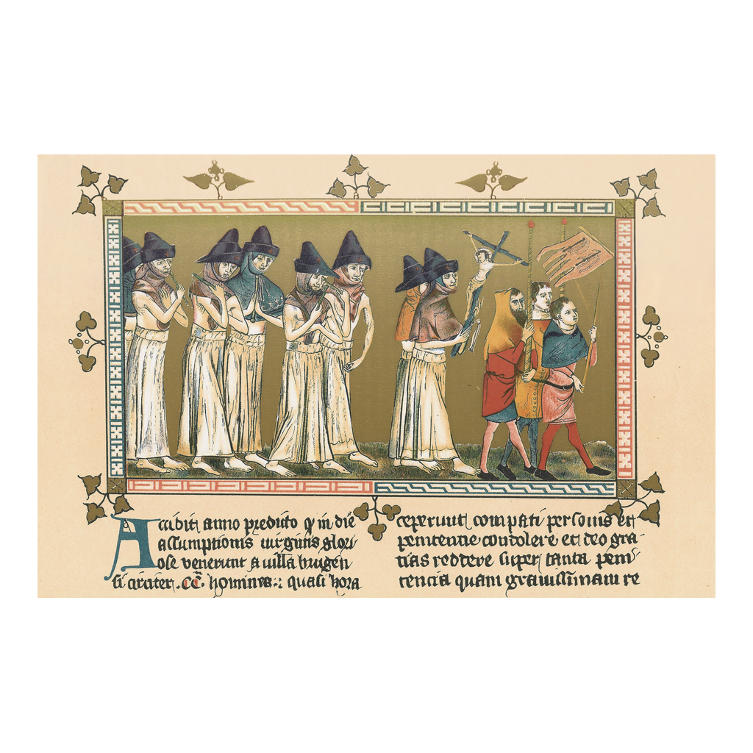
The Flagellants at Tournai, 1349
Flagellants processing at Tournai, 1349 (Pierart dou Tielt, c. 1353).
© More Lessons Less Planning | morelessonslessplanning.com
Notes:
From the same Tournai manuscript as the burial miniature - Gilles li Muisit's chronicle, illuminated by Pierart dou Tielt c. 1353. Note the details: the penitents walk barefoot in white robes, carrying scourges, while townspeople follow behind with a cross and banner. This is what slide 12 describes, drawn by someone who watched it happen. Both images in this deck come from the same eyewitness manuscript.
Reference labels (point to these chart features when teaching): Barefoot penitents, scourges; Crowd follows the procession

Slide 14
Blame and Violence
SCAPEGOATING means falsely blaming a group for a disaster.
Jewish communities were accused of poisoning wells to cause the plague.
The accusation was false - Jewish communities died of plague too.
Thousands were murdered; whole communities were destroyed.
Strasbourg's Jewish community was massacred in February 1349.
The plague had not even reached Strasbourg when the killings began.
Warning: SCAPEGOATING - falsely blaming a group for a disaster - led to the murder of thousands of Jewish people.
© More Lessons Less Planning | morelessonslessplanning.com
Notes:
SCAPEGOATING is falsely blaming a group for a disaster; Jewish communities were accused of causing the plague and thousands were MURDERED. The specific accusation was well-poisoning. It was false, and it was demonstrably false at the time: Jewish communities were dying of plague at the same rates as everyone else. Pope Clement VI issued papal bulls in 1348 condemning the accusation and the violence - and the killings continued anyway. The clearest evidence that fear, not evidence, drove this: in February 1349 the Jewish community of STRASBOURG was massacred months BEFORE the plague reached the city. Teach this plainly. It is a documented atrocity and belongs in the lesson.

Slide 15
A World Shaken
The Church Shaken
Death in Art and Mind
Priests died at high rates tending the sick.
Prayer and processions did not stop the dying.
Many survivors questioned the Church's authority.
The 'Dance of Death' showed death seizing rich and poor alike.
Tomb art grew grim and blunt about decay.
The message: plague spared no rank and no wealth.
Note: The plague shook the Church's authority and filled European art with the Dance of Death.
© More Lessons Less Planning | morelessonslessplanning.com
Notes:
Priests died at high rates because their duty took them to the bedsides of the dying. Prayer, processions, and relics did not stop the plague. Many survivors questioned the CHURCH's authority - not necessarily their faith, but the institution's claim to intercede. Meanwhile European art filled with death: the 'Dance of DEATH' (danse macabre) showed skeletons leading away king and peasant, bishop and beggar, hand in hand. Tomb art grew blunt about decay. The message was consistent: plague spared no rank and no wealth. That levelling idea was genuinely new and genuinely unsettling to a society built on rigid hierarchy.

Slide 16
Too Few Workers: The End of Serfdom
Labor Shortage
The lack of workers after the plague killed so many people, which pushed wages up and gave peasants new bargaining power.
Serfdom
The system binding peasants to a lord's land; it weakened in Western Europe as the labor shortage gave peasants new choices.
Big idea: The LABOR SHORTAGE after the plague pushed wages up and helped weaken SERFDOM in Western Europe.
© More Lessons Less Planning | morelessonslessplanning.com
Notes:
A LABOR SHORTAGE is the lack of workers after the plague killed so many people, which pushed WAGES up and gave peasants new bargaining power. Here is the chain: one-third to one-half of the people die, so the land still exists but the workers do not. Suddenly a peasant's labor is scarce and valuable. Peasants demanded pay, or walked to a lord who would pay. SERFDOM was the system binding peasants to a lord's land, and it weakened in Western Europe as the labor shortage gave peasants new CHOICES. Lords fought back - England's 1351 Statute of Labourers tried to freeze wages at pre-plague levels - and largely failed. Note the honest limit: serfdom weakened in WESTERN Europe; in Eastern Europe lords tightened control instead.

Slide 17
How Do We Know? Boccaccio and the Chroniclers
Giovanni Boccaccio survived the plague in Florence in 1348.
He described it in the introduction to The Decameron.
Chroniclers, tax rolls, and church records also count the dead.
The English translation used here was made by John Payne in 1886.
Eyewitnesses saw a great deal - but they also guessed at numbers.
Tip: Boccaccio's eyewitness account is our closest look at plague in Florence - but always check an eyewitness's numbers.
© More Lessons Less Planning | morelessonslessplanning.com
Notes:
Giovanni BOCCACCIO survived the plague in Florence in 1348 and described it in the introduction to The Decameron - his frame for the whole book is ten young people fleeing plague-struck Florence. The English translation used in this toolkit was made by John PAYNE in 1886 for the Villon Society, which is why we can reprint it freely. Beyond Boccaccio, historians use chroniclers (like Gilles li Muisis of Tournai), tax rolls, manor court records, and church burial registers to estimate the dead. The sourcing lesson: eyewitnesses are invaluable for what people SAW and DID, but weak on numbers. Boccaccio claims more than a hundred thousand died inside Florence's walls - more than the city's entire population. He was estimating, not counting.

Slide 18
Key Takeaways
The Black Death killed one-third to one-half of Europe, 1347-1351.
★
It followed trade: the Silk Road to Caffa, then ships to Messina.
★
Yersinia pestis rode on fleas on rats; pneumonic plague spread by coughing.
★
Germs were unknown, so medicine failed. Only quarantine really helped.
★
People blamed sin, and scapegoated Jewish communities - thousands died.
★
The labor shortage raised wages and helped end serfdom in the West.
★
© More Lessons Less Planning | morelessonslessplanning.com
Notes:
Close the loop. If students remember one causal chain, make it this: trade carried the plague, the plague killed a third to a half of Europe, the death toll created a labor shortage, and the labor shortage broke serfdom's grip in Western Europe. A disease reorganized an economy.

