Slide 1
The Billionaire Tax Debate
Wealth Tax Proposals, Loopholes, and the Constitutional Question
© More Lessons Less Planning | morelessonslessplanning.com
Notes:
Open by asking students: should the federal government tax someone's WEALTH (what they own) or only their INCOME (what they earn)? Take a quick show of hands. Then preview the punchline: every modern proposal to tax billionaires runs into the same three problems - measurement, capital flight, and a constitutional question about whether Congress can even do it without an amendment.

Slide 2
Learning Targets
Identify recent wealth tax and billionaire tax proposals
★
Apply tax incidence analysis to wealth tax debates
★
Evaluate practical and constitutional implementation challenges
★
© More Lessons Less Planning | morelessonslessplanning.com
Notes:
Read each target aloud. Tell students they will leave able to name the Warren and Sanders plans, explain the buy-borrow-die strategy, and identify at least two implementation challenges that have killed wealth tax proposals so far.

Slide 3
Why People Propose Taxing the Very Rich
The Concentration Problem
The Rate Mismatch
Top 1% holds about 30% of all U.S. wealth
About 800 U.S. billionaires held ~$5.5T in 2024
Wealth gap widened during 2020-2024 stock boom
Existing income tax barely touches stored wealth
Top statutory rate is 37 percent on wages
Long-term capital gains capped at 23.8 percent
Top-400 effective tax rate is just 8 percent
Working families often pay 15 to 25 percent
Key Concept: Most billionaire wealth is in stocks, not paychecks - so income tax misses it.
© More Lessons Less Planning | morelessonslessplanning.com
Notes:
The starting point of every wealth-tax debate is the same fact: U.S. wealth is heavily concentrated AND the federal tax code mainly taxes income, not wealth. So even high-income tax rates leave most billionaire net worth untouched. Set up the chart on the next slide to make the concentration visible. Key terms (Reference Guide): INCOME TAX = a tax on the wages, profits, and investment returns a household earns each year, the main federal tax most households pay. NET WORTH = the total value of everything you own (home, savings, stocks, businesses) minus everything you owe, the base for a wealth tax. EFFECTIVE TAX RATE = the percentage of a household's total income actually paid in federal tax; at the very top this rate can fall below what middle-income households pay.

Slide 4
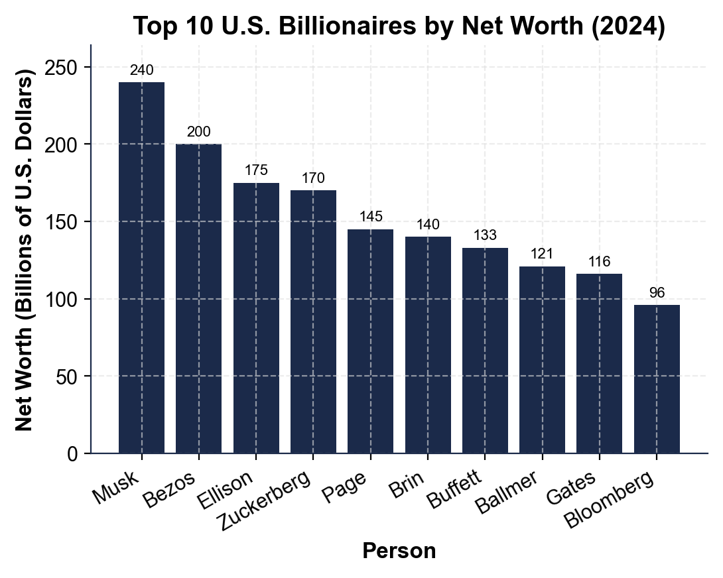
Top 10 U.S. Billionaires Net Worth (2024)
Note: Each bar is one person's NET WORTH in billions of dollars.
© More Lessons Less Planning | morelessonslessplanning.com
Notes:
Have students point to the bars. Ask: what would Warren's wealth tax actually owe on Musk's ~$240B? Apply the tiered plan: 2% on the first ~$950M (the $50M-to-$1B band) is about $19M, PLUS 6% on the ~$239B above $1B is about $14.34B. Total approximately $14.36B per year. (An earlier flat 2% x $240B estimate of about $4.8B undercounts because it ignored Warren's 6%-above-$1B bracket - that flat-rate version is NOT Warren's actual plan.) Use this to make Warren's tiered structure concrete BEFORE walking into the proposals on slide 5. The activity answer key A3-Q2 lands on the same ~$14.36B figure.
Reference labels (point to these chart features when teaching): Musk ~$240B (highest); Buffett ~$133B

Slide 5
Warren's 2% / Sanders's 8% Plans
Warren wealth tax (2019)
2% annual tax on net worth above $50 million; 6% above $1 billion
Sanders wealth tax (2019)
Sliding 1% to 8% on net worth above $32 million (married); top rate above $10B
Estimated revenue (Warren)
About $2.6 trillion over 10 years (Saez/Zucman)
Estimated revenue (Sanders)
About $4.4 trillion over 10 years (Saez/Zucman)
Households affected
About 75,000 (Warren) or 180,000 (Sanders) - top 0.1% only
Tip: Both plans target net worth, not income - that is what makes them WEALTH taxes.
© More Lessons Less Planning | morelessonslessplanning.com
Notes:
Drill the threshold ($50M Warren, $32M Sanders) - this is the most-missed quiz point. Stress that these plans hit only the top 0.1%; they are not on most working families. Both estimates come from Berkeley economists Emmanuel Saez and Gabriel Zucman.

Slide 6
The Buffett Rule
Named for Warren Buffett's 2011 op-ed
Buffett: my secretary pays a higher rate than I do
Proposed: 30% MINIMUM federal tax on $1M+ incomes
Targets the gap between wage and capital-gains rates
Applies to INCOME, not wealth (easier to enforce)
Introduced multiple times since 2012; never passed
Did You Know? Buffett's effective tax rate was about 17% in 2010, lower than his secretary's 36% rate.
© More Lessons Less Planning | morelessonslessplanning.com
Notes:
The Buffett Rule is NOT a wealth tax - it is a minimum income tax. Many students will conflate them. Stress the distinction: Buffett Rule taxes INCOME at a higher minimum rate; Warren/Sanders tax WEALTH directly. The Buffett Rule is an easier sell politically because it works inside the existing income tax system.

Slide 7
The 2024 Billionaire Minimum Income Tax
Who
Rate
Revenue
Households worth at least 100 million
About 0.01 percent of taxpayers
Roughly 8,000 U.S. households
25 percent MINIMUM federal tax
On TOTAL income
Includes UNREALIZED gains
About 500 billion over 10 years
Treasury 2024 estimate
Did not become law
Big Idea: The 2024 plan attacks unrealized gains - the loophole that lets billionaires defer taxes for life.
© More Lessons Less Planning | morelessonslessplanning.com
Notes:
The KEY innovation in the 2024 White House proposal is taxing UNREALIZED capital gains. Under current law, you only owe capital gains tax when you SELL an asset. Billionaires never sell - they borrow against the asset instead. The 2024 minimum would tax the paper gains anyway. This is what makes it politically explosive (and constitutionally questionable). Key term (Reference Guide): UNREALIZED CAPITAL GAINS = the increase in value of an asset you still own (like stock that has gone up) but have not yet sold; under current law these are not taxed.

Slide 8
How Billionaires Actually Avoid Taxes
Step 1: BUY assets
Hold stocks, real estate, and businesses that grow in value over decades
✔
Step 2: Skip the sale
Never sell - so no taxable capital gain is ever triggered
✔
Step 3: BORROW against assets
Banks lend at 2-5% against stock holdings; loans are NOT income, so not taxed
✔
Step 4: Live on the loans
Pay all expenses with borrowed dollars at low interest
✔
Step 5: DIE and reset
Heirs inherit assets at stepped-up basis - the lifetime gains are erased tax-free
✔
Real Talk: This is BUY-BORROW-DIE - completely legal under current U.S. tax law.
© More Lessons Less Planning | morelessonslessplanning.com
Notes:
BUY-BORROW-DIE is the backbone of billionaire tax avoidance. ProPublica's 2021 reporting on leaked IRS data showed Bezos paid $0 federal income tax in 2007 and 2011; Musk paid $0 in 2018 - all legal. Walk students through each step. The reform conversation only makes sense once they grasp the mechanism. Set up the next chart, which shows the resulting effective rates.

Slide 9
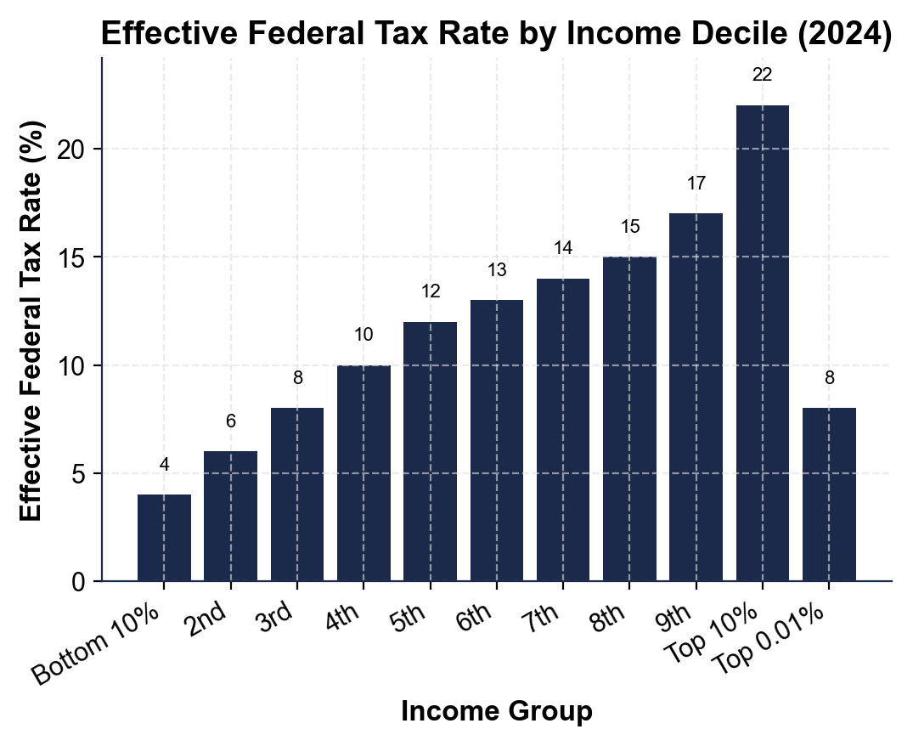
Effective Tax Rate Paid by Income Decile
Note: The top 0.01% effective rate drops below middle-decile rates.
© More Lessons Less Planning | morelessonslessplanning.com
Notes:
Read the chart left to right. The bottom decile pays a low effective rate (mostly payroll tax), middle deciles pay the highest effective rate (~12-15%), then the curve drops at the very top because wealthy households pay the 23.8% capital gains rate, not the 37% wage rate. Buffett's point is visible right here.
Reference labels (point to these chart features when teaching): Top 0.01% ~8%; Middle decile ~14%

Slide 10
Implementation Challenges
Valuation
How do you price a private business or art collection every year?
Capital flight
Wealthy households may move themselves or assets abroad to escape the tax
Liquidity
Owing 2% of $50B in cash means selling stock - which can move markets
Compliance cost
IRS would need teams of asset valuers; cost estimates run $100M to 500 million per year
European track record
12 European countries had wealth taxes in 1990; only 3 still do (collection problems)
Warning: Most European wealth taxes were repealed because revenue was lower than expected.
© More Lessons Less Planning | morelessonslessplanning.com
Notes:
These are the practical objections you will hear from economists who oppose wealth taxes - even ones who agree with the goal. The European experience is the strongest evidence: France, Germany, Sweden, and others tried wealth taxes and dropped them when collection costs ate up the revenue. Spain, Norway, and Switzerland still have one. Students should weigh this evidence in Activity Part 5.

Slide 11
The Constitutional Question
Article I, Section 9: direct taxes must be apportioned by state population
16th Amendment (1913) authorizes income taxes without apportionment
Wealth tax is arguably a DIRECT tax on property
If so, Congress would need a NEW constitutional amendment
2024 Moore v. United States case did NOT settle the question
Most legal scholars: untested but litigation-likely
Key Point: Even if Congress passes a wealth tax, it could be struck down in court.
© More Lessons Less Planning | morelessonslessplanning.com
Notes:
This is the LEGAL reason most economists treat wealth taxes as an open question even setting aside policy debates. The 16th Amendment authorized INCOME taxation. A wealth tax taxes PROPERTY. The Supreme Court has not directly ruled, but Moore v. United States in 2024 narrowed the path. If a wealth tax passed today, it would face immediate constitutional challenge. The Buffett Rule and 2024 minimum (both technically income taxes) would face less risk.

Slide 12
Key Takeaways
Warren (2%/6%) and Sanders (1-8%) tax NET WORTH above $32M-$50M
★
Buffett Rule and 2024 minimum tax target INCOME, not wealth - easier to pass
★
Buy-borrow-die lets billionaires legally avoid most income tax
★
Top 0.01% effective tax rate is about 8-10%, below middle-decile rates
★
Capital flight + constitutional questions have stopped every U.S. wealth tax
★
© More Lessons Less Planning | morelessonslessplanning.com
Notes:
Read each takeaway. Connect back to learning targets. Ask: which of these surprised you the most? Then point at the activity (the senator's policy memo). Students will recommend ONE proposal and defend it.

