Slide 1
The Berlin Wall
The Cold War you could see - and the night it came down
© More Lessons Less Planning | morelessonslessplanning.com
Notes:
Open by asking what a wall is normally FOR. Most students say keeping people out. This lesson flips that: the Berlin Wall was built to keep people in, and that single fact explains almost everything about it.

Slide 2
Learning Targets
Explain why Germany and Berlin were divided after World War II.
★
Describe why East Germany built the Berlin Wall in 1961.
★
Analyze how the Wall worked as a symbol for both sides.
★
Explain what brought the Wall down in 1989 and what followed.
★
© More Lessons Less Planning | morelessonslessplanning.com
Notes:
Point out that target three is the one the Activity's Primary Source Spotlight assesses: students read Reagan's 1987 Brandenburg Gate speech and explain what it reveals about the era.

Slide 3
Why Berlin Was Divided
1945: the Allies split defeated Germany into four occupation zones
Berlin sat about 100 miles inside the Soviet zone - and was split too
West Berlin became a democratic island inside communist East Germany
The Iron Curtain divided the communist East from the democratic West
By 1949 there were two Germanys: a democratic West and a communist East
Key Concept: Berlin was one city sitting inside two rival worlds.
© More Lessons Less Planning | morelessonslessplanning.com
Notes:
Iron Curtain - the dividing line between the communist East and the democratic West. West Berlin - the free, democratic half of Berlin surrounded by communist territory. East Germany - the communist German state, also called the GDR, controlled by Moscow. Stress the geography: West Berlin was 100 miles deep inside Soviet-controlled territory, which is why it was so exposed and so symbolic.

Slide 4
Why the Wall Went Up
The Brain Drain
A Political Wound
August 13, 1961
2.7 million East Germans left between 1949 and 1961
Doctors, engineers, and teachers walked west through Berlin
Every defection was proof people were voting with their feet
East Germany was losing the workers it needed most
Soldiers strung barbed wire across the city overnight
Concrete blocks replaced the wire within days
Fact: The border closed in a single night while Berliners slept.
© More Lessons Less Planning | morelessonslessplanning.com
Notes:
Brain drain - the loss of skilled workers who leave a country for a better life. Defection - leaving your own country permanently without government permission. The key move here is direction: East Germany's own people were the problem the Wall was built to solve.

Slide 5
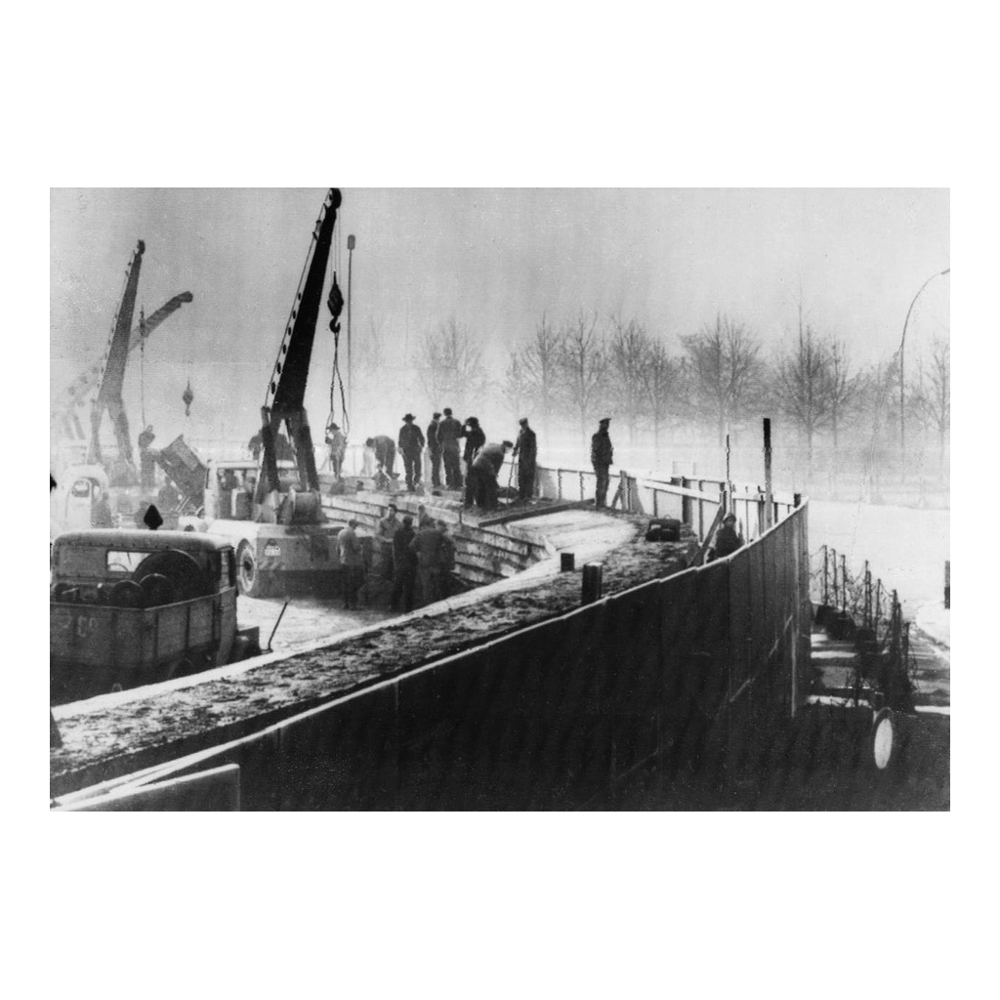
Building the Wall, 1961
Note: cranes lift slabs
© More Lessons Less Planning | morelessonslessplanning.com
Notes:
Give students ten seconds to look before you say anything. Point out the cranes and the barbed wire already strung along the top, then move on - this is a reference image, not an evidence task.

Slide 6
What the Wall Actually Was
Two walls, not one
An inner wall faced East Berlin and an outer wall faced the West.
✔
The death strip
Cleared open ground between the two walls, watched by armed guards.
✔
Watchtowers
Roughly 300 towers, floodlights and guards faced inward, toward East Berlin.
✔
Checkpoint Charlie
The best-known crossing point between East and West Berlin.
✔
Note: The Berlin Wall ran 96 miles and ringed all of West Berlin.
© More Lessons Less Planning | morelessonslessplanning.com
Notes:
Berlin Wall - concrete barrier that sealed West Berlin off from communist East Germany. Death strip - cleared open ground between the two walls, watched by armed guards. Checkpoint Charlie - the best-known crossing point between East and West Berlin. Keep the discussion on the engineering and on why so much of it faced inward; avoid graphic detail.

Slide 7
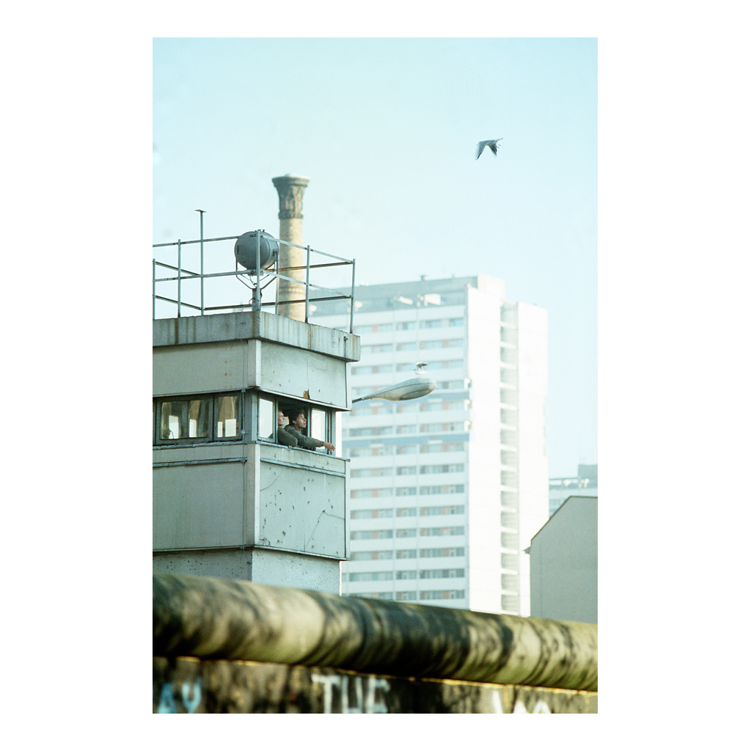
A Watchtower on the Border
Note: guard in the tower
© More Lessons Less Planning | morelessonslessplanning.com
Notes:
A guard leans from the observation window of a border tower; the rounded top of the Wall runs across the foreground with graffiti on it. Same photo previews the west-face graffiti point two slides later.

Slide 8
Life on Two Sides of the Wall
East Berlin
West Berlin
Travel to the West required permission almost no one got
The Stasi secret police watched neighbors, schools, and churches
Shortages made everyday goods hard to find
Open to the rest of the free world by air, road, and rail
Western money and aid poured in to keep the city alive
Artists covered the west face of the Wall in graffiti
Think about it: only one side of the Wall could be painted.
© More Lessons Less Planning | morelessonslessplanning.com
Notes:
The west face was covered in art because anyone could walk up and touch it. The east face stayed blank because East Berliners could not get near it. That contrast is the entire lesson compressed into one detail.

Slide 9
Trying to Get Out
5,000+
140
28
people escaped over, under, or through the Wall
people died at the Berlin Wall border
years the Wall stood, from 1961 to 1989
Real talk: escapes were rare because the risk was enormous.
© More Lessons Less Planning | morelessonslessplanning.com
Notes:
Escape methods included tunnels dug from basements, a homemade hot air balloon, and hidden car compartments. Keep the emphasis on the risk and the reasons people accepted it, not on graphic detail.

Slide 10
A Symbol the World Could See
Freedom has many difficulties and democracy is not perfect, but we have never had to put a wall up to keep our people in, to prevent them from leaving us.
— President John F. Kennedy, West Berlin, June 26, 1963
Both sides used the Wall as an argument. The West called it a prison wall; East Germany called it an antifascist protection barrier.
Key Point: both sides used the same wall to argue they were right.
© More Lessons Less Planning | morelessonslessplanning.com
Notes:
Kennedy spoke in West Berlin on June 26, 1963, two years after the Wall went up; a U.S. presidential address is a public domain government work. The line on this slide is quoted complete and unaltered through the end of Kennedy's sentence - the closing clause "to prevent them from leaving us" is the part that names what the Wall was actually for. East Germany's official name for the Wall was the antifascist protection barrier, which is worth writing on the board next to Kennedy's line.

Slide 11
Reagan at the Brandenburg Gate, 1987
June 12, 1987: President Reagan spoke feet from the Wall
He stood on the West Berlin side of the Brandenburg Gate
Loudspeakers carried his voice across into East Berlin
His most famous line asked Gorbachev to tear down this wall
State Department advisers cut that line; Reagan put it back
Fun fact: advisers tried to cut the most famous line, and Reagan kept it.
© More Lessons Less Planning | morelessonslessplanning.com
Notes:
This speech is the Primary Source Spotlight in the Activity. Students will read a trimmed excerpt and answer sourcing, comprehension, and analysis questions, so it is worth reading the closing lines aloud here.

Slide 12
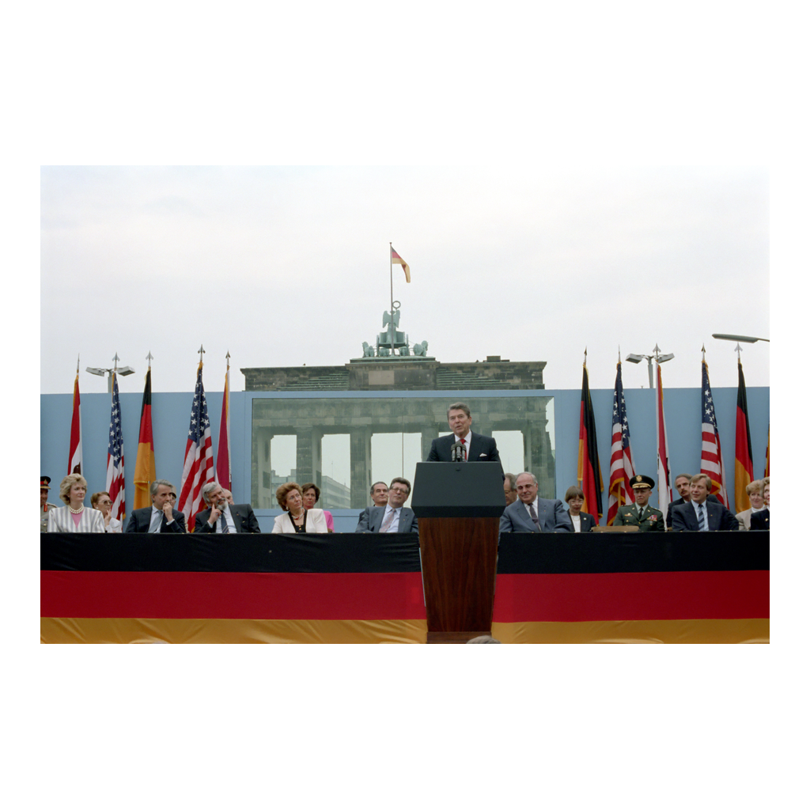
Reagan at the Wall, 1987
Note: Gate behind security glass
© More Lessons Less Planning | morelessonslessplanning.com
Notes:
Reagan speaks from a platform in front of the Brandenburg Gate. A pale blue security barrier with a bulletproof glass panel stands behind him, and the Gate shows through the glass. The Wall ran between the platform and the Gate but is not visible in this shot.

Slide 13
1989: The Pressure Builds
Glasnost
Hungary Opens Up
Monday Marches
Gorbachev allowed public criticism inside the Soviet Union
He told Eastern Europe Soviet tanks would not rescue them
May 1989: Hungary cut its border fence, but guards stayed
Sept 1989: it opened the border and East Germans poured west
Every Monday protesters marched in Leipzig
By November crowds numbered in the hundreds of thousands
Key Concept: the Wall only worked while the whole system held.
© More Lessons Less Planning | morelessonslessplanning.com
Notes:
Glasnost - Gorbachev's policy of openness that allowed public criticism in the USSR. Hungary began cutting its signal fence on May 2, 1989, but the border stayed guarded and East Germans were still detained; Hungary opened the border to them on September 11, 1989. The Wall failed from the outside in: once that route opened, a Berlin border made no sense, because East Germans could simply travel south.

Slide 14
November 9, 1989
An East German spokesman announced the border was open
He was reading a draft policy and got the timing wrong
Thousands of Berliners walked straight to the crossings
Guards had no orders, so they finally raised the barriers
By midnight people were dancing on top of the Wall
Fact: the Wall opened because of a mistake at a press conference.
© More Lessons Less Planning | morelessonslessplanning.com
Notes:
The spokesman was Guenter Schabowski, who had not read the policy carefully and answered a reporter's follow-up with immediately. Guards at the crossings had no orders and made their own decision. Not a shot was fired that night.

Slide 15
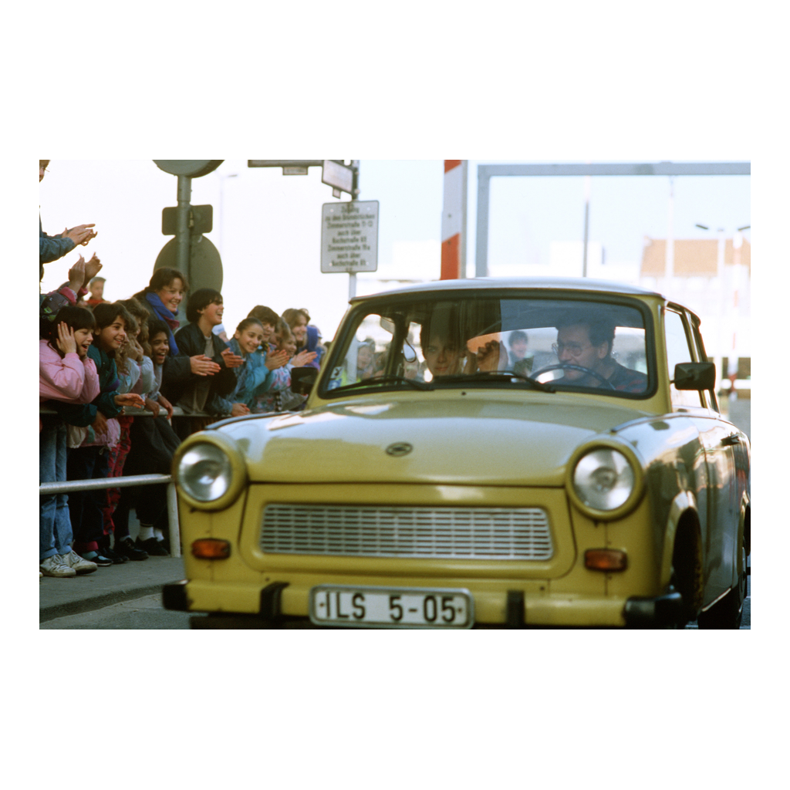
The Border Opens, November 1989
Note: a Trabant goes west
© More Lessons Less Planning | morelessonslessplanning.com
Notes:
A Trabant - the standard East German car - rolls west through Checkpoint Charlie while West Berliners applaud from behind the railing. Contrast it deliberately with the watchtower photo earlier in the deck.

Slide 16
What Came Next
Reunification
The joining of East and West Germany into one country in 1990.
Free elections
East Germany held its first free vote in March 1990.
The Wall today
Only short stretches remain; a double line of cobblestones marks the rest.
Key Point: the Wall opened in 1989 and Germany was one country by 1990.
© More Lessons Less Planning | morelessonslessplanning.com
Notes:
Reunification - the joining of East and West Germany into one country in 1990. The Soviet Union itself dissolved in 1991, two years after the Wall opened, which is why historians treat November 1989 as the beginning of the Cold War's end.

Slide 17
Key Takeaways
The Berlin Wall was built to keep East Germans in, not enemies out
★
It sealed West Berlin off for 28 years, from 1961 to 1989
★
The Wall was the Cold War made visible for both sides
★
It opened in 1989 and Germany reunified in 1990
★
© More Lessons Less Planning | morelessonslessplanning.com
Notes:
Close by returning to the opening question: a wall that needs its guns pointed inward is telling you something about the government that built it.

