Slide 1
The Berlin Conference
How European powers wrote rules for claiming African land - and what it cost the peoples never invited to the table.
© More Lessons Less Planning | morelessonslessplanning.com
Notes:
Open with the essential question: How did European powers set rules for claiming African land without African representatives at the table, and what were the consequences? Establish the frame immediately: this lesson reads the actual treaty rules as historical evidence and asks who they were written by, for, and about.

Slide 2
Learning Targets
Describe who met at the Berlin Conference of 1884-85 - and who was excluded.
★
Explain the General Act's claim rules: notification and real authority.
★
Separate what the conference really did from the borders myth.
★
Describe African sovereignty, agency, and resistance in this era.
★
Judge, with treaty evidence and lesson facts, why exclusion mattered.
★
© More Lessons Less Planning | morelessonslessplanning.com
Notes:
Preview the five targets. Flag target 3 explicitly: by the end of class students must be able to correct the common myth that diplomats drew all of Africa's borders at Berlin.

Slide 3
Africa in 1884: A Continent of Governments
1
2
Ethiopia
Sokoto Caliphate
An ancient empire whose rulers commanded armies and signed treaties.
A vast West African state governing millions across the Sahel.
3
4
Asante Empire
Sultanate of Zanzibar
A powerful Gold Coast kingdom ruled from its capital at Kumasi.
An Indian Ocean trading state linking Africa, Arabia, and India.
Key Concept: SOVEREIGNTY means a state's right to govern itself and control its own territory - and African states held it in 1884.
© More Lessons Less Planning | morelessonslessplanning.com
Notes:
Before any talk of the conference, establish that Africa in 1884 was full of functioning governments. Ethiopia was an ancient empire whose rulers commanded armies and signed treaties. The Sokoto Caliphate governed millions across the West African Sahel. The Asante Empire ruled from its capital at Kumasi on the Gold Coast. The Sultanate of Zanzibar ran an Indian Ocean trading state linking Africa, Arabia, and India. SOVEREIGNTY - a state's right to govern itself and control its own territory - was a fact on the ground, not a European gift. Every claim in the rest of the lesson should be measured against this slide.

Slide 4
Why Call a Conference?
Rival claims collide
Britain, France, Portugal, and King Leopold II all pushed rival claims on the Congo.
✔
Fear of war
European leaders feared that disputes over Africa could pull them into war with each other.
✔
Bismarck invites
Chancellor Otto von Bismarck invited the powers to Berlin in November 1884.
✔
Three months of talks
Diplomats met until February 1885 - with no African governments present.
✔
Note: The conference met to manage EUROPEAN rivalries. The peoples whose land was being discussed were never asked.
© More Lessons Less Planning | morelessonslessplanning.com
Notes:
The trigger was the Congo: Britain, France, Portugal, and King Leopold II of Belgium all pushed rival claims there in the early 1880s. European leaders feared that disputes over Africa could pull them into war with each other, so Germany's chancellor Otto von Bismarck invited the powers to Berlin in November 1884. The diplomats met until February 1885. The purpose was to manage European rivalry - no African government was invited, consulted, or even notified as a participant.

Slide 5
Berlin, 1884-85: Who Was at the Table
Seated at the table
Not invited
Twelve European states - Britain, France, Germany, more
The Ottoman Empire
The United States - signed but never ratified
No African government - not one
Ethiopia, Sokoto, Asante: all ignored
Decisions about African land, made without Africans
Key Concept: SIGNATORY POWERS were the governments that signed the General Act and promised to follow its rules.
© More Lessons Less Planning | morelessonslessplanning.com
Notes:
The table seated twelve European states - including Britain, France, Germany, Belgium, Portugal, Italy, and Spain - plus the Ottoman Empire and the United States. The United States attended and signed the treaty but never ratified it. The governments that signed the General Act are called the SIGNATORY POWERS. On the other side of the ledger: not one African government was invited. Ethiopia, the Sokoto Caliphate, and Asante - real states from the earlier slide - were ignored. Decisions about African land were made entirely without Africans.

Slide 6
The General Act of 1885
General Act
The treaty signed at the Berlin Conference in February 1885 recording the rules the powers promised to follow in Africa.
Congo Basin trade
Declared trade in the Congo Basin open to all nations.
Free navigation
Promised free navigation on the Congo and Niger Rivers.
Chapter VI claim rules
Set the notification and authority rules for new claims on Africa's coasts.
Did You Know? During the conference months the powers also recognized King Leopold II's personal claim to the Congo Basin.
© More Lessons Less Planning | morelessonslessplanning.com
Notes:
The conference's product was the GENERAL ACT, the treaty signed in February 1885 recording the rules the powers promised to follow in Africa. It declared trade in the Congo Basin open to all nations, promised free navigation on the Congo and Niger Rivers, included anti-slave-trade language, and - in Chapter VI - set the notification and authority rules for new claims on Africa's coasts. Alongside the conference, the powers separately recognized King Leopold II's personal claim to the Congo Basin - a preview of how claims were traded among Europeans, never negotiated with Africans.

Slide 7
The Rules of the Claim: Articles 34 and 35
Article 34: Tell the others
Article 35: Back it up
New coastal claims or protectorates required NOTIFICATION
Powers announced claims to the other signatory powers
So rivals could raise their own claims
Occupying powers owed an authority sufficient there
Authority had to protect acquired rights and trade
Real control - not just a flag on a map
Note: The treaty says coastal occupations must 'be considered as effective' - historians shorten this idea to EFFECTIVE OCCUPATION.
© More Lessons Less Planning | morelessonslessplanning.com
Notes:
Chapter VI held the two claim rules. Article 34: any power taking new coastal territory or a protectorate owed NOTIFICATION - it had to announce the claim to the other signatory powers so rivals could raise their own claims. Article 35: signatory powers had to maintain in occupied coastal territories an authority sufficient to protect acquired rights and agreed trade - real control, not just a flag on a map. Precision matters here: the treaty's own words say new occupations must 'be considered as effective'; the famous phrase EFFECTIVE OCCUPATION is the historians' shorthand for this idea, not a quotation from Article 35.

Slide 8
In the Treaty's Own Words
The Power which shall take possession of a territory upon the coast of the African continent... shall accompany the respective act with a notification addressed to the other signatory Powers.
— General Act of the Berlin Conference, Article 34 (1885)
A rule about telling other European powers - not about asking anyone in Africa.
Remember: Every duty in the claims process ran between the signatory powers. African consent appears nowhere in these rules.
© More Lessons Less Planning | morelessonslessplanning.com
Notes:
Read the treaty's own words slowly. The duty is to accompany a new claim with a notification 'addressed to the other signatory Powers.' Ask students: who gives this notice? Who receives it? Who is never mentioned? The answer to the last question - the peoples actually living on the land being claimed - is the heart of the lesson. This is Article 34 as printed in the 1909 American Journal of International Law translation, lightly shortened for the slide; students read the full passage in the Activity's Primary Source Spotlight.

Slide 9
From Paper Rules to Partition
After 1885, claims on Africa accelerated into a full PARTITION.
Powers used the HINTERLAND idea to push coastal claims deep inland.
Bilateral treaties between European capitals drew most borders.
By about 1914, roughly 90 percent of Africa was under European claims.
Only Ethiopia and Liberia kept their independence.
Key Concept: The PARTITION OF AFRICA was the carving of nearly the whole continent into European colonies and spheres in about thirty years.
© More Lessons Less Planning | morelessonslessplanning.com
Notes:
After 1885, claims accelerated into the full PARTITION OF AFRICA. The treaty's claim rules covered coasts, so powers stretched inland with the HINTERLAND idea - arguing the land behind a coastal claim came with it. Most actual borders were drawn by bilateral treaties negotiated between European capitals, then enforced by conquest. By about 1914, roughly 90 percent of Africa was under European claims; only Ethiopia and Liberia kept their independence. The next slide shows a real period atlas map of the result.

Slide 10
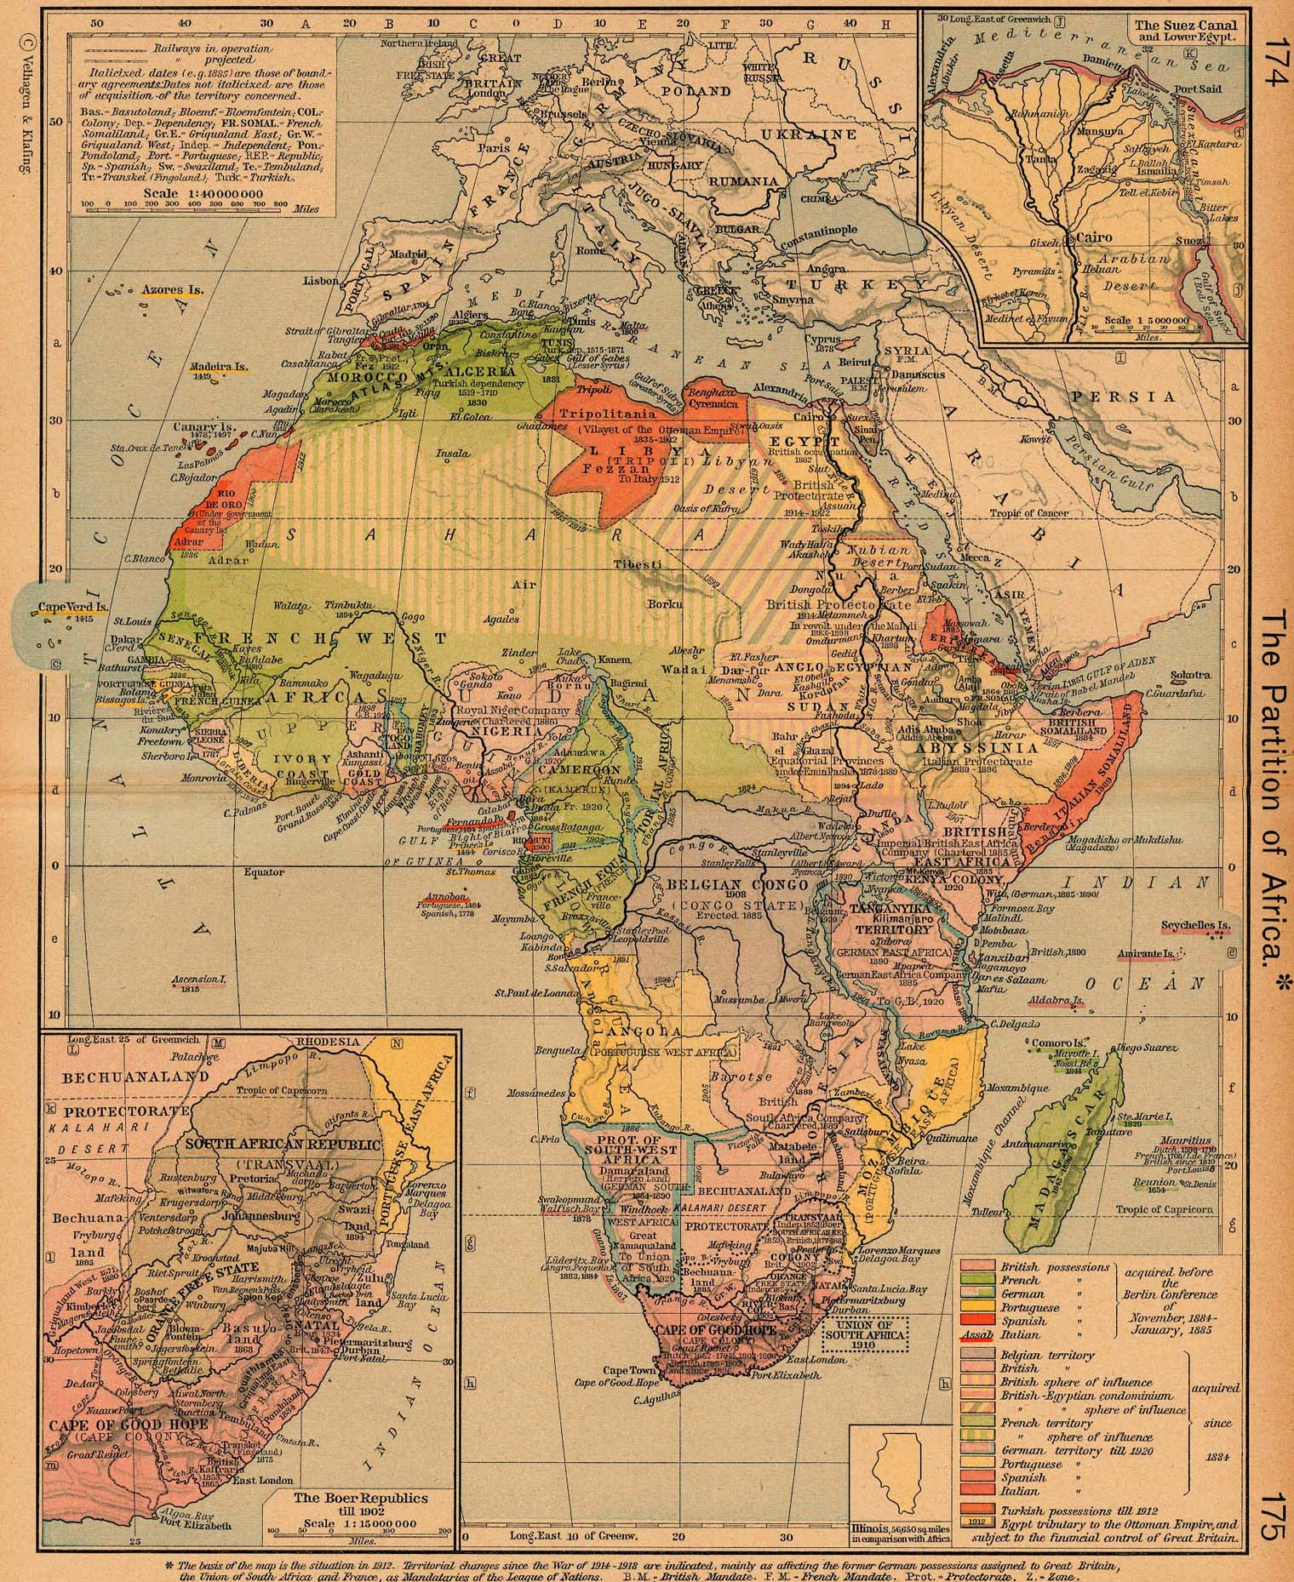
A Period Atlas Maps the Partition
'The Partition of Africa,' Shepherd's Historical Atlas, 1923 ed. (c. 1912).
© More Lessons Less Planning | morelessonslessplanning.com
Notes:
This is 'The Partition of Africa' from William R. Shepherd's Historical Atlas (1923 edition; the plate first appeared in 1911, and the map itself notes its basis is the situation in 1912). Each colonial power's claims are shaded in its own color; Abyssinia (Ethiopia) and Liberia stand apart. The plate's own printed legend sorts claims into territory acquired BEFORE the Berlin Conference of 1884-85 and territory acquired since - even period mapmakers treated the conference as the hinge of the story. Use it as a reference image of the outcome; no graded question asks students to read details off this map.
Reference labels (point to these chart features when teaching): Claims shaded by power; Legend cites Berlin Conference

Slide 11
What the Conference Did - and Did Not - Do
The myth
The reality
Why it mattered
Diplomats drew all of Africa's borders in one Berlin room
This common story overstates what the meeting itself did
Most borders were set later, treaty by treaty
The Act wrote RULES for claims: notify rivals, hold authority
It made claiming Africa legitimate among the powers
The race became faster, cheaper, and orderly - for Europe
Rules turned the seizure of African land into paperwork
Claims backed by the Act were defended with armies
African states faced a system built to exclude them
Warning: 'The conference drew Africa's borders' is a myth - it wrote claim RULES that sped up the carve-up.
© More Lessons Less Planning | morelessonslessplanning.com
Notes:
Correct the myth directly: the Berlin Conference did NOT sit down and draw every modern African border. What it actually did was write RULES for claiming - notify rivals, hold real authority - and, by doing so, made claiming Africa legitimate among the powers and made the race faster, cheaper, and orderly for Europe. Why it still mattered: the rules turned the seizure of African land into paperwork between outsiders, claims backed by the Act were then defended with armies, and African states confronted a legal system built to exclude them. The conference is the hinge of the partition story precisely because of its rules, not because of a map on the table.

Slide 12
Sovereignty Ignored, Sovereignty Defended
African states kept exercising SOVEREIGNTY after 1885.
Menelik II of Ethiopia played rival powers against each other.
At Adwa in 1896, Ethiopia defeated an invading Italian army.
Samori Toure fought French conquest for more than a decade.
Rulers used armies, diplomacy, and law - African agency never vanished.
Did You Know? Adwa made Ethiopia the era's clearest proof that an African state could defeat a European invasion.
© More Lessons Less Planning | morelessonslessplanning.com
Notes:
The conference ignored African sovereignty; Africans kept exercising it anyway. Emperor Menelik II of Ethiopia played rival European powers against each other, imported modern rifles, and built alliances. At the BATTLE OF ADWA on 1 March 1896, his forces defeated an invading Italian army outright - Ethiopia stayed independent. In West Africa, Samori Toure's forces fought French conquest for more than a decade. Across the continent rulers used armies, diplomacy, and law. African agency never vanished; teaching the conference without the resistance would repeat the conference's own erasure.

Slide 13
Reference Guide: The Conference and the Treaty
Berlin Conference
The 1884-85 meeting that set European rules for claiming African land; no African government was invited.
General Act
The treaty signed in February 1885 recording the rules the powers agreed to follow in Africa.
Signatory powers
Twelve European states plus the Ottoman Empire and the United States: the General Act's signers.
Notification
The Article 34 rule that new coastal claims had to be announced to the other signatory powers.
Protectorate
A setup where a European power controlled an African state while calling itself its protector.
Tip: These ten terms power the Activity's Reference Guide - five will be blanked, so learn all ten now.
© More Lessons Less Planning | morelessonslessplanning.com
Notes:
First five exact definitions. BERLIN CONFERENCE: The 1884-85 meeting that set European rules for claiming African land; no African government was invited. GENERAL ACT: The treaty signed in February 1885 recording the rules the powers agreed to follow in Africa. SIGNATORY POWERS: Twelve European states plus the Ottoman Empire and the United States: the General Act's signers. NOTIFICATION: The Article 34 rule that new coastal claims had to be announced to the other signatory powers. PROTECTORATE: A setup where a European power controlled an African state while calling itself its protector.

Slide 14
Reference Guide: Claims and Consequences
Effective occupation
Historians' name for the idea that claims needed real on-the-ground authority, speeding conquest.
Hinterland
The inland land behind a coastal claim, which powers argued gave them rights deep into Africa.
Partition of Africa
The carving of nearly the whole continent into European colonies in the thirty years after 1885.
Sovereignty
A state's right to govern itself and control its own territory - held by African states in 1884.
Battle of Adwa
The 1896 victory where Menelik II's Ethiopia defeated an invading Italian army, staying independent.
Tip: Every term on these two slides also appears in your Guided Notes with the same definition.
© More Lessons Less Planning | morelessonslessplanning.com
Notes:
Second five exact definitions. EFFECTIVE OCCUPATION: Historians' name for the idea that claims needed real on-the-ground authority, speeding conquest. HINTERLAND: The inland land behind a coastal claim, which powers argued gave them rights deep into Africa. PARTITION OF AFRICA: The carving of nearly the whole continent into European colonies in the thirty years after 1885. SOVEREIGNTY: A state's right to govern itself and control its own territory - held by African states in 1884. BATTLE OF ADWA: The 1896 victory where Menelik II's Ethiopia defeated an invading Italian army, staying independent.

Slide 15
Key Takeaways
In 1884-85, outside powers wrote rules for claiming Africa - without Africans.
★
Articles 34-35 required notifying rivals and holding real authority.
★
The conference set rules that sped the partition; borders came later.
★
African states held sovereignty and resisted - Adwa proved it could win.
★
© More Lessons Less Planning | morelessonslessplanning.com
Notes:
Close on the essential question. The rules were written in Berlin by outside powers; Articles 34 and 35 required notification to rivals and authority on the ground; the consequence was an accelerated partition reaching roughly 90 percent of the continent by about 1914 - while African states like Ethiopia proved sovereignty could be defended. The empty chairs at the table mattered as much as the words on the paper.

