Slide 1
The Battle of Britain
The Summer Britain Held the Sky
© More Lessons Less Planning | morelessonslessplanning.com
Notes:
Ask students what they already picture when they hear the Battle of Britain. Most will name planes; the lesson adds radar, civilians, and the American response.

Slide 2
Learning Targets
Explain why Germany had to beat the RAF before it could invade Britain.
★
Describe how radar and Fighter Command helped Britain hold the sky in 1940.
★
Explain what the Blitz was and how British civilians lived through it.
★
Trace the steps the United States took to support Britain in 1940 and 1941.
★
Use Roosevelt's 1940 fireside chat as evidence about American policy.
★
© More Lessons Less Planning | morelessonslessplanning.com
Notes:
Point out that targets four and five are about the United States. Half this lesson is about a country that had not yet entered the war.

Slide 3
Britain Stands Alone, June 1940
France surrendered to Germany on June 22, 1940.
Britain was the last major power in western Europe still fighting.
Hitler needed Britain to surrender or be invaded.
The English Channel is only 21 miles wide at its narrowest point.
The Royal Navy was far stronger than Germany's surface fleet.
Key Concept: Germany could not risk crossing the Channel while British planes could attack the barges.
© More Lessons Less Planning | morelessonslessplanning.com
Notes:
The Channel is the hinge of the whole lesson: it is narrow enough to cross and wide enough to defend, which is why the air battle happened at all.

Slide 4
The Air War in Three Words
Luftwaffe
Germany's air force, which attacked Britain from July 1940 to win control of the sky
Royal Air Force
Britain's air force, whose fighter pilots defended the island through the summer of 1940
Operation Sea Lion
Germany's plan to invade Britain by sea, postponed in September 1940 and never carried out
Note: Sea Lion was postponed on September 17, 1940 and was never carried out.
© More Lessons Less Planning | morelessonslessplanning.com
Notes:
These three words are the frame for everything that follows. Have students say each one aloud before moving on.

Slide 5
Why Germany Had to Win the Sky First
What Germany Needed
What Britain Had
Control of the sky over the Channel
RAF airfields and radar knocked out
Barges able to cross without air attack
A quick British surrender
Radar warning of every incoming raid
Home ground: shot-down pilots flew again
Aircraft factories still building fighters
The Royal Navy guarding the Channel
Did You Know: A German pilot shot down over Kent was captured; a British pilot could be flying again that afternoon.
© More Lessons Less Planning | morelessonslessplanning.com
Notes:
The home-ground advantage is the point students most often miss. Losing an aircraft and losing a trained crew are two different costs.

Slide 6
Britain's Hidden Advantage
Radar
A system that bounced radio waves off aircraft so defenders could track raids before seeing them
Fighter Command
The RAF branch that tracked incoming raids and decided which squadrons to send up
Chain Home
The line of radar stations along Britain's south and east coasts
Key Concept: Radar turned air defence from guesswork into a system that put fighters in the right place.
© More Lessons Less Planning | morelessonslessplanning.com
Notes:
Without radar the RAF would have had to fly constant patrols and would have burned out. Radar let a smaller force fight a bigger one.

Slide 7
Four Phases of the Battle, 1940
Phase | Dates in 1940 | German target
Channel battles | July 10 - August 12 | Ships and ports in the Channel
Attacks on airfields | August 13 - September 6 | RAF airfields and radar stations
The Blitz on London | September 7 - October 31 | London docks, homes, and factories
Night raids on cities | November 1940 - May 1941 | Industrial cities across Britain
Fact: Britain dates the Battle of Britain from July 10 to October 31, 1940.
© More Lessons Less Planning | morelessonslessplanning.com
Notes:
Read the second and third rows together. The change of target on September 7 is the turning point of the battle.

Slide 8
Who Flew for Fighter Command
About 3,000 aircrew flew for RAF Fighter Command in 1940.
Roughly one in five came from outside Britain.
Polish, Czech, Canadian and New Zealand pilots all flew.
Pilots often flew four or five sorties in a single day.
Ground crews refuelled and rearmed a fighter in minutes.
Did You Know: No. 303 Polish Squadron claimed more German aircraft than any other RAF squadron in the battle.
© More Lessons Less Planning | morelessonslessplanning.com
Notes:
The next slide is the photograph of these men. Do not rush past it; give the class thirty silent seconds with it.

Slide 9
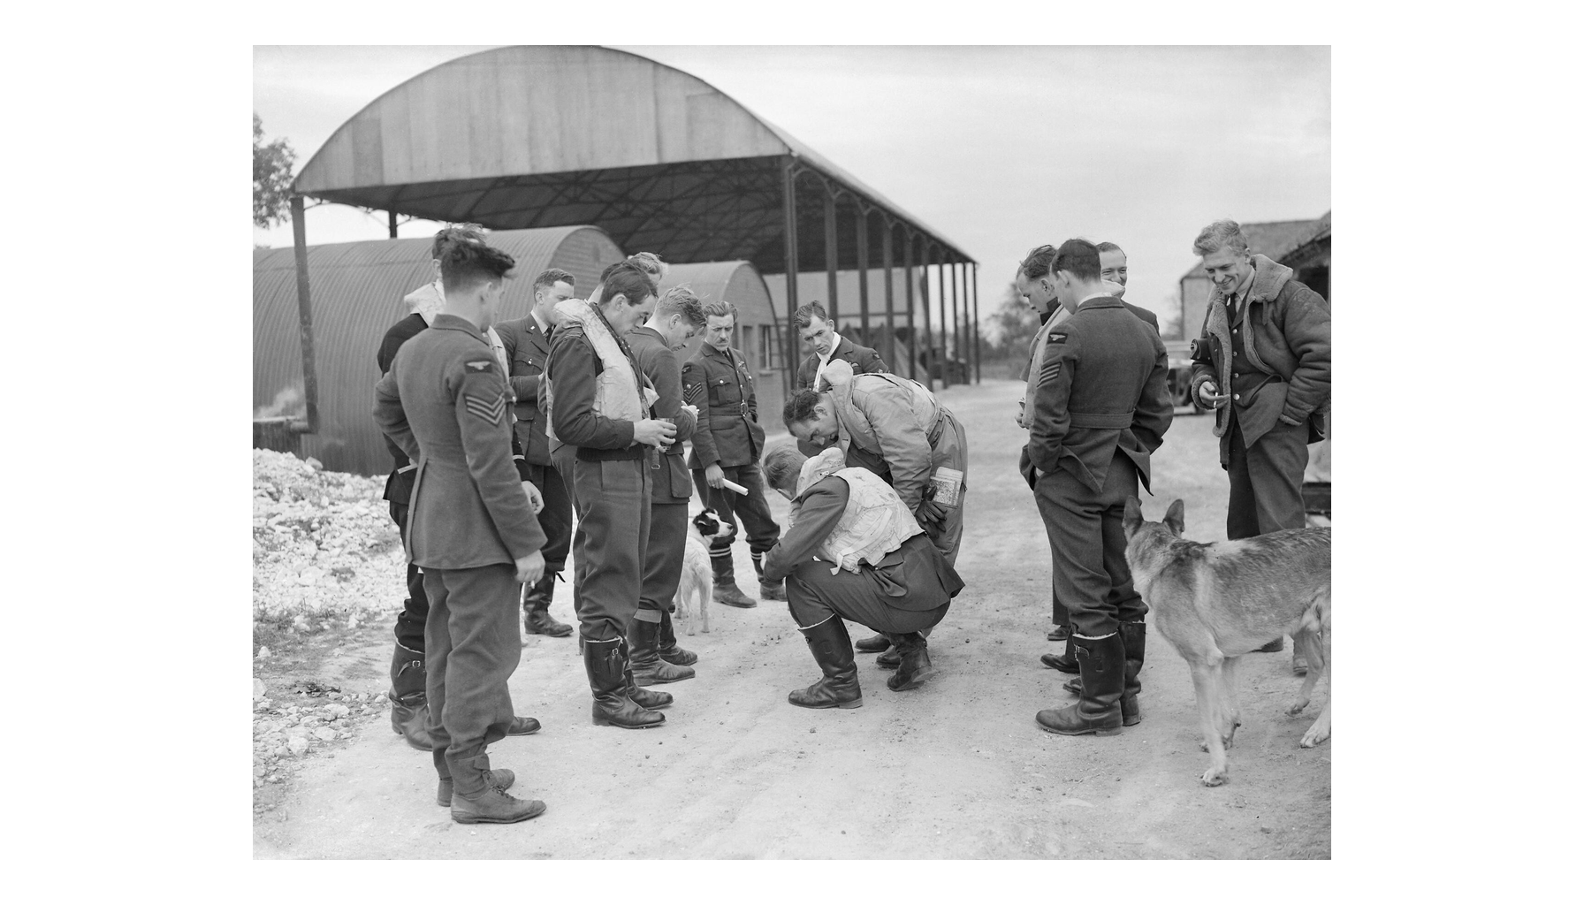
No. 19 Squadron RAF, September 1940
Note: between sorties.
© More Lessons Less Planning | morelessonslessplanning.com
Notes:
Give the class thirty seconds of silence with the photograph, then ask how old these men look. Most were in their early twenties.
Reference labels (point to these chart features when teaching): Flying kit still on; Waiting for the scramble

Slide 10
The Battle by the Numbers
Measure | Figure | Date or period
German aircraft lost | About 1,900 | July 10 - October 31, 1940
RAF fighters lost | About 1,000 | July 10 - October 31, 1940
Fighter Command aircrew killed | About 540 | July 10 - October 31, 1940
British fighters built each month | About 470 | Summer 1940
German fighters built each month | About 175 | Summer 1940
Key Concept: Britain replaced its fighters faster than Germany could, which mattered as much as the fighting.
© More Lessons Less Planning | morelessonslessplanning.com
Notes:
Students use this exact table again in Activity Part 3. Do not solve the arithmetic for them here; just make sure they can read the rows.

Slide 11
The Blitz Begins: September 7, 1940
September 7, 1940
Why Cities?
The Cost
Nearly 350 German bombers struck the London docks.
Fires burned along the Thames through the night.
London was then bombed for 57 nights in a row.
Hitler wanted to break British civilian morale.
RAF airfields got a break from constant attack.
Fighter Command repaired runways and rested crews.
About 43,000 civilians died, September 1940 to May 1941.
More than a million London homes were damaged.
Coventry, Liverpool and Glasgow were hit hard too.
Warning: The Blitz targeted civilians on purpose. Treat these numbers as people, not statistics.
© More Lessons Less Planning | morelessonslessplanning.com
Notes:
The middle card is the argument of the slide: the decision that was meant to break Britain is the decision that saved Fighter Command.

Slide 12
The Blitz in Three Words
The Blitz
The German bombing campaign against London and other British cities from September 1940
Air-Raid Shelter
A reinforced space, from a back-garden Anderson shelter to an Underground platform
Blackout
The rule that no light could show at night so bombers could not find their targets
Did You Know: About 150,000 Londoners slept in Underground stations on the busiest nights.
© More Lessons Less Planning | morelessonslessplanning.com
Notes:
Blitz is short for Blitzkrieg, lightning war, but the London campaign was the opposite of lightning: it was slow and grinding.

Slide 13
Living Through the Raids
Fit the blackout
No light could show after dark, so windows were covered every evening
✔
Take cover
Families used back-garden shelters, street shelters, or Underground platforms
✔
Evacuate the children
Hundreds of thousands of city children were sent to families in the countryside
✔
Clear up and carry on
Air Raid Precautions wardens, fire watchers, and rescue crews worked through every raid
✔
Note: Britain kept factories, schools, and shops running through the Blitz, which was part of the point.
© More Lessons Less Planning | morelessonslessplanning.com
Notes:
Ask students which of these four jobs they would have wanted. Evacuation splits a class fast, which is a useful discussion.

Slide 14
America Watches, 1940
In 1940 most Americans wanted to stay out of the war.
Cash-and-carry let Britain buy American arms, but only for cash up front.
Roosevelt won a third term in November 1940.
Britain was running out of dollars to pay for supplies.
Roosevelt looked for ways to help without sending troops.
Fact: Polls in 1940 showed most Americans wanted Britain to win but did not want to fight.
© More Lessons Less Planning | morelessonslessplanning.com
Notes:
Hold both facts together: Americans wanted Britain to win AND wanted to stay out. Roosevelt's whole policy lives in that gap.

Slide 15
The American Debate in Three Words
Isolationism
The belief that the United States should stay out of wars fought outside the Americas
Destroyers-for-Bases Deal
The September 1940 trade of fifty old American destroyers for leases on British bases
Neutrality Acts
The 1930s laws that barred arms sales to countries at war, until a 1939 revision allowed cash-and-carry purchases
Key Concept: The destroyer deal was an executive agreement, so it did not need a vote in Congress.
© More Lessons Less Planning | morelessonslessplanning.com
Notes:
Point out that the destroyer deal is a trade, not a gift. That framing is exactly what made it politically survivable.

Slide 16
The Fireside Chat of December 29, 1940
Roosevelt spoke to the nation by radio on December 29, 1940.
About 59 percent of American radio listeners heard the broadcast.
He argued that helping Britain was the way to stay out of war.
He promised weapons, not an American army in Europe.
He called the United States the great arsenal of democracy.
Did You Know: A fireside chat was Roosevelt speaking plainly by radio, as if to one family at a time.
© More Lessons Less Planning | morelessonslessplanning.com
Notes:
Students read five passages from this broadcast in Activity Part 4. Flag that now so the Activity feels like a continuation, not a new task.

Slide 17
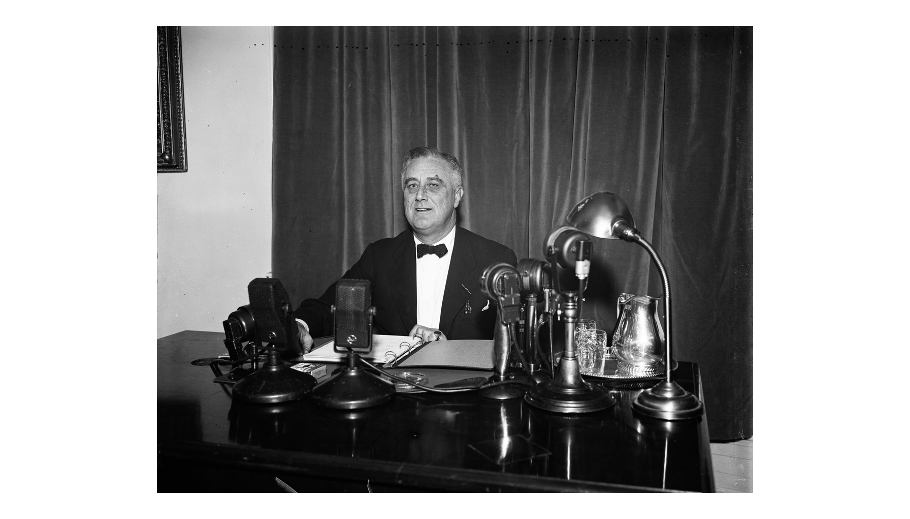
Roosevelt at the Fireside Chat Microphones, 1937
Note: 1937, not 1940.
© More Lessons Less Planning | morelessonslessplanning.com
Notes:
Say plainly that this photograph is from an earlier fireside chat in 1937, not from December 1940. It shows the format Roosevelt used, not the night itself.
Reference labels (point to these chart features when teaching): Network microphones; Speaking from a desk

Slide 18
From Arsenal to Lend-Lease
Arsenal of Democracy
Roosevelt's phrase for an America that supplies weapons to the nations fighting the Axis
✔
Lend-Lease
The March 1941 law that let the United States lend or lease war supplies to Britain
✔
Ships and planes cross the Atlantic
American aircraft, tanks, food, and fuel reached Britain without cash payment up front
✔
Britain keeps fighting
Supplied from across the ocean, Britain stayed in the war through 1941 and beyond
✔
Big Idea: Roosevelt argued that supplying Britain was the cheapest way to keep war away from America.
© More Lessons Less Planning | morelessonslessplanning.com
Notes:
This slide closes the American half of the lesson. The Blitz was still going on while Congress debated Lend-Lease.

Slide 19
Roosevelt Names America's Job
We must be the great arsenal of democracy. For us this is an emergency as serious as war itself.
— Franklin D. Roosevelt, fireside chat, December 29, 1940
Roosevelt spoke three months after the Blitz began, with Britain short of ships, planes, and dollars.
Remember: You will read a longer passage from this same broadcast in Activity Part 4.
© More Lessons Less Planning | morelessonslessplanning.com
Notes:
Read the quote aloud twice, once flat and once as a broadcast. Students hear the difference a national radio audience makes.

Slide 20
Key Takeaways
Germany had to win the sky before it could invade Britain, and it never did.
★
Radar and Fighter Command let a smaller air force fight a bigger one.
★
Switching to bomb cities on September 7, 1940 gave the RAF time to recover.
★
The Blitz killed about 43,000 civilians by May 1941 without breaking Britain.
★
Roosevelt answered with the Destroyers-for-Bases Deal and then Lend-Lease.
★
© More Lessons Less Planning | morelessonslessplanning.com
Notes:
Ask students which takeaway they would defend in Activity Part 5. Their verdict paragraph is easier once they have picked a side out loud.

