Slide 1
The Battle of Adwa: Ethiopia Defeats an Empire
How a disputed treaty clause helped spark a war that ended with an African army decisively defeating a European invader.
© More Lessons Less Planning | morelessonslessplanning.com
Notes:
Open with the essential question: How did a disputed treaty clause help spark a war that ended with an African army decisively defeating a European invader - and what does Ethiopia's victory at Adwa reveal about African sovereignty in the age of empire? Establish the frame immediately: Ethiopia was a sovereign African state that defended itself and won.

Slide 2
Learning Targets
Explain how Article 17's two language versions differed - and why.
★
Describe Menelik's mobilization and its key leaders.
★
Explain why Ethiopia won the Battle of Adwa on 1 March 1896.
★
Summarize the Treaty of Addis Ababa and its significance.
★
Evaluate Adwa as African strategy and sovereignty - not luck.
★
Analyze Menelik's own words in his 1895 war-proclamation as evidence.
★
© More Lessons Less Planning | morelessonslessplanning.com
Notes:
Preview the targets. Flag target 5 explicitly: by the end of class students must be able to explain Adwa as strategy and sovereignty, not luck. Flag target 6 too: students will analyze Menelik's own 1895 war-proclamation as primary source evidence in Activity Part 4.

Slide 3
Ethiopia in 1889: A Sovereign African State
1
2
Government
Religion
Emperor Menelik II ruled Ethiopia from its highland capital, commanding armies and signing treaties.
The Ethiopian Orthodox Church was a centuries-old national institution, not an import.
3
4
Military
Diplomacy
Ethiopia's regional forces, loyal to the emperor, were increasingly armed with modern rifles.
Ethiopia conducted its own foreign relations with Italy, France, and Russia.
Key Concept: SOVEREIGNTY means a state's right to govern itself and control its own territory and foreign relations.
© More Lessons Less Planning | morelessonslessplanning.com
Notes:
By 1889, Ethiopia was a fully sovereign African state, not a land waiting to be claimed. Emperor Menelik II ruled from the highlands, commanding armies and signing treaties as an equal. Ethiopia had its own centuries-old church, its own army, and its own diplomacy with European powers. Every claim in the rest of the lesson - including Italy's - should be measured against this fact.

Slide 4
The Treaty of Wichale (Ucciali), 1889
Signed May 1889
Italy and Emperor Menelik II signed the treaty shortly after Menelik took the throne.
✔
Recognition
Italy recognized Menelik as Ethiopia's ruler.
✔
Territory
Italy gained highland territory that became the colony of Eritrea.
✔
Article 17
A clause on Ethiopia's foreign relations - worded differently in each language version.
✔
Note: A single disputed article would turn this treaty into the spark for war.
© More Lessons Less Planning | morelessonslessplanning.com
Notes:
Italy and Menelik II signed the Treaty of Wichale (also called the Treaty of Ucciali) in May 1889. Italy recognized Menelik as Ethiopia's ruler and gained highland territory that became the colony of Eritrea. Buried in the treaty was Article 17, which addressed how Ethiopia would conduct relations with other foreign powers. That single article - worded differently in the Italian and Amharic versions - would become the spark for war.

Slide 5
One Treaty, Two Languages: Article 17
Italian Version
Amharic Version
Ethiopia MUST use Italy as its channel for dealing with other foreign powers.
Italy read this as making Ethiopia an Italian PROTECTORATE.
Ethiopia MAY use Italy as a channel, if it chooses to.
Menelik remained free to conduct his own diplomacy with any power.
Key Concept: This translation discrepancy - not a battlefield event - is the lesson's central cause.
© More Lessons Less Planning | morelessonslessplanning.com
Notes:
Article 17 was worded differently in the two official languages. The Italian text used a verb that made using Italy as a diplomatic channel mandatory - Italy then told other European powers that Ethiopia was now an Italian protectorate. The Amharic text used a verb that made it optional - leaving Menelik legally free to deal directly with any foreign power he chose. This treaty dispute over two differing versions of the same article - not any battlefield event - is what precipitated the war.

Slide 6
Menelik Rejects the Protectorate
Italy announced to other European powers that Ethiopia was now its protectorate.
Menelik formally denounced the Italian interpretation of Article 17.
Italy pushed troops deeper into Ethiopia's northern Tigray province.
By late 1895, diplomacy had collapsed - Menelik moved to mobilize the nation.
Warning: Diplomacy had failed - the next step was mobilization.
© More Lessons Less Planning | morelessonslessplanning.com
Notes:
Italy circulated its protectorate claim to other European governments as if it were settled fact. Menelik formally denounced that interpretation, insisting on the Amharic text's meaning. When words failed to resolve the dispute, Italy pushed troops deeper into Ethiopia's northern Tigray province. By late 1895, diplomacy had fully collapsed, and Menelik moved to mobilize the nation.

Slide 7
The Call to Arms: Menelik's Mobilization
100,000+
Soldiers mobilized
September 1895: Menelik issues a formal awaj (proclamation)
Criers: Read the proclamation aloud in towns across the empire
Every region: Men were called to report from across Ethiopia
Did You Know? Criers proclaimed Menelik's awaj on 17 September 1895 across the empire - the army assembled over the following months, not days.
© More Lessons Less Planning | morelessonslessplanning.com
Notes:
In September 1895, Menelik issued a formal awaj - a royal proclamation - calling the nation to arms. Criers read it aloud in towns and villages across the empire, and men from every region were called to report for duty. The mobilization gathered well over 100,000 soldiers, one of the largest African armies assembled to that date.

Slide 8
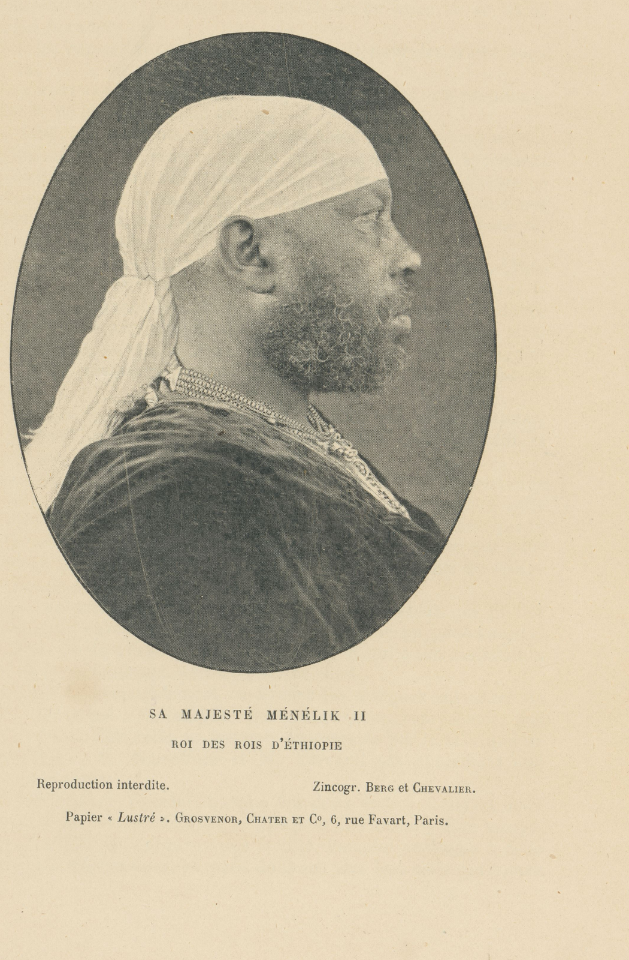
Emperor Menelik II
Emperor Menelik II of Ethiopia (Rijksmuseum)
© More Lessons Less Planning | morelessonslessplanning.com
Notes:
A period photogravure portrait of Emperor Menelik II, held by the Rijksmuseum (public domain), printed with the caption "Sa Majeste Menelik II, Roi des Rois d'Ethiopie." Reference only - let students connect a face to the name before moving on.
Reference labels (point to these chart features when teaching): Emperor Menelik II

Slide 9
Empress Taytu Betul's Leadership
Empress Taytu Betul was Menelik's wife and a powerful political partner.
She urged resistance to the protectorate claim from the very start.
She played a documented leadership role at the Mekelle siege, January 1896.
Her presence on campaign showed Ethiopian leadership was shared, not solo.
Key Concept: Ethiopian leadership during the war was not Menelik's alone.
© More Lessons Less Planning | morelessonslessplanning.com
Notes:
Empress Taytu Betul was far more than a royal spouse. She urged resistance to the Italian protectorate claim from the very start, and historical sources document her leadership role during the siege operations at Mekelle in January 1896. Her active presence on campaign is a documented fact, not a legend - Ethiopian leadership in this war was shared.

Slide 10
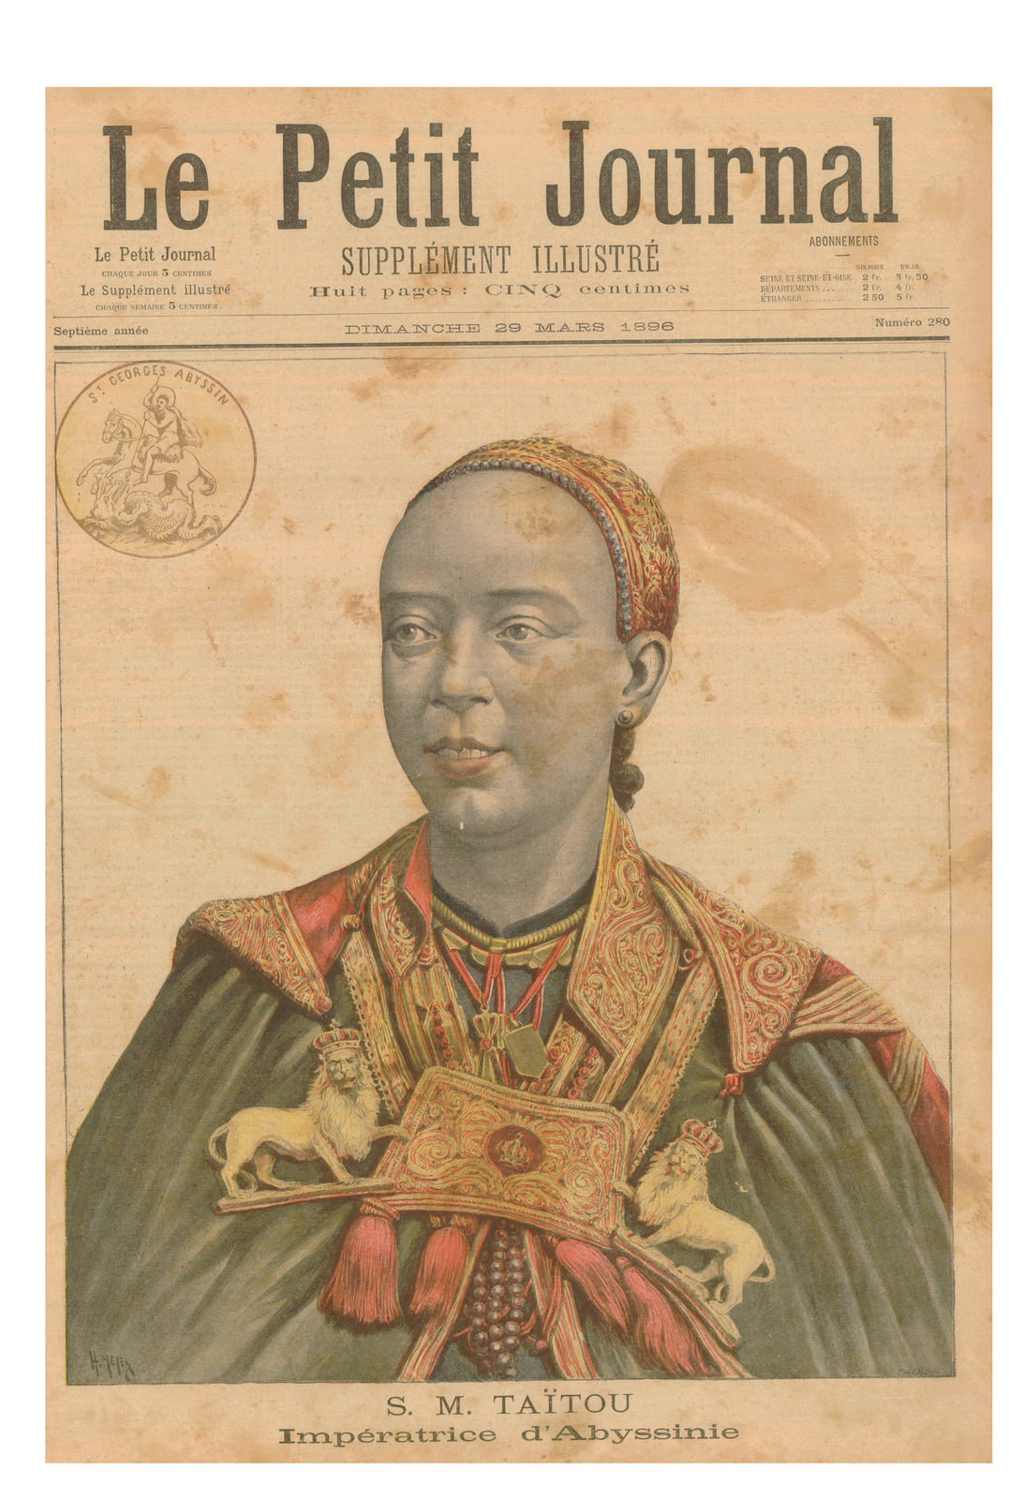
Empress Taytu Betul
Empress Taytu Betul, Impératrice d'Abyssinie (Le Petit Journal, 29 March 1896)
© More Lessons Less Planning | morelessonslessplanning.com
Notes:
A formal portrait of Empress Taytu Betul published on the cover of the French illustrated newspaper Le Petit Journal on 29 March 1896, weeks after the Ethiopian victory at Adwa (public domain). Reference only.
Reference labels (point to these chart features when teaching): Empress Taytu Betul

Slide 11
Ras Alula, Ras Makonnen, and the March North
1
2
Ras Alula
Ras Makonnen
A veteran commander of Tigray province who joined the mobilization.
Led troops from Harar province in the east.
3
4
Regional rulers
The march north
Rulers across Ethiopia's regions answered the call, forming a genuinely national army.
The combined force marched through difficult mountain terrain toward Tigray.
Note: RAS was a high regional title, roughly equivalent to duke or prince.
© More Lessons Less Planning | morelessonslessplanning.com
Notes:
Ras Alula, a veteran commander of Tigray, joined the mobilization alongside Ras Makonnen, who led troops from Harar province in the east. Regional rulers across Ethiopia answered the call, forming a genuinely national army rather than one region's force. The combined army then marched north through difficult mountain terrain toward Tigray to meet the Italians.

Slide 12
General Baratieri's Faulty Maps and Divided Columns
Italian General Oreste Baratieri commanded the invasion force.
Pressured by Rome to act quickly, he advanced at night using inaccurate maps.
His columns split apart and lost contact with each other in the dark terrain.
The divided Italian force could not support itself once the fighting began.
Warning: A divided army cannot support itself when the fighting starts.
© More Lessons Less Planning | morelessonslessplanning.com
Notes:
General Oreste Baratieri commanded the Italian invasion force, but he was under heavy pressure from Rome to act decisively and quickly. He advanced his army at night using inaccurate maps of the mountainous terrain. In the darkness, his columns split apart and lost contact with one another. When the fighting began, the divided Italian force could not support or reinforce itself.

Slide 13
The Battle of Adwa, 1 March 1896
On 1 March 1896, the separated Italian columns attacked near Adwa.
Ethiopian forces, unified and far more numerous, defeated each column in turn.
Italy lost thousands of soldiers - two generals killed, one captured.
One of the most decisive defeats of a European colonial army that century.
Did You Know? Adwa is one of the most decisive defeats of a European colonial army in the 19th century.
© More Lessons Less Planning | morelessonslessplanning.com
Notes:
On 1 March 1896, the divided Italian columns attacked near Adwa one after another rather than as a single force. Ethiopian forces - unified and far more numerous - defeated each column in turn. Italy lost thousands of soldiers; two generals, Arimondi and Dabormida, were killed, and a third, Albertone, was captured. Adwa stands as one of the most decisive defeats of a European colonial army anywhere in the 19th century.

Slide 14
The Treaty of Addis Ababa, October 1896
Italy sues for peace
Following the defeat at Adwa, Italy sought a negotiated end to the war.
✔
Signed October 1896
The Treaty of Addis Ababa formally ended the conflict.
✔
Independence recognized
Italy formally recognized Ethiopian independence and renounced the protectorate claim.
✔
Eritrea retained
Italy kept its colony of Eritrea, but Ethiopia's own sovereignty was confirmed.
✔
Key Concept: This treaty is the direct opposite of the protectorate Italy claimed in 1889.
© More Lessons Less Planning | morelessonslessplanning.com
Notes:
Following the decisive defeat at Adwa, Italy sought peace. The Treaty of Addis Ababa was signed in October 1896. Italy formally recognized Ethiopian independence and renounced the protectorate claim it had made in 1889 - the exact opposite of where the treaty dispute began. Italy kept its colony of Eritrea, but Ethiopia's sovereignty over its own territory was fully confirmed.

Slide 15
African Agency: Not Luck, but Strategy
The Wrong Explanation
The Evidence-Based Explanation
Adwa is sometimes wrongly explained away as luck, or as Italian error alone.
That framing treats Ethiopia as a passive bystander in its own victory.
Ethiopia won through strategy: mass mobilization, unified command.
Modern rifles came through years of diplomacy with France and Russia.
Ethiopia was sovereign - real African agency and statecraft, not chance.
Warning: Explaining Adwa as luck erases Ethiopian strategy, sovereignty, and statecraft.
© More Lessons Less Planning | morelessonslessplanning.com
Notes:
It is tempting to explain Adwa away as luck, or as an Italian blunder alone - but that framing erases everything Ethiopia actually did. Ethiopia succeeded through deliberate strategy: mass mobilization of over 100,000 soldiers, unified command under Menelik and his generals, and modern rifles obtained through years of diplomacy with France and Russia. Ethiopia was a sovereign state with its own government, army, church, and diplomacy long before 1896 - it was never an exception to a passive continent, because the continent was never passive. This was African agency and statecraft defeating a European invader, not luck.

Slide 16
Adwa's Continental and Diasporic Significance
Only African state to defeat Europe and stay independent through the Scramble.
A symbol of pride and resistance across the African continent.
Diaspora means communities of African descent living outside Africa.
It inspired Pan-Africanist movements across the African diaspora.
Ethiopia's flag colors were later adopted by African independence movements.
Did You Know? Ethiopia's flag colors were later adopted by independence movements across Africa.
© More Lessons Less Planning | morelessonslessplanning.com
Notes:
Adwa's significance reached far beyond Ethiopia's borders. Ethiopia remained the only African state to defeat a European colonial invasion and stay independent through the entire Scramble for Africa. The victory became a symbol of pride and resistance across the continent. The African diaspora - communities of African descent living outside the continent - is who it inspired: Pan-Africanist and anti-colonial movements in the diaspora drew on Adwa for generations afterward. Ethiopia's flag colors were later adopted by independence movements across Africa as a direct link to this victory.

Slide 17
Reference Guide: Treaty and Mobilization
Treaty of Wichale (Ucciali)
The 1889 Italy-Ethiopia treaty whose Article 17 read differently in Italian and Amharic - the spark for war.
Protectorate
A state whose foreign affairs are controlled by another power; Italy claimed this status over Ethiopia.
Amharic
Ethiopia's court language; its Article 17 text left Menelik free to choose whether to use Italy at all.
Mobilization
Gathering and arming a nation's forces for war; Menelik's 1895 awaj called over 100,000 soldiers to arms.
Awaj
A formal Ethiopian royal proclamation, read aloud by criers, calling every able man to arms against invasion.
Key Concept: These five terms anchor Part 1 of your Activity.
© More Lessons Less Planning | morelessonslessplanning.com
Notes:
Reference recap of the first five vocabulary terms: Treaty of Wichale (Ucciali), Protectorate, Amharic, Mobilization, and Awaj. Students will need all five for the Activity's Reference Guide.

Slide 18
Reference Guide: Battle and Legacy
Ras
A high Ethiopian noble title, roughly duke or prince; held by commanders such as Alula and Makonnen.
Sovereignty
A state's right to govern itself and control its own territory and foreign relations.
Treaty of Addis Ababa
The October 1896 peace treaty where Italy recognized Ethiopian independence but kept Eritrea.
Battle of Adwa
The 1 March 1896 battle where unified Ethiopian forces decisively defeated the invading Italian army.
Colonial resistance
Organized opposition to conquest or foreign control; Ethiopia's Adwa victory is a leading example.
Key Concept: These five terms anchor the rest of your Activity.
© More Lessons Less Planning | morelessonslessplanning.com
Notes:
Reference recap of the second five vocabulary terms: Ras, Sovereignty, Treaty of Addis Ababa, Battle of Adwa, and Colonial resistance.

Slide 19
Key Takeaways
Article 17's two language versions disagreed - and that gap sparked the war.
★
Menelik's 1895 awaj mobilized 100,000+ soldiers under shared leadership.
★
Unified Ethiopian forces defeated Italy's divided columns at Adwa, 1896.
★
The Treaty of Addis Ababa had Italy recognize Ethiopian independence.
★
Adwa was African strategy and sovereignty at work - not luck.
★
© More Lessons Less Planning | morelessonslessplanning.com
Notes:
Close by returning to the essential question. Make students state, in their own words, why Adwa should be understood as strategy and sovereignty rather than luck.

