Slide 1
The Atomic Bomb
The Manhattan Project, Hiroshima and Nagasaki, and Truman's Decision
© More Lessons Less Planning | morelessonslessplanning.com
Notes:
Open by telling the class this lesson ends with a question historians still argue about, and that they will be asked to take a side using evidence, not opinion.

Slide 2
Learning Targets
Describe the scale and the secrecy of the Manhattan Project.
★
Sequence the 1945 events from Trinity through Japan's surrender.
★
Explain the factors Truman and his advisers weighed before using the bomb.
★
Describe the human cost using sourced ranges instead of single numbers.
★
Weigh evidence on more than one side of the debate over the decision.
★
© More Lessons Less Planning | morelessonslessplanning.com
Notes:
Target four is the one students most often skip past. Point at it now so they listen for why the death tolls are given as ranges rather than as one number.

Slide 3
Where the War Stood in 1945
Germany surrendered on May 8, 1945, but the war against Japan went on.
Iwo Jima and Okinawa cost tens of thousands of American casualties.
American B-29s had firebombed more than 60 Japanese cities by mid-1945.
A U.S. invasion of Japan was planned to begin on Kyushu in November 1945.
Meanwhile a secret American weapons program had been running since 1942.
Key Concept: By mid-1945 American leaders were weighing an invasion against a new weapon.
© More Lessons Less Planning | morelessonslessplanning.com
Notes:
Set the stage before any bomb appears. The point is that August 1945 was not a choice between the bomb and peace; it was a choice made inside a war that was still killing people every week.

Slide 4
The Manhattan Project
The U.S. built an atomic bomb in secret, fearing Germany would build one first.
The Army created the Manhattan Engineer District in August 1942.
General Leslie Groves ran the military side of the whole program.
Physicist J. Robert Oppenheimer led weapon design at Los Alamos.
The project cost about two billion dollars in 1940s money.
Fact: About 125,000 people were working on the project at its peak in June 1944.
© More Lessons Less Planning | morelessonslessplanning.com
Notes:
Give the class the scale first and the physics second. The number that lands with students is the money and the headcount, not the chemistry.

Slide 5
Three Secret Cities
Site | What It Made | Why It Mattered
Oak Ridge, Tennessee | Enriched uranium | Took about 63 percent of the budget
Hanford, Washington | Plutonium, made in reactors | Fueled Trinity and the Nagasaki bomb
Los Alamos, New Mexico | Bomb design and assembly | Only about 4 percent of the budget
30-plus other sites | Research, metals, and parts | Universities and contractors nationwide
Note: The three secret cities were built from scratch and left off public maps.
© More Lessons Less Planning | morelessonslessplanning.com
Notes:
Walk the rows and stop on the budget column. Most students assume the laboratory was the expensive part; almost all of the money went into producing the fuel.

Slide 6
Secrecy by Design
Compartmentalization
Each worker was told only what their own job required
✔
In the dark
Most workers learned what they had built from the radio on August 6, 1945
✔
A senator warned off
In 1943 Secretary Stimson personally told Senator Truman to stop investigating
✔
A late briefing
Truman first learned of the bomb on April 12, 1945, and got details on April 25
✔
Warning: Vice President Truman was not fully briefed until after Roosevelt died.
© More Lessons Less Planning | morelessonslessplanning.com
Notes:
Row three is the row worth slowing down on. The standard story that Truman knew nothing is wrong; he knew a giant secret program existed and had been personally told to stop asking about it.

Slide 7
Atomic Age Words to Know
Manhattan Project
The secret U.S. government program that designed and built the first atomic bombs
Compartmentalization
The security system that told each worker only what their own job required
Fission
The splitting of atomic nuclei that releases the energy of an atomic bomb
Trinity Test
The first test explosion of an atomic bomb, in the New Mexico desert on July 16, 1945
Remember: You will use all four of these words again in the Activity packet.
© More Lessons Less Planning | morelessonslessplanning.com
Notes:
Read each definition aloud once. Fission is the only science term in the lesson; keep it at the level of splitting atoms to release energy and move on.

Slide 8
Trinity: The First Test
On July 16, 1945, the first atomic bomb was tested in the New Mexico desert.
The site was the Jornada del Muerto, on the Alamogordo Bombing Range.
Scientists called the Trinity device the Gadget, a plutonium implosion bomb.
Estimates of the blast run from about 18.6 to about 24.8 kilotons of TNT.
The Army told newspapers an ammunition magazine had exploded by accident.
Fact: The Army's cover story was written in advance to hide the test from the public.
© More Lessons Less Planning | morelessonslessplanning.com
Notes:
Trinity is where the lesson's habit of giving ranges begins. Tell students that even the size of this explosion is still being revised, most recently by a Los Alamos study in 2021.

Slide 9
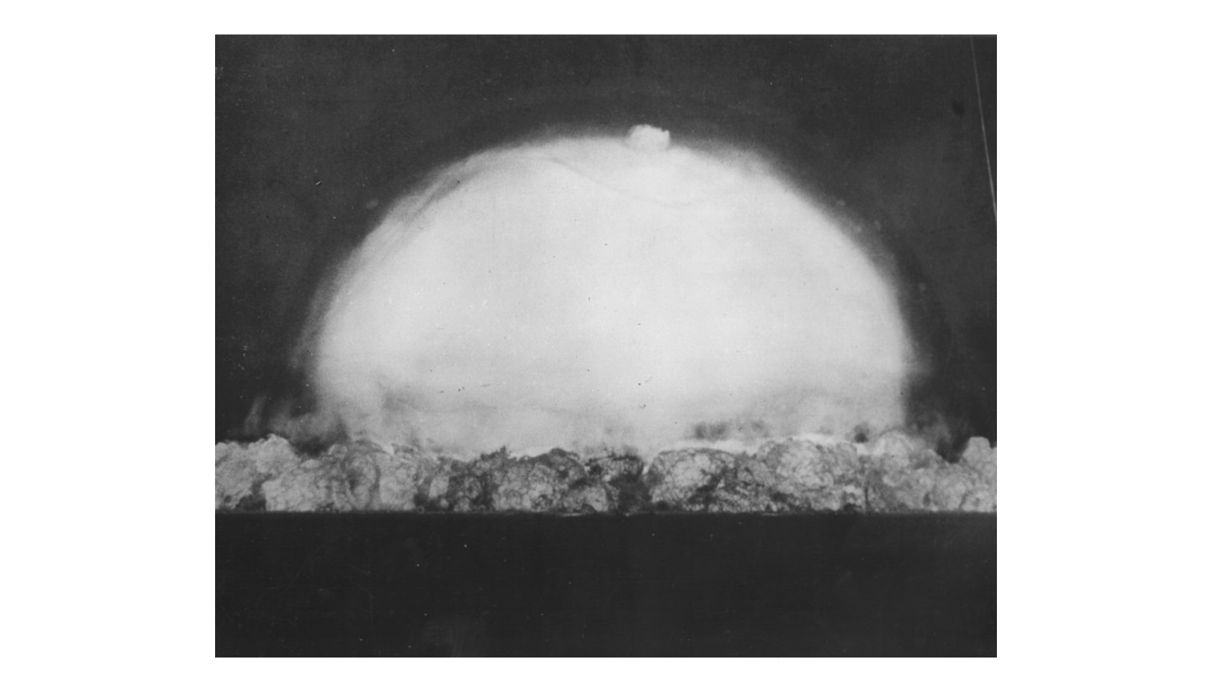
The Trinity Test, July 16, 1945
Note: Los Alamos photo.
© More Lessons Less Planning | morelessonslessplanning.com
Notes:
Give the class a few silent seconds with the photograph before you speak. Then point out that no camera in 1945 had ever recorded anything like it, and that the Army seized the film.
Reference labels (point to these chart features when teaching): Fireball and cloud; Desert horizon line

Slide 10
August 6, 1945: Hiroshima
The aircraft
A B-29 named the Enola Gay, flown by Colonel Paul Tibbets
✔
The bomb
Little Boy, a uranium-235 gun-type bomb, never tested before use
✔
The moment
It detonated about 8:15 a.m. roughly 600 meters above the city
✔
The city
About 350,000 people were present, along with an army headquarters
✔
Note: Hiroshima had been kept off the firebombing list so that it stayed intact.
© More Lessons Less Planning | morelessonslessplanning.com
Notes:
Row two matters: the Hiroshima bomb was used without ever being tested. Row four exists to head off both myths, that Hiroshima was purely military and that it was purely civilian.

Slide 11
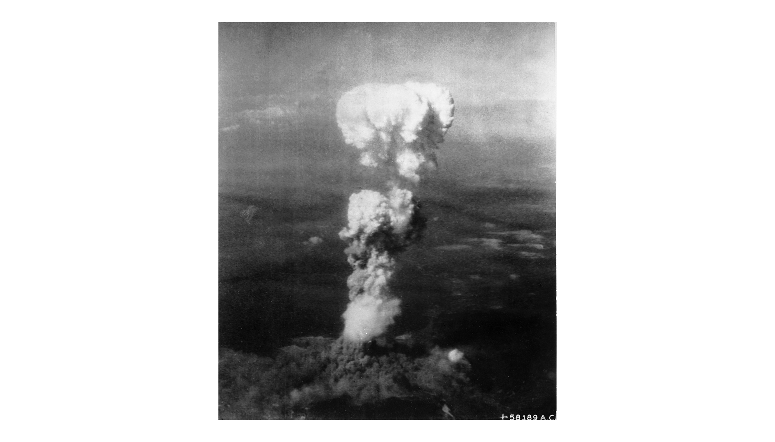
The Cloud Over Hiroshima, August 6, 1945
Note: USAAF photograph.
© More Lessons Less Planning | morelessonslessplanning.com
Notes:
This photograph was taken from the air, which is the only view most Americans ever had of Hiroshima in 1945. Say plainly that what is not visible in it is the city and the people underneath.
Reference labels (point to these chart features when teaching): Rising cloud column; Smoke over the city

Slide 12
August 9, 1945: Nagasaki
What Was Planned
What Actually Happened
Kokura was the primary target for the second atomic bomb
The mission was moved up from August 11 because bad weather was coming
The plane, Bockscar, carried Fat Man, a plutonium implosion bomb
Haze and smoke hid Kokura through three separate bombing runs
The crew turned to Nagasaki, the secondary target on the order
The bomb missed its aim point, and hills confined much of the blast
Key Point: Nagasaki was bombed because weather hid the primary target, Kokura.
© More Lessons Less Planning | morelessonslessplanning.com
Notes:
Two myths die on this slide. The three-day gap was a weather decision, not a deadline given to Japan, and the larger bomb killed fewer people than the smaller one because of terrain.

Slide 13
The Human Cost
Estimate | Hiroshima | Nagasaki
U.S. Army survey, 1946 | About 66,000 dead | About 39,000 dead
1977 international review | About 140,000 dead | About 70,000 dead
Range historians use today | 90,000 to 166,000 | 60,000 to 80,000
Share of the dead who were civilians | About 90 percent | Most of the dead
Important: There is no single agreed death toll, so historians report a range.
© More Lessons Less Planning | morelessonslessplanning.com
Notes:
Read this slide slowly and without drama. Say the numbers plainly, then explain why they differ. Students should leave able to say what a range means and why one exists here.

Slide 14
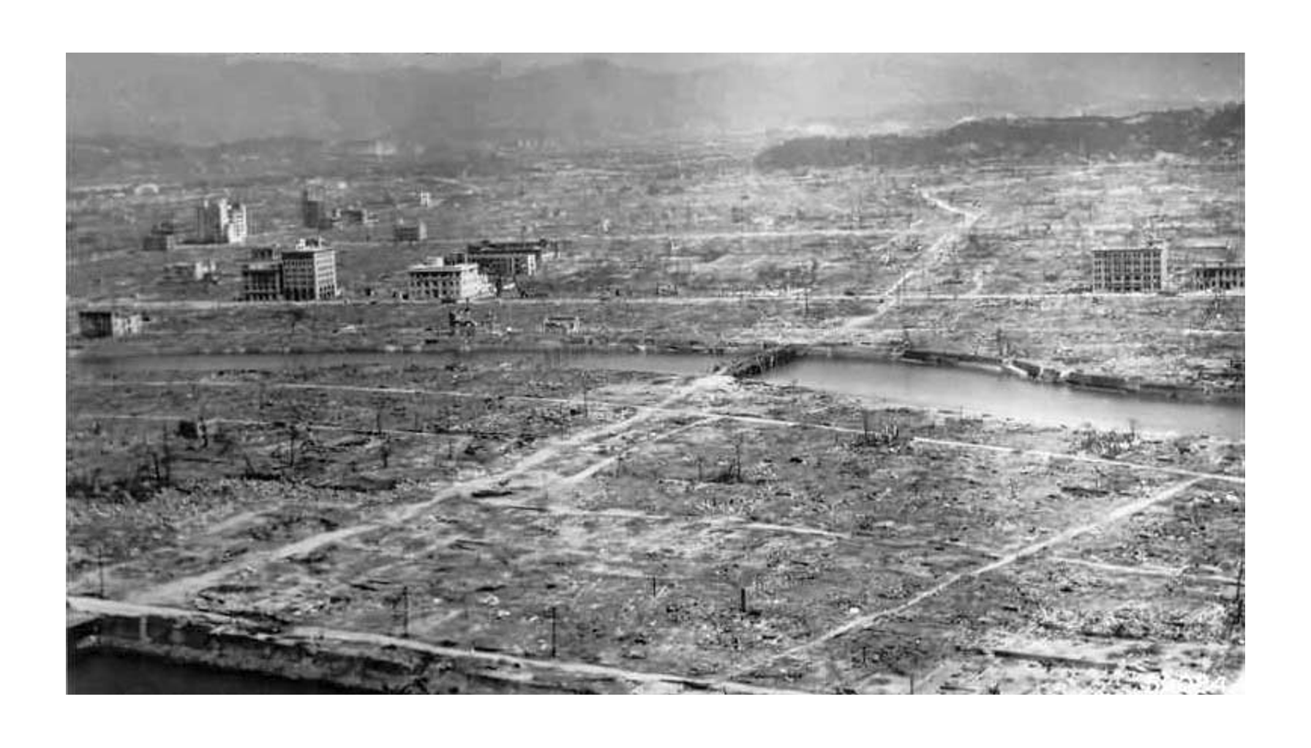
Hiroshima After the Bombing, 1945
Note: U.S. Navy photo.
© More Lessons Less Planning | morelessonslessplanning.com
Notes:
This is a photograph of a place, not of people. Say that out loud. Then have the class find the handful of buildings still standing and ask why those survived when everything around them did not.
Reference labels (point to these chart features when teaching): Flattened city blocks; Gutted concrete shells

Slide 15
Why the Counts Differ
Nobody knew a city's exact population on the morning of the bombing.
Japan's best record was rice ration cards, which missed transient workers.
The 1977 review added Korean laborers, soldiers, and unregistered commuters.
City offices burned, so many deaths were never recorded by anyone.
Both 1946 American surveys counted fewer groups than the 1977 team did.
Key Point: The gap comes from who was counted, not from anyone lying.
© More Lessons Less Planning | morelessonslessplanning.com
Notes:
This is the slide Activity Part 3 is built on. Students are asked in Part 3 to give two reasons the surveys disagree, and those reasons are here on the screen and in their Guided Notes, not only in what you say aloud.

Slide 16
Words for the Bombings
Enola Gay
The B-29 bomber that dropped the atomic bomb on Hiroshima on August 6, 1945
Hibakusha
The Japanese word for the people who survived the atomic bombings
Unconditional Surrender
A surrender in which the defeated side negotiates no terms of its own
Remember: Hibakusha survivors carried health effects for the rest of their lives.
© More Lessons Less Planning | morelessonslessplanning.com
Notes:
Hibakusha is the word that makes the human cost concrete. Say it aloud, have students say it once, and explain that survivors also faced discrimination in postwar Japan.

Slide 17
What Truman and His Advisers Weighed
Ending the War Fast
Pressure From Allies
Terms of Surrender
An invasion of Kyushu was set for November 1945.
Planners projected tens of thousands of American deaths.
After the war Truman cited far larger numbers than those.
By about August 8 the Soviets had promised to enter the war.
Some advisers wanted Japan beaten first.
Japan hoped the Soviets would broker peace.
The Potsdam Declaration of July 26 demanded surrender.
It never mentioned the new weapon or the emperor's future.
Japan publicly dismissed it.
Think about it: Each of these three pressures pointed toward acting quickly.
© More Lessons Less Planning | morelessonslessplanning.com
Notes:
Present these as pressures, not as a decision tree. Card one carries the biggest historical dispute in the lesson: the numbers Truman used after the war were much larger than the ones his own planners gave him in June 1945.

Slide 18
The Advice Truman's Government Received
Use It, and Use It Soon
Warn or Demonstrate First
The Interim Committee advised using the bomb on Japan without warning
Its scientific panel saw no acceptable alternative to direct military use
Target planners wanted a city that had not yet been bombed
The Franck Report in June 1945 urged a demonstration on a desert or island
Leo Szilard's July petition asked that surrender terms be made public first
Neither document ever reached President Truman before Hiroshima
Watch out: The scientists were divided, so there was no single scientific position.
© More Lessons Less Planning | morelessonslessplanning.com
Notes:
The last bullet on the right is the one students should carry out of this slide. The dissent existed, it was written down, and it was filtered out before it reached the president.

Slide 19
Words for the Decision
Potsdam Declaration
The July 1945 Allied ultimatum demanding Japan's surrender or facing utter destruction
Interim Committee
The group of advisers Stimson formed in 1945 to recommend how the bomb should be used
Franck Report
The June 1945 scientists' report urging a demonstration of the bomb before use on a city
Remember: All ten Reference Guide terms appear on the three word slides.
© More Lessons Less Planning | morelessonslessplanning.com
Notes:
These three terms are the ones students will need for the Primary Source Spotlight. Potsdam in particular shows up in Truman's own statement in Activity Part 4.

Slide 20
How the War Ended
August 8-9
The Soviet Union declared war and invaded Japanese-held Manchuria
✔
August 9-10
Japan's leaders deadlocked, and Emperor Hirohito broke the tie
✔
August 14
Army officers tried and failed to seize the surrender recording
✔
August 15
Hirohito's broadcast told Japan it would accept the Allied terms
✔
September 2
Japan formally surrendered aboard the USS Missouri in Tokyo Bay
✔
Key Point: Japan announced acceptance on August 15 but surrendered on September 2.
© More Lessons Less Planning | morelessonslessplanning.com
Notes:
Walk the five rows in order. Row three usually surprises students: the surrender was violently contested inside Japan's own army, and the recording was nearly destroyed.

Slide 21
Truman Explains the Bomb to the World
If they do not now accept our terms they may expect a rain of ruin from the air, the like of which has never been seen on this earth.
— President Harry S. Truman, White House statement, August 6, 1945
War Department staff drafted the statement while Truman was at sea returning from Potsdam.
Remember: You will read more of this statement in Activity Part 4.
© More Lessons Less Planning | morelessonslessplanning.com
Notes:
Frame this as evidence, not narration. It is the government's own public justification, released the same day as the bombing, and students will analyze its wording in the Activity.

Slide 22
The Debate That Followed
It Was Necessary
It Was Not Necessary
Secretary of War Stimson argued in 1947 that an invasion would cost more
Historian Richard Frank cites intercepts showing Japan planned to fight on
Japan's army leaders voted against surrender even after Nagasaki
Admiral Leahy wrote in 1950 that Japan was already defeated and beaten
The 1946 U.S. Strategic Bombing Survey said Japan would likely have surrendered
Later scholars showed that survey ignored much of its own evidence
Think about it: Both columns cite real documents, so the debate is about weighing them.
© More Lessons Less Planning | morelessonslessplanning.com
Notes:
Do not resolve this slide for students. Name the documents on both sides, note that the last bullet on the right undercuts the bullet above it, and hand the question to them.

Slide 23
Key Takeaways
The Manhattan Project built the bomb in secret for about two billion dollars.
★
Trinity, Hiroshima, and Nagasaki all happened within 24 days in 1945.
★
Truman weighed invasion costs, Soviet entry, and the terms of surrender.
★
Death-toll estimates differ by tens of thousands and are still debated.
★
Historians still disagree about whether the bombings were necessary.
★
© More Lessons Less Planning | morelessonslessplanning.com
Notes:
Close by connecting these five takeaways to the question students answer in Activity Part 5: were the bombings necessary to end the war, and what evidence supports your answer?

