Slide 1
The Assassination at Sarajevo
How two pistol shots on a Sarajevo street corner set off a chain reaction that pulled the world into war
© More Lessons Less Planning | morelessonslessplanning.com
Notes:
Open with the lesson question: how did the murder of one man and his wife in a Bosnian city lead, in less than six weeks, to a war among five of the six European great powers? Preview the arc: the Balkan powder keg, the plot, the day of the assassination, and the July Crisis chain reaction.

Slide 2
Learning Targets
Explain why Bosnia and the Balkans were called the powder keg of Europe in 1914.
★
Retell June 28, 1914: the failed bombing, the wrong turn, and the two shots.
★
Identify Gavrilo Princip, Young Bosnia, and the Black Hand and what each wanted.
★
Analyze the demands of the July 23 ultimatum and how Serbia answered them.
★
Trace the July Crisis chain from the assassination to a Europe-wide war.
★
© More Lessons Less Planning | morelessonslessplanning.com
Notes:
Read the five targets aloud. Flag target 4: students will read the actual ultimatum Austria-Hungary sent Serbia - the document that made war almost unavoidable.

Slide 3
Europe in 1914: The Powder Keg
By 1914 Europe was split into two armed camps.
Triple Alliance: Germany, Austria-Hungary, and Italy.
Triple Entente: France, Russia, and Great Britain.
Militarism ruled: armies had doubled in size in a generation.
Nationalism made every border dispute feel like a matter of honor.
Observers called the Balkans the powder keg of Europe.
Key Concept: Europe in 1914 was two armed alliance blocs waiting for a spark - the Balkans supplied it.
© More Lessons Less Planning | morelessonslessplanning.com
Notes:
By 1914 Europe was split into two armed camps: the Triple Alliance of Germany, Austria-Hungary, and Italy, and the Triple Entente of France, Russia, and Great Britain. Militarism ruled - armies had doubled in size in a generation - and nationalism made every border dispute feel like a matter of honor. Observers called the Balkans the powder keg of Europe: a region of small, ambitious nations, decaying empires, and great-power rivalry.

Slide 4
Bosnia: The Most Dangerous Province in Europe
The Empire's View
The Serbian Nationalist View
Annexed Bosnia in 1908 to strengthen the empire.
Ruled dozens of peoples, including many Slavs.
Feared Serbian nationalism could break the empire apart.
Bosnia was home to many Serbs.
Dreamed of a Greater Serbia uniting South Slavs.
Saw the annexation as theft of Slavic land.
Note: Austria-Hungary annexed Bosnia in 1908 - many Serbs never accepted it.
© More Lessons Less Planning | morelessonslessplanning.com
Notes:
Austria-Hungary annexed Bosnia in 1908 to strengthen the empire, which already ruled dozens of peoples, including many Slavs. The empire feared Serbian nationalism could break it apart. Serbian nationalists saw the same province from the other side: Bosnia was home to many Serbs, they dreamed of a Greater Serbia uniting the South Slavs, and they saw the annexation as theft of Slavic land. Two irreconcilable views of one province made Bosnia the most dangerous place in Europe.

Slide 5
The Archduke Comes to Sarajevo
Archduke Franz Ferdinand was heir to the Austro-Hungarian throne.
He came to Bosnia to inspect army maneuvers.
His wife Sophie joined him for the drive through Sarajevo.
June 28 was St. Vitus Day, a date sacred to Serbian national memory.
The couple rode in an open car along a route announced in the papers.
Warning: The route was published in advance, and the archduke rode in an open car with light security.
© More Lessons Less Planning | morelessonslessplanning.com
Notes:
Archduke Franz Ferdinand, heir to the Austro-Hungarian throne, came to Bosnia to inspect army maneuvers, and his wife Sophie joined him for the drive through Sarajevo. The date was June 28 - St. Vitus Day, sacred to Serbian national memory - which many Serbs read as a deliberate insult. The couple rode in an open car along a route announced in the newspapers, with light security. Every detail that made the visit ceremonial also made it dangerous.

Slide 6
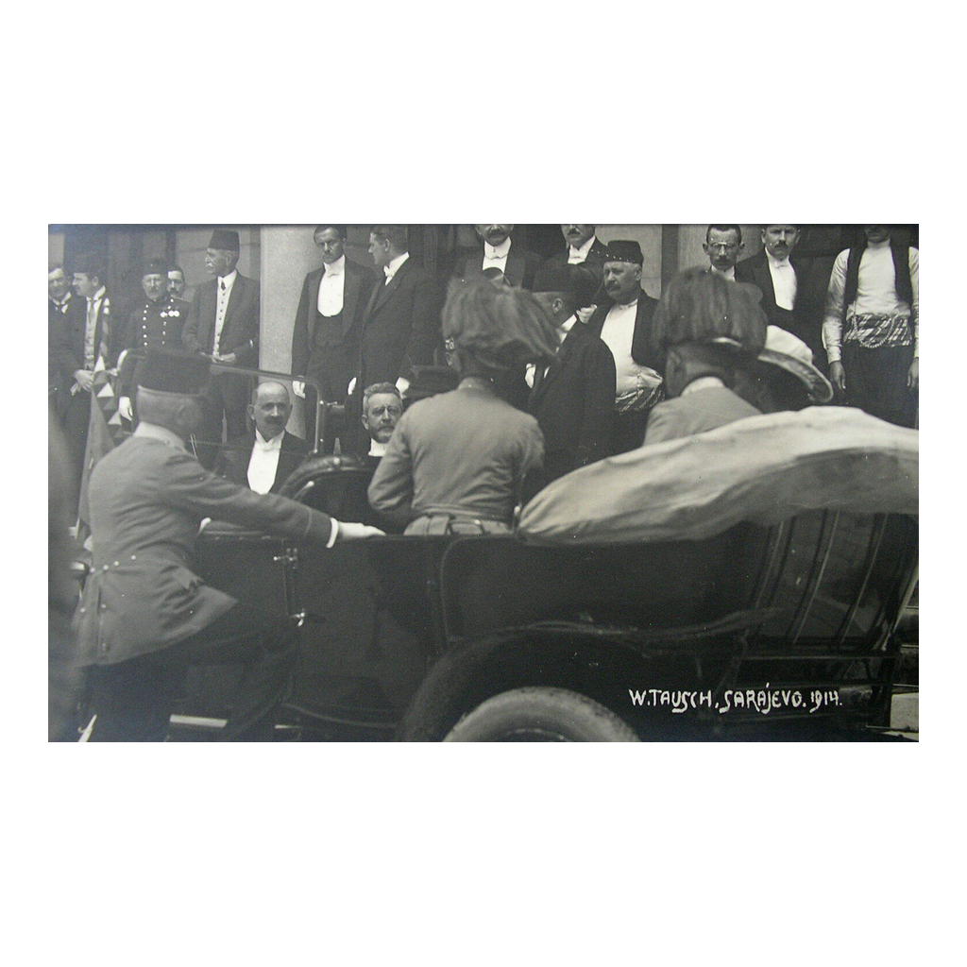
Sarajevo, June 28, 1914
Franz Ferdinand and Sophie leave the Sarajevo Town Hall, June 28, 1914
© More Lessons Less Planning | morelessonslessplanning.com
Notes:
This photograph shows Franz Ferdinand and Sophie leaving the Sarajevo Town Hall on June 28, 1914 - minutes before the assassination. Use it as a historical reference image: the open car, the uniforms, and the public setting all match what students just learned about the visit.

Slide 7
The Plot Against the Archduke
Young Bosnia
The Black Hand
The Plan
Students: Bosnian Serbs, Croats, and Muslims
Wanted Bosnia freed from Austria-Hungary
Gavrilo Princip was a member
Run by Serbian army officers in secret
Smuggled pistols and bombs to the assassins
Trained the plotters in Belgrade
Seven conspirators along the Appel Quay
Attack the car during the motorcade
Swallow cyanide if caught; it failed
Did You Know: Seven armed conspirators waited along the announced motorcade route that morning.
© More Lessons Less Planning | morelessonslessplanning.com
Notes:
The plot came from two connected groups. Young Bosnia was a student movement of Bosnian Serbs, Croats, and Muslims who wanted Bosnia freed from Austro-Hungarian rule - Gavrilo Princip was one of its members. The Black Hand, run by Serbian army officers acting in secret, smuggled pistols and bombs to the assassins and trained the young plotters in Belgrade. The plan: seven conspirators spread along the Appel Quay would attack the archduke's car during the motorcade, then swallow cyanide if caught - though the old poison failed to work.

Slide 8
June 28, 1914: The Day of the Assassination
✔
10:10 a.m. - The Bomb
Cabrinovic hurls a bomb; it bounces off the car and explodes behind.
✔
On to the Town Hall
The wounded go to the hospital; the motorcade speeds to the Town Hall.
✔
A Change of Plans
Franz Ferdinand insists on visiting the wounded officers at the hospital.
✔
The Wrong Turn
The driver, never told of the new route, turns onto Franz Joseph Street.
✔
The Fatal Stop
The car stops to back up - directly in front of Gavrilo Princip.
✔
Two Shots
Princip fires two shots; Franz Ferdinand and Sophie die within the hour.
Note: The fatal stop happened by accident - the driver was never told the route had changed.
© More Lessons Less Planning | morelessonslessplanning.com
Notes:
Walk the timeline in order. About 10:10 a.m., the conspirator Cabrinovic hurled a bomb that bounced off the archduke's car and exploded behind it, wounding officers and bystanders. The motorcade sped on to the Town Hall while the wounded went to the hospital. Franz Ferdinand insisted on visiting the wounded officers, and the route was changed for safety - but nobody told the driver. He turned onto Franz Joseph Street by mistake, stopped to back up, and halted directly in front of Gavrilo Princip, who fired two shots. Franz Ferdinand and Sophie died within the hour.

Slide 9
The Assassin: Gavrilo Princip
Gavrilo Princip was a 19-year-old Bosnian Serb student.
He belonged to Young Bosnia and was armed by the Black Hand.
He was seized by the crowd seconds after firing.
At 19 he was too young for the death penalty under Austro-Hungarian law.
He was sentenced to 20 years and died of tuberculosis in prison in 1918.
Note: Under Austro-Hungarian law, no one under 20 could receive the death penalty - Princip was 19.
© More Lessons Less Planning | morelessonslessplanning.com
Notes:
Gavrilo Princip was a 19-year-old Bosnian Serb student, a member of Young Bosnia armed by the Black Hand. He was seized by the crowd seconds after firing and never denied what he had done. Because Austro-Hungarian law barred the death penalty for anyone under 20, the court sentenced him to 20 years. He died of tuberculosis in an Austrian prison in April 1918, months before the war he helped start came to an end.

Slide 10
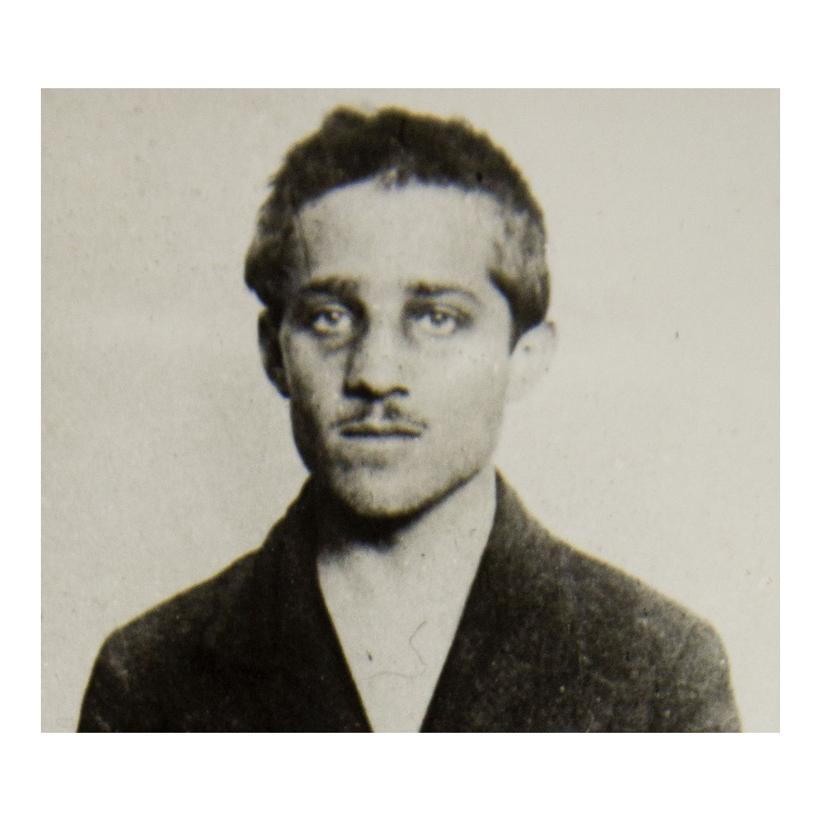
Gavrilo Princip
Gavrilo Princip, photographed in prison, 1914
© More Lessons Less Planning | morelessonslessplanning.com
Notes:
This is the 1914 prison photograph of Gavrilo Princip, taken after his arrest. Use it as a historical reference image. Worth noting for accuracy: the famous street photo often captioned as Princip's arrest is contested - historians are not certain the man being dragged away is Princip at all - which is why this verified prison photograph is used instead.

Slide 11
Austria-Hungary Reacts: The Blank Check
Austria-Hungary blamed Serbia for the assassination.
Before acting, it asked Germany for support.
On July 5-6, Kaiser Wilhelm II promised full German backing.
Historians call Germany's promise the blank check.
With Germany behind it, Austria-Hungary chose confrontation.
Key Concept: The blank check meant Austria-Hungary could act knowing Germany stood behind it.
© More Lessons Less Planning | morelessonslessplanning.com
Notes:
Austria-Hungary blamed Serbia for the assassination, but before acting it asked its powerful ally Germany for support. On July 5-6, Kaiser Wilhelm II promised full German backing - whatever Austria-Hungary decided to do. Historians call this promise the blank check, because like a signed blank check, Austria-Hungary could fill in any amount. With Europe's strongest army behind it, Austria-Hungary chose confrontation over compromise.

Slide 12
The Ultimatum to Serbia - July 23, 1914
The Demands
The Deadline
The Reply
Ten demands, delivered July 23, 1914
Shut anti-Austrian papers; fire named officials
Let its officials work inside Serbia
Serbia had just 48 hours to answer
Reply due by 6 p.m. on July 25
No room was left to negotiate
Serbia accepted nearly every demand
It hedged on the foreign-run inquiry
Vienna broke off relations that night
Warning: Serbia accepted nearly every demand - but nearly was not enough for Austria-Hungary.
© More Lessons Less Planning | morelessonslessplanning.com
Notes:
On July 23, 1914, Austria-Hungary delivered ten demands to Serbia: shut down anti-Austrian newspapers and societies, fire officials and officers that Austria-Hungary named, and - most explosive - let Austro-Hungarian officials operate inside Serbia itself. Serbia had just 48 hours to answer, with the reply due by 6 p.m. on July 25. Serbia accepted nearly every demand but hedged on letting a foreign power run an inquiry inside Serbia. Austria-Hungary broke off relations the same evening. Students read this document in the Primary Source Spotlight.

Slide 13
The Dominoes Fall: From Ultimatum to World War
Date (1914) | What Happened
July 28 | Austria-Hungary declares war on Serbia
July 30 | Russia mobilizes its army to back Serbia
August 1 | Germany declares war on Russia
August 3 | Germany declares war on France
August 4 | Germany invades neutral Belgium
August 4 | Britain declares war on Germany
Remember: Each declaration triggered the next - the alliance system worked like falling dominoes.
© More Lessons Less Planning | morelessonslessplanning.com
Notes:
Now the alliance system took over. On July 28 - exactly one month after the assassination - Austria-Hungary declared war on Serbia. On July 30, Russia mobilized to back its fellow Slavic nation. On August 1, Germany declared war on Russia; on August 3, on Russia's ally France. On August 4, Germany invaded neutral Belgium to reach France - and Britain, pledged to defend Belgian neutrality, declared war on Germany. Each declaration triggered the next, like falling dominoes.

Slide 14
The Spark vs. the Powder
The Spark
The Powder
Two pistol shots on June 28, 1914
The deaths of Franz Ferdinand and Sophie
A crisis between just two countries - at first
Two rival alliance blocs armed for war
Militarism: huge armies and rigid war plans
Nationalism and rivalry over land and power
Key Concept: The assassination was the spark; the alliances, armies, and rivalries were the powder.
© More Lessons Less Planning | morelessonslessplanning.com
Notes:
Close with the central historical question. The spark was the assassination itself: two pistol shots, two deaths, a crisis between just two countries - at first. The powder was everything already in place: two rival alliance blocs armed for war, militarism with its huge armies and rigid war plans, and nationalism and rivalry over land and power. Assassinations had happened in Europe before without causing world wars. What made 1914 different was the powder, not the spark.

Slide 15
Reference Guide: The People and the Place
Archduke Franz Ferdinand
The heir to the Austro-Hungarian throne, assassinated in Sarajevo on June 28, 1914.
Sarajevo
The capital of Bosnia, where the assassination took place.
Gavrilo Princip
The 19-year-old Bosnian Serb student who shot the archduke and his wife.
Black Hand
A secret Serbian nationalist society that trained and armed the assassins.
Ultimatum
A final set of demands backed by a threat if they are refused.
Tip: These five people, places, and terms anchor the whole story - learn them first.
© More Lessons Less Planning | morelessonslessplanning.com
Notes:
Walk the first five Reference Guide terms with their exact definitions: Archduke Franz Ferdinand, the heir to the Austro-Hungarian throne assassinated in Sarajevo on June 28, 1914; Sarajevo, the capital of Bosnia, where the assassination took place; Gavrilo Princip, the 19-year-old Bosnian Serb student who shot the archduke and his wife; the Black Hand, a secret Serbian nationalist society that trained and armed the assassins; and ultimatum, a final set of demands backed by a threat if they are refused. Students use these exact definitions to complete the Activity Reference Guide.

Slide 16
Reference Guide: The Crisis Vocabulary
Annexation
Taking over a territory and adding it to your own country, as Austria-Hungary did to Bosnia in 1908.
Mobilization
Assembling and moving armies into position, the last step before war.
Blank check
Germany's promise of full support for whatever Austria-Hungary decided to do.
July Crisis
The month of threats and failed diplomacy between the assassination and the outbreak of war.
Alliance system
The web of defense agreements that pulled Europe's great powers into war one by one.
Tip: These five terms explain how one local crisis became a world war.
© More Lessons Less Planning | morelessonslessplanning.com
Notes:
Walk the second five Reference Guide terms with their exact definitions: annexation, taking over a territory and adding it to your own country, as Austria-Hungary did to Bosnia in 1908; mobilization, assembling and moving armies into position, the last step before war; the blank check, Germany's promise of full support for whatever Austria-Hungary decided to do; the July Crisis, the month of threats and failed diplomacy between the assassination and the outbreak of war; and the alliance system, the web of defense agreements that pulled Europe's great powers into war one by one.

Slide 17
Key Takeaways
Bosnia was Europe's flashpoint: annexed in 1908, claimed by Serbian nationalism.
★
On June 28, 1914, a failed bombing and a wrong turn put Princip by the car.
★
Germany's blank check let Austria-Hungary send an ultimatum built to be refused.
★
The alliance system spread the war across Europe in just eight days.
★
The assassination was the spark - the powder was already packed.
★
© More Lessons Less Planning | morelessonslessplanning.com
Notes:
Close by rebuilding the chain with the class: powder keg, plot, wrong turn, blank check, ultimatum, dominoes. Then pose the exit question: if the driver had never taken the wrong turn, does Europe still go to war in 1914? Students answer a version of this in the Exit Ticket quick write.

