Slide 1
The 2022-2024 Inflation Crisis
How the U.S. lived through the worst inflation in 40 years - and what the Fed did about it.
© More Lessons Less Planning | morelessonslessplanning.com
Notes:
Open with the scale of the moment. Inflation reached 9.1% year over year in June 2022 - the highest annual rate since November 1981 (41 years). Today the class will follow the story from causes (four of them) through the Fed's 11-hike response to the gradual cooldown and the soft-landing debate. The activity will put students in the seat of Jordan Chen, a junior policy advisor at the Federal Reserve, writing an internal review.

Slide 2
Learning Targets
Trace the 2022-2024 inflation surge from causes through the Fed's response
★
Identify the four main drivers: stimulus, supply chains, energy, pent-up demand
★
Evaluate whether the Fed achieved a soft landing by late 2024
★
© More Lessons Less Planning | morelessonslessplanning.com
Notes:
Read the three targets aloud. Tell students that the activity puts them in Jordan Chen's seat - a junior policy advisor inside the Federal Reserve in December 2024 - writing an internal review. Part 3 will require reading specific values off the CPI chart; Part 4 will require reading specific values off the federal funds rate chart.

Slide 3
The Surge: When Prices Started Climbing
The Calm Before
The Climb
Through 2019: inflation steady at about 2%
May 2020 COVID low: only 0.1% year-over-year
Dec 2020: still tame at 1.4%
March 2021: first sign of trouble at 2.6%
June 2021: jumped to 5.4% (Fed: 'transitory')
December 2021: 7.0% - clearly not transitory
March 2022: 8.5% (Russia-Ukraine war begins Feb 24)
June 2022: 9.1% PEAK - highest since Nov 1981
Key Concept: The Fed called the 2021 spike 'transitory,' expecting it to fade. By late 2021 it was clear inflation was accelerating, not fading.
© More Lessons Less Planning | morelessonslessplanning.com
Notes:
Walk students through the timing. Inflation was at the Fed's 2% target through 2019 and most of 2020. It started climbing in spring 2021 (as stimulus checks landed and the economy reopened) and accelerated through 2022. The Fed's 'transitory' label - meaning 'short-lived, will fade' - turned out to be wrong, and that misjudgment is one reason the hiking cycle started LATE.

Slide 4
The Peak: 9.1% in June 2022
9.1%
1981
CPI peak, June 2022 (year over year)
Last time inflation was this high (Nov 1981)
Note: 41 years separate the Jun 2022 peak from the Nov 1981 high. An entire generation of U.S. workers had never lived through real inflation.
© More Lessons Less Planning | morelessonslessplanning.com
Notes:
Anchor the magnitude. 9.1% was 4.5 times the Fed's 2% target and the worst reading in 41 years. An entire generation of American workers (anyone under about 50) had never seen serious U.S. inflation in their adult lives. That context explains the political shock - it wasn't just bad data, it was something most Americans had never experienced.

Slide 5
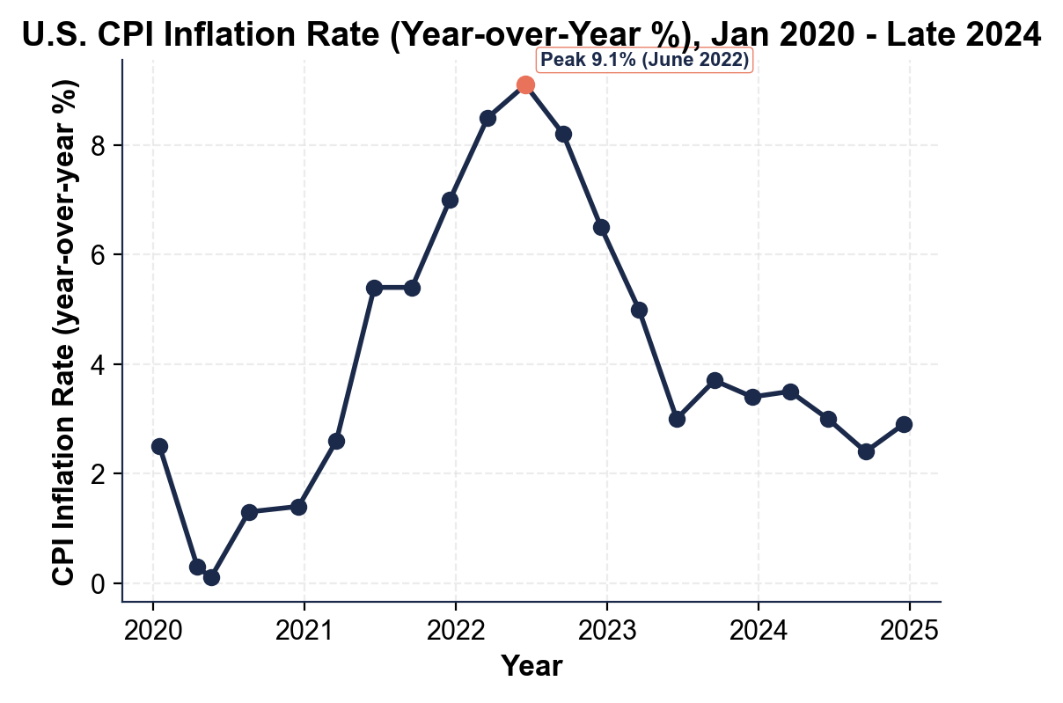
Note: U.S. CPI Inflation Rate, Jan 2020 - Late 2024
U.S. CPI inflation (year-over-year). Peak 9.1% June 2022.
© More Lessons Less Planning | morelessonslessplanning.com
Notes:
Have students trace the curve. Three features to name: (1) the May 2020 COVID-lockdown low of ~0.1%, (2) the climb through 2021 from ~1.4% in December 2020 to 7.0% by December 2021, (3) the June 2022 peak at 9.1% and the disinflation back toward the Fed's 2% target by late 2024 (about 2.9%).
Reference labels (point to these chart features when teaching): Peak 9.1% Jun 2022; Cooled to ~2.9% late 2024

Slide 6
Cause 1: COVID Stimulus and Money Supply
The Cash Injection
The Money Supply
CARES Act (Mar 2020): $1,200 checks
Dec 2020: $600 second round
ARP (Mar 2021): $1,400 third round
Total household direct payments: ~$931 billion
M2 money supply rose ~40% from Feb 2020 to Mar 2022
Fastest growth in M2 since World War II
Personal savings rate hit 33% in April 2020
Households held ~$2 trillion in 'excess savings' by 2021
Did You Know? The stimulus was bipartisan - Trump (CARES 2020) and Biden (ARP 2021). It prevented a depression but fed demand-pull inflation.
© More Lessons Less Planning | morelessonslessplanning.com
Notes:
Cause 1 is demand-side. Three rounds of stimulus checks plus expanded unemployment plus the Paycheck Protection Program injected unprecedented cash into the economy. M2 money supply rose 40% in two years - the fastest growth since World War II. Economists across the political spectrum (Larry Summers, John Cochrane, Olivier Blanchard) warned in early 2021 that this much demand on top of supply constraints would produce inflation. They were right.

Slide 7
Cause 2: Supply-Chain Disruption
✔
Port congestion
100+ ships waiting outside Los Angeles/Long Beach ports in fall 2021
✔
Container shortage
Container costs jumped from ~$1,500 in 2019 to ~$11,000 in Sep 2021 (Asia-US route)
✔
Chip shortage
Auto plants idled; new-car production fell ~30% in 2021, pushing buyers to used
✔
Factory closures
China's zero-COVID lockdowns repeatedly shut Shanghai, Shenzhen ports + factories
✔
Trucking
U.S. trucker shortage hit 80,000 - delays cascaded into store shelves
✔
Lumber + materials
Lumber prices quadrupled from spring 2020 to spring 2021
Warning: Cost-push from broken supply chains pushed producer prices first; consumers saw the price increases roughly 6 months later.
© More Lessons Less Planning | morelessonslessplanning.com
Notes:
Cause 2 is supply-side. The pandemic shut factories, idled ports, and broke logistics networks. Container shipping costs went up 7x in 18 months. The chip shortage idled auto plants. China's zero-COVID lockdowns repeatedly closed Shanghai and Shenzhen, the world's two largest container ports. This is classic cost-push: production got more expensive, and producers passed the cost on to consumers.

Slide 8
Cause 3: Energy Shock + Russia-Ukraine War
The Oil Shock
The Spillover
Russia invaded Ukraine on February 24, 2022
Brent crude rose from $80 to $120+ per barrel in weeks
U.S. national gas price hit $5.02/gallon (June 2022 peak)
Russia is the world's 3rd-largest oil producer
Diesel surged - hit transport costs everywhere
Natural gas prices doubled in Europe and the U.S.
Fertilizer (made from natural gas) tripled in price
Wheat prices rose ~40% (Ukraine = breadbasket)
Key Concept: Energy is a special category - it shows up in EVERY supply chain. A gas spike pushes up the cost of EVERYTHING transported or made.
© More Lessons Less Planning | morelessonslessplanning.com
Notes:
Cause 3 is also supply-side and overlapped with cause 2 in early 2022. Russia's invasion of Ukraine on February 24, 2022, sent oil and natural-gas prices soaring just as the U.S. supply-chain mess was clearing. June 2022 national average gasoline hit $5.02/gallon - a record. Because energy is an input to nearly every supply chain, the spike cascaded through trucking, manufacturing, fertilizer, food. This is why June 2022 became the inflation peak.

Slide 9
Cause 4: Pent-Up Demand as the Economy Reopened
The Lockdown Effect
The Release
Households built up ~$2 trillion in excess savings
Travel, restaurants, services shut down 2020
Personal savings rate hit 33% (April 2020)
Cars, vacations, dining out - all deferred
Vaccines rolled out spring 2021 - reopening began
Service spending exploded ('revenge spending')
Hotels, flights, restaurants saw demand surge
Workers quit at record rates (Great Resignation)
Did You Know? 'Revenge spending' described 2021-22 households compensating for missed travel and dining with premium-price reopenings.
© More Lessons Less Planning | morelessonslessplanning.com
Notes:
Cause 4 is also demand-side. Households built up roughly $2 trillion in excess savings during the lockdown - cash that had nowhere to go. When vaccines rolled out and the economy reopened in spring 2021, that money flooded into services. 'Revenge spending' described how households paid premium prices to take the vacations and meals they had missed. This combined with the stimulus to overwhelm supply that was still constrained from cause 2.

Slide 10
Fed Response: 11 Rate Hikes, 5.25 Percentage Points
11
5.25 pp
Consecutive rate hikes (Mar 2022 - Jul 2023)
Total: from 0.25% to 5.50%
Note: The Fed hiked +75 basis points in four single meetings in 2022 - the first +75 hikes since November 1994.
© More Lessons Less Planning | morelessonslessplanning.com
Notes:
The Fed's response was the most aggressive hiking cycle since the early 1980s. Eleven consecutive hikes, totaling 5.25 percentage points, from March 2022 to July 2023. The Fed quadrupled normal hike size (75 basis points instead of 25) four times in 2022 to catch up after the 'transitory' delay. Then an 11-month plateau (Aug 2023 - Jul 2024). Then the first cut in September 2024 as inflation cooled.

Slide 11
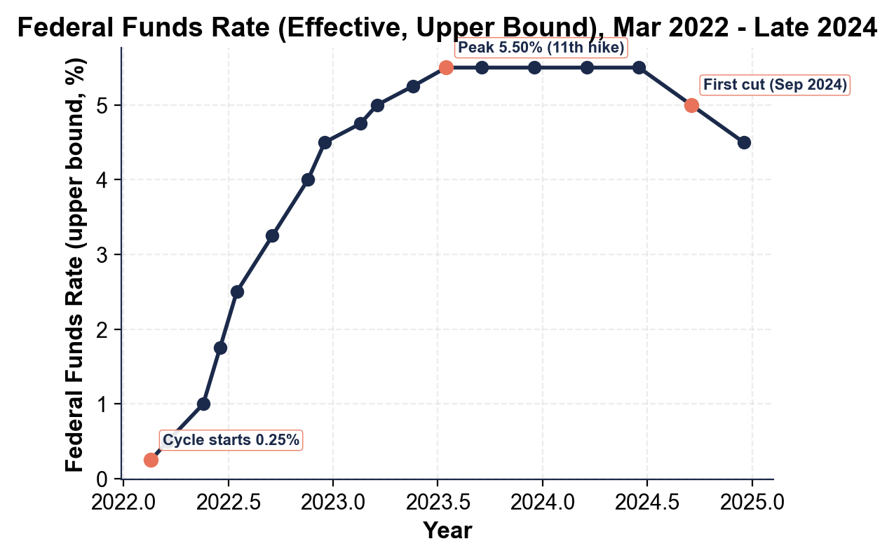
Note: Federal Funds Rate, 2022-2024 Hiking Cycle
Fed funds rate (upper bound). 0.25% to 5.50% (11 hikes).
© More Lessons Less Planning | morelessonslessplanning.com
Notes:
Have students trace the funds-rate curve. Features to name: (1) start at 0.25% in March 2022, (2) the four +75 basis-point jumps through fall 2022, (3) the 5.50% peak by July 2023, (4) the long plateau through 2023 and into 2024, (5) the September 2024 first cut as inflation cooled. Total of 11 hikes summing to 5.25 percentage points.
Reference labels (point to these chart features when teaching): 11 hikes; 5.25 pp total; First cut Sep 2024

Slide 12
Household Pain Points: Grocery and Gas
Grocery Inflation
Gas Prices
Food at home peaked at 13.5% YoY in Aug 2022
Eggs rose ~70% in 2022 (avian flu + feed costs)
Bread, milk, meat all up 10-15% in one year
Grocery bills landed first - households felt it weekly
U.S. national average peaked at $5.02/gal (Jun 2022)
Some California stations exceeded $7/gal
Average household paid $2,200 more for gas in 2022
Tracked daily by everyone - the most visible price
Key Concept: Grocery and gas are the two categories MOST people track daily. That visibility made the 2022 spike politically explosive.
© More Lessons Less Planning | morelessonslessplanning.com
Notes:
The political shock of 2022 inflation came mainly from groceries and gas - the two categories every household tracks weekly. Food-at-home inflation peaked at 13.5% in August 2022. Eggs rose 70%. Gasoline hit $5.02/gallon nationally with some California stations above $7. The Department of Energy estimated average households paid about $2,200 more in 2022 fuel costs. That kind of price increase shows up in lived experience long before it shows up in the official CPI - which is why political pressure on the Fed peaked in mid-2022.

Slide 13
The Gradual Cooldown: Disinflation 2023-2024
Disinflation defined
Inflation SLOWS while prices are still rising; not deflation (which is prices falling)
June 2022 peak
9.1% year-over-year CPI (the highest since November 1981)
June 2023
3.0% year-over-year - down 6 points in one year
December 2023
3.4% year-over-year (still above the Fed's 2% target)
Late 2024
About 2.9% year-over-year - the cooldown continues toward target
Core CPI
Slower to fall: still ~3.3% in late 2024 (housing slow to disinflate)
Did You Know? The 6-point drop from 9.1% to 3.0% in one year was the fastest U.S. disinflation since 1982 (the Volcker-era cool).
© More Lessons Less Planning | morelessonslessplanning.com
Notes:
Disinflation is NOT deflation. Prices are still RISING in 2023-2024 - they're just rising more slowly. The drop from 9.1% (Jun 2022) to 3.0% (Jun 2023) was the fastest 12-month disinflation since 1982. By late 2024 the rate has settled near 2.9%, still above the Fed's 2% target but in striking distance. Core CPI (excluding food and energy) has been stickier because housing costs lag - shelter inflation runs about 4-5% even when food and energy have cooled.

Slide 14
Did the Fed Achieve a Soft Landing?
Evidence FOR soft landing
Evidence AGAINST
Unemployment stayed below 4% throughout 2023
GDP grew about 2.5% per year 2023-2024
Recession never officially declared
Inflation cooled from 9.1% to ~3% in 18 months
Inflation still above 2% target in late 2024
Housing costs remained elevated (~4-5% YoY)
Mortgage rates near 7% locked many out of housing
Many lower-income households worse off in real terms
Key Concept: A soft landing = inflation DOWN without recession. Most economists doubted it in 2022; by late 2024 most agreed the Fed mostly succeeded.
© More Lessons Less Planning | morelessonslessplanning.com
Notes:
The soft-landing debate is the heart of the activity. The case FOR: unemployment stayed below 4% the whole time, GDP kept growing, inflation cooled from 9.1% to ~3% in 18 months. The case AGAINST: inflation still hasn't reached 2%, housing remains expensive, mortgage rates spent two years near 7%, and many lower-income households still feel worse off because of cumulative price increases. By late 2024 most mainstream economists graded the Fed as having mostly succeeded - but the verdict is honestly debatable, and that's what Part 5 of the activity asks students to wrestle with.

Slide 15
Key Takeaways
Inflation peaked at 9.1% in June 2022 - the worst since November 1981
★
Four causes converged: stimulus + supply chains + energy + pent-up demand
★
The Fed responded with 11 rate hikes totaling 5.25 percentage points
★
Disinflation followed: 9.1% (Jun 2022) -> ~3% (Jun 2023) -> ~2.9% (late 2024)
★
By late 2024 most observers judged the Fed had mostly achieved a soft landing
★
© More Lessons Less Planning | morelessonslessplanning.com
Notes:
Read each takeaway and connect to learning targets. T1 (trace the surge) -> Parts 1, 3. T2 (four drivers) -> Part 2 Reference Guide + Part 4. T3 (evaluate soft landing) -> Part 5 memo. Tell students the activity puts them in Jordan Chen's seat - junior Fed policy advisor writing a December 2024 internal review. They'll diagnose causes, read both charts, and reach a verdict on the soft landing.

