Slide 1
Taylor Swift Economics: Concert Ticket Pricing
Why a sold-out show is really a shortage you can see
© More Lessons Less Planning | morelessonslessplanning.com
Notes:
Title slide for the Unit 2 concert-ticket lesson. Open with the 2022 Eras Tour / Ticketmaster meltdown: millions of fans tried to buy tickets, the site crashed, and the show 'sold out in minutes.' The whole lesson uses Unit 2 supply and demand to explain what really happened. NOTE: Taylor Swift is named in text only; every visual is a chart, never a photo of a person.

Slide 2
Learning Targets
Why a sold-out show is a SHORTAGE caused by a price below equilibrium
★
How dynamic ('surge') pricing moves the price toward equilibrium
★
Why a big RESALE market with markups appears
★
How a popularity surge SHIFTS demand and raises the price
★
© More Lessons Less Planning | morelessonslessplanning.com
Notes:
Read the four targets aloud. Target 1 is the core idea (sold out = shortage). Targets 2 and 3 are the two market responses (surge pricing, resale market). Target 4 connects it to demand shifts.

Slide 3
The Hook: Why Couldn't Fans Buy a Ticket?
What Fans Saw
The Economics Behind It
Millions tried to buy at the same moment
The website crashed under the demand
Tickets 'sold out in minutes'
Then they appeared on resale for huge prices
A venue has a FIXED number of seats
Demand for a hot tour is HUGE
Face value was set BELOW equilibrium
Result: a shortage, then a resale boom
Did You Know: a 'sold-out' show is not magic - it is a shortage you can see.
© More Lessons Less Planning | morelessonslessplanning.com
Notes:
Frame the mystery, then preview the economic answer. The whole lesson is decoding the meltdown with supply and demand. Keep Taylor Swift in the spoken story; the slide stays text-only.

Slide 4
Fixed Supply: A Venue Has a Set Number of Seats
A stadium holds the SAME number of seats no matter the price
Raising the ticket price does NOT add more seats
So the supply of tickets is FIXED - the supply curve is nearly VERTICAL
Quantity supplied stays at the seat count (about 50,000)
This is different from pizza, where a shop can just make more
Fixed supply is the key reason concert prices behave the way they do
Key Concept: with a fixed number of seats, supply is nearly vertical - price can't add seats.
© More Lessons Less Planning | morelessonslessplanning.com
Notes:
Establish fixed supply before the shortage chart. A near-vertical supply curve is the single most important feature of this market. Contrast with a normal good (pizza) where producers can make more.

Slide 5
A Sold-Out Show Is a Shortage
Face value was set at $90 - far BELOW the equilibrium price of $450
At $90, way more fans want a ticket than the 50,000 fixed seats
Quantity demanded is far greater than quantity supplied = a SHORTAGE
That shortage is what 'sells out in minutes' really means
A price set below equilibrium ALWAYS creates a shortage
The next slide shows the face-value line below the equilibrium
Key Concept: price below equilibrium -> quantity demanded beats supply -> SHORTAGE.
© More Lessons Less Planning | morelessonslessplanning.com
Notes:
Setup slide paired with the face-value shortage chart. A $90 face value below the $450 equilibrium creates a shortage against the fixed 50,000 seats. The chart on the next slide shows the equilibrium, the fixed supply, and the face-value line.

Slide 6
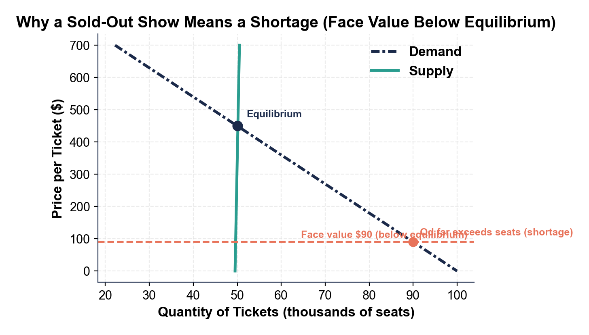
Face Value Sits Below the Equilibrium Price
Fixed supply, equilibrium $450; face value $90 leaves a shortage.
© More Lessons Less Planning | morelessonslessplanning.com
Notes:
The face-value shortage chart. The teal supply curve is nearly vertical at about 50,000 seats; the navy demand curve is steep; equilibrium is $450 and 50,000 seats. The coral dashed line marks the $90 face value, far below equilibrium - at $90 quantity demanded far exceeds the fixed seats, which is the shortage.
Reference labels (point to these chart features when teaching): Supply nearly vertical; Face value below equilibrium

Slide 7
Face Value vs Equilibrium: The Price Was Set Too Low
$90
$450
Face value - the price printed on the ticket
Equilibrium price - where Qd equals the 50k fixed seats
Below equilibrium: price set under $450 -> shortage (sells out fast)
At equilibrium: $450 -> quantity demanded equals the fixed seats
Why keep it low?: sellers want it to feel fair and affordable for fans
Key Concept: a low face value feels fair, but below equilibrium it guarantees a shortage.
© More Lessons Less Planning | morelessonslessplanning.com
Notes:
Compare the face value ($90) and the equilibrium price ($450). The gap is why the show sells out. Note the tension: a low face value feels fair to fans but creates a shortage and a resale market.

Slide 8
Dynamic ('Surge') Pricing: Let the Price Find Equilibrium
Dynamic (surge) pricing lets the listed price RISE and FALL with demand
As the listed price climbs from $90 toward $450, fewer fans will pay
Quantity demanded falls until it meets the 50,000 fixed seats
Because only the ticket's OWN price changed, this is a MOVEMENT along the curve
Raising the price toward equilibrium SHRINKS the shortage
The next slide shows the slide from the $90 point up to the $450 point
Key Concept: surge pricing moves the price toward equilibrium - a movement along the demand curve.
© More Lessons Less Planning | morelessonslessplanning.com
Notes:
Setup paired with the surge-pricing chart. Dynamic pricing raises the listed price toward equilibrium; because only the ticket's own price changes, it is a movement along the demand curve that shrinks the shortage. The chart shows the slide from the $90 point to the $450 point.

Slide 9
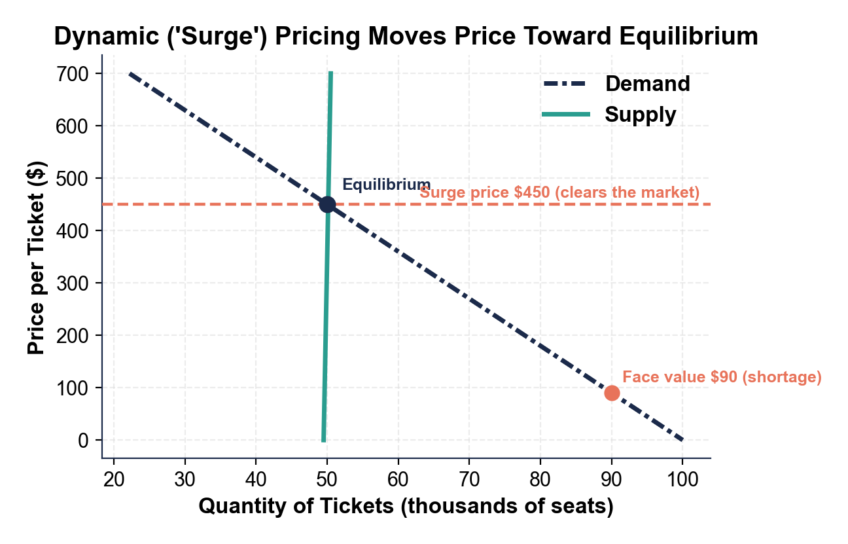
Sliding Up the Demand Curve to the Clearing Price
Price rises from the $90 point up to the $450 clearing price.
© More Lessons Less Planning | morelessonslessplanning.com
Notes:
The surge-pricing chart. The $90 face-value point and the $450 surge/clearing point sit on the SAME demand curve; raising only the ticket's own price slides buyers up the curve to where quantity demanded meets the 50,000 fixed seats. This is a movement along the demand curve, and it ends the shortage.
Reference labels (point to these chart features when teaching): Movement along demand; Shortage shrinks to zero

Slide 10
The Resale (Secondary) Market Appears
Why Resale Happens
Scalping in One Line
Face value sits BELOW the equilibrium price
A $90 ticket is worth far more than $90
Holders resell it for what fans will really pay
Resellers and scalpers pocket the gap
Buy at the low face value
Resell at the higher market price
Profit = the gap below equilibrium
No gap = no scalping profit
Warning: a face value below equilibrium hands the gap to resellers, not the artist or the fans.
© More Lessons Less Planning | morelessonslessplanning.com
Notes:
Setup paired with the resale-markup bar chart. A face value below equilibrium creates a profitable resale market; resellers capture the gap between the low face price and what fans will pay. The chart compares face value and resale for four seat tiers.

Slide 11
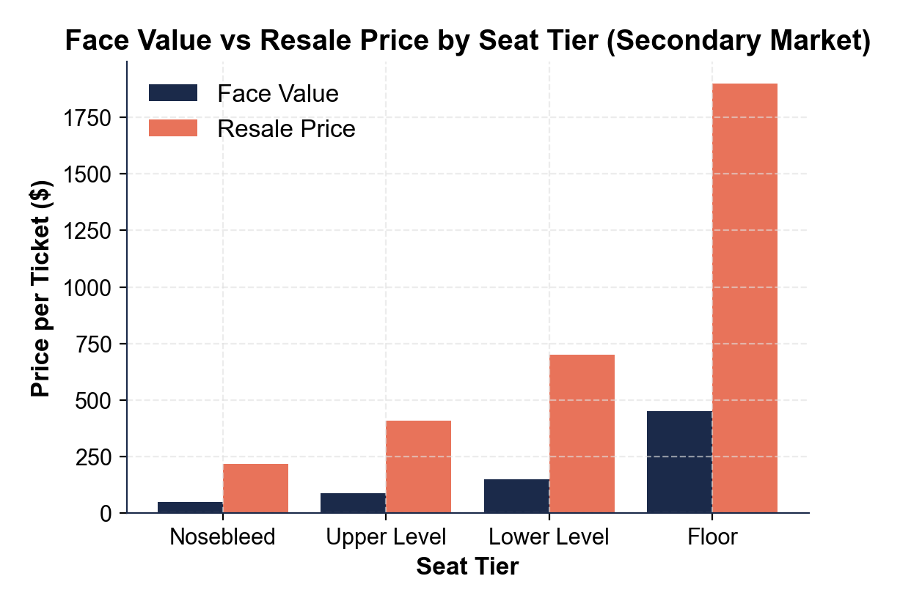
Face Value vs Resale Price by Seat Tier
Resale towers over face value; Floor seats jump $450 to ~$1,900.
© More Lessons Less Planning | morelessonslessplanning.com
Notes:
The resale-markup bar chart. For all four seat tiers (Nosebleed, Upper, Lower, Floor) the resale bar towers over the face-value bar. Floor shows the biggest jump, from $450 face value to about $1,900 resale - because face value was held below the equilibrium price.
Reference labels (point to these chart features when teaching): Resale far above face; Floor tier biggest gap

Slide 12
Why a Hot Tour Makes It Worse: Demand Surges
A blockbuster tour announcement makes tickets way more popular
Popularity is a NON-PRICE factor, so it SHIFTS the whole demand curve RIGHT
Fans want tickets at EVERY price - the entire demand curve moves out
Supply is still fixed at 50,000 seats, so the curve cannot move
The equilibrium price jumps from about $300 to $450; quantity stays at 50,000
The next slide shows the demand curve shifting right against fixed supply
Key Concept: a popularity surge is a demand SHIFT (non-price); with fixed supply, price jumps and quantity stays.
© More Lessons Less Planning | morelessonslessplanning.com
Notes:
Setup paired with the Eras demand-shift chart. A popularity surge is a non-price factor that shifts the whole demand curve right; with fixed supply, the equilibrium price jumps from $300 to $450 while quantity stays at 50,000. This connects to the shifts-vs-movements idea from TK 16.

Slide 13
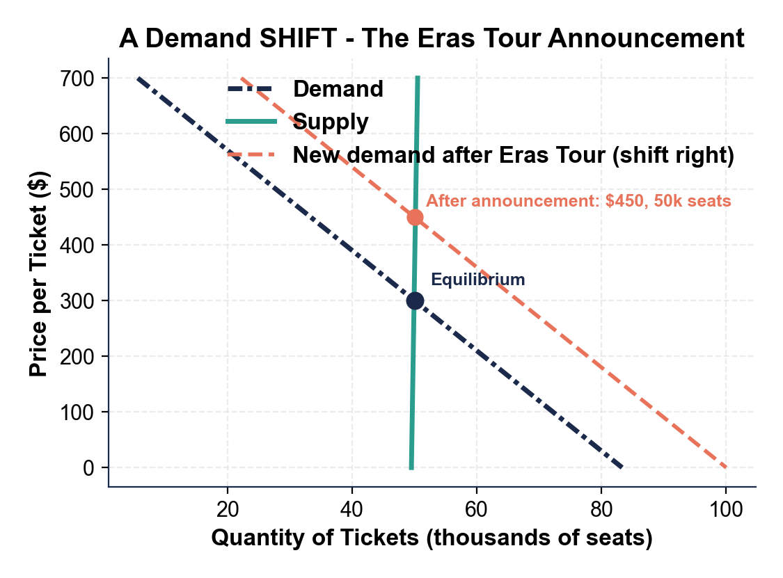
The Whole Demand Curve Shifts Right
Demand shifts right; price jumps $300 to $450, seats stay at 50k.
© More Lessons Less Planning | morelessonslessplanning.com
Notes:
The Eras demand-shift chart. The original demand curve crosses fixed supply at $300/50k; after the announcement (a non-price popularity surge) the whole demand curve shifts right and crosses the same fixed supply at $450/50k. With fixed supply, a rightward demand shift raises the equilibrium price sharply while quantity stays pinned at the seat count.
Reference labels (point to these chart features when teaching): Demand shifts RIGHT; Price up, quantity fixed

Slide 14
Movement vs Shift in the Ticket Market
Movement ALONG the Curve
Shift of the Whole Curve
Surge pricing raises the ticket's OWN price
Buyers slide up the SAME demand curve
$90 point up to the $450 point
A change in quantity demanded
A tour announcement is a NON-PRICE factor
Popularity (tastes) shifts the WHOLE curve right
Fans want tickets at every price
A change in demand
Remember: own price -> movement (surge pricing); popularity surge -> shift (the announcement).
© More Lessons Less Planning | morelessonslessplanning.com
Notes:
Tie the two big chart ideas together. Surge pricing is a movement along the curve (own price). A tour announcement is a shift of the curve (non-price popularity). This reinforces TK 16 directly inside the ticket market.

Slide 15
Concert Ticket Vocabulary (1 of 3)
Shortage
Quantity demanded is greater than quantity supplied; happens when the price is set BELOW equilibrium (a sold-out show)
Equilibrium price
The price where quantity demanded equals quantity supplied; the market-clearing price (about $450)
Fixed supply
A supply that cannot change with price; a venue has set seats, so its supply curve is nearly vertical
Remember: a sold-out show is a SHORTAGE because face value sat below equilibrium.
© More Lessons Less Planning | morelessonslessplanning.com
Notes:
Vocabulary 1 of 3: shortage, equilibrium price, fixed supply. These are the core terms students need before the activity.

Slide 16
Concert Ticket Vocabulary (2 of 3)
Face value
Dynamic pricing
Secondary market
The original price printed on the ticket
Set by the seller, here held BELOW equilibrium ($90)
Also called surge pricing
The listed price rises and falls toward equilibrium
The RESALE market after the original sale
Resale prices rise far above a below-equilibrium face value
Key Point: a below-equilibrium face value is what feeds dynamic pricing and the resale market.
© More Lessons Less Planning | morelessonslessplanning.com
Notes:
Vocabulary 2 of 3: face value, dynamic pricing, secondary market.

Slide 17
Concert Ticket Vocabulary (3 of 3)
Scalping
Buying at the low face value and reselling higher; profitable only when face value is below the equilibrium price
Movement along the curve
A slide on the SAME curve, caused by the good's OWN price (surge pricing); a change in quantity demanded
Shift of the curve
The WHOLE curve moves, caused by a NON-PRICE factor like a popularity surge; a change in demand
Demand
How much buyers are willing and able to buy at each price; for a hot tour, demand is huge
Key Point: scalping only pays when face value sits below equilibrium - that is the whole resale game.
© More Lessons Less Planning | morelessonslessplanning.com
Notes:
Vocabulary 3 of 3: scalping, movement along the curve, shift of the curve, demand. Together these complete the 10 Case Glossary terms.

Slide 18
Key Takeaways
A sold-out show is a SHORTAGE: face value was set below equilibrium
★
A venue has FIXED supply, so the supply curve is nearly vertical
★
Surge pricing moves price toward equilibrium - a movement along the curve
★
A below-equilibrium face value creates a big RESALE market with markups
★
A popularity surge SHIFTS demand right; fixed supply means price jumps
★
© More Lessons Less Planning | morelessonslessplanning.com
Notes:
Synthesis / review slide. Tier B in Guided Notes (deck-wide matching allowed). Recap all five big ideas: shortage, fixed supply, surge pricing, resale market, demand shift.

