Slide 1
Tax Refunds: Why a Big One Isn't a Win
A big refund means you overpaid all year - here's how to keep that money in your paychecks instead.
© More Lessons Less Planning | morelessonslessplanning.com
Notes:
Open with the moment almost everyone recognizes: someone gets a tax refund and celebrates it like free money or a bonus that fell out of the sky. Gently flip it: a refund is not a gift from the government - it is your OWN money coming back, money that was taken out of your paychecks all year even though you did not owe it. Ask students if they know anyone who looks forward to a big refund every spring. Tell them that by the end of this lesson they will be able to explain exactly where a refund comes from, calculate how much smaller each paycheck was because of it, understand why letting the IRS hold that money is an interest-free loan, and know how a single form (the W-4) puts that money back into every paycheck. Set the tone: this is not saying refunds are bad - it is showing that a big refund is a CHOICE with a real cost, and most people do not realize they are making it.

Slide 2
Learning Targets
Explain why a large tax refund means too much was withheld all year
★
Apply the LABELED refund model (Refund = total tax withheld - actual tax owed)
★
Explain why over-withholding is an interest-free loan to the IRS
★
Calculate the monthly cost of over-withholding (refund / 12) and adjust a W-4
★
© More Lessons Less Planning | morelessonslessplanning.com
Notes:
Read the four targets aloud and connect them to the arc of the lesson. Target 1 is the core reframe: a large refund is not a win - it means too much tax was withheld from your paychecks all year. Target 2 is the math: the LABELED refund model, Refund = total tax withheld minus actual tax owed, which students will apply to real numbers. Target 3 is the why-it-matters: over-withholding is an interest-free loan to the IRS - the government holds your extra money all year at 0% interest instead of you having it. Target 4 is the fix: calculate the monthly cost of over-withholding (refund divided by 12) and understand how adjusting your W-4 puts that money back into each paycheck. By the end, students can explain where a refund comes from, do the math, and describe the fix.

Slide 3
Why a Big Refund Isn't a Win
What most people think
What is really happening
A big refund feels like free money or a bonus
It arrives in one exciting lump sum in the spring
People plan vacations or big purchases around it
It feels like the government is giving you something
A refund is YOUR OWN money the IRS is giving back
You only get a refund because too much was taken from your paychecks
You could have had that money in every paycheck all year
A big refund means you overpaid - not that you won anything
Key Concept: A tax refund is not a bonus or free money - it is your OWN over-withheld money being returned because too much was taken all year.
© More Lessons Less Planning | morelessonslessplanning.com
Notes:
Set up the whole lesson by naming the misconception directly. Most people treat a big tax refund like a bonus or free money - an exciting lump sum that shows up in the spring, something to plan a vacation or a big purchase around. It FEELS like the government is handing you something. Now flip it, gently but clearly: a refund is not a gift and it is not free money. It is your OWN money coming back to you. The only reason you get a refund at all is that too much tax was taken out of your paychecks all year - more than you actually owed. That extra money was yours the whole time; you just did not have it, because it was sitting with the IRS. So a big refund does not mean you won anything - it means you OVERPAID, and the IRS is simply returning the overpayment. Reassure students this is not about calling anyone foolish for liking their refund; it is about seeing clearly what a refund really is, so they can decide on purpose whether they want one. Key term - Tax refund: money the IRS returns when MORE tax was withheld from your paychecks than you actually owed; it is your own over-withheld money, not a bonus.

Slide 4
What a Tax Refund Really Is - A Labeled Model
Withholding (what comes out)
WITHHOLDING is the tax your employer takes out of each paycheck and sends to the IRS for you, based on your W-4
Actual tax owed (what you really owe)
ACTUAL TAX OWED is the real tax you owe for the year based on your income - the true amount, separate from what was withheld
The REFUND formula (labeled model)
REFUND = total tax WITHHELD - actual tax OWED. You get a refund only when withheld is MORE than owed
Worked example
$4,200 withheld - $3,000 actually owed = a $1,200 REFUND. The refund is exactly the amount you overpaid
Key Concept: REFUND = total tax withheld - actual tax owed. A refund happens only when you overpaid; it equals the amount you overpaid.
© More Lessons Less Planning | morelessonslessplanning.com
Notes:
Introduce the FIRST labeled model students will apply throughout the lesson. Start with the two pieces. WITHHOLDING is the tax your employer takes out of each paycheck all year and sends to the IRS for you - it is set by the W-4 form you filled out. ACTUAL TAX OWED is the real amount of tax you owe for the whole year, based on your income; it is the true number, and it is usually different from what was withheld. At tax time, you compare the two. Write the labeled model on the board: REFUND = total tax WITHHELD minus actual tax OWED. Say it plainly: you only get a refund when the amount withheld is MORE than the amount you actually owed - in other words, when you overpaid. Work the pinned example: if $4,200 was withheld from your paychecks all year but you actually owed only $3,000, then your refund is $4,200 - $3,000 = $1,200. Point out that the $1,200 refund is EXACTLY the amount you overpaid - it is not a bonus, it is your own money that was withheld and did not need to be. Key term - Actual tax owed: the real tax you owe for the year based on your income, compared against total withholding to decide a refund or a balance due.

Slide 5
Over-Withholding: Where Big Refunds Come From
Over-withholding (defined)
OVER-WITHHOLDING means having MORE tax taken out of your paychecks all year than you actually owe
✔
What over-withholding produces
It produces a large refund - but also SMALLER monthly paychecks all year, because the extra was taken out before you got paid
✔
The trade you're making
A bigger refund in the spring means smaller TAKE-HOME PAY every month - the two move in opposite directions
✔
Take-home pay (defined)
TAKE-HOME PAY is what you actually keep from each paycheck after withholding is subtracted; over-withholding lowers it
✔
Key Concept: OVER-WITHHOLDING means too much tax comes out of every paycheck - a big refund AND smaller monthly take-home pay.
© More Lessons Less Planning | morelessonslessplanning.com
Notes:
Explain exactly where a big refund comes from: OVER-WITHHOLDING. Define it plainly - over-withholding means MORE tax is being taken out of your paychecks all year than you actually owe. Where does that extra go? Straight to the IRS, every payday, before you ever see it. Then it comes back to you as a refund at tax time. So over-withholding produces two things at once: a large refund in the spring, AND smaller paychecks every single month all year, because the extra was pulled out before you got paid. Make the trade-off explicit: a bigger refund in the spring is the SAME thing as smaller take-home pay every month - they are two sides of one coin, and they move in opposite directions. If you want a bigger refund you must accept smaller monthly paychecks; if you want bigger monthly paychecks you must accept a smaller refund. Define TAKE-HOME PAY here: it is the amount you actually keep from each paycheck after withholding is subtracted, and over-withholding lowers it. Tell students the next slides show exactly how much that monthly cost adds up to. Key term - Over-withholding: having more tax taken out of your paychecks all year than you actually owe, which produces a large refund but smaller monthly paychecks.

Slide 6
The Interest-Free Loan to the IRS
What over-withholding really is
Over-withholding is an INTEREST-FREE LOAN to the IRS: you let the government hold your extra money all year at 0% interest
Why 0% interest matters
When the IRS finally returns it as a refund, you get back the SAME amount - no interest for the year you went without it
What you gave up (opportunity cost)
You could have spent, saved, or earned interest on that money each month; giving that up is the OPPORTUNITY COST of a big refund
An illustration
A $2,400 refund is a $2,400 loan to the IRS at 0%. Had a $1,200 average balance sat in a 4% savings account, it could have earned about $48
Key Concept: Over-withholding is an INTEREST-FREE LOAN to the IRS at 0%. You give up the chance to spend, save, or earn interest on your own money.
© More Lessons Less Planning | morelessonslessplanning.com
Notes:
Give students the sharpest way to see over-withholding: it is an INTEREST-FREE LOAN to the IRS. When you over-withhold, you are letting the government hold your extra money for the entire year, and they pay you 0% interest for the privilege. When they finally return it as a refund, you get back the exact same amount you lent them - not a penny more - even though you went without that money for up to a year. Now name what you gave up. During that year, that money could have been in your pocket: you could have spent it on things you needed, put it toward paying down debt, or saved it and earned interest on it. Giving all of that up is the OPPORTUNITY COST of a big refund - the value of what you lose by choosing to let the IRS hold your money instead of keeping it yourself. Work the clearly-labeled illustration: a $2,400 refund is a $2,400 interest-free loan to the IRS. If about half of it - a $1,200 average balance, since it builds up over the year - had instead sat in a 4% savings account, it could have earned roughly $48 in interest over the year. Stress that $48 is just an illustration of the idea, not a promise; the real point is that any interest at all beats the 0% the IRS pays. Key term - Interest-free loan to the IRS: over-withholding, where the government holds your extra money all year at 0% interest. Opportunity cost: the value of what you give up - here, the spending, saving, or interest that money could have provided.

Slide 7
Same Salary, Different W-4
Meet two workers with the SAME salary
Both earn the same pay and both file as single. The ONLY difference is how they filled out their W-4
✔
Worker A over-withholds
Too much comes out of each paycheck: take-home pay is $2,300/month, and they get a big $2,400 refund
✔
Worker B withholds accurately
About the right amount comes out: take-home pay is $2,500/month, and they get about a $0 refund
✔
You will read this tradeoff off a bar chart next
The next slide shows both workers' monthly take-home pay and refund side by side
✔
Key Concept: Same salary, different W-4. Worker A: $2,300/mo, $2,400 refund. Worker B: $2,500/mo, $0 refund. $200/mo x 12 = $2,400 = the refund.
© More Lessons Less Planning | morelessonslessplanning.com
Notes:
Set up the chart students are about to read by walking the comparison in numbers first. Picture two workers who earn the exact SAME salary and both file as single. The only thing that is different between them is how they filled out their W-4 form. Worker A over-withholds - too much tax comes out of each paycheck - so their monthly take-home pay is $2,300, and at tax time they get a big $2,400 refund. Worker B set their W-4 to withhold accurately - about the right amount comes out - so their monthly take-home pay is $2,500, and at tax time they get about a $0 refund. Now make the load-bearing point that the whole chart is built to show: Worker B keeps $200 MORE every month than Worker A ($2,500 vs $2,300). Over 12 months, that is $200 x 12 = $2,400 - which is EXACTLY the size of Worker A's refund. In other words, Worker A's big refund is nothing more than the $200 a month that was quietly taken out of every paycheck and handed back at the end. Worker B had that same money the whole time, in each paycheck, to use as they wished. Tell students the next slide shows this exact comparison as a bar chart so they can see the tradeoff for themselves before reading the values in the activity.

Slide 8
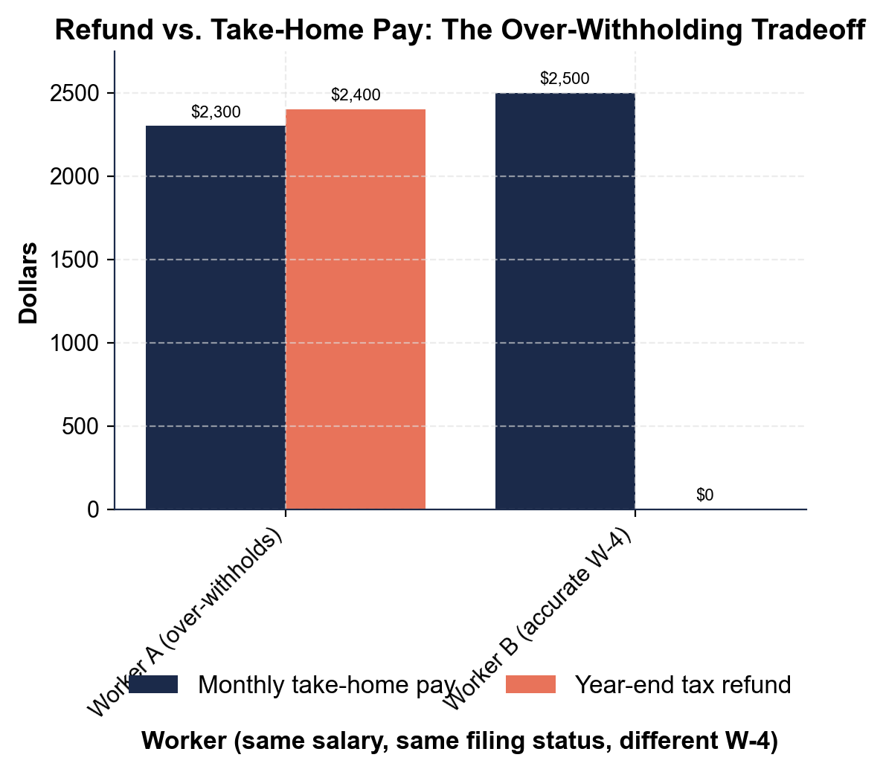
Refund vs. Take-Home Pay: The Over-Withholding Tradeoff
Same salary, different W-4: A's refund is the $200/mo missing from each check.
© More Lessons Less Planning | morelessonslessplanning.com
Notes:
Give students a moment to read the grouped bars on their own before discussing. For each worker there are two bars: monthly take-home pay and year-end refund. Worker A (over-withholds): the take-home bar is $2,300 and the refund bar is $2,400. Worker B (accurate W-4): the take-home bar is $2,500 and the refund bar is $0. Point out the pattern: the worker with the bigger refund (A) has the SMALLER monthly paycheck, and the worker with the bigger monthly paycheck (B) has almost no refund. Ask students to state the tradeoff in their own words: a big refund and a big monthly paycheck are not both available - choosing one means giving up the other. Then have them verify the identity: Worker B's paycheck is $200 bigger each month, and $200 x 12 = $2,400, which is exactly Worker A's refund. This is the chart Activity Part 4 reads and analyzes.
Reference labels (point to these chart features when teaching): A: $2,300/mo, $2,400 refund; B: $2,500/mo, $0 refund

Slide 9
Adjusting Your W-4
The W-4 form (defined)
Your W-4 tells your employer how much tax to WITHHOLD from each paycheck; it is the dial that sets the size of your refund
A big refund every year is a signal
If you get a large refund year after year, it is a signal to UPDATE your W-4 so less is withheld and more lands in each paycheck
Accurate withholding (the goal)
ACCURATE WITHHOLDING means setting your W-4 so about the right amount comes out - a refund close to $0 and the biggest legal paycheck
Aim for close to $0, not for a big refund
The goal is not to owe a lot OR to get a lot back - it is to break about even, so you keep your money as you earn it
Key Concept: Your W-4 sets your refund. A big refund yearly signals updating it toward ACCURATE WITHHOLDING - a refund near $0, the biggest paycheck.
© More Lessons Less Planning | morelessonslessplanning.com
Notes:
Give students the concrete fix. The W-4 form is the form you give your employer that tells them how much tax to WITHHOLD from each of your paychecks - it is the dial that controls the size of your refund. If you consistently get a big refund year after year, that is a clear SIGNAL that your W-4 is set to withhold too much: you can update it so that less tax comes out and more money lands in each paycheck instead. Connect this back to the W-2 and W-4 work students have already seen (a W-2 reports what was actually withheld; the W-4 is what you set to control it going forward). Define the goal: ACCURATE WITHHOLDING means setting your W-4 so that about the right amount of tax is taken out - producing a refund close to $0 and the largest legal take-home pay. Be careful and honest here: the goal is NOT to owe a big balance at tax time, and it is also NOT to get a big refund; the goal is to break about even, so you keep your own money as you earn it instead of lending it to the IRS. Frame updating the W-4 as a normal, allowed thing anyone can do when their situation changes - not tax advice about a specific number, just the direction to aim: closer to $0. Key term - W-4 form: the form that tells your employer how much tax to withhold from each paycheck; adjusting it changes the size of your refund and your take-home pay. Accurate withholding: setting your W-4 so about the right amount comes out, for a refund near $0 and the largest legal paycheck.

Slide 10
Owing vs. Refunding - A Labeled Model
The two outcomes at tax time
Compare total tax WITHHELD to actual tax OWED. If withheld is MORE, you get a refund; if withheld is LESS, you owe a balance
✔
The BALANCE DUE formula (labeled model)
BALANCE DUE = actual tax OWED - total tax WITHHELD. You owe money when you under-withheld (paid in too little)
✔
Worked example (you owe)
$3,600 actually owed - $3,000 withheld = a $600 BALANCE DUE. You under-withheld, so you owe $600 at filing
✔
Refund and balance due are mirror images
A refund means you overpaid; a balance due means you underpaid. Accurate withholding lands you near $0 either way
✔
Key Concept: BALANCE DUE = actual tax owed - total tax withheld. You owe when you under-withheld - the mirror image of a refund.
© More Lessons Less Planning | morelessonslessplanning.com
Notes:
Round out the model by showing the OTHER outcome at tax time, so students see the full picture and do not think under-withholding is the goal either. At tax time you compare two numbers: the total tax WITHHELD from your paychecks all year, and the actual tax you OWED. If withheld is MORE than owed, you overpaid and get a refund (the model from slide 4). If withheld is LESS than owed, you underpaid, and now you OWE money - a balance due. Write the second labeled model on the board: BALANCE DUE = actual tax OWED minus total tax WITHHELD. Work the pinned example: if you actually owed $3,600 but only $3,000 was withheld, then your balance due is $3,600 - $3,000 = $600 - you have to send the IRS $600 at filing time because you under-withheld. Make the symmetry explicit: a refund means you overpaid (too much withheld), and a balance due means you underpaid (too little withheld) - they are mirror images of the same comparison. Then tie it back to the goal from the previous slide: accurate withholding aims for the middle, landing you near $0 either way, so you neither hand the IRS a big interest-free loan NOR get hit with a surprise bill. Key term - Balance due: money you owe the IRS at tax time, which happens when LESS tax was withheld than you actually owed - the opposite of a refund.

Slide 11
The Monthly Cost of Over-Withholding - A Worked Example
The filer
Alex had $5,400 withheld all year but actually owed only $3,600 in tax
The refund (Model 1)
REFUND = $5,400 withheld - $3,600 owed = $1,800. Alex over-withheld by $1,800
The MONTHLY COST (Model 3)
MONTHLY COST = refund / 12 = $1,800 / 12 = $150. Every monthly paycheck was $150 smaller than it needed to be
Fixing the W-4
Adjusting the W-4 to withhold about $3,600 drops the refund toward $0 and adds about $150 to each of Alex's 12 monthly paychecks
Key Concept: MONTHLY COST = refund / 12. Alex's $1,800 / 12 = $150 - each paycheck was $150 smaller. Fixing the W-4 puts that $150 back.
© More Lessons Less Planning | morelessonslessplanning.com
Notes:
Work one complete, start-to-finish example that pulls the whole lesson together, because the activity will ask students to do the same thing. Meet Alex: over the year, Alex had $5,400 in tax withheld from their paychecks, but when they filed, their actual tax owed was only $3,600. Apply Model 1 (the refund formula): REFUND = total withheld minus actual owed = $5,400 - $3,600 = $1,800. So Alex gets an $1,800 refund - which means Alex over-withheld by $1,800 all year. Now apply the THIRD labeled model to see the real cost: MONTHLY COST OF OVER-WITHHOLDING = refund divided by 12 = $1,800 / 12 = $150. That means every single one of Alex's monthly paychecks was $150 smaller than it needed to be - Alex went the whole year with $150 less each month, just to get it all back in one lump at tax time. Finally, show the fix: if Alex adjusts their W-4 to withhold about $3,600 for the year (matching what they actually owe), their refund drops toward $0, and that $150 goes back into each of their 12 monthly paychecks - money Alex can use as they earn it. Tell students this worked example is the direct model for the activity's calculation task. Key term reminder - Monthly cost of over-withholding = refund / 12; this is how much smaller each paycheck was.

Slide 12
The Honest Nuance: Is a Refund Ever OK?
Some people over-withhold on purpose
A few people use a big refund as FORCED SAVINGS - a way to save money they fear they would otherwise spend if it were in each paycheck
✔
Why that can make sense for some
If someone truly cannot save on their own, a guaranteed lump-sum refund might be better than not saving at all
✔
But it still has a real cost
It is still an interest-free loan to the IRS with a real OPPORTUNITY COST - you give up any interest and the use of your own money
✔
The takeaway
A big refund is an OPTION, not automatically bad - but it is a choice with a cost. Accurate withholding plus your own savings plan usually wins
✔
Key Concept: A big refund is an OPTION with a real cost - still a 0% loan to the IRS. Accurate withholding plus your own savings usually wins.
© More Lessons Less Planning | morelessonslessplanning.com
Notes:
Be honest with students so a sharp one does not feel misled: there IS a real counterpoint, and it is worth naming. Some people intentionally over-withhold and treat their big refund as FORCED SAVINGS - a way to set money aside that they are afraid they would otherwise spend if it landed in each paycheck. For a person who genuinely struggles to save any other way, a guaranteed lump-sum refund every spring might honestly be better than saving nothing at all. Acknowledge that plainly; do not dismiss it. BUT be equally clear about the cost that does not go away: even used as forced savings, a big refund is still an interest-free loan to the IRS, and it still carries a real OPPORTUNITY COST - you give up any interest that money could have earned and the ability to use it during the year. So the honest takeaway is nuanced, not preachy: a big refund is an OPTION, not automatically 'bad' - but it is a choice with a real cost, and most people making it do not realize they are choosing it. For most people, the better plan is accurate withholding (a refund near $0) PLUS a real savings habit of their own - that way they keep their money AND still save it, instead of lending it to the IRS for free. This is the mature, complete version of the lesson's main point. Key term - Opportunity cost: the value of what you give up by choosing one option over another; here, the interest and use of your own money you give up for a big refund.

Slide 13
Key Takeaways
A tax refund is your OWN over-withheld money coming back - not a bonus
★
REFUND = total tax withheld - actual tax owed; a refund means you overpaid
★
Over-withholding is an interest-free loan to the IRS at 0% - a real cost
★
MONTHLY COST of over-withholding = refund / 12 (how much each paycheck shrank)
★
A big refund every year is a signal to adjust your W-4 toward a refund near $0
★
© More Lessons Less Planning | morelessonslessplanning.com
Notes:
Read each takeaway and connect it back to the learning targets and the opening hook. T1 (why a big refund isn't a win) -> a refund is your OWN money coming back, because too much was withheld all year; it is not a bonus or free money. T2 (apply the refund model) -> REFUND = total tax withheld minus actual tax owed, so a refund by definition means you overpaid; the balance-due mirror is BALANCE DUE = owed minus withheld. T3 (interest-free loan) -> over-withholding lets the IRS hold your money all year at 0% interest, and the opportunity cost is the spending, saving, or interest you gave up. T4 (monthly cost + the fix) -> MONTHLY COST OF OVER-WITHHOLDING = refund divided by 12 shows how much smaller each paycheck was, and a big refund every year is a signal to adjust your W-4 toward accurate withholding, aiming for a refund close to $0. Close by returning to the very first slide and the chart: Worker A's $2,400 refund was just the $200 a month missing from every paycheck - Worker B kept that same money all along. The mature goal is accurate withholding plus your own savings plan, so you keep your money AND still save it.

