Slide 1
Tariffs: Who Really Pays?
How tariffs work, who actually pays them, and what the 2018-2024 U.S. tariff rounds cost American consumers
© More Lessons Less Planning | morelessonslessplanning.com
Notes:
Open with a provocation. Most students hear 'tariff on China' and think China pays. The actual research shows 95-100% of recent U.S. tariffs were paid by American importers and consumers. Today we trace exactly how that happens, do the math on a $1,000 washing machine with a 25% tariff, and read real Federal Reserve and NBER data on the 2018-2024 tariff rounds. By the end of class students should be able to explain who legally writes the check (the importer), who economically bears the cost (the consumer), and how to evaluate a tariff as a policy tool.

Slide 2
Learning Targets
Define TARIFFS and trace who actually pays them
★
Calculate tariff impact on consumer prices using PASS-THROUGH
★
Evaluate tariffs as policy: protection and revenue vs consumer cost
★
© More Lessons Less Planning | morelessonslessplanning.com
Notes:
Read each target aloud. Connect target 1 to the importer-vs-consumer slides; target 2 to the math practice with the $1,000 washing machine; target 3 to the real-world 2018-2024 tariff outcomes and the policy memo in the activity. Tell students the surprise of this lesson: 'tariff on China' does NOT mean China pays. The legal payer is a U.S. importer; the economic payer is a U.S. consumer.

Slide 3
What Is a Tariff?
Definition
How It Reaches You
A TAX a government puts on IMPORTED goods
Collected at the border when goods arrive
Paid by the IMPORTER to U.S. Customs (CBP)
NOT paid by the foreign country
Importer pays tariff to enter the U.S.
Importer raises wholesale price to recover cost
Retailer raises shelf price
Final price hits the consumer
Key Concept: A tariff is a TAX on imports. The U.S. company that imports the goods writes the check, NOT the foreign exporter.
© More Lessons Less Planning | morelessonslessplanning.com
Notes:
Anchor the definition. A TARIFF is a TAX a government places on IMPORTED goods - meaning goods being brought INTO the country from abroad. The foreign country selling the goods does NOT pay the tariff. The U.S. company importing the goods is legally required to pay U.S. Customs and Border Protection (CBP) before the goods are released. So 'tariff on Chinese steel' actually means 'a U.S. importer who buys Chinese steel must pay the U.S. government a tax on it.' Most students - and many adults - get this wrong. The next slides trace where the cost actually lands.

Slide 4
Who Pays Tariffs? (Spoiler: Not the Foreign Country)
LEGAL payer
The U.S. importer (e.g., Walmart, Apple, Ford); they write the check to U.S. Customs at the port
ECONOMIC payer
The U.S. consumer; importers pass most of the cost forward into retail prices
Foreign exporter
Pays NOTHING directly; may lose sales if U.S. demand drops, but does not write a tariff check
How much passes through
Federal Reserve and NBER studies: 95-100% of the 2018-2019 China tariffs reached U.S. consumers
Common misconception
'China pays the tariff' - false; the U.S. importer pays at the border, then passes the cost to U.S. shoppers
Tip: The LEGAL payer is the importer; the ECONOMIC payer is the consumer. Studies show the foreign country usually pays close to ZERO.
© More Lessons Less Planning | morelessonslessplanning.com
Notes:
This is the most important concept of the lesson. Two payers: the LEGAL payer (the U.S. importer who writes the check at the port) and the ECONOMIC payer (the U.S. consumer who pays a higher retail price). The foreign exporter pays close to zero in the 2018-2024 U.S. tariff data. The Federal Reserve, NBER, and Peterson Institute all studied the 2018-2019 China tariffs and found 95-100% pass-through - meaning American consumers paid almost the entire tariff burden through higher prices on washing machines, electronics, furniture, and clothing. Drill this: when a politician says 'China is paying the tariffs,' the data say no - American importers and consumers paid almost all of it. The economic payer concept is what the activity Part 3 math will demonstrate concretely.

Slide 5
Pass-Through: How the Tax Reaches the Shelf
Step 1 - Foreign factory ships goods
A foreign factory exports a $1,000 washing machine to a U.S. importer.
✔
Step 2 - Importer pays tariff at port
At a 25% tariff, the importer pays $250 to U.S. Customs (CBP) before goods are released.
✔
Step 3 - Importer raises wholesale price
The importer's cost is now $1,250, so it raises the wholesale price by most of the tariff.
✔
Step 4 - Retailer raises shelf price
The retailer marks up the wholesale cost, raising the shelf and retail price.
✔
Step 5 - Consumer pays at checkout
At 95% pass-through, the consumer price rises about $237.50 - nearly the whole $250 tariff.
✔
Big Idea: A 25% tariff on a $1,000 import becomes about a 24% retail price increase under typical pass-through (~95%).
© More Lessons Less Planning | morelessonslessplanning.com
Notes:
The 5-step pass-through chain. Students need this for the activity Part 3 math. Step 1: foreign factory ships goods at a fixed wholesale price (the tariff does NOT change what the factory charges). Step 2: U.S. importer pays the tariff at the port; this is the tariff revenue collected by CBP that shows up in federal receipts. Step 3: importer's total cost is now original wholesale + tariff. To recover cost, importer raises the wholesale price they charge retailers. Step 4: retailers pass that wholesale price increase through to the shelf price (typical retail markups apply on top of the higher wholesale). Step 5: consumer sees the final shelf price. The PASS-THROUGH RATE is the percent of the tariff that ends up in the retail price. The 2018-2019 China tariff studies found pass-through close to 95-100% - almost all of the tariff cost reached consumers. The activity Part 3 will have students compute this on three real product examples.

Slide 6
Tariff Types: Ad Valorem vs Specific
Type | How it is calculated | Example | Used when
Ad valorem | A PERCENTAGE of the import value | 25% tariff on a $1,000 washer = $250 | Most common; flexible to price changes
Specific | A FIXED dollar amount per unit | $0.50 per pound of imported sugar | Used for raw commodities like sugar, milk
Compound | Both: a percentage PLUS a per-unit fee | 5% + $0.10 per item | Rare; some textile and food categories
Quota tariff | Low rate up to a quantity, high rate above | Low rate for first 1M tons, then 100% above | Used for protected agriculture (e.g., dairy)
Did You Know? Most of the 2018-2024 China tariffs are AD VALOREM - typically 7.5%, 25%, 50%, or 100% depending on the product category.
© More Lessons Less Planning | morelessonslessplanning.com
Notes:
Four tariff types. AD VALOREM is the most common - a percentage of the import value. The 2018 China tariffs were primarily ad valorem at 7.5% (List 4A) and 25% (Lists 1, 2, 3). The 2024 EV tariff is ad valorem at 100%. SPECIFIC tariffs are dollar-per-unit and used mostly for commodities like sugar and milk. COMPOUND tariffs combine both. QUOTA tariffs (also called tariff-rate quotas) charge a low rate up to a quantity and a punishing rate above - common in protected agriculture. The chart on the next slide shows the supply-demand effect of any ad valorem tariff.

Slide 7
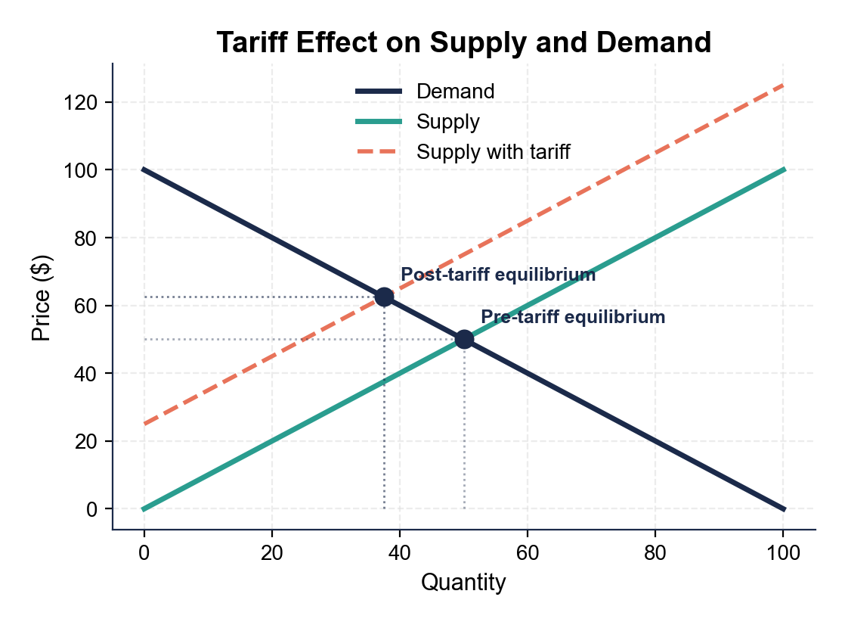
Supply-Demand: How a Tariff Raises Price
Note: Tariff shifts supply LEFT; price up $12.50, qty down 12.5.
© More Lessons Less Planning | morelessonslessplanning.com
Notes:
Students see graphically what they computed in pass-through. Pre-tariff: supply (S) and demand (D) intersect at the pre-tariff equilibrium ($50 price, 50 quantity), shown as the lower navy dot. Post-tariff: supply shifts LEFT/UP (the same quantity now requires a higher price because importers must cover the tariff), so the new equilibrium is at a HIGHER price ($62.50) and a LOWER quantity (37.5), shown as the upper navy dot. The dotted guide lines from each equilibrium to the axes let students read the values directly. The price gap ($62.50 - $50 = $12.50) is the consumer's share of the tariff burden; the quantity drop (50 - 37.5 = 12.5 units) is the deadweight loss - trade that no longer happens because the tariff made it uneconomic. This visualization is what justifies the pass-through math on the next-slide-but-one.
Reference labels (point to these chart features when teaching): Pre-tariff: $50, Q=50; Post-tariff: $62.50, Q=37.5

Slide 8
The 2018-2024 U.S. Tariff Rounds
2018 - Trump Round 1
2019-2020 - Trump Round 2
2024 - Biden Targeted Increases
Section 232 steel + aluminum (25% / 10%)
Section 301 China Lists 1-3 (25%)
Targeted about $ 250 billion of Chinese goods
China retaliated on U.S. soybeans, autos
Section 301 China List 4A (7.5%)
Brought total tariffs to ~$360B of Chinese goods
Phase One trade deal in 2020 paused escalation
Most tariffs stayed in place after deal
100% tariff on Chinese EVs
50% tariff on Chinese solar panels
25% on Chinese steel and aluminum (kept)
25% on EV batteries (phased)
Key Concept: Both administrations kept and expanded most tariffs - tariffs are now bipartisan U.S. China policy.
© More Lessons Less Planning | morelessonslessplanning.com
Notes:
Walk through the three escalations. 2018: the first major U.S. tariff move in decades. Section 232 (national security) on steel and aluminum, Section 301 (unfair trade practices) on Chinese imports across three lists totaling about $250B. China retaliated on U.S. soybeans, pork, autos, and aircraft. 2019-2020: Section 301 List 4A added 7.5% on another ~$110B of Chinese consumer goods. The 'Phase One' deal in early 2020 paused escalation but kept most tariffs in place. 2024: the Biden administration KEPT most Trump tariffs and added new ones - 100% on Chinese EVs, 50% on solar panels, 25% on EV batteries (phased), and 25% on Chinese steel. Tariffs on China are now bipartisan U.S. policy. The chart on the next slide shows the federal revenue effect of all three rounds.

Slide 9
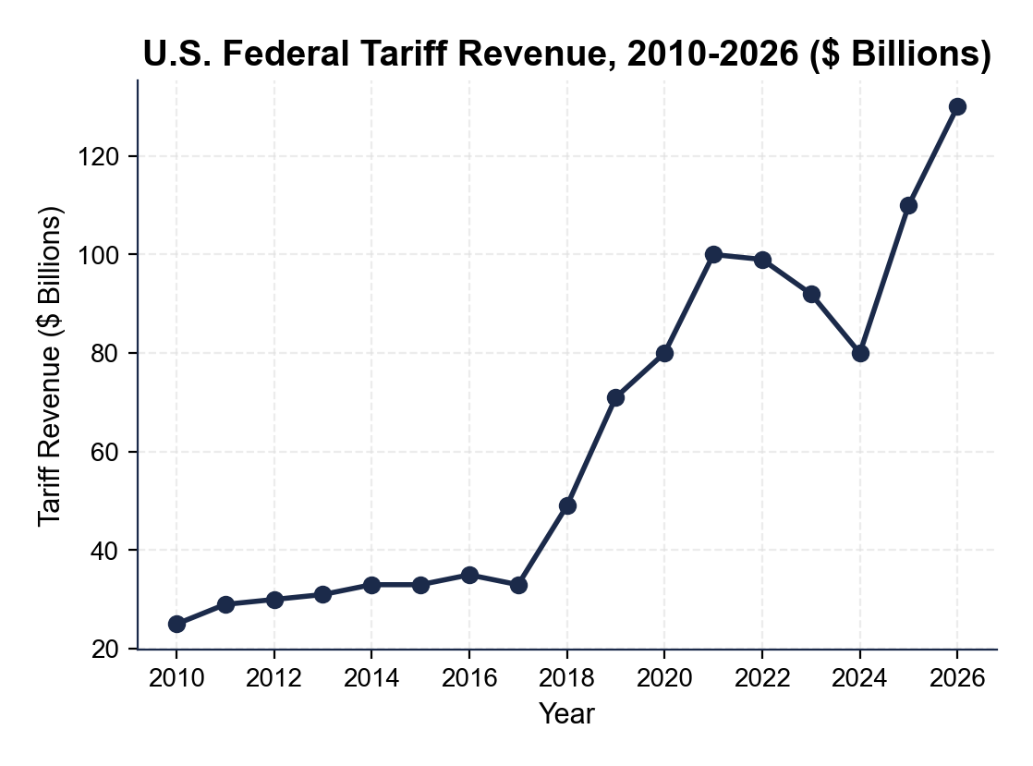
U.S. Tariff Revenue 2010-2026
Note: 2018 doubled revenue; 2024 dipped, then 2026 projected surge.
© More Lessons Less Planning | morelessonslessplanning.com
Notes:
Read the chart left to right. 2010-2017: tariff revenue is fairly flat in the $30-35B range; this is the long-running baseline of pre-Trump tariffs (mostly low-rate ad valorem on a wide range of goods). 2018-2019: revenue jumps to about $70-80B as the 2018 China tariffs and steel/aluminum tariffs flow through; the increase is approximately the additional tariff dollars collected. 2020-2023: stays elevated around $80-100B; some categories shifted away from China, but most tariffs remain. 2024-2026 (projected): rises further with Biden-era 100% EV and 50% solar tariffs, plus extension of Trump-era tariffs. The chart is the macro evidence: the 2018 escalation roughly DOUBLED federal tariff revenue, and that revenue came almost entirely from U.S. importers and (passed through) U.S. consumers - not from China.
Reference labels (point to these chart features when teaching): 2017: ~$33B; 2026 (proj): ~$130B

Slide 10
Protection vs Revenue: Why Governments Use Tariffs
Protection Motive
Revenue Motive
Shield U.S. industries from cheaper imports
Steel mills, washer factories, auto plants
Saves SOME jobs in protected sector
But raises consumer prices economy-wide
Raise money for the federal government
Pre-1913: tariffs were the main federal revenue
Today: under 2% of total federal revenue
$80B in 2024 vs $4.5T total federal revenue
Tip: Both motives are real - but recent U.S. tariffs are mostly PROTECTION-driven, not revenue-driven.
© More Lessons Less Planning | morelessonslessplanning.com
Notes:
Two reasons governments impose tariffs. PROTECTION: shield domestic producers from cheaper foreign competition. The 2018 steel tariffs were sold as protecting U.S. steel mills; the 2024 EV tariff is meant to protect U.S. EV manufacturers from Chinese BYD, Geely, etc. Protection saves SOME jobs in the protected sector but raises consumer prices for everyone who buys steel-using products (cars, appliances, construction). REVENUE: tariffs raise money for the government. Before the federal income tax (1913), tariffs were the MAIN source of federal revenue. Today they are a small share (under 2% of federal revenue, ~$80B vs ~$4.5T total in 2024). Recent U.S. tariffs are primarily protection-driven; the revenue is a side effect. The activity Part 4 will ask students to weigh protection against consumer cost using real numbers from the studies.

Slide 11
The Studies: How Much Consumers Actually Paid
Federal Reserve (Cavallo et al. 2019)
Found near-complete pass-through of the 2018 China tariffs to U.S. retail prices.
NBER (Amiti, Redding, Weinstein 2019)
Found the 2018 tariffs passed ~100% onto U.S. consumers; cost about $51 billion per year.
Peterson Institute (2019)
Estimated the average household paid about $400-$800 more per year from 2018-2019 tariffs.
Washing machine case (2019)
After the 2018 washer tariff, washer prices rose about 12%; bundled dryer prices rose too.
What it means
Almost all the cost reached U.S. consumers; foreign exporters absorbed close to zero
Big Idea: Multiple peer-reviewed studies converged on the same answer - 95-100% of recent U.S. tariffs were paid by Americans.
© More Lessons Less Planning | morelessonslessplanning.com
Notes:
The empirical evidence. Three independent peer-reviewed studies on the 2018-2019 tariffs converged on the same answer: nearly 100% pass-through to U.S. consumers. The Federal Reserve study (Cavallo, Gopinath, Neiman, and Tang 2019) used micro price data and found pass-through close to 100%. The NBER paper by Amiti, Redding, and Weinstein (2019) computed total annual cost at about $51 billion per year - paid by U.S. importers and consumers, not by foreign exporters. The Peterson Institute estimated the average U.S. household paid $400-$800 more per year due to the tariffs. The 2018 washing machine tariff is a clean natural experiment: washer prices rose ~12% after the tariff, and dryer prices ALSO rose (because washers and dryers are commonly bundled). The key takeaway: when a politician claims 'China is paying the tariff,' multiple studies say no - U.S. consumers paid almost all of it.

Slide 12
Practice Math - $1,000 Import + 25% Tariff
Step 1 - Original wholesale cost
Foreign factory exports a washing machine for $1,000 (no tariff scenario)
✔
Step 2 - Apply tariff
25% ad valorem tariff = 0.25 x $1,000 = $250 paid by U.S. importer at the port
✔
Step 3 - Compute pass-through
If pass-through = 95%, consumer price rises by 0.95 x $250 = $237.50
✔
Step 4 - New retail price
Original retail $1,000 + $237.50 increase = $1,237.50; the consumer pays $237.50 more
✔
Step 5 - Identify the payers
Consumer pays $237.50 (95%); importer absorbs $12.50 (5%); foreign exporter pays $0
✔
Tip: To find the consumer cost of a tariff: import value x tariff rate x pass-through rate.
© More Lessons Less Planning | morelessonslessplanning.com
Notes:
Walk through this together as a class before the activity. A foreign factory exports a $1,000 washing machine to a U.S. importer. The 25% ad valorem tariff means the U.S. importer pays $250 to U.S. Customs ($1,000 x 0.25 = $250). With 95% pass-through (the empirical rate from the 2018-2019 studies), 0.95 x $250 = $237.50 of that tariff ends up in the consumer's retail price. The new shelf price is $1,237.50. The importer absorbs the remaining $12.50 (5%); the foreign exporter pays nothing. Tell students: this is the EXACT calculation pattern in Activity Part 3. They will do this on three real products (washing machines, televisions, solar panels) at three different tariff rates and three different pass-through rates from the studies.

Slide 13
Key Takeaways
A tariff is a TAX on imports paid by the U.S. importer at the border
★
Studies find 95-100% PASS-THROUGH to U.S. consumer prices
★
China and other foreign exporters paid CLOSE TO ZERO in 2018-2024
★
Tariffs PROTECT some U.S. jobs but raise prices economy-wide
★
The 2018-2024 rounds cost U.S. households about $400-$800 per year
★
© More Lessons Less Planning | morelessonslessplanning.com
Notes:
Read each takeaway. Connect back to learning targets. Target 1 (define + trace): takeaways 1, 3 - importer is legal payer, consumer is economic payer, foreign exporter pays close to zero. Target 2 (calculate impact): takeaway 2 + the practice math - 95-100% pass-through means almost all of the tariff reaches the shelf. Target 3 (evaluate as policy): takeaways 4, 5 - protection benefits some workers in shielded industries but costs households $400-$800/year economy-wide. The activity Part 5 policy memo will require students to weigh both sides using specific numbers from the lesson.

