Slide 1
Taming Wild Animals
How and why early humans domesticated animals - and how herding changed prehistoric life forever.
© More Lessons Less Planning | morelessonslessplanning.com
Notes:
Opening slide. Thousands of years ago, humans began taming and breeding wild animals into livestock. This domestication reshaped what people ate, where they lived, and how their societies were organized. Today students learn how and why it happened.

Slide 2
Learning Targets
Tell the difference between taming one animal and domesticating a species.
★
Identify which animals were domesticated first and why.
★
Explain how selective breeding made animals docile.
★
Explain how herding reshaped diet, settlement, and society.
★
© More Lessons Less Planning | morelessonslessplanning.com
Notes:
Read the four learning targets. Today connects a survival story (taming animals) with a history skill (explaining how a change reshaped whole societies).

Slide 3
From Wild to Tame
Domestication
Taming wild animals and breeding them over generations to be useful to humans.
Taming
Making one wild animal less afraid of people; it does not change the whole species.
Key Concept: DOMESTICATION changes a whole species over generations; TAMING changes only one animal.
© More Lessons Less Planning | morelessonslessplanning.com
Notes:
DOMESTICATION is the slow process of taming wild animals and breeding them over many generations so they live with and are useful to humans. It is different from TAMING, which makes a single wild animal less afraid of people but does not change the whole species. You could tame one wolf, but domesticating dogs meant breeding tame wolves for thousands of years until a new, gentler animal existed.

Slide 4
The First Animals Tamed
The dog came first
Wolves became dogs and helped early humans hunt and guard camps.
✔
Then came livestock
Sheep, goats, cattle, and pigs were domesticated for food and materials.
✔
Why these animals
They were calm, bred easily in captivity, and were useful to people.
✔
Key Concept: The DOG was domesticated first; then LIVESTOCK - sheep, goats, cattle, and pigs.
© More Lessons Less Planning | morelessonslessplanning.com
Notes:
The very first animal domesticated was the DOG, bred from wolves to help early humans hunt and guard their camps. After the dog came LIVESTOCK - domesticated animals such as sheep, goats, cattle, and pigs raised for human use. These animals were chosen because they were calm, bred easily in captivity, ate food humans could provide, and gave meat, milk, wool, or labor in return.

Slide 5
Breeding for Calm
Selective breeding
Choosing the tamest, most useful animals to reproduce so calm traits pass on.
Docile
Calm, gentle, and easily handled - the trait herders selected for.
Key Concept: SELECTIVE BREEDING of DOCILE animals slowly made livestock calmer and more useful.
© More Lessons Less Planning | morelessonslessplanning.com
Notes:
Herders shaped their animals through SELECTIVE BREEDING - choosing the tamest, most useful animals to reproduce so their calm traits passed to the next generation. Over time this made livestock more DOCILE - calm, gentle, and easily handled. Aggressive or nervous animals were not allowed to breed, so each generation grew easier to control, smaller, and better suited to living with people.

Slide 6
A Herding Way of Life
Pastoralism
A way of life based on herding and raising domesticated animals.
✔
Herding
Keeping and moving a group of animals together for grazing and protection.
✔
Key Concept: In PASTORALISM, people live by HERDING - moving animals to graze and keeping them safe.
© More Lessons Less Planning | morelessonslessplanning.com
Notes:
Once people had livestock, some built a whole way of life around them called PASTORALISM - a way of life based on herding and raising domesticated animals for food and materials. HERDING means keeping and moving a group of domesticated animals together for grazing and protection. Herders followed grass and water, milked their animals, sheared wool, and slaughtered stock for meat and hides. The next slide shows herders driving cattle.

Slide 7
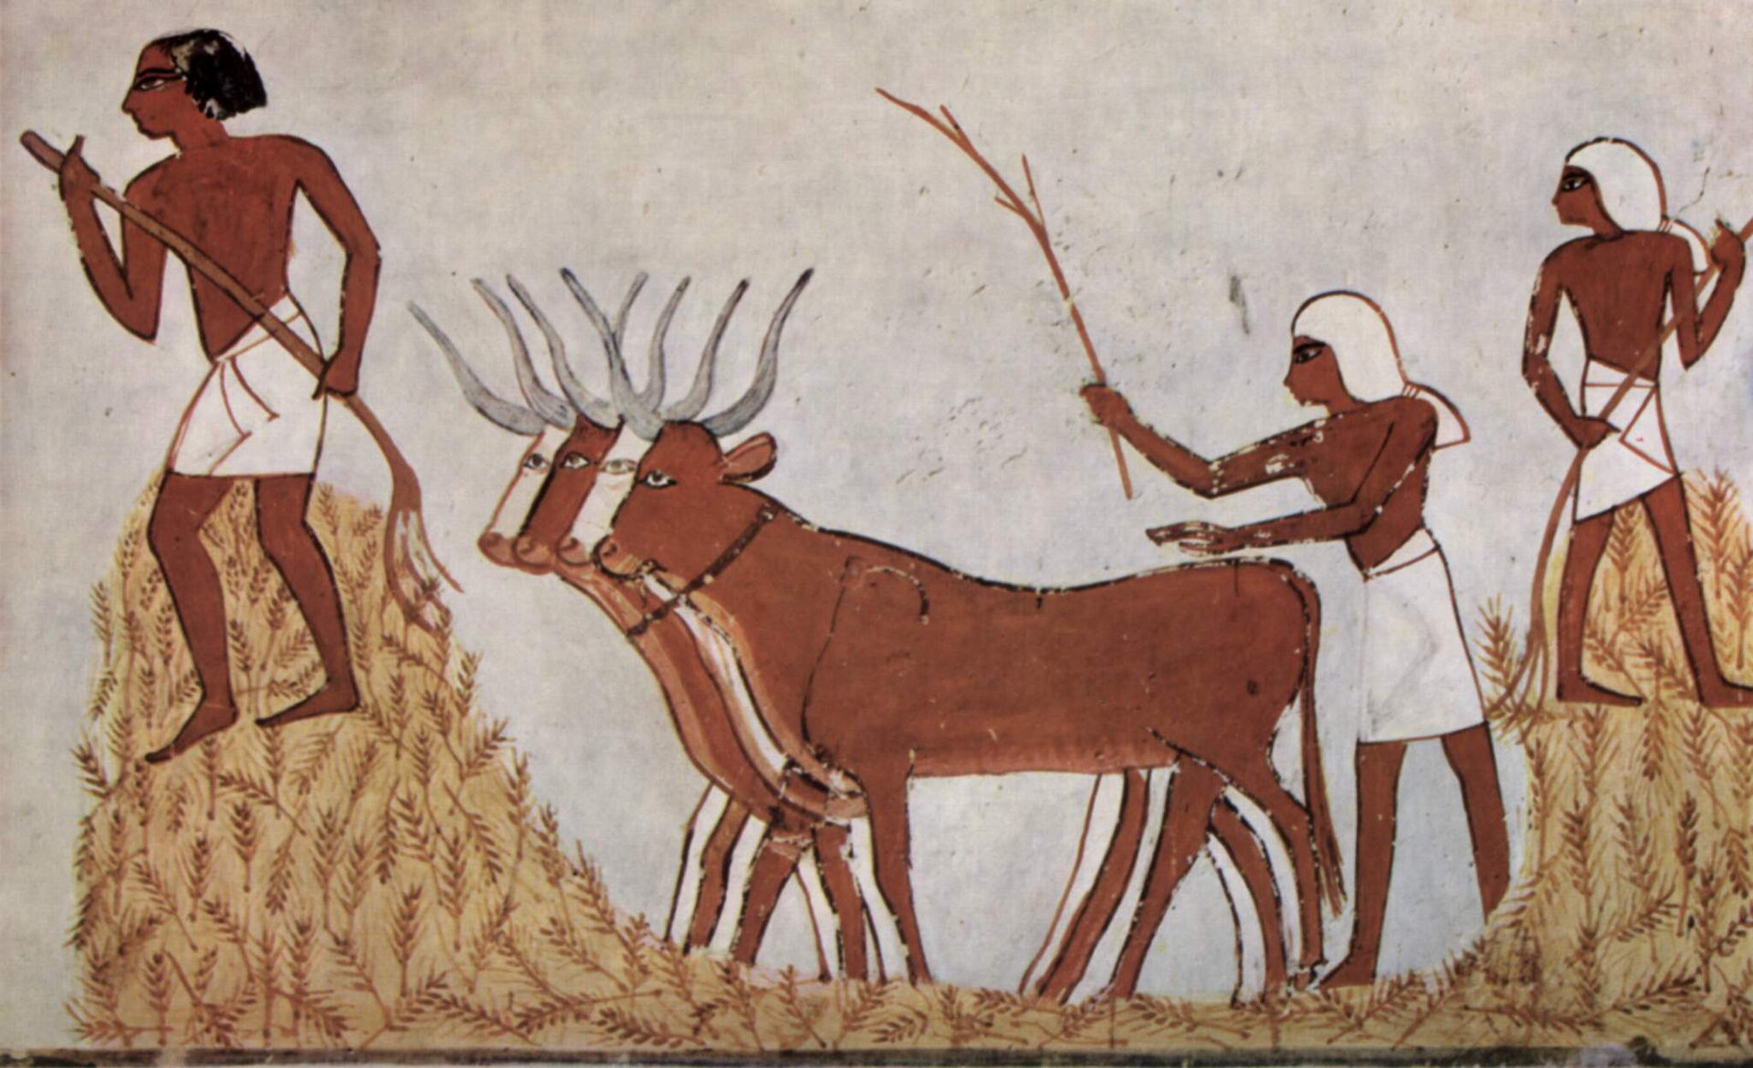
Driving the Cattle Herd
Herders drive domesticated cattle - an example of the herding way of life.
© More Lessons Less Planning | morelessonslessplanning.com
Notes:
Public-domain ancient Egyptian tomb painting (Tomb of Menna) of men driving a small herd of domesticated cattle. Give students a moment to notice the tame cattle being led and guided by people - herding in action.
Reference labels (point to these chart features when teaching): Domesticated cattle; Herders guiding the animals

Slide 8
Animals as Power
Oxen pulled plows to break and turn heavy soil for farming.
Donkeys and oxen carried loads far heavier than a person could.
A beast of burden did work that once needed many human hands.
Animal power let people farm more land and move more goods.
Key Concept: A BEAST OF BURDEN, such as an ox, carries loads or pulls a plow for people.
© More Lessons Less Planning | morelessonslessplanning.com
Notes:
Domesticated animals gave people more than food - they gave power. A BEAST OF BURDEN is a strong domesticated animal, such as an ox, used to carry loads or pull a plow. Oxen pulled plows through heavy soil, and donkeys and oxen carried loads far heavier than a person could lift. This animal muscle let people farm more land and move more goods than human hands alone ever could. The next slide shows animals at work.

Slide 9
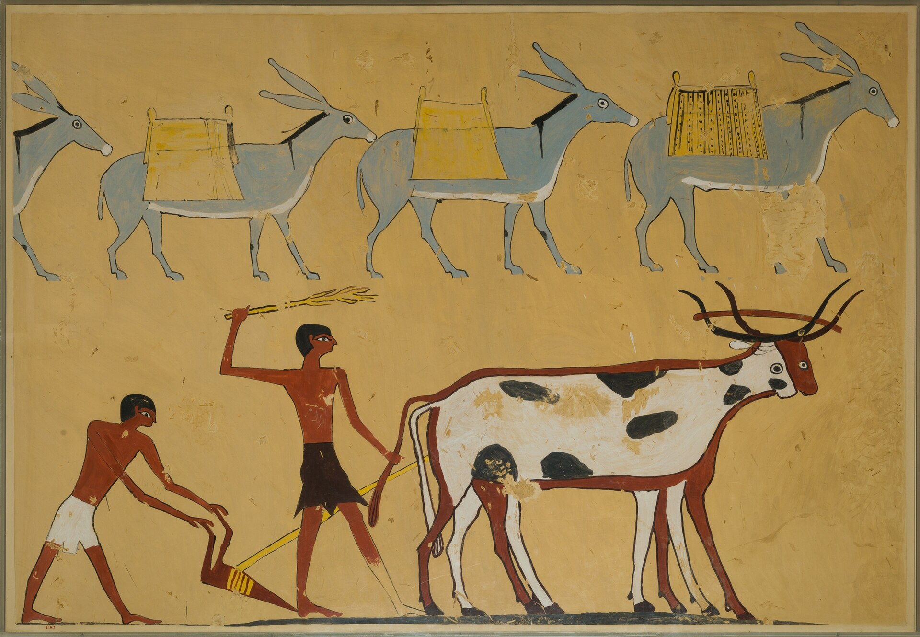
Beasts of Burden at Work
Laden donkeys carry loads while an ox pulls a plow - beasts of burden.
© More Lessons Less Planning | morelessonslessplanning.com
Notes:
CC0 ancient Egyptian tomb painting (Tomb of Djar, MET) of laden donkeys and an ox pulling a plow. Point out the donkeys carrying packs and the ox harnessed to the plow - domesticated animals doing heavy labor for people.
Reference labels (point to these chart features when teaching): Ox pulling a plow; Donkeys carrying loads

Slide 10
Animals and the Neolithic Revolution
Neolithic Revolution
The shift from hunting and gathering to farming and herding, letting people settle.
Surplus
Extra food and materials that supported larger, more complex societies.
Key Concept: Domesticating animals was part of the NEOLITHIC REVOLUTION and helped create a food SURPLUS.
© More Lessons Less Planning | morelessonslessplanning.com
Notes:
Domesticating animals was a key part of the NEOLITHIC REVOLUTION - the shift from hunting and gathering to farming and herding that let people settle in one place. Instead of chasing wild game, people now raised their own steady supply of meat, milk, and wool. Herding and farming together produced a SURPLUS - the extra food and materials that supported larger, more complex societies.

Slide 11
A New Kind of Society
A food surplus meant not everyone had to find food each day.
Some people took on new jobs: leaders, traders, and crafters.
Owning large herds made some families wealthier than others.
Villages grew larger and developed ranks and social classes.
Key Concept: A food SURPLUS let people take on new jobs and created wealth, ranks, and larger villages.
© More Lessons Less Planning | morelessonslessplanning.com
Notes:
Domesticated animals reshaped society itself. A food SURPLUS meant not everyone had to find food each day, so some people took on new jobs like leaders, traders, and crafters. Owning large herds made some families wealthier than others, creating ranks and social classes. Villages grew larger and more organized. Taming animals did not just change the menu - it changed diet, settlement, labor, and the whole structure of society.

Slide 12
How We Know
Animal bones
Scientists study old bones to see how domesticated animals changed over time.
✔
Written accounts
Thinkers like Francis Galton described which animals could be tamed and why.
✔
Key Concept: We reconstruct domestication from animal bones and from written accounts like Galton's.
© More Lessons Less Planning | morelessonslessplanning.com
Notes:
How do we know all this? Scientists study old animal BONES to see how domesticated animals changed in size and shape over time - sheep and goats grew smaller and calmer under human care. Historians also read written accounts, such as Francis GALTON's 1865 essay, which explained which qualities let a wild animal be tamed. In the activity you will read Galton's own words as a primary source.

Slide 13
Key Takeaways
Domestication breeds a whole species tame; taming changes one animal.
★
The dog came first, then livestock: sheep, goats, cattle, and pigs.
★
Selective breeding slowly made livestock docile and useful.
★
Herding gave a surplus that reshaped settlement, labor, and society.
★
© More Lessons Less Planning | morelessonslessplanning.com
Notes:
Recap the four takeaways. The big idea: domesticating animals was a turning point that changed not just diet but where people lived and how their societies were organized.

