Slide 1
Surge Pricing: Uber, Hotels & Hurricane Plywood
When a price spikes - is it fair gouging, or a market signal?
© More Lessons Less Planning | morelessonslessplanning.com
Notes:
Title slide for the Unit 2 surge-pricing lesson. Open with a familiar moment: the Uber app shows '2.5x surge' after a concert. The whole lesson uses Unit 2 supply and demand to explain why prices spike during demand surges across three markets - Uber rides, hotel rooms in an emergency, and plywood before a hurricane - and asks whether a spike is unfair price gouging or an efficient market signal.

Slide 2
Learning Targets
What surge (dynamic) pricing is and why prices spike when demand jumps
★
Why an Uber ride costs more after a concert - a movement to a new equilibrium
★
How a high price RATIONS scarce supply and SIGNALS more supply to enter
★
Both sides of the debate: is a spike price GOUGING or an efficient SIGNAL?
★
© More Lessons Less Planning | morelessonslessplanning.com
Notes:
Read the four targets aloud. Target 1 defines surge pricing. Target 2 applies it to Uber. Target 3 is the two jobs of a high price (ration + signal). Target 4 is the ethics debate that frames the whole lesson.

Slide 3
The Hook: Why Does an Uber Cost More After a Concert?
What You See
The Economics Behind It
Concert ends - thousands leave at once
Everyone opens the app at the same time
The app flashes '2.5x surge'
A $12 ride is suddenly $30
Demand SPIKES - tons of riders at once
The supply of drivers is fixed for now
Price rises to match riders to rides
The high price also pulls in more drivers
Did You Know: surge pricing is not random - the price rises to ration rides and pull in more drivers.
© More Lessons Less Planning | morelessonslessplanning.com
Notes:
Frame the everyday mystery, then preview the economic answer. A demand spike against a fixed short-run supply pushes the price up; the higher price both rations the rides and signals more drivers to log on.

Slide 4
What Surge (Dynamic) Pricing Is
Surge pricing lets a price RISE and FALL automatically as demand changes
It is also called DYNAMIC pricing (Uber, hotels, airlines all use it)
When lots of buyers want something at once, the price goes UP
When demand cools off, the price comes back DOWN
The goal is to keep quantity demanded equal to quantity supplied
In other words, surge pricing pushes the price toward the equilibrium price
Key Concept: surge pricing is a price that moves automatically with demand to keep the market clearing.
© More Lessons Less Planning | morelessonslessplanning.com
Notes:
Define surge/dynamic pricing before applying it. The key idea is that the price moves automatically with demand so quantity demanded keeps matching quantity supplied (the market clears at the equilibrium price).

Slide 5
A Demand Spike: More Buyers, Same Supply
After the concert, demand for rides SPIKES - the demand curve shifts RIGHT
The supply of drivers cannot grow instantly - it is fixed for now
At the old $12 fare, way more riders want a car than there are drivers
So the price rises along the supply curve to a new equilibrium of $30
Quantity stays near the same small number of drivers; the PRICE does the work
The next slide shows the demand spike pushing the equilibrium fare to $30
Key Concept: a demand spike against a fixed short-run supply pushes the equilibrium price UP.
© More Lessons Less Planning | morelessonslessplanning.com
Notes:
Setup slide paired with the Uber surge chart. A demand spike (non-price factor: the concert letting out) shifts demand right; with a fixed short-run supply of drivers, the equilibrium fare jumps from $12 to $30. The chart on the next slide shows both demand curves and the two equilibria.

Slide 6
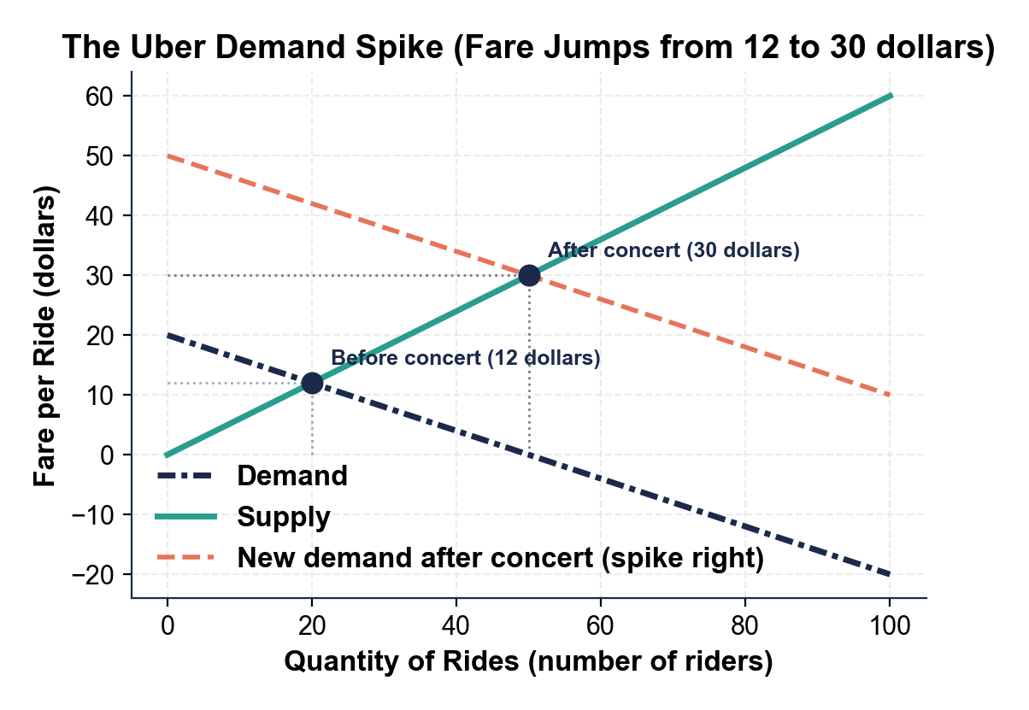
The Uber Demand Spike Pushes the Fare Up
Demand spikes right; the equilibrium fare jumps $12 to $30.
© More Lessons Less Planning | morelessonslessplanning.com
Notes:
The Uber surge chart. The teal supply curve is steep (drivers respond slowly in the short run); the original navy demand curve crosses at $12. After the concert, the coral dashed demand curve shifts right and crosses the same supply at $30. The demand spike pushes the equilibrium fare up from $12 to $30.
Reference labels (point to these chart features when teaching): Demand spikes RIGHT; Fare $12 to $30

Slide 7
Two Jobs of a High Price: Ration and Signal
Job 1: Rationing
Job 2: Signaling
Scarce supply has to go to SOMEONE
A higher price decides WHO gets it
Those who need it most (or value it most) pay
It rations without a line or a lottery
A high price is a message to sellers
It shouts 'bring MORE supply here, fast'
More Uber drivers log on; more sellers ship in
The extra supply pulls the price back down
Key Concept: a high price does TWO jobs at once - it RATIONS the scarce supply and SIGNALS more supply to come.
© More Lessons Less Planning | morelessonslessplanning.com
Notes:
The conceptual heart of the lesson. A high price rations (decides who gets the scarce supply) AND signals (tells sellers to bring more). This is the economist's case that surge pricing is useful, not just expensive. Keep both jobs on screen together.

Slide 8
Hold the Price Too Low: Hotel Room Shortage
A wildfire forces a whole town to evacuate to one nearby city
Demand for hotel rooms SPIKES; the number of rooms is fixed tonight
If a law CAPS the price at the normal $120, way too many people want rooms
Quantity demanded far exceeds the fixed rooms = a SHORTAGE
New equilibrium would be about $260 - that price rations the rooms
The next slide shows the $120 cap below equilibrium and the resulting shortage
Key Concept: holding the price below equilibrium during a demand spike creates a SHORTAGE.
© More Lessons Less Planning | morelessonslessplanning.com
Notes:
Setup paired with the hotel shortage chart. This is the flip side of surge pricing: if a price ceiling holds the price below equilibrium during a demand spike, you get a shortage (rooms sell out, people stranded). Letting the price rise to $260 would ration the fixed rooms. This is the economic cost of anti-gouging price caps.

Slide 9
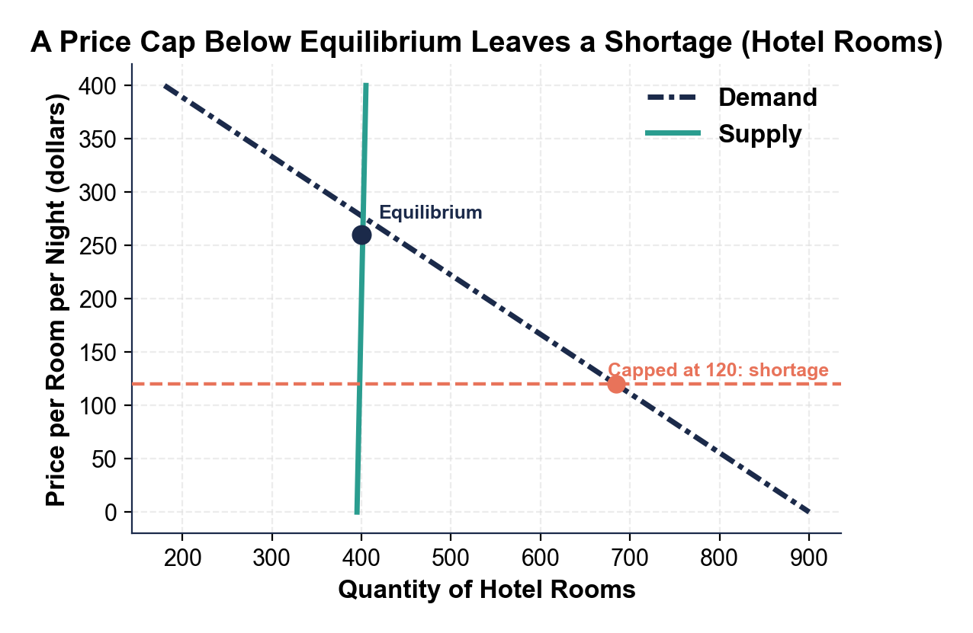
A Price Cap Below Equilibrium Leaves a Shortage
Price held at $120 (cap) below the $260 equilibrium leaves a shortage.
© More Lessons Less Planning | morelessonslessplanning.com
Notes:
The hotel shortage chart. The teal supply curve is nearly vertical at the fixed room count; the navy demand curve (after the evacuation demand spike) crosses supply at the $260 equilibrium. A coral dashed line marks the $120 capped price far below equilibrium. At $120, quantity demanded far exceeds the fixed rooms - the gap is the shortage.
Reference labels (point to these chart features when teaching): Cap $120 below equilibrium; Shortage gap

Slide 10
The Price Signal: A High Price Pulls in More Supply
Before a hurricane, everyone wants plywood to board up windows
Local stores have a FIXED amount on the shelf today - about 2,000 sheets
If the price is allowed to rise, that high price is a SIGNAL to sellers
Out-of-town suppliers load trucks and ship plywood in to capture the high price
Quantity supplied rises from about 2,000 to 5,000 sheets
The next slide shows the higher price drawing out a larger quantity supplied
Key Concept: a high price SIGNALS sellers to bring more supply - it pulls extra plywood into the disaster zone.
© More Lessons Less Planning | morelessonslessplanning.com
Notes:
Setup paired with the plywood price-signal chart. This shows the signaling job of price: a higher price draws out a larger quantity supplied (a movement UP the supply curve) as out-of-town sellers ship plywood in. This is the strongest economic argument against anti-gouging caps - caps remove the signal that brings in more supply.

Slide 11
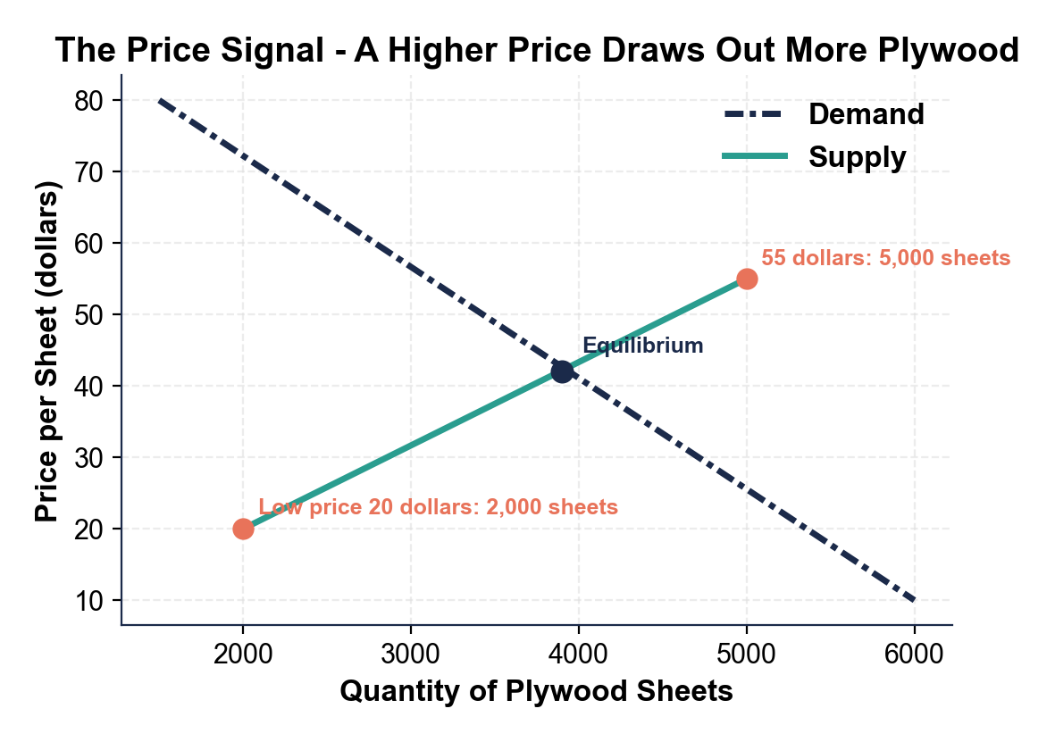
A Higher Price Draws Out More Plywood
Price rises along supply; quantity supplied grows 2,000 to 5,000 sheets.
© More Lessons Less Planning | morelessonslessplanning.com
Notes:
The plywood price-signal chart. The navy demand curve is high (everyone wants plywood). As the price rises, buyers slide up the upward-sloping teal supply curve: quantity supplied rises from about 2,000 sheets at the low price to about 5,000 sheets at the higher price. This is a movement along the supply curve - the higher price signals more plywood to be shipped in.
Reference labels (point to these chart features when teaching): Higher price = more supplied; Movement up supply

Slide 12
The Same Surge Pattern in Three Markets
Uber ride
Hotel room
Plywood sheet
Normal fare about $12
Surge after a concert about $30
Demand spike vs fixed drivers
Normal about $120 a night
Emergency about $260
Demand spike vs fixed rooms
Normal about $20
Before a hurricane about $55
Higher price signals more supply
Key Concept: in every surge market, the spike price sits far above the normal price.
© More Lessons Less Planning | morelessonslessplanning.com
Notes:
Setup paired with the three-market comparison bar chart. The same surge pattern appears in Uber rides, hotel rooms, and plywood: the surge/emergency price is far above the normal price. This generalizes surge pricing beyond any one market and sets up the ethics debate.

Slide 13
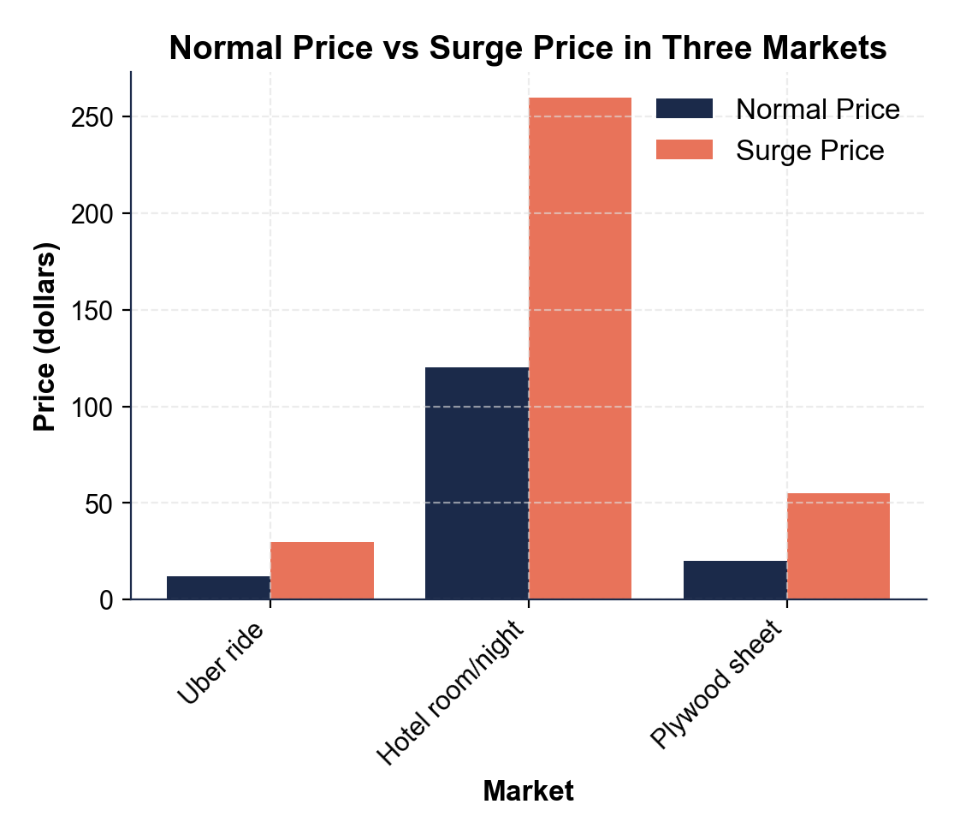
Normal Price vs Surge Price in Three Markets
Surge price towers over normal price in all three markets.
© More Lessons Less Planning | morelessonslessplanning.com
Notes:
The three-market comparison bar chart. For each market (Uber ride, hotel room, plywood sheet) there are two bars: the normal price and the surge/emergency price. Uber $12 vs $30, hotel $120 vs $260, plywood $20 vs $55. In every market the surge bar towers over the normal bar - the same surge pattern repeats.
Reference labels (point to these chart features when teaching): Surge far above normal; Same pattern everywhere

Slide 14
The Ethics Debate: Gouging or Signal?
"It's Price GOUGING"
"It's an Efficient SIGNAL"
Spiking prices on essentials in an emergency is unfair
It prices out people who need it most but have the least
Many states have anti-gouging LAWS during disasters
It can feel like profiting off people's fear
The high price RATIONS scarce supply to those who value it
It stops one person from grabbing all the plywood
It SIGNALS more supply to rush into the disaster zone
Caps cause shortages - empty shelves help no one
Think about it: is a price spike unfair GOUGING, or an efficient SIGNAL that rations supply and pulls in more?
© More Lessons Less Planning | morelessonslessplanning.com
Notes:
The ethics debate that frames the whole lesson and drives the activity discussion. There is no single 'right' answer - students should be able to argue BOTH sides using Unit 2 terms (shortage, rationing, price signal, gouging). This is the discussion hook.

Slide 15
Surge Pricing Vocabulary (1 of 3)
Surge pricing
Also called dynamic pricing; letting a price rise and fall automatically as demand changes so the market clears
Demand spike
A sudden jump in how much buyers want something at a given moment, pushing the demand curve right (a concert lets out, a storm nears)
Rationing
Using the higher price to decide WHO gets the scarce supply - those willing and able to pay the most get it first
Remember: a demand spike against a fixed supply is what makes surge pricing kick in.
© More Lessons Less Planning | morelessonslessplanning.com
Notes:
Vocabulary 1 of 3: surge pricing, demand spike, rationing. These are the core terms students need before the activity.

Slide 16
Surge Pricing Vocabulary (2 of 3)
Price signal
Price gouging
Equilibrium price
A high price is a message to sellers
It tells them to bring MORE supply here
The negative term for spiking prices on essentials in an emergency
Many states have laws against it
Where quantity demanded equals quantity supplied
Surge pricing pushes the price toward this clearing price
Key Point: the SAME price spike is a 'signal' to an economist and 'gouging' to a critic.
© More Lessons Less Planning | morelessonslessplanning.com
Notes:
Vocabulary 2 of 3: price signal, price gouging, equilibrium price. Note that price signal and price gouging describe the SAME spike from two viewpoints.

Slide 17
Surge Pricing Vocabulary (3 of 3)
Shortage
Quantity demanded is greater than quantity supplied; happens when a price is held BELOW equilibrium during a demand spike
Fixed supply
A supply that cannot grow quickly with price in the short run (rooms in a town tonight, plywood on shelves today)
Movement along the curve
A slide on the SAME curve, caused by a change in the good's OWN price (surge pricing moving up the demand or supply curve)
Shift of the curve
The WHOLE curve moves, caused by a NON-PRICE factor such as an approaching storm raising demand for plywood
Key Point: a demand spike SHIFTS demand; surge pricing then MOVES the price along the curve to clear it.
© More Lessons Less Planning | morelessonslessplanning.com
Notes:
Vocabulary 3 of 3: shortage, fixed supply, movement along the curve, shift of the curve. Together these complete the 10 Case Glossary terms.

Slide 18
Key Takeaways
Surge pricing lets a price rise when a demand spike hits a fixed or slow supply
★
An Uber surges because demand spikes while drivers stay fixed
★
A high price does TWO jobs: it RATIONS supply and SIGNALS more to enter
★
Holding the price below equilibrium during a spike causes a SHORTAGE
★
The debate: a spike is GOUGING to critics, a SIGNAL to economists
★
© More Lessons Less Planning | morelessonslessplanning.com
Notes:
Synthesis / review slide. Tier B in Guided Notes (deck-wide matching allowed). Recap all five big ideas: surge pricing, the Uber demand spike, ration + signal, the shortage from a cap, and the ethics debate.

