Slide 1
Subsidies: Farm Bills, EVs & Solar
Why politicians love them - and the distortions they hide
© More Lessons Less Planning | morelessonslessplanning.com
Notes:
Open with the question: 'When you bought your last gallon of gasoline, you paid about $0.184 in federal gas tax. When your neighbor bought an electric vehicle last year, he got a $7,500 federal tax credit. Why does the government TAX gasoline but SUBSIDIZE electric cars?' The lesson teaches the economic logic of subsidies (a payment from the government that lowers producer cost and raises the quantity sold), walks through three major federal programs (the Farm Bill, the EV tax credit, the solar ITC), and ends with the political-economy question of WHY subsidies are so durable.

Slide 2
Learning Targets
Define a subsidy and name three major federal subsidy programs.
★
Apply supply-demand analysis: a subsidy shifts supply RIGHT.
★
Evaluate the winners and losers of each subsidy.
★
© More Lessons Less Planning | morelessonslessplanning.com
Notes:
Read each learning target aloud. Anchor: by the end of class, students should be able to define a subsidy, draw the supply-shift graph, name the three major federal programs with dollar amounts, and identify winners and losers for each.

Slide 3
What Is a Subsidy?
Definition
Two Delivery Methods
A government PAYMENT to producers (or buyers)
Lowers the cost of doing business
The price the consumer pays FALLS
The quantity sold RISES
CASH PAYMENT: direct check (Farm Bill commodity payments)
TAX CREDIT: dollar-for-dollar tax reduction (EV credit, solar ITC)
Both lower the producer's COST per unit
Both shift the SUPPLY curve to the right
Key Concept: A SUBSIDY is a payment that lowers producer cost. Cash check or tax credit - same effect.
© More Lessons Less Planning | morelessonslessplanning.com
Notes:
Define SUBSIDY in plain English. A subsidy is a government payment to producers (or sometimes consumers) that lowers their cost of doing business. The two main delivery methods are (1) a CASH PAYMENT (the Farm Bill writes checks to farmers) and (2) a TAX CREDIT (the EV tax credit and the solar ITC reduce the buyer's tax bill, which is economically equivalent to a cash check). Both lower the producer's effective cost per unit, both shift the supply curve to the right, both LOWER the consumer's price and RAISE the quantity sold.

Slide 4
The Supply-Shift Mechanic
Original supply curve S0 reflects producers' costs
A subsidy LOWERS the cost for every producer
Supply curve shifts DOWN and to the RIGHT
New equilibrium: LOWER CONSUMER PRICE, HIGHER quantity
Vertical gap between curves = per-unit subsidy
Consumers pay less; producers receive more
Tip: The subsidy splits between consumer (lower price) and producer (higher net). Split depends on elasticities.
© More Lessons Less Planning | morelessonslessplanning.com
Notes:
Walk students through the supply-shift mechanic. Start with the original supply curve S0 representing producers' costs without the subsidy. A per-unit subsidy of $S lowers cost for every producer, so the curve shifts DOWN by $S (equivalently RIGHT). The new equilibrium quantity is HIGHER and the consumer price is LOWER. The vertical gap between the two supply curves equals the per-unit subsidy. Most importantly: the subsidy is SPLIT between consumers (who pay a lower price) and producers (who receive the post-subsidy price minus consumer price = part of the subsidy).

Slide 5
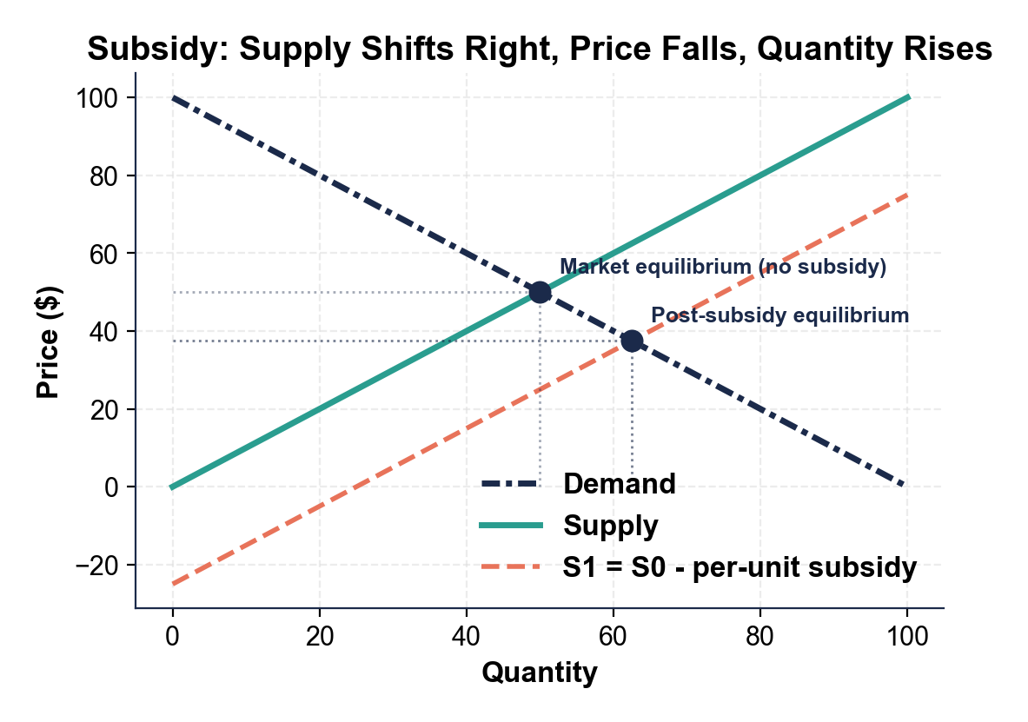
Subsidy Supply-Shift Graph
Note: subsidy shifts supply right; price falls, quantity rises.
© More Lessons Less Planning | morelessonslessplanning.com
Notes:
Display the subsidy supply-shift graph. SOLID supply curve S0 reflects pre-subsidy costs. DASHED supply curve S1 (= S0 minus subsidy) sits BELOW S0 because the subsidy lowers cost for every producer. The market equilibrium under S0 is at (P0, Q0); under S1 it is at (P1, Q1) where P1 < P0 and Q1 > Q0. The vertical gap between S0 and S1 at Q1 is the per-unit subsidy. The triangle to the right of Q0 represents the deadweight loss from overproduction relative to the un-subsidized social optimum.
Reference labels (point to these chart features when teaching): Subsidy gap (vertical); Quantity rise (horizontal)

Slide 6
The Farm Bill: $1.5 Trillion over a Decade
Crop Insurance
Commodity Supports (PLC + ARC)
SNAP (Nutrition)
Largest line: ~$80B over 10 years
Feds pay ~62% of premiums
Covers weather, price, and yield losses
Two-thirds of payments go to corn, soy, wheat, cotton
~$45B over 10 years
PLC: pays when price falls below target
ARC: pays when revenue falls below benchmark
Counter-cyclical (not paid every year)
Largest single program: ~$1.1T over 10 years
Pays ~42 million Americans per month
Politically bundled with crop subsidies
Coalition makes the bill durable
Did You Know? The Farm Bill is renewed every 5 years. The 2018 version has been extended twice past its 2023 sunset.
© More Lessons Less Planning | morelessonslessplanning.com
Notes:
The Farm Bill is the umbrella legislation that bundles federal agriculture and food-aid programs. The 2018 Farm Bill cost about $428 billion over 5 years (about $1.5 trillion over a decade including the SNAP food-stamp portion). The three main subsidy buckets: (1) CROP INSURANCE - the largest at ~$80B over 10 years, where the federal government pays about 62 percent of farmers' insurance premiums; (2) COMMODITY SUPPORTS (PLC = Price Loss Coverage, ARC = Agriculture Risk Coverage) - ~$45B over 10 years, counter-cyclical payments that kick in only when prices or revenue fall below targets; (3) SNAP - the food-stamp program, ~$1.1T over 10 years and politically bundled with crop subsidies to build a durable urban-rural coalition that protects both programs. About two-thirds of crop insurance and commodity payments go to four crops: corn, soybeans, wheat, and cotton.

Slide 7
EV Tax Credit: $7,500 Under the IRA
Credit size
$7,500 for new EVs; $4,000 for used EVs under the 2022 Inflation Reduction Act
Income cap
$300,000 joint / $150,000 single - excludes top earners
MSRP cap
$80,000 SUVs/trucks, $55,000 sedans - excludes luxury vehicles
Sourcing requirement
Final assembly in North America + escalating battery mineral and component sourcing rules
Point-of-sale
Transferable to dealer in 2024 - reduces sticker price immediately rather than waiting for next year's tax return
Annual cost
Estimated ~$7B/year at full ramp; CBO 2023 score
Note: The MSRP and income caps were added to prevent the credit from going only to high-income buyers.
© More Lessons Less Planning | morelessonslessplanning.com
Notes:
The EV tax credit is the most visible IRA clean-energy subsidy. Maximum credit is $7,500 per new EV plus $4,000 per used EV. Eligibility caps: household income up to $300K joint / $150K single, vehicle MSRP up to $80K for SUVs/trucks and $55K for sedans. SOURCING REQUIREMENT: final assembly must be in North America, AND escalating percentages of battery minerals and components must come from the U.S. or free-trade-agreement partners (this is why the IRS list of eligible vehicles has shrunk year over year as the sourcing thresholds tighten). 2024 update: the credit is now transferable to the dealer at point of sale, so buyers get the discount immediately rather than waiting to claim it at tax time. CBO estimate: about $7B/year at full ramp over the IRA decade.

Slide 8
Solar Investment Tax Credit: 30 Percent Through 2032
Residential ITC
Commercial ITC
30 percent credit on installation cost
Applies to solar panels + battery storage
Through 2032, then steps down to 22 percent
No income or system-size cap
30 percent base + 10 percent domestic-content bonus
Additional 10 percent low-income bonus
Can stack to 40-50 percent total credit
Cost: ~$8B/year by 2030
Tip: ITC and EV credit are mechanically identical - both cut the buyer's price at purchase via federal tax credit.
© More Lessons Less Planning | morelessonslessplanning.com
Notes:
The Solar Investment Tax Credit (ITC) gives buyers a federal tax credit equal to 30 percent of the cost of a solar installation through 2032. Residential ITC: 30 percent of the installed system cost (including battery storage); no income or system-size cap. Commercial ITC: 30 percent base plus stackable bonuses (10 percent for domestic-content sourcing, 10 percent for low-income community deployment, more for U.S. labor standards). The 30 percent rate steps down to 26 percent in 2033 and 22 percent in 2034 unless renewed. CBO estimate: about $8B/year of solar ITC by 2030. The IRA also includes a Production Tax Credit (PTC) for wind, geothermal, hydrogen, and clean manufacturing - a per-unit credit applied over the project's life rather than at purchase.

Slide 9
Top 5 Federal Subsidies by Cost
Program | Annual Cost (Billion $) | Type
IRA Clean-Energy Credits | $37B | Tax credits
Farm Bill (Crop + PLC + ARC) | $30B | Cash + insurance
Solar ITC | $8B | Tax credit
EV Tax Credit | $7B | Tax credit
CHIPS Act (semiconductors) | $5B | Cash + tax credit
Did You Know? Top 5 programs total ~$87B/year - about 1.4% of federal spending and similar in size to all Pell Grants.
© More Lessons Less Planning | morelessonslessplanning.com
Notes:
Show the top five federal subsidy programs by annual cost in billions of dollars. IRA clean-energy credits about 37 billion per year blended decade average. Farm Bill commodity supports and crop insurance about 30 billion per year. Solar ITC about 8 billion per year. EV tax credit about 7 billion per year at full ramp. CHIPS Act about 5 billion per year average. Together about 87 billion per year - roughly 1.4 percent of total federal spending. For comparison: Pell Grants are about 30 billion per year; the federal highway program is about 50 billion per year; defense is about 850 billion per year. So subsidies are large in absolute dollars but small relative to entitlements and defense.

Slide 10
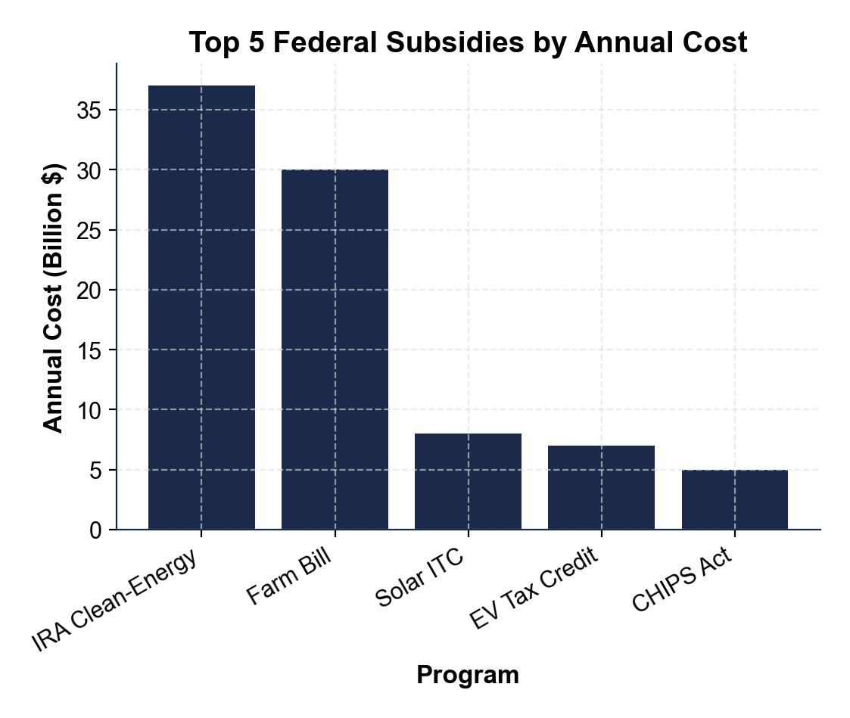
Top 5 Federal Subsidies (Bar Chart)
Note: federal subsidies are dominated by clean-energy + agriculture.
© More Lessons Less Planning | morelessonslessplanning.com
Notes:
Display the bar chart of the top 5 federal subsidy programs. Bars from largest to smallest: IRA Clean-Energy Credits ($37B), Farm Bill ($30B), Solar ITC ($8B), EV Tax Credit ($7B), CHIPS Act ($5B). The chart visually reinforces that two programs (IRA + Farm Bill) account for more than 75 percent of the top-5 total.
Reference labels (point to these chart features when teaching): IRA leads at $37B; Farm Bill at $30B

Slide 11
Who Benefits, Who Pays - Subsidy Incidence
Who Benefits
Who Pays
Direct: subsidy recipients (farmers, EV buyers, solar installers)
Indirect: workers and suppliers in those industries
Geographic: rural Midwest (Farm Bill), Sunbelt (solar), Detroit (EV)
Income: depends on income cap - varies by program
Direct: federal taxpayers (lost revenue)
Indirect: consumers of unsubsidized substitutes
Hidden: sugar consumers (sugar quota), gasoline drivers (ethanol mandate)
Future: borrowers when subsidies are deficit-financed
Warning: Subsidy INCIDENCE often does NOT match the bill's named beneficiary. About 40% of farm subsidies go to landowners as rent.
© More Lessons Less Planning | morelessonslessplanning.com
Notes:
Walk students through SUBSIDY INCIDENCE - the question of who actually keeps the money. The bill names the FARMER as the beneficiary, but landowners often capture about 40 percent of farm subsidy dollars through higher land rents. The EV credit names the BUYER as the beneficiary, but research shows roughly 30-50 percent of the pre-IRA credit was captured by manufacturers through higher MSRPs. The general rule: subsidy incidence depends on relative elasticities of supply and demand - the inelastic side of the market captures more of the subsidy. HIDDEN COSTS: sugar consumers pay roughly 2x world price because of the sugar quota; gasoline drivers pay slightly more because of the ethanol mandate; these are subsidies hidden in higher consumer prices rather than line-item federal spending.

Slide 12
Farm Subsidies Are Concentrated
10%
$2B/yr
78%
of states get >50% of farm subsidy dollars
to Iowa alone (top-receiving state)
of farm payments to top 10% of farms
Top 5 states (IA, IL, TX, NE, KS): over 50% of all farm subsidy dollars
Top 10% of farms: collect 78% of all payments
1996 Freedom to Farm Act: locked in historical acreage
Did You Know? U.S. has ~2 million farms but the top 10% receive 78% of federal payments. Most small farms get nothing.
© More Lessons Less Planning | morelessonslessplanning.com
Notes:
Drill the CONCENTRATION pattern. The Farm Bill is sold as 'helping family farmers,' but the dollars are extremely concentrated. Iowa receives about 2.0 billion dollars per year, the largest single state. Other top farm states are Illinois 1.6 billion, Texas 1.5 billion, Nebraska 1.4 billion, Kansas 1.2 billion. Top 5 states (Iowa, Illinois, Texas, Nebraska, Kansas) get more than 50 percent of all farm subsidy dollars. About 10 percent of states get more than 50 percent of all farm subsidy dollars. Top 10 percent of farms get about 78 percent of all payments. This concentration is not accidental: the 1996 Freedom to Farm Act tied payments to historical acreage, so the biggest established producers got locked in as the biggest beneficiaries. This concentration is exactly what political-economy theory predicts (concentrated benefit + diffuse cost = durable subsidy).

Slide 13
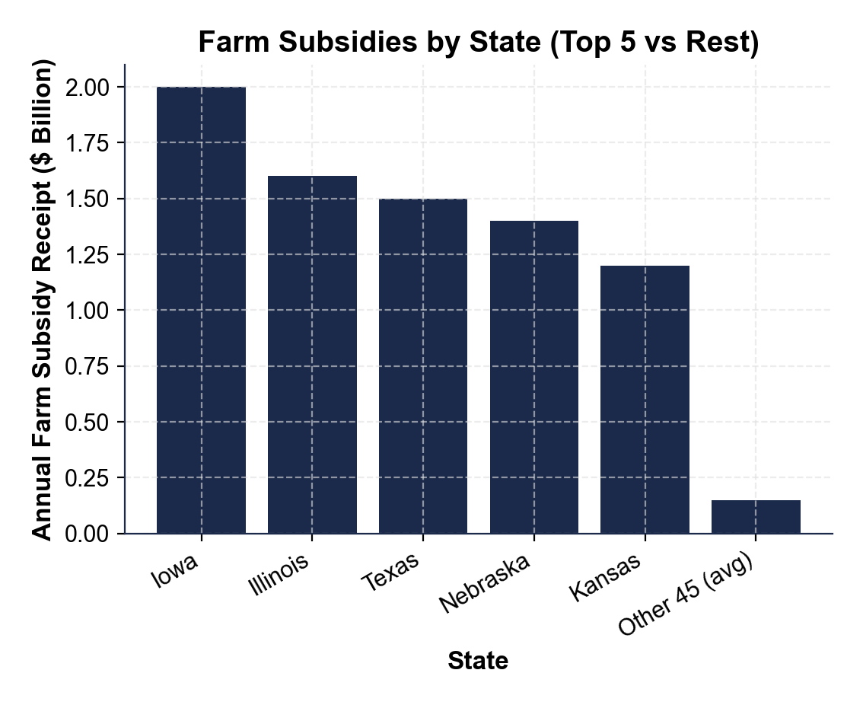
Farm Subsidies by State (Bar Chart)
Note: top 5 states collect over 50% of all farm subsidy dollars.
© More Lessons Less Planning | morelessonslessplanning.com
Notes:
Display the bar chart of farm subsidies by state. Top 5 bars: Iowa ($2.0B), Illinois ($1.6B), Texas ($1.5B), Nebraska ($1.4B), Kansas ($1.2B), totaling $7.7B. A single short bar shows the average ($0.15B) for the other 45 states (total $6.75B). The top 5 states collect about 53 percent of the $14.45B national farm subsidy total. The visual makes the concentration pattern unmistakable. Data source: USDA ERS + EWG Farm Subsidy Database, averaged recent annual data.
Reference labels (point to these chart features when teaching): Iowa #1 at $2.0B; Long tail of 45 small states

Slide 14
Why Politicians Love Subsidies
Concentrated benefit
A few thousand recipients each collect a large per-person check - they organize easily and lobby hard.
✔
Diffuse cost
300 million Americans share $87B - roughly $290 per person per year, too small to organize against.
✔
Visible groundbreaking
A new solar plant or EV factory makes a great photo-op; the tax cost is invisible on a 1040 form.
✔
District-specific dollars
Every Farm-Bill subsidy goes to a specific district - legislators trade votes for local money (pork).
✔
Bipartisan coalition
Pair urban SNAP with rural commodity supports - both parties' base voters benefit.
✔
Key Concept: Subsidies are durable because concentrated benefit beats diffuse cost. Small lobby beats large public.
© More Lessons Less Planning | morelessonslessplanning.com
Notes:
The political-economy logic of subsidies. The pattern is CONCENTRATED BENEFIT + DIFFUSE COST: a few recipients each get a large benefit (so they organize, lobby, and donate to politicians), while a large number of taxpayers each pay a tiny share of the cost (so they do not organize). Add VISIBLE GROUNDBREAKING (the politician gets a photo at the new factory) and DISTRICT-SPECIFIC DOLLARS (every Farm Bill earmark goes to a specific congressional district), and you have a recipe for durable bipartisan support. The most durable subsidies (Farm Bill, sugar quota, corn ethanol) bundle multiple coalition partners (urban SNAP + rural farmers; sugar growers + their food-industry buyers; ethanol producers + corn farmers) into a single unbeatable voting bloc.

Slide 15
The Distortions Subsidies Create
DEADWEIGHT LOSS: subsidized goods produced beyond their social value
CROWDING OUT: corn ethanol raises feed prices for livestock farmers
INPUT INFLATION: solar ITC and EV credit raised input prices ~10%
PICKING WINNERS: government bets on technologies that may flop
RENT SEEKING: industries spend on lobbying instead of new value
FOREIGN RETALIATION: WTO disputes on sugar, ethanol, EV sourcing
Warning: Even subsidies that hit their goal create side effects. Corn ethanol barely cut emissions but doubled corn prices.
© More Lessons Less Planning | morelessonslessplanning.com
Notes:
The economic distortions subsidies create. DEADWEIGHT LOSS: when the government pays $7,500 per EV, some buyers who would not have bought an EV at full price do buy one - but the social benefit of THAT marginal EV is less than its production cost; the difference is deadweight loss. CROWDING OUT: corn ethanol subsidies pull corn into the ethanol industry, raising corn prices for livestock farmers and food manufacturers. INPUT INFLATION: research found that the pre-IRA solar ITC and EV credit raised the price of solar panels and EV batteries by about 10 percent within a year of enactment - producers captured part of the subsidy by raising sticker prices. PICKING WINNERS: government bets on specific technologies (corn ethanol over cellulosic; solar over geothermal) may pick the wrong winner. RENT SEEKING: an industry that exists because of a subsidy spends political resources to keep the subsidy rather than improving its product. FOREIGN RETALIATION: U.S. sugar quotas, corn ethanol, and IRA sourcing rules have triggered WTO disputes and tariff retaliation.

Slide 16
Key Takeaways
SUBSIDY = government payment that lowers producer cost; supply shifts RIGHT.
★
Three big federal programs: Farm Bill, EV credit ($7,500), and Solar ITC (30%).
★
Subsidies are durable because of CONCENTRATED BENEFIT + DIFFUSE COST.
★
Every subsidy creates DISTORTIONS: deadweight loss, crowding out, rent seeking.
★
© More Lessons Less Planning | morelessonslessplanning.com
Notes:
Final synthesis. Subsidies are large, durable, and economically distortionary - and they are popular with politicians and recipient industries precisely because of the political-economy math. The lesson sets up the next conversation about WHEN subsidies are justified (positive externalities, infant industries) versus when they are pure rent-seeking (sugar quota, ethanol mandate).

