Slide 1
Student Loans and Financial Aid
U.S. student loan debt has passed $1.77 trillion - learn how loan type and repayment term change the true cost of a degree.
© More Lessons Less Planning | morelessonslessplanning.com
Notes:
Open with the scale of the problem: total U.S. student loan debt is $1.77 trillion, and the average student leaves school owing $37,574. The big idea students must leave with: the loan you choose and the term you pick change what a degree really costs. Preview the arc of the lesson - how students pay for college (grants, federal loans, private loans), federal vs private differences, the key loan terms, subsidized vs unsubsidized loans (and how interest accrues while you are still in school), the debt numbers, the FAFSA, repayment plans, smart payoff strategies, and finally the true cost of borrowing under simple interest. The spine of the math: Total Repayment = Principal x (1 + Annual Rate x Years). A $30,000 loan at 6.53% costs $49,590 over 10 years but $69,180 over 20 years - the extra decade adds $19,590 in interest. As the fourth toolkit of Unit 5, this builds on what a loan is (TK41) and how interest works (TK42) and applies it to the biggest loan most students will ever take.

Slide 2
Learning Targets
Explain the difference between federal and private student loans
★
Identify key components of a loan including principal, interest rate, and term
★
Calculate total repayment cost using the simple-interest formula
★
Compare repayment plan options and their long-term financial impact
★
Evaluate whether borrowing for education is worth the investment
★
© More Lessons Less Planning | morelessonslessplanning.com
Notes:
Read the five targets aloud. Target 1: students will explain how federal student loans (from the government, fixed rates, borrower protections) differ from private student loans (from banks, credit-based rates, fewer protections). Target 2: students will identify the key loan components - principal (the amount borrowed), interest rate (the yearly percentage), and loan term (the time to repay). Target 3 is the quantitative core: students will calculate total repayment cost using simple interest, Total Repayment = Principal x (1 + Annual Rate x Years). Target 4: students will compare the standard repayment plan (fixed 10-year payments, least interest) with income-driven repayment (payments based on income, longer term, more interest). Target 5 is the judgment: students will evaluate whether borrowing for a degree is worth it by weighing the true cost against the benefit. Tell students the lesson uses one anchor calculation - a $30,000 loan at 6.53% - to make the cost comparisons concrete.

Slide 3
How Do Students Pay for College?
Grants and scholarships (free money)
Free money that does not need to be repaid, based on financial need, merit, or both; a Pell Grant from the FAFSA covers up to $7,395 per year
Federal student loans
Borrowed from the U.S. government at fixed interest rates set by Congress, with income-driven repayment options and a 6-month grace period after graduation
Private student loans
Borrowed from banks or credit unions at variable or fixed rates based on credit; they have fewer borrower protections and often require a co-signer
The smart order
Always exhaust grants, scholarships, and federal loans before considering private loans, because free money and federal protections cost you the least
Key Concept: Pay for college in order - grants and scholarships first (free money), then federal loans, and only then private loans.
© More Lessons Less Planning | morelessonslessplanning.com
Notes:
Lay out the three ways students pay for college, in the order they should use them. First, grants and scholarships are FREE MONEY that does not need to be repaid - awarded for financial need, merit, or both. A Pell Grant, awarded through the FAFSA, covers up to $7,395 per year. Second, federal student loans are borrowed from the U.S. government at fixed interest rates set by Congress; they offer income-driven repayment options and a 6-month grace period after graduation. Third, private student loans are borrowed from banks or credit unions at variable or fixed rates based on the borrower's credit; they carry fewer borrower protections and often require a co-signer. The rule students must remember: always exhaust grants, scholarships, and federal loans before considering private loans, because private loans cost the most and protect you the least.

Slide 4
Federal vs. Private Loans: Key Differences
Federal Loans
Private Loans
Fixed interest rates set by Congress
No credit check required for most undergraduates
Income-driven repayment options available
Loan forgiveness programs available
6-month grace period after graduation
Interest rates vary by the borrower's creditworthiness
Credit check and often a co-signer required
Repayment terms set by the lender
No federal forgiveness programs
Grace periods vary by lender
Key Concept: Federal loans offer fixed rates, income-driven repayment, and forgiveness; private loans offer none of those protections.
© More Lessons Less Planning | morelessonslessplanning.com
Notes:
Put federal and private loans side by side so students see why federal comes first. Federal loans have FIXED interest rates set by Congress, require no credit check for most undergraduates, offer income-driven repayment options, come with loan forgiveness programs, and give a 6-month grace period after graduation. Private loans, by contrast, have interest rates that vary by the borrower's creditworthiness, require a credit check and often a co-signer, have repayment terms set entirely by the lender, offer NO federal forgiveness programs, and have grace periods that vary by lender. The headline: private loan rates can be two to three times higher than federal rates for borrowers with limited credit history, and private loans strip away the income-driven repayment and forgiveness that make federal loans survivable. This is why the smart order from the last slide matters - federal protections are worth a lot.

Slide 5
Key Loan Terms Every Borrower Must Know
Principal
The original amount of money borrowed before any interest is added
Interest rate
The percentage charged annually on the outstanding loan balance
Loan term
The total length of time you have to repay the loan in full
Grace period
The time after graduation before your first loan payment is due
APR
Annual Percentage Rate - the true yearly cost of borrowing, including fees
Key Concept: Principal is what you borrow, the loan term is how long you take to repay, and the APR is the true yearly cost of borrowing.
© More Lessons Less Planning | morelessonslessplanning.com
Notes:
Define the five vocabulary terms every borrower must know - these are the words students use for the rest of the lesson and the whole Activity. The PRINCIPAL is the original amount of money borrowed before any interest is added. The INTEREST RATE is the percentage charged annually on the outstanding loan balance. The LOAN TERM is the total length of time you have to repay the loan in full. The GRACE PERIOD is the time after graduation before your first loan payment is due - for most federal loans it is 6 months. And the APR, or Annual Percentage Rate, is the true yearly cost of borrowing, including fees - it is a fuller picture of the cost than the interest rate alone. The did-you-know for context: the average federal student loan interest rate for undergraduates is 6.53%, the rate students will use in every calculation in this lesson.

Slide 6
Subsidized vs. Unsubsidized: Interest While in School
Subsidized loan (interest paid for you)
Unsubsidized loan (interest accrues now)
A federal loan the government pays the interest on while you are enrolled
The balance does NOT grow while you are still in school
A $10,000 subsidized loan is still $10,000 at graduation
Only available to students with financial need
A loan on which interest accrues immediately, even while you are still in school
The balance GROWS every year you are enrolled
A $10,000 unsubsidized loan grows to $12,612 after 4 years of school
That is $2,612 of interest added before you make one payment
Key Concept: A subsidized loan's balance stays flat in school because the government pays the interest; an unsubsidized loan's balance grows.
© More Lessons Less Planning | morelessonslessplanning.com
Notes:
Teach the single most important federal-loan distinction: subsidized vs unsubsidized, and what it means for interest while you are still in school. On a SUBSIDIZED LOAN, the government pays the interest while you are enrolled, so the balance does NOT grow during school - a $10,000 subsidized loan is still $10,000 at graduation. Subsidized loans are only available to students with demonstrated financial need. On an UNSUBSIDIZED LOAN, interest accrues immediately, even while you are still in school, so the balance GROWS every year you are enrolled. Using simple interest at 6.53%, a $10,000 unsubsidized loan adds $653 each year, so after 4 years of school it has grown to $12,612 - that is $2,612 of interest added before the borrower makes a single payment. The next slide shows this as a chart so students can see the two balances pull apart over the four years of school.

Slide 7
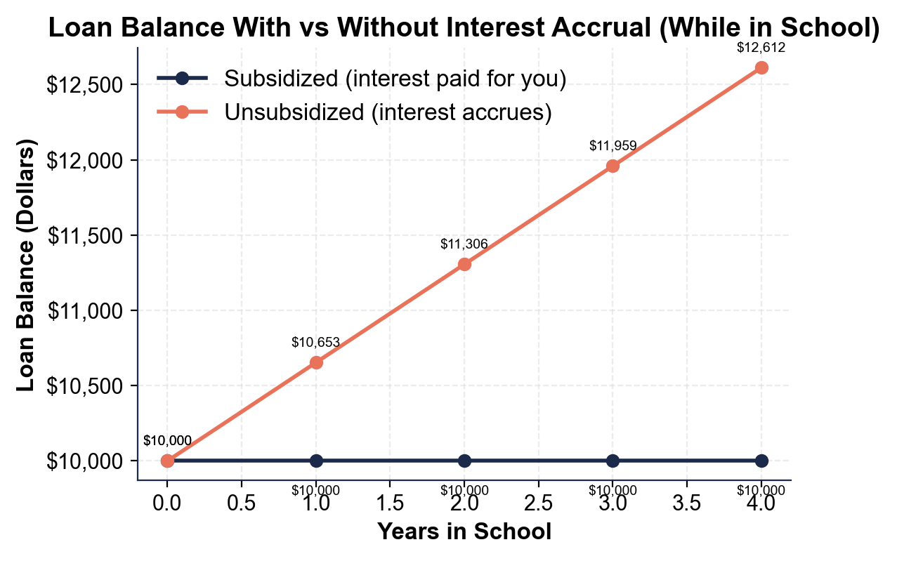
Loan Balance With vs Without Interest Accrual (While in School)
Unsubsidized interest accrues while in school; subsidized stays flat.
© More Lessons Less Planning | morelessonslessplanning.com
Notes:
Have students read the two-line chart. The x-axis is years in school (0 through 4) and the y-axis is the loan balance in dollars, both for the SAME $10,000 loan at 6.53%. The flat line is the SUBSIDIZED loan: it stays at $10,000 all four years because the government pays the interest while the student is enrolled. The rising line is the UNSUBSIDIZED loan: it climbs $653 each year - $10,000, $10,653, $11,306, $11,959, and $12,612 at graduation - because interest accrues immediately. The gap at graduation is $2,612, the head start the subsidized borrower keeps. The picture makes the lesson obvious: on an unsubsidized loan you are already behind before your first payment. This is the chart the Activity Part 4 reads.
Reference labels (point to these chart features when teaching): Subsidized: $10,000; Unsubsidized: $12,612

Slide 8
Student Debt by the Numbers
$37,574 average debt at graduation
The average student leaves school owing about $37,574 in loans
✔
$1.77 trillion total U.S. student debt
Student loan debt is the second-largest consumer debt in the U.S., behind only mortgages
✔
$393 average monthly payment
The average borrower pays about $393 per month, often for 20 years
✔
43.2 million borrowers, ~13% default
About 43.2 million Americans carry student debt, and roughly 13% default within 3 years
✔
Key Concept: Student debt is huge and long-lasting - $1.77 trillion total, $37,574 on average, paid off over about 20 years.
© More Lessons Less Planning | morelessonslessplanning.com
Notes:
Ground the lesson in the real numbers so students take borrowing seriously. The average student leaves school owing about $37,574. Total U.S. student loan debt is $1.77 trillion - the second-largest consumer debt category in the country, behind only mortgages. The average monthly payment is about $393, and the average borrower takes around 20 years to repay. About 43.2 million Americans carry student loan debt, and roughly 13% default within three years of entering repayment. The point students should take away: this is not abstract - it is a monthly payment that follows people into their 40s, and defaulting damages credit for years. Knowing how to compare loans and calculate the true cost, which the rest of the lesson teaches, is how a borrower avoids becoming one of these statistics.

Slide 9
FAFSA: Your First Step to Financial Aid
What FAFSA is
The FAFSA is the Free Application for Federal Student Aid - the first step that unlocks grants, work-study, and federal loans
✔
Create an FSA ID and gather documents
Both you and a parent need an FSA ID to sign electronically; you will need tax returns, W-2s, and bank statements
✔
Complete the application and review your SAR
Answer questions about family size and income at studentaid.gov; your Student Aid Report (SAR) shows your Expected Family Contribution
✔
File early - October 1st
The FAFSA opens October 1st each year, and filing early maximizes aid because some funds are first-come, first-served
✔
Key Concept: The FAFSA is your first step - it unlocks grants, work-study, and federal loans, and filing early maximizes your aid.
© More Lessons Less Planning | morelessonslessplanning.com
Notes:
Walk students through the FAFSA, the gateway to nearly all financial aid. FAFSA stands for the Free Application for Federal Student Aid, and it is the FIRST step every student must take - it unlocks grants, work-study, and federal loans. To complete it: first, both the student and a parent create an FSA ID to sign the application electronically. Second, gather financial documents - tax returns, W-2s, and bank statements. Third, complete the application at studentaid.gov, answering questions about family size, income, and college choices. Fourth, review the Student Aid Report (SAR), which shows the Expected Family Contribution and aid eligibility, and compare the award letters each college sends. The critical tip: the FAFSA opens October 1st each year, and filing EARLY maximizes aid because some funds are first-come, first-served. A student who skips the FAFSA leaves free grant money and low-rate federal loans on the table.

Slide 10
Standard vs. Income-Driven Repayment
Standard Plan
Income-Driven Repayment
Fixed monthly payments over 10 years
The highest monthly payment amount
The LOWEST total interest paid over time
Best for borrowers who can afford the payment
A federal plan that sets your payment based on your income and family size
Lower payments when your income is low
The repayment term extends to 20-25 years
Any remaining balance may be forgiven after the term
Key Concept: The standard plan costs the least interest over 10 years; income-driven repayment lowers the payment but costs more in total.
© More Lessons Less Planning | morelessonslessplanning.com
Notes:
Compare the two main federal repayment paths. The STANDARD plan has fixed monthly payments over 10 years. It has the highest monthly payment but the LOWEST total interest paid over time, because you pay the loan off fastest - it is best for borrowers who can afford the payment. INCOME-DRIVEN REPAYMENT is a federal plan that sets your monthly payment based on your income and family size; payments are lower when income is low, but the repayment term extends to 20-25 years, and any remaining balance may be forgiven after the term ends (you must recertify your income each year). The trade-off students must see: income-driven repayment makes the monthly payment affordable, but a longer term means more total interest. The next slide shows a chart of the monthly payment at different repayment terms so students can see the payment fall as the term lengthens - and remember from the debt slide that a longer term also raises the total cost.

Slide 11
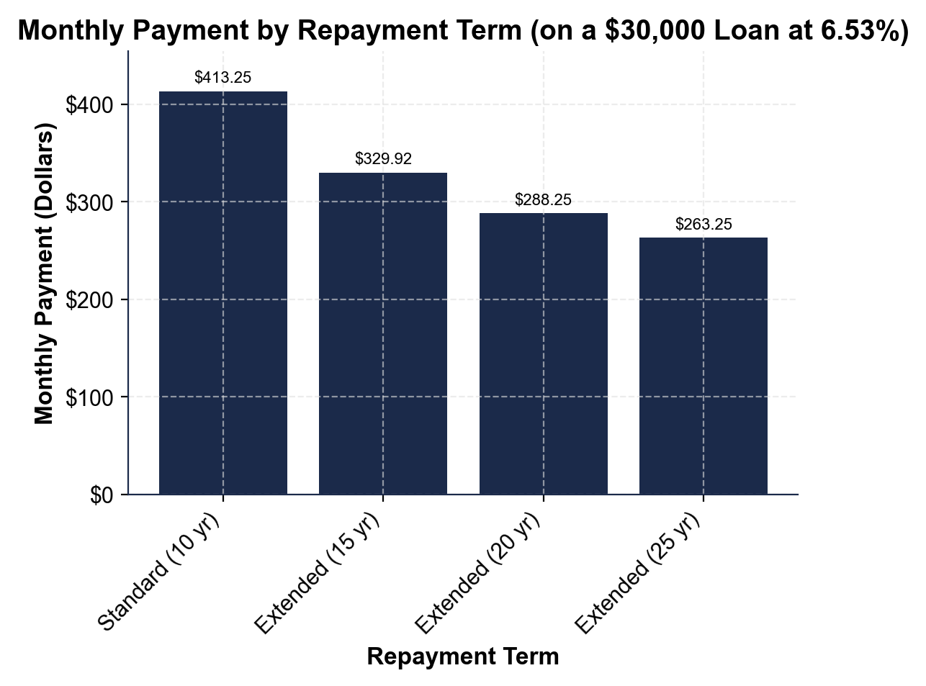
Monthly Payment by Repayment Term (on a $30,000 Loan at 6.53%)
Same $30,000 loan: a longer repayment term means a lower monthly payment.
© More Lessons Less Planning | morelessonslessplanning.com
Notes:
Have students read the bar chart. Each bar is the monthly payment on the SAME $30,000 loan at 6.53% simple interest, at a different repayment term. The bars fall as the term gets longer: Standard 10 years is $413.25 a month, Extended 15 years is $329.92, Extended 20 years is $288.25, and Extended 25 years is $263.25 - the lowest monthly payment. The chart makes the repayment trade-off visible: a longer term lowers the monthly payment, which is exactly what income-driven and extended plans do. But students must connect it back to total cost - the same $30,000 loan costs $49,590 over 10 years and $69,180 over 20 years, so the lower monthly payment on a longer term comes with much more total interest. This is the chart the Activity Part 4 reads.
Reference labels (point to these chart features when teaching): 10 yr: $413.25; 25 yr: $263.25

Slide 12
Smart Repayment Strategies
Pay more than the minimum
Even $50 extra a month cuts total interest; apply extra payments to the highest interest-rate loan first
Refinancing
Combining one or more loans into a single new loan, usually at a lower interest rate; federal loans lose forgiveness if refinanced privately
Employer assistance
Some employers offer loan repayment help - up to $5,250 per year is tax-free - so ask during job negotiations
The warning
Never refinance federal loans privately unless you are sure you will not need income-driven repayment or forgiveness
Key Concept: Pay more than the minimum and use employer help - but never refinance federal loans privately unless you are sure.
© More Lessons Less Planning | morelessonslessplanning.com
Notes:
Give students three concrete strategies to pay loans off faster and cheaper. First, pay MORE than the minimum: even $50 extra per month significantly reduces total interest, and you should always apply extra payments to the highest interest-rate loan first (and specify the extra goes to principal). Second, REFINANCING means combining one or more loans into a single new loan, usually at a lower interest rate; it requires good credit and steady income, and the crucial catch - federal loans LOSE their forgiveness eligibility if they are refinanced into a private loan. Third, employer assistance: some employers offer student loan repayment benefits, and up to $5,250 per year is tax-free, so students should ask about it during job negotiations. The warning that ties it together: never refinance federal loans into private ones unless you are certain you will not need income-driven repayment or forgiveness, because those protections are gone once you refinance away from federal.

Slide 13
The Real Cost of Borrowing
The simple-interest model
A $30,000 loan at 6.53% worked out
Total Interest = Principal x Annual Rate x Years
Total Repayment = Principal x (1 + Annual Rate x Years)
Write the rate as a decimal: 6.53% = 0.0653
This is the formula you use for every loan cost in this lesson
10 years: $30,000 x (1 + 0.0653 x 10) = $49,590 total
20 years: $30,000 x (1 + 0.0653 x 20) = $69,180 total
The extra 10 years add $19,590 in interest
Every dollar of interest cannot go toward savings or retirement
Key Concept: Total Repayment = Principal x (1 + Rate x Years). $30,000 at 6.53% is $49,590 over 10 years but $69,180 over 20 years.
© More Lessons Less Planning | morelessonslessplanning.com
Notes:
Pull the whole lesson into one calculation students can do themselves. The SIMPLE-INTEREST MODEL is the labeled foundational formula: Total Interest = Principal x Annual Rate x Years, and Total Repayment = Principal x (1 + Annual Rate x Years). Remind students to write the rate as a decimal - 6.53% becomes 0.0653. Now work the anchor loan. A $30,000 loan at 6.53% over 10 years: Total Repayment = $30,000 x (1 + 0.0653 x 10) = $30,000 x 1.653 = $49,590. The same loan over 20 years: Total Repayment = $30,000 x (1 + 0.0653 x 20) = $30,000 x 2.306 = $69,180. The extra 10 years add $69,180 - $49,590 = $19,590 in additional interest - nearly two-thirds of the original loan, just from stretching the term. The idea students must leave with: every dollar of interest paid is a dollar that cannot go toward savings, housing, or retirement, so a shorter term and a smaller principal save real money. This is exactly the calculation students run for three graduates in the Activity.

Slide 14
Key Takeaways
Complete the FAFSA first - it unlocks grants, scholarships, and federal loans
★
Federal loans offer more protections and lower rates than private loans
★
Know the principal, interest rate, and loan term before you borrow
★
A shorter repayment term costs more monthly but saves thousands in interest
★
Use Total Repayment = Principal x (1 + Rate x Years) to find a loan's true cost
★
© More Lessons Less Planning | morelessonslessplanning.com
Notes:
Read each takeaway and tie it to a learning target. T5/T1 -> always complete the FAFSA first, because it unlocks grants, scholarships, and federal loans - free and low-cost money before any private borrowing. T1 -> federal loans offer more protections (income-driven repayment, forgiveness, no credit check for most) and lower rates than private loans. T2 -> understanding the principal, interest rate, and loan term lets you make informed decisions instead of just signing. T4 -> a shorter repayment term costs more each month but saves thousands in total interest, because you pay interest for fewer years. T3 -> the simple-interest model ties it together: Total Repayment = Principal x (1 + Rate x Years), so a $30,000 loan at 6.53% costs $49,590 over 10 years and $69,180 over 20. The spine of the lesson: borrow as little as you can, take federal before private, pick the shortest term you can afford, and always run the true-cost math before you sign. As the fourth toolkit of Unit 5, this connects what a loan is (TK41) and how interest works (TK42) to the biggest borrowing decision most students will make.

