Slide 1
Stonehenge and the Megaliths
How did Neolithic people raise a monument of giant stones without metal tools or writing, and how do archaeologists figure out what it was for?
© More Lessons Less Planning | morelessonslessplanning.com
Notes:
Opening slide. Around 5,000 years ago, Neolithic people on Salisbury Plain in England began building Stonehenge, a ring of standing stones so large we call them megaliths. They had no metal tools, no wheels, and no writing. Students will investigate how it was built and how archaeologists infer what it was for.

Slide 2
Learning Targets
Explain what megaliths are and how Stonehenge was built without metal.
★
Describe the engineering and organized labor that raised the stones.
★
Analyze how archaeologists infer Stonehenge's purpose from mute stone.
★
Evaluate how ideas about Stonehenge, like the Druid theory, have changed.
★
© More Lessons Less Planning | morelessonslessplanning.com
Notes:
Read the four learning targets. Today combines an engineering puzzle (moving and raising giant stones) with a history skill (inferring meaning and judging old interpretations against evidence).

Slide 3
What Is a Megalith?
Megalith
A large stone used to build a prehistoric monument, often weighing many tons.
Neolithic
The last part of the Stone Age, when people farmed and built monuments before metal.
Key Concept: A MEGALITH is a large stone used to build a prehistoric monument; the builders lived in the NEOLITHIC, before metal tools.
© More Lessons Less Planning | morelessonslessplanning.com
Notes:
A MEGALITH is a large stone used to build a prehistoric monument, often weighing many tons (mega means large, lith means stone). Stonehenge is the most famous megalith monument, but hundreds of others stand across Europe. The people who built them lived in the NEOLITHIC, the last part of the Stone Age, when people farmed and built permanent monuments before they had metal tools.

Slide 4
Stonehenge on Salisbury Plain
Stonehenge
A ring of standing stones built in stages from about 3000 to 2000 BCE.
✔
Where
On Salisbury Plain in southern England.
✔
How old
Built about 2,000 years BEFORE the Celtic Druids ever existed.
✔
Key Concept: STONEHENGE was built in stages between about 3000 and 2000 BCE - long before the Druids.
© More Lessons Less Planning | morelessonslessplanning.com
Notes:
STONEHENGE is a ring of standing stones built in stages between about 3000 and 2000 BCE on Salisbury Plain in England. It was not built all at once; Neolithic and early Bronze Age people added to it over roughly a thousand years. An important fact: Stonehenge is so old that it was finished about 2,000 years BEFORE the Celtic Druids ever existed, so the Druids did not build it.

Slide 5
The Stones: Sarsens and Bluestones
Sarsen
The huge, hard sandstone blocks that form the outer ring and giant trilithons.
Bluestone
Smaller stones dragged about 150 miles from the Preseli Hills in Wales.
Key Concept: The giant SARSEN sandstone blocks and the smaller BLUESTONES (hauled 150 miles from Wales) make up Stonehenge.
© More Lessons Less Planning | morelessonslessplanning.com
Notes:
Stonehenge is built from two kinds of stone. The SARSEN stones are the huge, hard sandstone blocks that form the outer ring and the giant trilithons; the largest weigh about 25 tons. The BLUESTONES are the smaller stones, and they were dragged about 150 miles from the Preseli Hills in Wales - an astonishing feat of organized labor for people with no wheels or metal.

Slide 6
Engineering Without Metal
Trilithon
Two upright stones topped by a horizontal stone: post-and-lintel.
✔
Mortise-and-tenon
A woodworking joint that locks each lintel onto pegs on the uprights.
✔
How
Shaped with stone hammers; moved on wooden sledges and ramps.
✔
Key Concept: A TRILITHON is post-and-lintel; MORTISE-AND-TENON joints from woodworking lock the lintels in place.
© More Lessons Less Planning | morelessonslessplanning.com
Notes:
A TRILITHON is two upright stones topped by a horizontal stone - a form called post-and-lintel. To keep the top stones from sliding off, the builders carved a MORTISE-AND-TENON joint, a technique borrowed from woodworking that locks each lintel onto pegs carved on the upright stones. With no metal, they shaped the stones by pounding them with stone hammers and moved them on wooden sledges pulled with ropes over ramps.

Slide 7
Standing Among the Stones
The outer ring is made of giant sarsen stones capped with lintels.
Inside stand the taller trilithons and the smaller bluestones.
The next slide shows the whole stone circle on Salisbury Plain.
Key Concept: The next image shows the full stone circle - sarsen ring, trilithons, and bluestones together.
© More Lessons Less Planning | morelessonslessplanning.com
Notes:
The next slide is a real photograph of Stonehenge. Point out the outer ring of giant sarsen stones capped with lintels, the taller trilithons inside, and the smaller bluestones. Seeing the scale helps students grasp what it took to raise these megaliths by hand.

Slide 8
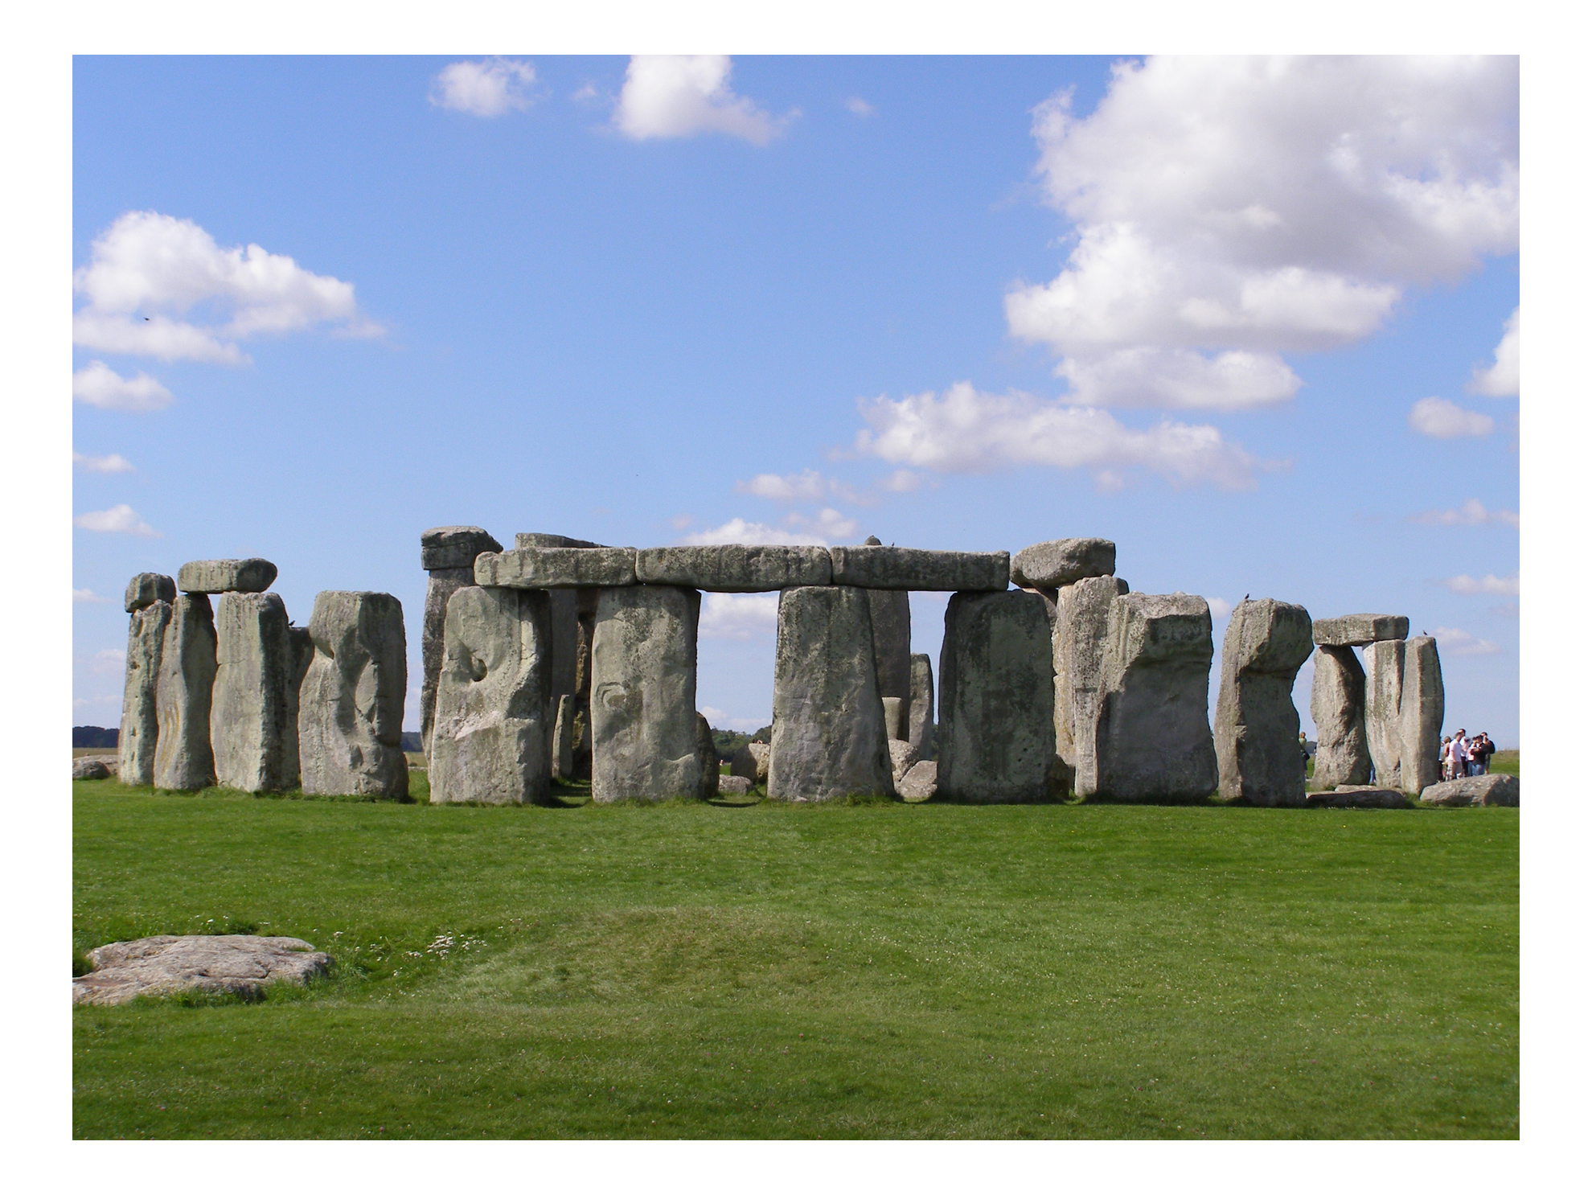
The Stonehenge Stone Circle
The sarsen ring, trilithons, and bluestones of Stonehenge on Salisbury Plain.
© More Lessons Less Planning | morelessonslessplanning.com
Notes:
Real public-domain photograph of the Stonehenge stone circle on Salisbury Plain. Give students a moment to take in the scale and locate the lintels resting on the upright sarsens before discussing how they were raised.
Reference labels (point to these chart features when teaching): Sarsen ring with lintels; Inner trilithons

Slide 9
Aligned to the Sun
Solstice
The day with the longest or shortest sunlight; Stonehenge lines up with it.
The alignment
The main axis points to the summer sunrise and the winter sunset.
Key Concept: Stonehenge is aligned to the SOLSTICE - the summer sunrise and the winter sunset.
© More Lessons Less Planning | morelessonslessplanning.com
Notes:
A SOLSTICE is the day of the year with the longest or shortest sunlight. Stonehenge's main axis is lined up so that at the summer solstice the sun rises over the Heel Stone, and at the winter solstice the sun sets between the tallest trilithon. This careful alignment tells archaeologists the builders watched the sky closely and probably used the monument to mark the turning points of the year.

Slide 10
A Closer Look at a Trilithon
A trilithon is two upright stones with a lintel across the top.
The lintel is locked on with a mortise-and-tenon joint.
The next slide shows a trilithon up close.
Key Concept: The next image shows a trilithon - post-and-lintel construction locked with a stone joint.
© More Lessons Less Planning | morelessonslessplanning.com
Notes:
The next slide shows a Stonehenge trilithon up close. Point out how the horizontal lintel rests across the two uprights, and remind students it is held in place by a mortise-and-tenon joint - pegs carved on the uprights fit into holes in the lintel. This is post-and-lintel construction in giant stone.

Slide 11
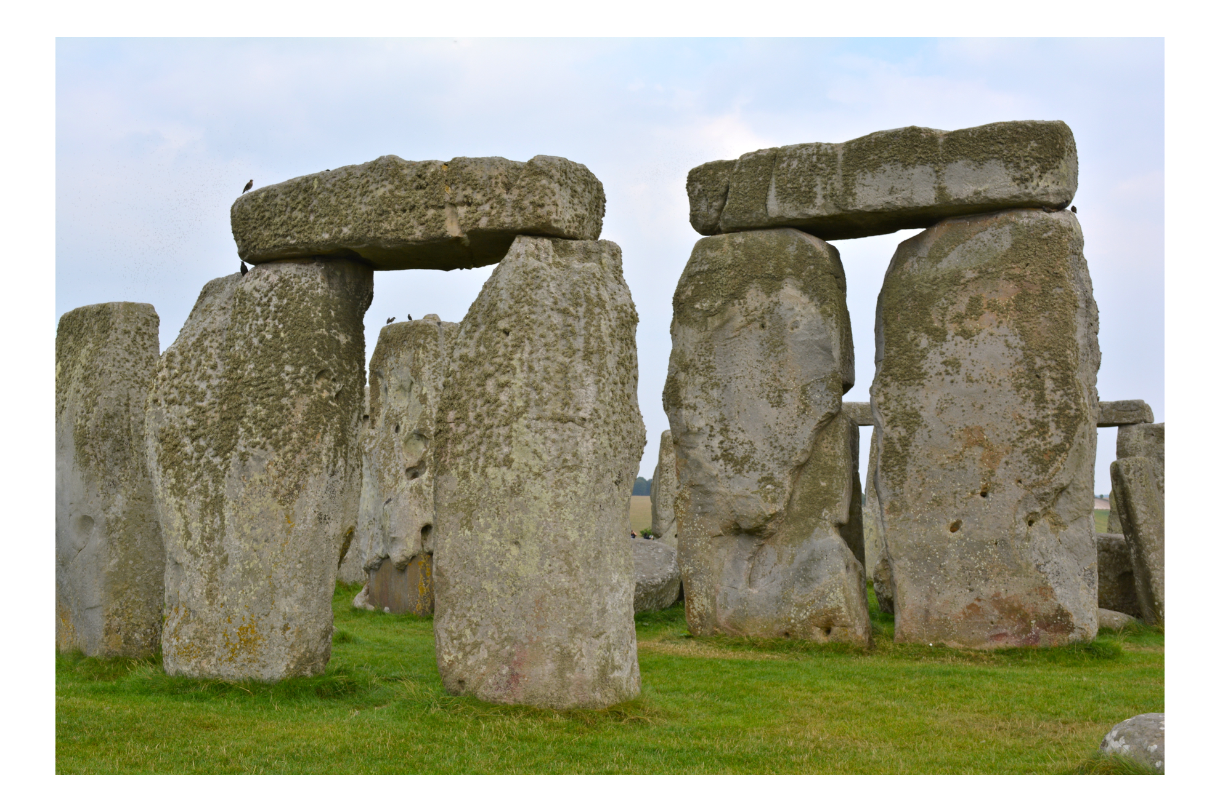
Two Uprights and a Lintel
A trilithon: two upright sarsens capped by a horizontal lintel.
© More Lessons Less Planning | morelessonslessplanning.com
Notes:
Real public-domain photograph of a Stonehenge trilithon. Have students trace the two upright posts and the horizontal lintel and imagine lifting the top stone into place without a crane.
Reference labels (point to these chart features when teaching): Upright stones (posts); Horizontal lintel

Slide 12
Reading Mute Stones
Archaeology
The study of the past through physical remains, not written records.
✔
The problem
Stonehenge left no writing, so its purpose must be inferred.
✔
The clues
Sun alignments, buried human remains, and the giant scale.
✔
Key Concept: ARCHAEOLOGY infers Stonehenge's purpose from mute stone - its alignments, burials, and scale - because there is no writing.
© More Lessons Less Planning | morelessonslessplanning.com
Notes:
ARCHAEOLOGY is the study of the past through physical remains, used to infer meaning when there are no written records. Because Stonehenge left no writing, archaeologists cannot simply read what it was for; they must infer its purpose from the stones themselves. The solstice alignment suggests a calendar or sky temple, cremated human remains found on site suggest a burial and ceremonial place, and the sheer scale suggests it united many communities.

Slide 13
Good Data, Wrong Conclusion
Antiquarian
An early student of ancient monuments, like William Stukeley in the 1700s.
Stukeley's mistake
Good measurements, but his Druid theory has been disproven.
Key Concept: ANTIQUARIAN William Stukeley measured Stonehenge well, but his Druid theory has been DISPROVEN.
© More Lessons Less Planning | morelessonslessplanning.com
Notes:
An ANTIQUARIAN is an early student of ancient monuments, like William Stukeley, who measured Stonehenge carefully in the 1700s. Stukeley did real, valuable fieldwork - he was the first to record that the avenue lines up with the solstice sunrise. But in his 1740 book he concluded that the Druids built Stonehenge. That conclusion has been DISPROVEN: Stonehenge is about 2,000 years older than the Druids. This is a lesson in itself: a person can gather good evidence and still reach a wrong conclusion.

Slide 14
Key Takeaways
Neolithic people built Stonehenge (c. 3000-2000 BCE) with no metal or writing.
★
Sarsens and bluestones were raised as trilithons using post-and-lintel joints.
★
The solstice alignment points to a sky-watching, ceremonial purpose.
★
Stukeley measured well but was wrong: the Druids did not build Stonehenge.
★
© More Lessons Less Planning | morelessonslessplanning.com
Notes:
Recap the four takeaways. The big skills: engineering without metal, and inferring purpose (and judging old interpretations) from physical evidence alone.

